Slide 1


Overview of SQL Server Data Tools (Visual Studio 2017)
New England Microsoft Developers
By John Miner
Blog: www.craftydba.com www.mssqltips.com
Tweet: JohnMiner3

Slide 2
What is SSDT?
SQL Server Data Tools is a modern development tool that leverages the Visual Studio graphical interface.
One can use this tool to build SQL Server relational databases, craft Integration Services packages, design Analysis Services data models, and deploy Reporting Services reports.
The best part of SSDT is that it is free!
2 |

Slide 3
Presentation Overview
Review the following subjects.
Supported SQL Versions
Stand-alone install.
Visual Studio 2017
Database Project
Integration Services Project
Reporting Services Project
Analysis Services Project
Viewing tabular model via Power BI
3 |

Slide 4
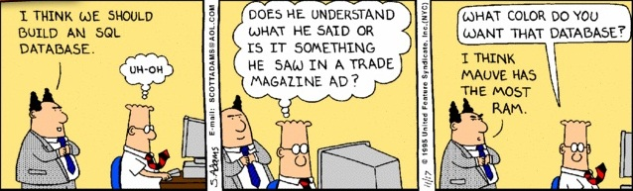
WARNING – TSQL Skills Required
All of the demonstrations are code based to give a real life example of how to apply a technique.
I will be not offended if you decide to leave now.
4 |

Slide 5
Supported SQL Versions
Database schema (2008 - 2016)
Azure SQL database
Azure SQL data warehouse (query only)
Integration services (2012 - 2016)
Analysis services (2008 - 2016)
Reporting services (2008 – 2016)
SQL Versions
http://tinyurl.com/k2mt9fe
5 |

Slide 6
Stand-alone install
There are two main branches of the SSDT code.
The current production release.
The SQL Server vNext candidate release.
If you install SSDT without Visual Studio, you end up with the integrated minimal shell version of VS 2015.
Download URL
http://tinyurl.com/k2mt9fe
6 |

Slide 7
Visual Studio 2017
Includes relational database support: Database Projects, Schema Compare, Data Compare, SQL Server Object Explorer and more.
Both analysis and reporting services are project types available from the VS gallery. Integration services project types being worked on but not ready for GA release (07 Mar 2017).
Developers can leverage Red Gate Data Tools. SQL Search is available in all editions, and SQL Prompt core and Ready Roll core are available for VS 2017 Enterprise subscribers.
Team Blog
http://tinyurl.com/lkmuxtl
7 |

Slide 8
Database Project
Can import an existing database as a project.
Implement schema changes by adding, modifying or deleting the definitions.
Can use schema compare to make sure production and project schema are in synch.
Snapshots can be used to capture database at point in time.
SSDT integrates with versions control.
8 |

Slide 9
Sample Database Project
Restore Adventure Works 2014 from a backup file.
Create new project by importing from server.
Change target to Azure SQL database.
Deploy schema to the cloud.
9 |

Slide 10
Integration Services Project
Microsoft SQL Server Integration Services (SSIS) is a platform for building enterprise-level data integration and transformation solutions.
Integration Services contains a rich set of built-in tasks, connectors and transformations that can be used to create solutions (packages) for your business problems.
Using the graphical tool, you can create solutions without writing a single line of code; or you can program the extensive object model to dynamically create packages. In addition, scripting using a .NET language can add custom functionality.
Home Page
http://tinyurl.com/lqf8b8m

Slide 11
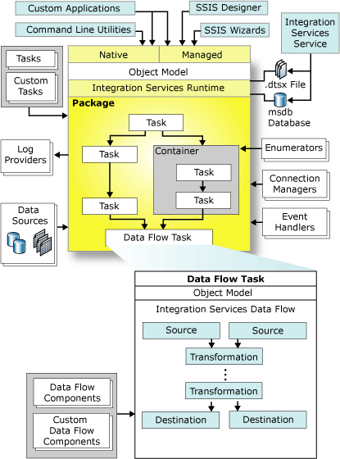
Architectural Overview
Control Flow
Data Flow

Slide 12
Control Flow
A package consists of a control flow and, optionally, one or more data flows.
Three different types of control flow elements: containers that provide structures in packages, tasks that provide functionality, and precedence constraints that connect elements into a ordered flow.
https://msdn.microsoft.com/en-us/library/ms137681.aspx

Slide 13
Precedence Constraints
There are three constraints based on the execution of the preceding task.
Did the task finish to completion?
Did the task return a success code?
Did the task return a failure code?
In addition, we can define an evaluation operation. Is the user defined variable greater than a constant?
https://msdn.microsoft.com/en-us/library/ms141261.aspx

Slide 14
Data Flow
Data flows have three different types of elements: sources, transformations, and destinations.
A data connection is where information is stored in a relational table, various file formats, analysis services database or etc.
Sources extract data from a connection. Transformations modify, summarize, and clean the data. Destinations load data into the final connection.
https://msdn.microsoft.com/en-us/library/ms137681.aspx

Slide 15
Sample Integration Project
Restore Adventure Works 2008R2 from a backup file.
Download data refresh example from Code Plex.
Change source path variable.
Run package to create OLAP database from OLTP database.
Deploy package to server.
15 |

Slide 16
Reporting Services Project
Reporting Services is a solution that customers deploy on their own premises for creating, publishing, and managing reports. Then delivering them to the right users in different ways, whether that’s viewing them in web browser, on their mobile device, or as an email.
Home Page
http://tinyurl.com/l2vm8rw
What is new in January 2017? You now can deploy power bi reports in Reporting Services.
PBI Blog
http://tinyurl.com/mlejaxp
16 |

Slide 17
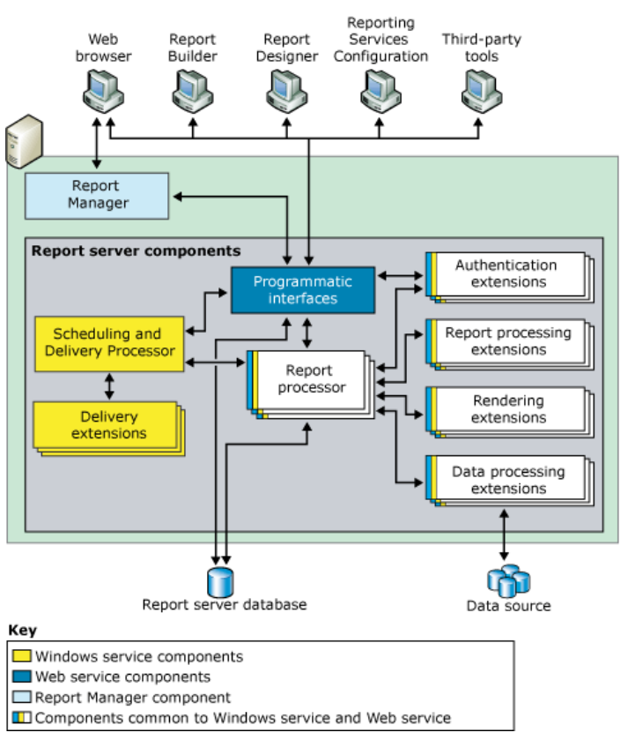
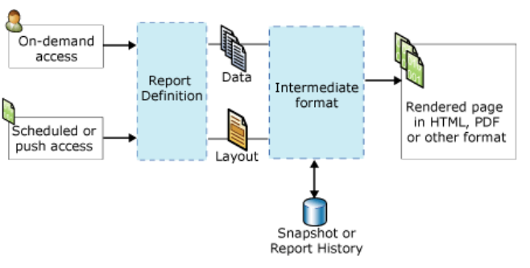
Architectural Overview
Paginated report processing

Slide 18
Paginated Reporting Components
Data source includes a name and connection properties that are dependent on the connection type. A data connection does not specify which data to retrieve from the external data source.
Dataset represents report data that is returned from running a query on an external data source. The dataset depends on the data connection that contains information about the external data source.
You can add report parameters to paginated and mobile reports to link related reports, to control the report appearance, to filter report data, or to narrow the scope of a report to specific users or locations.
The term report can apply to a specific type of report server item, a layout design, or a solution design. Some example of report types are stand-alone, a sub-report, drill-through and linked.
18 |

Slide 19
Sample Reporting Project
Download SSRS 2008 report samples from Code Plex.
Open solution using SSDT.
Run report to show it still works.
Deploy reports to server.
19 |

Slide 20
Analysis Services Project
BISM: Provides “Semantic” layer over data for the business and business users to ask questions and gain insights
Can consolidate numerous different data sources into a format that makes sense
Removes complexity of sophisticated querying and SQL programming logic
Data can be pre-aggregated so business users can get exactly what they need
Home Page
http://tinyurl.com/mp77peb

Slide 21
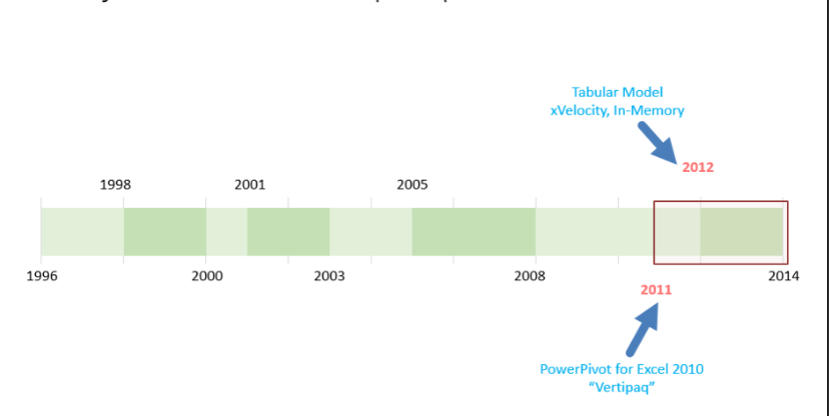
Analysis Services Through the Years
Multi-Dimensional Cubes

Slide 22
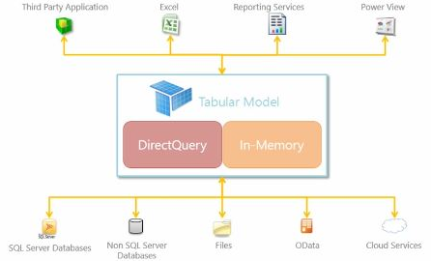
Tabular model Architecture
On Premise SQL Server
Azure

Slide 23
What makes up a Tabular model?
What do our business users need to get deeper insights into their data? What are the key components?
Import Data Sources – Tables, Files, Feeds, etc.
Tables & Relationships are the key
Calculated Columns
Measures
Hierarchies
KPIs
Roles & Perspectives
Partitions

Slide 24
Sample Analysis Project
Download internet sales backup from Code Plex.
Create new solution in SSDT from existing server.
Examine calculations and measures.
Insight can be gained by viewing model using SSRS, Excel or Power BI.
24 |

Slide 25
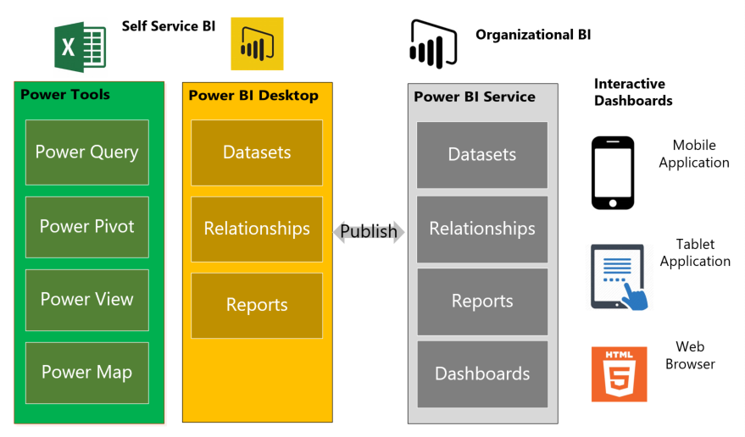
Power BI – Architectural Overview
25 |

Slide 26
Power BI Desktop
There are three main components to every Power BI solutions.
Data sets is where information can be mashed up and transformed.
Relationships implies order between the data sets. For instance, there is a 1-to-m relationship between the sales and geography tables.
Reports are visuals are used to display the data. Since each report is interactive, this is where insight can be gained.

Slide 27
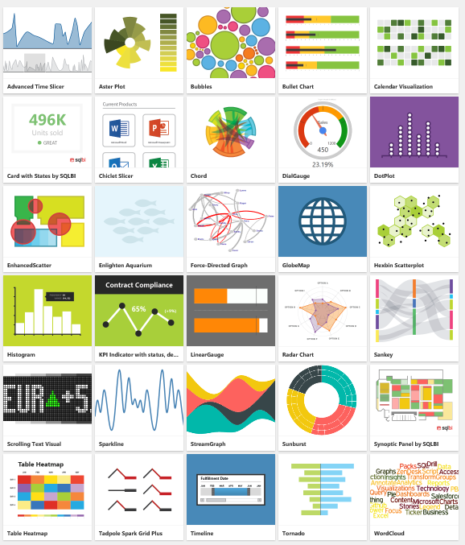
Standard & Custom Visuals
Out of the box, Power BI Desktop contains 26 visuals.
The actual code for creating your own visual is on GitHub.
Below are some visuals that were contributed by the community.
27 |

Slide 28
Sample Power BI Solution
Connect to Internet Sales tabular model via direct query.
Create a report for just US internet sales.
Show location of sales on map.
What are the most popular products?
What months do we sell the most product?
What percentage of sales comes from the state MA?
28 |

Slide 29
In Summary
SQL Server data tools is the development tool of choice for Database, Integration, Reporting and Analysis projects.
More services are being release as platform as a service offerings in Azure. I am expecting that SSDT will evolve to include those platforms as targets.
Power BI is a very powerful dashboard reporting tool. Because the mashup language is easy to use, this tool is gaining in popularity.
The best part about both these tools are the cost ($0).
29 |

Slide 30
Biography
Has twenty five years of data processing and proven project management experience, specializing in the banking, health care, and government areas.
His credentials include a Masters degree in Computer Science from the University of Rhode Island; and Microsoft Certificates (MCDBA 2000, MCSA 2003, MCSA 2012).
John is currently a Data Platform & Analytics TSP for Microsoft. He was award the MVP honor (2014/2015) for his contributions to the community.
When he is not busy working, he spends time with his wife, daughter and dog enjoying outdoor activities

Slide 31
Questions & Answers
Please visit SQL Server Books Online for more info.
Please ask about the presentation or visit my blog (www.mssqltips.com or www.craftydba.com) for articles on these subjects.
If you have any questions, you can contact me at john@craftydba.com
31 |

