Slide 1

Securing your delta lake with table access controls
John Miner Data Architect
john.miner@insight.com

Slide 2
Business Problem & Solution
Many companies are starting to use spark to process big data in the cloud. How can we secure the data lake to provide the correct level of access to the end users?
For this design pattern to be functional, one must create a high concurrency cluster and enable table access control in Azure Databricks (ADB).
Today, we are going review concepts related to accessing storage, crafting hive tables, creating users, assigning rights, masking data and encrypting data.

Slide 3
Topics
What is the Apache Spark platform?
What is a logical data lake?
Review of data engineering concepts
Local vs Remote storage
AD credential passthrough vs mounted storage
Creating users and starting clusters
Two types of hive tables
Assigning rights to clusters and tables
Custom data masking and encryption

Slide 4
Apache Spark
Logical Data Lake
Data Engineering
Storage Concepts
Clusters, Users & Tables
Data Privacy Concepts
Summary

Slide 5
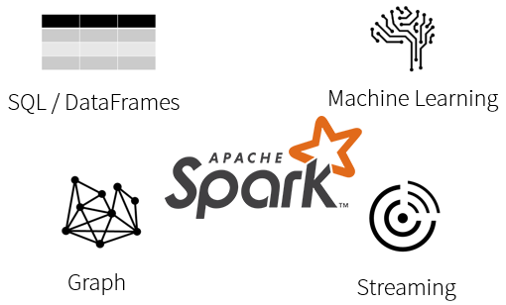
What is Spark?
Spark is a unified processing engine that can analyze big data using SQL, machine learning, graph processing or real-time stream analysis.

Slide 6
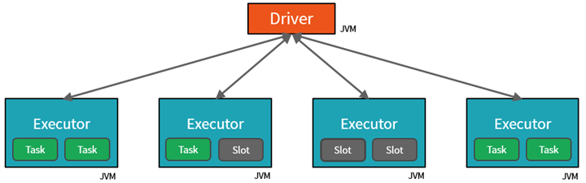
Databricks Cluster
By creating Tasks, the Driver can assign units of work to Slots for parallel execution.
The Driver must also decide how to partition the data so that it can be distributed for parallel processing.

Slide 7
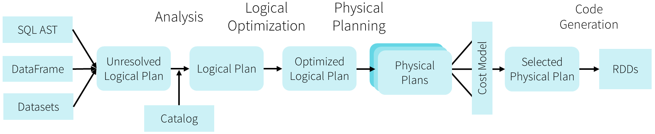
Databricks Optimizer
The Catalyst Optimizer converts the notebook code into an execution model that uses Resilient Distributed Datasets for in memory processing. The resulting code is Java Byte code that can execute on the cluster.
The optimizer is one key difference between open-source Spark and Databricks environment.

Slide 8
Apache Spark
Logical Data Lake
Data Engineering
Storage Concepts
Clusters, Users & Tables
Data Privacy Concepts
Summary

Slide 9
Why use a data lake?
Large and relatively cheap storage system allows companies to store data from a variety of source systems into the cloud.
Many different formats of data can be stored and retrieved easily.
Fine grain security can be applied anywhere in the hierarchal file system.
Many different types of software and users can access the data.

Slide 10
Various File Types
Weakly typed file formats can lead to data quality and ETL pipeline issues. For instance, a delimited file type as Comma Separated Values (CSV) can be easily broken. This file type does not allow for compression.
Strongly typed file formats can lead to better data quality and the least amount of ETL pipeline issues. For instance, an Apache Parquet file format is stored as binary data, contains columns names/types and allows for compression of the data.

Slide 11
Delta File Format – Uses parquet files +
ACID transactions make sure complete writes are committed.
Schema enforcement allows only clean data inserted into the lake.
Time travel allows for versioning the delta lake table. Thus, we can view data at any given point.
Snapshot isolation allows for multiple readers and writers.
Open-source format that is built for distributed systems such as Spark.

Slide 12
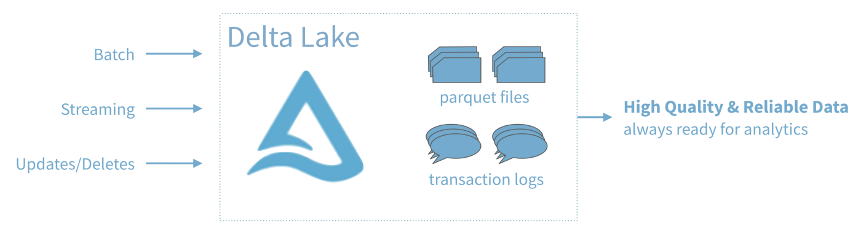
Delta Table = Hive Table based on Delta File

Slide 13
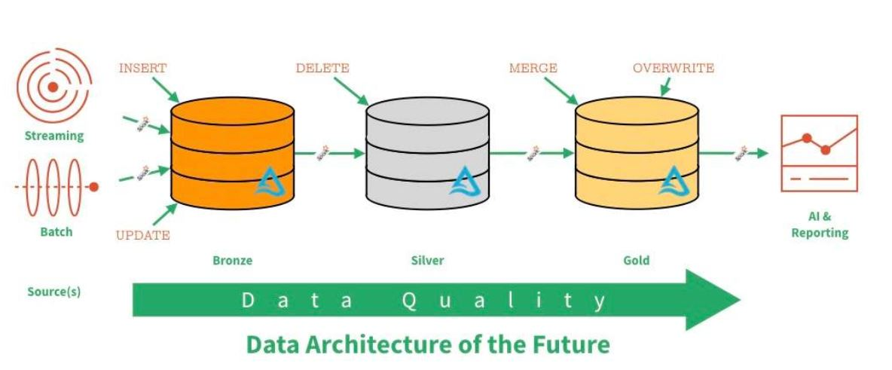
Data Lake – Zones & Data Quality

Slide 14
Apache Spark
Logical Data Lake
Data Engineering
Storage Concepts
Clusters, Users & Tables
Data Privacy Concepts
Summary

Slide 15
Load Patterns
The full load design pattern involves replacing the target dataset with a completely new version. Use this pattern with small sized data.
An incremental load design pattern involves merging the target dataset with a small dataset the represents changes over a given time period. For instance, a daily update file. This pattern can be used with small to medium sized data.
For the largest datasets, the use of a partitioning allows the full or incremental patterns to work with a subset of the data.

Slide 16
Data Dictionary
Some companies use a data dictionary to enhance the information stored in the data lake.
It is very important to use naming convention standards on directories, sub-folders and files so that the information in the lake be easily found and understood.

Slide 17
Directory Naming Conventions
Here is a sample convention.
/datalake/raw/
/datalake/refined/
/datalake/curated/
Unprocessed files land in raw zone; UPSERTED files keep delta table up-to-date in refined zone; and curated files are a unique business combination and aggregation.

Slide 18
Folder Naming Conventions
Here is just a sample convention.
Newest files in raw format
/datalake/raw/erp/sales/order_details/202102/
Delta tables for key data.
/datalake/refined/erp/sales/order_details/
Output files / tables for business line
/datalake/curated/sales/fact

Slide 19
Files Naming Conventions
Again, the actual naming of the files is dependent upon the organizational needs. Here is some information that can be embedded in the name.
Application Name
Information Name
Date & Time
For instance, activity hours for clarity might result in the following file in the raw zone.
sales_order_details_full_20210228001530.parquet.

Slide 20
Apache Spark
Logical Data Lake
Data Engineering
Storage Concepts
Clusters, Users & Tables
Data Privacy Concepts
Summary

Slide 21
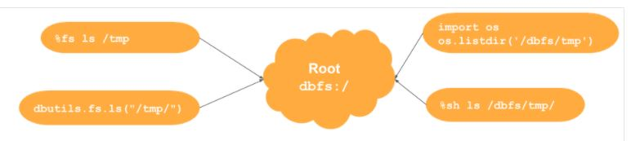
Local Storage
Out of the box, the Azure Databricks system has a local file system. Remote storage can be mounted or attached to at run time.
There are many ways to work with files and folders.

Slide 22
Remote Storage
The size of the local storage is managed and limited by Azure Databricks.
It is advised to use remote Azure Data Lake Storage. It is virtually unlimited in size.
encryption of data in transit or at test
storage account firewalls
virtual network integration
role-based access security
hierarchical namespaces with granular ACLs

Slide 23
Attach vs Mount
Attaching to storage requires the spark session variables to be set at runtime. This technique requires more access management on the storage level.
Mounting is a one-time effort. Once mounted, all users of an interactive cluster have rights to the storage. Some python libraries only work with mounted storage.
Example 1 – Attach vs Mount storage
Example 2 – Create Data Lake File System

Slide 24
PySpark – Read and write files
PySpark is a Python API for Apache Spark to process larger datasets in a distributed cluster.
Spark.Read() – allows the Python program to read one or more files into a dataframe.
Spark.Write() – allows the Python program write the dataframe to given format using one or more files.
Example 3 – Read and write files.

Slide 25
Spark SQL – Leveraging existing knowledge
The main use of Spark SQL is to execute SQL queries instead of dataframe methods.
Spark SQL can also be used to read data from an existing Hive installation.
A common practice is to use temporary tables or views off dataframes with PySpark. Then use Spark SQL to translate (engineer) the data into a different resulting data set.
Example 4 – Using Spark SQL for curated data.

Slide 26
Apache Spark
Logical Data Lake
Data Engineering
Storage Concepts
Clusters, Users & Tables
Data Privacy Concepts
Summary

Slide 27
Databricks Clusters
Three types of clusters:
Single node cluster is good for one user. Both the driver and executor are on one virtual machine.
Standard cluster is great for data engineering.
High concurrency cluster allows for table access. Thus, permissions can be done at the hive table layer instead of the data lake storage.
Example 5 – Manually create a cluster.

Slide 28
Databricks Users
Databricks supports the use of groups. This allows the assignment of rights at the group level.
Groups can be restricted from creating or starting clusters.
High concurrency cluster allows for table access. Thus, permissions can be done at the hive table layer instead of the data lake storage.
Example 6 – Manually create a user, add to a group, and assign entitlements.

Slide 29
Hive Tables
Managed tables allows the Spark engine to manage both the data and the metadata. Dropping a table results in the data being removed from the system if an INSERT action was used.
Unmanaged tables allows the Spark engine to keep track of the metadata for given file(s). Dropping a tables does not result in data loss.
Example 7 – Managed vs Unmanaged tables.

Slide 30
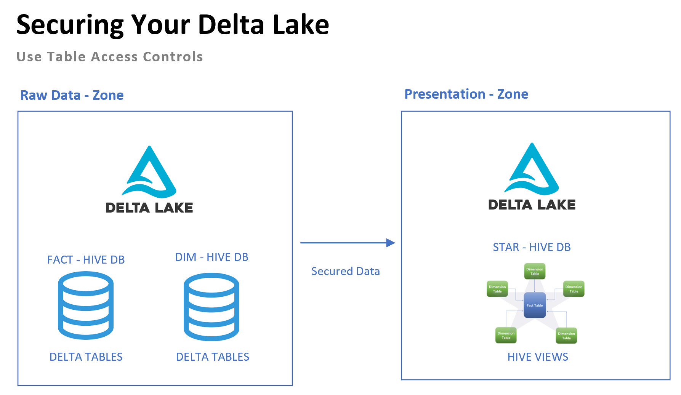
Implementing Security
Set owner of databases, tables and views to service account.
Revoke access to database, tables and views to target (group/user)
Grant usage access to star database to (group/user).
Grant select & read meta data rights to views to (group/user).
Test security settings.
Example 8 – Testing table access controls

Slide 31
Apache Spark
Logical Data Lake
Data Engineering
Storage Concepts
Clusters, Users & Tables
Data Privacy Concepts
Summary

Slide 32
Data Masking
Create user defined function to mask data such as an SSN.
Use function in view definition.
Allow access to data via views.
Example 9 – Testing data masking

Slide 33
Data Encryption
Create user defined function to encrypt data as text.
Create user defined function to decrypt data as text.
Save refined data in encrypted format.
Use decrypt function to see data in Spark SQL query.
Example 10 – Testing data encryption

Slide 34
Apache Spark
Logical Data Lake
Data Engineering
Storage Concepts
Clusters, Users & Tables
Data Privacy Concepts
Summary

Slide 35
Big Data Solutions
Schema on write is represented by the traditional relational database. Raw data is ingested by an extract, transform and load (ETL) process. The data is stored in tables that enforce integrity and allow for quick retrieval. Only a small portion of the total data owned by the company resides in the database.
Schema on read is represented by technologies such as Hadoop or PolyBase. These technologies assumed that data integrity was applied during the generation of the text files. The actual definition of the table is applied during the read operation. All data owned by the company can reside in simple storage.

Slide 36
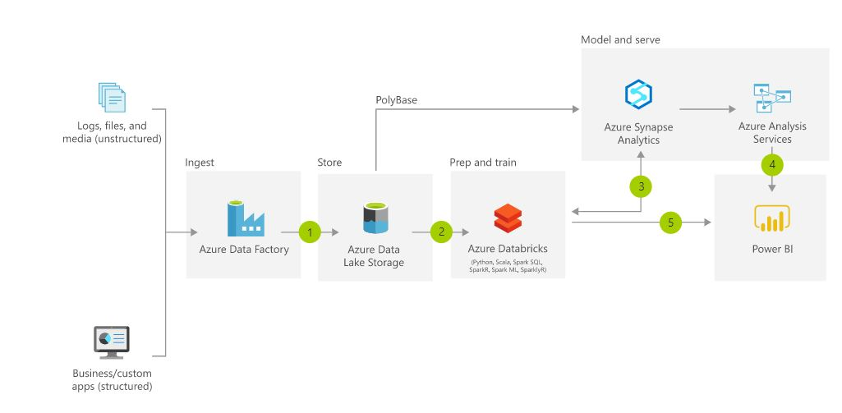
Modern Data Warehouse – Pattern 1
A modern data warehouse lets you bring together all your data at any scale easily and to get insights through analytical dashboards, operational reports or advanced analytics for all your users.

Slide 37
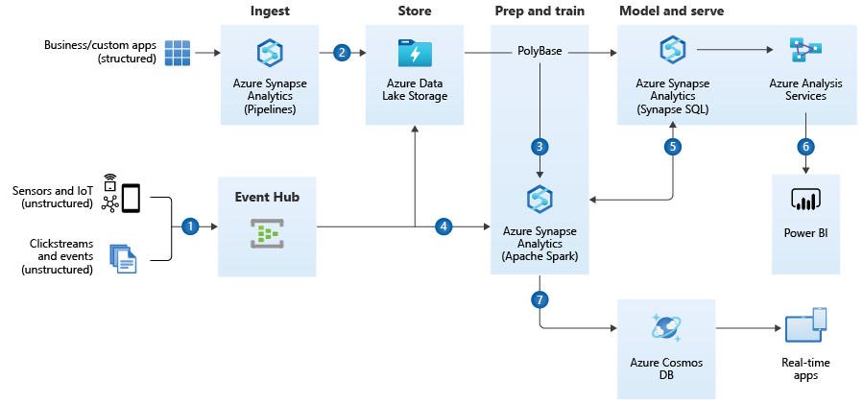
Modern Data Warehouse – Pattern 2
A modern data warehouse lets you bring together all your data at any scale easily and to get insights through analytical dashboards, operational reports or advanced analytics for all your users.

Slide 38
Summary
The modern data platform design for Microsoft Azure allows companies to place a variety of data into a data lake.
Essentially, this data lake follows the spoke and hub design pattern. Source data from producers can be either pushed or pulled into the data lake. Processing can be done on a sub-set of data to allow for investigational queries. Data Science models can be used to predict future events. The final curated data can be available to consumers for analytic reports.
The most important part about deploying objects, creating data lake entries or coding data factory pipelines is the use of naming standards. These standards allow the end user to easily understand the nature and purpose of the item in question.
Both Azure Databricks and Azure Synapse support the Apache Spark architecture. Skills that you learn with Python and Spark will be transferable between the products. The future is bright for those who can adapt.

Slide 39
References (1)
Databricks Documentation
https://docs.databricks.com/index.html
Spark SQL functions
https://spark.apache.org/docs/latest/api/sql/index.html
Spark Data Frames
https://spark.apache.org/docs/latest/api/python/pyspark.sql.html#pyspark.sql.DataFrame
ADB – Local File System
https://www.mssqltips.com/sqlservertip/6700/azure-databricks-local-file-system-management/

Slide 40
References (2)
Hive Tables
https://docs.microsoft.com/en-us/azure/databricks/data/tables
Granting Rights
https://docs.databricks.com/security/access-control/table-acls/index.html
User Defined Functions
https://docs.databricks.com/spark/latest/spark-sql/udf-python.html
Column Level Encryption
https://tinyurl.com/3rhuzrah

Slide 41
Questions / Thank You

