Slide 1

Custom Maintenance Plans
Using Ola Hallengren Scripts
Database Administrator Virtual Chapter
By John Miner ~ www.craftydba.com
Blog: www.craftydba.com
Tweet: JohnMiner3

Slide 2
Presentation Overview
Review the following subjects.
Installing Ola Hallengren scripts.
Identify system vs user databases.
Understanding recovery models.
Basic backup options.
Advance backup options.
Like to see ‘MIRROR TO’ clause added.
Why backup to disk then swipe to tape?
Known tape rotations:
‘Tower of Hanoi’ versus ‘Grandfather-Father-Son’
2 |

Slide 3
Presentation Overview (cont)
Checking database integrity.
Index Maintenance:
Reorganize versus Rebuild.
Updating statistics on your table.
Restore Command:
FILE LIST ONLY (information)
VERIFY ONLY (integrity)
How do I restore my database from a backup chain?
How to do a point in time recovery?
What is a tail backup?
Testing backups via restores.
Best practices for daily, weekly and monthly tasks?
3 |

Slide 4
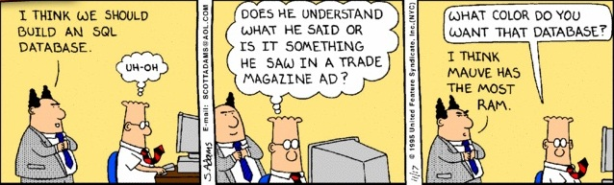
WARNING – TSQL Skills Required
Most of the demonstrations are code based.
A basic understanding of SSMS / TSQL is required.
I will be not offended if you decide to leave now.
4 |

Slide 5
Why implement plans?
Prevent loss of data.
Hardware failure
Unintentional software action
Database corruption
Provide good server performance to users.
Ordered Indexes
Up-to-date statistics
Surprising how many systems do not have these plans in place correctly.
5 |

Slide 6
Before creating plans
Database Mail has to be setup to send failure notifications.
At least one Operator needs to be configured to receive the messages.
Active Directory distribution lists should assigned to the Operator for the ease of maintenance.
6 |

Slide 7
About Ola Hallengren
Mr. Ola Hallengren, a SQL Server 2014 MVP from Sweden, has given these free scripts to the community.
The solution is based on stored procedures, the sqlcmd utility, and SQL Server agent jobs.
Gold winner in the 2010–2013 SQL Server Magazine Awards
These scripts allow a DBA to perform backups, integrity checks, and index/statistics maintenance with ease.
All editions of Microsoft SQL Server are supported.
7 |

Slide 8
Installing the script
Download the latest version from ola.hallengren.com
Change the following settings before executing the script.
-- Target db, Make jobs, Backup dir, Output dir, Log cmds.
USE [master]
SET @CreateJobs = 'Y'
SET @BackupDirectory = N'C:\MSSQL\BACKUP'
SET @OutputFileDirectory = NULL
SET @LogToTable = 'Y'
8 |

Slide 9
What objects are installed?
Tables
[CommandLog] – log of executed commands.
Store Procedures
[CommandExecute] – log & execute the command.
[DatabaseBackup] – backup database.
[DatabaseIntegrityCheck] – check database integrity.
[IndexOptimize] – optimize indexes.
Jobs
Eleven predefined jobs are created. Scheduling and notifications need to be configured.
9 |

Slide 10
System versus User databases
The scripts defines the following databases as system databases.
[master], [msdb], [model], [tempdb]
All other databases are considered user databases.
Example 1
10 |

Slide 11
Recovery Models
Simple Recovery – transaction log is automatically truncated during periodic checkpoints and can’t be used for recovery.
Full Recovery – transaction log is not automatically truncated during periodic checkpoints and can be used for recovery.
Bulk-Logged Recovery - Same as Full Recovery except for bulk operations are minimally logged saving significantly on processing time, but preventing point-in-time restore options.
11 |

Slide 12
Basic Backup Options
@Databases – database name or keywords
@Directory – a destination path
@Description – just a comment.
@BackupType – FULL | DIFF | LOG
@CleanupTime – expressed in hours
@Verify; @Compress; @CopyOnly; @CheckSum;
@LogToTable ; @Execute; – Y or N
Example 2
12 |

Slide 13
Advance Backup Options
@MAXTRANSFERSIZE - the largest transfer unit between SQL Server and the backup media. The default is 1 MB.
@BLOCKSIZE - the physical block size in bytes. The default is 512.
@BUFFERCOUNT - the total number of I/O buffers to be used for the backup operation which is equal to buffercount * maxtransfersize.
@NumberOfFiles – the number of backup files.
@ReadWriteFileGroups - perform a backup of the primary filegroup and any read/write filegroups.
Example 3
13 |

Slide 14
Backup 2 Disk, Swipe 2 Tape
Hard Disk:
Disk space is very inexpensive. Can use 7.2K RPM disks.
Restoration is quicker if files are on disk.
Mirror To would be nice to get an extra copy.
Place on network share.
Tape:
Backup will stop if tape is full.
Operators sometimes do not change tapes.
Just need incremental tape backup.
Suggest notification on job failure.
Must rotate tapes offsite for DR purposes.
14 |

Slide 15
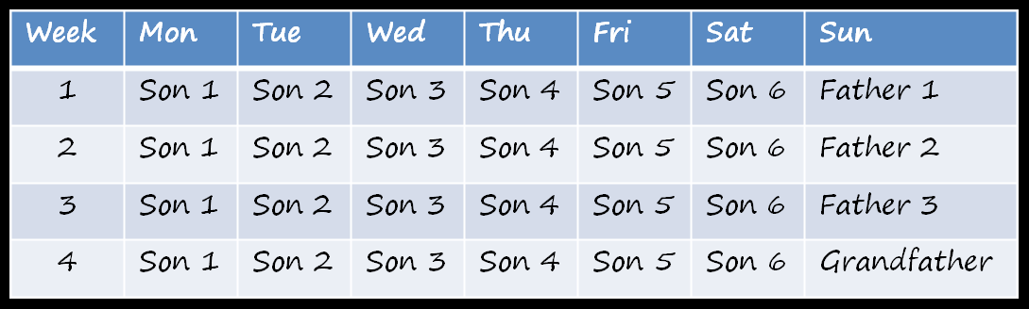
Tape Rotation (GFS)
The Grand-Father-Son approach uses three levels of tape rotation.
Level 1 - daily backups
Level 2 - weekly backups
Level 3 - monthly backups
15 |

Slide 16
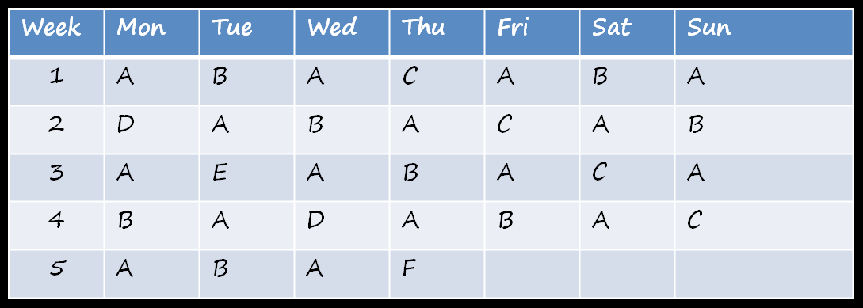
Tape Rotation (TOH)
The Tower of Hanoi approach uses five levels of tape rotation.
Level A every 2 days; Level B every 4 days
Level C every 8 days; Level D every 16 days
Level E every 32 days
16 |

Slide 17
Database Integrity Options
@Databases – database name or keywords
@FileGroups – named filegroups
@Objects – named objects
@CheckCommands -
CHECKDB - check the whole database.
CHECKFILEGROUP – check a filegroup.
CHECKTABLE – check the tables & indexed views.
CHECKALLOC – check disk space allocation structures.
CHECKCATALOG – check catalog consistency.
@PhysicalOnly; @NoIndex; @TabLock; @LockTimeout;
@LogToTable ; @Execute; – Y or N
Example 4
17 |

Slide 18
Maintaining Indexes
REBUILD versus REORGANIZE options of ALTER INDEX command.
Both commands reduce the amount of fragmentation in Indexes which increases database performance.
REBUILD is a very server intensive command but is quick. Only perform during off-line hours.
REORGANIZE can be performed during on-line hours but is slower.
One must run the UPDATE STATISTICS command on the object after a REORGANIZE operation.
18 |

Slide 19
Maintaining Statistics
The ‘sp_updatestats’ stored procedure can be executed in the current database.
Updates only the statistics that require refreshing. Uses the rowmodctr in sys.sysindexes for older versions and modification_counter in sys.dm_db_stats_properties for new versions.
Can cause stored code to be recompiled.
Gives Query plan optimizer better information to work with.
19 |

Slide 20
Index Optimize
@Databases – database name or keywords
@Fragmentation [Low, Medium, High];
INDEX_REBUILD_ONLINE | INDEX_REBUILD_OFFLINE
INDEX_REORGANIZE | NULL
@FragmentationLevel [1|2] – fragmentation percentage
@Delay- time in seconds
@UpdateStatistics = ALL | Index | Columns | NULL
@SortInTempdb; @OnlyModifiedStatistics;@LogToTable ; @Execute; – Y or N
Example 5
20 |

Slide 21
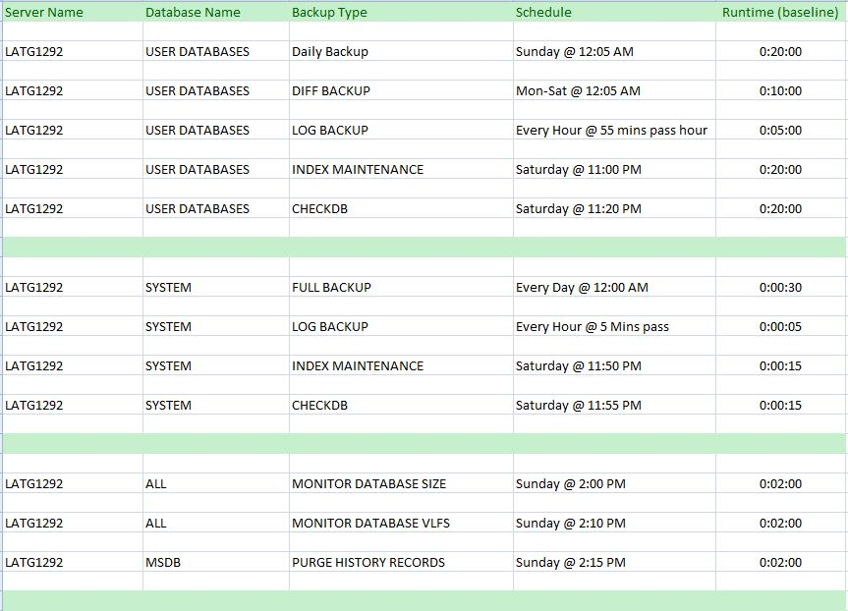
Maintenance Schedule
21 |

Slide 22
Restoring your database
Current schedule allows for 1 hour of data loss.
Take a tail log backup. This can be done even if all data files are missing. Any actions since the last log backup will be there.
Figure out backup chain. FULL, DIFF, LOG(S), TAIL LOG.
STOPAT = ‘Jan 22, 2014 12:10 PM‘ – Exact time if you need it.
Example 6
22 |

Slide 23
Best Practices (Daily)
Full or Differential backups at the start of the day.
Transactional Log backups every x hours.
Copy backups from database server to archive server.
Swipe backups from archive server to tape daily.
Rotate tapes daily using either the GFS or Tower of Hanoi schemes.
Store tapes off site.
23 |

Slide 24
Best Practices (Weekly)
Verify the integrity of each database.
Remove old data from [msdb] and file system.
Rebuild or Reorganize Indexes *
Update statistics on changed tables *
Perform full backups on large databases.
Store tapes off site.
* - Move to daily if time permits in over night schedule.
24 |

Slide 25
Best Practices (Monthly)
Send full tape backup of databases to parent site from offsite storage.
Restore backup from tape to test validity.
25 |

Slide 26
Some Comments
Like to see MIRROR TO added to syntax.
Make sure tapes are sent offsite. This is critical.
A test server can be used to automatically restore backups from archive server. This allows one to perform CHECKDB not on production.
The cloud (AZURE) is an option for offsite storage. Need good internet connection.
I know the backup script does not handle two databases only differing by spaces.
Ola is currently working on scripts for 2014.
In summary, awesome freeware for you or your client.
26 |

Slide 27
References – Page1
Ola Hallengren Site
http://ola.hallengren.com/sql-server-index-and-statistics-maintenance.html
Brad McGehee Article
https://www.simple-talk.com/sql/database-administration/automate-and-improve-your-database-maintenance-using-ola-hallengrens-free-script
Backup Command
http://technet.microsoft.com/en-us/library/ms186865.aspx
Restore Command
http://technet.microsoft.com/en-us/library/ms186858.aspx
DBCC CHECKDB Command
http://technet.microsoft.com/en-us/library/ms176064.aspx
27 |

Slide 28
References – Page2
UPDATE STATISTICS
http://technet.microsoft.com/en-us/library/ms187348.aspx
Reorganize vs. Rebuild Article
http://technet.microsoft.com/en-us/library/ms189858.aspx
ALTER INDEX
http://technet.microsoft.com/en-us/library/ms188388.aspx
TAIL-LOG Backup
http://technet.microsoft.com/en-us/library/ms179314.aspx
28 |

Slide 29
Biography
Has twenty years of data processing and proven project management experience, specializing in the banking, health care, and government areas.
His credentials include a Masters degree in Computer Science from the University of Rhode Island; and Microsoft Certificates (MCDBA & MCSA).
John is currently a Developing DBA at SENSATA working with SQL Server silo of products.
When he is not busy working, he spends time with his wife, daughter and dog enjoying outdoor activities
29 |

Slide 30
Questions & Answers
Please visit SQL Server Books Online for more info.
Please ask about the presentation or visit my blog (www.craftydba.com) for articles on this and many other subjects.
If you have any questions, you can contact me at j.miner@cox.net
30 |

