Slide 1




Navigating Azure SQL Services
John Miner Data Architect
john.miner@insight.com
Blogs: www.craftydba.com www.mssqltips.com
Tweet: JohnMiner3

Slide 2
Target Audience
Technical Managers
Knowledge of the various offerings of the SQL Server engine in Azure.
Data Architects
How to correctly choose a service for a given problem.

Slide 3
Service Selection Problem
Five years ago there was a limited number of ways to deploy and use the SQL Server engine in the Azure Cloud. Today, there are many different services that one can choose.
How do you determine which service to use?
In this presentation we focus on key attributes of your data to pick the correct service. Certain services have limits on size, performance and movability of database. Other factors, such as the budget of your project, may also come into the decision making.

Slide 4
Presentation Overview
What is IOPS
Reducing cost by using services?
Azure SQL Database (Singleton vs Pool)
Azure SQL Data Warehouse (MPP)
Virtual Cores (General Purpose vs Business Critical)
Azure SQL Managed Instance
Hyper Scale offering
Large Azure VM with SQL Server

Slide 5
Definition - IOPS
When evaluating a new storage system, especially an all-flash array, the number of IOPS (Inputs/Outputs per Second) that the storage system can sustain is often used to differentiate one storage system from another. But is this really a standard that has any merit?
There are three factors that when combined tell the full story of storage performance; bandwidth rate, latency and IOPS.

Slide 6
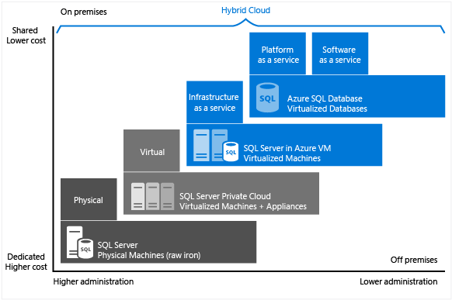
Reducing Cost? (IAAS vs PAAS)
There are many different offerings in the cloud. The idea is to reduce administration and provide highly available services with the possibility of saving money.
On the left side of the diagram is physical hardware and virtual machines. This is considered infrastructure as a service (IAAS).
On the right side of the diagram is an Azure service provided by Microsoft. This is considered platform as a service (PAAS).

Slide 7
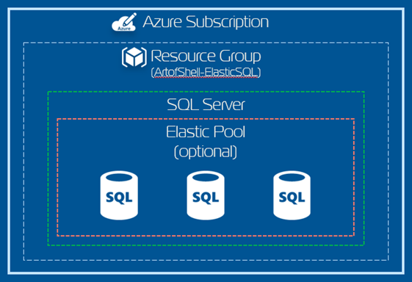
Azure SQL Database
Azure Portal or PowerShell can be used to create a server and database. By default, a firewall is in place to protect your data.

Slide 8
Azure SQL Database
Azure SQL database is a share service. Therefore, other companies maybe executing workloads on the same hardware at the same time.
Resources are measured as a blend of CPU and memory. The statistics that differentiates one tier and level from another is called database transaction units.
Unless you have enabled MS peering on your express route, secure packets will be sent over the public internet.
This service is not 100% transaction SQL compatible. For instance, the SQL Agent is missing from this service. Any features that are file based or NON-ANSI specific are not supported.

Slide 9
Azure SQL Database - Details
Tier | Feature | Limit
Basic | Database Size | 2 GB
 | Database Transaction Units | 5
 | IOPS | 1-5 per DTU
Standard | Database Size | 1 TB
 | Database Transaction Units | 3000
 | IOPS | 1-5 per DTU
Premium | Database Size | 4 TB
 | Database Transaction Units | 4000
 | IOPS | 25 per DTU

Slide 10
Azure SQL Database – Elastic Pools
There are two main reasons why to use elastic pools:
1 – Many databases have usage patterns at different times.
2 – SAS vendor that has the same schema for every client.
There is a database threshold in which switching from singleton databases to a pool makes sense in terms of money ($).

Slide 11
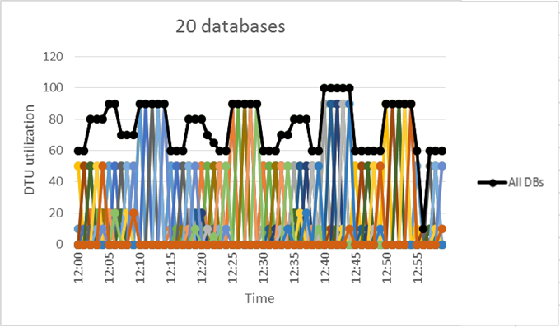
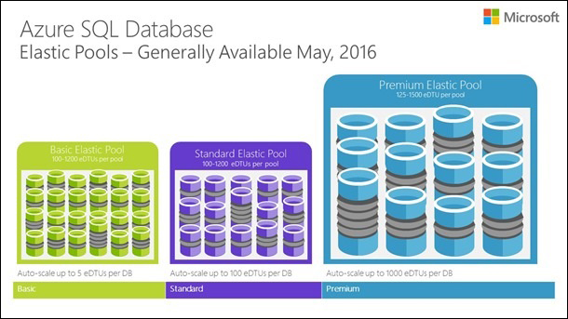
Azure SQL Database – Elastic Pools

Slide 12
Azure SQL Database – Elastic Pools - Details
Tier | Feature | Limit
Basic | Database Size | 156 GB
 | Database Transaction Units | 1600
 | # Databases | 500
Standard | Database Size | 4 TB
 | Database Transaction Units | 3000
 | No Databases | 500
Premium | Database Size | 4 TB
 | Database Transaction Units | 4000
 | Databases | 100

Slide 13
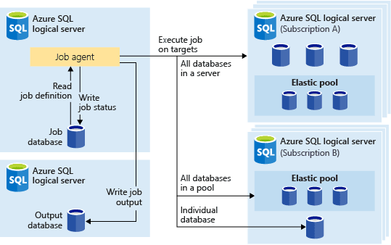
Azure SQL Database – Elastic Jobs
How do you add a table to 100 databases in an elastic pool?
Elastic jobs allow for the execution of a job against one, or all databases in a pool.

Slide 14
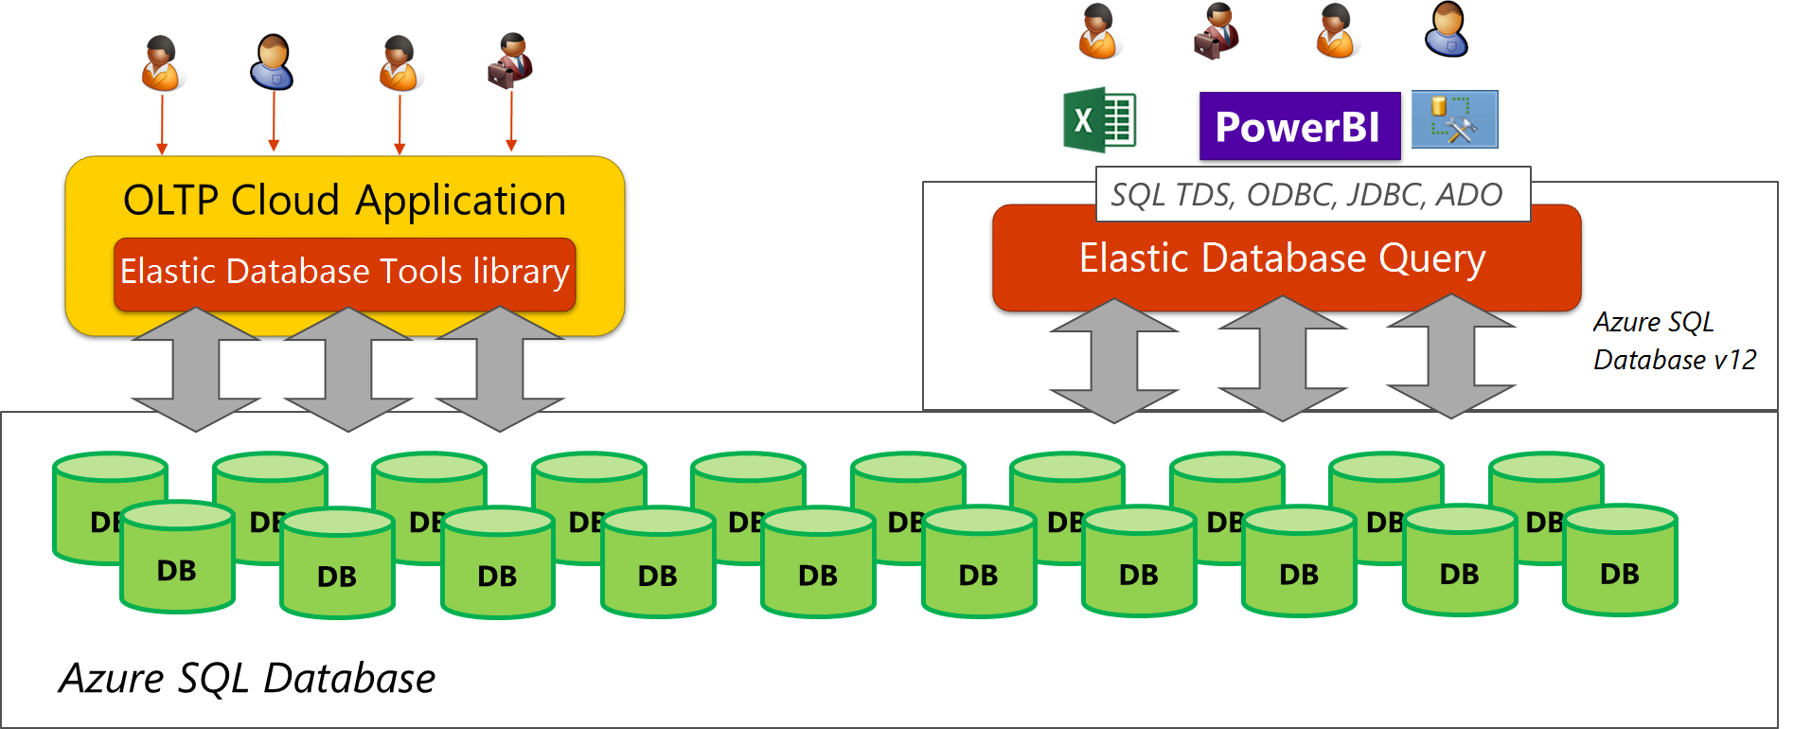
Azure SQL Database – Elastic Query
How do you execute a query against all the databases in an elastic pool?
Elastic query allows you to execute query against all databases and return a single result set.

Slide 15
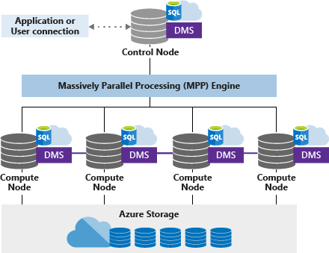
Azure SQL Data Warehouse (DW)

Slide 16
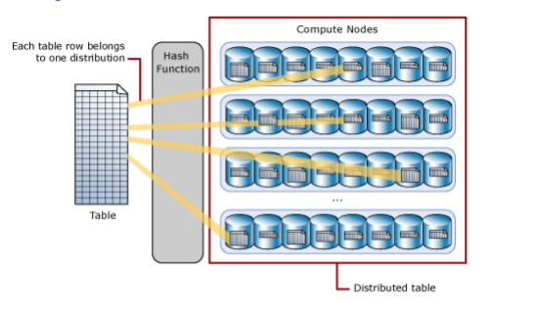
Azure SQL DW (data/compute)
Data hashed across 60 files.
One to sixty compute nodes.
Ability to pause/resume compute.
Ability to scale at will.
Data Move (Shuffle) is bad.
Replicate reference tables (< 2GB)
Cluster Column Store Index (60M)

Slide 17
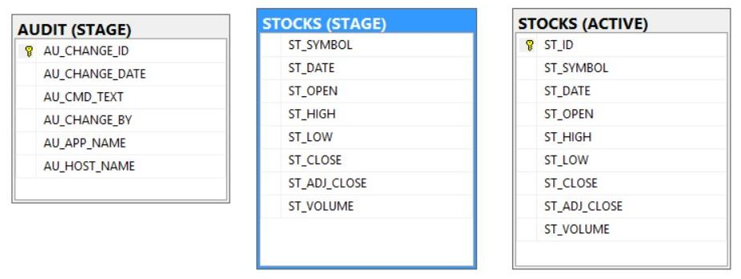
Azure SQL DW (Restrictions)
Not fully T-SQL compliant.
No primary keys
No constraints
Must hash data
No cursors

Slide 18
Azure SQL DW - Details
Feature | Description
Data Warehouse Tier | Regular or compute optimized
Database Max Size | Scales to petabytes (PB)
Security | Firewall and TLS connection.
Concurrency | Limited by tier
Optimization | Must understand hashing and queries.
Loading Data | Polybase
Moving Data | Create Table As (CTAS) statement

Slide 19
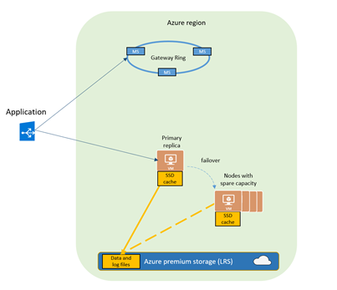
Virtual Cores ~ General Purpose
Offers budget oriented balanced compute and storage options.
CPU
Specify Gen 4 or Gen 5 hardware
Specify number of required cores (2-80)
Compute queue for high availability
Memory
Gen 4 ~ 7 GB per v-Core ~ Provision up to 168 GB
Gen 5 ~ 5.1 GB per v-Core -~ Provision up to 408 GB
https://tinyurl.com/y3qt9486
Disk
Azure Premium Blob Storage = data redundancy
Maximum database size of 8TB
Actual database file size impacts IOPS
https://tinyurl.com/y3z3t6o2
If used with Azure SQL database, same TSQL restrictions apply.

Slide 20
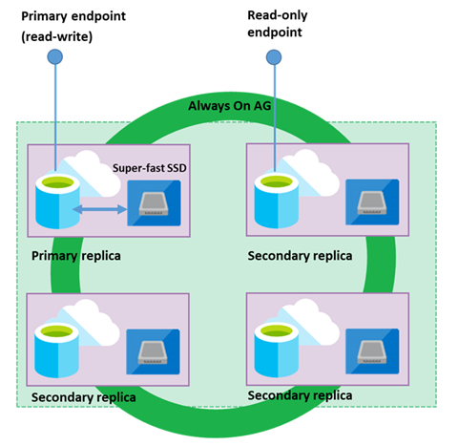
Virtual Cores ~ Business Critical
Offers business applications the highest resilience and performance per database replica.
CPU
Same as general purpose.
Memory
Same as general purpose.
Disk
Maximum database size of 4TB
5000 IOPS per v-Core ~ Provision up to 200K
H.A.
Replicate data on super fast SSD
Readable end point to reduce traffic.
If used with Azure SQL database, same TSQL restrictions apply.

Slide 21
Virtual Cores - Details
Tier | Feature | Limit
General Purpose | CPU | 2 - 80
 | RAM | 5.1 – 408 GB
 | IOPS | 500 – 16,000
 | MAX DB Size | 8 TB
Business Critical | CPU | 2 - 80
 | RAM | 5.1 – 408 GB
 | IOPS | 500 – 200,000
 | MAX DB size | 4 TB

Slide 22
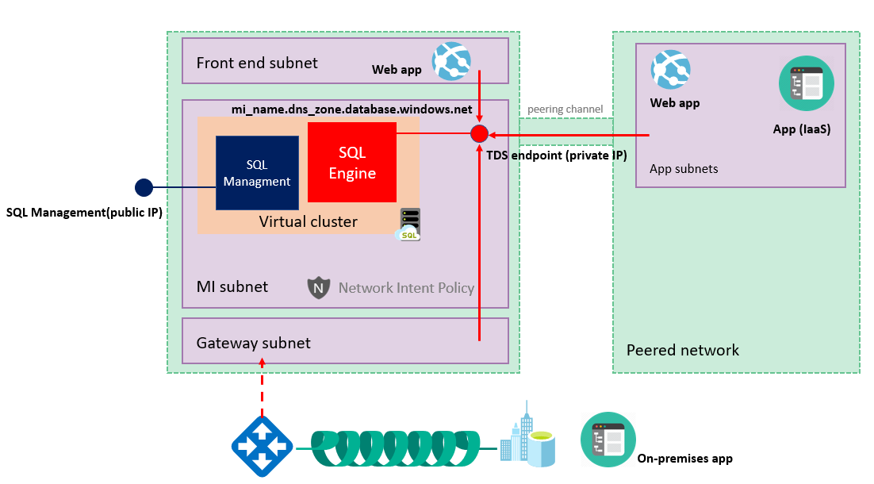
Azure SQL Managed Instance

Slide 23
Managed Instance - Details
Feature | Description
SQL Server Engine | Almost 100% compatible
Security | V-net locks down service
Onsite connection | Express Route or VPN
Other SQL Features | SQL Agent, DB Mail, etc.
Virtual Cores | General Purpose and Business Critical
Transfer Database (IN) | BACPAC or BAK
Transfer Database (OUT) | BACPAC

Slide 24
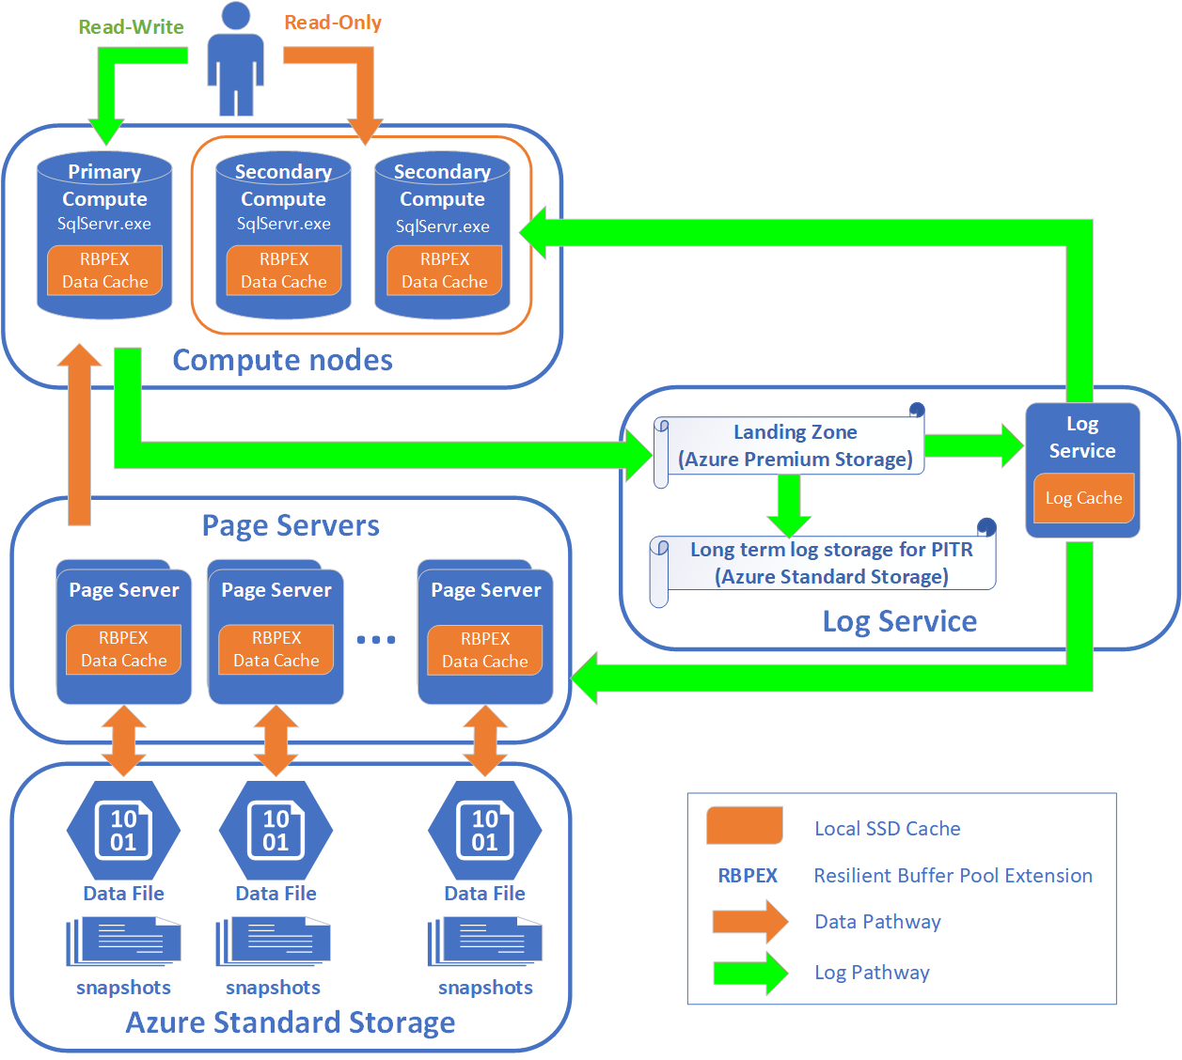
Azure SQL Hyper Scale
Radically new distributed database design.
Compute node is where the relational engine lives. Additional compute nodes are required for high availability and use the same page servers.
Resilient Buffer Pool Extension (RBPEX) caches data on high speed storage.
The log service accepts persists primary node changes in a durable cache, and forwards the log records to the rest of compute replicas as well as the relevant page server(s),
Page servers are systems represent a scaled-out storage engine. They contain up to 1 TB of data read from disk.
Azure Storage contains all data files in a database. Backup and restores are done by using high speed snapshots.

Slide 25
Hyper Scale - Details
Feature | Description
SQL Server Engine | Reduced T-SQL feature set
Security | Firewall and secure TLS connection
Onsite connection | MS Peering ~ send packets to express route
Other SQL Features | Missing features like Azure SQL DB
Transfer Database (IN/OUT) | BACPAC
Max Database Size | 100 TB
Performance | Depends upon workload.
Optimization | No cookbook provided by Microsoft

Slide 26
Scheduling Jobs
Many of the platform as a service offerings do not support the execution of T-SQL jobs.
The work around is to use the following Azure Services.
1 – Azure Automation
2 – Azure Data Factory
A quick overview of these services are on the next few pages.

Slide 27
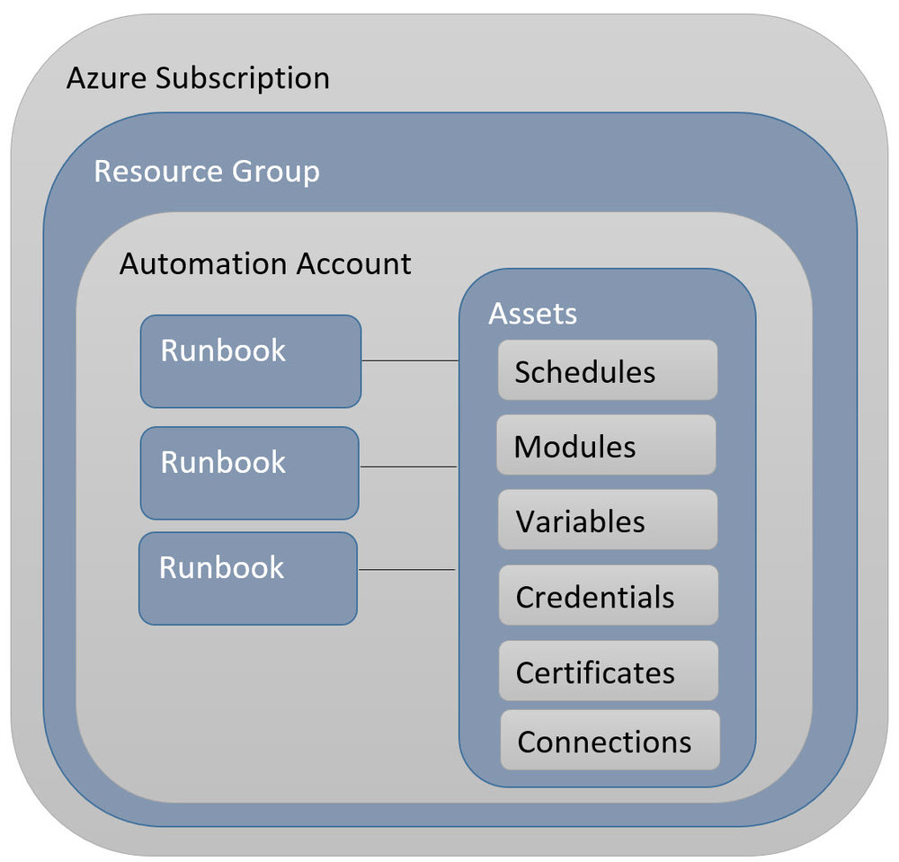
Azure Automation - Overview
PowerShell work-flows are at the heart of this service.
Connections and credentials allow you to customize by environment.
There is no support for alerting when a job fails.
Suggest using SendGrid as a mail service.
Wrap all code with error handling.

Slide 28
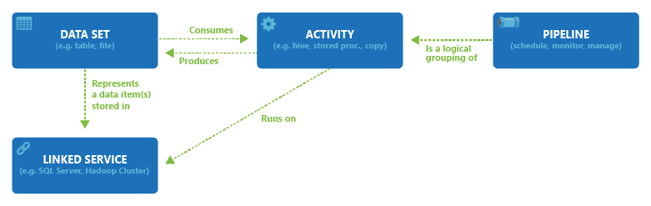
Azure Data Factory - Overview
Linked service and dataset represent tables or dynamic T-SQL.
Copy activity transfers data within or between databases.
Stored procedure activity can execute proven code.
Wrap complex activities together into a pipeline and schedule with triggers.
Alerting can be defined within the Azure Portal.

Slide 29
Moving data
Moving data between on premise and the cloud can be done many ways.
1 – Azure Data Sync
2 – Azure Data Migration Service
3 – Self Hosted Integration Runtime
A quick overview of these services are on the next few pages.

Slide 30
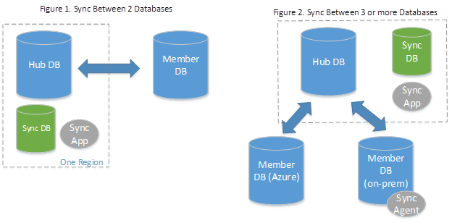
Azure Data Sync

Slide 31
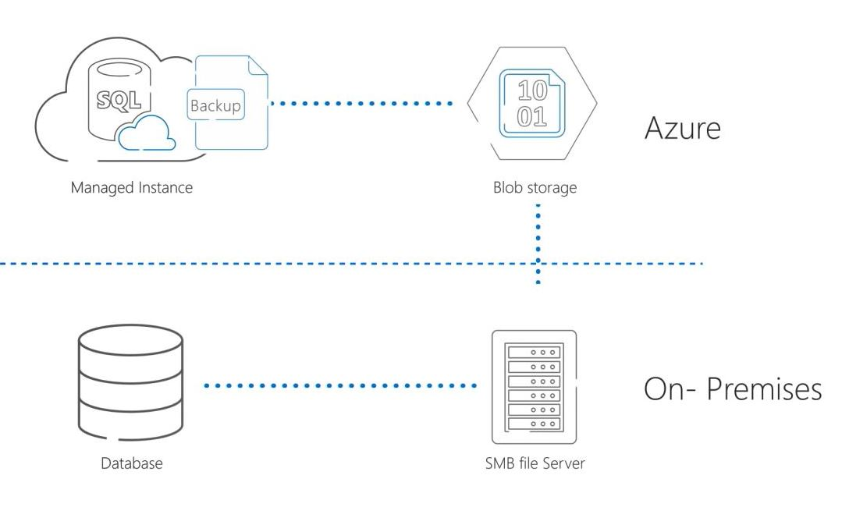
Azure Data Migration Service

Slide 32
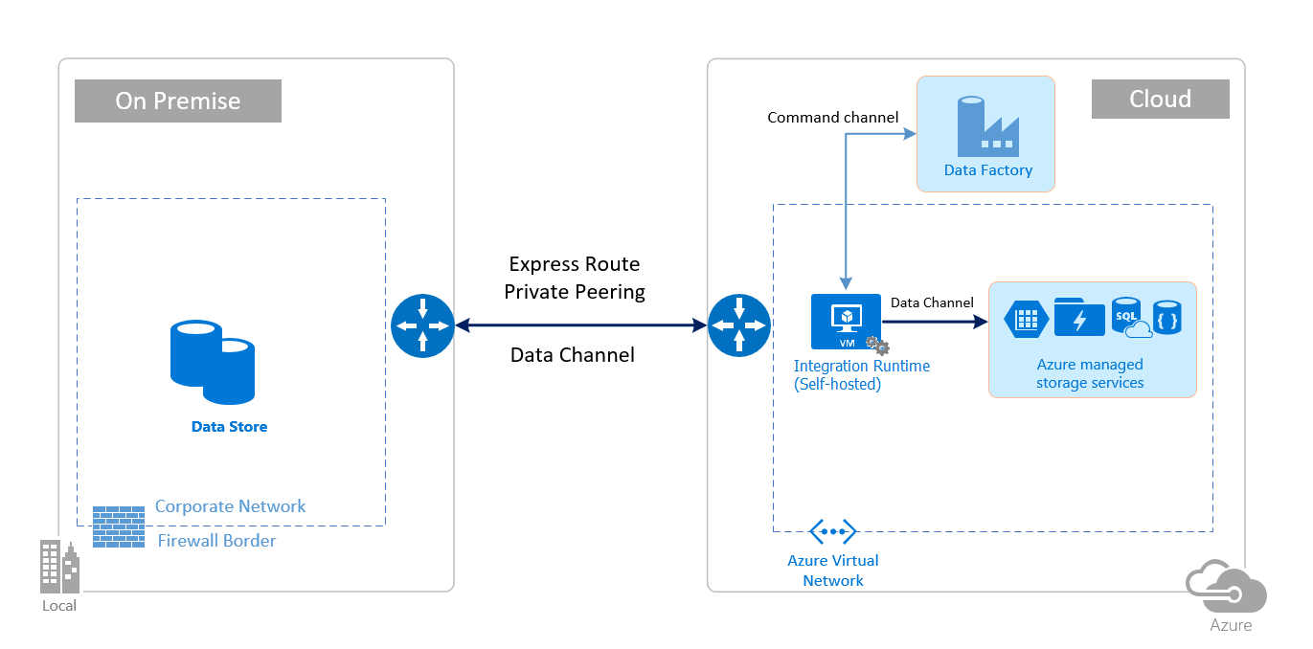
Self Hosted Runtime Integration (ADF)

Slide 33
Integration Services
Many companies have invested time and money on developing SSIS packages. How can these packages be lifted and shifted to the cloud?
Deploy Engine
Azure-SSIS Integration Runtime
Component of Azure Data Factory
Deploy Catalog On
Azure SQL DB
Azure SQL Managed Instance
Execute packages
Call Catalog stored procedures

Slide 34

!! Warning Label !!
This is not a complete coverage of all the techniques and services involved.
I suggest you pick a service that is applicable to your business problem.
Researching these topics will increase your knowledge and will allow you to pick the correct service.

Slide 35
Summary
There are many ways to deploy an Azure SQL Service.
The platform as a service PASS offerings promise a reduction of overhead and cost. However, at the higher end tiers, services become costly. Also, restrictions on functionality and database size come to play.
The infrastructure as a service (IAAS) offering in Azure increases over head at an equal cost. On the other hand, limitations in functionality and size are reduced.
As an Azure Data Architect, you must out weight the benefits and drawbacks to pick a service that is right for your company and a given business problem.

Slide 36
References – P1
IAAS vs PAAS
https://docs.microsoft.com/en-us/azure/sql-database/sql-database-paas-vs-sql-server-iaas
Single Azure SQL DB
https://docs.microsoft.com/en-us/azure/sql-database/sql-database-single-database
Elastic Pools
https://docs.microsoft.com/en-us/azure/sql-database/sql-database-elastic-pool
Elastic Jobs
https://docs.microsoft.com/en-us/azure/sql-database/elastic-jobs-powershell

Slide 37
References – P2
Elastic Query
https://docs.microsoft.com/en-us/azure/sql-database/sql-database-elastic-query-overview
Azure SQL DW
https://docs.microsoft.com/en-us/azure/sql-data-warehouse/sql-data-warehouse-overview-what-is
Azure SQL DB - vCore
https://docs.microsoft.com/en-us/azure/sql-database/sql-database-service-tiers-vcore
SQL Server Managed Instance
https://docs.microsoft.com/en-us/azure/sql-database/sql-database-managed-instance

Slide 38
References – P3
Azure Hyperscale
https://docs.microsoft.com/en-us/azure/sql-database/sql-database-service-tier-hyperscale
Azure Data Sync
https://docs.microsoft.com/en-us/azure/sql-database/sql-database-sync-data
Database Migration Service
https://docs.microsoft.com/en-us/azure/dms/dms-overview
ADF – Overview of service
https://docs.microsoft.com/en-us/azure/data-factory/concepts-datasets-linked-services

Slide 39
References – P3
ADF – Self hosted integration runtime
https://docs.microsoft.com/en-us/azure/data-factory/create-self-hosted-integration-runtime
ADF – SSIS package deployment
https://docs.microsoft.com/en-us/azure/data-factory/tutorial-deploy-ssis-packages-azure
Azure Automation
https://docs.microsoft.com/en-us/azure/automation/automation-intro

Slide 40
Biography
John Miner is a Data Architect for Insight Digital Innovations and helps corporations solve their business needs with various data platform solutions. He has thirty years of data processing experience, and his architecture expertise encompasses all phases of the software project life cycle, including design, development, implementation, and maintenance of systems. His credentials include undergraduate and graduate degrees in Computer Science from the University of Rhode Island. He has also earned certificates from Microsoft for Database Administration (MCDBA), System Administration (MCSA), Data Management & Analytics (MCSE) and Data Science (MPP). John has won the Data Platform MVP award in four time since 2014 for his outstanding contributions to the SQL Server community. When he is not busy talking to local user groups or writing blog entries on new technology, he spends time with his wife and daughter enjoying outdoor activities. Some of John’s hobbies include wood working projects, crafting a good beer and playing a game of chess.

Slide 41
Questions / Thank You

