Slide 1




Staging Data for Azure SQL Services
John Miner Data Architect
john.miner@insight.com
Blogs: www.craftydba.com www.mssqltips.com
Tweet: JohnMiner3

Slide 2
Target Audience
SQL Server Developers
How to code objects in Transaction SQL (TSQL) for both Azure SQL database and Azure SQL data warehouse.
SQL Server Administrators
How to use PowerShell to create and manage various Azure objects.

Slide 3
Big Data Problem
Most companies are faced with the ever-growing big data problem. It is estimated that there will be 40 zettabytes of new data generated between 2012 to 2020. See the computer world article for details.
Most of this data will be generated by sensors and machines. However, only a small portion of the data is available for users. How can IT professionals help business lines gather and process data from various sources?

Slide 4
Big Data Solution
Schema on write is represented by the traditional relational database. Raw data is ingested by an extract, transform and load (ETL) process. The data is stored in tables that enforce integrity and allow for quick retrieval. Only a small portion of the total data owned by the company resides in the database.
Schema on read is represented by technologies such as Hadoop or PolyBase. These technologies assumed that data integrity was applied during the generation of the text files. The actual definition of the table is applied during the read operation. All data owned by the company can reside in simple storage.

Slide 5
Presentation Overview
Grab some big data.
Create blob storage account.
Copy data to container.
Azure SQL database plumbing.
Loading data with BULK INSERT.
Azure SQL data warehouse plumbing.
Loading data with POLYBASE.
Azure automation with RUNBOOKS.

Slide 6
Big Data = Stock Data?
When dealing with big data, most computer scientist talk about Volume, Velocity and Variety.
If we are talking about real time trading, the volume tickets to buy or sell at NASDAQ can be high.
The velocity is at the second or less time frame. This means many records over the period of 7 hours.
However, the variety is static. All trading data conforms to a particular format.

Slide 7
S&P 500 Stock Data
The S&P 500 stock data from yahoo financials is a subset of a big data problem.
We have roughly 500 companies defined on Wikipedia as being part of the prestigious group.
Each day, we have one record that states the open, low, high and close stock values. Also, the total traded volume is recorded.
Example 1 – Grab stock data

Slide 8
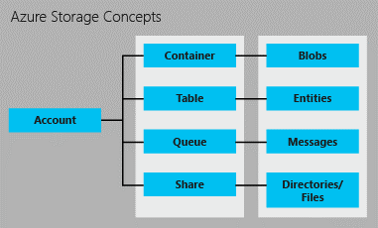
Azure Storage Concepts
Azure supplies the developer with many different storage concepts. Today, we are going to focus on blob storage.

Slide 9
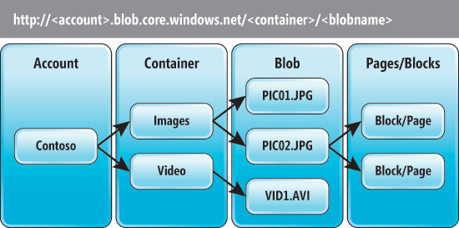
Azure Blob Storage
There is an hierarchy of objects when dealing with storage. A blob (file) resides in a container and a container resides in an storage account. Hot, cool and archive storage tiers are now available.

Slide 10
Access to Storage
There are two ways to access an Azure storage.
Storage Account Keys are an all access pass to the resources. There are two keys per account so that rotation can occur.
Share Access Signature is a finer way to give out access. For instance, read access for the next 30 days can be give out this way.

Slide 11
Copying Data 2 Azure Storage
There are many ways to perform this task. I am going to list two methods that can be automated with windows scheduler.
AzCopy is a utility from the Azure Resource Kit. Calling this utility from the command line with a shared access signature is one way to automate uploads.
PowerShell is the defacto language to use with Azure. There are many cmdlets that deal with Azure Storage.
Example 2 – Azure Storage & Upload Files

Slide 12
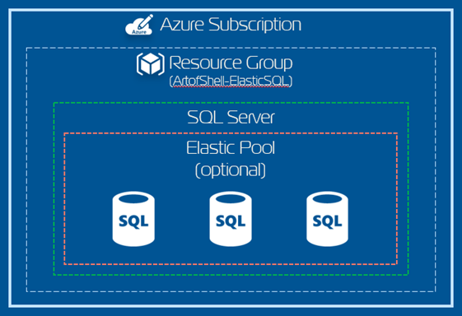
Azure SQL Database
Azure Portal or PowerShell can be used to create a server and database. By default, a firewall is in place to protect your data.
Example 3 – Create Azure SQL DB

Slide 13
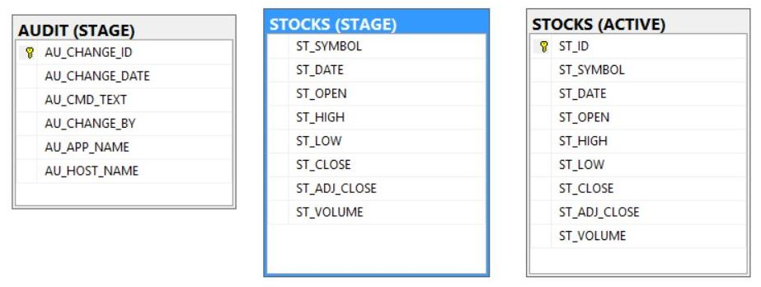
Stocks Database (SQL DB)
The audit table is used to track each step of the load process. Additional data can be added before transferring from the STAGE to ACTIVE schemas.
Example 4 – Azure SQL DB Schema

Slide 14
SQL Database Plumbing
The following objects are required for BULK INSERT or OPENROWSET to work.
master key
database credential
external data source
Ultimate goal is to call a stored procedure which loads all files from blob storage into the staging table. A packing list will be used to determine what is loaded. Auditing of the process will be required for production debugging.
Example 5 – Bulk Insert Data From Files

Slide 15
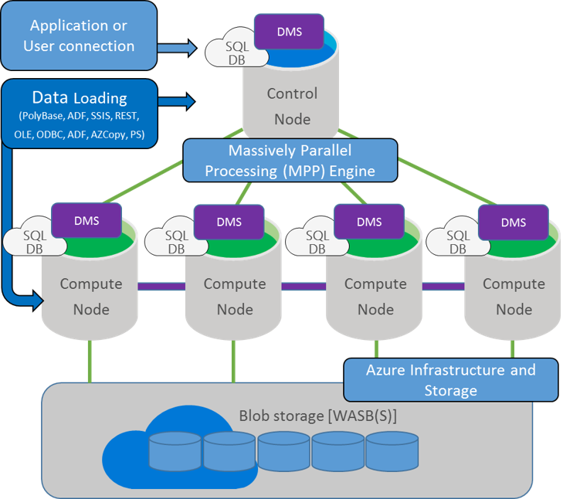
Azure SQL Data Warehouse

Slide 16
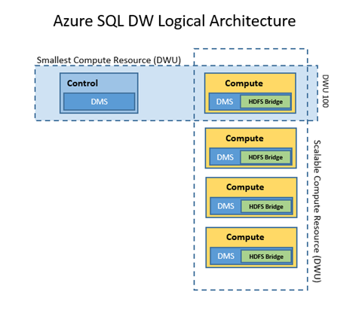
Azure SQL DW (data/compute)
Data hashed across 60 files.
One to sixty compute nodes.
Ability to pause/resume compute.
Ability to scale at will.
Example 6 – Create Azure SQL DW

Slide 17
Stocks Database (SQL DW)
Not fully T-SQL compliant.
No primary keys
No constraints
Must hash data
No cursors
Example 7 – Azure SQL DW Schema

Slide 18
Data Warehouse Plumbing
The following objects are required in order for PolyBase to work.
master key
database credential
external data source
external file format
external table (PolyBase)
Ultimate goal is to call a stored procedure that loads all files from blob storage into the staging table. Because this service does not support cursors, a view with dynamic T-SQL is used in a WHILE loop to duplicate the original logic.
Example 8 – Import data from external tables

Slide 19
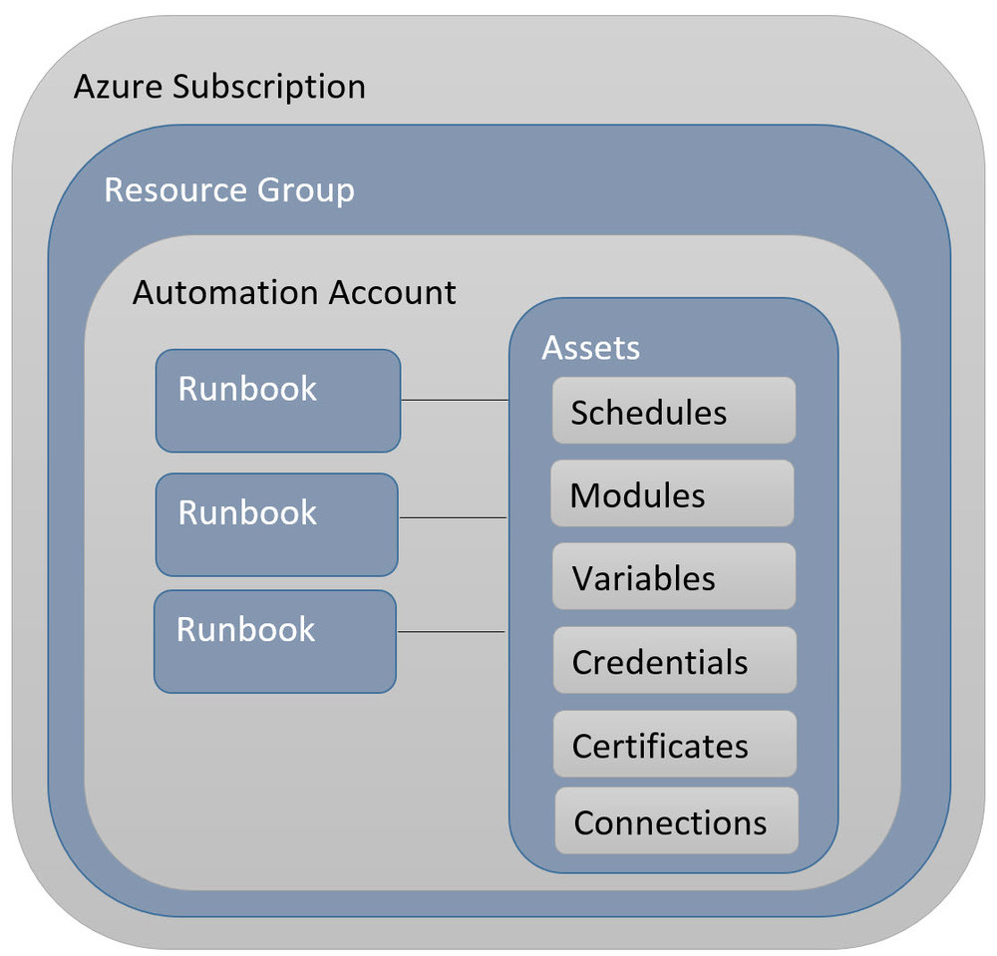
Azure Automation Overview
PowerShell work flows are at the heart of this service.
Connections and credentials allow you to customize by environment.
Support for Python run books was added in the summer of 2018.
The lack of modules and limitation of version 2.7 make it unusable at this point for complex problems.

Slide 20
Azure Automation Solution
The following algorithm is used to automate the load process from the Azure side.
Grab database credential
Show packing list
Call stored procedure to load data.
Insert data from stage to active tables.
Copy files to archive container.
Remove files from inbox container
Example 9 – Azure Run Book

Slide 21

!! Warning Label !!
This is not a complete coverage of all the techniques involved.
I suggest you get familiar with how I solved this one simple problem.
Researching these topics will increase your knowledge and will allow you to solve more complex problems.

Slide 22
Summary
The same old techniques are being used to solve larger and complex problems.
During the 1960’s to 1980’s, file directories structures on the mainframe were used to transfer data between different batch steps.
During the 1990’s to 2000’s, file transfer protocol (sites) were used to transfer data between different business.
Today, azure blob storage can be used as an staging area when dealing with large amounts of data and Azure SQL services.

Slide 23
References
Azure Blob Storage
https://docs.microsoft.com/en-us/azure/storage/blobs/storage-blob-storage-tiers
Staging SQL Data
https://www.mssqltips.com/sqlservertip/4573/using-azure-to-store-and-process-large-amounts-of-sql-data/
Azure SQL Database
https://www.mssqltips.com/sqlservertip/4378/deploying-azure-sql-database-using-resource-manager-powershell-cmdlets/
Azure SQL Data Warehouse
https://www.mssqltips.com/sqlservertip/4590/deploying-azure-sql-data-warehouse-using-resource-manager/

Slide 24
References (cont.)
Azure SQL Database – Bulk Insert
https://www.mssqltips.com/sqlservertip/5064/bulk-insert-data-into-a-azure-sql-database-with-powershell/
Azure SQL Data Warehouse – PolyBase
https://docs.microsoft.com/en-us/azure/sql-data-warehouse/sql-data-warehouse-get-started-load-with-polybase
Azure Automation – Run Books
https://docs.microsoft.com/en-us/azure/automation/automation-starting-a-runbook

Slide 25
Biography
John Miner is a Data Architect for Insight Digital Innovations and helps corporations solve their business needs with various data platform solutions. He has thirty years of data processing experience, and his architecture expertise encompasses all phases of the software project life cycle, including design, development, implementation, and maintenance of systems. His credentials include undergraduate and graduate degrees in Computer Science from the University of Rhode Island. He has also earned certificates from Microsoft for Database Administration (MCDBA), System Administration (MCSA) and Data Management & Analytics (MCSE). Before joining Insight, John won the Data Platform MVP award in 2014, 2015 and 2018 for his outstanding contributions to the SQL Server community. When he is not busy talking to local user groups or writing blog entries on new technology, he spends time with his wife and daughter enjoying outdoor activities. Some of John’s hobbies include wood working projects, crafting a good beer and playing a game of chess.

Slide 26
Questions / Thank You

