Slide 1



Azure SQL Database = SAAS (Software as a Service)
Boston Code Camp #23
By John Miner ~ john@craftydba.com
Blog: www.craftydba.com
Tweet: JohnMiner3

Slide 2
Typical Business Problems
Your company is under staffed to keep up with the demand of installing, configuring and patching Microsoft SQL Server.
Your companies current virtual machine infrastructure is maxed out. Any new initiatives are on hold.
You need to support a new acquisition in a different country. Team members both locally and abroad need a development copy of the database.
2 |

Slide 3
Presentation Overview
Review the following subjects.
Create Azure Account
Create Database Server
Adding IP Rules for client access
Capturing the connection string
Using SSMS, SSDT or SQLCMD
Creating a database from TSQL
Sample database with common objects
Good, bad and ugly truths
Exciting new features in Azure SQL DB
Various Migration patterns
3 |

Slide 4
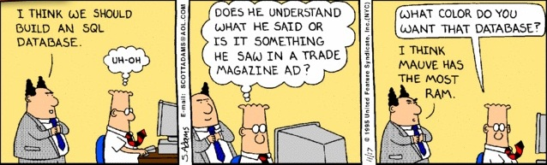
WARNING – TSQL Skills Required
All of the demonstrations are code based to give a real life example of how to apply a technique.
I will be not offended if you decide to leave now.
4 |

Slide 5
Create Azure Account
Get a subscription to Azure. This comes free as part of the Visual Studio Ultimate edition ($150/month).
Start a thirty data trial of Azure. This is free for the first month. Need to supply a credit card number.
Keep an eye on your daily usage. Leaving on virtual machines (IAAS) will eat up money.
5 |

Slide 6
Create Database Server
Use the azure portal wizard to create the database server. It will prompt you for admin name, admin password and first database name.
For finer control over azure, learn the power shell commands. See blog post below.
Craig Kitterman
http://azure.microsoft.com/blog/2013/02/07/windows-azure-sql-database-management-with-powershell/
6 |

Slide 7
Server Limitations
DTUs provide a way to describe the relative capacity of a performance level based on a blended measure of CPU, memory, reads, and writes.
Each server has a maximum of 2000 DTUs for Basic, Standard, and Premium databases. DTUs are consumed based on the DTU rating for that performance level.
There is a maximum of a 150 databases per server less the master database.
7 |

Slide 8
Database Service Tiers
Basic: Best suited for a small size database, supporting typically one single active operation at a given time. Examples include databases used for development or testing, or small scale infrequently used applications.
Standard: The go-to option for most cloud applications, supporting multiple concurrent queries. Examples include workgroup or web applications.
Premium: Designed for high transactional volume, supporting a large number of concurrent users and requiring the highest level of business continuity capabilities. Examples are databases supporting mission critical applications.
8 |

Slide 9
Database Connectivity
Add the IP to the firewall rule to connect to the database server.
The default port (1433) is enabled for the server.
Determine what tool you are going to use. Some tools like SSMS want to get a listing of all the databases. With that tool you need to create a traditional login and user. The account need to be a user on the [msdb] database.
Other tools like BCP allow the user to select the wanted database in the connection string. You can use a partially contained database user account.
9 |

Slide 10
Azure SQL Database
Microsoft is trying to get the cloud and on premise versions to be similar in nature.
Most core TSQL objects are supported.
Today, we are going to create a fictitious bank with customer, accounts and transactions.
A typical database that supports INSERT, SELECT, UPDATE and DELETE.
10 |

Slide 11
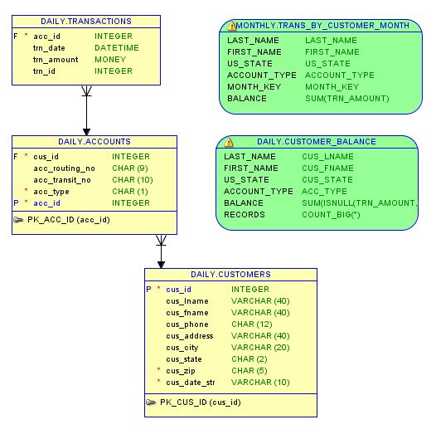
Sample Database – [JD Bank]
11 |

Slide 12
Various Objects in [JD Bank]
OBJECT NAME | OBJECT TYPE | OBJECT DESCRIPTION
CK_ACC_TYPE | C | CHECK_CONSTRAINT
DF_ACC_TYPE | D | DEFAULT_CONSTRAINT
DF_TRAN_ID | D | DEFAULT_CONSTRAINT
FK_CUSTOMER_ID | F | FOREIGN_KEY_CONSTRAINT
FK_ACCT_ID | F | FOREIGN_KEY_CONSTRAINT
GET_LUHN_ACCOUNT | FN | SQL_SCALAR_FUNCTION
ADD_RAND_TRANSACTIONS | P | SQL_STORED_PROCEDURE
PK_ACC_ID | PK | PRIMARY_KEY_CONSTRAINT
PK_CUS_ID | PK | PRIMARY_KEY_CONSTRAINT
SEQ_TRANS | SO | SEQUENCE_OBJECT
TRG_PATRIOT_ACT_VIOLATION | TR | SQL_TRIGGER
CUSTOMERS | U | USER_TABLE
TRANSACTIONS | U | USER_TABLE
ACCOUNTS | U | USER_TABLE
UQ_ACC_ID | UQ | UNIQUE_CONSTRAINT
TRANS_BY_CUSTOMER_MONTH | V | VIEW
CUSTOMER_BALANCE | V | VIEW
12 |

Slide 13
Good, Bad and Ugly?
Good Things?
Microsoft is responsible for the up-time of the database.
File management is handled by Microsoft.
Read Committed Snapshot Isolation is the concurrency level.
You do not have to maintain patching levels on your DBMS.
Bad Things:
Advance features such as file stream and file table are not supported.
Other features such as custom CLR code are partially supported.
Check the full list here.
https://msdn.microsoft.com/en-us/library/azure/ee336281.aspx
13 |

Slide 14
New Features
Data masking is a new feature in SQL Azure database.
http://azure.microsoft.com/en-us/documentation/articles/sql-database-dynamic-data-masking-get-started/
Automatic backups are taken by Microsoft. Users can restore via the Azure Portal. Backup frequency correlates to the edition and service level.
https://msdn.microsoft.com/en-us/library/azure/jj650016.aspx
Geo replication allows the customer to replicate the data to the same or another region. The secondary databases are readable and can be used for off loading of work.
https://msdn.microsoft.com/en-us/library/azure/dn741339.aspx
Elastic scale is a C# library that can be used to partition data into shards in Azure SQL database. Queries can be shard specific or execute against all shards.
http://azure.microsoft.com/en-us/documentation/articles/sql-database-elastic-scale-documentation-map/
14 |

Slide 15
Migration Patterns
A community project has created the SQL Database Migration Wizard to help migrate on premise databases to the cloud.
http://sqlazuremw.codeplex.com/
The following are some of the solutions are outlined by Microsoft.
To migrate the database Schema, either script the database from TSQL or create a DAC using the SSMS wizard.
To migrate the data from on premise to the cloud using BCP, Import/Export Wizard or SSIS.
To migrate both schema and data, try create a DAC BACPAC using SSMS Wizard. This DAC files have to be stored in a azure blob for access by the Azure SQL database.
https://msdn.microsoft.com/en-us/library/azure/ee730904.aspx
15 |

Slide 16
In Summary
The total cost of ownership for IT infrastructure has increase in price. This includes vendor licensing and keeping the hardware/software up-to-date with upgrades and patching.
The Azure SQL database, which is a software as a service (SAS), allows the consumer to worry about structure and content of the information without the headaches of installing, configuring and patching the database engine.
The current release of Azure SQL database V12 reduces the compatibility differences between on premise and in-cloud databases.
Given the current price point of the service, it might be worth while to see if this SAS fits in your companies current IT roadmap.
16 |

Slide 17
Biography
Has twenty years of data processing and proven project management experience, specializing in the banking, health care, and government areas.
His credentials include a Masters degree in Computer Science from the University of Rhode Island; and Microsoft Certificates (MCDBA & MCSA).
John is currently senior consultant at Atrion. He was award the MVP honor for his contributions to the community.
When he is not busy working, he spends time with his wife, daughter and dog enjoying outdoor activities

Slide 18
Questions & Answers
Please visit SQL Server Books Online for more info.
Please ask about the presentation or visit my blog (www.craftydba.com) for articles on this subject.
If you have any questions, you can contact me at jminer@craftydba.com
18 |

