Slide 1




Introduction to Data Analysis Expressions (DAX)
John Miner Data Architect
john.miner@insight.com
Blogs: www.craftydba.com www.mssqltips.com
Tweet: JohnMiner3

Slide 2
Target Audience
Every Business Intelligence professional should have a basic understating of the DAX language. Products such as Power BI and Analysis Services have a tabular semantic model that can be extended with custom measures, calculated columns and/or calculated tables.
The DAX language depends upon the relationships defined between tables in the model. The two different contexts (row and filter) come to play when writing expressions and queries.
At the end of the presentation, a professional will have working knowledge how DAX can be applied to a given model.

Slide 3
Presentation Overview
The Architectural diagram of formula and storage engines.
What is DAX language?
Exploring the various data types.
Using (inactive) relationships.
Using functions to create calculated columns.
The various categories of DAX functions.
Three type of references.
Using aggregates to create calculated measures.
Advanced evaluation contexts.

Slide 4
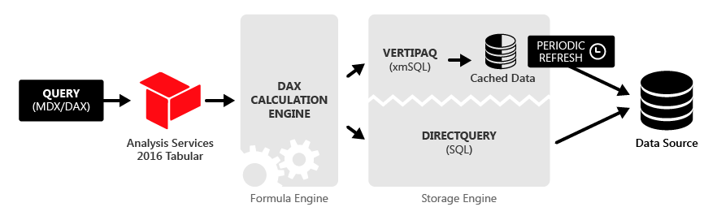
Architectural Diagram
* - Power Pivot, Power BI & Analysis Services

Slide 5
What is DAX?
DAX is a functional language used with the tabular data model. It is best to base the model off a star schema.
Relationships define how tables are connected. The connection can be 1-to-1 or 1-to-many. Filtering by default is in one direction.
Calculated columns and measures are the two common ways to extended the data model.
Example 1 – Calculated Columns vs Measures

Slide 6
Calculated (Columns vs Measures)
Calculated columns are processed during the import process. Since they are stored in the model, they take up memory. Typically, the user does not notice this process time. The evaluation uses the row context.
Calculated measures are evaluated when value is needed by the report. The user will notice the processing time of a slow expression. However, the measure does not take up memory. The evaluation uses the filter context.
Example 1 – Calculated Columns vs Measures

Slide 7
Numeric Data Types
Whole numbers are stored as integers.
Decimal numbers are stored as floats.
Currency numbers are stored as integers * 10,000.
The DAX language supports over 200 functions that can be used by the developer when creating a calculated columns.

Slide 8
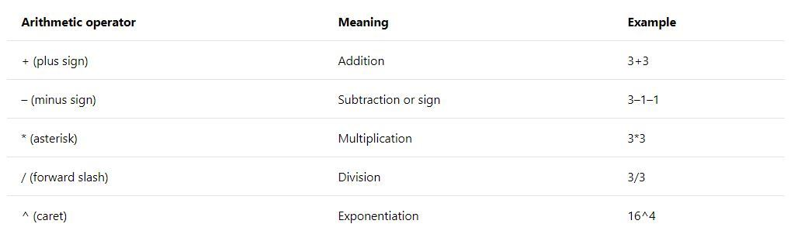
Arithmetic Operators
Example 2 – Calculated Columns – Numeric Data

Slide 9
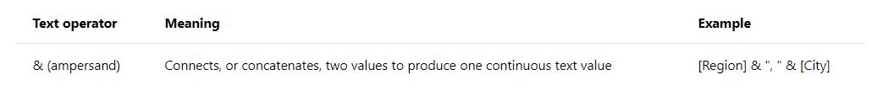
String Data Type
Every string value is stored as an array of Unicode characters and each character takes up 16 bits of space.
The DAX language is case insensitive when strings are compared. Therefore, ‘Power BI’ and ‘power bi’ are equal.
Example 3 – Calculated Columns – String Data

Slide 10
Date Data Type
The DAX language stores date values in a DateTime format which is represented by a floating point number.
The integer part of the number is the number of day since Dec 30, 1899. The fractional part represents hours, minutes, and seconds on a given day.
For backward compatibility, the year 1900 is considered a leap year. For accurate date and times, only store value greater than Mar 01, 1900.

Slide 11
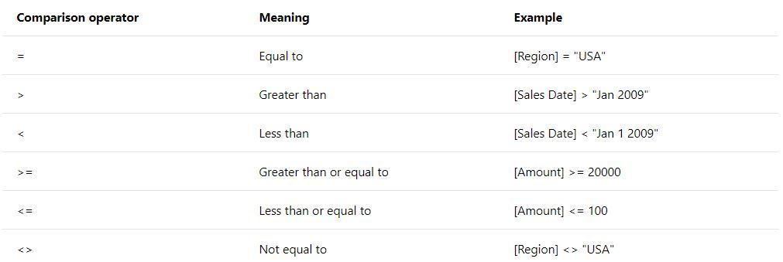
Comparison Operators
The comparison operators can be used with numeric, date and string data types.
Example 4 – Calculated Columns – Date Data

Slide 12
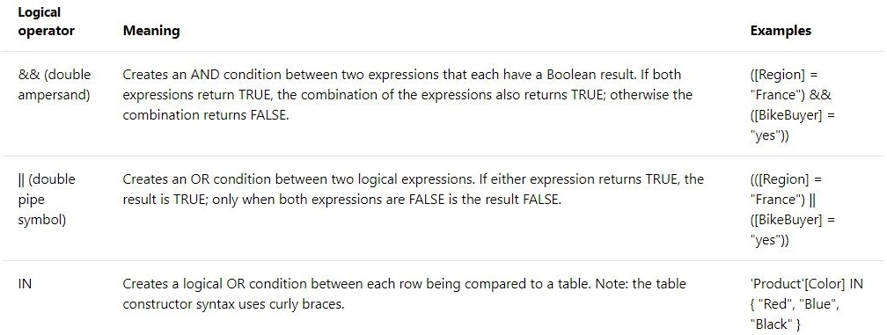
Boolean Data Type
Boolean values are used to express the logical conditions of TRUE and FALSE. The following operators return a Boolean value.
Example 5 – Calculated Columns – Boolean Data

Slide 13
Image Data Type
Image data is stored as a binary object.
However, Power BI desktop is based on a web application. We need to transform the binary data to a base 64 text.
The actual display type of the field needs to be set to URL image so that it can be viewed as a visual.
Last but not least, size of the image counts. Large images seem to get cropped regardless of the visual component.
Example 6 – Calculated Columns – Image Data

Slide 14
Using (inactive) relationships
There can only be one active relationship. This is why we can not retrieve the logo.
RELATED() - returns a column using existing relationships.
RELATEDTABLE() – returns a table to be used in a function.
USERELATIONSHIP() – can specify the relationship to use in a function.
LOOKUPVALUE() – return a result column, give a search column and search value.
The last function can be used to solve our problem.
Example 7 – Retrieving missing logo

Slide 15
DAX functions by category
There is not enough time in one class to go over the 200 functions that are part of the DAX language.
Math & Trigonometry, Text, Date & Time, Logical, Statistics, Time Intelligence, Information, Child & Parent, Filter

Slide 16
Various DAX References
Table reference
‘Date’ or Date
‘Product Category’
Column reference
‘Date’[Month]
‘Sales’[Quantity]
Measure reference
[Average Sale]
[Max Price]

Slide 17
Aggregate functions
Some of the statistical functions come in three flavors. The various implementations of an average function are listed below.
AVERAGE – calculates the average of a numeric column.
AVERAGEA – calculates the average of a column.
AVERAGEX – calculates the average given a table and expression.
Usually, aggregate functions are a developers first introduction to measures. Remember, the calculation uses the filter context.
Example 8 – Calculated Measures – Aggregate Functions

Slide 18
Advanced Evaluation Contexts
The are business cases in which you want to running total of sum value. How can we implement this expression?
There are two functions that allow you to alter the evaluation context.
CALCULATE() – expression evaluation ~ context modified by specified filters.
CALCULATETABLE() – table evaluation ~ context modified by specified filters.
Example 9 – Altering the filter context

Slide 19

!! Warning Label !!
This is not a complete coverage of all the techniques involved.
I suggest you get familiar with how I solved these simple problems.
Researching these topics will increase your knowledge and will allow you to solve more complex problems.

Slide 20
Summary
The invention of the tabular model has become popular with products such as Power Pivot, Power BI and Analysis Services. The model can be extended with calculated columns and calculated measures.
The Vertipaq storage engine is very efficient at saving data in a columnar format. This data is loaded directly into memory for speed. It is suggested to use a star schema as a data source for your model since it has medium normalization.
Columns are evaluated when data is imported and take up memory space. Measures are evaluated when needed and take up the processing time.
This is your first introduction into DAX. There is much more to learn!

Slide 21
References
Calculated columns vs Measures
https://www.sqlbi.com/articles/calculated-columns-and-measures-in-dax/
Advanced evaluation context
https://www.sqlbi.com/articles/filter-arguments-in-calculate/
DAX language reference
https://docs.microsoft.com/en-us/dax/data-analysis-expressions-dax-reference
M Language reference
https://docs.microsoft.com/en-us/powerquery-m/power-query-m-reference

Slide 22
Biography
John Miner is a Data Architect for Insight Digital Innovations and helps corporations solve their business needs with various data platform solutions. He has thirty years of data processing experience, and his architecture expertise encompasses all phases of the software project life cycle, including design, development, implementation, and maintenance of systems. His credentials include undergraduate and graduate degrees in Computer Science from the University of Rhode Island. He has also earned certificates from Microsoft for Database Administration (MCDBA), System Administration (MCSA) and Data Management & Analytics (MCSE). Before joining Insight, John won the Data Platform MVP award in 2014, 2015 and 2018 for his outstanding contributions to the SQL Server community. When he is not busy talking to local user groups or writing blog entries on new technology, he spends time with his wife and daughter enjoying outdoor activities. Some of John’s hobbies include wood working projects, crafting a good beer and playing a game of chess.

Slide 23
Questions / Thank You

