Slide 1

Introduction to the data build tool (dbt) For Azure Databricks
John Miner Data Architect
john.miner@insight.com

Slide 2
Agenda
Data Modeling
Background and Setup
Materializing Data
Testing Data Quality
Producing Documentation

Slide 3
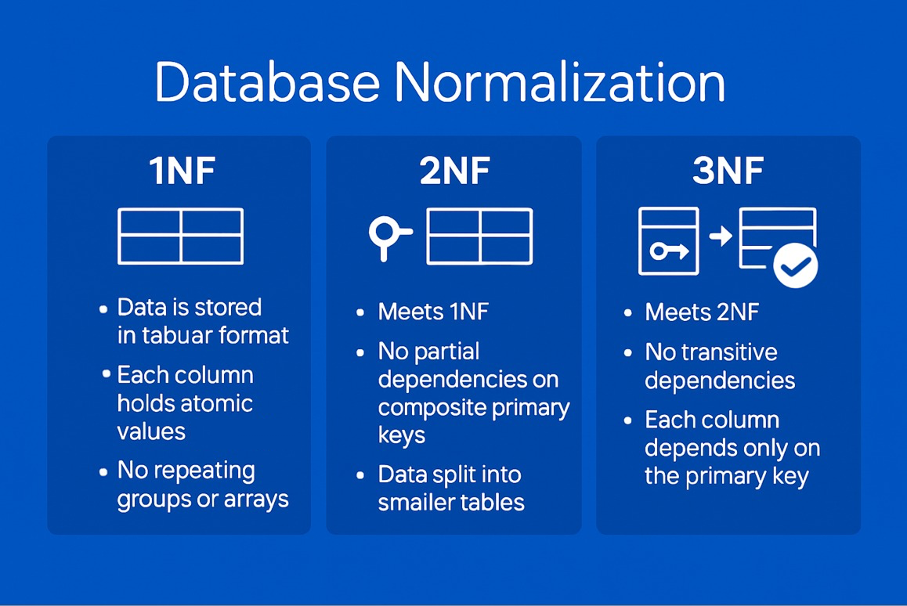
Data Modeling
Normal Forms
Normalization entails organizing the columns (attributes) and tables (relations) of a database to ensure that their dependencies are properly enforced by database integrity constraints.

Slide 4
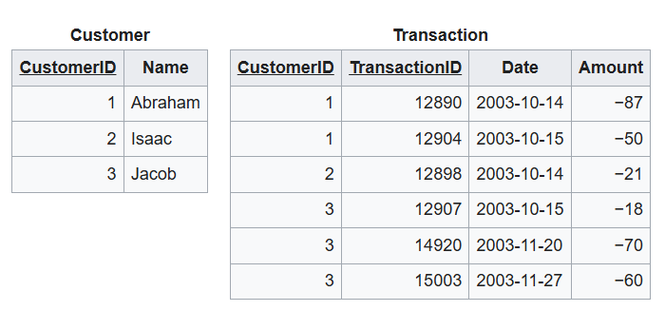
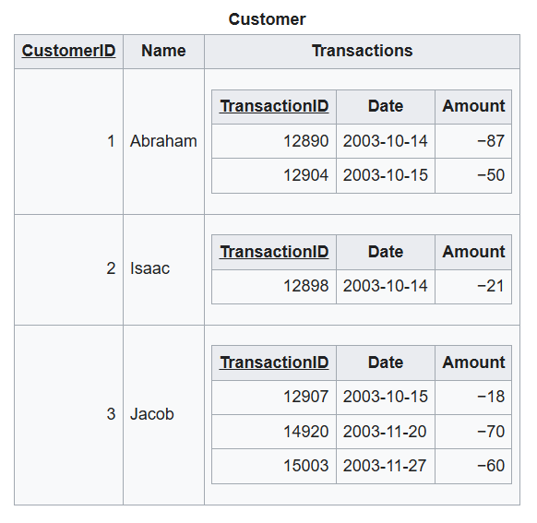
1st Normal Form
Move nested array (object) into its’ own table. This can happen with JSON documents in SQL Server.

Slide 5
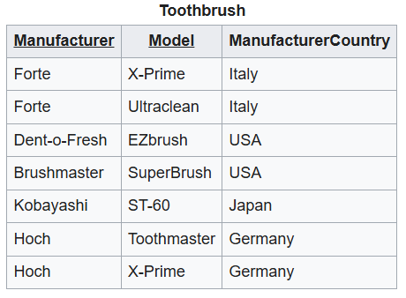
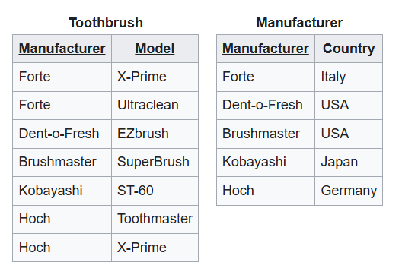
2nd Normal Form
Partial dependency occurs between manufacturer country and manufacturer name. Break into two tables to eliminate.

Slide 6
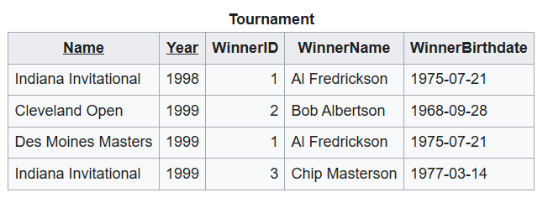
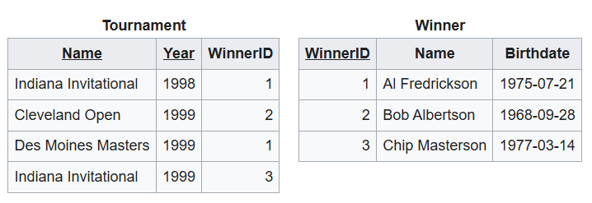
3rd Normal Form
Transitive dependency between name, year, and winner id. Break into two tables to eliminate redundancy and possible date entry errors.

Slide 7
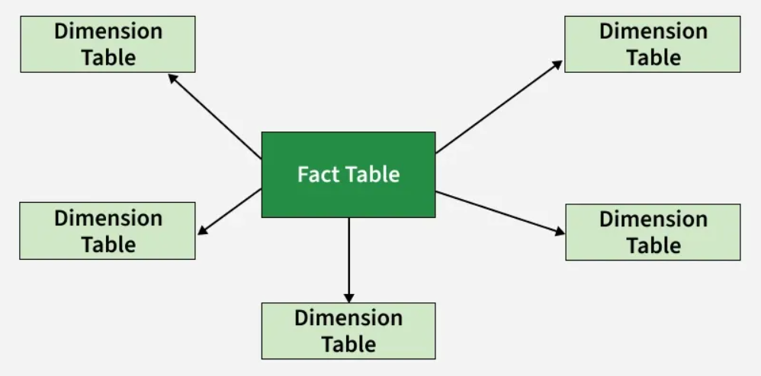
Star Schema
Data Warehousing
The star model is widely used to develop data warehouses. The model has one or more fact tables referencing any number of dimension tables.
Fact tables hold the quantitative data about a business and dimension tables are descriptive attributes related to fact data. Querying is extremely fast since the joining keys are typically integers.

Slide 8
Background
Concept
Data build tool (dbt) is an open-source tool that helps engineers transform existing data within their warehouses.
VS Code Integration
The framework is written in Python with the translations defined as SQL scripts and/or YAML files.
Target Platforms
The real power comes from the fact that adapters have been written for many different target database management systems.

Slide 9
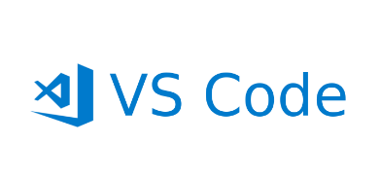

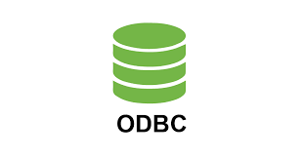
Setup
Install SSMS for SQL Server
Install Visual Studio Code
Install Python language version 3.7 or above.
Pip install dbt-core.
Pip install dbt-(adapter) *
Local ODBC driver for (adapter) *
* - We will learn with Lakebase first.

Slide 10





Architectural Diagram
Software Requirements
Framework Features
target adapter
generated SQL
dbt core using cli
from VS code
transform, test,
document, and model

Slide 11
Library Toy Schema
AI generated tables
CSV sample records

Slide 12
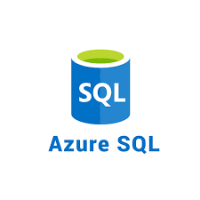
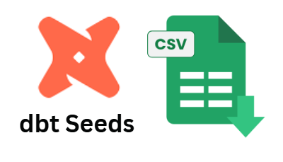
Seeding Data
Understanding the “dbt_project.yml” file
Configure the “profile.yml” file
Test Azure Database connection
Seed one vs all tables
Tear down the database
Lakebase supports only basic authentication
Exercise 01

Slide 13
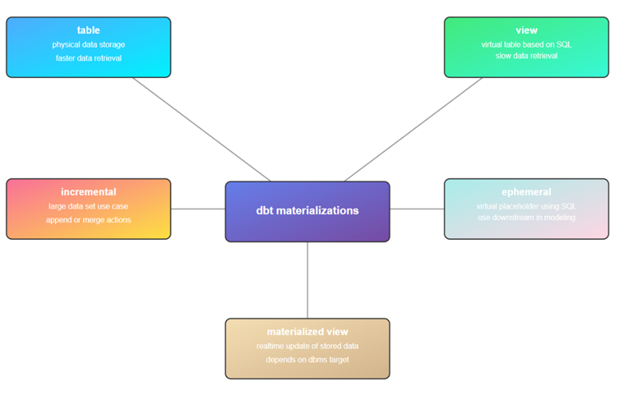
Materializing Data
Tables
Views
Incremental
Ephemeral
Materialized Views (Depends)
Snapshots (SCD2)
Exercise 02

Slide 14
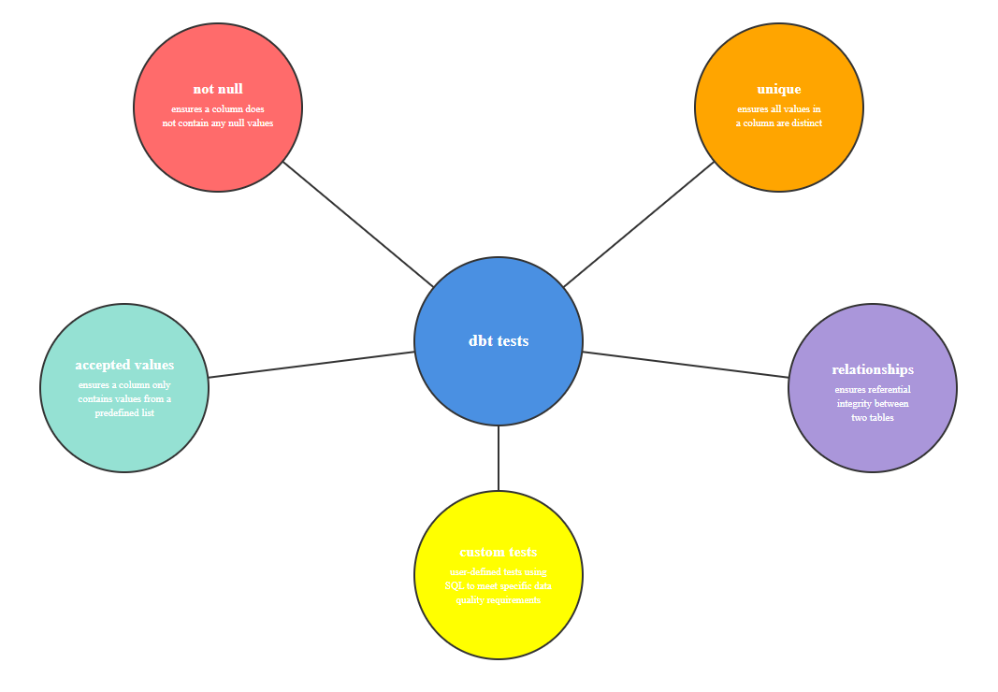
Data Quality
Not Null
Unique
Accepted Values
Relationships
Custom
Exercise 03

Slide 15
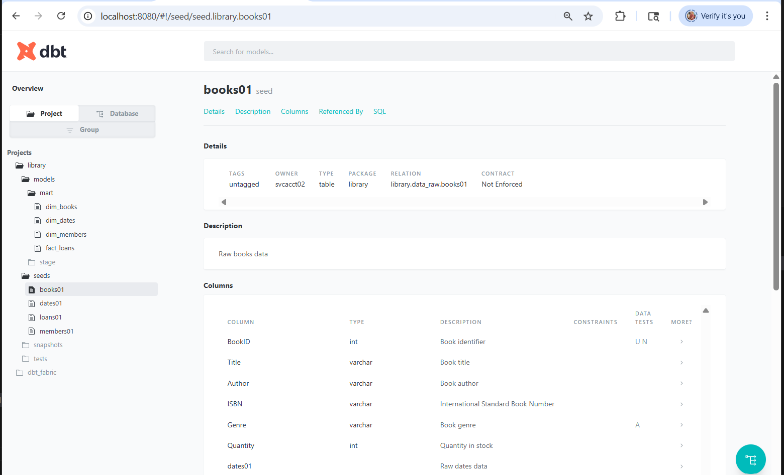
Producing Documentation
dbt docs generate
dbt docs serve
Exercise 04

Slide 16
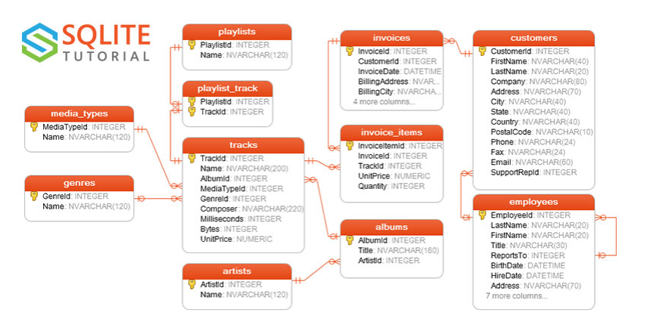
Capstone
Semi-Static Data
Artists; Albums; Genres; Employees; Media Types; Playlists; Playlist Tracks; Tracks
Transactional Data
Customers; Invoices; Invoice Lines
Schemas
Raw; Snapshot; Stage; Mart
Exercise 05

Slide 17
Summary
Today, we talked about the project, profile, schema, and properties YAML files. Each one is designed for a specific reason. The key to modeling in dbt is the different ways to materialize data. We covered seeding, snapshots, tables, views, and materialized views.
The real power of dbt comes from its many adapters. I can run the same model with a target of Databricks SQL Warehouse or Databricks PostgreSQL database. Jinga macros allows the developer to call prebuilt code and/or create dynamic SQL for the target.
Finally, documentation is always lacking in these systems. We learnt how to use Claude Opus to take those database schemas and guess at descriptions. In the end, the tool allows the developer to create documentation on all the models.
There is still more to learn. For instance, Python models allow for advanced calculations, calls to REST API end points and machine learning. Always check performance before usage.

Slide 18
Installations Links
Install dbt core
https://tinyurl.com/4n7umrhy
Install Visual Studio Code
https://tinyurl.com/jmj6v9rx
Install Anaconda Python
https://tinyurl.com/4hvhdbvw
Install SSMS
https://tinyurl.com/5fs44kvb
Install Postgres ODBC Driver
https://tinyurl.com/296cfvrd
PowerShell for VS Code
https://tinyurl.com/2bj5y2pr
Install dbt Postgres adapter
https://tinyurl.com/48cj55rc
Install dba Tools for PowerShell
https://tinyurl.com/ytxp375j

Slide 19
References
dbt project file
https://tinyurl.com/ym75b3kx
dbt profiles file
https://tinyurl.com/k6kfcnjs
dbt command reference
https://tinyurl.com/yc6ef236
dbt materializations
https://tinyurl.com/tb2nfsdy
dbt data tests
https://tinyurl.com/4677bet2
dbt Incremental Models
https://tinyurl.com/2jmnsmnb
dbt Jinga Functions
https://tinyurl.com/hscx36k3
Great Expectations Module
https://tinyurl.com/8ztr7r5b

Slide 20
THANK YOU
John Miner
401-477-4565
john@craftydba.com
www.youtube.com/@ninedatamuses

