Slide 1
Cloud Database & Application Backups

Slide 2
Warnings
Not a cloud expert and do not play one TV
I learn new things everyday
You may hear some different vocabulary
Roles of the data professional are changing

Slide 3
Why host an app on a cloud?
Total cost of ownership
Plethora of technologies to use
Cheaper and quick proof of concepts

Slide 4
But My App is hosted…
Backups are not automatic*
Many of the on premise methodologies apply
Restore most likely won’t be a hardware failure
Self inflicted, human cause
Resume generating event(s)
If your provider is having issues, you are having issues
But…If your provider is down so are you

Slide 5
Outages
Most recent Azure September 4 2018
Read the postmortem https://blogs.msdn.microsoft.com/vsoservice/?p=17485
AWS March 2018
Read about it https://virtualizationreview.com/articles/2018/03/05/aws-outage.aspx
Impacted Slack, Twilio and others
Status pages might be stale
https://outage.report/

Slide 6
Backup Strategy
FIRST, Determine your SLA
Plan for region downtime if needed
Determine the type of backup
Point in time
Export
3rd party utilities (Commvault, Veeam)
Monthly, yearly
Legal requirements
Storage
Determine retention requirements
Legal and regulation requirements
Cattle not pets

Slide 7
Automation
Script out creation of resources
Network, VMs, etc.
Out of the box backup options for VMs (DB images)
Help control retention/archiving
Have quirks and hidden cost
Geo Replication
$$$$
Depends on the scenario for application
https://docs.microsoft.com/en-us/azure/sql-database/sql-database-geo-replication-portal
Point in time recovery options
Retention is usually determined on the performance tier
Custom retention options available
Deployment of environments
Infrastructure as code (AWS CloudFormation, Chef, Puppet)
Establish repeatable one deployments to different environments (network setup)

Slide 8
Automation and Deployment Tools Available
VM to run automation scripts or other tasks
Visual Studio
Unit testing automation
Deployment of objects
Server-less functions
( AWS Lambda, Azure Function Apps, Azure Automation, Google Cloud Functions)
Pick your flavor (PoSh, C#, Python, AWS CLI, etc)
Check availability of supported languages
Some platforms move around i.e. PowerShell to Azure Automation

Slide 9
Monitoring
Watch your backup storage
Hidden costs in forgetting to archive or failing jobs
3rd Party Tools
PRTG, Dynatrace, Solarwinds

Slide 10
Document your application
Team(s) responsible for the different pieces
Keep it updated
Note your providers and what services are on each
Include you performance and backup pricing tiers for hosted services
IaaS, DBaaS, etc.
VM size and configuration
Licensing
Bring your own or leased through your cloud provider (VM Images)
Talk to your licensing rep
Networking connections and configuration in and out
VPN info, ACLs, Etc.
Use collaboration tools to help organize
Know your billing numbers

Slide 11
Create an Operational Matrix
What pieces are needed to run your cloud app
Helps decide what is truly important
Different tier of backups, processing, storage
Costs $$$$
Provides a simplified view of your application(s)
Optional – Create a cost matrix per whatever
Helps rationalize what you are trying to accomplish

Slide 12
Operational Matrix Example
Operational Status | User Identity Mgmt. (Azure AD, AWS Cognito) | Cloud Relational DB Data (DBaaS) | NoSQL Data (DynamoDB, CosmosDB) | Server less Functions (AWS Lambda , Azure Functions) | Web Front End/Mobile app (IIS VM)
NO | O | O | O | O | X
LIMITED | O | O | O | X | O
LIMITED | O | O | X | O | O
NO | O | X | O | O | O
NO | X | O | O | O | O
YES | O | O | O | O | O

Slide 13
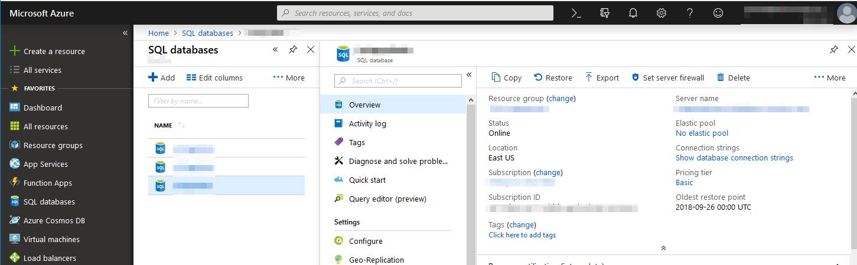

Slide 14
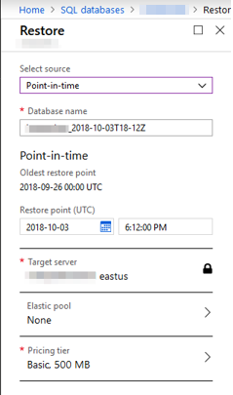
DBA who?
After clicking the restore option you can select
you point in time you wish to restore to.
Also you can change the performance tier
that the new data will live on.

Slide 15
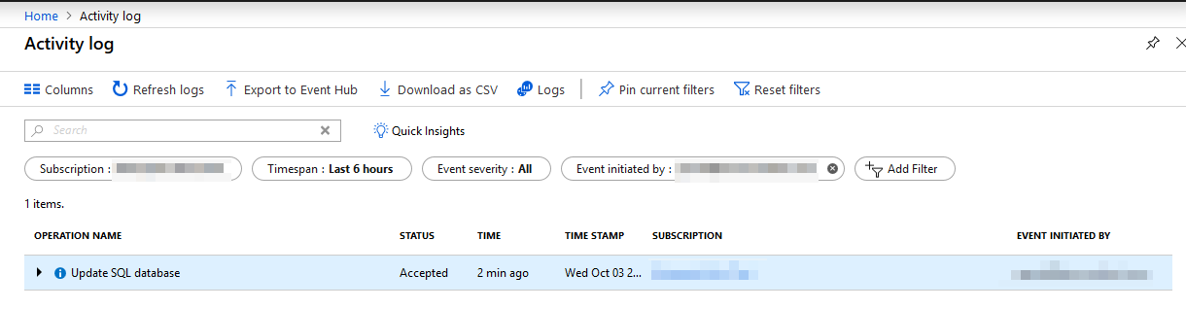
All restore actions are available in the Activity log

Slide 16
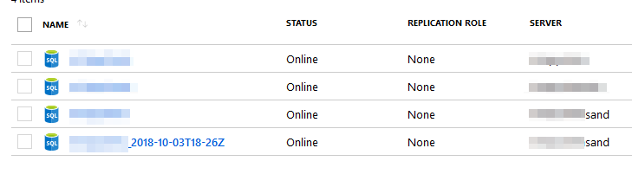
Now the restored database will be listed
with the restore given in the restore process

Slide 17
Cosmo DB Backups
Call Azure Support within 8 hours
Azure support will handle the restore operations
Retains last 2 backups
In the case of corruption reach out to Azure support
It is recommended that the user should delete the corrupted container to avoid an automatic backup of the corruption
https://docs.microsoft.com/en-us/azure/cosmos-db/online-backup-and-restore

Slide 18
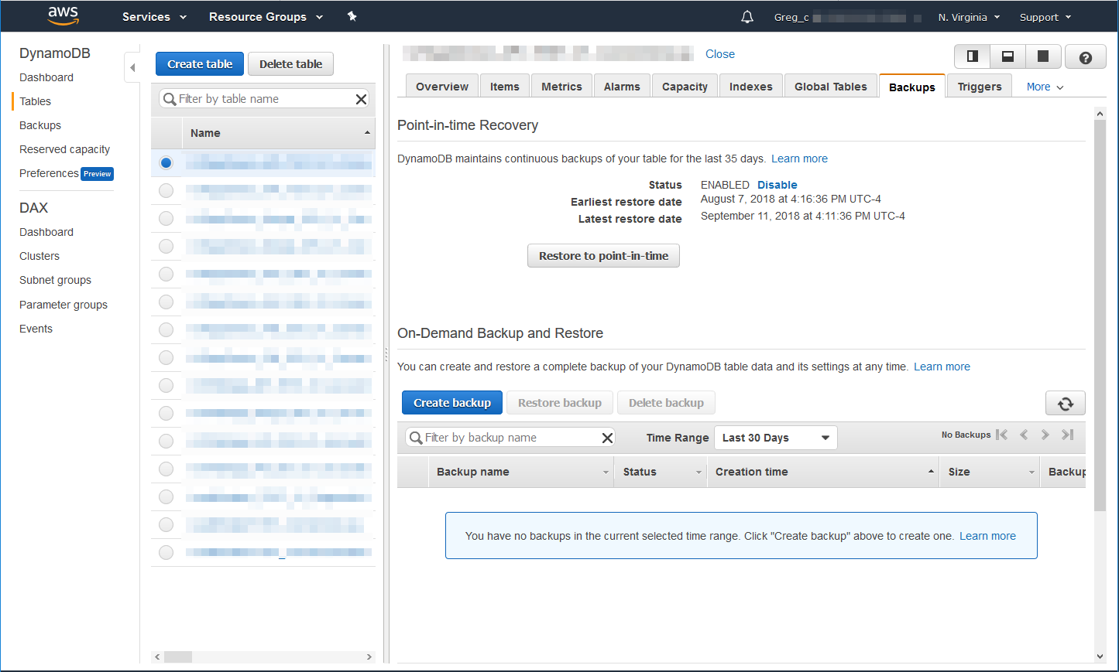

Slide 19
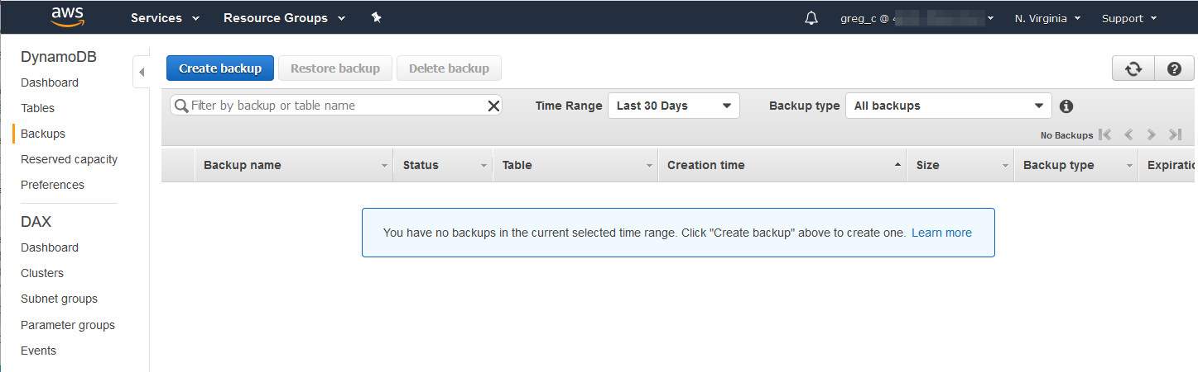

Slide 20
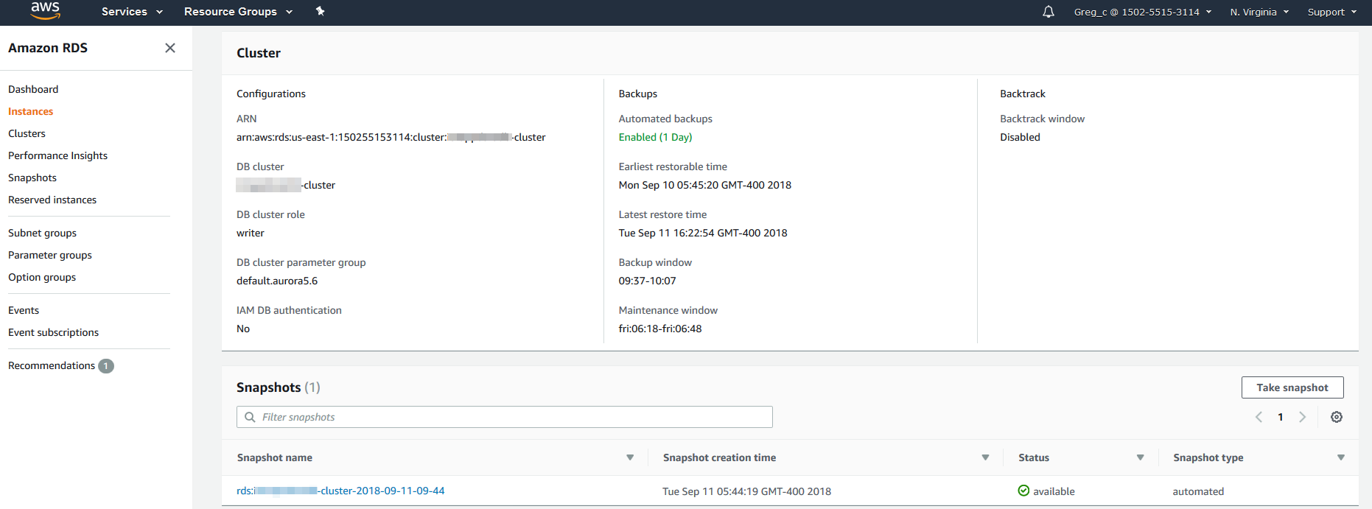

Slide 21
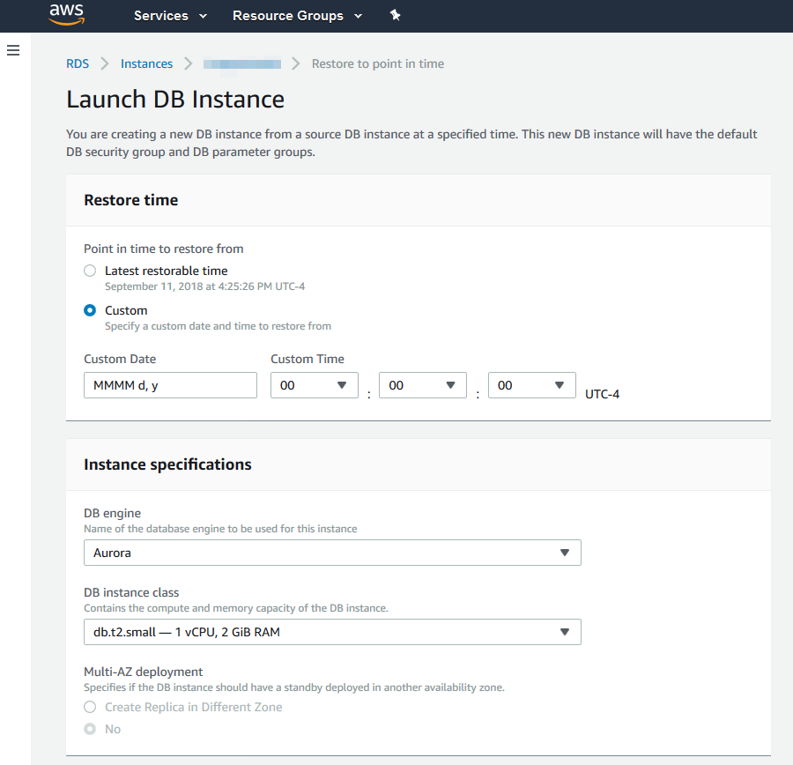

Slide 22
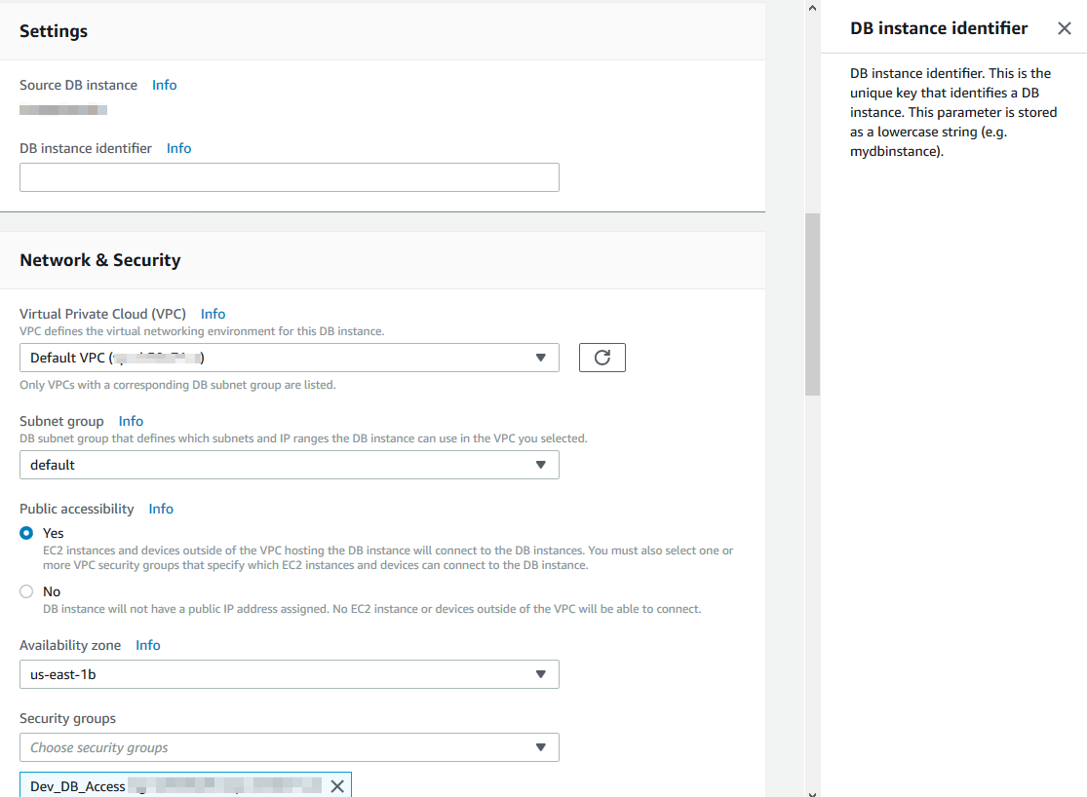

Slide 23
