Slide 1
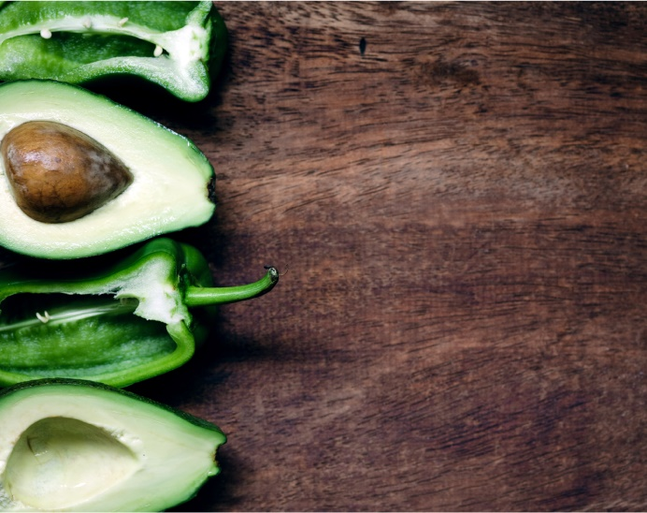
ZestyMeals Zest for Success

Slide 2
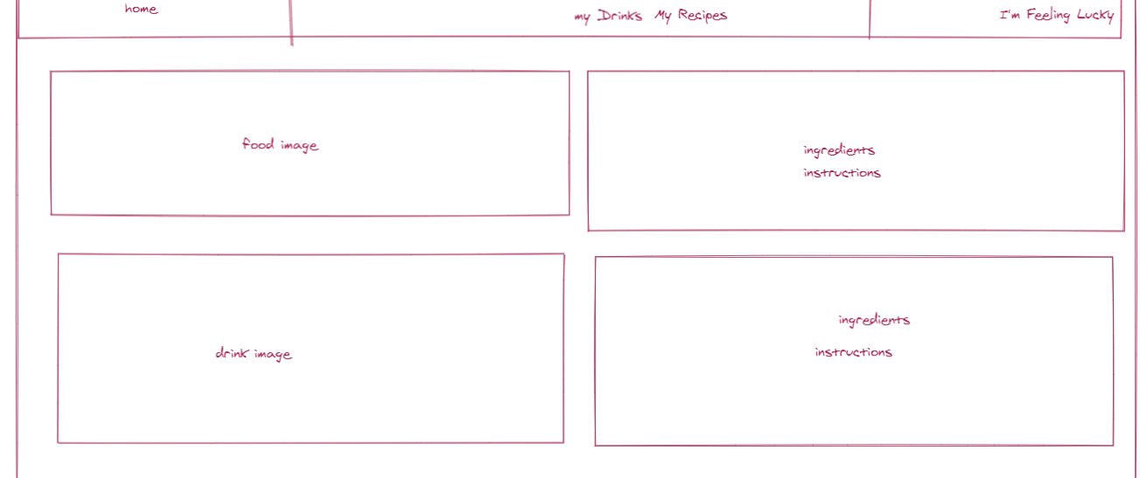
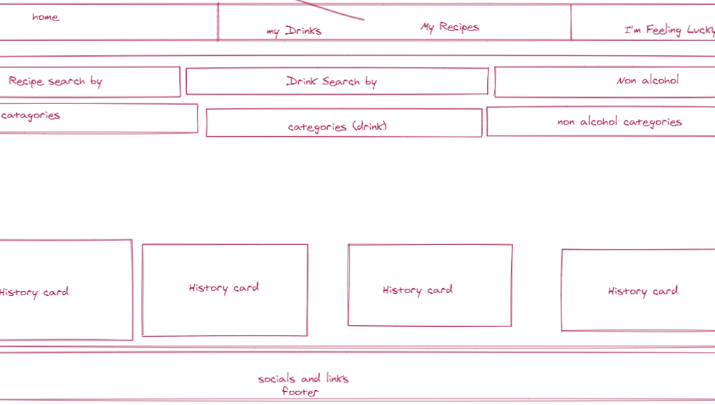

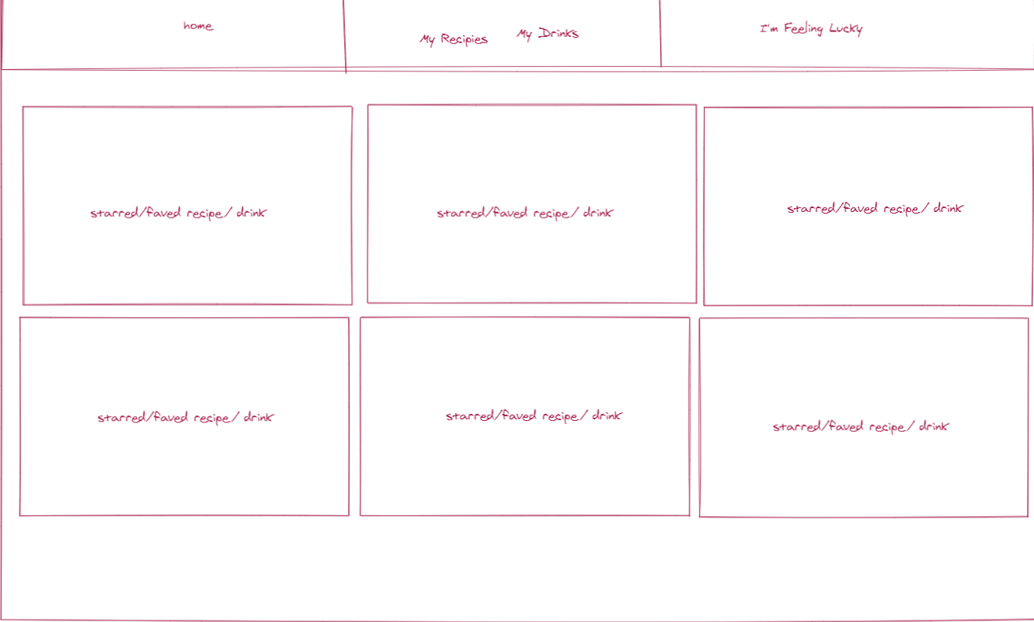
Wireframe Design Concept
Group 7 LLC Have Clearly Defined Our Wireframes to Ensure Our Application Represents the Quality Our Vision Demands. Our Double API Integration Offers Superior Features to Stand-out In a Busy Market.

Slide 3


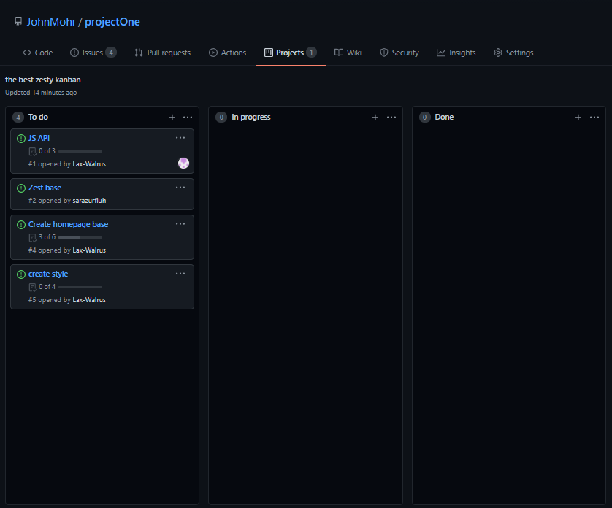

Only The Best Of Zesty To-Do’s.
We Have Created a Path of The Best Zesty To-Do’s To Maintain a Clean, Modern Application That, At Its Base, Functions As a Recipe Guide.

Slide 4



USER STORY
As A Quarantine Victim, and frazzled home cook,
I WANT to find a food or drink recipe
SO THAT I can figure out what to eat

Slide 5


EXPANDED FEATURES
Group 7 LLC Will Expand Our Application To Offer Various Options For Group Events or Simple Family Dinners.
Choose from Food and Alcohol Database API’s Simultaneously to Create a Meal Plan. Complete with Food and Drink Photos, Recipes and Instructions to Create.
Use Built-in Local Storage Features to Save Favorite Food and Drink Recipes.
Try Your Luck With Randomly Generated Options Curated By Group 7 LLC.
The Taco Gods Are All Around Us. Speak To Them.

Slide 6

Take Out The Stress With The Zest.
When the Family Needs a New Go-to Recipe,
or When the Squad Finally Gets Vaccinated,
Add a Little Zest to Your Life With ZestyMeals.
(These Smiles Brought To You By ZestyMeals)
This guy used our app.

