Slide 1
Advanced CFD-DEM Coupling Framework
Project Presentation
Geotechnical Applications

Slide 2
Project Overview
Key Components:
• Validation Manager
• Statistical Analysis
• Sensitivity Analysis
• Case Studies

Slide 3
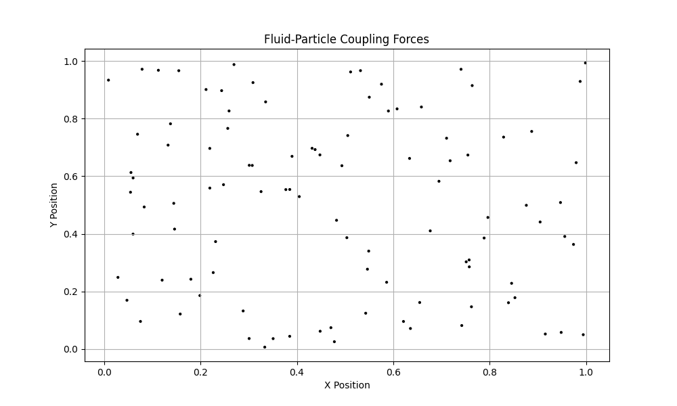
Fluid-Particle Coupling

Slide 4
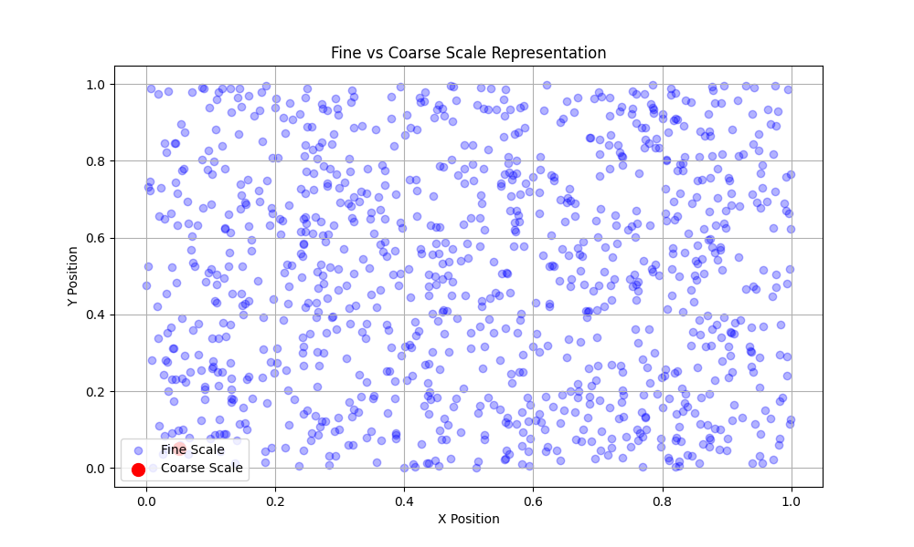
Coarse-Grained Approach

Slide 5
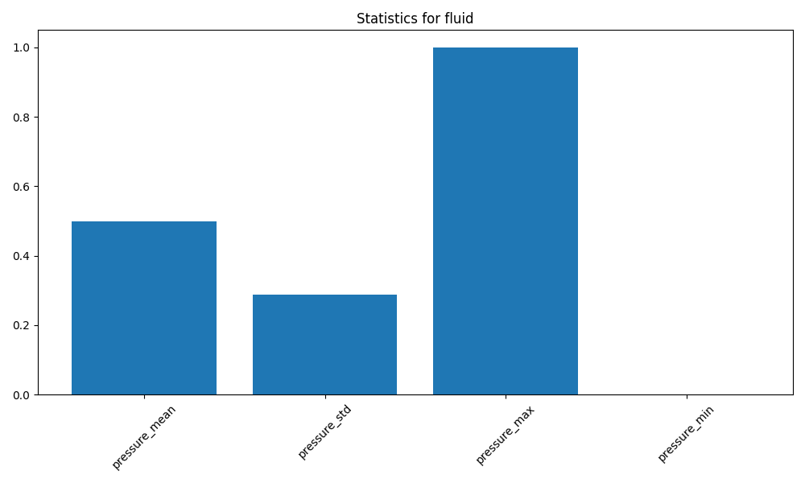
Fluid Flow Statistics

Slide 6
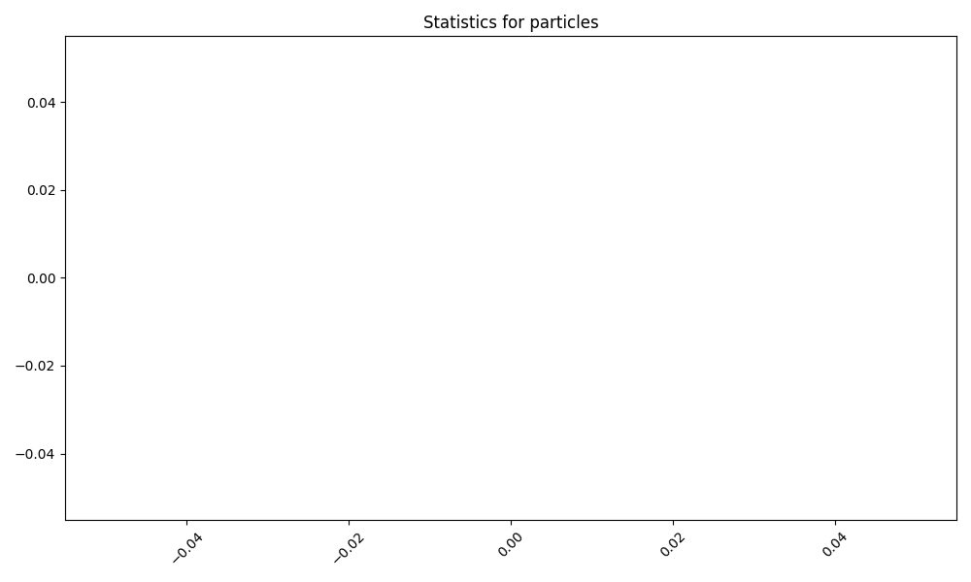
Particle Behavior Analysis

Slide 7
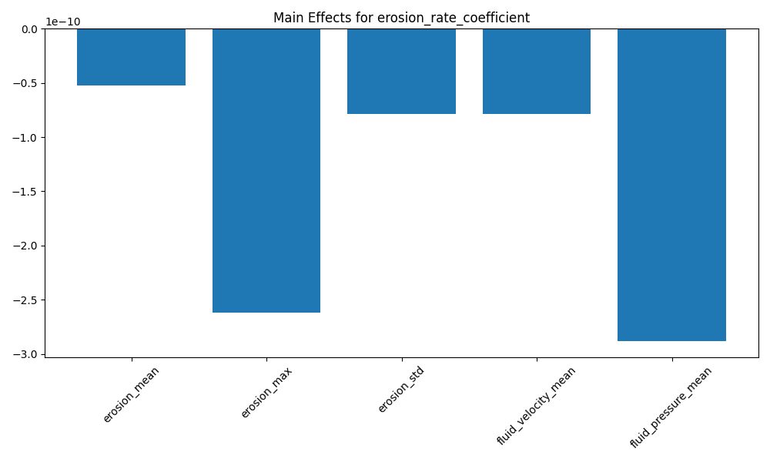
Sensitivity Analysis Results

Slide 8
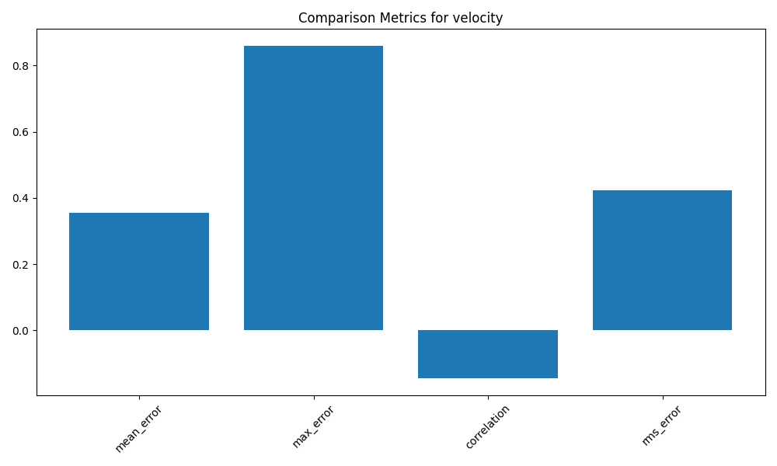
Validation Results

Slide 9
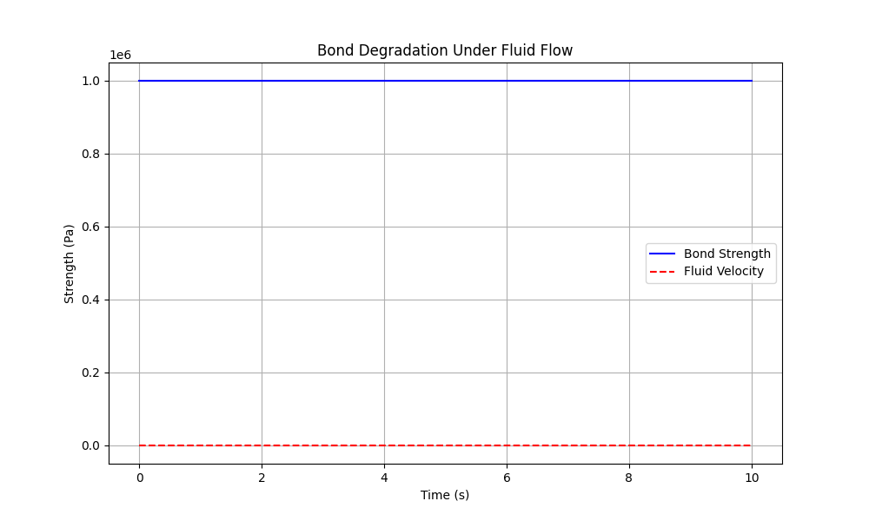
Bond Degradation Model

