Slide 1
Small Business Database Management System
Transforming Data Into Decision-Making Power
🎯 Team 3 | IT 125 SQL | Summer 2026

Slide 2
📋 Project Roadmap
01 PROJECT OVERVIEW & Business Challenge
02 DATABASE ARCHITECTURE & 8 Core Tables
03 ENTITY RELATIONSHIP DIAGRAM & Visual Design
04 TABLE STRUCTURES & Data Dictionary
05 SALES TRANSACTION MODEL & Data Flow
06 INVENTORY & PRODUCT MANAGEMENT
07 ANALYTICS QUERIES & Business Intelligence
08 IMPLEMENTATION & Real-World Applications

Slide 3
PROJECT OVERVIEW
Problems to Solutions

Slide 4
🎯 Business Challenge
❌ PROBLEM: Data Fragmentation
• Spreadsheets, emails, paper records scattered everywhere
• Customer data in multiple places (CRM, spreadsheets, emails)
• No visibility into inventory or cash flow
❌ IMPACT: Operational Inefficiency
• Duplicate customer records → billing errors
• Stockouts due to poor inventory tracking
• Hours spent manually compiling reports
• No real-time business metrics for decision-making

Slide 5
✅ Modern Database Solution
✓ UNIFIED DATA MODEL
• 8 interconnected tables capturing all business operations
• Single source of truth for all customer, product, sales data
✓ AUTOMATED REPORTING
• 20+ ready-to-run analytics queries
• Real-time dashboards ready for development
✓ DATA INTEGRITY & SECURITY
• Enforced relationships prevent data errors
• Audit trails with timestamps
• Historical data preservation

Slide 6
DATABASE ARCHITECTURE
8 Interconnected Tables

Slide 7
🗄️ 8 Core Tables
👥 CUSTOMERS | Client contact, location, loyalty program data
🏢 VENDORS | Supplier information, payment terms, contacts
📦 PRODUCTS | Master product catalog with pricing
📊 INVENTORY_ITEMS | Real-time warehouse stock levels
💳 SALES | Transaction headers with payment info
🛒 SALES_LINE_ITEMS| Individual products per transaction (many-to-many)
💰 EXPENSES | Financial outflows, vendor payments, budgets
✅ COMPLIANCE | Licenses, permits, renewals, certifications

Slide 8
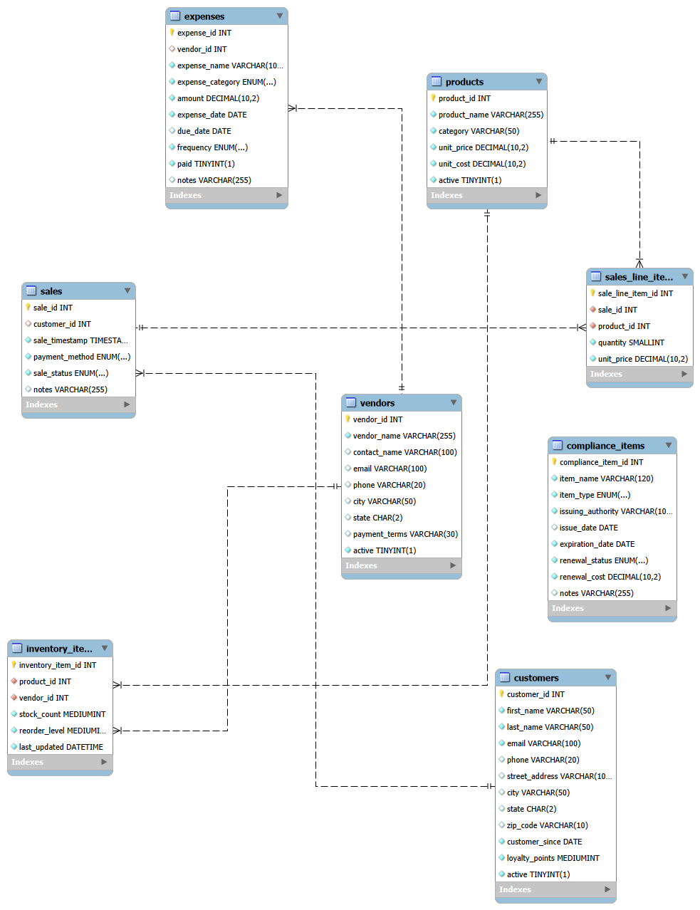
🔗 Entity Relationship Diagram (ERD)
Complete visual representation of database relationships showing how 8 tables interconnect

Slide 9
TABLE STRUCTURES
Field-by-Field Details

Slide 10
👥 CUSTOMERS Table
PRIMARY KEY:
• customer_id (INT)
CONTACT INFO:
• first_name, last_name
• email, phone
ADDRESS:
• street_address
• city, state, zip_code
ACCOUNT DATA:
• customer_since (DATE)
• loyalty_points (MEDIUMINT)
• active (TINYINT 1)
WHY THIS DESIGN:
✓ Soft-delete via 'active'
preserves sales history
✓ Loyalty points for
rewards program

Slide 11
📦 Dual-Layer Inventory System
PRODUCTS TABLE
(Static Master Catalog)
• product_id (PK)
• product_name
• category
• unit_price (DECIMAL)
• unit_cost (DECIMAL)
• active flag
Purpose: Price anchor
for all transactions
INVENTORY_ITEMS TABLE
(Dynamic Stock Levels)
• inventory_item_id (PK)
• product_id (FK)
• vendor_id (FK)
• stock_count
• reorder_level
• last_updated (TIMESTAMP)
Purpose: Real-time
warehouse tracking

Slide 12
💳 Two-Part Sales Model
SALES TABLE (Header)
One record per transaction
• sale_id (PK)
• customer_id (FK)
• sale_timestamp
• payment_method (ENUM)
- Cash, Credit, Check,
Digital
• sale_status (ENUM)
- Pending, Completed,
Refunded, Cancelled
SALES_LINE_ITEMS TABLE
(Details)
Many items per sale
• sale_line_item_id (PK)
• sale_id (FK)
• product_id (FK)
• quantity
• unit_price (FROZEN)
🔑 KEY: Price captured
at sale time, survives
price changes

Slide 13
💰 Expenses & Vendor Management
VENDORS TABLE
• vendor_id (PK)
• vendor_name
• contact_name
• email, phone
• city, state
• payment_terms
(e.g., 'Net 30')
• active flag
Links to: Inventory &
Expenses tables
EXPENSES TABLE
• expense_id (PK)
• vendor_id (FK)
• expense_name
• expense_category (ENUM)
• amount (DECIMAL 10,2)
• expense_date, due_date
• paid (TINYINT 1)
• frequency (ENUM)
• notes
Tracks: Payables, budgets,
overdue payments

Slide 14
✅ COMPLIANCE_ITEMS Table
Standalone table for regulatory requirements
Key Fields:
• compliance_item_id (PK) - Unique identifier
• item_name - License, permit, insurance name
• item_type (ENUM) - License | Insurance | Permit | Certification
• issuing_authority - Government agency
• issue_date, expiration_date - Timeline tracking
• renewal_status (ENUM) - Current | Due Soon | Expired
• renewal_cost (DECIMAL) - Budget planning
Business Value: Never miss a deadline, prevent penalties

Slide 15
DATA INTEGRITY
Constraints & Relationships

Slide 16
🎯 Data Types & Storage Precision
INT (4 bytes) | Primary/Foreign keys, counts
VARCHAR (variable) | Text fields (names, addresses, emails)
DECIMAL(10,2) ⭐ CRITICAL | Currency (never FLOAT for money!)
DATE | Dates (customer_since, expense_date)
TIMESTAMP | Exact moments (sale_timestamp, last_updated)
TINYINT(1) | Boolean flags (active=1, inactive=0)
MEDIUMINT (3 bytes) | Larger quantities (stock count, loyalty points)
ENUM | Restricted choices (payment_method, sale_status)
Result: Balanced efficiency + accounting accuracy

Slide 17
🔒 Database Constraints
✓ PRIMARY KEYS (PK)
Guarantee uniqueness • Enable fast indexed lookups
✓ FOREIGN KEYS (FK)
Maintain relationships • Prevent orphaned records
✓ ENUM CONSTRAINTS
Only valid values accepted (prevents typos)
✓ NOT NULL CONSTRAINTS
Ensure critical fields always have data
✓ CHECK CONSTRAINTS
Enforce business rules (e.g., unit_price > 0)
✓ SOFT DELETES
'active' flag allows deactivation while preserving history

Slide 18
BUSINESS INTELLIGENCE
20+ Ready-to-Run Queries

Slide 19
📊 Query Categories (20+ Available)
👥 CUSTOMER ANALYTICS
✓ New signups per month • Top customers by revenue
✓ Repeat vs one-time buyers • Purchase frequency
💳 SALES INSIGHTS
✓ Daily/monthly revenue trends • Revenue by payment method
✓ Average order value • Transaction status breakdown
📦 PRODUCT PERFORMANCE
✓ Best-selling products • Profit margins • Category analysis
🏭 INVENTORY MANAGEMENT
✓ Items below reorder level • Total inventory value
💰 FINANCIAL REPORTS
✓ Expense tracking by category • Vendor analysis • Payables aging

Slide 20
💼 Real-World Use Cases
QUARTERLY BUSINESS REVIEW
→ Are we growing? | Monthly revenue trends | Product profitability
INVENTORY CRISIS
→ What's running low? | Stock value analysis | Turnover rates
BUDGET PLANNING
→ Where's the money going? | Expense breakdown | Vendor analysis
CUSTOMER RETENTION
→ Who might leave? | Purchase frequency | Churn risk analysis
COMPLIANCE MANAGEMENT
→ What's expiring? | Renewal schedule | Cost forecasting

Slide 21
IMPLEMENTATION
From Design to Deployment

Slide 22
📦 Project Deliverables
✓ DATABASE SCHEMA
smallbiz.sql | 8 tables | 50+ fields | Full documentation
✓ SAMPLE DATA
100+ realistic test records across all tables
✓ ANALYTICS QUERIES
20+ production-ready SQL queries with documentation
✓ DOCUMENTATION
Data Dictionary | Database Design Explanation | ERD Diagram
✓ DEPLOYMENT READY
One command to deploy: mysql < smallbiz.sql

Slide 23
🚀 Quick Start (5 Minutes)
1️⃣ Download: smallbiz.sql from project folder
2️⃣ Deploy: Import into MySQL
mysql -u root -p < smallbiz.sql
3️⃣ Verify: Check all 8 tables created
SHOW TABLES;
4️⃣ Test: Run sample queries
SELECT * FROM customers;
5️⃣ Customize: Modify for your business needs

Slide 24
📈 KPI Dashboard Ready
REVENUE METRICS
→ Monthly revenue | Customer lifetime value | Product profit margins
OPERATIONAL METRICS
→ Inventory turnover | Days sales outstanding | Expense ratios
CUSTOMER METRICS
→ New customer acquisition | Repeat purchase rate | Churn risk
COMPLIANCE METRICS
→ Renewal compliance rate | Overdue renewals | Cost forecasting
All built into the database schema for easy dashboard integration!

Slide 25
🏗️ Database Design Principles
✓ 3NF NORMALIZATION
Eliminates redundancy | Prevents update anomalies
✓ REFERENTIAL INTEGRITY
Foreign keys maintain data consistency
✓ SCALABILITY
Lightweight for startups | Grows with business
✓ EXTENSIBILITY
Easy to add features: reviews, returns, multi-location
✓ SECURITY
Ready for role-based access control & encryption

Slide 26
🔮 Future Roadmap
PHASE 1 (Immediate)
→ Web dashboard (Python Flask / Node.js) | KPI visualizations
PHASE 2 (Short-term)
→ Mobile app | Real-time alerts | Email notifications
PHASE 3 (Medium-term)
→ Predictive analytics | Churn prediction | Inventory optimization
PHASE 4 (Long-term)
→ Multi-location support | Supply chain integration | AI recommendations

Slide 27
🎓 SQL & Database Skills
✓ DATABASE DESIGN
ERD modeling | Normalization | Schema architecture
✓ SQL FUNDAMENTALS
CREATE TABLE | Data types | Constraints | Relationships
✓ QUERY WRITING
SELECT | WHERE | GROUP BY | Aggregates | JOINs | Subqueries
✓ DATA ANALYSIS
KPI calculation | Trend analysis | Business intelligence
✓ PRODUCTION SKILLS
Documentation | Testing | Deployment | Best practices

Slide 28
✨ Project Impact
TRANSFORMATION ACHIEVED
From: Scattered spreadsheets, manual reporting, data inconsistency
To: Unified database, automated reporting, data-driven decisions
BUSINESS VALUE DELIVERED
✓ Single source of truth for all operations
✓ Real-time visibility into revenue, inventory, expenses
✓ Automated reporting & analytics foundation
✓ Production-ready for immediate deployment
Ready to transform your small business data into competitive advantage!

Slide 29
Thank You!
Small Business Database Management System | Transforming Data Into Decisions
🎯 Team 3 | IT 125 SQL | Summer 2026

