Slide 1

ScholarBot: Lightweight Research Assistant Agent
Simple agent that retrieves and summarizes information
Includes safety filters and structured reasoning
Stores past queries with reinforcement-style feedback
Demonstrates input → tools → output agent pipeline
Notes:
ScholarBot is a lightweight research assistant agent built for the final project. It takes a user question, applies safety rules, performs a simulated search, summarizes the results, and saves the interaction. It uses two tools, a fake search module and a summarizer, and maintains a simple reward system through user ratings. The goal was to build a minimal but complete agent pipeline.

Slide 2
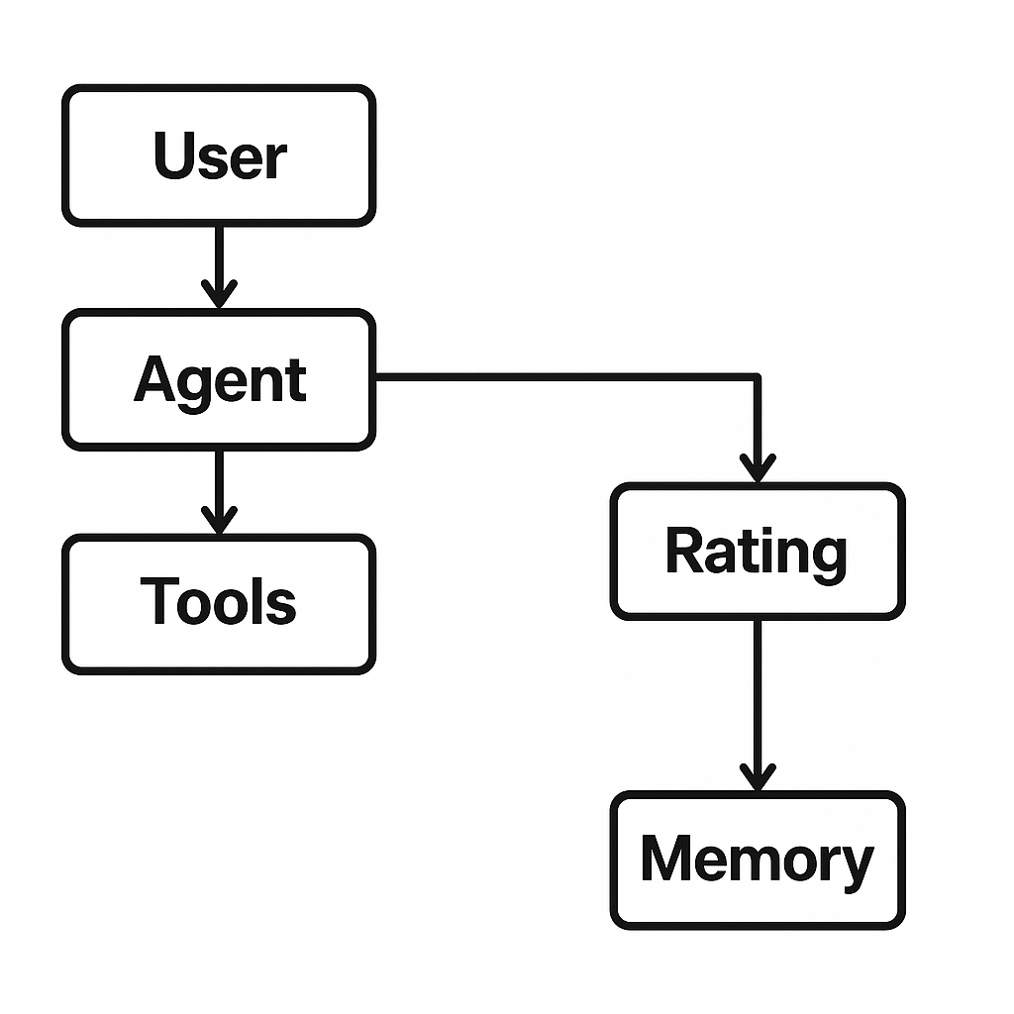
Inside the Agent: Reason + Tools + Memory
Safety check for harmful topics
ReAct-style reasoning trace
Tool 1: FakeSearchTool retrieves results
Tool 2: SummarizerTool builds a short report
Memory stores queries, feedback, and average rating
Notes:
ScholarBot follows a simple reasoning pipeline. Every query goes through a safety filter, then the agent generates a short reasoning plan. It calls two tools, a fake search tool and a summarizer tool. Results are returned in a structured format, and the system logs the interaction. When a user gives a rating, the agent updates its average score, simulating reinforcement learning.

Slide 3
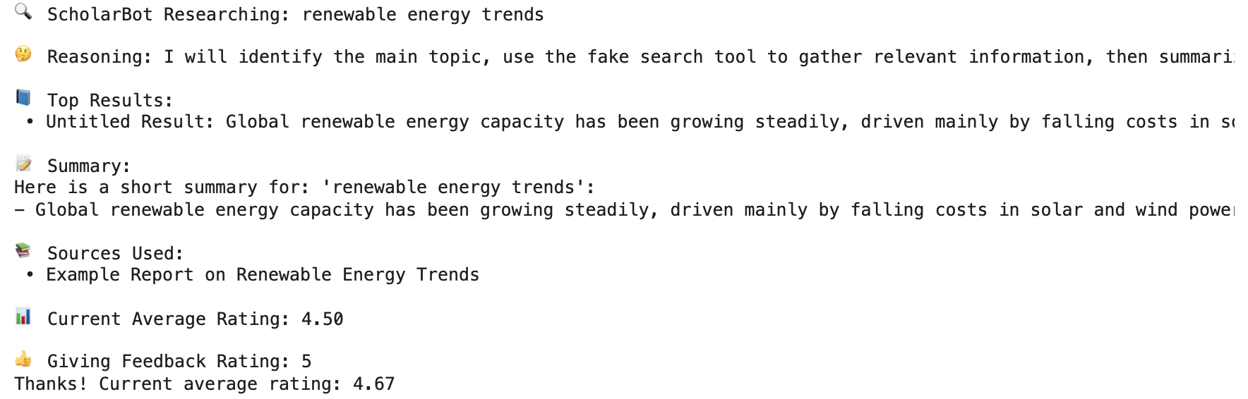
Demo Highlights
Accepts research questions
Generates summaries and sources
Refuses unsafe requests
Learns from ratings
Fully contained inside one notebook
Notes:
In the demo, ScholarBot answers research questions using its local knowledge base and summarizer. It shows its reasoning process and returns sources along with a short report. Unsafe or harmful queries get blocked with a refusal message. Ratings update the average score, which the agent displays in later runs. The entire system is implemented in a single Colab notebook with clean, reproducible code.

