Slide 1
ORGANIZATIONAL BEHAVIOUR AND PROFESSIONAL COMMUNICATION (18ME661) UNIT1
Organizational behaviour (often abbreviated OB) is a field of study that investigates the impact that individuals, groups, and structure have on behaviour within organizations, for the purpose of applying such knowledge toward improving an organization’s effectiveness.

Slide 2
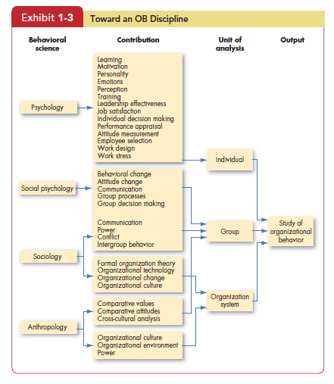
ORGANIZATIONAL BEHAVIOUR AND PROFESSIONAL COMMUNICATION (18ME661) UNIT1
Disciplines That Contribute to the OB Field

Slide 3
ORGANIZATIONAL BEHAVIOUR AND PROFESSIONAL COMMUNICATION (18ME661) UNIT1
Psychology
Psychology seeks to measure, explain, and sometimes change the behaviour of humans and other animals.
Early industrial/organizational psychologists studied the problems of fatigue, boredom, and other working conditions that could impede efficient work performance.
More recently, their contributions have expanded to include learning, perception, personality, emotions, training, leadership effectiveness, needs and motivational forces, job satisfaction, decision-making processes, performance appraisals, attitude measurement, employee-selection techniques, work design, and job stress.

Slide 4
ORGANIZATIONAL BEHAVIOUR AND PROFESSIONAL COMMUNICATION (18ME661) UNIT1
Social Psychology
Social psychology , generally considered a branch of psychology, blends concepts from both psychology and sociology to focus on peoples’ influence on one another.
Social psychologists also contribute to measuring, understanding, and changing attitudes; identifying communication patterns; and building trust.

Slide 5
ORGANIZATIONAL BEHAVIOUR AND PROFESSIONAL COMMUNICATION (18ME661) UNIT1
Sociology
While psychology focuses on the individual, sociology studies people in relation to their social environment or culture.
Sociologists have contributed to OB through their study of group behaviour in organizations, particularly formal and complex organizations. Perhaps most important, sociologists have studied organizational culture, formal organization theory and structure, organizational technology, communications, power, and conflict.

Slide 6
ORGANIZATIONAL BEHAVIOUR AND PROFESSIONAL COMMUNICATION (18ME661) UNIT1
Anthropology
Anthropology is the study of societies to learn about human beings and their activities.
Anthropologists’ work on cultures and environments has helped us understand differences in fundamental values, attitudes, and behaviour between people in different countries and within different organizations.

Slide 7
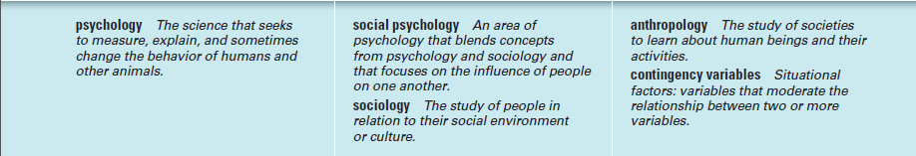
ORGANIZATIONAL BEHAVIOUR AND PROFESSIONAL COMMUNICATION (18ME661) UNIT1

Slide 8
ORGANIZATIONAL BEHAVIOUR AND PROFESSIONAL COMMUNICATION (18ME661) UNIT1
Challenges and Opportunities for OB
1. Responding to Economic Pressures
During difficult economic times, effective management is often at a premium.
Anybody can run a company when business is booming, because the difference between good and bad management reflects the difference between making a lot of money and making a lot more money. When times are bad, though, managers are on the front lines with employees who must be fired, who are asked to make do with less, and who worry about their futures. The difference between good and bad management can be the difference between profit and loss or, ultimately, between survival and failure.

Slide 9
ORGANIZATIONAL BEHAVIOUR AND PROFESSIONAL COMMUNICATION (18ME661) UNIT1
2. Responding to Globalization
Organizations are no longer constrained by national borders.
The world has become a global village. In the process, the manager’s job has changed.
Increased Foreign Assignments
Working with People from Different Cultures
Overseeing Movement of Jobs to Countries with Low-Cost Labour

Slide 10
ORGANIZATIONAL BEHAVIOUR AND PROFESSIONAL COMMUNICATION (18ME661) UNIT1
3. Managing Workforce Diversity
Workforce diversity acknowledges a workforce of women and men; many racial and ethnic groups; individuals with a variety of physical or psychological abilities; and people who differ in age and sexual orientation. Managing this diversity is a global concern.

Slide 11
ORGANIZATIONAL BEHAVIOUR AND PROFESSIONAL COMMUNICATION (18ME661) UNIT1
4. Improving Customer Service
Service jobs include technical support representatives, fast-food counter workers, sales clerks, waiters and waitresses, nurses, automobile repair technicians, consultants, credit representatives, financial planners, and flight attendants. The common characteristic of these jobs is substantial interaction with an organization’s customers. And because an organization can’t exist without customers

Slide 12
ORGANIZATIONAL BEHAVIOUR AND PROFESSIONAL COMMUNICATION (18ME661) UNIT1
5. Improving People Skills
Ways to Design motivating jobs, techniques for improving your listening skills, and how to create more effective teams.

Slide 13
ORGANIZATIONAL BEHAVIOUR AND PROFESSIONAL COMMUNICATION (18ME661) UNIT1
6. Coping with “Temporariness”
Globalization, expanded capacity, and advances in technology have required organizations to be fast and flexible if they are to survive. The result is that most managers and employees today work in a climate best characterized as “temporary.”
Workers must continually update their knowledge and skills to perform new job requirements.
Today’s managers and employees must learn to cope with temporariness, flexibility, spontaneity, and unpredictability. The study of OB can help you better understand a work world of continual change, overcome resistance to change, and create an organizational culture that thrives on change.

Slide 14
ORGANIZATIONAL BEHAVIOUR AND PROFESSIONAL COMMUNICATION (18ME661) UNIT1
7. Working in Networked Organizations
Networked organizations allow people to communicate and work together even though they may be thousands of miles apart.
Independent contractors can telecommute via computer to workplaces around the globe and change employers as the demand for their services changes. Software programmers, graphic designers, systems analysts, technical writers, photo researchers, book and media editors, and medical transcribers are just a few examples of people
who can work from home or other non office locations.

Slide 15
ORGANIZATIONAL BEHAVIOUR AND PROFESSIONAL COMMUNICATION (18ME661) UNIT1
8. Helping Employees Balance Work–Life Conflicts
The typical employee in the 1960s or 1970s showed up at a specified workplace Monday through Friday and worked for clearly defined 8- or 9-hour chunks of time.
That’s no longer true for a large segment of today’s workforce. Employees are increasingly complaining that the line between work and non work time has become blurred, creating personal conflicts and stress.
How do work–life conflicts come about?
First, the creation of global organizations means the world never sleeps. At any time on any day, thousands of General Electric employees are working somewhere. The need to consult with colleagues or customers eight or ten time zones away means many employees of global firms are “on call” 24 hours a day.
Second, communication technology allows many technical and professional employees to do their work at home, in their cars, or on the beach in Tahiti—but it also means many feel like they never really get away from the office.

Slide 16
ORGANIZATIONAL BEHAVIOUR AND PROFESSIONAL COMMUNICATION (18ME661) UNIT1
Third, organizations are asking employees to put in longer hours.
Finally, the rise of the dual-career couple makes it difficult for married employees to find time to fulfill commitments to home, spouse, children, parents, and friends.

Slide 17
ORGANIZATIONAL BEHAVIOUR AND PROFESSIONAL COMMUNICATION (18ME661) UNIT1
9. Creating a Positive Work Environment
Although competitive pressures on most organizations are stronger than ever, some organizations are trying to realize a competitive advantage by fostering a positive work environment.
Some key independent variables in positive OB research are engagement, hope, optimism, and resilience in the face of strain.

Slide 18
ORGANIZATIONAL BEHAVIOUR AND PROFESSIONAL COMMUNICATION (18ME661) UNIT1
10. Improving Ethical Behaviour
In an organizational world characterized by cutbacks, expectations of increasing productivity, and tough competition, it’s not surprising many employees feel pressured to cut corners, break rules, and engage in other questionable practices.
Increasingly they face ethical dilemmas and ethical choices , in which they arerequired to identify right and wrong conduct.

Slide 19
ORGANIZATIONAL BEHAVIOUR AND PROFESSIONAL COMMUNICATION (18ME661) UNIT1
THE INDIVIDUAL
Biographical Characteristics
Biographical characteristics such as age, gender, race, disability, and length of service are some of the most obvious ways employees differ.

Slide 20
ORGANIZATIONAL BEHAVIOUR AND PROFESSIONAL COMMUNICATION (18ME661) UNIT1
Age
The relationship between age and job performance
Many believe productivity declines with age. It is often assumed that skills like speed, agility, strength, and coordination decay over time and that prolonged job boredom and lack of intellectual stimulation contribute to reduced productivity.

Slide 21
ORGANIZATIONAL BEHAVIOUR AND PROFESSIONAL COMMUNICATION (18ME661) UNIT1
What are the effects of discrimination against individuals on the basis of age?
One large-scale study of more than 8,000 employees in 128 companies found that an organizational climate favouring age discrimination was associated with lower levels of commitment to the company. This lower commitment was, in turn, related to lower levels of organizational performance. 15 Such results suggest that combating age discrimination may be associated with higher levels of organizational performance.

Slide 22
ORGANIZATIONAL BEHAVIOUR AND PROFESSIONAL COMMUNICATION (18ME661) UNIT1
Sex
Few issues initiate more debates, misconceptions, and unsupported opinions than whether women perform as well on jobs as men do.
There are no consistent male–female differences in problem-solving
ability, analytical skills, competitive drive, motivation, sociability, or learning ability.
Psychological studies have found women are more agreeable and willing to conform to authority, whereas men are more aggressive and more likely to have expectations of success, but those differences are minor.

Slide 23
ORGANIZATIONAL BEHAVIOUR AND PROFESSIONAL COMMUNICATION (18ME661) UNIT1
Race and Ethnicity
Race is a controversial issue.
Race and ethnicity have been studied as they relate to employment outcomes such as hiring decisions, performance evaluations, pay, and workplace discrimination.
Most research has concentrated on the differences in outcomes and attitudes between Whites and African Americans, with little study of issues relevant to Asian, Native American, and Hispanic populations.

Slide 24
ORGANIZATIONAL BEHAVIOUR AND PROFESSIONAL COMMUNICATION (18ME661) UNIT1
Disability
Making inferences about the relationship between disability and employment outcomes is difficult because the term disability is so broad.
A person as disabled who has any physical or mental impairment that substantially limits one or more major life activities. Examples include missing limbs, seizure disorder, Down Syndrome, deafness, schizophrenia, alcoholism, diabetes, and chronic back pain.

Slide 25
ORGANIZATIONAL BEHAVIOUR AND PROFESSIONAL COMMUNICATION (18ME661) UNIT1
Other Biographical Characteristics: Tenure, Religion, Sexual Orientation, and Gender Identity
Tenure, expressed as work experience, appears to be a good predictor of employee productivity.
Not only do religious and nonreligious people question each other’s
belief systems; often people of different religious faiths conflict.

Slide 26
ORGANIZATIONAL BEHAVIOUR AND PROFESSIONAL COMMUNICATION (18ME661) UNIT1
Ability
What does ability mean?
ability is an individual’s current capacity to perform the various tasks in a job. Overall abilities are essentially made up of two sets of factors: intellectual and physical.

Slide 27
ORGANIZATIONAL BEHAVIOUR AND PROFESSIONAL COMMUNICATION (18ME661) UNIT1
Intellectual abilities The capacity to do mental activities—thinking, reasoning, and problem solving.
physical abilities The capacity to do tasks that demand stamina, dexterity, strength, and similar characteristics.

Slide 28
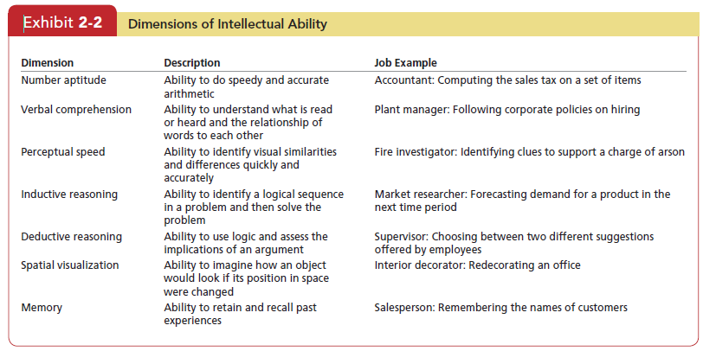
ORGANIZATIONAL BEHAVIOUR AND PROFESSIONAL COMMUNICATION (18ME661) UNIT1

Slide 29
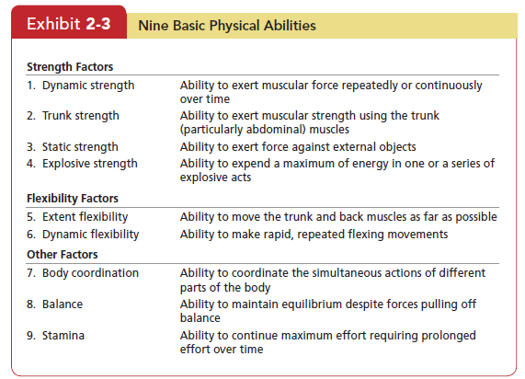
ORGANIZATIONAL BEHAVIOUR AND PROFESSIONAL COMMUNICATION (18ME661) UNIT1

Slide 30
ORGANIZATIONAL BEHAVIOUR AND PROFESSIONAL COMMUNICATION (18ME661) UNIT1
Values represent basic convictions that “a specific mode of conduct or
end-state of existence is personally or socially preferable to an opposite or converse mode of conduct or end-state of existence.
Values have both content and intensity attributes.
The content attribute says a mode of conduct or end-state of existence is important.
The intensity attribute specifies how important it is.

Slide 31
ORGANIZATIONAL BEHAVIOUR AND PROFESSIONAL COMMUNICATION (18ME661) UNIT1
The Importance of Values
Values lay the foundation for our understanding of people’s attitudes and
motivation and influence our perceptions.
Suppose you enter an organization with the view that allocating pay on the basis of performance is right, while allocating pay on the basis of seniority is wrong.
You’re likely to be disappointed—and this can lead to job dissatisfaction and a decision not to exert a high level of effort

Slide 32
ORGANIZATIONAL BEHAVIOUR AND PROFESSIONAL COMMUNICATION (18ME661) UNIT1
Terminal versus Instrumental Values
Terminal values Desirable end-states of existence; the goals a person would like to achieve during his or her lifetime.
Some examples of terminal values
Prosperity and economic success, Freedom, Health and well-being, World peace, Social recognition, and Meaning in life.
Instrumental values Preferable modes of behaviour or means of achieving one’s terminal values.
The types of instrumental values
Self-improvement, Autonomy and self-reliance, Personal discipline, kindness, Ambition, and Goal-orientation.

Slide 33
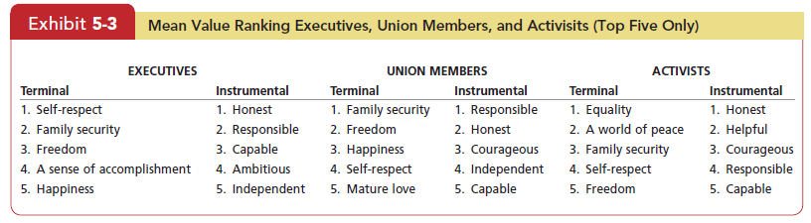
ORGANIZATIONAL BEHAVIOUR AND PROFESSIONAL COMMUNICATION (18ME661) UNIT1

Slide 34
ORGANIZATIONAL BEHAVIOUR AND PROFESSIONAL COMMUNICATION (18ME661) UNIT1
Attitudes
Attitudes are evaluative statements—either favourable or unfavourable—about objects, people, or events.
They reflect how we feel about something. When I say “I like my job,” I am expressing my attitude about work.

Slide 35
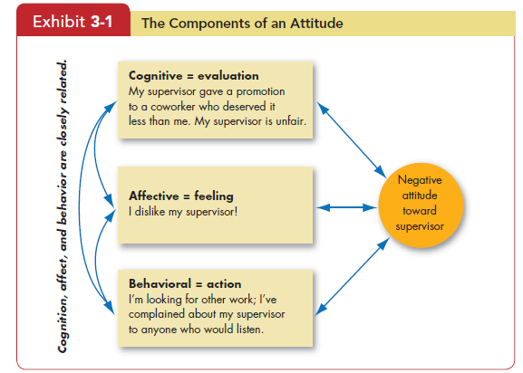
ORGANIZATIONAL BEHAVIOUR AND PROFESSIONAL COMMUNICATION (18ME661) UNIT1

Slide 36
ORGANIZATIONAL BEHAVIOUR AND PROFESSIONAL COMMUNICATION (18ME661) UNIT1
attitudes Evaluative statements or judgments concerning objects, people, or events.
cognitive component The opinion or belief segment of an attitude.
affective component The emotional or feeling segment of an attitude.
behavioural component An intention to behave in a certain way toward someone or something.

Slide 37
ORGANIZATIONAL BEHAVIOUR AND PROFESSIONAL COMMUNICATION (18ME661) UNIT1
Does Behaviour Always Follow from Attitudes?
Moderating Variables The most powerful moderators of the attitudes relationship are the importance of the attitude, its correspondence to behaviour, its accessibility, the presence of social pressures, and whether a person has direct experience with the attitude.
cognitive dissonance Any incompatibility between two or more
attitudes or between behaviour and attitudes.

Slide 38
ORGANIZATIONAL BEHAVIOUR AND PROFESSIONAL COMMUNICATION (18ME661) UNIT1
Job Satisfaction and Employee performance
When people speak of employee attitudes, they usually mean job satisfaction , which describes a positive feeling about a job, resulting from an evaluation of its characteristics.
A person with a high level of job satisfaction holds positive feelings about his or her job, while a person with a low level holds negative feelings.

Slide 39
ORGANIZATIONAL BEHAVIOUR AND PROFESSIONAL COMMUNICATION (18ME661) UNIT1
Job Involvement
Related to job satisfaction is job involvement , which measures the degree to which people identify psychologically with their job and consider their perceived performance level important to self-worth.

Slide 40
ORGANIZATIONAL BEHAVIOUR AND PROFESSIONAL COMMUNICATION (18ME661) UNIT1
Organizational Commitment
In organizational commitment , an employee identifies with a particular organization and its goals and wishes to remain a member. Most research has focused on emotional attachment to an organization and belief in its values as the “gold standard” for employee commitment.

Slide 41
ORGANIZATIONAL BEHAVIOUR AND PROFESSIONAL COMMUNICATION (18ME661) UNIT1
Perceived Organizational Support is the degree to which employees believe the organization values their contribution and cares about their well-being (for example, an employee believes his organization would accommodate him if he had a child care problem or would forgive an honest mistake on his part).
employee engagement An individual’s involvement with, satisfaction with,and enthusiasm for the work he or she does.

Slide 42
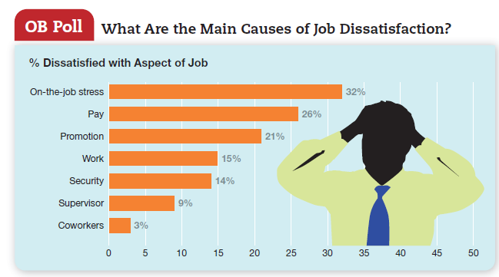
ORGANIZATIONAL BEHAVIOUR AND PROFESSIONAL COMMUNICATION (18ME661) UNIT1

Slide 43
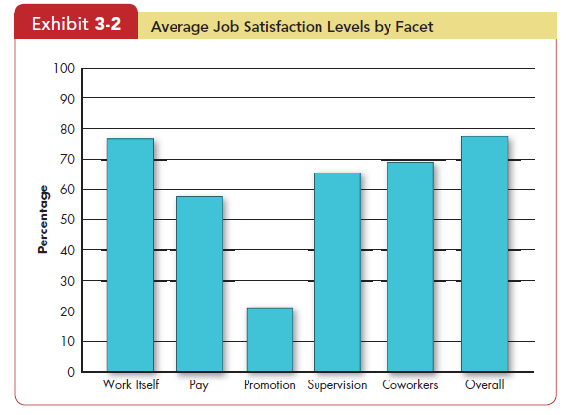
ORGANIZATIONAL BEHAVIOUR AND PROFESSIONAL COMMUNICATION (18ME661) UNIT1

Slide 44
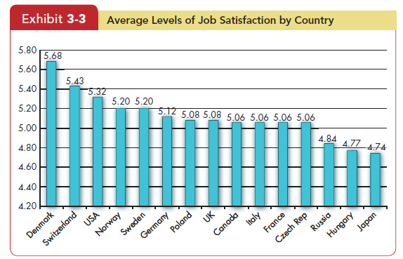
ORGANIZATIONAL BEHAVIOUR AND PROFESSIONAL COMMUNICATION (18ME661) UNIT1

Slide 45
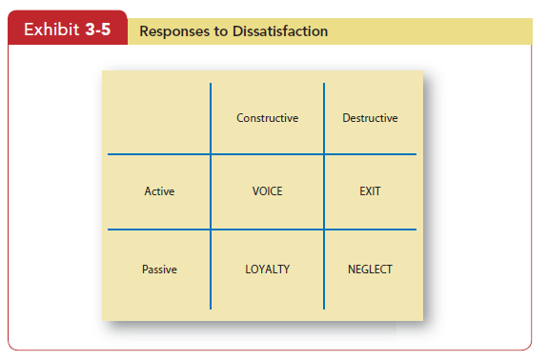
ORGANIZATIONAL BEHAVIOUR AND PROFESSIONAL COMMUNICATION (18ME661) UNIT1

Slide 46
ORGANIZATIONAL BEHAVIOUR AND PROFESSIONAL COMMUNICATION (18ME661) UNIT1
core self-evaluations Bottom-line conclusions individuals have about their capabilities, competence, and worth as a person.
exit Dissatisfaction expressed through behaviour directed toward leaving the organization.
voice Dissatisfaction expressed through active and constructive attempts to improve conditions.
loyalty Dissatisfaction expressed by passively waiting for conditions to
improve.
neglect Dissatisfaction expressed through allowing conditions to worsen.

Slide 47
ORGANIZATIONAL BEHAVIOUR AND PROFESSIONAL COMMUNICATION (18ME661) UNIT1
Job Satisfaction and Job Performance
Happy workers are more likely to be productive workers.
Job Satisfaction and OCB It seems logical to assume job satisfaction should be a major determinant of an employee’s organizational citizenship behaviour (OCB). Satisfied employees would seem more likely to talk positively about the organization, help others, and go beyond the normal expectations in their job, perhaps because they want to reciprocate their positive experiences.

Slide 48
ORGANIZATIONAL BEHAVIOUR AND PROFESSIONAL COMMUNICATION (18ME661) UNIT1
Job Satisfaction and Customer Satisfaction
For frontline employees who have regular customer contact, the answer is “yes.” Satisfied employees increase customer satisfaction and loyalty.
Job Satisfaction and Absenteeism We find a consistent negative relationship between satisfaction and absenteeism.
Job Satisfaction and Turnover
The relationship between job satisfaction and turnover is stronger than between satisfaction and absenteeism.

Slide 49
ORGANIZATIONAL BEHAVIOUR AND PROFESSIONAL COMMUNICATION (18ME661) UNIT1
Job Satisfaction and Workplace Deviance Job dissatisfaction and antagonistic relationships with co-workers predict a variety of behaviours organizations find undesirable, including unionization attempts, substance abuse, stealing at work, undue socializing, and tardiness.

