Slide 1
ORGANIZATIONAL BEHAVIOUR AND PROFESSIONAL COMMUNICATION (18ME661) UNIT2
Unit – II 08Hours
Learning: Definition, Theories of learning, classical conditioning, operant conditioning, social learning theory, shaping, methods of shaping behaviour, continuous and intermittent reinforcement.
Personality and emotions: Definition, personality determinants-hereditary, environment, situation. Major personality attributes influencing OB- locus of control, Machiavellianism, self esteem, self monitoring, risk taking. Definition of emotions, felt versus displayed emotions, OB applications of emotions.
Self learning topics: specific application of perception in organization.

Slide 2
ORGANIZATIONAL BEHAVIOUR AND PROFESSIONAL COMMUNICATION (18ME661) UNIT2
LEARNING THEORY BACKGROUND
Although learning theory has not been as popular in organizational behaviour as motivation or personality theories, both scholars and practitioners would agree on its importance to both the understanding and the effective development and management of human resources. In fact, practically all organizational behaviour is either directly or indirectly affected by learning. For example, a worker’s skill, a manager’s attitude, a staff assistant’s motivation, a salesperson’s optimism and confidence, and an accountant’s mode of dress are all learned. With the application of learning processes and principles, employees’ behaviour can be analysed and managed to improve their performance.

Slide 3
ORGANIZATIONAL BEHAVIOUR AND PROFESSIONAL COMMUNICATION (18ME661) UNIT2
THEORIES OF LEARNING:
Classical Conditioning.
Operant Conditioning.
Social learning.

Slide 4
ORGANIZATIONAL BEHAVIOUR AND PROFESSIONAL COMMUNICATION (18ME661) UNIT2
Classical Conditioning
classical conditioning can be defined as a process in which a formerly neutral stimulus, when paired with an unconditioned stimulus, becomes a conditioned stimulus that elicits a conditioned response.
Pavlov’s classical conditioning experiment using dogs as subjects is arguably the single most famous study ever conducted in the behavioural sciences. A simple surgical procedure permitted Pavlov to measure accurately the amount of saliva secreted by a dog.

Slide 5
ORGANIZATIONAL BEHAVIOUR AND PROFESSIONAL COMMUNICATION (18ME661) UNIT2
When he presented meat powder (unconditioned stimulus) to the dog in the experiment, Pavlov noticed a great deal of salivation (unconditioned response). On the other hand, when he merely rang a bell (neutral stimulus), the dog did not salivate. The next step taken by Pavlov was to accompany the meat with the ringing of the bell. After doing this a number of times, Pavlov rang the bell without presenting the meat. This time, the dog salivated to the bell alone. The dog had become classically conditioned to salivate (conditioned response) to the sound of the bell (conditioned stimulus).

Slide 6
ORGANIZATIONAL BEHAVIOUR AND PROFESSIONAL COMMUNICATION (18ME661) UNIT2
Operant Conditioning
Operant conditioning is concerned primarily with learning that occurs as a consequence of behaviour, or R-S. It is not concerned with the eliciting causes of behaviour, as classical, or respondent, conditioning is.
The specific differences between classical and operant conditioning may be summarized as follows:
1. In classical conditioning, a change in the stimulus (unconditioned stimulus to conditioned stimulus) will elicit a particular response. In operant conditioning, one particular response out of many possible ones occurs in a given stimulus situation. The stimulus situation serves as a cue in operant conditioning. It does not elicit the response but serves as a cue for a person to emit the response.

Slide 7
ORGANIZATIONAL BEHAVIOUR AND PROFESSIONAL COMMUNICATION (18ME661) UNIT2
2. During the classical conditioning process, the unconditioned stimulus, serving as a reward, is presented every time. In operant conditioning, the reward is presented only if the organism gives the correct response. The organism must operate on the environment (thus the term operant conditioning) in order to receive a reward.
Operant conditioning has a much greater impact on human learning than classical conditioning.

Slide 8
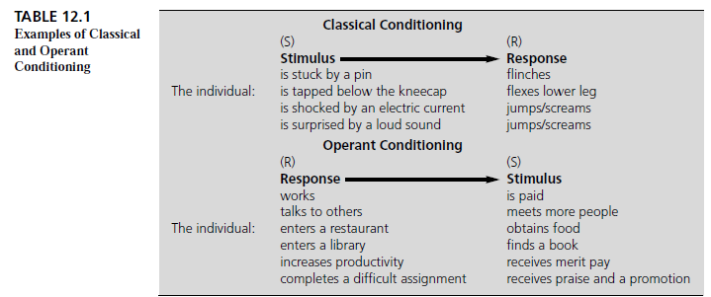
ORGANIZATIONAL BEHAVIOUR AND PROFESSIONAL COMMUNICATION (18ME661) UNIT2

Slide 9
ORGANIZATIONAL BEHAVIOUR AND PROFESSIONAL COMMUNICATION (18ME661) UNIT2
Social Learning
This theoretical approach to learning was the first to combine and integrate both behaviourist and cognitive concepts and emphasized the interactive, reciprocal nature of cognitive, behavioural, and environmental determinants.
Social learning theory posits that learning can also take place via vicarious, or modelling, and self-control processes.

Slide 10
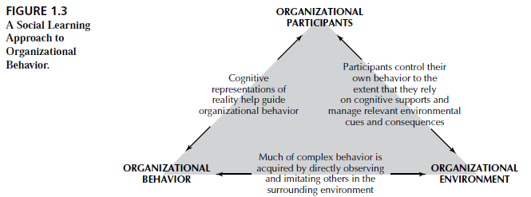
ORGANIZATIONAL BEHAVIOUR AND PROFESSIONAL COMMUNICATION (18ME661) UNIT2

Slide 11
ORGANIZATIONAL BEHAVIOUR AND PROFESSIONAL COMMUNICATION (18ME661) UNIT2
Shaping Behaviour:
Systematically reinforcing each successive step that moves an individual closer to the desired response.
If an employee who has chronically been a half-hour late for work comes in only 20 minutes late, we can reinforce that improvement. Reinforcement would increase as responses more closely approximated the desired behaviour.
Schedules of Reinforcement: Two major types
Continuous Reinforcement
Intermittent reinforcement

Slide 12
ORGANIZATIONAL BEHAVIOUR AND PROFESSIONAL COMMUNICATION (18ME661) UNIT2
Continuous Reinforcement: A desired behaviour is reinforced each time it is demonstrated.
Intermittent reinforcement: A desired behaviour is reinforced often enough to make the behaviour worth repeating but not every time it is demonstrated.
For example, in Continuous reinforcement, the case of someone who has historically had trouble arriving at work on time. Every time he is not tardy his manager might complement him on his desirable behaviour. In an intermittent schedule, on the other hand , not every instance of the desirable behaviour is reinforced, but reinforcement is given often enough to make the behaviour worth repeating.

Slide 13
ORGANIZATIONAL BEHAVIOUR AND PROFESSIONAL COMMUNICATION (18ME661) UNIT2
Intermittent reinforcement can be of a ratio or interval type.
Fixed interval schedule: Rewards are spaced at uniform time interval schedule.
When you get your pay check on a weekly, semi-monthly, monthly, or other predetermined time basis, you are rewarded on a fixed-interval reinforcement schedule.
Variable-interval schedule: Rewards are initiated after a fixed or constant number of responses.
A series of randomly timed unannounced visits to a company office by the corporate audit staff is an example of a variable-interval schedule.
When an instructor advises her class that pop quizzes will be given during the term(the exact number of which is unknown to students) and the quizzes will account for 20% of the term grade, she is using a variable interval schedule.

Slide 14
ORGANIZATIONAL BEHAVIOUR AND PROFESSIONAL COMMUNICATION (18ME661) UNIT2
PERSONALITY
personality The stable patterns of behaviour and consistent internal states that determine how an individual reacts to and interacts with others.
When we talk of personality we don’t mean that a person has charm, a positive attitude toward life, a smiling face, or is a finalist for “Miss Congeniality.” When psychologists talk of personality, they mean a dynamic concept describing the growth and development of a person’s whole psychological system. Rather than looking at parts of the person, personality looks at the whole person.

Slide 15
ORGANIZATIONAL BEHAVIOUR AND PROFESSIONAL COMMUNICATION (18ME661) UNIT2
Personality Determinants
Heredity
Environmental Factors
Situational Conditions
An adult’s personality is generally considered to be made up of both hereditary and environmental factors, moderated by situational conditions.

Slide 16
ORGANIZATIONAL BEHAVIOUR AND PROFESSIONAL COMMUNICATION (18ME661) UNIT2
Heredity
Heredity refers to those factors that were determined at conception.
Physical stature, facial attractiveness, gender, temperament, muscle composition and reflexes, energy level, and biological rhythms are characteristics that are generally considered to be either completely or largely influenced by your parents’ biological, physiological, and inherent psychological makeup.

Slide 17
ORGANIZATIONAL BEHAVIOUR AND PROFESSIONAL COMMUNICATION (18ME661) UNIT2
Environmental Factors
Among the factors that exert pressures on our personality formation are the culture in which we are raised; our early conditioning; the norms among our family, friends, and social groups; and other influences that we experience. The environment we are exposed to plays a substantial role in shaping our personalities.

Slide 18
ORGANIZATIONAL BEHAVIOUR AND PROFESSIONAL COMMUNICATION (18ME661) UNIT2
Situational Conditions
A third factor, the situation, influences the effects of heredity and environment on personality. An individual’s personality, although generally stable and consistent, does change in different situations. More specifically, the demands of different situations call forth different aspects of an individual’s personality. We should not, therefore, look at personality patterns in isolation.

Slide 19
ORGANIZATIONAL BEHAVIOUR AND PROFESSIONAL COMMUNICATION (18ME661) UNIT2
Major Personality Attributes Influencing OB
Locus of Control
Machiavellianism
Self-Esteem
Self-Monitoring
Risk-Taking

Slide 20
ORGANIZATIONAL BEHAVIOUR AND PROFESSIONAL COMMUNICATION (18ME661) UNIT2
Locus of Control
internals Individuals who believe that they control their destinies.
externals Individuals who believe that their lives are controlled by outside
forces, such as luck or chance.
locus of control The degree to which people believe they are in control of their own fates.

Slide 21
ORGANIZATIONAL BEHAVIOUR AND PROFESSIONAL COMMUNICATION (18ME661) UNIT2
Individuals with an internal locus of control are more likely to problem solve when they encounter an obstacle while trying to achieve a goal.
Individuals with an external locus of control are more likely to see the obstacle as caused by outside forces, and they will not necessarily know what to do in the face of that obstacle.
Managers thus need to be more aware of obstacles facing employees who have an external locus of control, and do what they can to remove those obstacles.

Slide 22
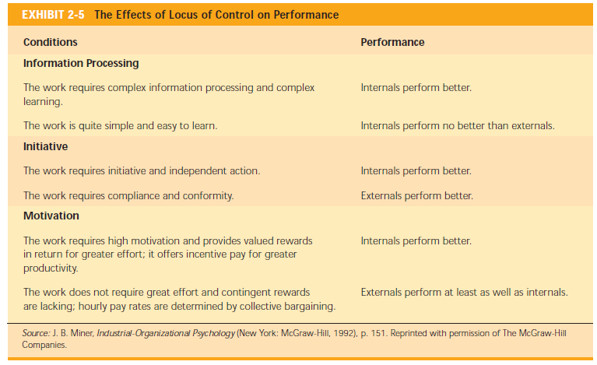
ORGANIZATIONAL BEHAVIOUR AND PROFESSIONAL COMMUNICATION (18ME661) UNIT2

Slide 23
ORGANIZATIONAL BEHAVIOUR AND PROFESSIONAL COMMUNICATION (18ME661) UNIT2
Machiavellianism
The personality characteristic of Machiavellianism (Mach) is named after Niccolò
Machiavelli, who wrote in the sixteenth century on how to gain and use power. An individual high in Machiavellianism is highly practical, maintains emotional distance, and believes that ends can justify means. “If it works, use it” is consistent with a high-Mach perspective.

Slide 24
ORGANIZATIONAL BEHAVIOUR AND PROFESSIONAL COMMUNICATION (18ME661) UNIT2
Self-Esteem
People differ in the degree to which they like or dislike themselves. This trait is called self esteem.
Self-esteem is directly related to expectations for success.

Slide 25
ORGANIZATIONAL BEHAVIOUR AND PROFESSIONAL COMMUNICATION (18ME661) UNIT2
High SEs believe that they have the ability to succeed at work.
Individuals with high self-esteem will take more risks in job selection and are more likely to choose unconventional jobs than are people with low self-esteem.
High SEs also tend to emphasize the positive when confronted with failure
The most generalizable finding on self-esteem is that low SEs are more easily influenced by external factors than are high SEs.
Low SEs are dependent on the receipt of positive evaluations from others.
In managerial positions, low SEs tend to be concerned with pleasing others and, therefore, are less likely to take unpopular stands than are high SEs.

Slide 26
ORGANIZATIONAL BEHAVIOUR AND PROFESSIONAL COMMUNICATION (18ME661) UNIT2
Self-Monitoring
self-monitoring A personality trait that measures an individual’s ability to adjust behaviour to external, situational factors.
They are highly sensitive to external cues and can behave differently in different situations.
High self-monitors are capable of presenting striking contradictions between their public personae and their private selves.
Low self-monitors cannot disguise themselves in the same way. They tend to display their true dispositions and attitudes in every situation; hence, there is high behavioural consistency between who they are and what they do.

Slide 27
ORGANIZATIONAL BEHAVIOUR AND PROFESSIONAL COMMUNICATION (18ME661) UNIT2
Risk-Taking
risk-taking A person’s willingness to take chances or risks.
The tendency to assume or avoid risk has been shown to have an impact on how long it takes managers to make a decision and how much information they require before making their choice.
For instance, 79 managers worked on simulated exercises that required them to make hiring decisions. High risk-taking managers made more rapid decisions and used less information in making their choices than did the low risk-taking managers. Interestingly, the decision accuracy was the same for both groups.

Slide 28
ORGANIZATIONAL BEHAVIOUR AND PROFESSIONAL COMMUNICATION (18ME661) UNIT2
EMOTIONS
emotions Intense feelings that are directed at someone or something.
Emotions are reactions to an object; they are not lasting personality traits. You show your emotions when you are “happy about something, angry at someone, afraid of something.”

Slide 29
ORGANIZATIONAL BEHAVIOUR AND PROFESSIONAL COMMUNICATION (18ME661) UNIT2
moods Feelings that tend to be less intense than emotions and that
lack a contextual stimulus.
Moods, on the other hand, are not directed at an object. Emotions can turn
into moods when you lose focus on the contextual object.

Slide 30
ORGANIZATIONAL BEHAVIOUR AND PROFESSIONAL COMMUNICATION (18ME661) UNIT2
So when a colleague criticizes you for the way you spoke to a client, you might become angry at him. That is, you show emotion (anger) toward a specific object (your colleague). But later in the day, you might find yourself just generally dispirited. You cannot attribute this feeling to any single event; you are just not your normal, upbeat self. This state describes a mood.
Research has identified six universal emotions: anger, fear, sadness, happiness, disgust, and surprise.

Slide 31
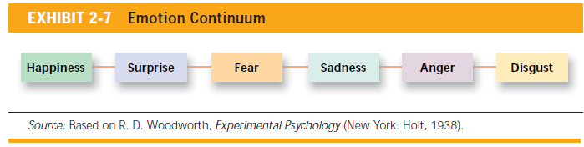
ORGANIZATIONAL BEHAVIOUR AND PROFESSIONAL COMMUNICATION (18ME661) UNIT2
Exhibit 2-7 illustrates that the six emotions can be conceptualized as existing along a continuum. The closer any two emotions are to each other on this continuum, the more people are likely to confuse them. For instance, happiness and surprise are frequently mistaken for each other, while happiness and disgust are rarely confused. Be aware that cultural factors can also influence interpretations of facial expressions.

Slide 32
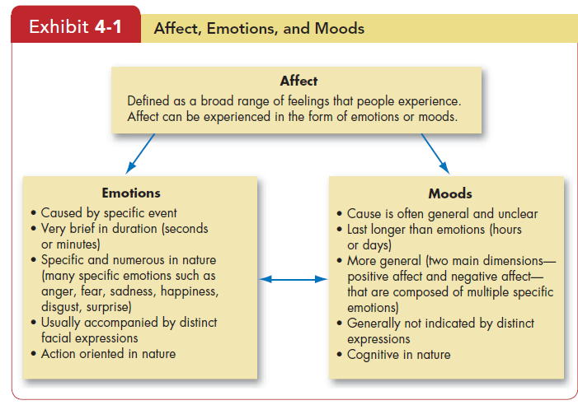
ORGANIZATIONAL BEHAVIOUR AND PROFESSIONAL COMMUNICATION (18ME661) UNIT2

Slide 33
ORGANIZATIONAL BEHAVIOUR AND PROFESSIONAL COMMUNICATION (18ME661) UNIT2
Felt emotions are an individual’s actual emotions.
Displayed emotions are those that the organization requires workers to show and considers appropriate in a given job.
Displaying fake emotions requires us to suppress real ones.

Slide 34
ORGANIZATIONAL BEHAVIOUR AND PROFESSIONAL COMMUNICATION (18ME661) UNIT2
Surface acting is hiding inner feelings and forgoing emotional expressions in response to display rules. A worker who smiles at a customer even when he doesn’t feel like it is surface acting.
Deep acting is trying to modify our true inner feelings based on display rules. A health care provider trying to genuinely feel more empathy for her patients is deep acting.
Surface acting deals with displayed emotions,
and deep acting deals with felt emotions.

Slide 35
ORGANIZATIONAL BEHAVIOUR AND PROFESSIONAL COMMUNICATION (18ME661) UNIT2
OB Applications of Emotions and Moods
An understanding of emotions and moods can improve our ability to explain and predict the selection process in organizations, decision making, creativity, motivation, leadership, interpersonal conflict, negotiation, customer service, job attitudes, deviant workplace behaviours and managers can influence our moods.

Slide 36
ORGANIZATIONAL BEHAVIOUR AND PROFESSIONAL COMMUNICATION (18ME661) UNIT2
Selection
One implication from the evidence on EI to date is that employers should consider it a factor in hiring employees, especially in jobs that demand a high degree of social interaction.
Decision Making
Positive moods and emotions seem to help. People in good moods or experiencing positive emotions are more likely than others to use heuristics, or rules of thumb, to help make good decisions quickly. Positive emotions also enhance problem-solving skills, so positive people find better solutions to problems.

Slide 37
ORGANIZATIONAL BEHAVIOUR AND PROFESSIONAL COMMUNICATION (18ME661) UNIT2
Creativity
People in good moods tend to be more creative than people in bad moods. They produce more ideas and more options, and others think their ideas are original. It seems people experiencing positive moods or emotions are more flexible and open in their thinking, which may explain why they’re more creative.
Supervisors should actively try to keep employees happy because doing so creates more good moods (employees like their leaders to encourage them and provide positive feedback on a job well done), which in turn leads people to be more creative.

Slide 38
ORGANIZATIONAL BEHAVIOUR AND PROFESSIONAL COMMUNICATION (18ME661) UNIT2
Motivation
One study set two groups of people to solving word puzzles. The first group saw a funny video clip, intended to put the subjects in a good mood first. The other group was not shown the clip and started working on the puzzles right away. The results? The positive-mood group reported higher expectations of being able to solve the puzzles, worked harder at them, and solved more puzzles as a result.
Another study looked at the moods of insurance sales agents in Taiwan.
Agents in a good mood were more helpful toward their co-workers and also felt better about themselves. These factors in turn led to superior performance in the form of higher sales and better supervisor reports of performance.

Slide 39
ORGANIZATIONAL BEHAVIOUR AND PROFESSIONAL COMMUNICATION (18ME661) UNIT2
Leadership
Leaders who focus on inspirational goals also generate greater optimism and enthusiasm in employees, leading to more positive social interactions with co-workers and customers.

Slide 40
ORGANIZATIONAL BEHAVIOUR AND PROFESSIONAL COMMUNICATION (18ME661) UNIT2
Negotiation
Negotiation is an emotional process.
It is a game of bluff and there is fantastic human emotion and tension, seeing who can bluff the longest.
Customer Service
A worker’s emotional state influences customer service, which influences levels of repeat business and of customer satisfaction.

Slide 41
ORGANIZATIONAL BEHAVIOUR AND PROFESSIONAL COMMUNICATION (18ME661) UNIT2
Job Attitudes
Ever hear the advice “Never take your work home with you,” meaning you
should forget about work once you go home?
People who have a stressful day at work also have trouble relaxing after they get off work.
Deviant Workplace Behaviours
Evidence suggests people who feel negative emotions, particularly anger or hostility, are more likely than others to engage in deviant behaviour at work. Once aggression starts, it’s likely that other people will become angry and aggressive, so the stage is set for a serious escalation of negative behaviour.

Slide 42
ORGANIZATIONAL BEHAVIOUR AND PROFESSIONAL COMMUNICATION (18ME661) UNIT2
Safety and Injury at Work
Research relating negative affectivity to increased injuries at work suggests employers might improve health and safety (and reduce costs) by ensuring workers aren’t engaged in potentially dangerous activities when they’re in a bad mood.
Bad moods can contribute to injury at work in several ways. Individuals in
negative moods tend to be more anxious, which can make them less able to cope effectively with hazards.

