Slide 1
ORGANIZATIONAL BEHAVIOUR AND PROFESSIONAL COMMUNICATION (18ME661) UNIT5
Unit – V 08 Hours
Organizational change: Forces of change, managing planned change, change agents, what can change agents change, resistance to change-individual and organizational resistance, overcoming resistance to change
Work stress and its management: Definition, model of stress, potential sources of stress, individual differences, consequences of stress, managing stress.

Slide 2
ORGANIZATIONAL BEHAVIOUR AND PROFESSIONAL COMMUNICATION (18ME661) UNIT5
Forces for Change
No company today is in a particularly stable environment. Even those with dominant market share must change, sometimes radically. Even though Apple has been successful with its iPad, the growing number of competitors in the field of tablet computers suggests that Apple will need to continually update and innovate to keep ahead of the market.
Exhibit 18-1 summarizes six specific forces stimulating change.

Slide 3
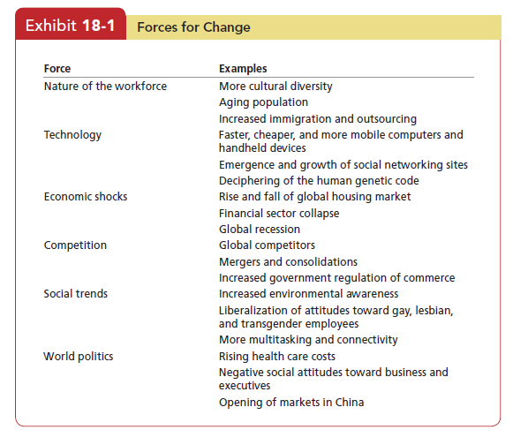
ORGANIZATIONAL BEHAVIOUR AND PROFESSIONAL COMMUNICATION (18ME661) UNIT5

Slide 4
ORGANIZATIONAL BEHAVIOUR AND PROFESSIONAL COMMUNICATION (18ME661) UNIT5
Managing Planned Change
A group of housekeeping employees who work for a small hotel confronted the owner: “It’s very hard for most of us to maintain rigid 7-to-4 work hours,” said their spokeswoman. “Each of us has significant family and personal responsibilities. And rigid hours don’t work for us. We’re going to begin looking for someplace else to work if you don’t set up flexible work hours.”
The owner listened thoughtfully to the group’s ultimatum and agreed to its request. The next day, a flexitime plan for these employees was introduced.

Slide 5
ORGANIZATIONAL BEHAVIOUR AND PROFESSIONAL COMMUNICATION (18ME661) UNIT5
A major automobile manufacturer spent several billion dollars to install state-of-the-art robotics. One area that would receive the new equipment was quality control, where sophisticated computers would significantly improve the company’s ability to find and correct defects. Because the new equipment would dramatically change the jobs in the quality-control area, and because management anticipated considerable employee resistance to it, executives were developing a program to help people become familiar with it and deal with any anxieties they might be feeling.

Slide 6
ORGANIZATIONAL BEHAVIOUR AND PROFESSIONAL COMMUNICATION (18ME661) UNIT5
What can change agents change
Who in organizations is responsible for managing change activities? The answer is change agents. They see a future for the organization that others have not identified, and they are able to motivate, invent, and implement this vision.
Change agents can be managers or nonmanagers, current or new employees, or outside consultants.

Slide 7
ORGANIZATIONAL BEHAVIOUR AND PROFESSIONAL COMMUNICATION (18ME661) UNIT5
Jeff Bezos is the change agent at Amazon.com . He founded the company as an online bookstore in 1994 and then built it into the largest retailer on the Web that sells everything from groceries to electronics.
Amazon changed from a seller of electronics to also become a product developer when it created the Kindle reading device and the Kindle service for downloading
books in less than 60 seconds. In his drive for change at Amazon, Bezos combines a long-term orientation with identifying a customer need. Bezos is shown here unveiling the Kindle DX, a large-screen version of the original Kindle designed for reading newspapers, magazines, and textbooks.

Slide 8
ORGANIZATIONAL BEHAVIOUR AND PROFESSIONAL COMMUNICATION (18ME661) UNIT5
Resistance to Change
Many change agents fail because organizational members resist change.
Our egos are fragile, and we often see change as threatening.
Employees who have negative feelings about a change cope by not thinking about it, increasing their use of sick time, and quitting. All these reactions can sap the organization of vital energy when it is most needed.

Slide 9
ORGANIZATIONAL BEHAVIOUR AND PROFESSIONAL COMMUNICATION (18ME661) UNIT5
Resistance to change can be positive if it leads to open discussion and debate. These responses are usually preferable to apathy or silence and can indicate that members of the organization are engaged in the process, providing change agents an opportunity to explain the change effort. Change agents can also use resistance to modify the change to fit the preferences of other members of the organization. When they treat resistance only as a threat, rather than a point of view to be discussed, they may increase dysfunctional conflict.

Slide 10
ORGANIZATIONAL BEHAVIOUR AND PROFESSIONAL COMMUNICATION (18ME661) UNIT5
Resistance doesn’t necessarily surface in standardized ways. It can be overt, implicit, immediate, or deferred. It’s easiest for management to deal with overt and immediate resistance, such as complaints, a work slowdown, or a strike threat. The greater challenge is managing resistance that is implicit or deferred. These responses—loss of loyalty or motivation, increased errors or absenteeism—are more subtle and more difficult to recognize for what they are.
Exhibit 18-2 summarizes major forces for resistance to change, categorized
by their sources. Individual sources reside in human characteristics such as perceptions, personalities, and needs. Organizational sources reside in the structural makeup of organizations themselves.

Slide 11
ORGANIZATIONAL BEHAVIOUR AND PROFESSIONAL COMMUNICATION (18ME661) UNIT5
Sources of Resistance to Change
Individual Sources
Habit—To cope with life’s complexities, we rely on habits or programmed responses. But when confronted with change, this tendency to respond in our accustomed ways becomes a source of resistance.
Security—People with a high need for security are likely to resist change because it threatens their feelings of safety.
Economic factors—Changes in job tasks or established work routines can arouse economic fears if people are concerned that they won’t be able to perform the new tasks or routines to their previous standards, especially when pay is closely tied to productivity.

Slide 12
ORGANIZATIONAL BEHAVIOUR AND PROFESSIONAL COMMUNICATION (18ME661) UNIT5
Fear of the unknown—Change substitutes ambiguity and uncertainty for the unknown.
Selective information processing—Individuals are guilty of selectively processing information in order to keep their perceptions intact. They hear what they want to hear, and they ignore information that challenges the world they’ve created.

Slide 13
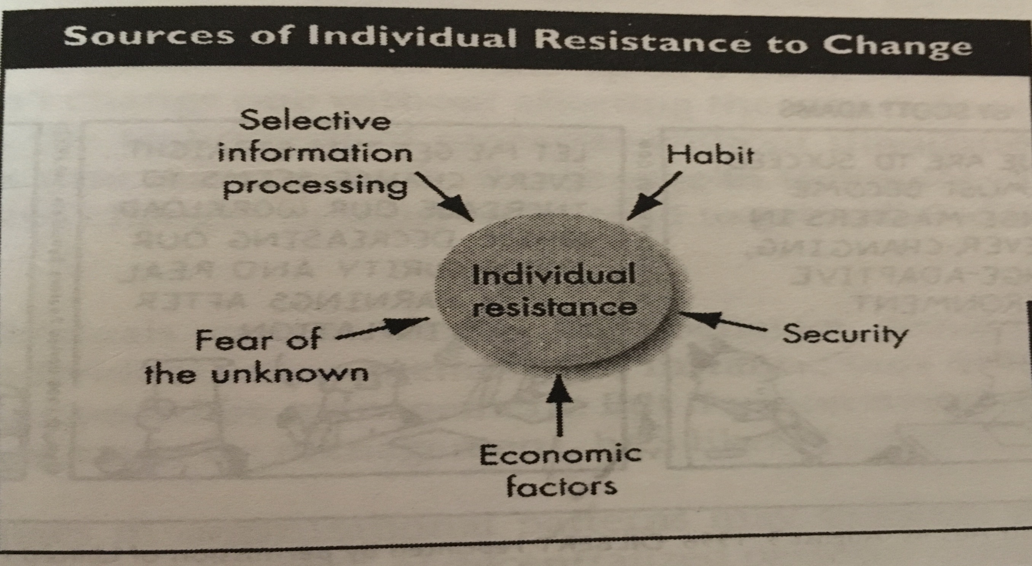
ORGANIZATIONAL BEHAVIOUR AND PROFESSIONAL COMMUNICATION (18ME661) UNIT5

Slide 14
ORGANIZATIONAL BEHAVIOUR AND PROFESSIONAL COMMUNICATION (18ME661) UNIT5
Organizational Sources
Structural inertia—Organizations have built-in mechanisms—such as their selection processes and formalized regulations—to produce stability. When an organization is confronted with change, this structural inertia acts as a counterbalance to sustain stability.
Limited focus of change—Organizations consist of a number of interdependent subsystems. One can’t be changed without affecting the others. So limited changes in subsystems tend to be nullified by the larger system.

Slide 15
ORGANIZATIONAL BEHAVIOUR AND PROFESSIONAL COMMUNICATION (18ME661) UNIT5
Group inertia—Even if individuals want to change their behaviour, group norms may act as a constraint.
Threat to expertise—Changes in organizational patterns may threaten the expertise of specialized groups.
Threat to established power relationships—Any redistribution of decision-making authority can threaten long-established power relationships within the organization.
Threat to established Resource Allocations- Groups in the organisation that control sizable resources often see change as a threat.

Slide 16
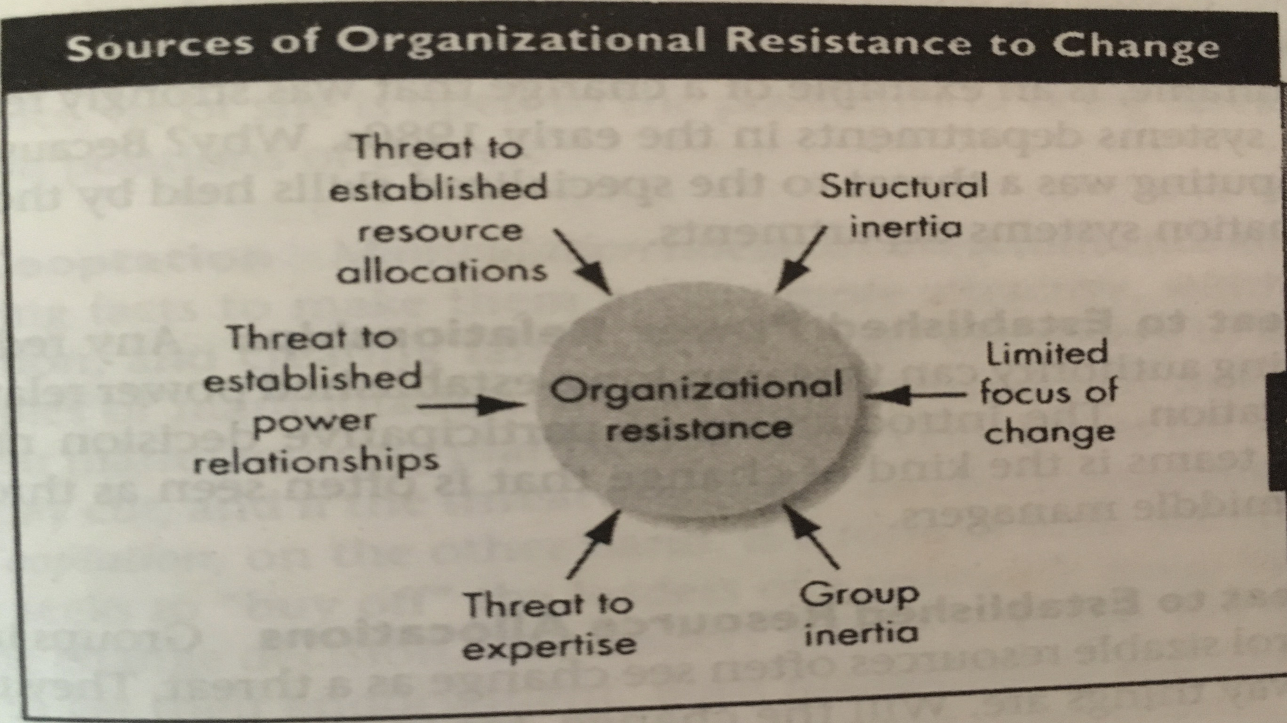
ORGANIZATIONAL BEHAVIOUR AND PROFESSIONAL COMMUNICATION (18ME661) UNIT5

Slide 17
ORGANIZATIONAL BEHAVIOUR AND PROFESSIONAL COMMUNICATION (18ME661) UNIT5
Overcoming Resistance to Change
Eight tactics can help change agents deal with resistance to change.
Education and Communication Communicating the logic of a change can reduce employee resistance on two levels. First, it fights the effects of misinformation and poor communication: if employees receive the full facts and clear up misunderstandings, resistance should subside. Second, communication can help “sell” the need for change by packaging it properly.

Slide 18
ORGANIZATIONAL BEHAVIOUR AND PROFESSIONAL COMMUNICATION (18ME661) UNIT5
2. Participation It’s difficult to resist a change decision in which we’ve participated. Assuming participants have the expertise to make a meaningful contribution, their involvement can reduce resistance, obtain commitment, and increase the quality of the change decision.
3. Building Support and Commitment When employees’ fear and anxiety are
high, counselling and therapy, new-skills training, or a short paid leave of absence may facilitate adjustment. When managers or employees have low emotional commitment to change, they favour the status quo and resist it. Employees are also more accepting of changes when they are committed to the organization as a whole. So, firing up employees and emphasizing their commitment to the organization overall can also help them emotionally commit to the change rather than embrace the status quo.

Slide 19
ORGANIZATIONAL BEHAVIOUR AND PROFESSIONAL COMMUNICATION (18ME661) UNIT5
4. Develop Positive Relationships People are more willing to accept changes if they trust the managers implementing them. If managers are able to facilitate positive relationships, they may be able to overcome resistance to change even among those who ordinarily don’t like changes.
5. Implementing Changes Fairly One way organizations can minimize negative impact is to make sure change is implemented fairly. Procedural fairness is especially important when employees perceive an outcome as negative, so it’s crucial that employees see the reason for the change and perceive its implementation as consistent and fair.

Slide 20
ORGANIZATIONAL BEHAVIOUR AND PROFESSIONAL COMMUNICATION (18ME661) UNIT5
6. Manipulation and Cooptation Manipulation refers to covert influence attempts. Twisting facts to make them more attractive, withholding information, and creating false rumours to get employees to accept change are all examples of manipulation.
Cooptation, on the other hand, Combines manipulation and participation. It seeks to “buy off” the leaders of a resistance group by giving them a key role, seeking their advice not to find a better solution but to get their endorsement.
Both manipulation and cooptation are relatively inexpensive ways to gain the support of adversaries, but they can backfire if the targets become aware they are being tricked or used. Once that’s discovered, the change agent’s credibility may drop to zero.

Slide 21
ORGANIZATIONAL BEHAVIOUR AND PROFESSIONAL COMMUNICATION (18ME661) UNIT5
7. Selecting People Who Accept Change Research suggests the ability to easily accept and adapt to change is related to personality—some people simply have more positive attitudes about change than others. Such individuals are open to experience, take a positive attitude toward change, are willing to take risks, and are flexible in their behaviour.
Besides selecting individuals who are willing to accept changes, it is also possible to select teams that are more adaptable.

Slide 22
ORGANIZATIONAL BEHAVIOUR AND PROFESSIONAL COMMUNICATION (18ME661) UNIT5
8. Coercion Last on the list of tactics is coercion, the application of direct threats or force on the resisters. If management really is determined to close a manufacturing plant whose employees don’t acquiesce to a pay cut, the company is using coercion. Other examples are threats of transfer, loss of promotions, negative performance evaluations, and a poor letter of recommendation. The advantages and drawbacks of coercion are approximately the same as for manipulation and cooptation.

Slide 23
ORGANIZATIONAL BEHAVIOUR AND PROFESSIONAL COMMUNICATION (18ME661) UNIT5
Work Stress and Its Management
What Is Stress?
Stress is a dynamic condition in which an individual is confronted with an opportunity, demand, or resource related to what the individual desires and for which the outcome is perceived to be both uncertain and important. This is a complicated definition.
stress An unpleasant psychological process that occurs in response to environmental pressures.

Slide 24
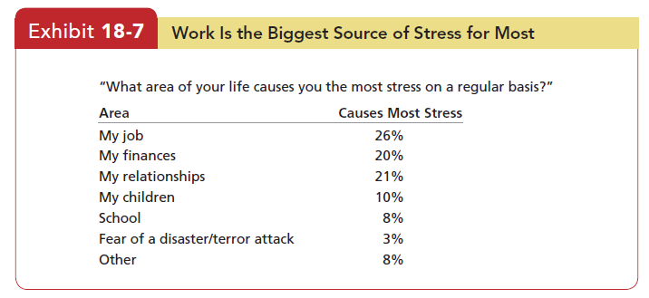
ORGANIZATIONAL BEHAVIOUR AND PROFESSIONAL COMMUNICATION (18ME661) UNIT5

Slide 25
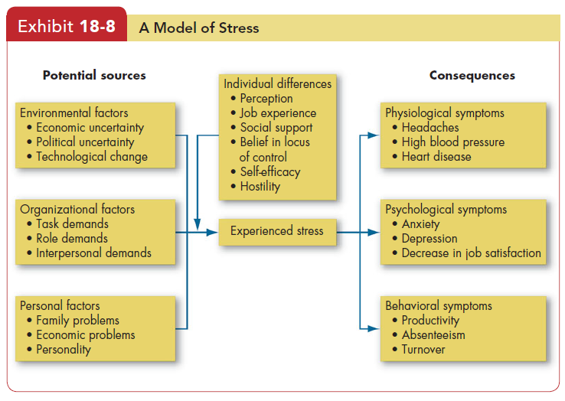
ORGANIZATIONAL BEHAVIOUR AND PROFESSIONAL COMMUNICATION (18ME661) UNIT5
Potential Sources of Stress
As the model in Exhibit 18-8 shows, there are three categories of potential stressors: environmental, organizational, and personal.

Slide 26
ORGANIZATIONAL BEHAVIOUR AND PROFESSIONAL COMMUNICATION (18ME661) UNIT5
Environmental Factors
There are three main types of environmental uncertainty: economic, political, and technological.
Changes in the business cycle create economic uncertainties. When the economy is contracting, for example, people become increasingly anxious about their job security.
Political uncertainties don’t tend to create stress. Threats of terrorism in developed and developing nations, lead to political uncertainty that becomes stressful to people in these countries.
Because innovations can make an employee’s skills and experience obsolete in a very short time, computers, robotics, automation, and similar forms of technological change are also a threat to many people and cause them stress.

Slide 27
ORGANIZATIONAL BEHAVIOUR AND PROFESSIONAL COMMUNICATION (18ME661) UNIT5
Organizational Factors
There is no shortage of factors within an organization that can cause stress. Pressures to avoid errors or complete tasks in a limited time, work overload, a demanding and insensitive boss, and unpleasant co-workers are a few examples.
Task demands relate to a person’s job. They include the design of the job
(its degrees of autonomy, task variety, degree of automation), working conditions, and the physical work layout. Assembly lines can put pressure on people when they perceive the line’s speed to be excessive. Working in an overcrowded room or a visible location where noise and interruptions are constant can increase anxiety and stress.

Slide 28
ORGANIZATIONAL BEHAVIOUR AND PROFESSIONAL COMMUNICATION (18ME661) UNIT5
Task demands are organizational factors that can cause stress. These call center employees of Encore Capital Group in Gurgaon, India, have the difficult job of collecting mostly credit card and auto debts of Americans. The nature of their job can cause stress, as the people they call may be abusive, emotional, frustrated, sad, or angry. Encore strives to reduce the on-the-job stress of its call center workers by teaching them how to empathize with the delinquent borrowers and how to handle verbal abuse. Collectors learn that the debtors respond to them when they are very polite and respectful and never raise their voice.

Slide 29
ORGANIZATIONAL BEHAVIOUR AND PROFESSIONAL COMMUNICATION (18ME661) UNIT5
Role demands relate to pressures placed on a person as a function of the particular role he or she plays in the organization. Role conflicts create expectations that may be hard to reconcile or satisfy. Role overload occurs when the employee is expected to do more than time permits. Role ambiguity means role expectations are not clearly understood and the employee is not sure what to do. Individuals who face high situational constraints (such as fixed work hours or demanding job responsibilities) are also less able to engage in the proactive coping behaviours that reduce stress levels.

Slide 30
ORGANIZATIONAL BEHAVIOUR AND PROFESSIONAL COMMUNICATION (18ME661) UNIT5
Interpersonal demands are pressures created by other employees. Lack of social support from colleagues and poor interpersonal relationships can cause stress, especially among employees with a high social need. A rapidly growing body of research has also shown that negative co-worker and supervisor behaviours, including fights, bullying, incivility, racial harassment, and sexual harassment, are especially strongly related to stress at work.

Slide 31
ORGANIZATIONAL BEHAVIOUR AND PROFESSIONAL COMMUNICATION (18ME661) UNIT5
Personal Factors
The typical individual works about 40 to 50 hours a week. But the experiences and problems people encounter in the other 120-plus can spill over to the job. Our final category, then, is factors in the employee’s personal life: family issues, personal economic problems, and inherent personality characteristics.
National surveys consistently show people hold family and personal relationships dear. Marital difficulties, the breaking of a close relationship, and discipline troubles with children create stresses employees often can’t leave at the front door when they arrive at work.

Slide 32
ORGANIZATIONAL BEHAVIOUR AND PROFESSIONAL COMMUNICATION (18ME661) UNIT5
Individual Differences
What individual variables moderate the relationship between potential stressors and experienced stress? At least four—perception, job experience, social support, and personality—are relevant.
Perception, therefore, will moderate the relationship between a potential stress condition and an employee’s reaction to it. Layoffs may cause one person to fear losing his job, while another sees an opportunity to get a large severance allowance and start her own business.
So stress potential doesn’t lie in objective conditions; rather, it lies in an employee’s interpretation of those conditions.

Slide 33
ORGANIZATIONAL BEHAVIOUR AND PROFESSIONAL COMMUNICATION (18ME661) UNIT5
Experience on the job tends to be negatively related to work stress. Why?
Two explanations have been offered. First is selective withdrawal. Voluntary turnover is more probable among people who experience more stress. Therefore, people who remain with an organization longer are those with more stress-resistant traits or those more resistant to the stress characteristics of their organization. Second, people eventually develop coping mechanisms to deal with stress. Because this takes time, senior members of the organization are more likely to be fully adapted and should experience less stress.

Slide 34
ORGANIZATIONAL BEHAVIOUR AND PROFESSIONAL COMMUNICATION (18ME661) UNIT5
Social support —collegial relationships with co-workers or supervisors—can buffer the impact of stress. This is among the best-documented relationships in the stress literature. Social support acts as a palliative, mitigating the negative effects of even high-strain jobs.
Perhaps the most widely studied personality trait in stress is neuroticism. Neurotic individuals are more prone to experience psychological strain. Neurotic individuals are more prone to believe there are stressors in their work environments, so part of the problem is that they believe their environments are more threatening. They also tend to select less adaptive coping mechanisms, relying on avoidance as a way of dealing with problems rather than attempting to resolve them.

Slide 35
ORGANIZATIONAL BEHAVIOUR AND PROFESSIONAL COMMUNICATION (18ME661) UNIT5
Workaholism is another personal characteristic related to stress levels. Workaholics are people obsessed with their work; they put in an enormous number of hours, think about work even when not working, and create additional work responsibilities to satisfy an inner compulsion to work more. In some ways, they might seem like ideal employees.
Workaholics are not necessarily more productive than other employees, despite their extreme efforts. The strain of putting in such a high level of work effort eventually begins to wear on the workaholic, leading to higher levels of work–life conflict and psychological burnout.

Slide 36
ORGANIZATIONAL BEHAVIOUR AND PROFESSIONAL COMMUNICATION (18ME661) UNIT5
Consequences of Stress
Stress shows itself in a number of ways, such as high blood pressure, ulcers, irritability, difficulty making routine decisions, loss of appetite, accident proneness, and the like. These symptoms fit under three general categories: physiological, psychological, and behavioural symptoms.
Physiological Symptoms Most early concern with stress was directed at physiological symptoms because most researchers were specialists in the health and medical sciences. Their work led to the conclusion that stress could create changes in metabolism, increase heart and breathing rates and blood pressure, bring on headaches, and induce heart attacks.

Slide 37
ORGANIZATIONAL BEHAVIOUR AND PROFESSIONAL COMMUNICATION (18ME661) UNIT5
Psychological Symptoms Job dissatisfaction is “the simplest and most obvious psychological effect” of stress. But stress shows itself in other psychological states—for instance, tension, anxiety, irritability, boredom, and procrastination. For example, a study that tracked physiological responses of employees over time found that stress due to high workloads was related to higher blood pressure and lower emotional well-being.
Jobs that make multiple and conflicting demands or that lack clarity about the incumbent’s duties, authority, and responsibilities increase both stress and dissatisfaction.
Similarly, the less control people have over the pace of their work, the greater their stress and dissatisfaction. Jobs that provide a low level of variety, significance, autonomy, feedback, and identity appear to create stress and reduce satisfaction and involvement in the job.

Slide 38
ORGANIZATIONAL BEHAVIOUR AND PROFESSIONAL COMMUNICATION (18ME661) UNIT5
Behavioural Symptoms Research on behaviour and stress has been conducted across several countries and over time, and the relationships appear relatively consistent. Behaviour-related stress symptoms include reductions in productivity, absence, and turnover, as well as changes in eating habits, increased smoking or consumption of alcohol, rapid speech, fidgeting, and sleep disorders.

Slide 39
ORGANIZATIONAL BEHAVIOUR AND PROFESSIONAL COMMUNICATION (18ME661) UNIT5
Managing Stress
Because low to moderate levels of stress can be functional and lead to higher performance, management may not be concerned when employees experience them. Employees, however, are likely to perceive even low levels of stress as undesirable. It’s not unlikely, therefore, for employees and management to have different notions of what constitutes an acceptable level of stress on the job. What management may consider to be “a positive stimulus that keeps the adrenaline running” is very likely to be seen as “excessive pressure” by the employee.

Slide 40
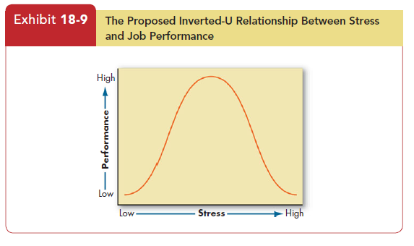
ORGANIZATIONAL BEHAVIOUR AND PROFESSIONAL COMMUNICATION (18ME661) UNIT5

Slide 41
ORGANIZATIONAL BEHAVIOUR AND PROFESSIONAL COMMUNICATION (18ME661) UNIT5
Individual Approaches
An employee can take personal responsibility for reducing stress levels. Individual strategies that have proven effective include time-management techniques, increased physical exercise, relaxation training, and expanded social support networks.

Slide 42
ORGANIZATIONAL BEHAVIOUR AND PROFESSIONAL COMMUNICATION (18ME661) UNIT5
Many people manage their time poorly. The well-organized employee, like the well-organized student, can often accomplish twice as much as the person who is poorly organized. So an understanding and utilization of basic time-management principles can help individuals better cope with tensions created by job demands.
A few of the best-known time-management principles are
making daily lists of activities to be accomplished.
(2) prioritizing activities by importance and urgency.
(3) scheduling activities according to the priorities set.
(4) knowing your daily cycle and handling the most demanding parts of your job
when you are most alert and productive.
(5) avoiding electronic distractions like frequently checking e-mail, which can limit attention and reduce efficiency.
These time-management skills can help minimize procrastination by focusing efforts on immediate goals and boosting motivation even in the face of tasks that are less desirable.

Slide 43
ORGANIZATIONAL BEHAVIOUR AND PROFESSIONAL COMMUNICATION (18ME661) UNIT5
Physicians have recommended non-competitive physical exercise , such as aerobics, walking, jogging, swimming, and riding a bicycle, as a way to deal with excessive stress levels. These activities increase lung capacity, lower the at-rest heart rate, and provide a mental diversion from work pressures, effectively reducing work-related levels of stress.

Slide 44
ORGANIZATIONAL BEHAVIOUR AND PROFESSIONAL COMMUNICATION (18ME661) UNIT5
Individuals can also teach themselves to reduce tension through relaxation techniques such as meditation, hypnosis, and deep breathing. The objective is to reach state of deep physical relaxation, in which you focus all your energy on release of muscle tension. Deep relaxation for 15 or 20 minutes a day releases strain and provides a pronounced sense of peacefulness, as well as significant changes in heart rate, blood pressure, and other physiological factors. A growing body of research shows that simply taking breaks from work at routine intervals can facilitate psychological recovery and reduce stress significantly and may improve job performance, and these effects are even greater if relaxation techniques are employed.

Slide 45
ORGANIZATIONAL BEHAVIOUR AND PROFESSIONAL COMMUNICATION (18ME661) UNIT5
As we have noted, friends, family, or work colleagues can provide an outlet when stress levels become excessive. Expanding your social support network provides someone to hear your problems and offer a more objective perspective on a stressful situation than your own.

Slide 46
ORGANIZATIONAL BEHAVIOUR AND PROFESSIONAL COMMUNICATION (18ME661) UNIT5
Organizational Approaches
Several organizational factors that cause stress— particularly task and role demands—are controlled by management and thus can be modified or changed. Strategies to consider include improved employee selection and job placement, training, realistic goal-setting, redesign of jobs, increased employee involvement, improved organizational communication, employee sabbaticals, and corporate wellness programs.

Slide 47
ORGANIZATIONAL BEHAVIOUR AND PROFESSIONAL COMMUNICATION (18ME661) UNIT5
Certain jobs are more stressful than others but, as we’ve seen, individuals differ in their response to stressful situations. We know individuals with little experience or an external locus of control tend to be more prone to stress. Selection and placement decisions should take these facts into consideration. Obviously, management shouldn’t restrict hiring to only experienced individuals with an internal locus, but such individuals may adapt better to high-stress jobs and perform those jobs more effectively. Similarly, training can increase an individual’s self-efficacy and thus lessen job strain.

Slide 48
ORGANIZATIONAL BEHAVIOUR AND PROFESSIONAL COMMUNICATION (18ME661) UNIT5
goal-setting: Individuals perform better when they have specific and challenging goals and receive feedback on their progress toward these goals. Goals can reduce stress as well as provide motivation. Employees who are highly committed to their goals and see purpose in their jobs experience less stress because they are more likely to perceive stressors as challenges rather
than hindrances. Specific goals perceived as attainable clarify performance expectations. In addition, goal feedback reduces uncertainties about actual job performance. The result is less employee frustration, role ambiguity, and stress.

Slide 49
ORGANIZATIONAL BEHAVIOUR AND PROFESSIONAL COMMUNICATION (18ME661) UNIT5
Redesigning jobs to give employees more responsibility, more meaningful work, more autonomy, and increased feedback can reduce stress because these factors give employees greater control over work activities and lessen dependence on others.
But as we noted in our discussion of work design, not all employees want enriched jobs. The right redesign for employees with a low need for growth might be less responsibility and increased specialization. If individuals prefer structure and routine, reducing skill variety should also reduce uncertainties and stress levels.

Slide 50
ORGANIZATIONAL BEHAVIOUR AND PROFESSIONAL COMMUNICATION (18ME661) UNIT5
Role stress is detrimental to a large extent because employees feel uncertain about goals, expectations, how they’ll be evaluated, and the like. By giving these employees a voice in the decisions that directly affect their job performance, management can increase employee control and reduce role stress. Thus, managers should consider increasing employee involvement in decision making, because evidence clearly shows that increases in employee empowerment reduce psychological strain.

Slide 51
ORGANIZATIONAL BEHAVIOUR AND PROFESSIONAL COMMUNICATION (18ME661) UNIT5
Increasing formal organizational communication with employees reduces uncertainty by lessening role ambiguity and role conflict. Given the importance that perceptions play in moderating the stress–response relationship, management can also use effective communications as a means to shape employee perceptions. Remember that what employees categorize as demands, threats, or opportunities at work is an interpretation and that interpretation can be affected by the symbols and actions communicated by management.

Slide 52
ORGANIZATIONAL BEHAVIOUR AND PROFESSIONAL COMMUNICATION (18ME661) UNIT5
Some employees need an occasional escape from the frenetic pace of their work. Companies including Genentech, American Express, Intel, General Mills, Microsoft, Morningstar, DreamWorks Animation, and Adobe Systems have begun to provide extended voluntary leaves. These sabbaticals —ranging in length from a few weeks to several months—allow employees to travel, relax, or pursue personal projects that consume time beyond normal vacations. Proponents say they can revive and rejuvenate workers who might otherwise be headed for burnout.

Slide 53
ORGANIZATIONAL BEHAVIOUR AND PROFESSIONAL COMMUNICATION (18ME661) UNIT5
Wellness programs . These typically provide workshops to help people quit smoking, control alcohol use, lose weight, eat better, and develop a regular exercise program; they focus on the employee’s total physical and mental condition. Some help employees improve their psychological health as well. A meta-analysis of 36 programs designed to reduce stress (including wellness programs) showed that interventions to help employees reframe stressful situations and use active coping strategies appreciably reduced stress levels. Most wellness programs assume employees need to take personal responsibility for their physical and mental health and that the organization is merely a means to that end.

