Slide 1
Time and Global States

Slide 2
Time and Global States
Introduction
Clocks, events and process states
Synchronizing physical clocks
Logical time and logical clocks
Global states
Distributed debugging
Summary

Slide 3
11.1 Introduction
Importance of time in distributed systems
A quantity to timestamp events accurately
To know what time a particular event occurs
i.e. Recording when an e-commerce transaction occurs
A synchronization source for several distributed algorithms
To maintain consistency of distributed data
i.e. Eliminating duplicate updates
A timing source for multiple events
To provide relative order of two events
i.e. Ensuring the order of cause and effect
Clocks in computers to establish
Time at which an event occurred
Duration of an event or interval between two events
Sequence of a series of events or the order in which events occurred

Slide 4
11.2 Clocks, Events and Process States
A distributed system consists of a collection P of
N processes p_{i}, i = 1,2,… N
Each process p_{i} has a state s_{i} consisting of its variables (which it transforms as it executes)
Processes communicate only by messages (via a network)
Actions of processes: Send, Receive, change own state
Event: the occurrence of a single action that a process carries out as it executes
Events at a single process p_{i}, can be placed in a total ordering
denoted by the relation →_{i} between the events. i.e.
e →_{i  }e’ if and only if event e occurs before event e’ at process p_{i}
A history of process p_{i:} is a series of events ordered by →_{i}
history(p_{i}) = h_{i} = <e_{i0} , e_{i} , e_{i} …>
1 2

Slide 5
Clocks
Clocks are used to timestamp the events i.e., to assign to them a date and time of day. Computers each contain their own physical clocks. These clocks are electronic devices that count oscillations occurring in a crystal at a definite frequency, and typically divide this count and store the result in a counter register.

Slide 6
Clocks Cont..
To timestamp events, use the computer’s clock
At real time, t, the OS reads the time
on the
computer’s hardware clock H_{i}(t)
It calculates the time on its software clock C_{i}(t)=
αH_{i}(t) + β
e.g. a 64 bit value giving nanoseconds since some base time
Clock resolution: period between updates of the clock value
In general, the clock is not completely accurate
but if C_{i} behaves well enough, it can be used to timestamp events at p_{i}

Slide 7




Skew between computer clocks in a distributed system
Network
Figure 11.1
Computer clocks are not generally in perfect agreement
Clock skew: the difference between the times on two clocks (at any instant)
Computer clocks use crystal-based clocks that are subject to physical variations
Clock drift: they count time at different rates and so diverge (frequencies of oscillation differ)
Clock drift rate: the difference per unit of time from some ideal reference clock
Ordinary quartz clocks drift by about 1 sec in 11-12 days. (10⁻⁶ secs/sec).
High precision quartz clocks drift rate is about 10⁻⁷ or 10⁻⁸ secs/sec

Slide 8
Coordinated Universal Time (UTC)
UTC is an international standard for time keeping
It is based on atomic time, but occasionally adjusted to astronomical time
International Atomic Time is based on very accurate physical clocks (drift rate 10⁻¹³)
It is broadcast from radio stations on land and satellite (e.g.
GPS)
Computers with receivers can synchronize their clocks with these timing signals (by requesting time from GPS/UTC source)
Signals from land-based stations are accurate to about 0.1-10 millisecond
Signals from GPS are accurate to about 1 microsecond

Slide 9
11.3 Synchronizing physical clocks
Two modes of synchronization
External synchronization: a computer’s clock C_{i} is synchronized with an external authoritative time source S, so that:
|S(t) - C_{i}(t)| < D for i = 1, 2, … N over an interval, I of real time
The clocks C_{i} are accurate to within the bound D.
Internal synchronization: the clocks of a pair of computers are synchronized with one another so that:
| C_{i}(t) - C_{j}(t)| < D for i = 1, 2, … N over an interval, I of real time
The clocks C_{i} and C_{j} agree within the bound D.
Internally synchronized clocks are not necessarily externally synchronized, as they may drift collectively
if the set of processes P is synchronized externally within a bound D, it is also internally synchronized within bound 2D (worst case polarity)

Slide 10
Clock correctness
Correct clock: a hardware clock H is said to be correct if its drift rate is within a bound ρ > 0 (e.g. 10⁻⁶ secs/ sec)
This means that the error in measuring the interval between real times t and
t’ is bounded:
– (1 - ρ ) (t’ - t) ≤ H(t’) - H(t) ≤ (1 + ρ ) (t’ - t) (where t’>t)
Which forbids jumps in time readings of hardware clocks
Clock monotonicity: weaker condition of correctness
– t' > t ⇒ C(t’) > C(t)
e.g. required by Unix make
A hardware clock that runs fast can achieve monotonicity by adjusting the values of α  and β such that C_{i}(t)= αH_{i}(t) + β
Faulty clock: a clock not keeping its correctness condition
crash failure - a clock stops ticking
arbitrary failure - any other failure
e.g. jumps in time; Y2K bug

Slide 11
11.3.1 Synchronization in a synchronous system
A synchronous distributed system is one in which the following bounds are defined (Section 2.3.1; p.48):
the time to execute each step of a process has known lower and upper
bounds
each message transmitted over a channel is received within a known bounded time (min and max)
each process has a local clock whose drift rate from real time has a known bound
Internal synchronization in a synchronous system
One process p₁ sends its local time t to process p₂ in a message m
p₂ could set its clock to t + T_{trans} where T_{trans} is the time to transmit m
T_{trans} is unknown but min ≤ T_{trans} ≤ max
uncertainty u = max-min. Set clock to t + (max - min)/2 then skew ≤ u/2

Slide 12

Cristian’s Algorithm: External Sync
Uses a time server to synchronize clocks
Mainly designed for LAN
Time server keeps the reference time (say UTC)
A client asks the time server for time, the server responds with its current time, and the client uses the received value ‘t’ to set its clock
But network round-trip time introduces an error.
So what do we need to do?
Estimate one-way delay

Slide 13
Cristian’s Algorithm Cont..
A time server S receives signals from a UTC source
– Process p requests time in m_{r} and receives t in m_{t} from S
p sets its clock to t + T_{round}/2
Accuracy ± (T_{round}/2 - min) :
T_{round} is the round trip time recorded by p min is an estimated minimum round trip time
because the earliest time S puts t in message m_{t} is min after p sent m_{r}
the latest time was min before m_{t} arrived at p
the time by S’s clock when m_{t} arrives is in the range [t+min, t + T_{round} - min]
the width of the range is T_{round} - 2min
m_{r}
m_{t}
Figure 11.2
p
Time server,S

Slide 14
Cristian’s Algorithm in brief
The accuracy is: ± (T_{round}/2 - min)
Cristian’s algorithm
Step1.A client asks its time server.
Step2. The time server sends its time T.
Step3.The client estimates the one-way delay and sets its time.
It uses t + T_{round}/2
Want to improve accuracy?
Take multiple readings and use the minimum RTT → tighter bound
For unusually long RTTs, ignore them and repeat the request → removing outliers

Slide 15
11.3.3 The Berkeley algorithm
Problem with Cristian’s algorithm
a single time server might fail, so they suggest the synchronized servers
it does not deal with faulty servers
Berkeley algorithm (also 1989)
use of a group of
An algorithm for internal synchronization of a group of computers
A master polls to collect clock values from the others (slaves)
The master uses round trip times to estimate the slaves’ clock values
It takes an average (eliminating any above some average round trip time or with faulty clocks)
It sends the required adjustment to the slaves (better than sending the time which depends on the round trip time)
Measurements
15 computers, clock synchronization 20-25 millisecs drift rate < 2x10⁻⁵
If master fails, can elect a new master to take over (not in bounded time)

Slide 16











Berkeley Algorithm: example
master
3:00
3:50
2:50
9:10
3:50
2:50
9:10
1. Request timestamps from all slaves
September 24, 2018
© 2014-2018 Paul Krzyzanowski
26

Slide 17




Berkeley Algorithm: example
master
3:00
3:50
9:10
2:50
3:50
2:50
9:10
2. Compute fault-tolerant average:
Suppose
max ∂=0:50
3 : 50 + 2 : 50 + 3 : 00
3
= 3 : 00
September 24, 2018
© 2014-2018 Paul Krzyzanowski
27

Slide 18


Berkeley Algorithm: example
master
3:00
-0:50
+0:50
-6:10
3:50
2:50
9:10
3. Send offset to each client
September 24, 2018
© 2014-2018 Paul Krzyzanowski
28

Slide 19
Network Time Protocol, NTP
• 1991, 1992
– Internet Standard, version 3: RFC 1305
• June 2010
– Internet Standard, version 4: RFC 5905-5908
– IPv6 support
– Improve accuracy to tens of microseconds
– Dynamic server discovery
September 24, 2018
© 2014-2018 Paul Krzyzanowski
29

Slide 20
NTP’s chief design aims and features are as follows:
To provide a service enabling clients across the Internet to be synchronized accurately to UTC: Although large and variable message delays are encountered in Internet communication, NTP employs statistical techniques for the filtering of timing data and it discriminates between the quality of timing data from different servers.
To provide a reliable service that can survive lengthy losses of connectivity: There are redundant servers and redundant paths between the servers. The servers can reconfigure so as to continue to provide the service if one of them becomes unreachable.
To enable clients to resynchronize sufficiently frequently to offset the rates of drift found in most computers: The service is designed to scale to large numbers of clients and servers.
To provide protection against interference with the time service, whether malicious or accidental: The time service uses authentication techniques to check that timing data originate from the claimed trusted sources. It also validates the return addresses of messages sent to it.

Slide 21
11.3.4 Network Time Protocol (NTP)
Architecture
Primary servers are connected to UTC sources
Secondary servers are synchronized to primary servers
Synchronization subnet - lowest level servers in users’ computers
strata: the hierarchy level
1
2
2
3 3 3
Figure 11.3 An example synchronization subnet in an NTP implementation

Slide 22
NTP Architecture (cont..)
Primary servers occupy stratum 1: they are at the root. Stratum 2 servers are secondary servers that are synchronized directly with the primary servers; stratum 3 servers are synchronized with stratum 2 servers, and so on. The lowest-level (leaf) servers execute in users’ workstations.
The clocks belonging to servers with high stratum numbers are liable to be less accurate than those with low stratum numbers, because errors are introduced at each level of synchronization. NTP also takes into account the total message round-trip delays to the root in assessing the quality of timekeeping data held by a particular server.

Slide 23
NTP - synchronization of servers
The synchronization subnet can reconfigure if failures occur
a primary that loses its UTC source can become a secondary
a secondary that loses its primary can use another primary
Modes of synchronization for NTP servers:
Multicast
A server within a high speed LAN multicasts time to others which set clocks assuming some delay (not very accurate)
Procedure call
A server accepts requests from other computers (like Cristian’s algorithm)
Higher accuracy. Useful if no hardware multicast.
Symmetric
Pairs of servers exchange messages containing time information
Used where very high accuracies are needed (e.g. for higher levels)

Slide 24
Messages exchanged between a pair of NTP peers
All modes use UDP
Each message bears timestamps of recent events:
Local times of Send and Receive of previous message
Local times of Send of current message
Recipient notes the time of receipt T_{i} ( we have T_{i-3}, T_{i-2}, T_{i-1}, T_{i})
In symmetric mode there can be a non-negligible delay between messages
d_{i} = T_{i – 2} - T_{i – 3} +T_{i} -T_{i – 1} delay di , which is the total transmission time for the two messages
Server B
^{T}i-2
^{T}i-1
Time
m
m'
Time
Server A
^{T}i- 3
T_{i}
Figure 11.4
15

Slide 25
11.4 Logical time and logical clocks
Instead of synchronizing clocks, event ordering can be used
If two events occurred at the same process pi (i = 1, 2, … N) then they occurred in the order observed by pi, that is order   →_{i}
when a message, m is sent between two processes, send(m) happened before receive(m)
Lamport[1978] generalized these two relationships into the
happened-before relation: e →_{i} e'
HB1: if e →_{i} e' in process p_{i}, then e → e'
HB2: for any message m, send(m) → receive(m)
HB3: if e → e' and e' → e'', then e → e''

Slide 26




Happened Before Relation(Cont..) Figure 11.5 Events occurring at three processes
p₁
a | b | m₁
c |  |  | d | m₂
p₂
Physica time
p₃
e f
HB1: a→b, c→d, e→f
HB2: b→c, d→f
HB3: a→b→c→d→f
a||e: a and e are concurrent (neither a→e nor e→a)

Slide 27
Lamport’s logical clocks
Each process p_{i} has a logical clock L_{i}
a monotonically increasing software counter
not related to a physical clock
Apply Lamport timestamps to events with happened-before relation
LC1: L_{i} is incremented by 1 before each event at process p_{i}
LC2:
when process p_{i} sends message m, it piggybacks t = L_{i}
when p_{j} receives (m,t), it sets L_{j} := max(L_{j}, t) and applies LC1 before timestamping the event receive (m)
e →e’ implies L(e)<L(e’), but L(e)<L(e') does not imply e→e’
1 2
L(b)>L(e)
but b||e
p₁
a
b
m₁
3
4
Physical time
p₂
c
d
m₂
1
5
p₃
Figure 11.6
e
f
19

Slide 28
Totally ordered logical clocks
Some pairs of distinct events, generated by different processes, may have numerically identical Lamport timestamps
Different processes may have same Lamport time
Totally ordered logical clocks
If e is an event occurring at p_{i} with local timestamp T_{i}, and if e’ is an event occurring at p_{j} with local timestamp T_{j}
Define global logical timestamps for the events to be (T_{i}, i ) and (T_{j}, j)
Define (T_{i}, i ) < (T_{j}, j ) iff
T_{i} < T_{j} or
T_{i} = T_{j} and i < j
No general physical significance since process identifiers are arbitrary

Slide 29
Vector clocks
Shortcoming of Lamport clocks:
L(e) < L(e') doesn't imply e → e'
Vector clock: an array of N integers for a system of N processes
Each process keeps its own vector clock V_{i} to timestamp local events
Piggyback vector timestamps on messages
Rules for updating vector clocks:
V_{i} [ i ] is the number of events that pi has timestamped
V_{i} [ j ] ( j≠ i) is the number of events at p_{j} that p_{i} has been affected by VC1: Initially, V_{i}[ j ] := 0 for p_{i}, j=1.. N (N processes)
VC2: before p_{i} timestamps an event, V_{i}[ i ] := V_{i}[ i ]+1 VC3: p_{i} piggybacks t = V_{i} on every message it sends
VC4: when p_{i} receives a timestamp t, it sets V_{i}[ j ] := max(V_{i}[ j ] , t[ j ]) for
j=1..N (merge operation)

Slide 30
Figure 11.7 Vector timestamps for events shown in Figure 11.5
(1,0,0) (2,0,0)
p₁
a
b
m ₁
(2,1,0)
(2,2,0)
Physical time
p₂
c
d
m ₂
(0,0,1)
(2,2,2)
p₃
e
f
Figure 11.7 shows
a→f since V(a) < V(f)
c || e since neither V(c) <= V(e) nor V(e) <= V(c)

Slide 31

11.5 Global states
How do we find out if a particular property is true in a distributed system? For examples, we will look at:
Distributed Garbage Collection
Deadlock Detection
Termination Detection
– Debugging
p₁
p ₂
object reference
message
a. Garbage collection
garbage object
p₁
wait-for
p ₂
b. Deadlock
wait-for
Figure 11.8 Detecting
p₁
p ₂
global properties
activate
c. Termination
passive
passive

Slide 32
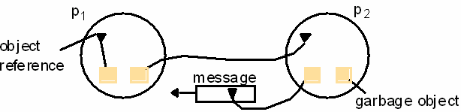
Distributed Garbage Collection
Objects are identified as garbage when there are no longer any references to them in the system
Garbage collection reclaims memory used by those objects
In figure 11.8a, process p₂ has two objects that do not have any references to other objects, but one object does have a reference to a message in transit. It is not garbage, but the other p₂ object is
Thus we must consider communication channels as well as
object references to determine unreferenced objects

Slide 33
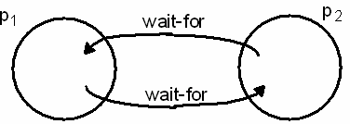
Deadlock Detection
A distributed deadlock occurs when each of a collection of processes waits for another process to send it a message, and there is a cycle in the graph of the waits-for relationship
In figure 11.8b, both p₁ and p₂ wait for a message from the other, so both are blocked and the system cannot continue

Slide 34
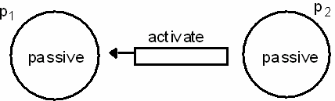
Termination Detection
It is
difficult to tell whether a distributed algorithm has
terminated. It is not enough to detect whether each process has halted
In figure 11.8c, both processes are in passive mode, but
there is an activation request in the network
Termination detection examines multiple states like deadlock detection, except that a deadlock may affect only a portion of the processes involved, while termination detection must ensure that all of the processes have completed

Slide 35
Distributed Debugging
Distributed processes are complex to debug. One of many possible problems is that consistency restraints must be evaluated for simultaneous attribute values in multiple processes at different instants of time
All four of the distributed problems discussed in this section have particular solutions, but all of them also illustrate the need to observe global states. We will now look at a general approach to observing global states

Slide 36
11.5.1 Global states and consistent cuts
Without global time identified by perfectly synchronized clocks, the ability to identify successive states in an individual process does not translate into the ability to identify successive states in distributed processes
We can assemble meaningful global states from local states recorded at different local times in many circumstances, but must do so carefully and recognize limits to our capabilities
A general system P of N processes p_{i} (i=1..N)
p_{i}’s history: history(p_{i})=h_{i}=<e_{i} , e_{i} , e_{i} , …>
0 1 2
finite prefix of p_{i}’s history: h_{i} = <e_{i} , e_{i} , e_{i} , …, e_{i} >
k 0 1 2 k
state of p_{i} immediately before the kth event occurs: s_{i}
k
global history H=h₁ U h₂ U…U h_{N}
A cut of the system’s execution is a subset of its global history that is a
union of prefix of process histories C=h₁^{c1} U h₂^{c2} U…U h_{N}^{cN}
28

Slide 37






Figure 11.9 Cuts
Figure 11.9 gives an example of an inconsistent cut_{ic} and a consistent cut_{cc}. The distinguishing characteristic is that
cut_{ic} includes the receipt of message m₁ but not the sending of it, while
cut_{cc} includes the sending and receiving of m₁ and cuts between the sending and receipt of the message m₂.
A consistent cut cannot violate temporal causality by implying that a result occurred before its cause, as in message m₁ being received before the cut and being sent after the cut.
_{e}0 _{e} 1 _{e} 2 _{e} 3
1 1 1 1
p₁
m₁
m₂
p₂
Physical time
_{e} 0 _{e} 1
_{e} 2
2
2
2
Inconsistent cut
Consistent cut
29

Slide 38
11.5.2 Global state predicates
A Global State Predicate is a function that maps from the set of global process states to True or False.
Detecting a condition like deadlock or termination requires evaluating a Global State Predicate.
A Global State Predicate is stable: once a system enters a
state where it is true, such as deadlock or termination, it remains true in all future states reachable from that state. However, when we monitor or debug an application, we are interested in non stable predicates.

Slide 39
Safety and Liveliness
Safety
Suppose there is an undesirable property D that is a predicate of the system’s global state – for example, D could be the property of being deadlocked. Let S0 be the original state of the system. Safety with respect to D is the assertion that D evaluates to False for all states S reachable from S0 .
Liveliness
Conversely, let E be a desirable property of a system’s global state – for example, the property of reaching termination. Liveness with respect to E is the property that, for any linearization L starting in the state S0 , E evaluates to True for some state SL reachable from S0 .

Slide 40
Mutual Exclusion
Distributed processes often need to coordinate their activities. If a collection of processes share a resource or collection of resources, then often mutual exclusion is required to prevent interference and ensure consistency when accessing the resources. This is the critical section problem, familiar in the domain of operating systems. In a distributed system, however, neither shared variables nor facilities supplied by a single local kernel can be used to solve it, in general. We require a solution to distributed mutual exclusion: one that is based solely on message passing.
Essential requirements for mutual exclusion are as follows:
ME1: (safety) At most one process may execute in the critical section (CS) at a time.
ME2: (liveness) Requests to enter and exit the critical section eventually succeed.

Slide 41
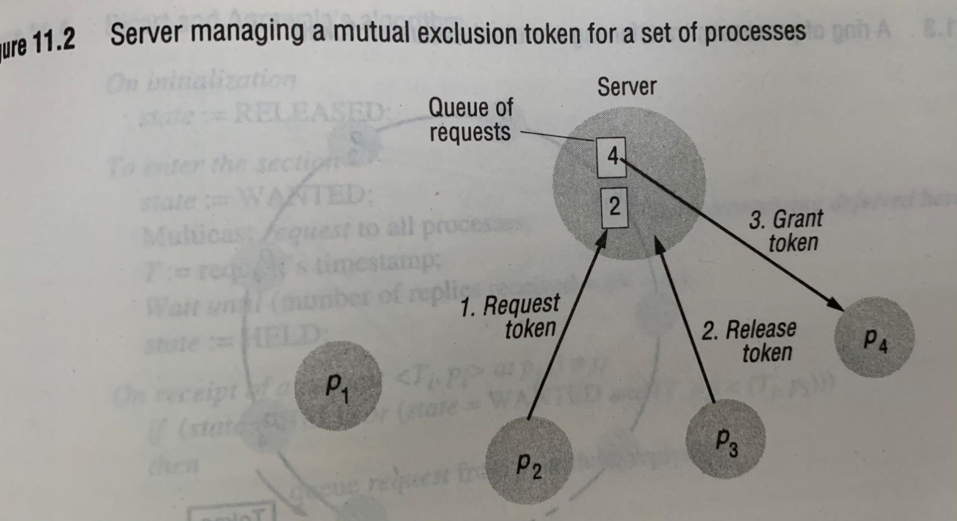
Central Server Algorithm

Slide 42
The simplest way to achieve mutual exclusion is to employ a server that grants permission to enter critical section as shown in the diagram To enter Critical Section a process sends a request message to server and awaits a reply from it. Conceptually the reply constitutes a token signifying permission to enter Critical Section If no other process has token at that time of request, then the server replies immediately granting the token. If the token is currently held by another process then the server does not reply but queues the request. On exiting the Critical Section a message is sent to the server giving it back the token.
Central Server Algorithm cont..

Slide 43
If the queue of writing processes is not empty then the server chooses the oldest entry in the queue removes it and replies to the corresponding process. The chosen process holds the token Ex as shown in the diagram P2 request appended to queue which contains P4 request P3 exits Critical section Server removes P4 and grants permission to P4 by replying to it P1 does not currently request entry to critical section
Central Server Algorithm cont..

Slide 44
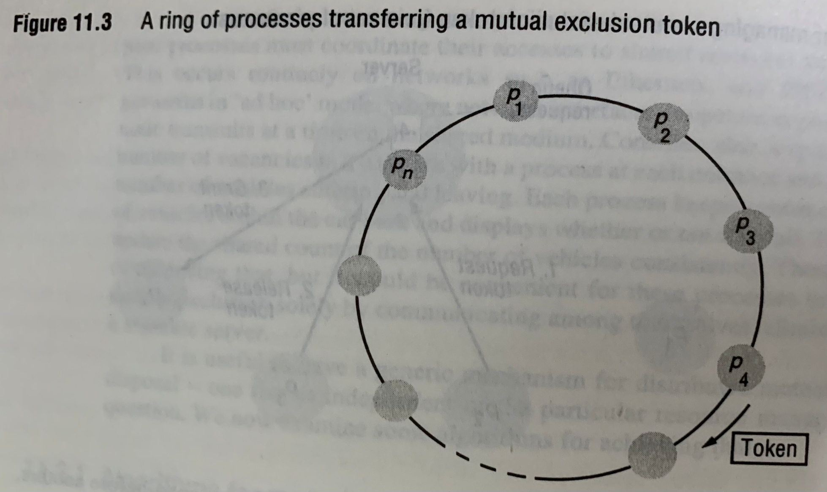
A ring Based algorithm

Slide 45
Simplest ways to arrange mutual exclusion between N processes without requiring an additional process is to arrange them in a logical ring as shown below This requires that each process Pi has a communication channel to the next process in the ring P(i+1) mod N. The idea is that exclusion is conferred by obtaining from process to process in a single direction say clockwise If a process does not require to enter the critical section when it receives the token then it immediately forwards the token to its neighbor.
A ring Based Algorithm cont..

Slide 46
A ring Based Algorithm(Cont..)
A process that requires the token waits until it receives it but retains it. To exit the Critical Section the process sends the token on its neighbor. The conditions ME1 and ME2 are met by this algorithm but the token is not necessarily obtained in the happened before order
The algorithm continuously consumes network bandwidth (except when a process is in critical section).The delay experienced by a process requesting entry to Critical Section is between o messages to N messages
Exiting Critical section requires only one message

