Slide 1
System Models

Slide 2
System models
Purpose
illustrate/describe common properties and design choices for distributed system in a single descriptive model.

Slide 3
System Models
Two types of models
Architectural Models
Fundamental Models
Architectural model is concerned with the placement if its components and the relationships between them.
Fundamental models are concerned with a more formal description of the properties that are common in all of the architectural models.

Slide 4
2.2 Architectural System Model
An architectural model of a distributed system is concerned with the placement of its parts and the relationships between them.
Examples
Client-server
Peer-to-peer
Interaction Model
Deals with performance and the difficulty to set time limits (e.g., in message delivery).
Failure Model
Gives a precise specification of the faults of the processes and the links.
Defines reliable communication and correct processes.

Slide 5
Architectural Models
The architecture abstracts the functions of the individual components of the distributed system.
ensure that the structure will meet present and likely future demands
make the system reliable, manageable, adaptable, and cost-effective
Classification of processes
Servers, clients, peers
Identifies responsibilities, helps to assess their workloads, determines the impact of failures in each of them.

Slide 6
Software Layers
Software architecture refers to services offered and requested between processes located in the same or different computers.
structuring of software as layers or modules
Service layers
Distributed service
One or more server processes
Client processes
Platform -> the lowest level hardware and software layers
Examples: Intel x86/Windows, Intel x86/Solaris, PowerPC/MAC OS, Intel x86/Linux
Lowest level layers that provide services to other higher layers
Middleware
masks heterogeneity & provides a convenient programming model
Provides useful building blocks:
Remote method invocation, communication between a group of processes, notification of events, partitioning, placement and retrieval of data or objects, replication, transmission of multimedia data in real time

Slide 7
2.2.1 Software and hardware service layers in DS
Applications, services
Middleware
Operating system
Computer & network hardware
Platform

Slide 8
Middleware
Eg CORBA,
Java RMI,
DCOM

Slide 9
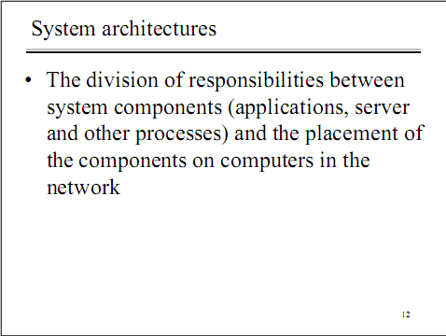
2.2.2 System Architectures

Slide 10
System Architectures
Client- server model
Peer processes

Slide 11
1. Client- server model
The system is structured as a set of processes, called servers, that offer services to the
users , called clients.
The client-server model is usually based on a simple request/reply protocol, implemented with send/receive primitives or RPC or RMI.
The client processes interact with individual server processes in separate host computers in order to access the shared resource that they manage
The server does the work and returns a result or error code if the work could not be performed.
A server can itself request services from other servers, thus the server itself acts like a client.
Eg: Web Server is often a client of Local file server, Apache Database Server is client of HTTP server

Slide 12
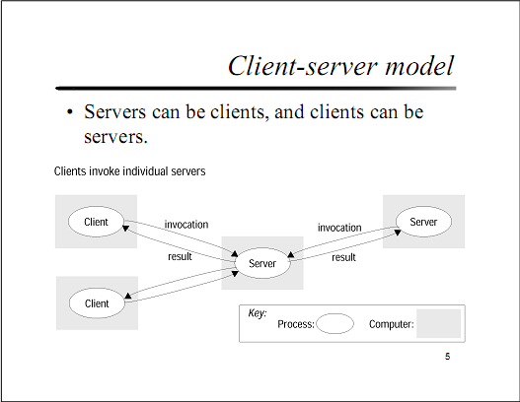

Slide 13
4. Peer processes
All processes(objects) play similar roles without distinction between client or servers.
The aim of peer to peer architecture is to exploit the resources in a large no. of participating computers for fulfillment of given task or activity.
A large number of data objects are shared; any individual computers hold only a small part of the application database.
It distributes shared resources widely.
It shares computing and communication loads.
Ex Napster application for sharing digital Music files

Slide 14
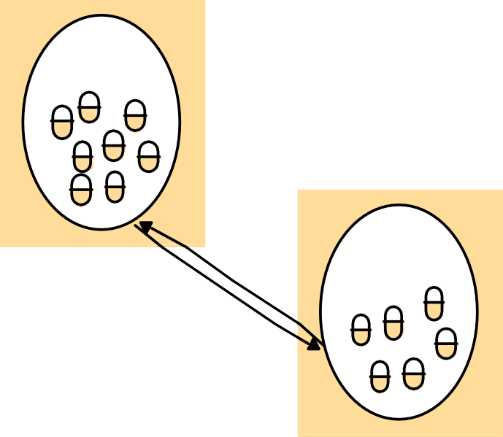








A distributed application based on peer Processes
Peer 2
Peer 1
Application
Application
Sharable
Peer 3
objects
Application
Peer 4
Application
Peers 5 .... N

Slide 15
Variations on the client-server model
Including :-
1 Services provided by multiple servers
2 Proxy Servers and Caches
3 Mobile Code
4 Mobile Agents
Network Computers
Thin Clients
7 Mobile devices and spontaneous networking

Slide 16
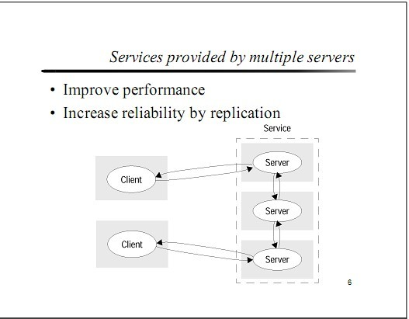
1. Services provided by multiple servers
Services may be implemented as several server processes in separate host computers interacting as necessary to provide a service to client processes.

Slide 17
2. Proxy Servers and Caches
Proxy Servers
proxy servers are used to increase availability and performance of the services by reducing the load on the network and web-server.
Proxy server provides copies(replications) of resources which are managed by other server.

Slide 18
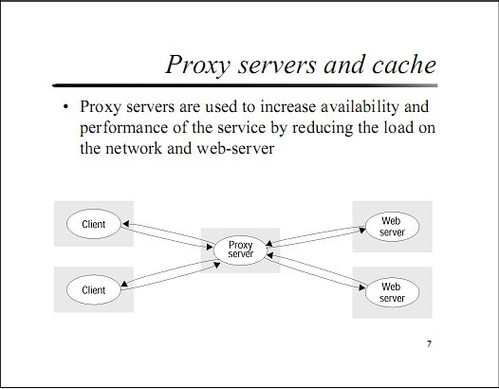

Slide 19
Cache
A store of recently used data objects that is closer to the client process than those remote objects.
When an object is needed by a client process the caching service checks the cache and supplies the objects from there in case of an up-to-date copy is available.
Purpose : is to increase performance and availability by avoiding frequent accesses to remote servers.

Slide 20
3. Mobile code
It is used to refer to code that can be sent from one computer to another and run at the destination.
Example : java applets

Slide 21
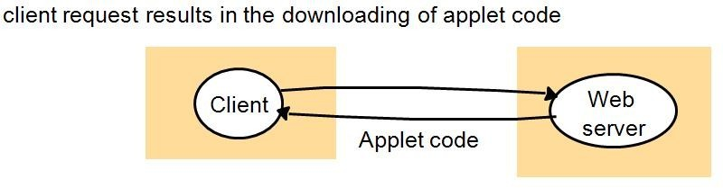
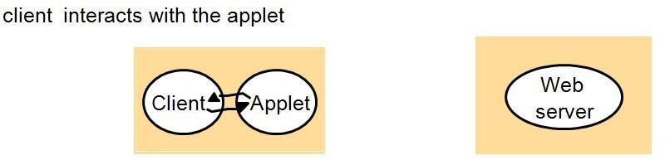
Step : 1--The user running a browser selects a link to an applets whose code is stored on a web server.
The code is downloaded to the browser and runs there.
Step:2-Client interacts with the applet.

Slide 22
Advantages & Disadvantages
Advantages:
Remote invocations are replaced by local ones.
Good interactive response.
Does not suffer from the delays. Disadvantages:
Security threat to the local resources in the destination computer.

Slide 23
4 Mobile Agents
Mobile agent is a running program that travels from one computer to another carrying out a task to someone’s behalf, such as collecting information, eventually returning with the results.(eg: Google form)
Mobile agent is a complete program(including both code & data) that can work independently.
Mobile agent can invoke local resources/data.

Slide 24
Advantages:
Reduce communication cost and time by replacing remote invocation with local ones.
Disadvantages:
Limited applicability
Security threat of the visited sites resources

Slide 25
5 Network Computers
•
Network computers do not store locally operating system or application code.
Downloads its operating system and any applications needed by the user from a remote file server.
Applications run locally but files are managed by a remote file server.
Users can migrate from one network computer to another.
Its processor and memory capacities can be restricted to reduce its cost.
•
•
•
•

Slide 26
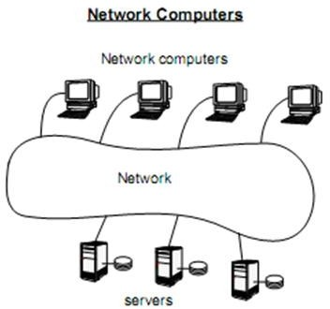

Slide 27
Advantages
The network computers can be simpler, with limited capacity, it does not need even a local hard disk.
User can login from any computers.
No user effort for software management or
administration.

Slide 28
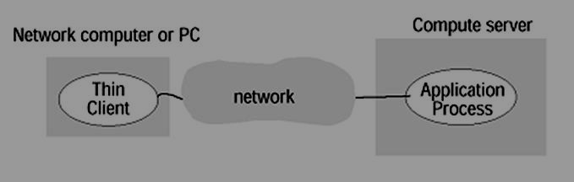
6. Thin Clients
Thin clients do not download code (operating system or application) from the server to run it locally.
All code is run on the server, in parallel for several clients.
The thin client only runs the user interface.
It is same as network computer scheme but instead of downloading the application code into the user’s computer, it runs them on a server machine, compute server.

Slide 29
Disadvantages:
High latencies:- increasing of the delays in highly interactive graphical applications.

Slide 30
7. Mobile Devices and Spontaneous Networking
Mobile Devices : Mobile devices are hardware computing components that move between physical locations.
Spontaneous Network: integrate mobile devices and other devices into a given network.

Slide 31
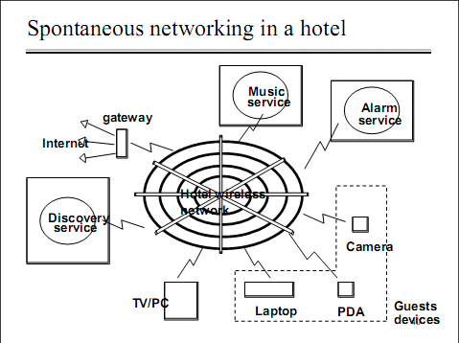

Slide 32
Advantages & Disadvantages
Advantages:
Easy connection to a local network.
Easy integration with local services. Disadvantages:
Limited connectivity
Less Security and privacy

Slide 33
2.2.5. Design Requirements for Distributed Architectures
Including
Performance issues
Quality of services
Use of caching & replication
Dependability issues

Slide 34
Design Requirements for Distributed Architectures
1.Performance Issues
Responsiveness
The speed of a remote invocation depends on:
The load and performance of the server and network
Delays in all the software components (client and server operation systems and middleware, code of the process that implements the service)
Transfer of data is slow
Throughput
Rate at which computational work is done
Fairness
Balancing of Computational Loads
Applets remove load from the server
Use several computers to host a single service

Slide 35
Design Requirements for Distributed Architectures
2.Quality of Service
Reliability & Security
ability of a system to perform and maintain its function in every circumstance
Performance
Ability to meet Timeliness guarantees
Adaptability
the ability of a system to adapt itself efficiently and fast to changed circumstances

Slide 36
Design Requirements for Distributed Architectures
3.Use of Caching and Replication
Cached copies of resources should be kept up-to-date when the resource at a server is updated.
A variety of cache-coherency protocols are used to suit different applications.
Web Caching Protocol
Web browsers and proxy servers cache responses to client requests from web servers
The cache-consistency protocol can provide browsers with fresh copies of the resources held by the web server, but for performance reasons the freshness condition can be relaxed.
A browser or proxy can validate a datum with the server.
Web servers assign approximate expiry times to their resources
The expiry time of the resource and the current time at the server are attached to the response.

Slide 37
Design Requirements for Distributed Architectures
4.Dependability Issues
1) Correctness
2) Fault Tolerance:Dependable applications should continue to function correctly in the presence of faults in hardware, software and networks.
Reliability is achieved through Redundancy
Multiple computers – multiple communication paths
Several replicas of a data item
But redundancy is costlier.
3) Security
Safety (Confidentiality) – absence of incorrect behavior
Integrity – absence of improper system alteration
Availability – readiness for correct service

Slide 38
2.3 Fundamental Models
A model contains only the essential ingredients needed to understand and reason about some aspects of a system’s behavior.
A system model has to address the following:
What are the main entities in the system?
How do they interact?
What are the characteristics that affect their individual and collective behavior?
Purpose
Make explicit all the relevant assumptions about the system we are modeling
Make generalizations concerning what is possible or impossible, given those assumptions.
General purpose algorithms
Desirable properties
Interaction
Communication takes place with delays
Maintaining the same notion of time across all nodes of a distributed system is difficilt.
Failure
Security

Slide 39
Types of FUNDAMENTAL MODELS:
Interaction: Computation occurs within processes; the processes interact by passing messages, resulting in communication (information flow) and coordination (synchronization and ordering of activities) between processes.
Failure: The correct operation of a distributed system is threatened whenever a fault occurs in any of the computers on which it runs (including software faults) or in the network that connects them. Our model defines and classifies the faults.
Security: The security model defines and classifies the type of attacks that may take place, providing a basis for the analysis of threats to a system and for the design of systems that are able to resist them.

Slide 40
Interaction Model
Multiple server processes may cooperate with one another to provide a service;
the examples include , the Domain Name System, which partitions and replicates its data at servers throughout the Internet,
and Sun’s Network Information Service, which keeps replicated copies of password files at several servers in a local area network.

Slide 41
Contd…
Factors affecting interacting processes are,
Communication performance
No global notion of time
Communication over computer network has the following performance characteristics,
Latency(Time taken by first string of bits to reach its destination+delay in accessing n/w+ time taken by os communication services at both ends)
Bandwidth(Amount of data that can be sent in unit time)
Jitter( Variation in packet delivery)

Slide 42
Computer clocks and timing events
Each computer in a distributed system has its own internal clock, which can be used by local processes to obtain the value of the current time.
Two processes running on different computers can associate timestamp with their events.
Even if two processes read their clock at the same time, their local clocks may supply different time. This is because computer clock drift from perfect time and their drift rates differ from one another.
Two variations of interaction model are,
Synchronous Distributed system and
Asynchronous Distributed systems

Slide 43
Synchronous distributed systems
• It has a strong assumption of time
• The time to execute each step of a process has known lower and upper bounds.
• Each message transmitted over a channel is received within a known bounded time.
• Each process has a local clock whose drift rate from real time has a known bound.
Asynchronous distributed system
• It has no assumption about time.
• There is no bound on process execution speeds.
• There is no bound on message transmission delays.A message may be received after an arbitrary long time.
• There is no bound on clock drift rates. The drift rate of a clock is arbitrary.

Slide 44
Event Ordering
In many cases, we are interested in knowing whether an event (sending or receiving a message) at one process occurred before, after, or concurrently with another event at another process.
The execution of a system can be described in terms of events and their ordering despite the lack of accurate clocks.
For example, consider a mailing list with users X, Y, Z, and A.
1. User X sends a message with the subject Meeting.
2. Users Y and Z reply by sending a message with the subject RE: Meeting

Slide 45
Figure: Real-time ordering of events

Slide 46
Contd..
Since clocks cannot be synchronized perfectly across distributed system, Lamport proposed a model of logical time that provides ordering among events in a distributed system.
e.g. in the previous example we know that the message is received after it was sent. Hence a logical order can be derived here,
x sends m1 before y receives m1
Y sends m2(reply) before x receives m2(reply).
We also know that reply are sent only after receiving message.
Hence, we say that “Y receives m1 before sending m2”.

Slide 47
Failure model
In a distributed system both processes and communication channels may fail.
Failure model defines the types of failure,
Omission failure
Arbitrary Failure
Timing Failure

Slide 48
Figure Processes and Channels

Slide 49
Omission and arbitrary failures
Class of failure Affects Description
Fail-stop Process
Crash Process
Omission Channel Send-omission Process Receive-omission Process
Process halts and remains halted. Other processes may detect this state.
Process halts and remains halted. Other processes may not be able to detect this state.
A message inserted in an outgoing message buffer never arrives at the other end’s incoming message buffer.
A process completes asend, but the message is not put
in its outgoing message buffer.
A message is put in a process’s incoming message buffer, but that process does not receive it.
Arbitrary (Byzantine)
Process or Process/channel exhibits arbitrary behaviour: it may
channel
send/transmit arbitrary messages at arbitrary times, commit omissions; a process may stop or take an incorrect step.

Slide 50
Timing failures
Class of Failure | Affects | Description
Clock | Process | Process’s local clock exceeds the bounds on its
 |  | rate of drift from real time.
Performance | Process | Process exceeds the bounds on the interval
 |  | between two steps.
Performance | Channel | A message’s transmission takes longer than the
stated bound.

Slide 51
Masking Failures – Reliability of one-to-one Communication
A service masks a failure, either by hiding it all
together or by converting it into a more acceptable type of failure.
Checksums are used to mask corrupting messages -> a corrupted message is handled as a missing message
Message omission failures can be hidden by re- transmitting messages.
The term reliable communication is defined in terms of validity and integrity as follows:
Validity: any message in the outgoing buffer is eventually delivered to the incoming message buffer
Integrity: the message received is identical to one sent, and no messages are delivered twice.

Slide 52
Security Model
The security of a distributed system can be achieved by securing the processes and the channels used for their interactions and by protecting the objects that they encapsulate against unauthorized access
Protecting Objects: AS shown in the diagram the server manages a collection of objects on behalf of some users. Users can run client programs that send invocations to the servers to perform operations on the objects.
The server carries out the operations specified in each invocation and sends result to client.
Objects are intended to be used in different ways by different users. To support this access rights specify who is allowed to perform the operations of an object .Ex read or write its state

Slide 53
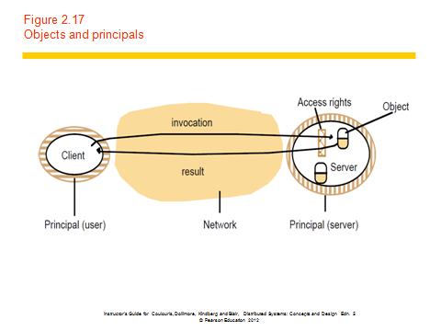
Protecting Objects(cont..)

Slide 54
Security Model(cont..)
The enemy
The enemy is capable of sending any message to any process and reading or copying any message between a pair of processes as shown in diagram
Such attacks can be made simply by using a computer connected to a network to run a program that reads network messages addressed to other computers on the network or a program that make false requests to services and purporting to come from authorized users

Slide 55
Figure 2.18 The enemy
Copy of
m
The enemy
m’
Process
p
m
Process
q
Communication channel
Instructor’s Guide for Coulouris, Dollimore, Kindberg and Blair, Distributed Systems: Concepts and Design Edn. 5 © Pearson Education 2012

Slide 56
Security Model (Cont..)
Secure Channels :Encryption and Authentication are used to build secure channels as a service layer on top of existing communication services. It has the following properties
Each of the processes knows identity of the principal on whose behalf the other process is executing
A secure channel ensures privacy and integrity
Each message includes physical or logical time stamp to prevent messages from being replayed or reordered

Slide 57
Figure 2.19 Secure channels
Principal
A
Principal
B
Process
p
Secure channel
Process
q
Instructor’s Guide for Coulouris, Dollimore, Kindberg and Blair, Distributed Systems: Concepts and Design Edn. 5 © Pearson Education 2012

Slide 58
Thank You

