Slide 1
ORGANIZATIONAL BEHAVIOUR AND PROFESSIONAL COMMUNICATION (18ME661) UNIT3
Unit – III 08 Hours
Motivation: Definition, Theories of motivation- Maslow’s hierarchy of needs theory, Mc-Gregor’s theory X and theory Y, Herzberg’s motivation hygiene theory, David Mc- Clelland’s theory of needs, Victor Vroom’s expectancy theory of motivation.
Management by objectives(MBO), employee recognition programs, employee involvement programs-participative management, representative participation, quality circles, employee stock ownership plans(ESOP’s)

Slide 2
ORGANIZATIONAL BEHAVIOUR AND PROFESSIONAL COMMUNICATION (18ME661) UNIT3
Defining Motivation
motivation is the processes that account for an individual’s intensity, direction, and persistence of effort toward attaining a goal.
The three key elements in definition are intensity, direction, and persistence.

Slide 3
ORGANIZATIONAL BEHAVIOUR AND PROFESSIONAL COMMUNICATION (18ME661) UNIT3
Intensity describes how hard a person tries. This is the element most of us focus on when we talk about motivation.
However, high intensity is unlikely to lead to favourable job-performance outcomes unless the effort is channelled in a direction that benefits the organization. Therefore, we consider the quality of effort as well as its intensity. Effort directed toward, and consistent with, the organization’s goals is the kind of effort we should be seeking.
Finally, motivation has a persistence dimension. This measures how long a person can maintain effort. Motivated individuals stay with a task long enough to achieve their goal.

Slide 4
ORGANIZATIONAL BEHAVIOUR AND PROFESSIONAL COMMUNICATION (18ME661) UNIT3
Early Theories of Motivation
Maslow’s hierarchy of needs theory.
Mc-Gregor’s theory X and theory Y.
Herzberg’s motivation hygiene theory.
David Mc- Clelland’s theory of needs.
Victor Vroom’s expectancy theory of motivation.

Slide 5
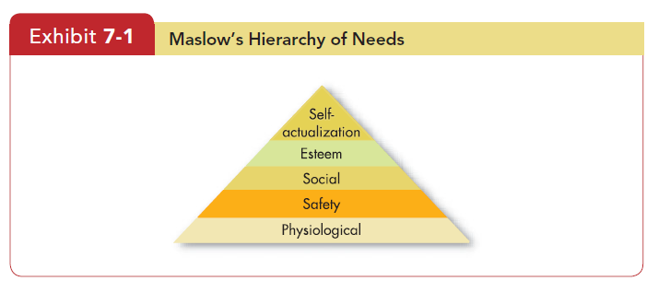
ORGANIZATIONAL BEHAVIOUR AND PROFESSIONAL COMMUNICATION (18ME661) UNIT3
Hierarchy of Needs Theory

Slide 6
ORGANIZATIONAL BEHAVIOUR AND PROFESSIONAL COMMUNICATION (18ME661) UNIT3
The best-known theory of motivation is Abraham Maslow’s hierarchy of needs .Maslow hypothesized that within every human being, there exists a hierarchy offive needs:
Physiological. Includes hunger, thirst, shelter, and other bodily needs.
2. Safety. Security and protection from physical and emotional harm.
3. Social. Affection, belongingness, acceptance, and friendship.
4. Esteem. Internal factors such as self-respect, autonomy, and achievement, and external factors such as status, recognition, and attention.
5. Self-actualization. Drive to become what we are capable of becoming; includes growth, achieving our potential, and self-fulfilment.

Slide 7
ORGANIZATIONAL BEHAVIOUR AND PROFESSIONAL COMMUNICATION (18ME661) UNIT3
hierarchy of needs Abraham Maslow’s hierarchy of five needs—physiological,safety, social, esteem, and self-actualization—in which, as each need is substantially satisfied, the next need becomes dominant.
So if you want to motivate someone, according to Maslow, you need to
understand what level of the hierarchy that person is currently on and focus on satisfying needs at or above that level, moving up the steps in Exhibit 7-1 .

Slide 8
ORGANIZATIONAL BEHAVIOUR AND PROFESSIONAL COMMUNICATION (18ME661) UNIT3
lower-order needs Needs that are satisfied externally, such as physiological and safety needs.
Social, esteem, and self-actualization are higher-order needs . Higher-order needs are satisfied internally (within the person), whereas lower-order needs are predominantly satisfied externally (by things such as pay, union contracts, and tenure).

Slide 9
ORGANIZATIONAL BEHAVIOUR AND PROFESSIONAL COMMUNICATION (18ME661) UNIT3
1. Physiological needs. The most basic level in the hierarchy, the physiological needs, generally corresponds to the unlearned primary needs discussed earlier. The needs of hunger, thirst, sleep, and sex are some examples. According to the theory, once these basic needs are satisfied, they no longer motivate. For example, a starving person will strive to obtain a carrot that is within reach. However, after eating his or her fill of carrots, the person will not strive to obtain another one and will be motivated only by the next higher level of needs.

Slide 10
ORGANIZATIONAL BEHAVIOUR AND PROFESSIONAL COMMUNICATION (18ME661) UNIT3
2. Safety needs. This second level of needs is roughly equivalent to the security need. Maslow stressed emotional as well as physical safety. The whole organism may become a safety-seeking mechanism. Yet, as is true of the physiological needs, once these safety needs are satisfied, they no longer motivate.

Slide 11
ORGANIZATIONAL BEHAVIOUR AND PROFESSIONAL COMMUNICATION (18ME661) UNIT3
3. Love needs. This third, or intermediate, level of needs loosely corresponds to the
affection and affiliation needs. Like Freud, Maslow seems guilty of poor choice of wording to identify his levels. His use of the word love has many misleading connotations, such as sex, which is actually a physiological need. Perhaps a more appropriate word describing this level would be belongingness or social needs.

Slide 12
ORGANIZATIONAL BEHAVIOUR AND PROFESSIONAL COMMUNICATION (18ME661) UNIT3
4. Esteem needs. The esteem level represents the higher needs of humans. The needs for power, achievement, and status can be considered part of this level. Maslow carefully pointed out that the esteem level contains both self-esteem and esteem from others.

Slide 13
ORGANIZATIONAL BEHAVIOUR AND PROFESSIONAL COMMUNICATION (18ME661) UNIT3
5. Needs for self-actualization. Maslow’s major contribution, he portrays this level as the culmination of all the lower, intermediate, and higher needs of humans. People who have become self-actualized are self-fulfilled and have realized all their potential. In effect, self-actualization is the person’s motivation to transform perception of self into reality.

Slide 14
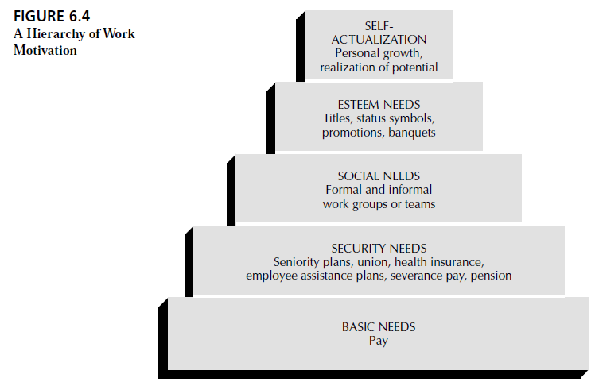
ORGANIZATIONAL BEHAVIOUR AND PROFESSIONAL COMMUNICATION (18ME661) UNIT3

Slide 15
ORGANIZATIONAL BEHAVIOUR AND PROFESSIONAL COMMUNICATION (18ME661) UNIT3
Mc-Gregor’s Theory X and Theory Y
Douglas McGregor proposed two distinct views of human beings: one basically negative, labelled Theory X, and the other basically positive, labelled Theory Y.
Under Theory X , managers believe employees inherently dislike work and must therefore be directed or even coerced into performing it.
Under Theory Y , in contrast, managers assume employees can view work as being as natural as rest or play, and therefore the average person can learn to accept, and even seek, responsibility.

Slide 16
ORGANIZATIONAL BEHAVIOUR AND PROFESSIONAL COMMUNICATION (18ME661) UNIT3
Therefore, he proposed such ideas as participative decision making, responsible and challenging jobs, and good group relations to maximize an employee’s job motivation.
Theory X represents the traditional authoritarian style of leadership and Theory Y represents an enlightened, humanistic style.

Slide 17
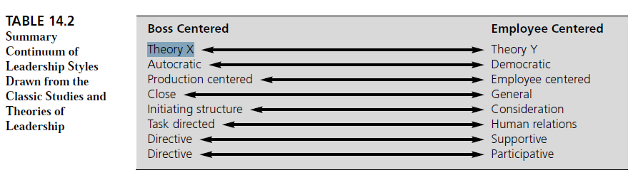
ORGANIZATIONAL BEHAVIOUR AND PROFESSIONAL COMMUNICATION (18ME661) UNIT3

Slide 18
ORGANIZATIONAL BEHAVIOUR AND PROFESSIONAL COMMUNICATION (18ME661) UNIT3
Theory X The assumption that employees dislike work, are lazy, dislike responsibility, and must be coerced to perform.
Theory Y The assumption that employees like work, are creative, seek responsibility, and can exercise self direction.

Slide 19
ORGANIZATIONAL BEHAVIOUR AND PROFESSIONAL COMMUNICATION (18ME661) UNIT3
Herzberg’s motivation hygiene theory
Unlike Maslow, Herzberg many years ago conducted a widely reported motivational study on about 200 accountants and engineers employed by firms in
and around Pittsburgh, Pennsylvania. He used the critical incident method of obtaining data for analysis. The professional subjects in the study were essentially asked two questions:
(1) When did you feel particularly good about your job—what turned you on; and (2) When did you feel exceptionally bad about your job—what turned you off?

Slide 20
ORGANIZATIONAL BEHAVIOUR AND PROFESSIONAL COMMUNICATION (18ME661) UNIT3
Tabulating these reported good and bad feelings, Herzberg concluded that job satisfiers are related to job content and that job dissatisfiers are allied to job context. Herzberg labelled the satisfiers motivators, and he called the dissatisfiers hygiene factors. The term hygiene refers (as it does in the health field) to factors that are preventive; in Herzberg’s theory the hygiene factors are those that prevent dissatisfaction. Taken together, the motivators and the hygiene factors have become known as Herzberg’s two-factor theory of motivation.

Slide 21
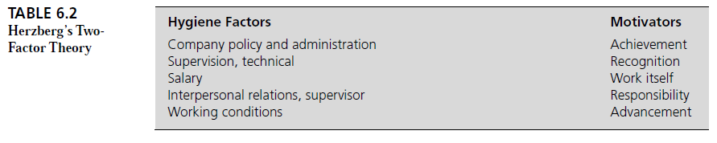
ORGANIZATIONAL BEHAVIOUR AND PROFESSIONAL COMMUNICATION (18ME661) UNIT3

Slide 22
ORGANIZATIONAL BEHAVIOUR AND PROFESSIONAL COMMUNICATION (18ME661) UNIT3
Two-factor theory A theory that relates intrinsic factors to job satisfaction
and associates extrinsic factors with dissatisfaction. Also called motivation hygiene theory.
Hygiene factors Factors—such as company policy and administration,
supervision, and salary—that, when adequate in a job, placate workers.
When these factors are adequate, people will not be dissatisfied.

Slide 23
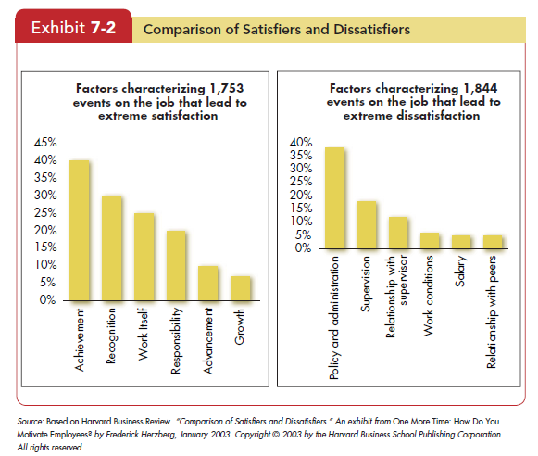
ORGANIZATIONAL BEHAVIOUR AND PROFESSIONAL COMMUNICATION (18ME661) UNIT3

Slide 24
ORGANIZATIONAL BEHAVIOUR AND PROFESSIONAL COMMUNICATION (18ME661) UNIT3
David Mc- Clelland’s theory of needs
McClelland’s theory of needs A theory that states achievement, power, and affiliation are three important needs that help explain motivation.
need for achievement (nAch) The drive to excel, to achieve in relationship to a set of standards, and to strive to succeed.
need for power (nPow) The need to make others behave in a way in which they would not have behaved otherwise.
need for affiliation (nAff) The desire for friendly and close interpersonal relationships.

Slide 25
ORGANIZATIONAL BEHAVIOUR AND PROFESSIONAL COMMUNICATION (18ME661) UNIT3
First, when jobs have a high degree of personal responsibility and feedback and an intermediate degree of risk, high achievers are strongly motivated. They are successful in entrepreneurial activities such as running their own businesses, for example, and managing self-contained units within large organizations.
Second, a high need to achieve does not necessarily make someone a good manager, especially in large organizations. People with a high achievement need are interested in how well they do personally, and not in influencing others to do well.
HighnAch salespeople do not necessarily make good sales managers, and the good general manager in a large organization does not typically have a high need
to achieve.

Slide 26
ORGANIZATIONAL BEHAVIOUR AND PROFESSIONAL COMMUNICATION (18ME661) UNIT3
Third, needs for affiliation and power tend to be closely related to managerial success. The best managers are high in their need for power and low in their need for affiliation. In fact, a high power motive may be a requirement for managerial effectiveness.

Slide 27
ORGANIZATIONAL BEHAVIOUR AND PROFESSIONAL COMMUNICATION (18ME661) UNIT3
Victor Vroom’s expectancy theory of motivation.
expectancy theory A theory that says that the strength of a tendency to act in a certain way depends on the strength of an expectation that the act will be followed by a given outcome and on the attractiveness of that outcome to the individual.
In more practical terms, employees will be motivated to exert a high level of effort when they believe it will lead to a good performance appraisal; that a good appraisal will lead to organizational rewards such as bonuses, salary increases, or promotions; and that the rewards will satisfy the employees’ personal goals.

Slide 28
ORGANIZATIONAL BEHAVIOUR AND PROFESSIONAL COMMUNICATION (18ME661) UNIT3
Effort–performance relationship. The probability perceived by the individual that exerting a given amount of effort will lead to performance.
2. Performance–reward relationship. The degree to which the
individual believes performing at a particular level will lead to the
attainment of a desired outcome.
3. Rewards–personal goals relationship. The degree to which organizational
rewards satisfy an individual’s personal goals or needs and the attractiveness
of those potential rewards for the individual.

Slide 29
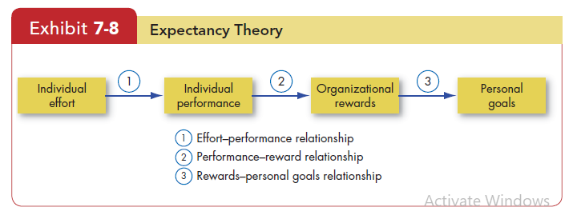
ORGANIZATIONAL BEHAVIOUR AND PROFESSIONAL COMMUNICATION (18ME661) UNIT3

Slide 30
ORGANIZATIONAL BEHAVIOUR AND PROFESSIONAL COMMUNICATION (18ME661) UNIT3
Management by objectives(MBO)
A more systematic way to utilize goal-setting is with management by
objectives (MBO) , which emphasizes participatively set goals that are tangible, verifiable, and measurable.
The organization’s overall objectives are translated into specific objectives for each level (divisional, departmental, individual). But because lower-unit managers jointly participate in setting their own goals, MBO works from the bottom up as well as from the top down. The result is a hierarchy that links objectives at one level to those at the next. And for the individual employee, MBO provides specific personal performance objectives.

Slide 31
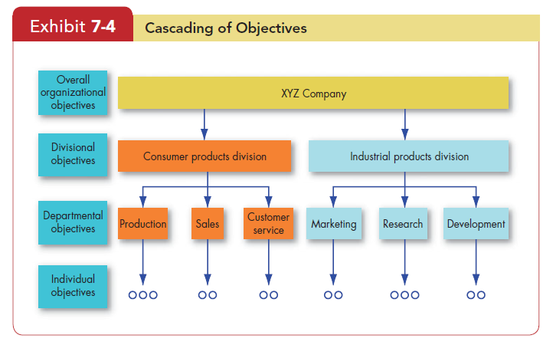
ORGANIZATIONAL BEHAVIOUR AND PROFESSIONAL COMMUNICATION (18ME661) UNIT3

Slide 32
ORGANIZATIONAL BEHAVIOUR AND PROFESSIONAL COMMUNICATION (18ME661) UNIT3
Four ingredients are common to MBO programs: goal specificity, participation in decision making (including the setting of goals or objectives), an explicit time period, and performance feedback.
You’ll find MBO programs in many business, health care, educational, government, and non-profit organizations. Their popularity does not mean they always work. When MBO fails, the culprits tend to be unrealistic expectations, lack of commitment by top management, and inability or unwillingness to allocate rewards based on goal accomplishment.

Slide 33
ORGANIZATIONAL BEHAVIOUR AND PROFESSIONAL COMMUNICATION (18ME661) UNIT3
Employee Recognition Programs
Rewards are intrinsic in the form of employee recognition programs and extrinsic in the form of compensation systems.
Employee recognition programs range from a spontaneous and private thank-you to widely publicized formal programs in which specific types of behaviour are encouraged and the procedures for attaining recognition are clearly identified. Some research suggests financial incentives may be more motivating in the short term, but in the long run it’s nonfinancial incentives.
Employees and managers give “Hero Grams” and “Caught in the Act” cards to colleagues for exceptional accomplishments at work.
https://www.youtube.com/watch?v=SGUnguePLk4

Slide 34
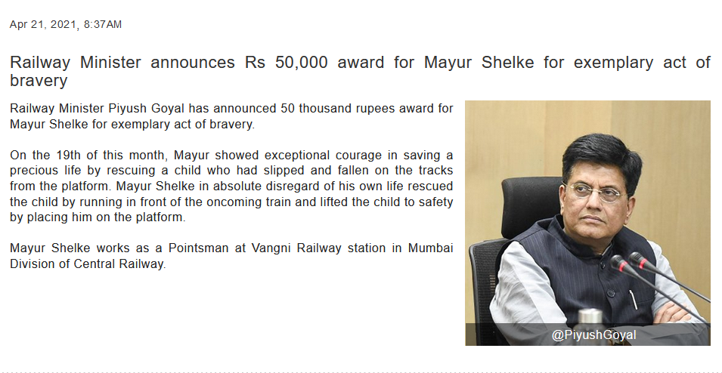
ORGANIZATIONAL BEHAVIOUR AND PROFESSIONAL COMMUNICATION (18ME661) UNIT3

Slide 35
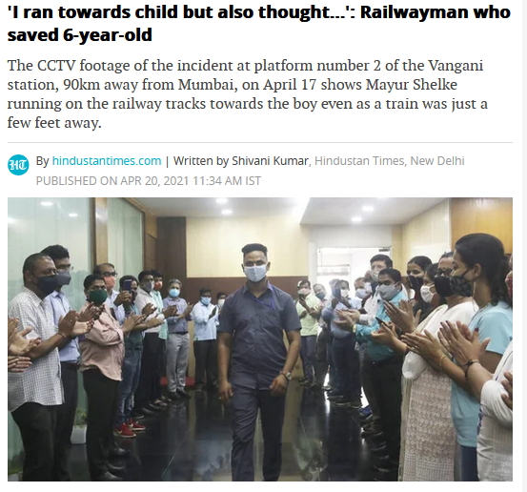
ORGANIZATIONAL BEHAVIOUR AND PROFESSIONAL COMMUNICATION (18ME661) UNIT3

Slide 36
ORGANIZATIONAL BEHAVIOUR AND PROFESSIONAL COMMUNICATION (18ME661) UNIT3
Employee Involvement
Employee involvement is a participative process that uses employee’s input to increase their commitment to the organization’s success.
The logic is that if we engage workers in decisions that affect them and increase their autonomy and control over their work lives, they will become more motivated, more committed to the organization, more productive, and more satisfied with their jobs.
Employee involvement programs differ among countries.

Slide 37
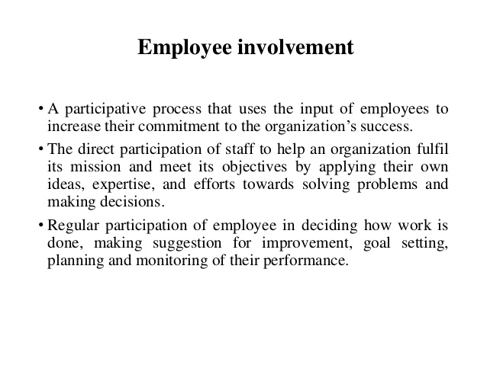
ORGANIZATIONAL BEHAVIOUR AND PROFESSIONAL COMMUNICATION (18ME661) UNIT3

Slide 38
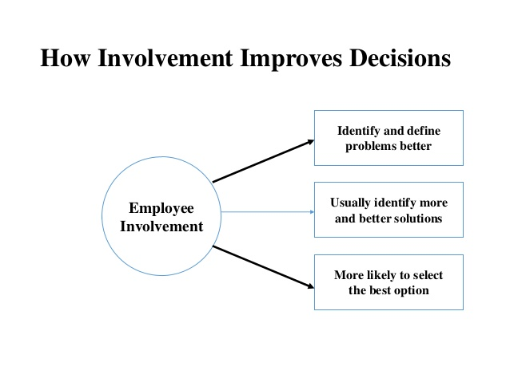
ORGANIZATIONAL BEHAVIOUR AND PROFESSIONAL COMMUNICATION (18ME661) UNIT3

Slide 39
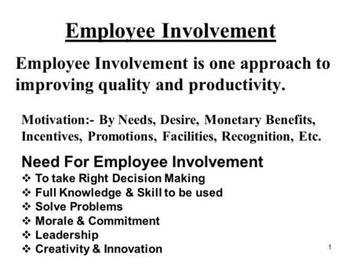
ORGANIZATIONAL BEHAVIOUR AND PROFESSIONAL COMMUNICATION (18ME661) UNIT3

Slide 40
ORGANIZATIONAL BEHAVIOUR AND PROFESSIONAL COMMUNICATION (18ME661) UNIT3
Examples of Employee Involvement Programs
Participative Management
Representative Management
Quality circles
Employee stock ownership plans

Slide 41
ORGANIZATIONAL BEHAVIOUR AND PROFESSIONAL COMMUNICATION (18ME661) UNIT3
Participative Management
Common to all participative management programs is joint decision making, in which subordinates share a significant degree of decision-making power with their immediate superiors. Participative management has, at times, been promoted as a panacea for poor morale and low productivity. But for it to work, employees must be engaged in issues relevant to their interests so they’ll be motivated, they must have the competence and knowledge to make a useful contribution, and trust and confidence must exist among all parties.

Slide 42
ORGANIZATIONAL BEHAVIOUR AND PROFESSIONAL COMMUNICATION (18ME661) UNIT3
Organizations that institute participative management do have higher stock returns, lower turnover rates, and higher estimated labour productivity, although these effects are typically not large.

Slide 43
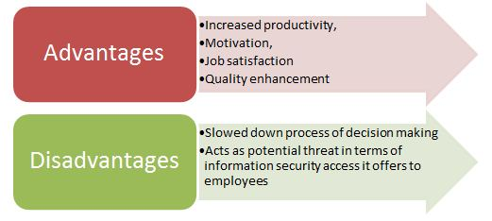
ORGANIZATIONAL BEHAVIOUR AND PROFESSIONAL COMMUNICATION (18ME661) UNIT3

Slide 44
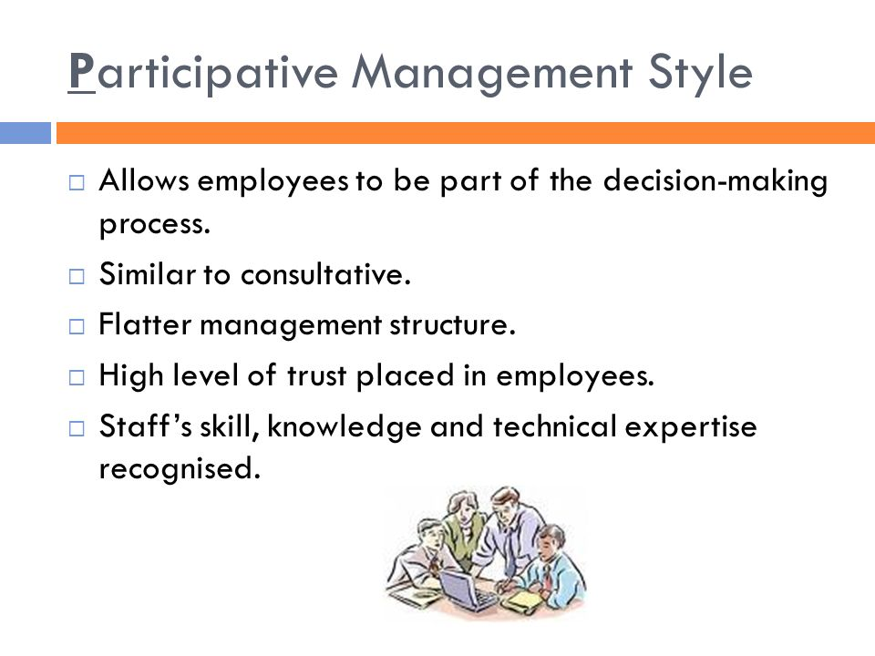
ORGANIZATIONAL BEHAVIOUR AND PROFESSIONAL COMMUNICATION (18ME661) UNIT3

Slide 45
ORGANIZATIONAL BEHAVIOUR AND PROFESSIONAL COMMUNICATION (18ME661) UNIT3
Representative Participation/Management
Almost every country in western Europe requires companies to practice representative participation , called “the most widely legislated form of employee involvement around the world.
Its goal is to redistribute power within an organization, putting labour on a more equal footing with the interests of management and stockholders by letting workers be represented by a small group of employees who actually participate.
The two most common forms are works councils and board representatives.

Slide 46
ORGANIZATIONAL BEHAVIOUR AND PROFESSIONAL COMMUNICATION (18ME661) UNIT3
Works councils are groups of nominated or elected employees who must
be consulted when management makes decisions about employees.
Board representatives are employees who sit on a company’s board of directors and represent employees’ interests.
The influence of representative participation on working employees seems to be minimal. Works councils are dominated by management and have little impact on employees or the organization.

Slide 47
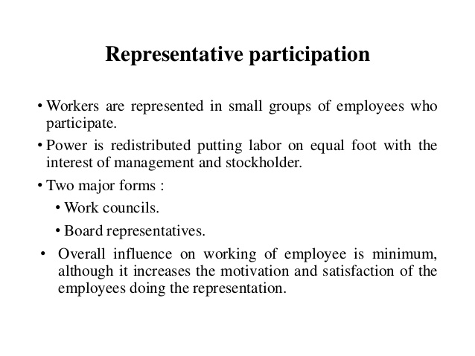
ORGANIZATIONAL BEHAVIOUR AND PROFESSIONAL COMMUNICATION (18ME661) UNIT3

Slide 48
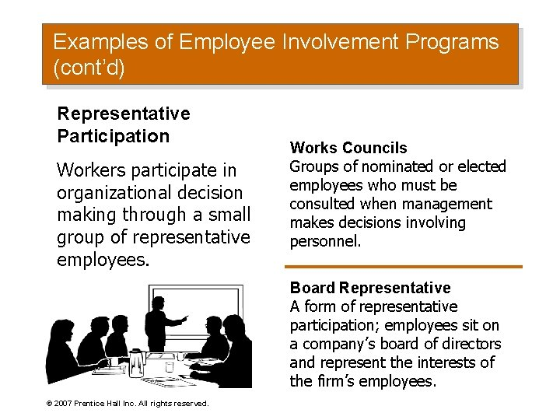
ORGANIZATIONAL BEHAVIOUR AND PROFESSIONAL COMMUNICATION (18ME661) UNIT3

Slide 49
ORGANIZATIONAL BEHAVIOUR AND PROFESSIONAL COMMUNICATION (18ME661) UNIT3
Quality Circles
A quality circle or quality control circle is a group of workers who do the same or similar work, who meet regularly to identify, analyze and solve work-related problems. It consists of minimum three and maximum twelve members in number. Normally small in size, the group is usually led by a supervisor or manager and presents its solutions to management; where possible, workers implement the solutions themselves in order to improve the performance of the organization and motivate employees. Quality circles were at their most popular during the 1980s, but continue to exist in the form of Kaizen groups and similar worker participation schemes

Slide 50
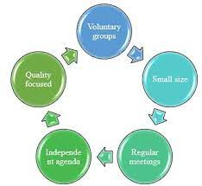
ORGANIZATIONAL BEHAVIOUR AND PROFESSIONAL COMMUNICATION (18ME661) UNIT3

Slide 51
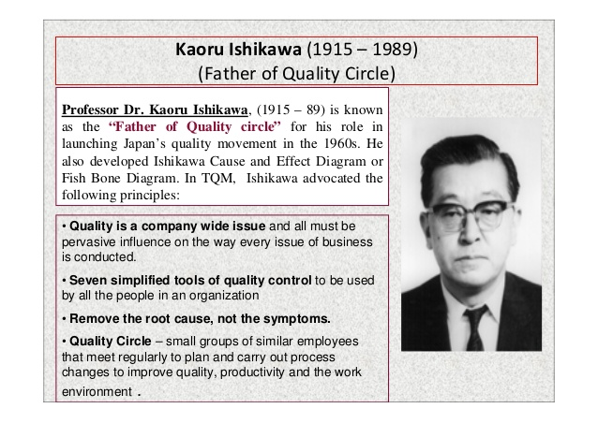
ORGANIZATIONAL BEHAVIOUR AND PROFESSIONAL COMMUNICATION (18ME661) UNIT3

Slide 52
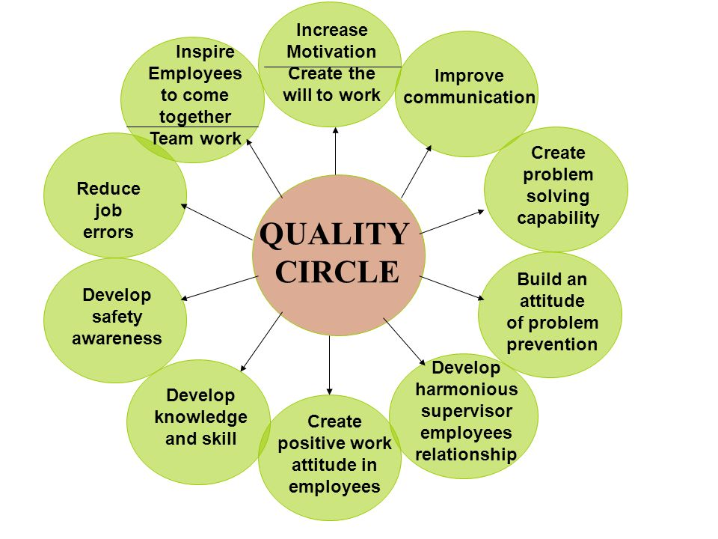
ORGANIZATIONAL BEHAVIOUR AND PROFESSIONAL COMMUNICATION (18ME661) UNIT3

Slide 53
ORGANIZATIONAL BEHAVIOUR AND PROFESSIONAL COMMUNICATION (18ME661) UNIT3
Employee stock ownership plans(ESOP)
An employee stock ownership plan (ESOP) is a company-established benefit plan in which employees acquire stock, often at below-market prices, as part of their benefits.
Research on ESOPs indicates they increase employee satisfaction and innovation. But their impact on performance is less clear. ESOPs have the potential to increase employee job satisfaction and work motivation, but employees need to psychologically experience ownership. That is, in addition to their financial stake in the company, they need to be kept regularly informed of the status of the business and have the opportunity to influence it in order to significantly improve the organization’s performance.

Slide 54
ORGANIZATIONAL BEHAVIOUR AND PROFESSIONAL COMMUNICATION (18ME661) UNIT3
ESOP plans for top management can reduce unethical behaviour. CEOs are more likely to manipulate firm earnings reports to make themselves look good in the short run when they don’t have an ownership share, even though this manipulation will eventually lead to lower stock prices. However, when CEOs own a large amount of stock, they report earnings accurately because they don’t want the negative consequences of declining stock prices.

Slide 55
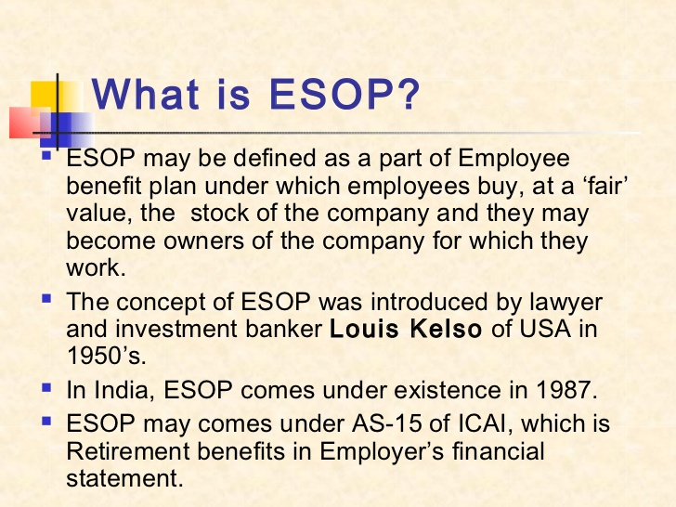
ORGANIZATIONAL BEHAVIOUR AND PROFESSIONAL COMMUNICATION (18ME661) UNIT3

Slide 56
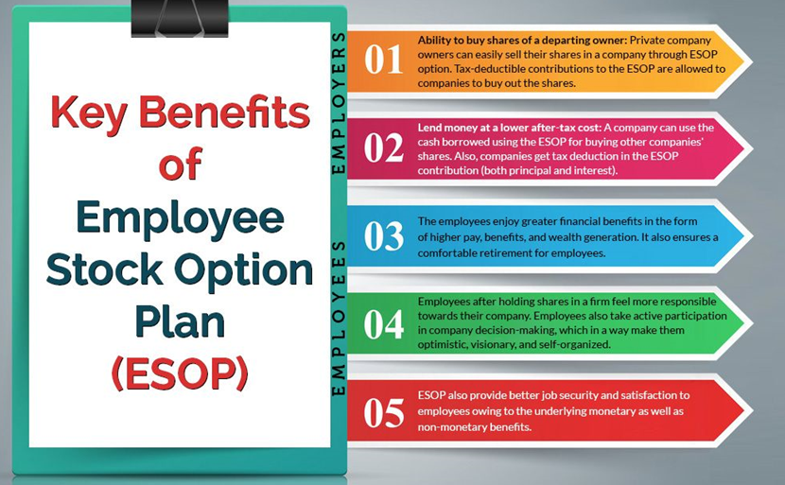
ORGANIZATIONAL BEHAVIOUR AND PROFESSIONAL COMMUNICATION (18ME661) UNIT3

Slide 57
ORGANIZATIONAL BEHAVIOUR AND PROFESSIONAL COMMUNICATION (18ME661) UNIT3
https://www.moneycontrol.com/company-facts/infosys/history/IT

