Slide 1
ORGANIZATIONAL BEHAVIOUR AND PROFESSIONAL COMMUNICATION (18ME661) UNIT4
Unit – IV 08Hour
Groups: Definition, classification of groups, five stage group development model,
factors affecting group formation, norms, status, size, composition, cohesiveness ,group processes, group tasks, group decision making.
Communication: Definition, functions of communication, Direction of communication:
downward, upward and lateral communication, Interpersonal Communication: Oral,
Written, non verbal communication,
organizational communication: formal vs. informal networks, The grapevine,
Computer aided communication, choice of communication channel, Barriers to effective communication
Self learning topics: Group think and group shift, recent trends in electronics
communication.

Slide 2
ORGANIZATIONAL BEHAVIOUR AND PROFESSIONAL COMMUNICATION (18ME661) UNIT4
Group Two or more individuals, interacting and interdependent, who have come together to achieve particular objectives. Groups can be either
formal or informal.
Formal group A designated work group defined by an organization’s
Structure.
informal group A group that is neither formally structured nor organizationally determined; such a group appears in response to the need for social contact.

Slide 3
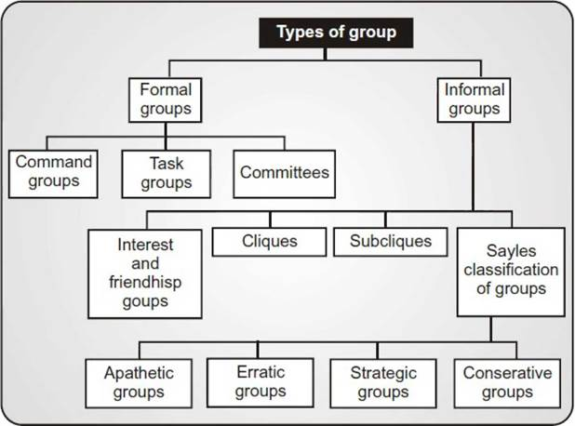
ORGANIZATIONAL BEHAVIOUR AND PROFESSIONAL COMMUNICATION (18ME661) UNIT4
Classification of groups

Slide 4
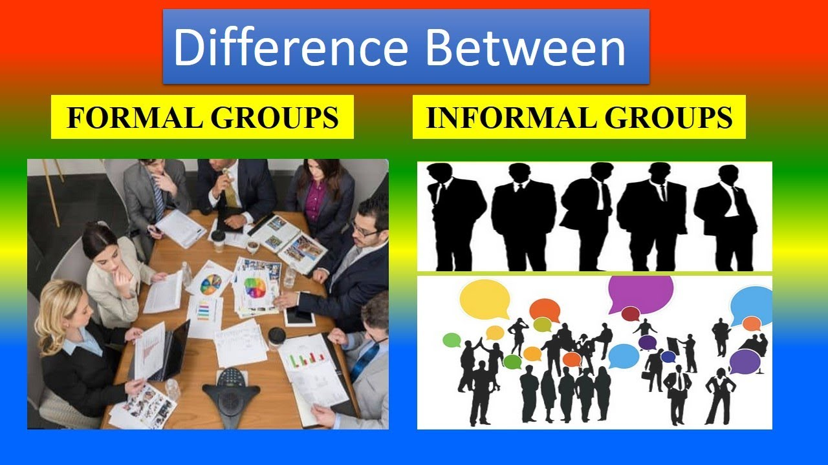
ORGANIZATIONAL BEHAVIOUR AND PROFESSIONAL COMMUNICATION (18ME661) UNIT4

Slide 5
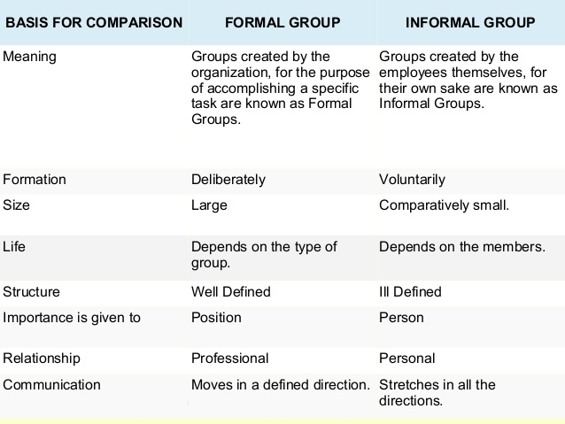
ORGANIZATIONAL BEHAVIOUR AND PROFESSIONAL COMMUNICATION (18ME661) UNIT4

Slide 6
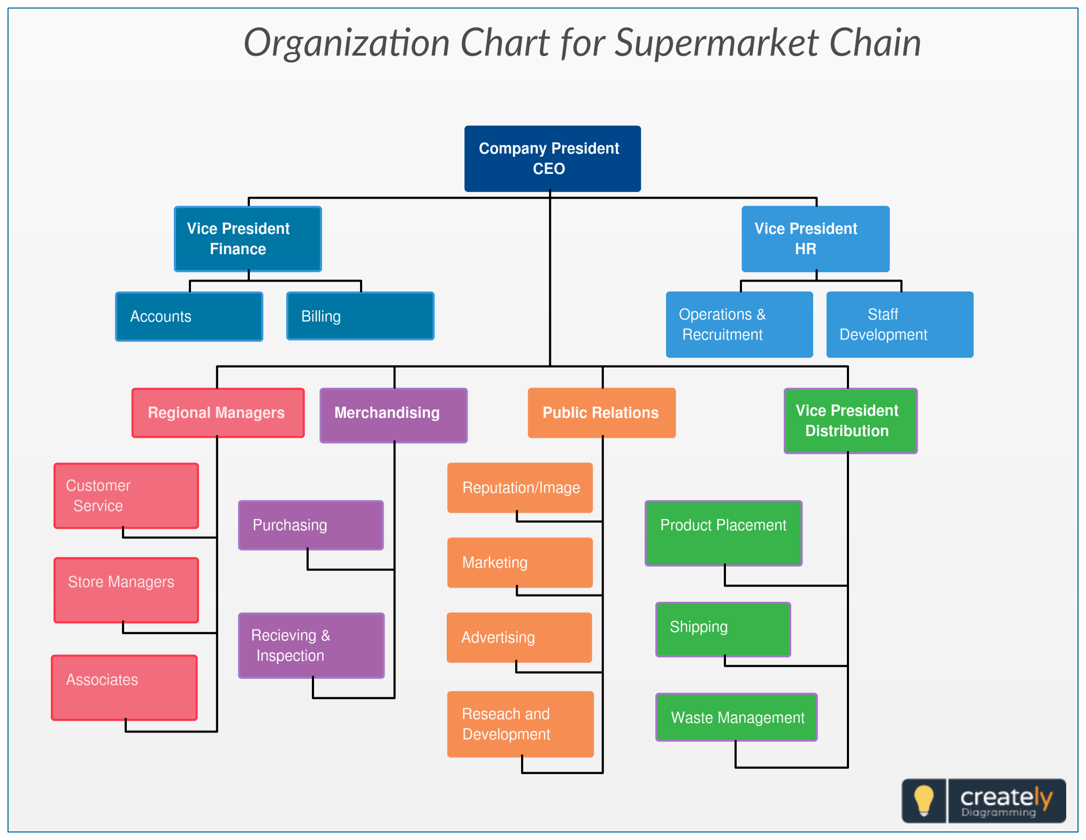
ORGANIZATIONAL BEHAVIOUR AND PROFESSIONAL COMMUNICATION (18ME661) UNIT4

Slide 7
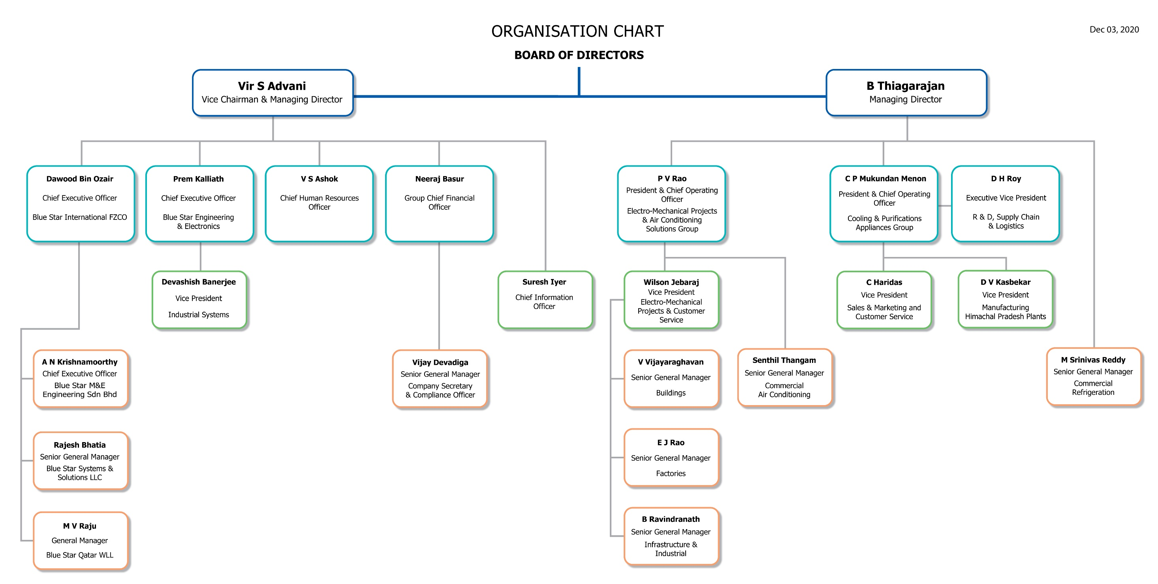
ORGANIZATIONAL BEHAVIOUR AND PROFESSIONAL COMMUNICATION (18ME661) UNIT4

Slide 8
ORGANIZATIONAL BEHAVIOUR AND PROFESSIONAL COMMUNICATION (18ME661) UNIT4
Command Group: A group composed of the individuals who report directly to a
Given manager. Ex: An elementary school principal and her 18 teachers form a command group.
Task group: Those working together to complete a job task. However a task group’s boundaries are not limited to its immediate hierarchical superior. It can cross command relationships. Ex: If a college student is accused of a campus crime, it may require communication and coordination among the dean of academic affairs, the dean of students, the registrar, the director of security, and the student’s affairs. Such a formation would constitute a task group.

Slide 9
ORGANIZATIONAL BEHAVIOUR AND PROFESSIONAL COMMUNICATION (18ME661) UNIT4
Interest Group: Those working together to attain a specific objective with which each is concerned. Ex: Employees who band together to have their vacation schedules altered, to support a peer who has been fired, or to seek improved work conditions represent the formation of a united body to further their common interest.
Friendship groups: Those brought together because they share one or more common characteristics. Ex: Social alliances, which frequently extend outside the work situation, can be based on similar age or ethnic heritage, support for a cricket team, or holding of similar political views, to name just a few such characteristics.

Slide 10
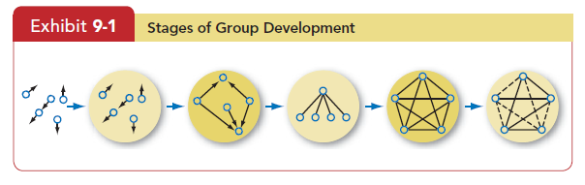
ORGANIZATIONAL BEHAVIOUR AND PROFESSIONAL COMMUNICATION (18ME661) UNIT4
Five stage group development model
The five-stage group-development model characterizes groups as proceeding through the distinct stages of prestage1 1)forming, 2)storming, 3)norming, 4)performing, and 5)adjourning.
Prestage1 Forming Storming Norming Performing Adjourning

Slide 11
ORGANIZATIONAL BEHAVIOUR AND PROFESSIONAL COMMUNICATION (18ME661) UNIT4
The five distinct stages groups go through: forming, storming, norming, performing, and adjourning.
The first stage, forming stage , is characterized by a great deal of uncertainty about the group’s purpose, structure, and leadership. Members “test the waters” to determine what types of behaviours are acceptable. This stage is complete when members have begun to think of themselves as part of a group.
The storming stage is one of intragroup conflict. Members accept the existence of the group but resist the constraints it imposes on individuality.
There is conflict over who will control the group. When this stage is complete, there will be a relatively clear hierarchy of leadership within the group.

Slide 12
ORGANIZATIONAL BEHAVIOUR AND PROFESSIONAL COMMUNICATION (18ME661) UNIT4
In the third stage, close relationships develop and the group demonstrates
cohesiveness. There is now a strong sense of group identity and camaraderie. This norming stage is complete when the group structure solidifies and the group has assimilated a common set of expectations of what defines correct member behaviour.
The fourth stage is performing . The structure at this point is fully functional and accepted. Group energy has moved from getting to know and understand each other to performing the task at hand.

Slide 13
ORGANIZATIONAL BEHAVIOUR AND PROFESSIONAL COMMUNICATION (18ME661) UNIT4
For permanent work groups, performing is the last stage in development. However, for temporary committees, teams, task forces, and similar groups that have a limited task to perform, the adjourning stage is for wrapping up activities and preparing to disband. Some group members are upbeat, basking in the group’s accomplishments. Others may be depressed over the loss of camaraderie and friendships gained during the work group’s life.

Slide 14
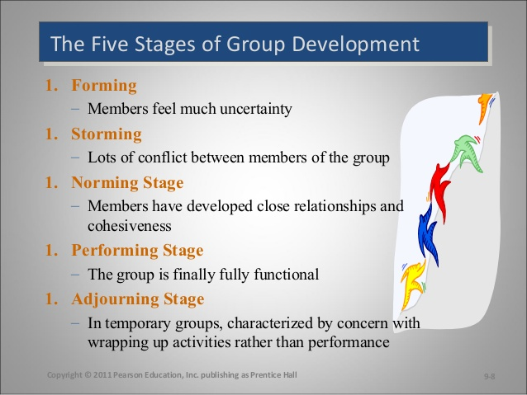
ORGANIZATIONAL BEHAVIOUR AND PROFESSIONAL COMMUNICATION (18ME661) UNIT4

Slide 15
ORGANIZATIONAL BEHAVIOUR AND PROFESSIONAL COMMUNICATION (18ME661) UNIT4
Factors affecting group formation:
Formal leadership
Roles
Norms
Status
Group size
Composition of the group
Degree of group cohesiveness

Slide 16
ORGANIZATIONAL BEHAVIOUR AND PROFESSIONAL COMMUNICATION (18ME661) UNIT4
Formal Leadership:
Almost every workgroup has a formal leader.
He or she is typically identified by titles such as unit or Department manager, supervisor, foreman, project leader, task force head, or committee chair.
This leader can play important role in group’s success.

Slide 17
ORGANIZATIONAL BEHAVIOUR AND PROFESSIONAL COMMUNICATION (18ME661) UNIT4
Roles:
A set of expected behaviour patterns attributed to someone occupying a given position in a social unit.
Role identity: Certain attitudes and behaviours consistent with a role.
Role perception: An individual’s view of how he or she is supposed to act in a given situation.
Role expectations: How others believe a person should act in a given situation.
Role Conflict: A situation in which an individual is confronted by divergent role expectations.

Slide 18
ORGANIZATIONAL BEHAVIOUR AND PROFESSIONAL COMMUNICATION (18ME661) UNIT4
Norms:
Acceptable standards of behaviour within a group that are shared by the group’s members. Norms tell members what they ought and ought not to do under certain circumstances.
Did you ever notice that golfers don’t speak while their partners are putting on the green.
Employees don’t criticize their bosses in public?

Slide 19
ORGANIZATIONAL BEHAVIOUR AND PROFESSIONAL COMMUNICATION (18ME661) UNIT4
Common classes of Norms:
Performance Norms: Work groups typically provide their members with explicit cues on how hard they should work, how to get the job done, their level of output, appropriate level of tardiness, and the like.
2. Appearance Norms: This includes things like appropriate dress, loyalty to
the work group or organization, when to look busy, and when it is
acceptable to goof off, formal dress codes.

Slide 20
ORGANIZATIONAL BEHAVIOUR AND PROFESSIONAL COMMUNICATION (18ME661) UNIT4
3. Social arrangement Norms: These norms come from informal work groups and primarily regulate social interactions within the group. With whom group members eat lunch, friendships on and off the job, social games, and the like are influences by these norms.
4. Allocation of resources Norms: These norms can originate in the group or in the organisation and cover things like pay, assignment of difficult jobs, and allocation of new tools and equipment.

Slide 21
ORGANIZATIONAL BEHAVIOUR AND PROFESSIONAL COMMUNICATION (18ME661) UNIT4
Status —a socially defined position or rank given to groups or group members by others—permeates every society. Even the smallest group will develop roles, rights, and rituals to differentiate its members. Status is a significant motivator and has major behavioural consequences when individuals perceive a disparity between what they believe their status is and what others perceive it to be.

Slide 22
ORGANIZATIONAL BEHAVIOUR AND PROFESSIONAL COMMUNICATION (18ME661) UNIT4
What Determines Status? According to status characteristics theory , status tends to derive from one of three sources:
1. The power a person wields over others. Because they likely control the group’s resources, people who control the outcomes tend to be perceived as high status.
2. A person’s ability to contribute to a group’s goals. People whose contributions are critical to the group’s success tend to have high status. Some thought NBA star Kobe Bryant had more say over player decisions
than his coaches (though not as much as Bryant wanted!).
3. An individual’s personal characteristics. Someone whose personal
characteristics are positively valued by the group (good looks, intelligence, money, or a friendly personality) typically has higher status than someone with fewer valued attributes.

Slide 23
ORGANIZATIONAL BEHAVIOUR AND PROFESSIONAL COMMUNICATION (18ME661) UNIT4
Status and Norms Status has some interesting effects on the power of norms and pressures to conform. High-status individuals are often given more freedom to deviate from norms than are other group members.
As high-status individuals, they’re given a wider range of discretion as long as their activities aren’t severely detrimental to group goal achievement.

Slide 24
ORGANIZATIONAL BEHAVIOUR AND PROFESSIONAL COMMUNICATION (18ME661) UNIT4
Status and Group Interaction High-status people tend to be more assertive group members. They speak out more often, criticize more, state more commands, and interrupt others more often. But status differences actually inhibit diversity of ideas and creativity in groups, because lower-status members tend to participate less actively in group discussions. When they possess expertise and insights that could aid the group, failure to fully utilize them reduces the group’s overall performance.

Slide 25
ORGANIZATIONAL BEHAVIOUR AND PROFESSIONAL COMMUNICATION (18ME661) UNIT4
Status and Culture:
Do cultural differences affect status and the criteria that create it? The answer is a resounding “yes.” The French are highly status conscious. Latin Americans and Asians derive status from family position and formal roles in organizations. In the United States and Australia, status is more often conferred for accomplishments.

Slide 26
ORGANIZATIONAL BEHAVIOUR AND PROFESSIONAL COMMUNICATION (18ME661) UNIT4
Group Size:
Does the size of a group affect the group’s overall behaviour? Yes, but the effect depends on what dependent variables we look at.
Smaller groups are faster at completing tasks than larger ones, and individuals perform better in smaller groups. However, in problem solving, large groups consistently get better marks than their smaller counterparts.
Translating these results into specific numbers is a bit more hazardous, but groups with a dozen or more members are good for gaining diverse input. So if the goal is fact-finding, larger groups should be more effective. Smaller groups of about seven members are better at doing something productive with that input.

Slide 27
ORGANIZATIONAL BEHAVIOUR AND PROFESSIONAL COMMUNICATION (18ME661) UNIT4
Composition of the group:
Most group activities require a variety of skills and knowledge.
Given this requirement, it would be reasonable to conclude that heterogeneous groups- those composed of dissimilar individuals- would be more likely to have diverse abilities and information and should be more effective.
When a group is diverse in terms of personality, gender, age, education, functional specification and experience, there is increased probability that the group will posses the needed characteristics to complete its tasks effectively.

Slide 28
ORGANIZATIONAL BEHAVIOUR AND PROFESSIONAL COMMUNICATION (18ME661) UNIT4
Degree of group cohesiveness:
Groups differ in their cohesiveness —the degree to which members are attracted to each other and motivated to stay in the group. Some work groups are cohesive because the members have spent a great deal of time together, or the group’s small size facilitates high interaction, or external threats have brought members close together.

Slide 29
ORGANIZATIONAL BEHAVIOUR AND PROFESSIONAL COMMUNICATION (18ME661) UNIT4
Cohesiveness affects group productivity.
Studies consistently show that the relationship between cohesiveness and productivity depends on the group’s performance-related norms.
If norms for quality, output, and cooperation with outsiders, for instance, are high, a cohesive group will be more productive than will a less cohesive group.
But if cohesiveness is high and performance norms are low, productivity will be low.
If cohesiveness is low and performance norms are high, productivity increases, but less than in the high-cohesiveness/ high-norms situation.
When cohesiveness and performance-related norms are both low, productivity tends to fall into the low-to-moderate range.

Slide 30
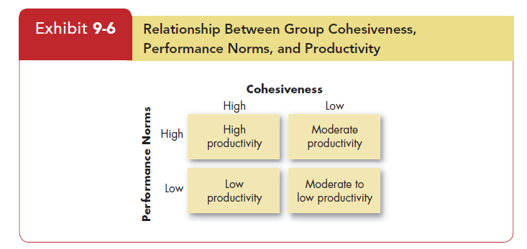
ORGANIZATIONAL BEHAVIOUR AND PROFESSIONAL COMMUNICATION (18ME661) UNIT4

Slide 31
ORGANIZATIONAL BEHAVIOUR AND PROFESSIONAL COMMUNICATION (18ME661) UNIT4
What can you do to encourage group cohesiveness?
(1) Make the group smaller
(2) encourage agreement with group goals
(3) increase the time members spend together
(4) increase the group’s status and the perceived difficulty of attaining
membership,
(5) stimulate competition with other groups,
(6) give rewards to the group rather than to individual members, and
(7) physically isolate the group.

Slide 32
ORGANIZATIONAL BEHAVIOUR AND PROFESSIONAL COMMUNICATION (18ME661) UNIT4
GROUP PROCESSES
Team effectiveness is process variables such as member commitment to a common purpose, establishment of specific team goals, team efficacy, a managed level of conflict, and minimized social loafing.

Slide 33
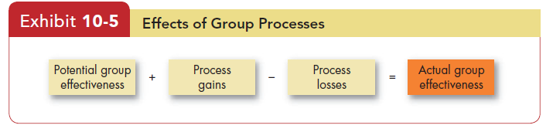
ORGANIZATIONAL BEHAVIOUR AND PROFESSIONAL COMMUNICATION (18ME661) UNIT4
When each member’s contribution is not clearly visible, individuals tend to decrease their effort. Social loafing, in other words, illustrates a process loss from using teams. But teams should create outputs greater than the sum of their inputs, as when a diverse group develops creative alternatives. Exhibit 10-5 illustrates how group processes can have an impact on a group’s actual effectiveness.

Slide 34
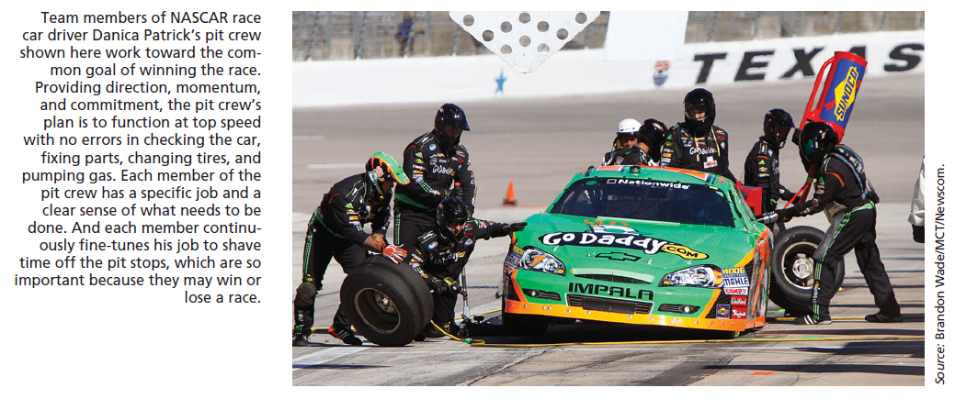
ORGANIZATIONAL BEHAVIOUR AND PROFESSIONAL COMMUNICATION (18ME661) UNIT4
https://www.youtube.com/watch?v=aHSUp7msCIE

Slide 35
Group Tasks
ORGANIZATIONAL BEHAVIOUR AND PROFESSIONAL COMMUNICATION (18ME661) UNIT4
Decision-making
Large groups facilitate the pooling of information about complex tasks.
Smaller groups are better suited to coordinating and facilitating the implementation of complex tasks.

Slide 36
ORGANIZATIONAL BEHAVIOUR AND PROFESSIONAL COMMUNICATION (18ME661) UNIT4
Imagine that there are two groups at a major oil company.
The job of the first is to consider possible locations for a new refinery. The decision is going to affect people in many areas of the Company- production, engineering, marketing, distribution, purchasing, real estate development, etc.,- key people from each of these areas will need to provide input to the decision. (Large group)
The job of the second group is to coordinate the building of the refinery after the site has been selected, the design finalised, and the financial arrangements completed. (smaller group)

Slide 37
ORGANIZATIONAL BEHAVIOUR AND PROFESSIONAL COMMUNICATION (18ME661) UNIT4
Group Decision Making
Groups versus the Individual
Decision-making groups may be widely used in organizations, but are group decisions preferable to those made by an individual alone? The answer depends on a number of factors. Let’s begin by looking at the strengths and weaknesses of group decision making.

Slide 38
ORGANIZATIONAL BEHAVIOUR AND PROFESSIONAL COMMUNICATION (18ME661) UNIT4
Group Decision Making contd…
Strengths of Group Decision Making Groups generate more complete information and knowledge. By aggregating the resources of several individuals, groups bring more input as well as heterogeneity into the decision process. They offer increased diversity of views. This opens up the opportunity to consider more approaches and alternatives. Finally, groups lead to increased acceptance of a solution. Group members who participated in making a decision are more likely to enthusiastically support and encourage others to accept it.

Slide 39
ORGANIZATIONAL BEHAVIOUR AND PROFESSIONAL COMMUNICATION (18ME661) UNIT4
Group Decision Making contd…
Weaknesses of Group Decision Making Group decisions are time consuming because groups typically take more time to reach a solution. There are conformity pressures. The desire by group members to be accepted and considered an asset to the group can squash any overt disagreement. Group discussion can be dominated by one or a few members. If they’re low- and medium-ability members, the group’s overall effectiveness will suffer. Finally, group decisions suffer from ambiguous responsibility. In an individual decision, it’s clear who is accountable for the final
outcome. In a group decision, the responsibility of any single member is diluted.

Slide 40
ORGANIZATIONAL BEHAVIOUR AND PROFESSIONAL COMMUNICATION (18ME661) UNIT4
Group Decision Making contd…
Effectiveness and Efficiency Whether groups are more effective than individuals depends on how you define effectiveness. Group decisions are generally more accurate than the decisions of the average individual in a group, but less accurate than the judgments of the most accurate. In terms of speed, individuals are superior. If creativity is important, groups tend to be more effective. And if effectiveness means the degree of acceptance the final solution achieves, the nod again goes to the group.

Slide 41
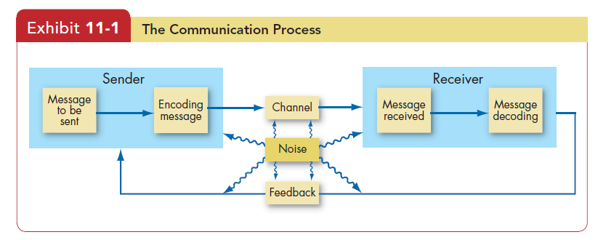
ORGANIZATIONAL BEHAVIOUR AND PROFESSIONAL COMMUNICATION (18ME661) UNIT4
Communication
communication The transfer and understanding of a message between two or more people.

Slide 42
ORGANIZATIONAL BEHAVIOUR AND PROFESSIONAL COMMUNICATION (18ME661) UNIT4
Exhibit 11-1 depicts this communication process .
The key parts of this model are
the sender,
(2) encoding,
(3) the message,
(4) the channel,
(5) decoding,
(6) the receiver,
(7) noise, and
(8) feedback.

Slide 43
ORGANIZATIONAL BEHAVIOUR AND PROFESSIONAL COMMUNICATION (18ME661) UNIT4
encoding Converting a message to symbolic form.
decoding Interpreting a sender’s message.
message What is communicated.
channel The medium through which a message travels.
communication apprehension Undue tension and anxiety about oral communication, written communication, or both.
channel richness The amount of information that can be transmitted during a communication episode.
feedback loop The final link in the communication process; it puts the message back into the system as a check against misunderstandings.

Slide 44
ORGANIZATIONAL BEHAVIOUR AND PROFESSIONAL COMMUNICATION (18ME661) UNIT4
Functions of Communication
Communication serves four major functions within a group or organization:
control, motivation, emotional expression, and information.
1. Communication acts to control member behaviour in several ways. Organizations have authority hierarchies and formal guidelines employees are required to follow. When employees must communicate any job-related grievance to their immediate boss, follow their job description, or comply with company policies, communication is performing a control function. Informal communication controls behaviour too. When work groups tease or harass a member who produces too much (and makes the rest of the group look bad), they are informally communicating, and controlling, the member’s behaviour.

Slide 45
ORGANIZATIONAL BEHAVIOUR AND PROFESSIONAL COMMUNICATION (18ME661) UNIT4
2. Communication fosters motivation by clarifying to employees what they must do, how well they are doing it, and how they can improve if performance is subpar. The formation of specific goals, feedback on progress toward the goals, and reward for desired behaviour all stimulate motivation and require communication.
3. Their work group is a primary source of social interaction for many employees. Communication within the group is a fundamental mechanism by which members show their satisfaction and frustrations. Communication, therefore, provides for the emotional expression of feelings and fulfillment of social needs.

Slide 46
ORGANIZATIONAL BEHAVIOUR AND PROFESSIONAL COMMUNICATION (18ME661) UNIT4
4. The final function of communication is to facilitate decision making. Communication provides the information individuals and groups need to make decisions by transmitting the data needed to identify and evaluate choices.
Almost every communication interaction that takes place in a group or organization performs one or more of these functions, and none of the four is more important than the others. To perform effectively, groups need to maintain some form of control over members, stimulate members to perform, allow emotional expression, and make decision choices.

Slide 47
ORGANIZATIONAL BEHAVIOUR AND PROFESSIONAL COMMUNICATION (18ME661) UNIT4
Direction of Communication
Communication can flow vertically or laterally. We further subdivide the vertical dimension into downward and upward directions.
Downward Communication
Communication that flows from one level of a group or organization to a lower level is downward communication . Group leaders and managers use it to assign goals, provide job instructions, explain policies and procedures, point out problems that need attention, and offer feedback about performance.

Slide 48
ORGANIZATIONAL BEHAVIOUR AND PROFESSIONAL COMMUNICATION (18ME661) UNIT4
Upward Communication
Upward communication flows to a higher level in the group or organization. It’s used to provide feedback to higher-ups, inform them of progress toward goals, and relay current problems. Upward communication keeps managers aware of how employees feel about their jobs, co-workers, and the organization in general. Managers also rely on upward communication for ideas on how conditions can be improved.
Lateral Communication
When communication takes place among members of the same work group, members of work groups at the same level, managers at the same level, or any other horizontally equivalent workers, we describe it as lateral communication.

Slide 49
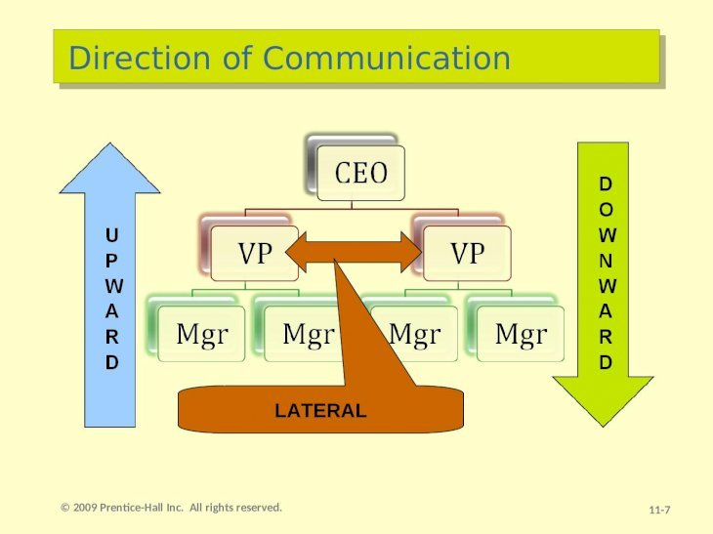
ORGANIZATIONAL BEHAVIOUR AND PROFESSIONAL COMMUNICATION (18ME661) UNIT4

Slide 50
ORGANIZATIONAL BEHAVIOUR AND PROFESSIONAL COMMUNICATION (18ME661) UNIT4
Interpersonal Communication
The chief means of conveying messages is oral communication. Speeches, formal one-on-one and group discussions, and the informal rumour mill or grapevine are popular forms of oral communication.
The advantages of oral communication are speed and feedback. We can convey a verbal message and receive a response in minimal time. If the receiver is unsure of the message, rapid feedback allows the sender to quickly detect and correct it. As one professional put it, “Face-to-face communication on a consistent basis is still the best way to get information to and from employees.

Slide 51
ORGANIZATIONAL BEHAVIOUR AND PROFESSIONAL COMMUNICATION (18ME661) UNIT4
The major disadvantage of oral communication surfaces whenever a message has to pass through a number of people: the more people, the greater the potential distortion. If you’ve ever played the game “Telephone,” you know the problem. Each person interprets the message in his or her own way. The message’s content, when it reaches its destination, is often very different from the original. In an organization, where decisions and other communiqués are verbally passed up and down the authority hierarchy, considerable opportunities
arise for messages to become distorted.

Slide 52
ORGANIZATIONAL BEHAVIOUR AND PROFESSIONAL COMMUNICATION (18ME661) UNIT4
Written Communication
Written communications include memos, letters, fax transmissions, e-mail, instant messaging, organizational periodicals, notices placed on bulletin boards (including electronic ones), and any other device that transmits via written words or symbols.
It’s often tangible and verifiable. Both the sender and receiver have a record of the communication; and the message can be stored for an indefinite period. If there are questions about its content, the message is physically available for later reference.

Slide 53
ORGANIZATIONAL BEHAVIOUR AND PROFESSIONAL COMMUNICATION (18ME661) UNIT4
Of course, written messages have drawbacks. They’re time consuming.
The other major disadvantage is lack of a built in feedback mechanism. Oral communication allows the receiver to respond rapidly to what he thinks he hears. But emailing a memo or sending an instant message provides no assurance it has been received or that the recipient will interpret it as the sender intended.

Slide 54
ORGANIZATIONAL BEHAVIOUR AND PROFESSIONAL COMMUNICATION (18ME661) UNIT4
Nonverbal Communication
nonverbal communication —which includes body movements, the intonations or emphasis we give to words, facial expressions, and the physical distance between the sender and receiver.
Body language adds to, and often complicates, verbal communication. A body position or movement can communicate something of the emotion behind a message, but when it is linked with spoken language, it gives fuller meaning to a sender’s message.
Facial expressions also convey meaning. A snarling face says something different from a smile. Facial expressions, along with intonations, can show arrogance, aggressiveness, fear, shyness, and other characteristics.

Slide 55
ORGANIZATIONAL BEHAVIOUR AND PROFESSIONAL COMMUNICATION (18ME661) UNIT4
Physical distance also has meaning. What is considered proper spacing
between people largely depends on cultural norms. A business like distance in some European countries feels intimate in many parts of North America.

Slide 56
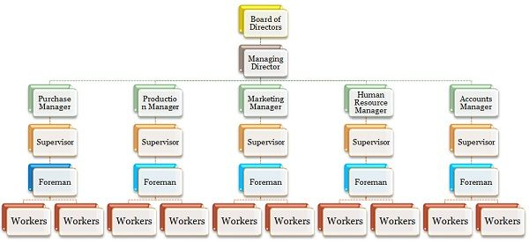
ORGANIZATIONAL BEHAVIOUR AND PROFESSIONAL COMMUNICATION (18ME661) UNIT4
Formal vs. informal networks:
Definition of Formal Communication
The communication in which the flow of information is already defined is termed as Formal Communication. The communication follows a hierarchical chain of command which is established by the organisation itself. In general, this type of communication is used exclusively in the workplace, and the employees are bound to follow it while performing their duties.
Example: Requests, commands, orders, reports etc.

Slide 57
ORGANIZATIONAL BEHAVIOUR AND PROFESSIONAL COMMUNICATION (18ME661) UNIT4
The formal communication is of four types:
Upward or Bottom-up: The communication in which the flow of information goes from subordinate to superior authority.
Downward or Top-down: The communication in which the flow of information goes from superior to subordinate.
Horizontal or Lateral: The communication between two employees of different departments working at the same level.
Crosswise or Diagonal: The communication between the employees of two different departments working at different levels.

Slide 58
ORGANIZATIONAL BEHAVIOUR AND PROFESSIONAL COMMUNICATION (18ME661) UNIT4
Definition of Informal Communication
The communication which does not follow any pre-defined channel for the transmission of information is known as informal communication. This type of communication moves freely in all directions, and thus, it is very quick and rapid. In any organization, this type of communication is very natural as people interact with each other about their professional life, personal life, and other matter.
Example: Sharing of feelings, casual discussion, gossips, etc.

Slide 59

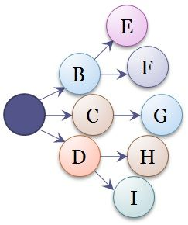
ORGANIZATIONAL BEHAVIOUR AND PROFESSIONAL COMMUNICATION (18ME661) UNIT4
The informal communication is of four types:
Single Strand Chain: The communication in which one person tell something to another, who again says something to some other person and the process goes on.
Cluster Chain: The communication in which one person tells something to some of its most trusted people, and then they tells them to their trustworthy friends and the communication continues.

Slide 60
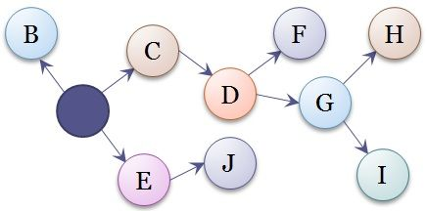
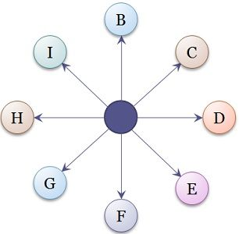
ORGANIZATIONAL BEHAVIOUR AND PROFESSIONAL COMMUNICATION (18ME661) UNIT4
Probability Chain: The communication happens when a person randomly chooses some persons to pass on the information which is of little interest but not important.
Gossip Chain: The communication starts when a person tells something to a group of people, and then they pass on the information to some more people and in this way the information is passed on to everyone.

Slide 61
ORGANIZATIONAL BEHAVIOUR AND PROFESSIONAL COMMUNICATION (18ME661) UNIT4
Key Differences Between Formal and Informal Communication
Formal communication is also known by the name of official communication. Informal Communication is also known by the name of grapevine.
2.In formal communication, the information must follow a chain of command. Conversely, the informal communication can move freely in any direction.
3. In formal communication, full secrecy is maintained, but in the case of informal communication maintenance of secrecy is a very tough task.
4. Formal communication is written, whereas Informal communication is oral.

Slide 62
ORGANIZATIONAL BEHAVIOUR AND PROFESSIONAL COMMUNICATION (18ME661) UNIT4
5. Formal communication is time-consuming as opposed to Informal communication, which is rapid and quick.
6. Formal communication is more reliable than Informal communication.
7. Formal communication is designed by the organization. Informal communication starts itself due to the urge of ‘human to talk’.
8. In formal communication, the documentary evidence is always available. On the other hand, in the case of informal communication, the supporting documents are not available.

Slide 63
ORGANIZATIONAL BEHAVIOUR AND PROFESSIONAL COMMUNICATION (18ME661) UNIT4
Comparison Chart
Basis for Comparison | Formal Communication | Informal Communication
Meaning | A type of verbal communication in which the interchange of information is done through the pre-defined channels is known as formal communication. | A type of verbal communication in which the interchange of information does not follow any channels i.e. the communication stretches in all directions.
Another Name | Official Communication | Grapevine communication
Reliability | More | Comparatively less
Speed | Slow | Very Fast

Slide 64
ORGANIZATIONAL BEHAVIOUR AND PROFESSIONAL COMMUNICATION (18ME661) UNIT4
Basis for Comparison | Formal Communication | Informal Communication
Evidence | As the communication is generally written, documentary evidence is present. | No documentary evidence.
Time Consuming | Yes | No
Advantage | Effective due to timely and systematic flow of information. | Efficient because employees can discuss work related problems, this saves time and cost of the organization.
Disadvantage | Distortion due to long chain of communication. | Spread of rumors
Secrecy | Full secrecy is maintained. | It is difficult to maintain the secrecy.
Flow of Information | Only through predefined channels. | Can move freely.

Slide 65
ORGANIZATIONAL BEHAVIOUR AND PROFESSIONAL COMMUNICATION (18ME661) UNIT4
Grapevine Communication: It is a form of informal communication in business that develops within an organisation. The information flows in any order i.e. it does not follow horizontal or vertical communication. The information spreads very rapidly than other channel of communications.
Grapevine is an informal channel of business communication. It is called so because it stretches throughout the organization in all directions irrespective of the authority levels. Man as we know is a social animal. Despite existence of formal channels in an organization, the informal channels tend to develop when he interacts with other people in organization. It exists more at lower levels of organization.

Slide 66

ORGANIZATIONAL BEHAVIOUR AND PROFESSIONAL COMMUNICATION (18ME661) UNIT4
Grapevine generally develops due to various reasons. One of them is that when an organization is facing recession, the employees sense uncertainty. Also, at times employees do not have self-confidence due to which they form unions. Sometimes the managers show preferential treatment and favour some employees giving a segregated feeling to other employees. Thus, when employees sense a need to exchange their views, they go for grapevine network as they cannot use the formal channel of communication in that case. Generally during breaks in cafeteria, the subordinates talk about their superior’s attitude and behaviour and exchange views with their peers. They discuss rumours about promotion and transfer of other employees. Thus, grapevine spreads like fire and it is not easy to trace the cause of such communication at times.

Slide 67
ORGANIZATIONAL BEHAVIOUR AND PROFESSIONAL COMMUNICATION (18ME661) UNIT4
Types of Grapevine Communication:
1. Single Strand Chain: It is the passing of information from the line of persons to the recipient. For example, when the person 1 tells 2, who tells 3, who tells 4, till the information reaches most of them.
2. Gossip Chain: Gossip chain is when a person goes around communicating the information or message he or she has obtained.
3. Probability Chain: Probability chain is when there are selected listeners and the information passed may be interesting but no essential.
4. Cluster Chain: In cluster chain, the information is passed to selected persons who may further pass the information or message to other selected persons.

Slide 68
ORGANIZATIONAL BEHAVIOUR AND PROFESSIONAL COMMUNICATION (18ME661) UNIT4
Benefits of Grapevine Communication:
• Grapevine communication helps the message or information to spread rapidly.
• It helps to keep the employees well informed about the management in the organisation.
• It also helps to create a healthy environment in the organisation.
• It helps in identification of leaders and also win their confidence.
• It can act as a substitute for formal channel of communication.
• It can sometimes allow the organisation to get quick feedback.

Slide 69
ORGANIZATIONAL BEHAVIOUR AND PROFESSIONAL COMMUNICATION (18ME661) UNIT4
Grapevine communication can also prove detrimental to any organization in following ways.(Disadvantages)
• Grapevine can sometimes carry partial information as it is more based on rumours. Thus, the complete state of affairs cannot be depicted.
• It cannot always be trustworthy as it is unofficial path of communication and it is spread more by gossips.
• It can also lead to making hostility against the executives.
• Grapevine communication may hamper goodwill of the organisation as it carries false information about the higher management in the organization.
• It can lead to discouraging rumours and character assassination.

Slide 70
ORGANIZATIONAL BEHAVIOUR AND PROFESSIONAL COMMUNICATION (18ME661) UNIT4
Computer aided communication/Computer mediated communication.
is defined as any human communication that occurs through the use of two or more electronic devices which include e-mail, text messaging, networking software, blogs, and video conferencing.
E-mail uses the Internet to transmit and receive computer-generated text and documents. Its growth has been spectacular, and its use is now so pervasive it’s hard to imagine life without it. E-mail messages can be quickly written, edited, and stored. They can be distributed to one person or thousands with a click of a mouse. And the cost of sending formal e-mail messages to employees is a fraction of the cost of printing, duplicating, and distributing a comparable letter or brochure.

Slide 71
ORGANIZATIONAL BEHAVIOUR AND PROFESSIONAL COMMUNICATION (18ME661) UNIT4
Instant Messaging and Text Messaging Like e-mail, instant messaging (IM) and text messaging (TM) use electronic media. Unlike e-mail, though, IM and TM either occur in real time (IM) or use portable communication devices (TM).
In just a few years, IM and TM have become pervasive. As you no doubt know from experience, IM is usually sent via computer, whereas TM is transmitted via cell phones or handheld devices such as BlackBerrys and iPhones.
Social Networking Nowhere has communication been more transformed than in the rise of social networking. You are doubtless familiar with and perhaps a user of social networking platforms such as Facebook and LinkedIn.

Slide 72
ORGANIZATIONAL BEHAVIOUR AND PROFESSIONAL COMMUNICATION (18ME661) UNIT4
Blogs A blog (Web log) is a Web site about a single person or company. Experts estimate that more than 156 million blogs now exist. Millions of U.S. workers have blogs. And, of course, many organizations and organizational leaders have blogs that speak for the organization.
Twitter is a hybrid social networking service that allows users to post “microblog” entries to their subscribers about any topic, including work. Many organizational leaders send Twitter messages (“tweets”), but they can also come from any employee about any work topic, leaving organizations with less control over the communication of important or sensitive information.

Slide 73
ORGANIZATIONAL BEHAVIOUR AND PROFESSIONAL COMMUNICATION (18ME661) UNIT4
Video Conferencing Video conferencing permits employees in an organization to have real-time meetings with people at different locations. Live audio and video images let participants see, hear, and talk with each other without being physically in the same location.
Ex: Google meet, zoom, etc.,

Slide 74
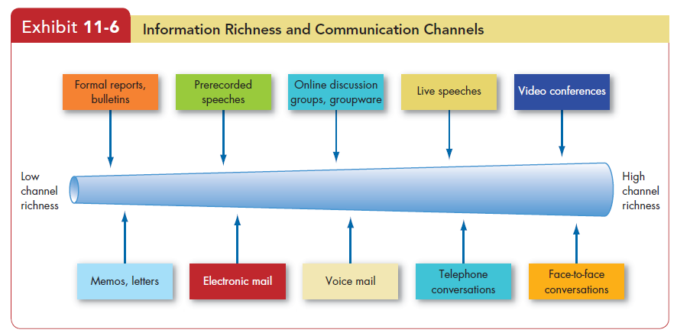
ORGANIZATIONAL BEHAVIOUR AND PROFESSIONAL COMMUNICATION (18ME661) UNIT4
Choice of Communication Channel
Why do people choose one channel of communication over another—say,
a phone call instead of a face-to-face talk? A model of media richness helps explain channel selection among managers.

Slide 75
ORGANIZATIONAL BEHAVIOUR AND PROFESSIONAL COMMUNICATION (18ME661) UNIT4
Channels differ in their capacity to convey information. Some are rich in that they can (1) handle multiple cues simultaneously, (2) facilitate rapid feedback, and (3) be very personal. Others are lean in that they score low on these factors.
As Exhibit 11-6 illustrates, face-to-face conversation scores highest in channel richness because it transmits the most information per communication episode—multiple information cues (words, postures, facial expressions, gestures, intonations), immediate feedback (both verbal and nonverbal), and the personal touch of being present. Impersonal written media such as formal reports and bulletins rate lowest in richness.

Slide 76
ORGANIZATIONAL BEHAVIOUR AND PROFESSIONAL COMMUNICATION (18ME661) UNIT4
The choice of channel depends on whether the message is routine. Routine messages tend to be straightforward and have minimal ambiguity; channels low in richness can carry them efficiently. Non routine communications are likely to be complicated and have the potential for misunderstanding. Managers can communicate them effectively only by selecting rich channels.

Slide 77
ORGANIZATIONAL BEHAVIOUR AND PROFESSIONAL COMMUNICATION (18ME661) UNIT4
Barriers to Effective Communication
A number of barriers can retard or distort effective communication.
Filtering
Filtering refers to a sender’s purposely manipulating information so the receiver will see it more favourably. A manager who tells his boss what he feels the boss wants to hear is filtering information.
The more vertical levels in the organization’s hierarchy, the more opportunities there are for filtering. But some filtering will occur wherever there are status differences. Factors such as fear of conveying bad news and the desire to please the boss often lead employees to tell their superiors what they think they want to hear, thus distorting upward communications.

Slide 78
ORGANIZATIONAL BEHAVIOUR AND PROFESSIONAL COMMUNICATION (18ME661) UNIT4
Selective Perception
It appears here because the receivers in the communication process selectively see and hear based on their needs, motivations, experience, background, and other personal characteristics. Receivers also project their interests and expectations into communications as they decode them. An employment interviewer who expects a female job applicant to put her family ahead of her career is likely to see that in all female applicants, regardless of whether they actually feel that way.

Slide 79
ORGANIZATIONAL BEHAVIOUR AND PROFESSIONAL COMMUNICATION (18ME661) UNIT4
Information Overload
Individuals have a finite capacity for processing data. When the information we have to work with exceeds our processing capacity, the result is information overload. We’ve seen that dealing with it has become a huge challenge for individuals and for organizations.
What happens when individuals have more information than they can sort and use? They tend to select, ignore, pass over, or forget. Or they may put off further processing until the overload situation ends. In any case, lost information and less effective communication results, making it all the more important to deal well with overload.

Slide 80
ORGANIZATIONAL BEHAVIOUR AND PROFESSIONAL COMMUNICATION (18ME661) UNIT4
Emotions
You may interpret the same message differently when you’re angry or distraught than when you’re happy. For example, individuals in positive moods are more confident about their opinions after reading a persuasive message, so well-crafted arguments have stronger impacts on their opinions. People in negative moods are more likely to scrutinize messages in greater detail, whereas those in positive moods tend to accept communications at face value. Extreme emotions such as jubilation or depression are most likely to hinder effective communication. In such instances, we are most prone to disregard our rational and objective thinking processes and substitute emotional judgments.

Slide 81
ORGANIZATIONAL BEHAVIOUR AND PROFESSIONAL COMMUNICATION (18ME661) UNIT4
Language
Even when we’re communicating in the same language, words mean different things to different people. Age and context are two of the biggest factors that influence such differences. In short, our use of language is far from uniform. If we knew how each of us modified the language, we could minimize communication difficulties, but we usually don’t know. Senders tend to assume the words and terms they use mean the same to the receiver as to them. This assumption is often incorrect.

Slide 82
ORGANIZATIONAL BEHAVIOUR AND PROFESSIONAL COMMUNICATION (18ME661) UNIT4
Silence
It’s easy to ignore silence or lack of communication, precisely because it is defined by the absence of information. Employee silence means managers lack information about ongoing operational problems. And silence regarding discrimination, harassment, corruption, and misconduct means top management cannot take action to eliminate this behaviour. Finally, employees who are silent about important issues may also experience psychological stress.
Silence is less likely where minority opinions are treated with respect,
workgroup identification is high, and high procedural justice prevails.

Slide 83
ORGANIZATIONAL BEHAVIOUR AND PROFESSIONAL COMMUNICATION (18ME661) UNIT4
Communication Apprehension
An estimated 5 to 20 percent of the population suffers debilitating communication apprehension , or social anxiety. These people experience undue tension and anxiety in oral communication, written communication, or both. They may find it extremely difficult to talk with others face-to-face or may become extremely anxious when they have to use the phone, relying on memos or e-mails when a phone call would be faster and more appropriate.

Slide 84
ORGANIZATIONAL BEHAVIOUR AND PROFESSIONAL COMMUNICATION (18ME661) UNIT4
Lying
The final barrier to effective communication is outright misrepresentation of information, or lying. People differ in their definition of what constitutes a lie. For example, is deliberately withholding information about a mistake you made a lie, or do you have to actively deny your role in the mistake to pass the threshold of deceit?
In sum, the frequency of lying and the difficulty in detecting liars makes this an especially strong barrier to effective communication in organizations.

Slide 85
ORGANIZATIONAL BEHAVIOUR AND PROFESSIONAL COMMUNICATION (18ME661) UNIT4

