Slide 1

five weeks with an agent…
TWO BRANDS, ONE AGENT
OTTO OTTINGER · AI SOLOPRENEUR GRADUATION
Notes:
Title. One person, two brands, one project-manager agent. Five weeks of shipping.

Slide 2
first, the introductions…
ONE PERSON, TWO STUDIOS
BOTH in MELBOURNE, BOTH on WORDPRESS, BOTH MINE
the odd one…
the numbers one…
ODDTOE
THE DATALABS AGENCY
Experiential design and animation. Giant characters, installations, activations and generative animation — designed in Melbourne, shipped anywhere.
Data visualization and storytelling since 2012. Dashboard design, BI style guides and training workshops for some very large names.
INSTALLATIONS · ANIMATION · CHARACTER DESIGN · PROPS & INFLATABLES
DASHBOARD DESIGN · WORKSHOPS · POWER BI · TABLEAU · STYLE GUIDES
Notes:
Oddtoe = experiential/animation. The Datalabs Agency = data visualization since 2012. Both Melbourne WordPress businesses, both run solo.

Slide 3
the machine behind it…
AN AGENT that SHIPS
A PROJECT MANAGER that WORKS while I SLEEP
DESIGN KITS
OVERNIGHT ROUTINES
THE FULL PUBLISH FLOW
Both brands' page templates snapshotted as reusable pattern kits. The agent composes real WordPress pages from them — it never touches my art direction.
A 4pm scout reads the search data and picks the next page worth building. A 5am builder drafts it. Both brands, every night.
Draft, my review, publish, internal link pass, then Google and Bing indexing — every step logged in ledgers the agent keeps.
Search data
→
Scout picks a target
→
Builder composes a draft
→
Otto reviews
→
Publish, links, indexing
Notes:
The repo: design kits, the 4pm scout + 5am builder cloud routines, and the full publish flow with ledgers.

Slide 4
chapter one: foundations…
THE UN-SEXY WINS
NONE of THIS is VISIBLE. ALL of IT DECIDES if the VISIBLE WORK GETS FOUND.
THE VANISHING WEBSITE
IDENTITY PAPERS
Caught oddtoe.com intermittently serving the Datalabs homepage — a cache incident that risked one brand being deleted from Google.
Organization and Person schema, entity fixes and llms.txt on both sites, so AI assistants know who these businesses are.
ON THE MAP
THE REAL RATE CARD
Google Business Profile and Bing Places listings claimed, cleaned and synced for both brands.
Nine years of Xero invoices analysed to lock a public price list and an internal floor — pricing from evidence, not vibes.
108 MISSING BLURBS
REDIRECT REPAIRS
A site-wide meta-description audit and writing pass, so every page pitches itself in search results.
Killed broken chains — including a keyword page that sent English visitors to a German blog post.
INDEXING PLUMBING
Search Console and IndexNow wired for both sites. Every new page is requested, tracked and re-crawled.
Notes:
The un-sexy slide. Seven invisible fixes that decide whether anything else gets found. Speak to one or two only — the cache incident and the rate card are the best stories.

Slide 5
chapter two: storefronts…
ELEVEN MONEY PAGES in TWELVE DAYS
EVERY PAGE TARGETS a REAL SEARCH GAP, COMPOSED from MY DESIGN KITS
ODDTOE · 14 AUG
ODDTOE · 16 AUG
ODDTOE · 16 AUG
ODDTOE · 19 AUG
BRAND ACTIVATION IDEAS
WHAT IS GENERATIVE AI ANIMATION?
INSTALLATION ARTIST REBUILD
BIGGEST EXPERIENTIAL AGENCIES
ODDTOE · 24 AUG
ODDTOE · 24 AUG
DATALABS · 14 AUG
DATALABS · 19 AUG
ANIMATION AGENCY
CHARACTER DESIGN SERVICES
WORKSHOP PRICING
DATA VIZ & DESIGN CONFERENCES
DATALABS · 19 AUG
DATALABS · 24 AUG
DATALABS · 25 AUG
IN REVIEW
DATA ANALYTICS CONFERENCES
TYPES OF DATA VISUALIZATION
DASHBOARD DESIGN SERVICES
INFLATABLE ARTIST · PROP FABRICATION
■ ODDTOE ■ THE DATALABS AGENCY
Notes:
Eleven pages live between 14 and 25 August, two more in review. Each targets validated search demand from GSC + keyword data.

Slide 6
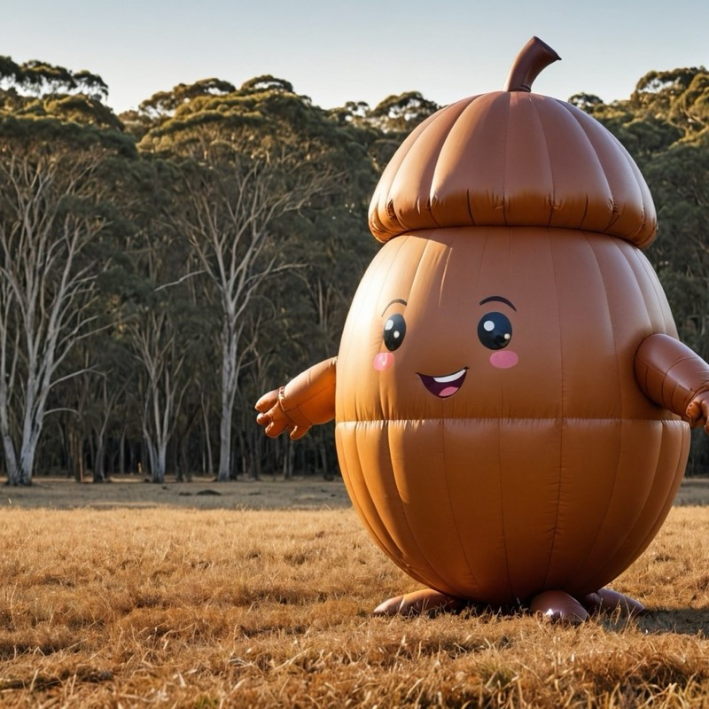

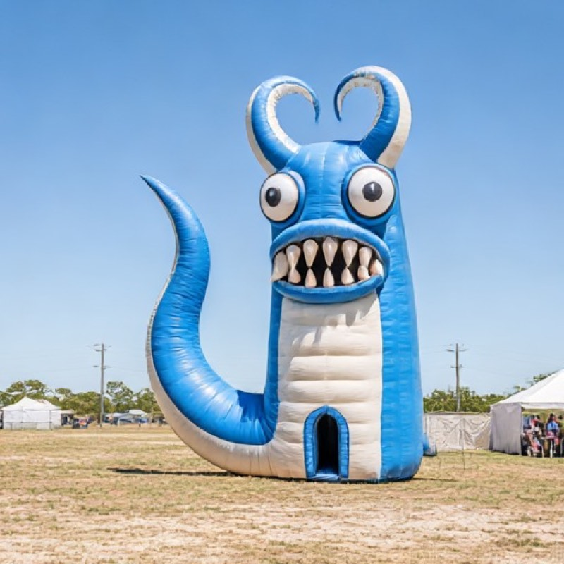

a new line of work…
ODDTOE ENTERS INFLATABLES
AIR is the CHEAPEST MEDIUM to DESIGN in, and the EASIEST to SHIP
Fun shapes, odd forms. Then voilà — a two-storey sculpture.
GIANT ACORN CHARACTER
ILLUMINATED NIGHT SPHERE
WALK-IN FESTIVAL MONSTER
3D PANEL-PATTERN DESIGN
Notes:
New service line: Inflatable Artist page in review, imagery from the Midjourney style work. Quote Otto's line: air is the cheapest and most reliable medium to design in.

Slide 7
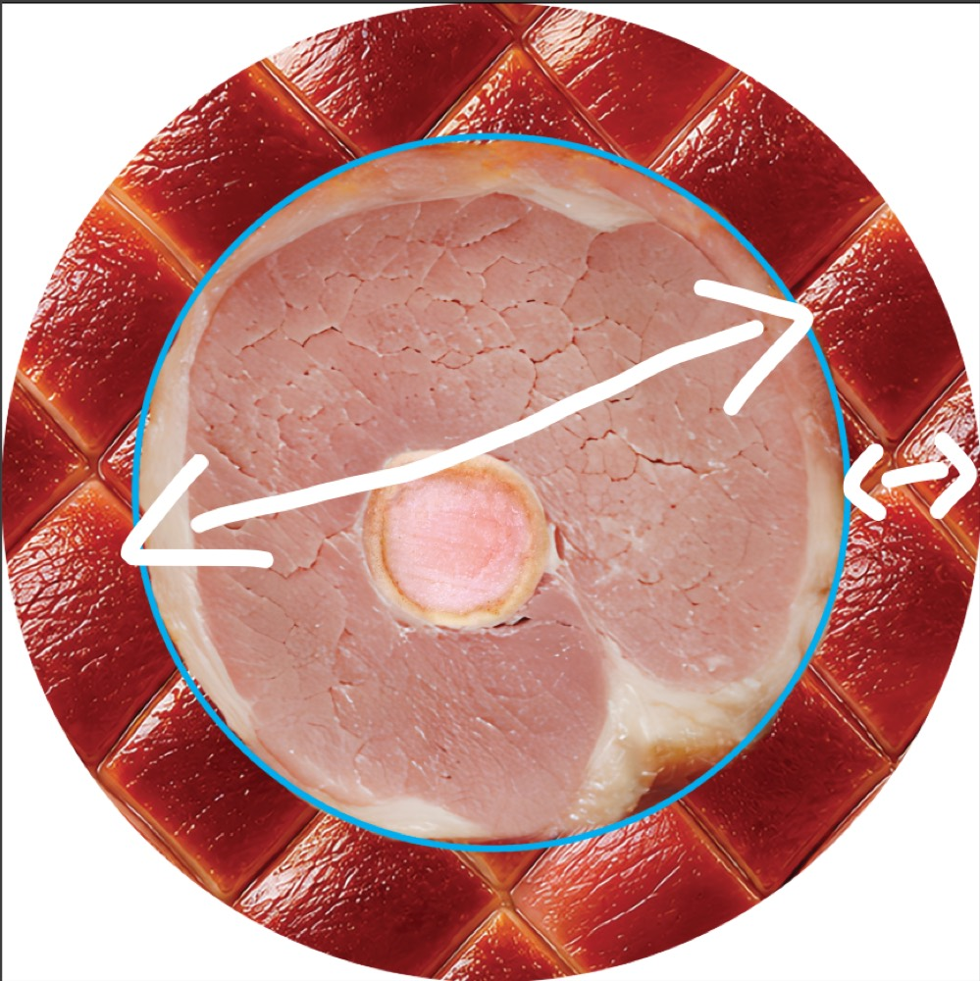
chapter three: showpieces…
THE HAM-BAG
FIRST SALE of the MODERN ODDTOE ERA
A neoprene cooler bag shaped like a Christmas ham — the hero giveaway for a major Australian retailer's activation, via agency Havas. The agent ran sourcing, quoting, the critical-path timeline, freight and customs. Sold on 20 August.
$17,655
~50%
DEAL VALUE · 150 UNITS
MARGIN, TOP OF BAND
CHINA → SYDNEY
SOLD 20 AUG
THREADING GOLDEN WEEK
SAMPLE NOW IN MOTION
Notes:
The Havas Ham-Bag: sold 20 Aug, 150 units at $17,655 inc GST, ~50% margin. The image is the actual plug-end artwork spec. The agent ran supplier sourcing (Szoneier), three quote tiers, the critical-path timeline around Golden Week, freight comparison and customs guidance.

Slide 8
and for the numbers one…
EIGHT CASE STUDIES in ONE NIGHT
VISUAL, ANIMATED, BUILT from 14 YEARS of CLIENT ARCHIVES
Interactive case-study pages drafted overnight by the agent — diagrams, hotspots and real project artefacts, ready for my review.
MARRIOTT
ADIDAS
73 metrics to 4 dashboards
150+ trained, 4 continents
INTEL
BLACKROCK
a Power BI design system
one design language
LOCKHEED MARTIN
NEOM
287 emerging leaders
education data foundations
INTEL'S 90-MODULE DESIGN SYSTEM
TRANSURBAN
GUMTREE / EBAY
a public policy calculator
visual BI strategy
Notes:
Eight Visual Case Studies drafted in one overnight batch, from Marriott to Gumtree/eBay. The grid is Intel's 90-module Power BI design system — on the live page it assembles cell by cell.

Slide 9
the moral of the story…
DO the UN-SEXY WORK.
the SEXY WORK COMPOUNDS on IT.
FIVE WEEKS, ONE PERSON, ONE AGENT
11
10
2
1
PAGES PUBLISHED
DRAFTS STAGED
BRANDS REBUILT
PRODUCT SOLD
ODDTOE + THE DATALABS AGENCY · Otto Ottinger
Notes:
Close on the olive end slide. 11 published, 10 staged, 2 brands rebuilt, 1 product sold — in five weeks, solo, with one agent.

