Slide 1
The Protein-Folding Problem
John healey

Slide 2
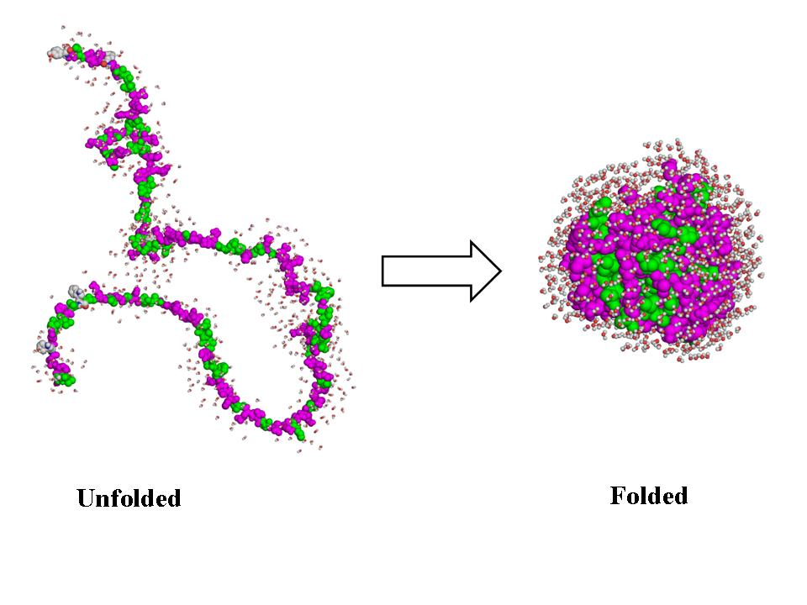
Biology Background
A protein is a molecule that performs some biological function.
Proteins are made up of amino acids.
The types of the amino acids that make up a protein determine its primary structure.
The way in which the protein is folded determines its tertiary structure.

Slide 3
The Problem
Assume there are 4 possible orientation angles between connected amino acids.
For a protein made up of 300 amino acids, there will be 4³⁰⁰ ≈ 10¹⁸⁰ possible tertiary structures, for any given primary structure.
The conundrum is that when unfolded, a protein is able to fold back to the correct tertiary structure in a matter of seconds.
The “correct” tertiary structure is the one that minimizes free energy.

Slide 4
Objectives
Create a realistic model of a protein.
Accurately simulate the folding process.
Use this simulation to investigate how proteins might be able to select their correct tertiary structure.
Why?
Could have applications to searching algorithms.
To design new proteins, must understand how to control folding.

Slide 5
The Physics
Similar to the Ising Model in 2-D.
The nearest-neighbour amino acid interactions determine the free energy of the system.
The primary structure is constant, so interactions between bonded amino acids are not considered.
Only non-bonded nearest neighbours contribute.
Each pair of acid types will have a characteristic interaction energy.
Calculation of this energy is very complicated.

Slide 6
The Physics (cont.)
Forces governing the interactions include the Van der Waals force, Hydrogen bonding, and the attractive or repulsive force of an acid with its surroundings.
For this experiment, it was assumed that interaction energies varied randomly on a set range.

Slide 7
Method
Amino acids are just integers corresponding to their type.
Protein is a chain (array) of randomly selected amino acids.
Folding uses Monte Carlo method:
An amino acid in the chain is randomly selected.
1 of 4 possible new positions is randomly selected.
If the acid can move there without breaking the chain, the change in energy from the move is calculated.
If the change is negative, the acid is moved.
Otherwise, the acid is moved with probability e^{-ΔE/kT}.

Slide 8
Results #1
To test the accuracy of my model, I measured the average energy of the protein as a function of temperature.
Results show decrease in energy with decrease in temperature.
Sharp decrease at T ≈ 2.
Length of chain determines range of energies.

Slide 9
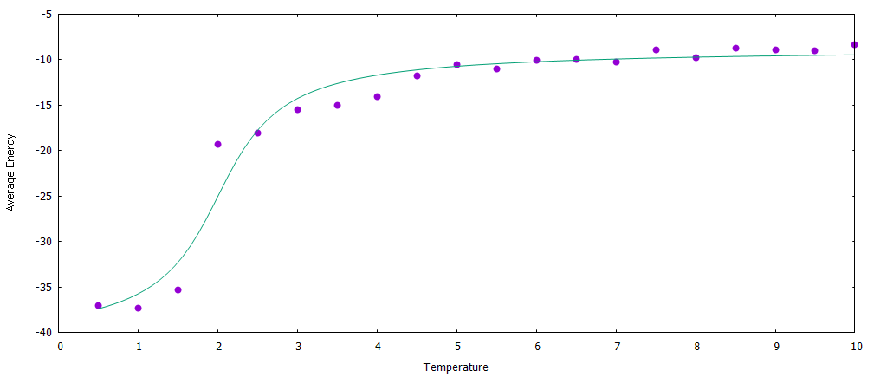
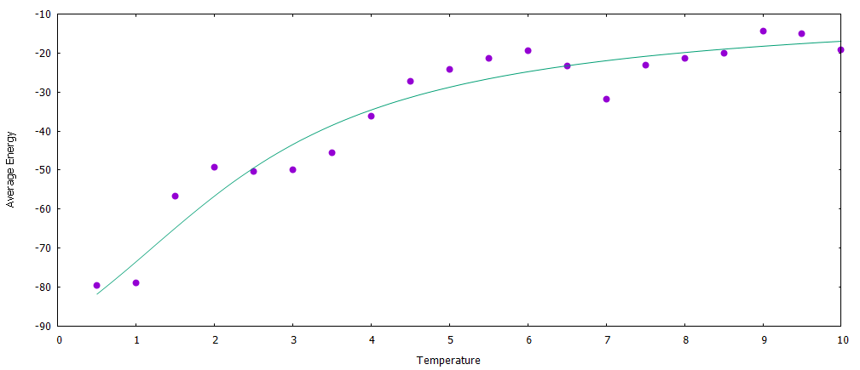
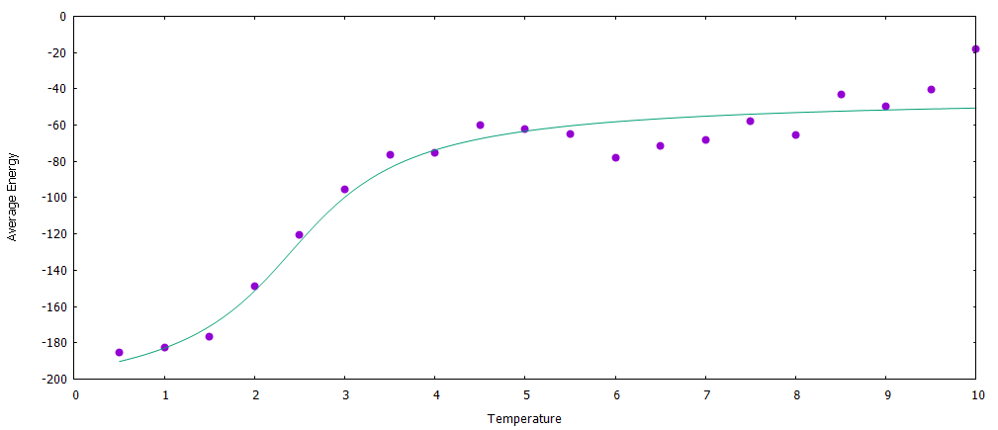
Results #1
N = 15
N = 30
N = 100

Slide 10
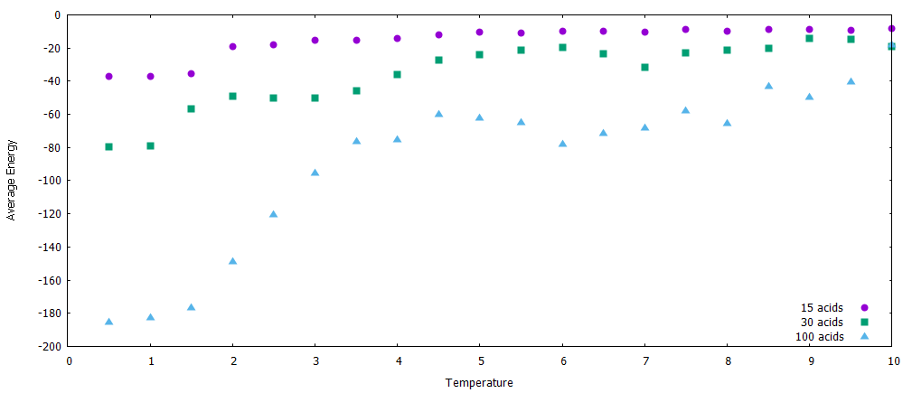
Results #1

Slide 11
Results #1
Sharp decrease at a certain critical temperature has been observed experimentally in real proteins, as they fold abruptly as conditions are changed.
Energy dependence on length makes sense, since the more acids in the protein, the more possible NBNN.
From these results, my model appeared to be accurate.

Slide 12
Results #2
With a seemingly accurate model of a protein, I sought to actually address the protein-folding problem.
The problem is that each time a protein is unfolded, it will fold back to the correct tertiary structure.
To investigate this, I ran 2 simulations on an identical protein at low temperature, to see if they folded to the same final structure.
They did not.

Slide 13
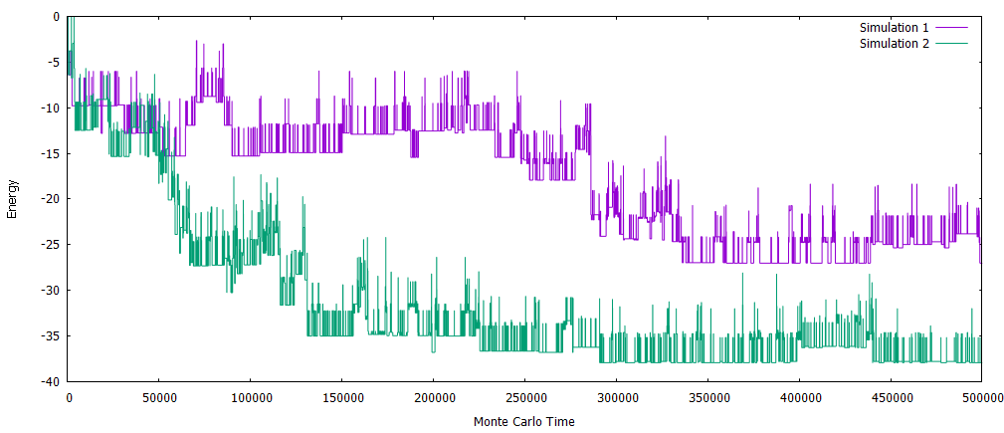
Results #2

Slide 14
Results #2
The protein clearly found different final structures in each simulation.
These correspond to metastable states.
As the protein searches for the global energy minimum (correct final state), it gets stuck in a local minimum (metastable state).
This explains why my protein did not find the correct final structure.
How do real proteins deal with this?

Slide 15
Results #3
One solution to this is annealing.
The protein is started at a temperature that is high enough to allow it to explore many different states.
The temperature is slowly lowered, so the protein spends an increasing amount of time in the lowest-energy states.
When the temperature is sufficiently low, the hope is that the protein has settled in the minimum energy state.
I attempted to use annealing on the same protein as was used in the previous section.

Slide 16
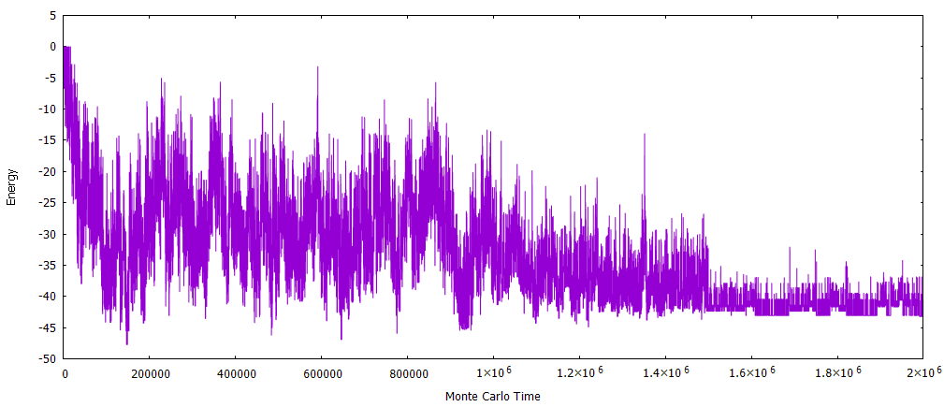
Results #3

Slide 17
Results #3
Without annealing, the lowest-energy final state reached had an energy of approximately -37.
With annealing, the protein settled in a state with energy of approximately -43.
Annealing enabled the protein to find a more stable state, meaning it behaved more like a real protein.

Slide 18
Discussion
Annealing made my model behave more realistically.
However, the protein could still get stuck in a metastable state, even when annealing is used.
One explanation for this is that annealing is how real proteins are able to find the correct final state, even though it is not perfect.
So, some proteins will end up in the wrong final structure, so they will be unable to perform their biological function.

Slide 19
Discussion
However, as long as the majority do find the correct structure, nature may be able to tolerate the small number of inert proteins.
The protein-folding problem is unsolved.
I cannot say with certainty if my explanation is correct, but the evidence I have gathered illustrates a possible solution to the problem.

