Slide 1
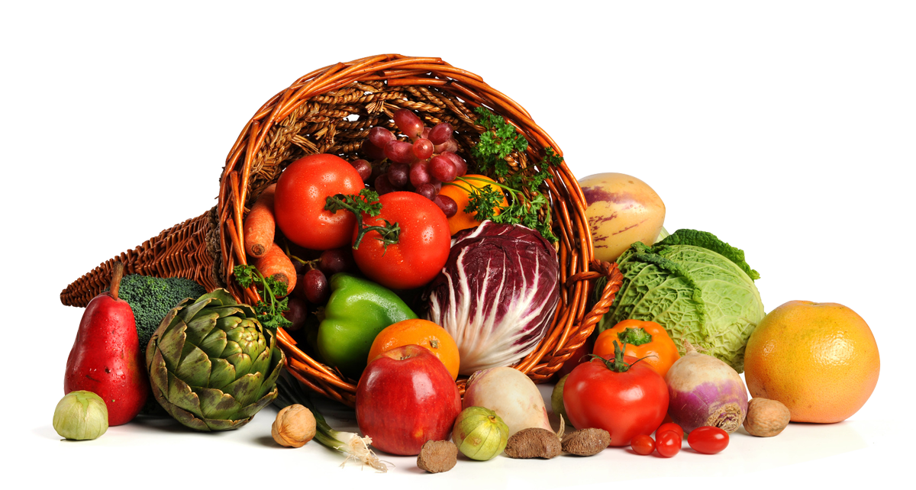

GALA GROCERIES DATA MODELING STAGE
Objective
Predict the stock levels of products based on sales data and sensor data on an hourly basis.
Strategic Planning
Data Cleaning
Exploratory Data Analysis
Model Building
Model Deployment and Monitoring
Tables | Columns
sensor_stock_levels | id, timestamp, product_id, estimated_stock_pct
sales | transaction_id, timestamp, product_id, category, customer_type, unit_price, quantity, total, payment_type
sensor_storage_temperature | id, timestamp, temperature
All the data will be required, the feature “estimated_stock_pct” is the one that needs to be predicted. Sales data will help in indicating the movement of the stocks and sensor data will help in showing products life cycle based on temperature.

