Slide 1
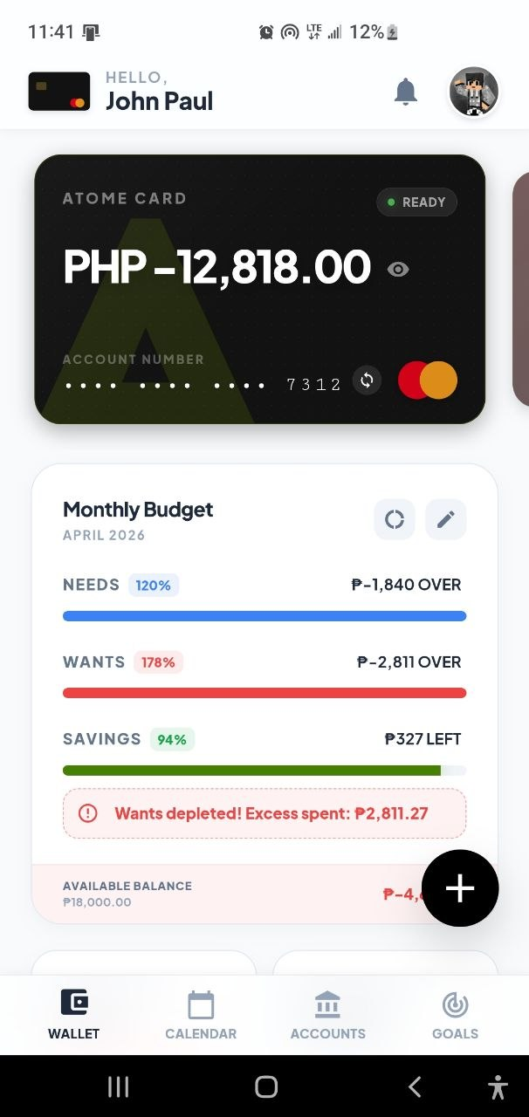
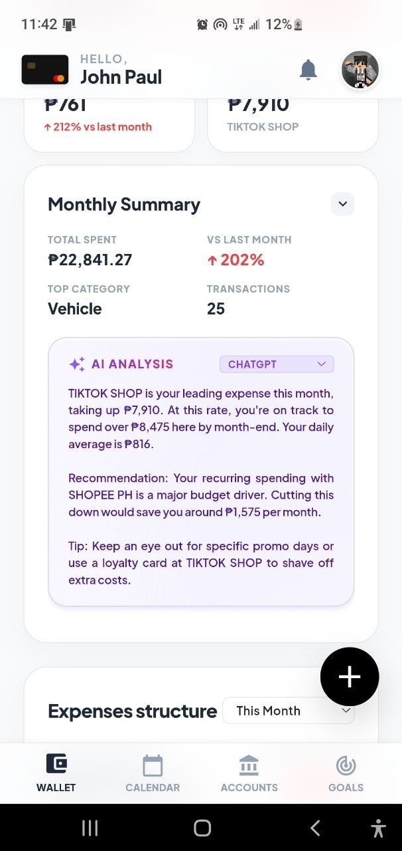
SMART WALLET
A Short Overview of the App
A mobile-first personal finance app with dashboard analytics, AI spending summaries, and recurring expense tracking.
Main highlight
The app does not only track expenses. It also explains spending behavior through AI and shows repeated monthly costs clearly.
Short PPT Presentation
Focus: dashboard, charts, AI summary, and recurring expenses
Smart Wallet Project Presentation

Slide 2
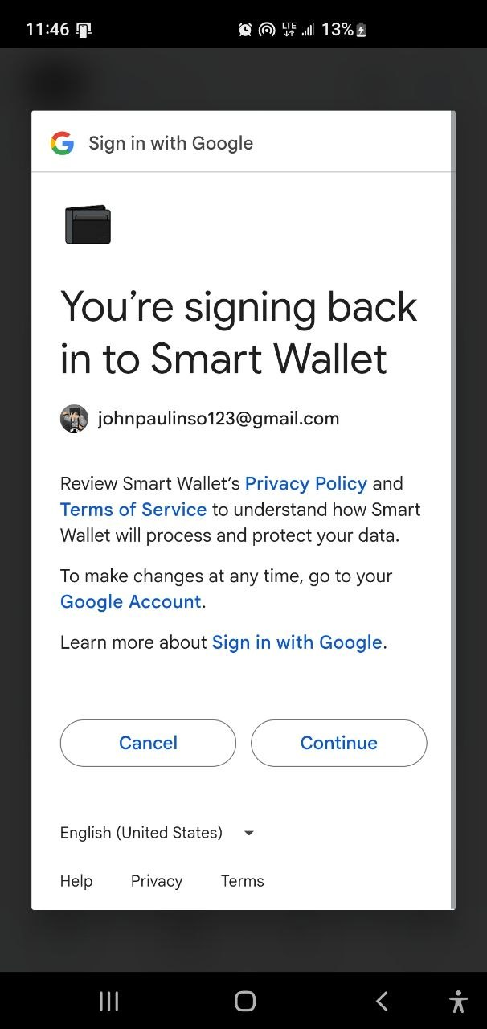
PROBLEM AND SOLUTION
Why Smart Wallet Was Created
The app was built to make monthly spending easier to understand instead of leaving users with raw lists and totals only.
Main problem
Proposed solution
•
Users can track expenses, but still struggle to understand spending behavior.
•
A simple wallet dashboard that shows monthly expenses clearly.
•
Traditional apps often stop at charts or totals without giving explanation.
•
Visual charts, summary cards, and a finance overview in one place.
•
Recurring expenses and spending habits are easy to miss each month.
•
An AI Summary card plus recurring-expense tracking for faster understanding.
Smart Wallet Project Presentation

Slide 3
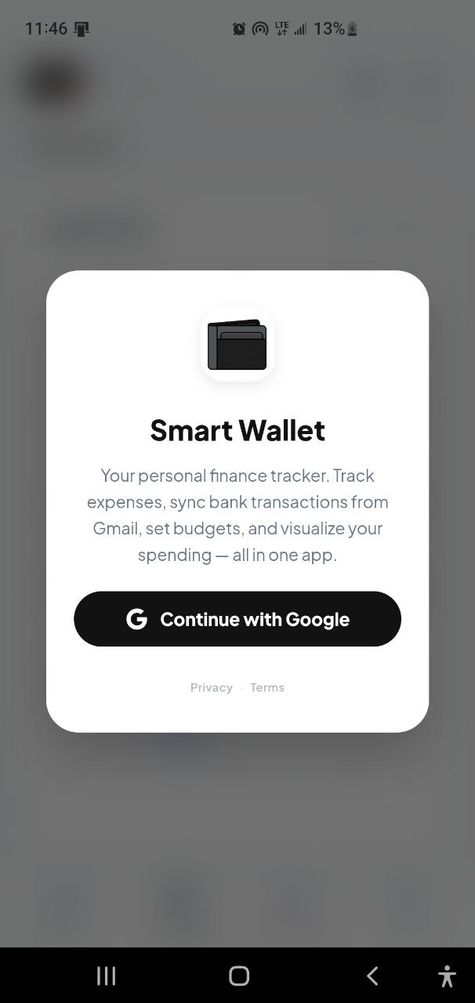
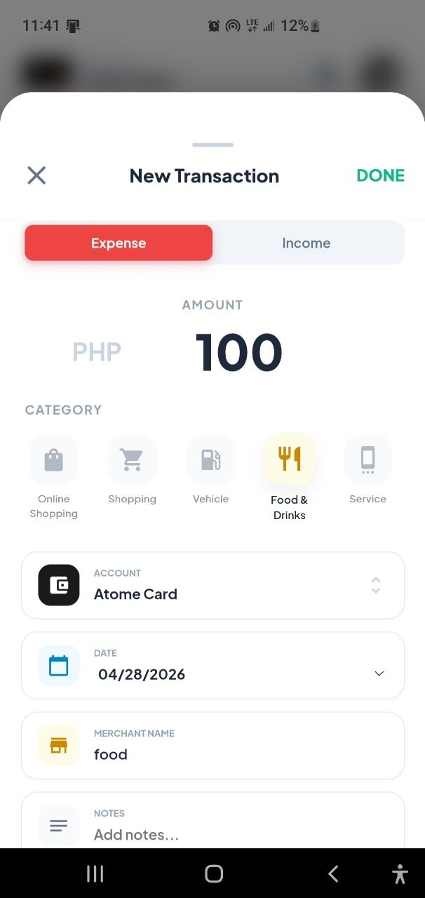
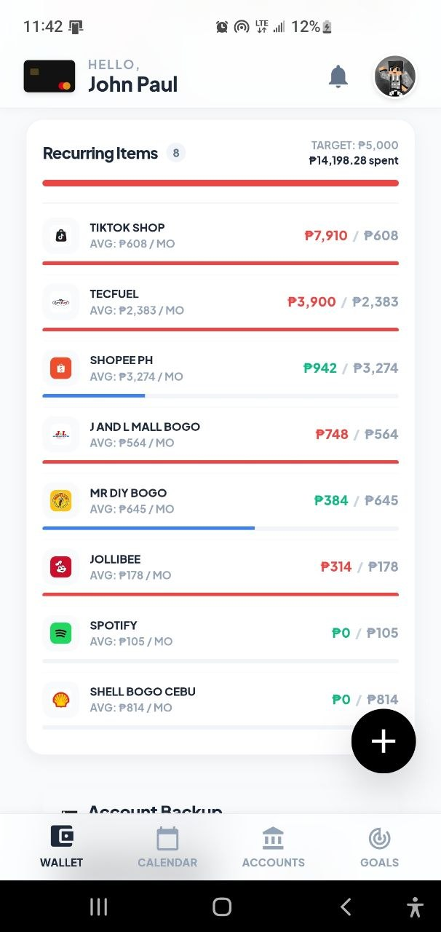
CORE FLOW
Simple User Journey
The project focuses on a short and practical flow: log in, manage wallet activity, and monitor the monthly dashboard.
1. Log In
2. Add Transactions
3. Track Monthly Spending
The user signs in and enters the app securely.
New expenses can be entered and organized inside the wallet.
The dashboard updates and shows summaries, charts, AI insight, and recurring expenses.
Smart Wallet Project Presentation

Slide 4
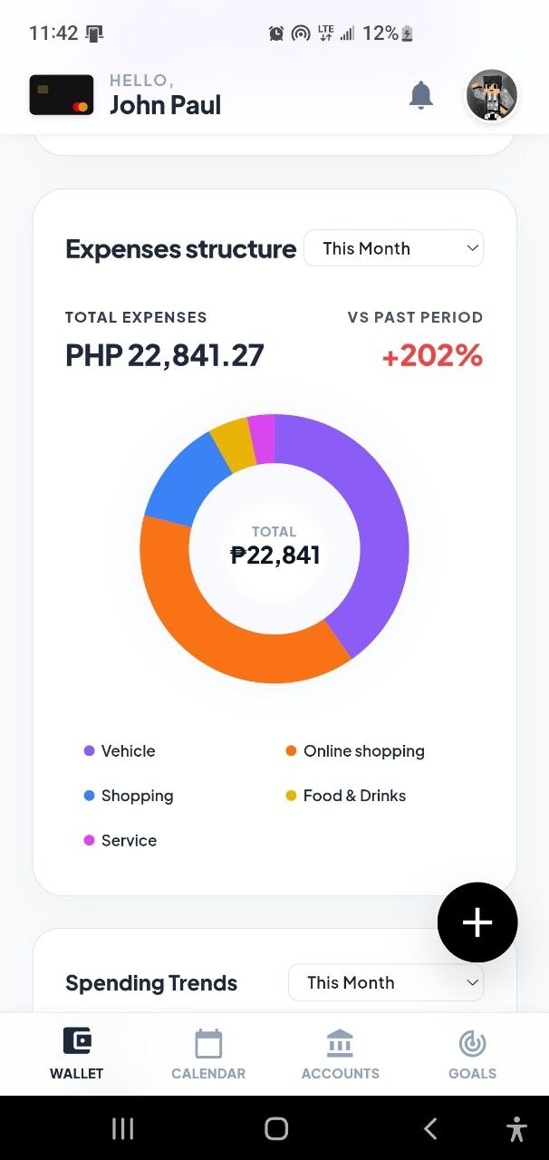
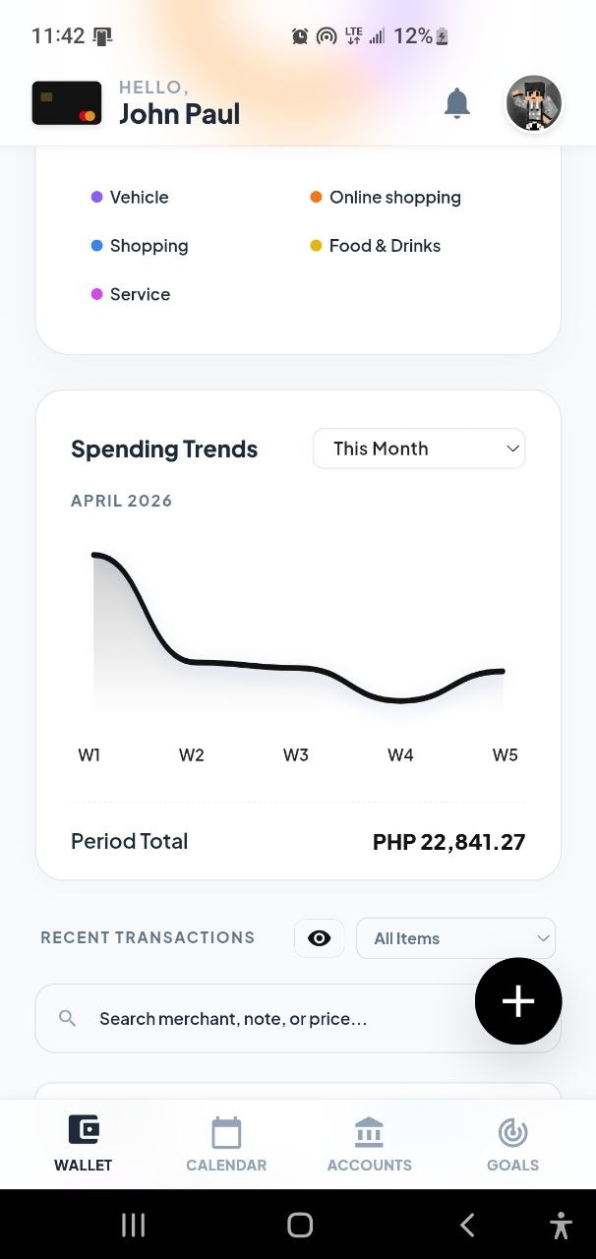
DASHBOARD
Monthly Expense Monitoring
The dashboard is the main area of the app, showing the user’s monthly financial position through cards, a donut chart, and a line chart.
What the dashboard shows
•
Overall monthly balance and spending overview
•
Donut chart for spending distribution
•
Line chart for monthly expense trend
•
Quick cards for easier monitoring
Smart Wallet Project Presentation

Slide 5
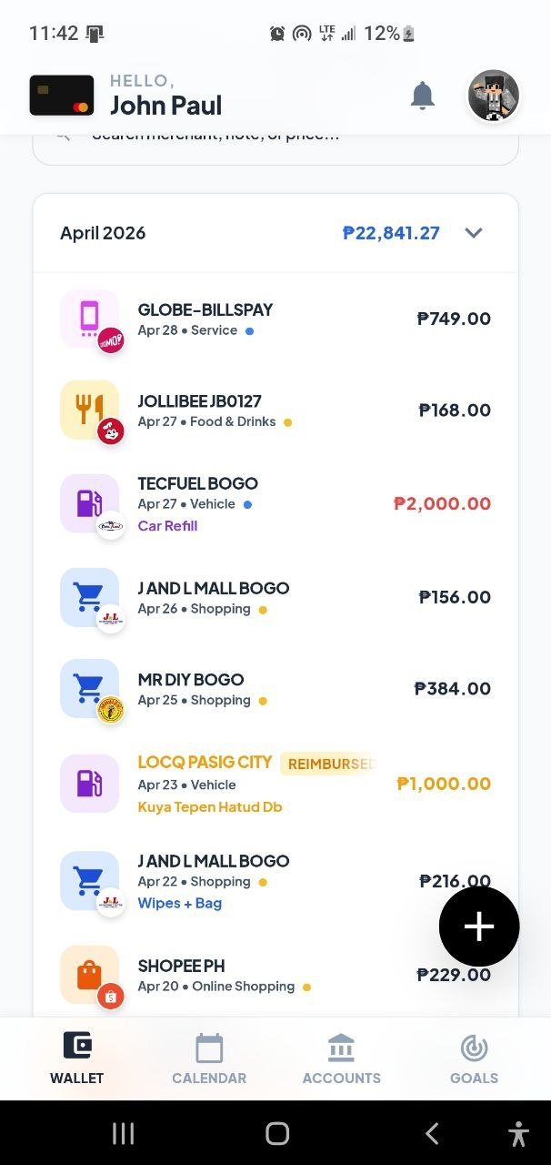
AI FEATURES
AI Summary and Recurring Expenses
These features make Smart Wallet more than a normal expense tracker by helping users understand both spending meaning and repeated monthly costs.
AI Summary Card
Recurring Expenses
Explains the user’s spending in simple language and gives quick insight about financial behavior.
Highlights repeated costs so the user can easily see subscriptions and recurring monthly spending patterns.
Smart Wallet Project Presentation

Slide 6
SMART WALLET
Project Value
Smart Wallet combines simple finance tracking with a clearer and more intelligent dashboard experience.
•
Helps users log in, manage wallet activity, and track monthly expenses
•
Shows spending visually through dashboard cards, a donut chart, and a line chart
•
Adds more value through AI Summary and recurring-expense tracking
Future direction: stronger testing, smarter budgeting, and more advanced financial recommendations.
Smart Wallet Project Presentation

