Slide 1

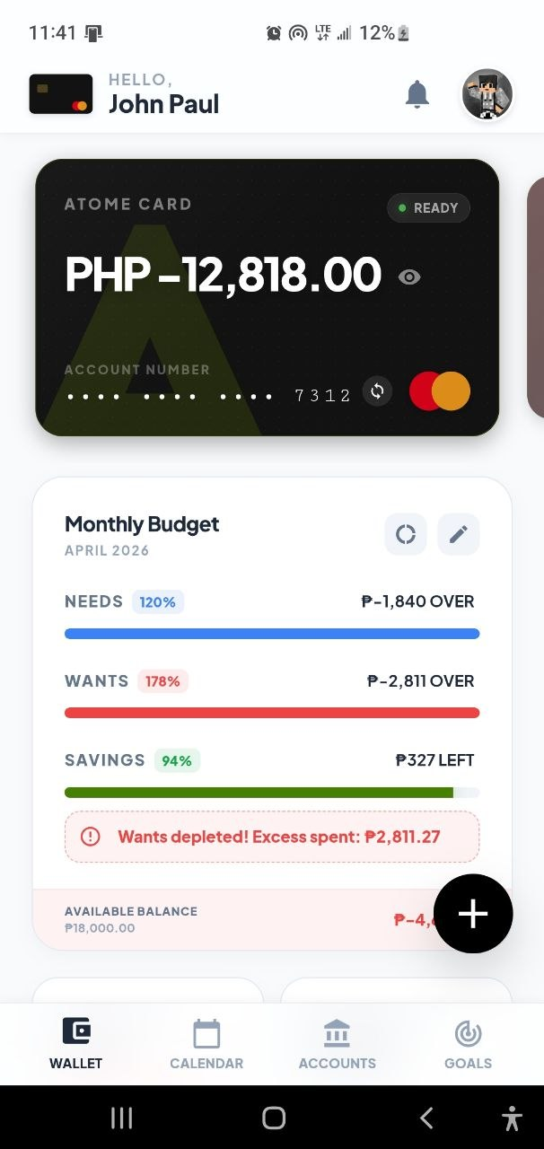

Project Title: BDSE-CAI-Capstone Project - AI
Smart Wallet
A short presentation of the app
A mobile-first finance tracker with dashboard analytics, AI spending summary, and recurring expense monitoring.
Module Project
Module: Applied Machine Learning
Course: BDSE
Start Date :
End Date : Submission Date :
Learner Name :
Enrollment ID :
John Paul Inso
BDSE-0922-119
Presentation Date :

Slide 2
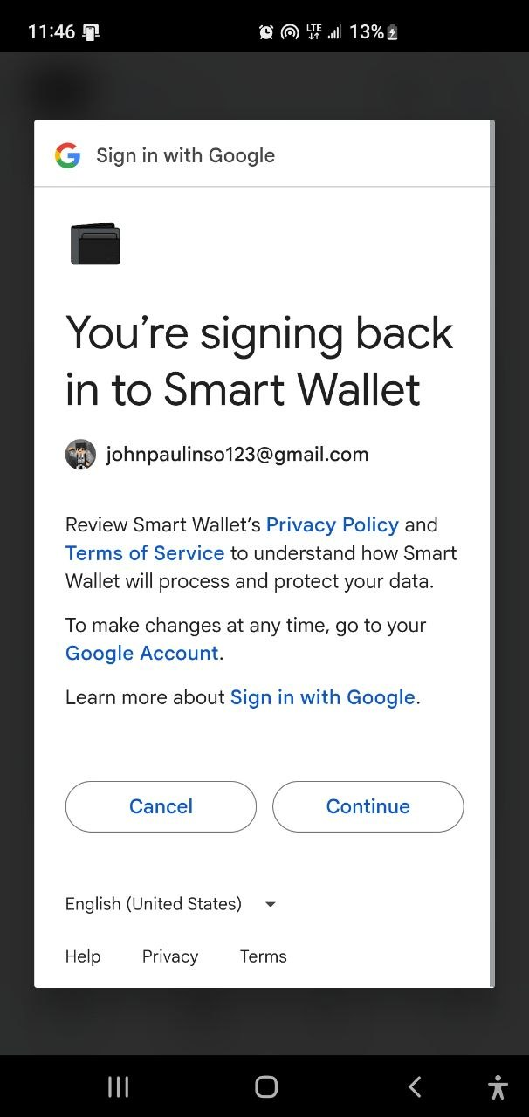
Document History
Table of Contents
Version Number | Effective Date of release | Summary of Included Changes | Author
1 | 15 Sept 2023 | First Edition | Dr. Roshan
•
Project overview
•
Core user flow
•
Dashboard and charts
•
AI and recurring expenses

Slide 3
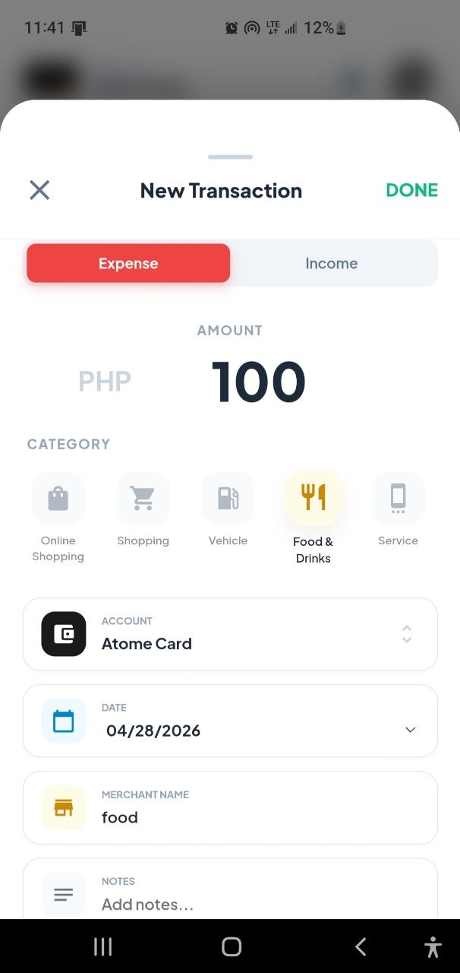
Contents
Core User Flow
•
Log in to access the wallet dashboard
•
Switch wallet accounts when needed
•
Add transactions and track spending

Slide 4
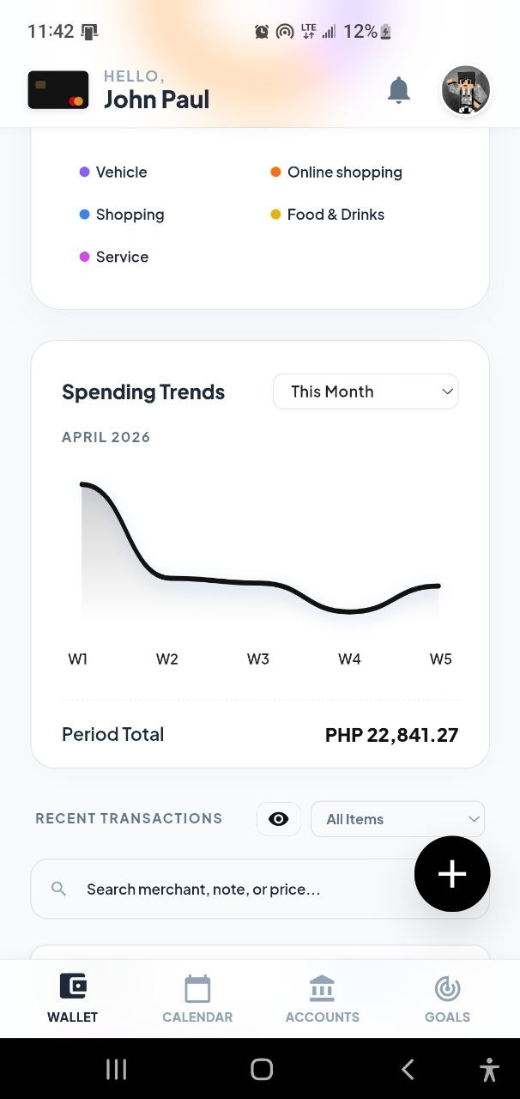


1. Title
Dashboard and Charts
•
Tracks all monthly expenses in one dashboard
•
Shows quick summaries and spending trends
•
Includes donut and line chart views

Slide 5
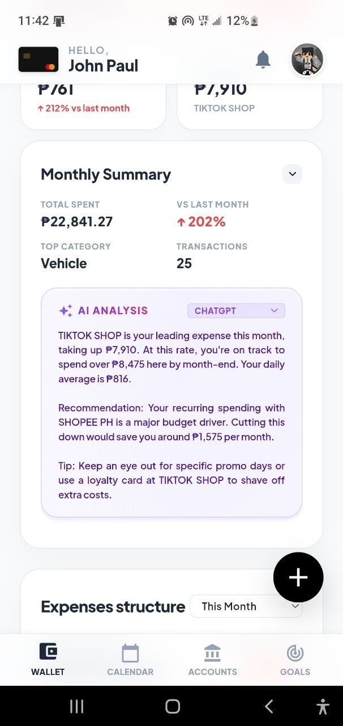
2. Proposed Solution
AI Summary
•
Explains spending behavior in simple words
•
Helps users understand their monthly pattern
•
Makes the app feel more helpful and intelligent

Slide 6
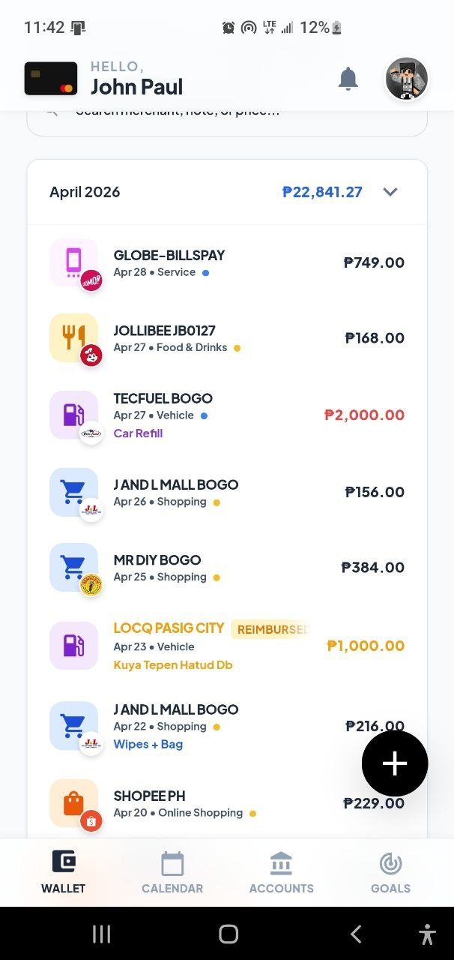

5. Conclusion and Proposed Improvements
Recurring Expenses
•
Highlights repeated monthly spending
•
Helps users notice recurring costs faster
•
Supports better budget awareness each month

