Slide 1

PEMS
Picking
Exception
Management
System
Captain Rollout & Training

Slide 2

Why are we doing this?
The Look-alike Problem
When two similar products are on the same shelf, pickers scan the wrong one.
The scanner rejects it, but it looks like a barcode glitch. The picker overrides it.
The wrong item ships. We find out days later when a customer complains.
Goal: Catch the pattern before the customer does.

Slide 3
How the system helps
We are not watching individual pickers.
We are looking at the shelf. If multiple pickers scan the same wrong product at the same location, it's a shelf problem.
Every morning, the system generates a Dispatch Sheet.
It ranks locations by Risk Score, based on:
  Frequency
  Diversity
  Consistency
  Recency

Slide 4
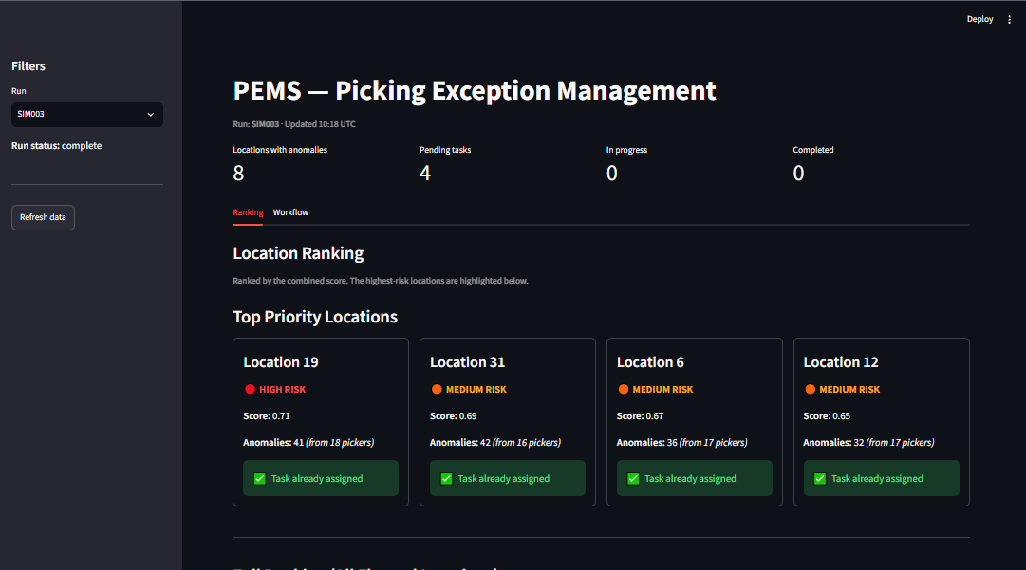
The Captain Dashboard
This is your view. Open the browser, check the ranking, and see the evidence.

Slide 5
Your Daily Workflow
Review the suggested tasks.
Accept the ones that look right. Reject duplicates or known issues.
Assign a Quality Shopper.
Shopper visits, records the cause, and closes the loop.
The system learns from the shopper's feedback.

Slide 6
System Status & Impact
Current Status (Run SIM003):
Top flagged location: 19
41 mismatch events detected
This week, we have a clear list of where to send shoppers first.
Open the Excel dispatch sheet to manage your shift.

