Slide 1
Applied Business Forecasting and Planning
MOVING AVERAGES AND EXPONENTIAL SMOOTHING

Slide 2
Introduction
This chapter introduces models applicable to time series data with seasonal, trend, or both seasonal and trend component and stationary data.
Forecasting methods discussed in this chapter can be classified as:
  Averaging methods.
    Equally weighted observations
  Exponential Smoothing methods.
    Unequal set of weights to past data, where the weights decay exponentially from the most recent to the most distant data points.
    All methods in this group require that certain parameters to be defined.
    These parameters (with values between 0 and 1) will determine the unequal weights to be applied to past data.

Slide 3
Introduction
Averaging methods
  If a time series is generated by a constant process subject to random error, then mean is a useful statistic and can be used as a forecast for the next period.
  Averaging methods are suitable for stationary time series data where the series is in equilibrium around a constant value ( the underlying mean) with a constant variance over time.

Slide 4
Introduction
Exponential smoothing methods
  The simplest exponential smoothing method is the single smoothing (SES) method where only one parameter needs to be estimated
  Holt’s method makes use of two different parameters and allows forecasting for series with trend.
  Holt-Winters’ method involves three smoothing parameters to smooth the data, the trend, and the seasonal index.

Slide 5
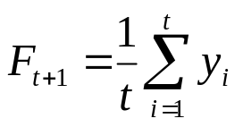
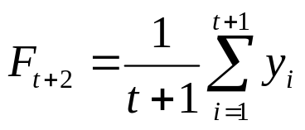
Averaging Methods
The Mean
  Uses the average of all the historical data as the forecast
  When new data becomes available , the forecast for time t+2 is the new mean including the previously observed data plus this new observation.
  This method is appropriate when there is no noticeable trend or seasonality.

Slide 6
Averaging Methods
The moving average for time period t is the mean of the “k” most recent observations.
The constant number k is specified at the outset.
The smaller the number k, the more weight is given to recent periods.
The greater the number k, the less weight is given to more recent periods.

Slide 7
Moving Averages
A large k is desirable when there are wide, infrequent fluctuations in the series.
A small k is most desirable when there are sudden shifts in the level of series.
For quarterly data, a four-quarter moving average, MA(4), eliminates or averages out seasonal effects.

Slide 8
Moving Averages
For monthly data, a 12-month moving average, MA(12), eliminate or averages out seasonal effect.
Equal weights are assigned to each observation used in the average.
Each new data point is included in the average as it becomes available, and the oldest data point is discarded.

Slide 9
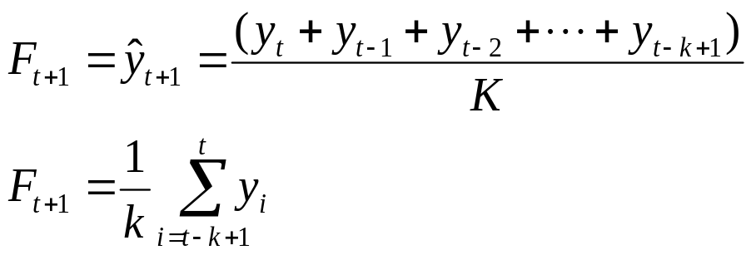
Moving Averages
A moving average of order k, MA(k) is the value of k consecutive observations.
  K is the number of terms in the moving average.
The moving average model does not handle trend or seasonality very well although it can do better than the total mean.

Slide 10
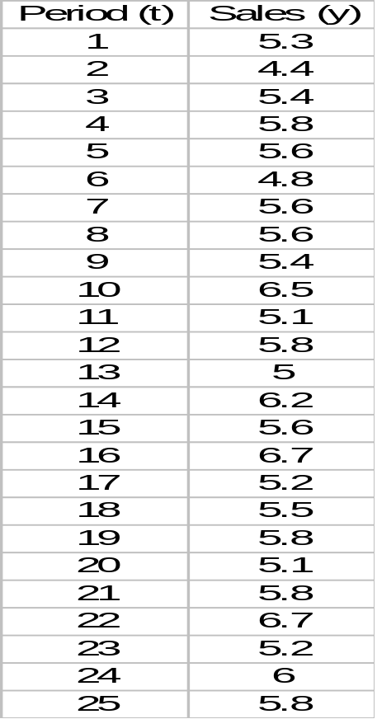
Example: Weekly Department Store Sales
The weekly sales figures (in millions of dollars) presented in the following table are used by a major department store to determine the need for temporary sales personnel.

Slide 11
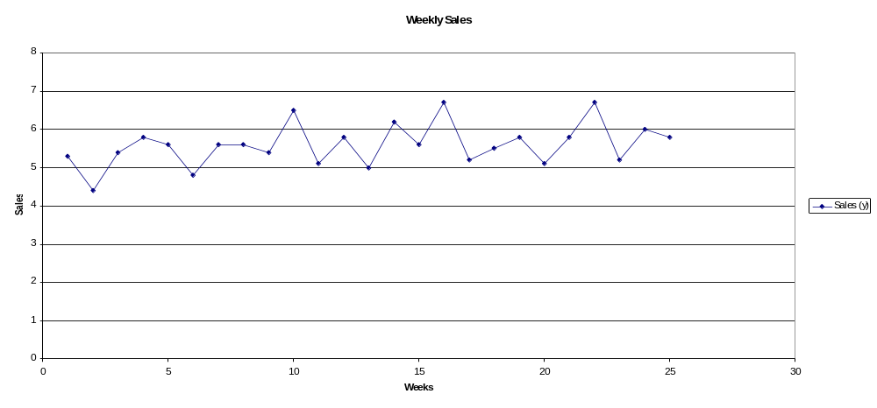
Example: Weekly Department Store Sales

Slide 12
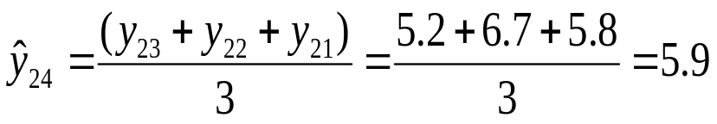

Example: Weekly Department Store Sales
Use a three-week moving average (k=3) for the department store sales to forecast for the week 24 and 26.
The forecast error is

Slide 13
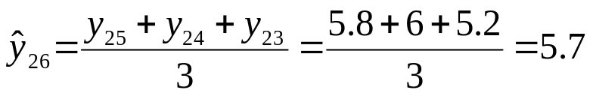
Example: Weekly Department Store Sales
The forecast for the week 26 is

Slide 14
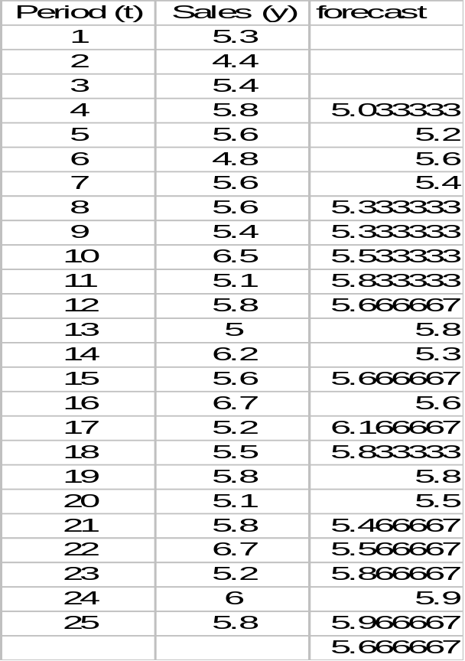
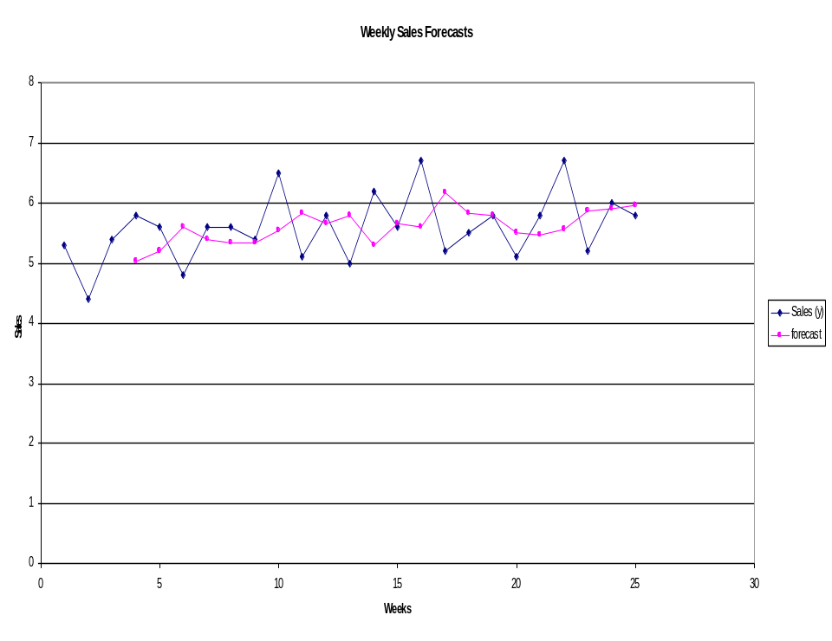
Example: Weekly Department Store Sales
RMSE = 0.63

Slide 15
Exponential Smoothing Methods
This method provides an exponentially weighted moving average of all previously observed values.
Appropriate for data with no predictable upward or downward trend.
The aim is to estimate the current level and use it as a forecast of future value.
Notes:
This is an obvious extension the moving average method. With simple moving average forecasts the mean of the past k observations used as a forecast have equal eights (1/k) for all k data points. With exponential smoothing the idea is that the most recent observations will usually provide the best guide as to the future, so we want a weighting scheme that has decreasing weights as the observations get older

Slide 16



Simple Exponential Smoothing Method
Formally, the exponential smoothing equation is
    forecast for the next period.
    α = smoothing constant.
    y_{t} = observed value of series in period t.
    = old forecast for period t.
  The forecast F_{t+1} is based on weighting the most recent observation y_{t} with a weight α and weighting the most recent forecast F_{t} with a weight of 1- α

Slide 17
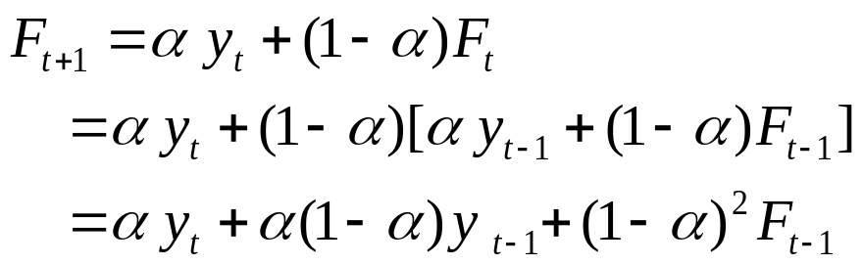
Simple Exponential Smoothing Method
The implication of exponential smoothing can be better seen if the previous equation is expanded by replacing F_{t} with its components as follows:

Slide 18
Simple Exponential Smoothing Method
If this substitution process is repeated by replacing F_{t-1} by its components, F_{t-2} by its components, and so on the result is:
Therefore, F_{t+1} is the weighted moving average of all past observations.

Slide 19
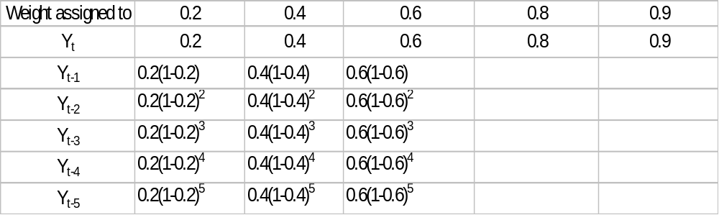
Simple Exponential Smoothing Method
The following table shows the weights assigned to past observations for α = 0.2, 0.4, 0.6, 0.8, 0.9

Slide 20

Simple Exponential Smoothing Method
The exponential smoothing equation rewritten in the following form elucidate the role of weighting factor α.
Exponential smoothing forecast is the old forecast plus an adjustment for the error that occurred in the last forecast.

Slide 21
Simple Exponential Smoothing Method
The value of smoothing constant α must be between 0 and 1
α can not be equal to 0 or 1.
If stable predictions with smoothed random variation is desired then a small value of α is desire.
If a rapid response to a real change in the pattern of observations is desired, a large value of α is appropriate.

Slide 22
Simple Exponential Smoothing Method
To estimate α, Forecasts are computed for α equal to .1, .2, .3, …, .9 and the sum of squared forecast error is computed for each.
The value of α with the smallest RMSE is chosen for use in producing the future forecasts.

Slide 23
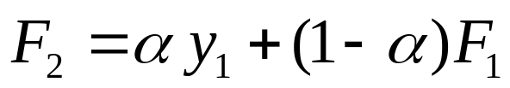
Simple Exponential Smoothing Method
To start the algorithm, we need F₁ because
Since F₁ is not known, we can
  Set the first estimate equal to the first observation.
  Use the average of the first five or six observations for the initial smoothed value.

Slide 24
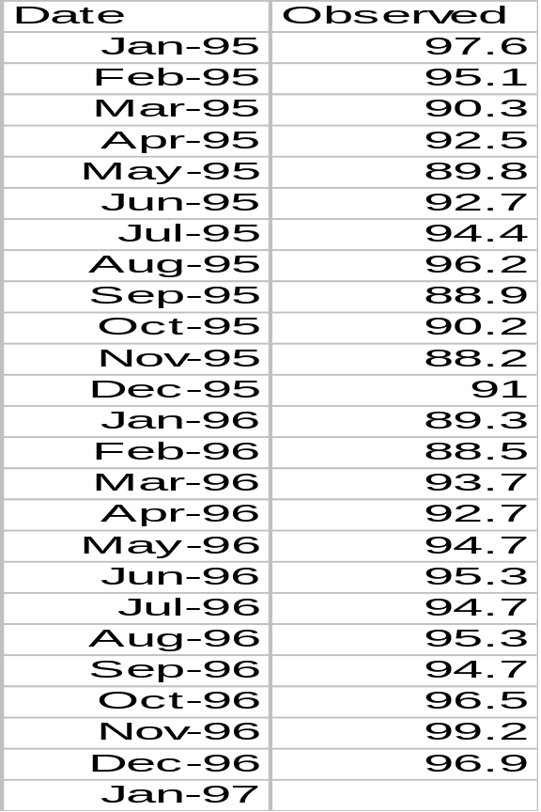
Example:University of Michigan Index of Consumer Sentiment
University of Michigan Index of Consumer Sentiment for January1995- December1996.
we want to forecast the University of Michigan Index of Consumer Sentiment using Simple Exponential Smoothing Method.

Slide 25
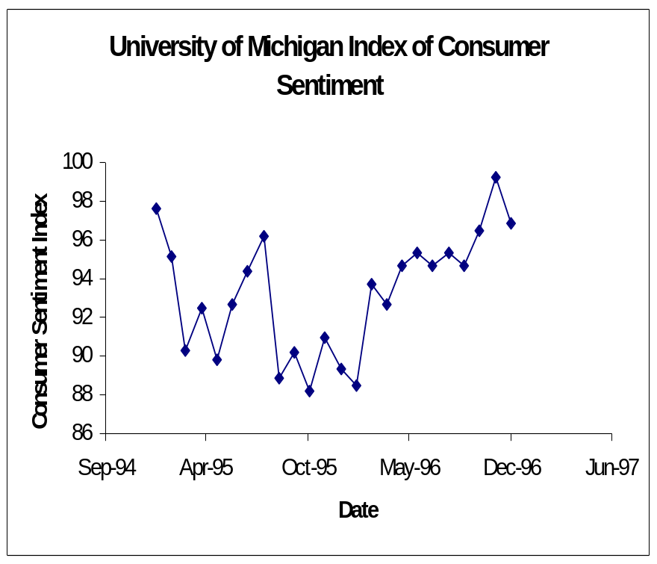
Example:University of Michigan Index of Consumer Sentiment
Since no forecast is available for the first period, we will set the first estimate equal to the first observation.
We try α =0.3, and 0.6.

Slide 26
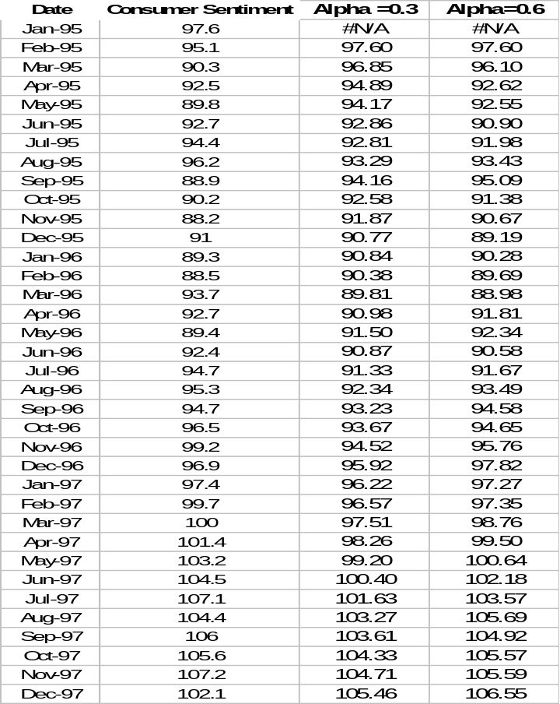
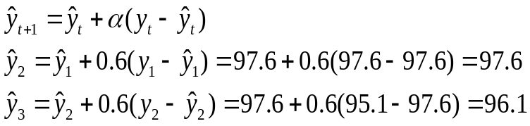
Example:University of Michigan Index of Consumer Sentiment
Note the first forecast is the first observed value.
The forecast for Feb. 95 (t = 2) and Mar. 95 (t = 3) are evaluated as follows:

Slide 27
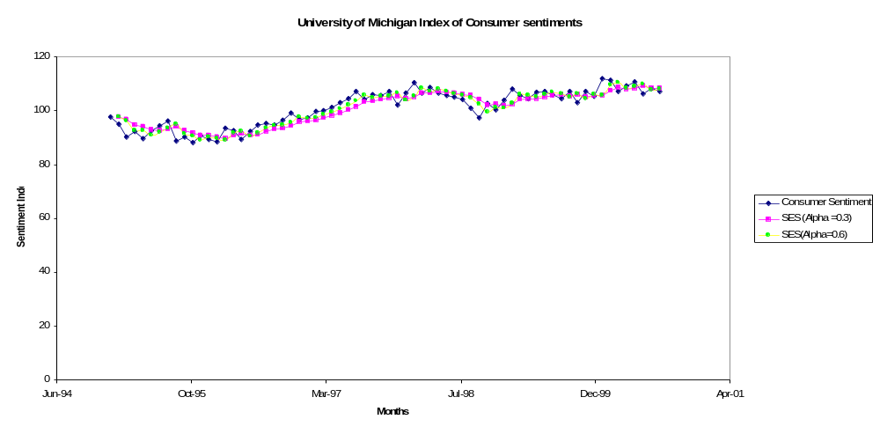
Example:University of Michigan Index of Consumer Sentiment
RMSE =2.66 for α = 0.6
RMSE =2.96 for α = 0.3

Slide 28
Holt’s Exponential smoothing
Holt’s two parameter exponential smoothing method is an extension of simple exponential smoothing.
It adds a growth factor (or trend factor) to the smoothing equation as a way of adjusting for the trend.

Slide 29



Holt’s Exponential smoothing
Three equations and two smoothing constants are used in the model.
  The exponentially smoothed series or current level estimate.
  The trend estimate.
  Forecast m periods into the future.

Slide 30
Holt’s Exponential smoothing
  L_{t} = Estimate of the level of the series at time t
  α = smoothing constant for the data.
  y_{t} = new observation or actual value of series in period t.
  β = smoothing constant for trend estimate
  b_{t} = estimate of the slope of the series at time t
  m = periods to be forecast into the future.

Slide 31
Holt’s Exponential smoothing
The weight α and β can be selected subjectively or by minimizing a measure of forecast error such as RMSE.
Large weights result in more rapid changes in the component.
Small weights result in less rapid changes.

Slide 32
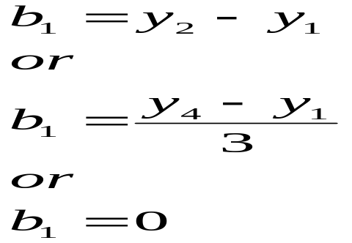
Holt’s Exponential smoothing
The initialization process for Holt’s linear exponential smoothing requires two estimates:
  One to get the first smoothed value for L₁
  The other to get the trend b₁.
One alternative is to set L₁ = y₁ and

Slide 33
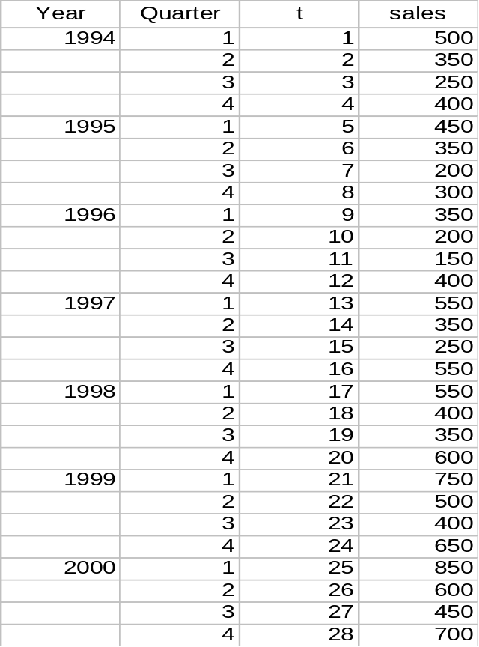
Example:Quarterly sales of saws for Acme tool company
The following table shows the sales of saws for the Acme tool Company.
These are quarterly sales From 1994 through 2000.

Slide 34
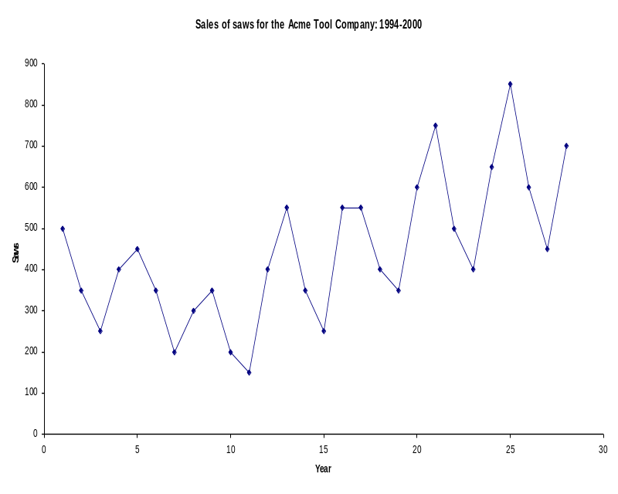
Example:Quarterly sales of saws for Acme tool company
Examination of the plot shows:
  A non-stationary time series data.
  Seasonal variation seems to exist.
    Sales for the first and fourth quarter are larger than other quarters.

Slide 35
Example:Quarterly sales of saws for Acme tool company
The plot of the Acme data shows that there might be trending in the data therefore we will try Holt’s model to produce forecasts.
We need two initial values
  The first smoothed value for L₁
  The initial trend value b₁.
We will use the first observation for the estimate of the smoothed value L₁, and the initial trend value b₁ = 0.
We will use α = .3 and β=.1.

Slide 36
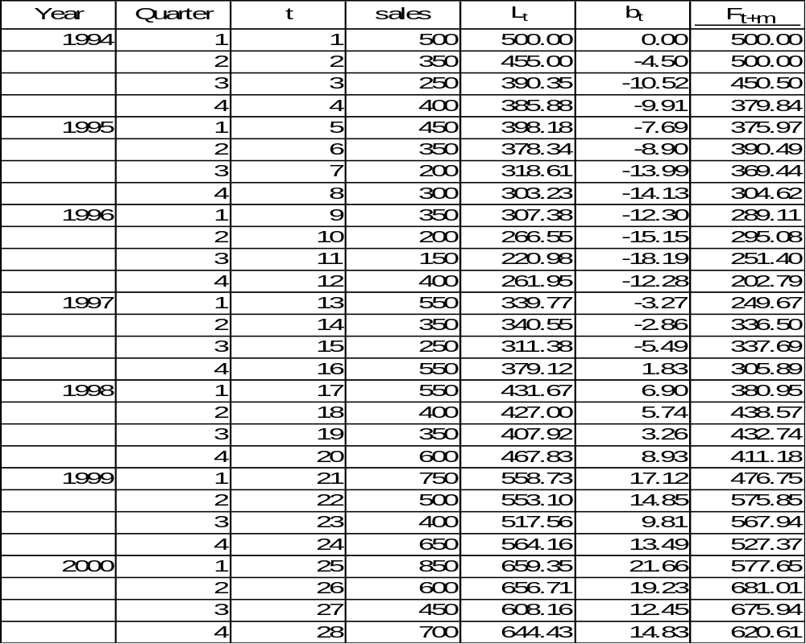
Example:Quarterly sales of saws for Acme tool company

Slide 37
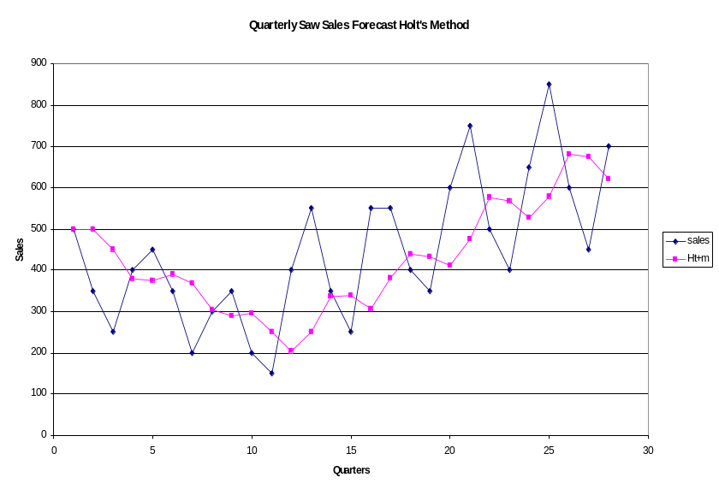
Example:Quarterly sales of saws for Acme tool company
RMSE for this application is:
α = .3 and β= .1 RMSE = 155.5
The plot also showed the possibility of seasonal variation that needs to be investigated.

Slide 38
Winter’s Exponential Smoothing
Winter’s exponential smoothing model is the second extension of the basic Exponential smoothing model.
It is used for data that exhibit both trend and seasonality.
It is a three parameter model that is an extension of Holt’s method.
An additional equation adjusts the model for the seasonal component.

Slide 39
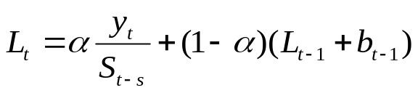

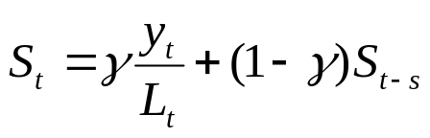
Winter’s Exponential Smoothing
The four equations necessary for Winter’s multiplicative method are:
  The exponentially smoothed series:
  The trend estimate:
  The seasonality estimate:

Slide 40


Winter’s Exponential Smoothing
  Forecast m period into the future:
    L_{t} = level of series.
    α = smoothing constant for the data.
    y_{t} = new observation or actual value in period t.
    β = smoothing constant for trend estimate.
    b_{t} = trend estimate.
    γ = smoothing constant for seasonality estimate.
    S_{t} =seasonal component estimate.
    m = Number of periods in the forecast lead period.
    s = length of seasonality (number of periods in the season)
    = forecast for m periods into the future.

Slide 41
Winter’s Exponential Smoothing
As with Holt’s linear exponential smoothing, the weights α, β, and γ can be selected subjectively or by minimizing a measure of forecast error such as RMSE.
As with all exponential smoothing methods, we need initial values for the components to start the algorithm.
To start the algorithm, the initial values for L_{t}, the trend b_{t}, and the indices S_{t} must be set.

Slide 42
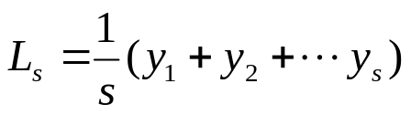
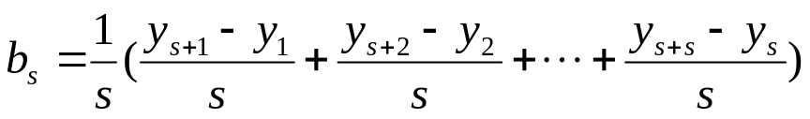
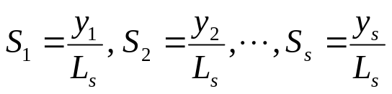
Winter’s Exponential Smoothing
To determine initial estimates of the seasonal indices we need to use at least one complete season's data (i.e. s periods).Therefore,we initialize trend and level at period s.
Initialize level as:
Initialize trend as
Initialize seasonal indices as:

Slide 43
Winter’s Exponential Smoothing
We will apply Winter’s method to Acme Tool company sales. The value for α is .4, the value for β is .1, and the value for γ is .3.
The smoothing constant α smoothes the data to eliminate randomness.
The smoothing constant β smoothes the trend in the data set.

Slide 44
Winter’s Exponential Smoothing
The smoothing constant γ smoothes the seasonality in the data.
The initial values for the smoothed series L_{t}, the trend b_{t}, and the seasonal index S_{t} must be set.

Slide 45
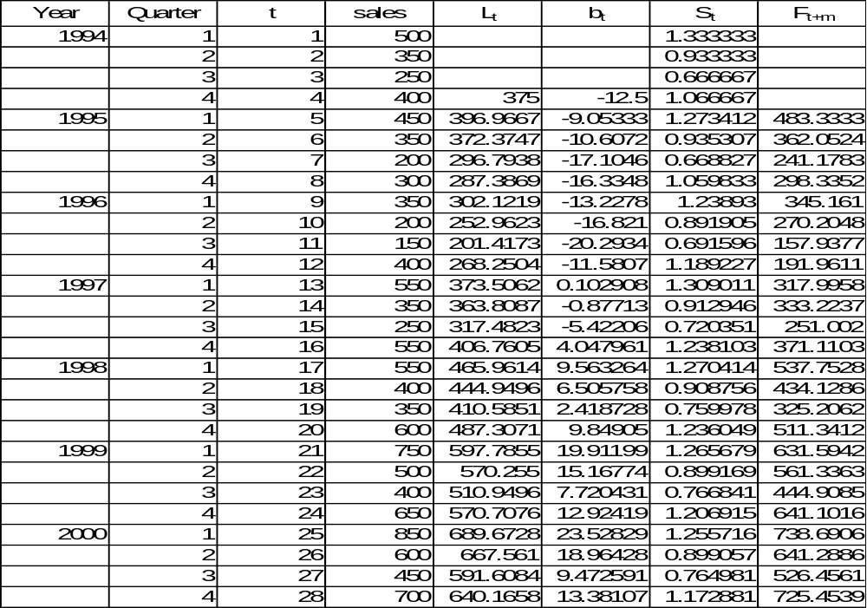
Example: Quarterly Sales of Saws for Acme tool

Slide 46
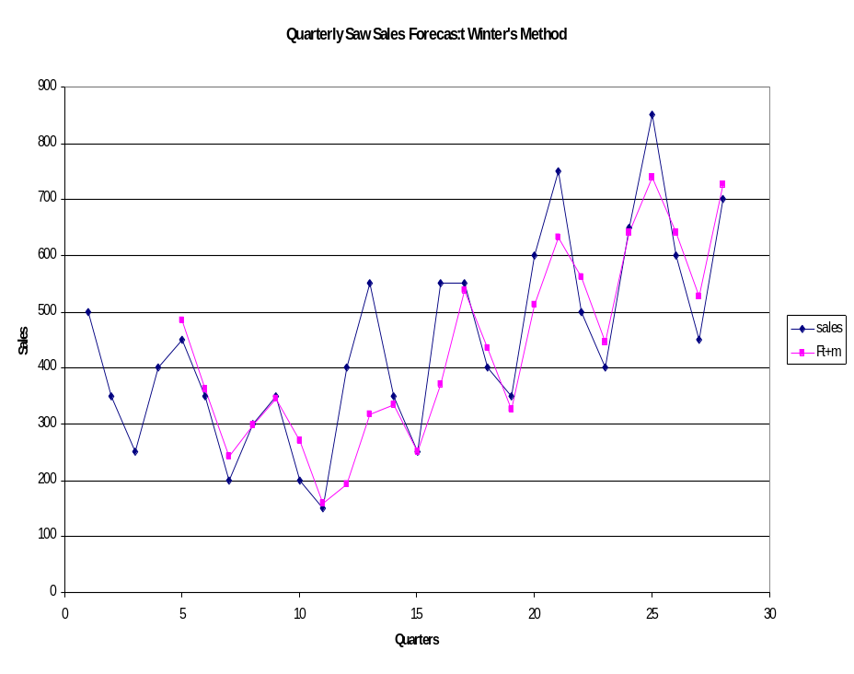
Example: Quarterly Sales of Saws for Acme tool
RMSE for this application is:
α = 0.4, β= 0.1, γ = 0.3 and RMSE = 83.36
Note the decrease in RMSE.

Slide 47
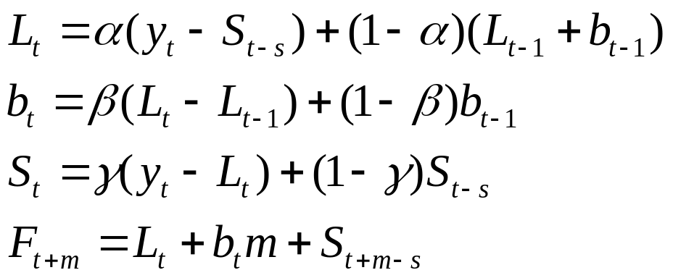
Additive Seasonality
The seasonal component in Holt-Winters’ method.
The basic equations for Holt’s Winters’ additive method are:

Slide 48
Additive Seasonality
The initial values for L_{s} and b_{s} are identical to those for the multiplicative method.
To initialize the seasonal indices we use

