Slide 1
Core Java
MCE – 2nd Year

Slide 2
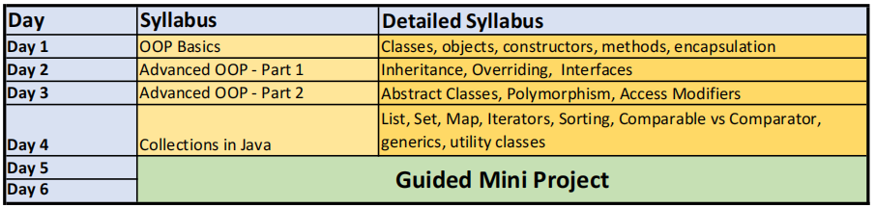
Day Wise Schedule

Slide 3
Hands-on Project
Project Name: Order Management System
Application Type: Console Application.
Concepts Included: Classes, Objects, Constructors, Methods, Encapsulation, Inheritance, Overriding, Interfaces, Abstract classes, Polymorphism, Access Modifiers, List, Set, Map, Iterators, Sorting, Comparable vs Comparator, Generics and Java Util Classes.

Slide 4
Pre Requisite
Latest Version of Java 25
Latest Version of Eclipse IDE

Slide 5
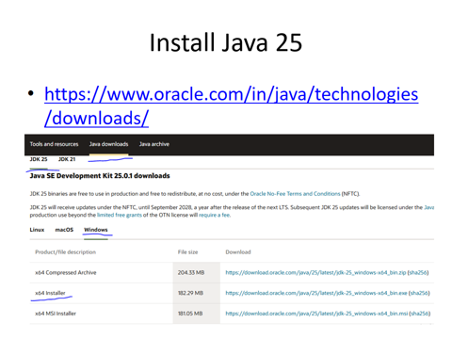

Slide 6
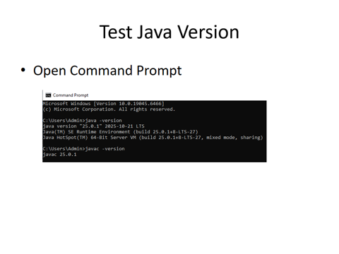

Slide 7
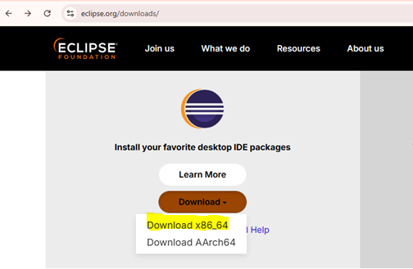
Install Eclipse

Slide 8
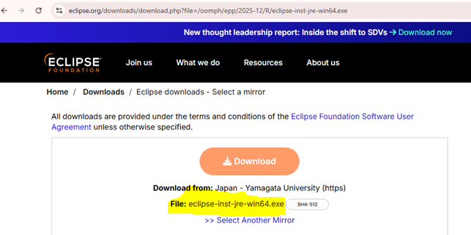
Install Eclipse

Slide 9
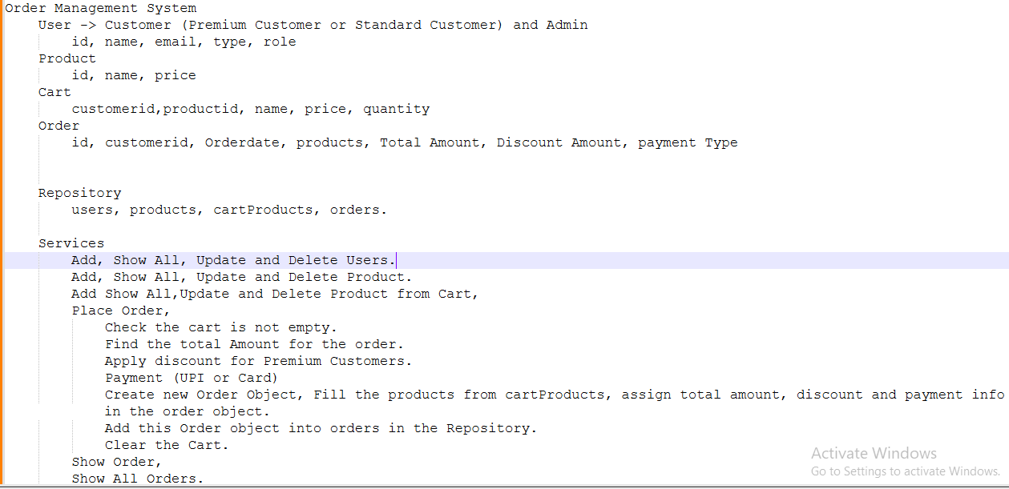
Order Management System: Objects Identification

Slide 10
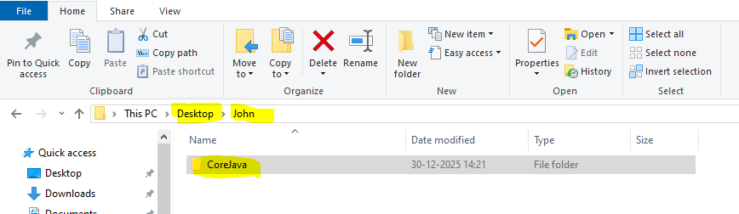
Workspace Folder
In Desktop, Create a folder (your name).
In that folder, create a folder CoreJava

Slide 11
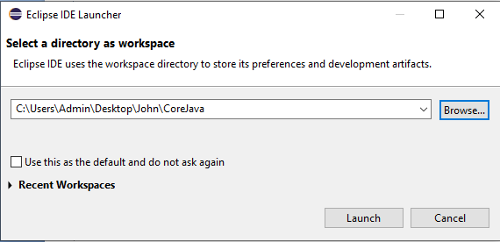
Launch Workspace Folder in Eclipse

Slide 12
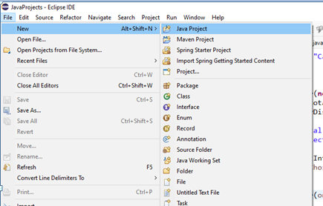
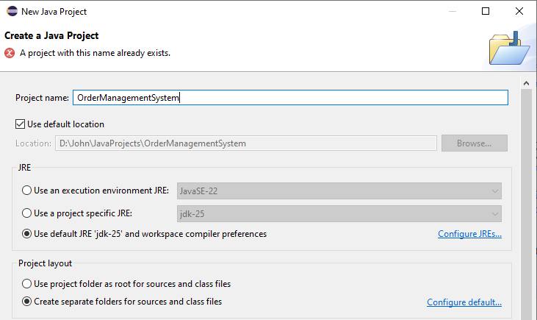
Create New Java Project

Slide 13
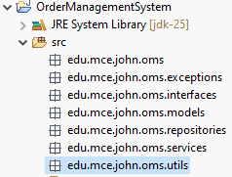
Create Project Structure (Packages)

Slide 14
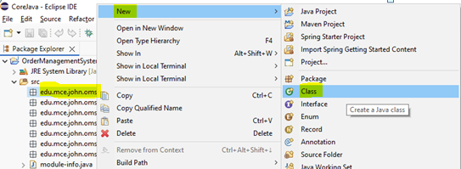
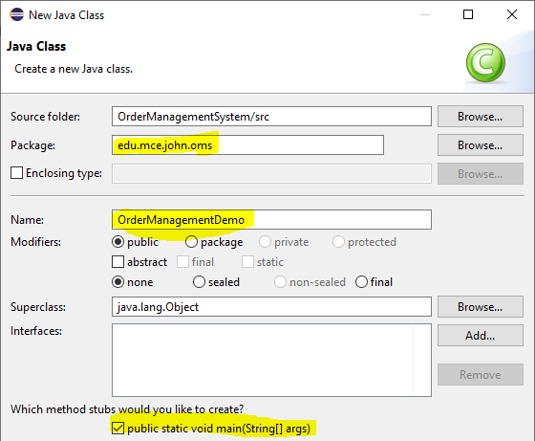
Create New Class

Slide 15
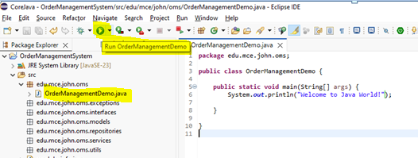
Run First Java Program

Slide 16
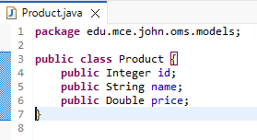
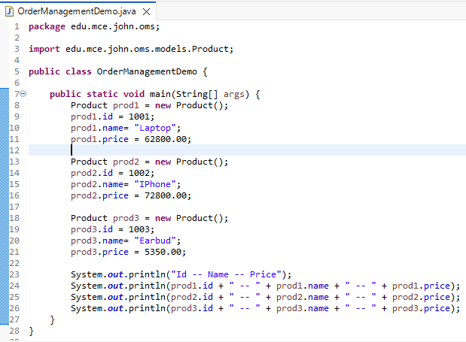
Class Product and Product Objects

Slide 17
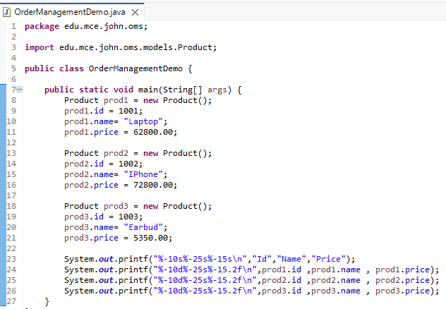
Formatted Output

Slide 18
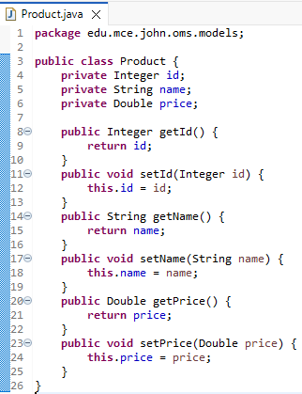
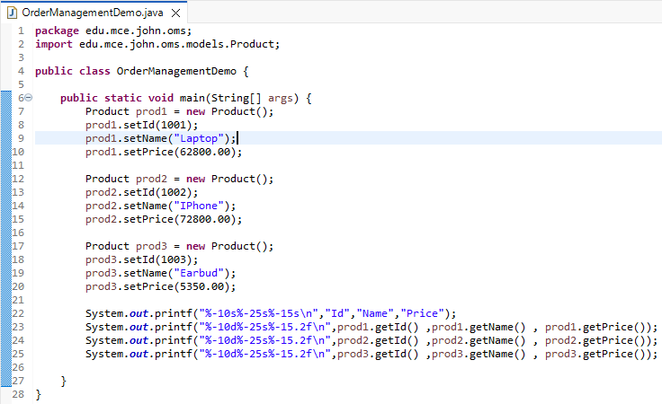
Getters and Setters

Slide 19
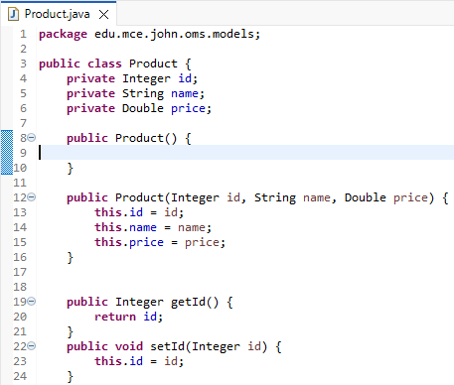
Default and Parameterized Constructors

Slide 20
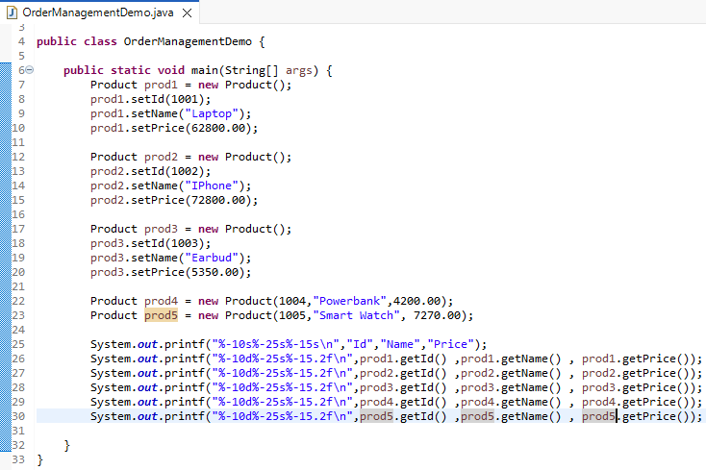
Default and Parameterized Constructors

Slide 21
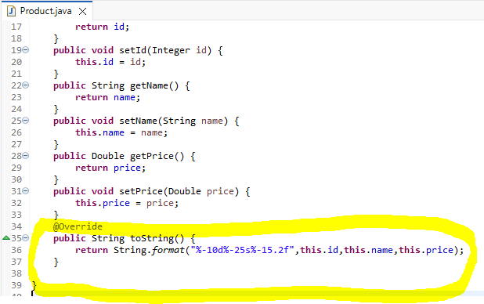
toString Method

Slide 22
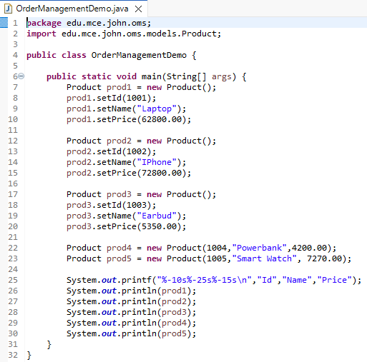
toString Method

Slide 23
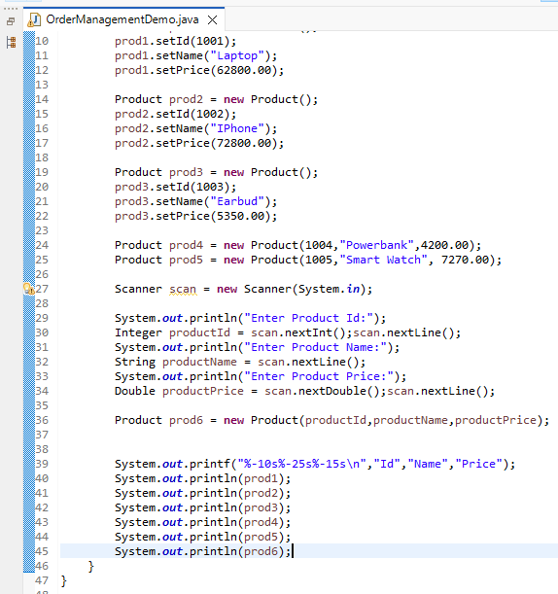
Scanner – Read Input

Slide 24
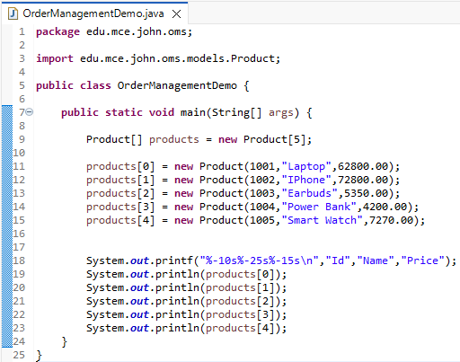
Array of Objects

Slide 25
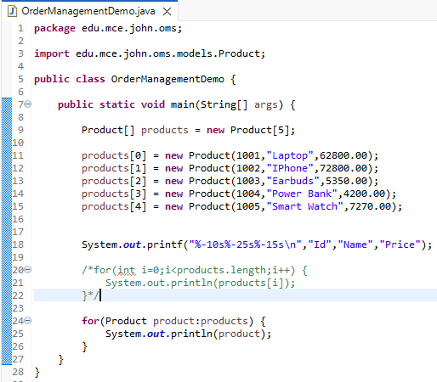
Array of Objects

Slide 26
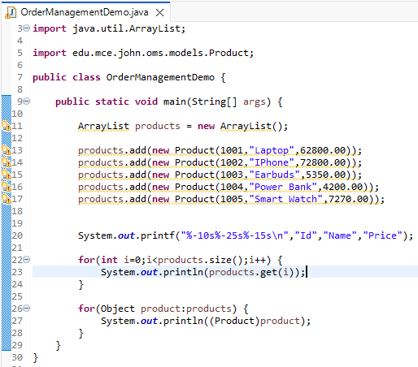
ArrayList

Slide 27
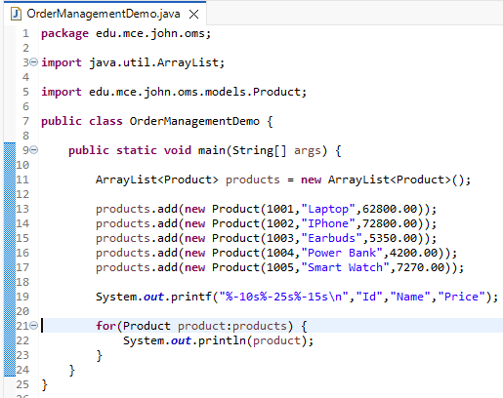
ArrayList with Generics

Slide 28
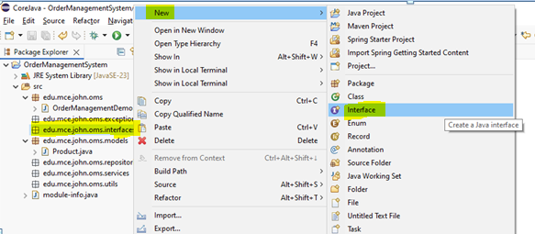
Create Interface ProductCRUD

Slide 29
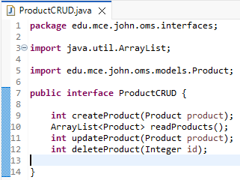
ProductCRUD

Slide 30
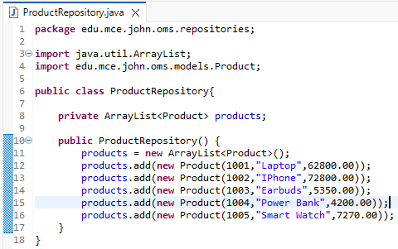
ProductRepository

Slide 31
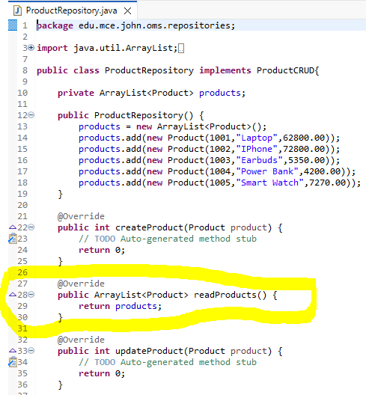
Repository – Read All Products

Slide 32
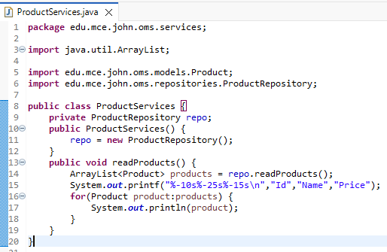
Service – Read All Products

Slide 33
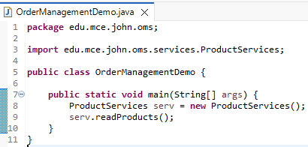
Test – Read All Products

Slide 34
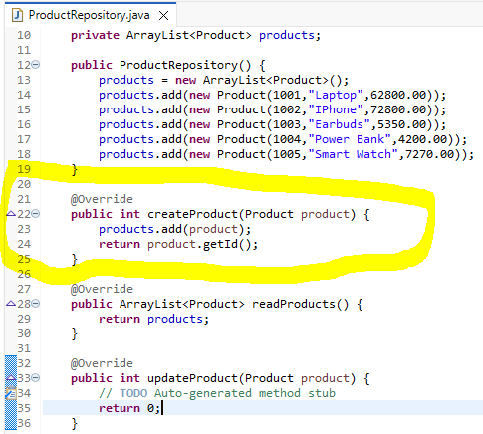
Repository: Create New Product

Slide 35
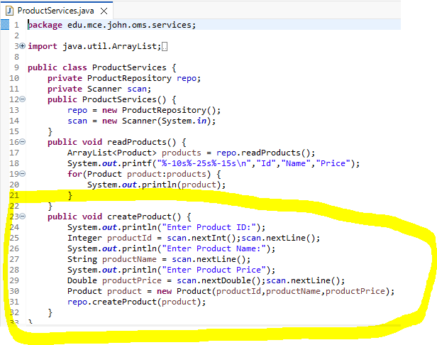
Service: Create New Product

Slide 36
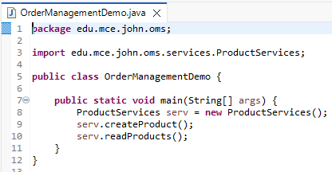
Test: Create New Product

Slide 37
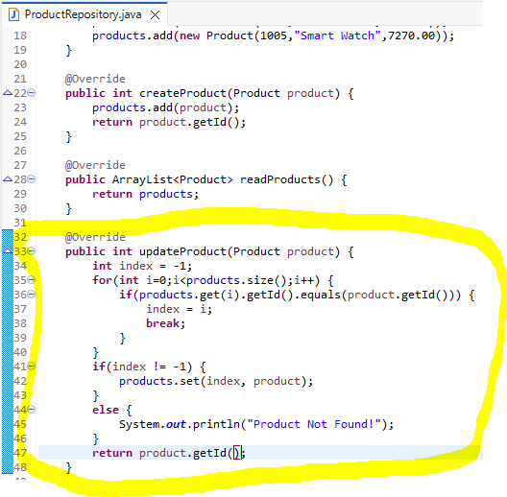
Repository: Update Product

Slide 38
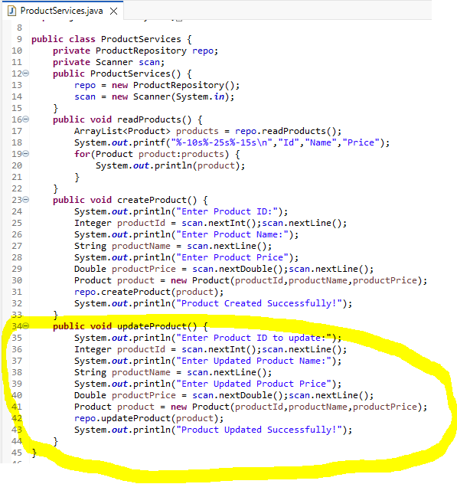
Service: Update Product

Slide 39
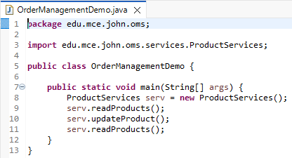
Test: Update Product

Slide 40
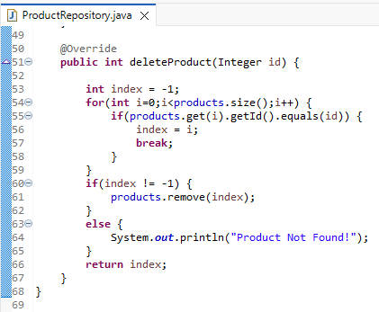
Repository: Delete Product

Slide 41
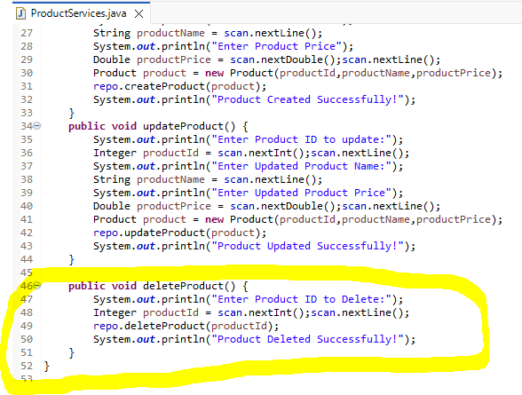
Service: Delete Product

Slide 42
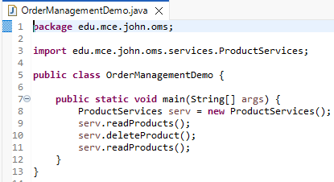
Test: Delete Product

Slide 43
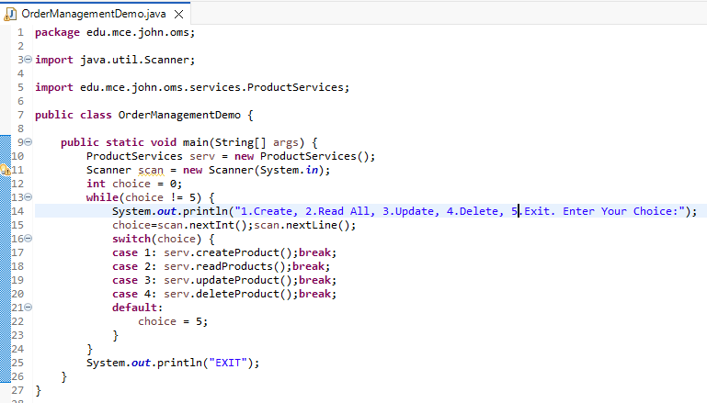
Product CRUD – Menu Driven

Slide 44
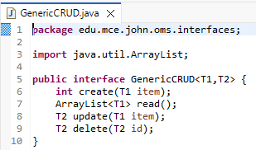
GenericCRUD

Slide 45
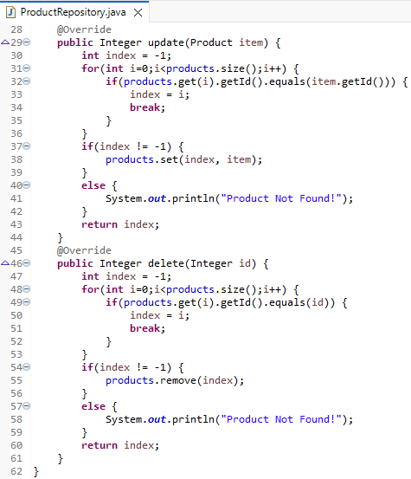
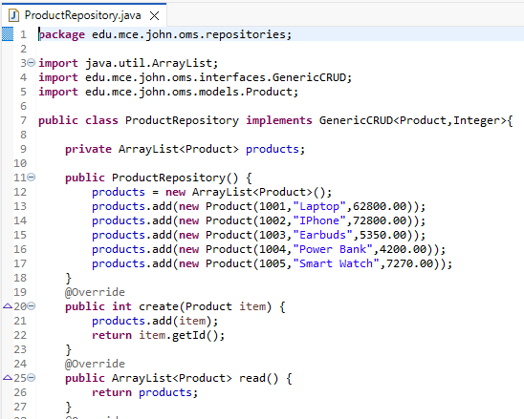
Product Repository with Generic CRUD

Slide 46
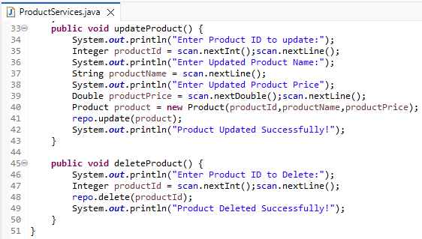
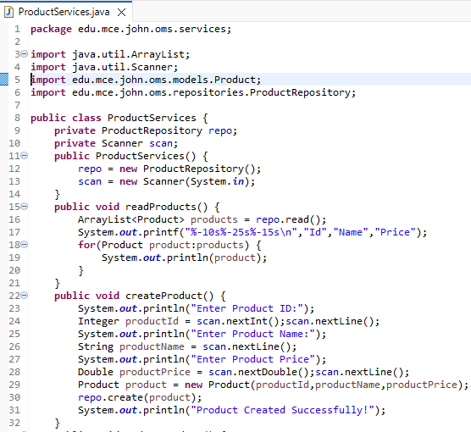
Product Service with Generic CRUD

Slide 47
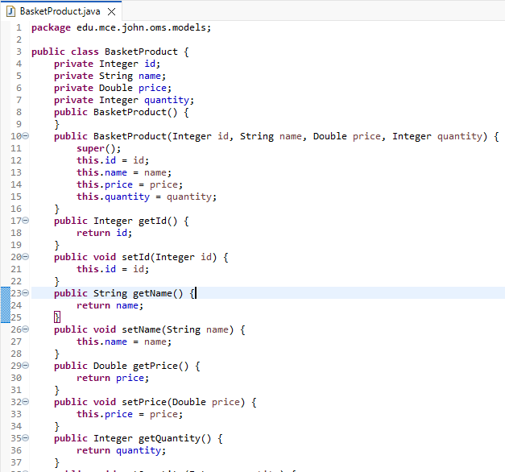

BasketProduct

Slide 48

BasketProductRepository

Slide 49

BasketProductRepository

Slide 50

BasketProductServices

Slide 51

BasketProductServices

Slide 52

Test BasketProducts

Slide 53


User

Slide 54


Admin and Customer

Slide 55


UserRepository

Slide 56


UserServices

Slide 57

UserServices

Slide 58

Test User Services

