Slide 1
Java – Hands On
Career Craft Academy

Slide 2
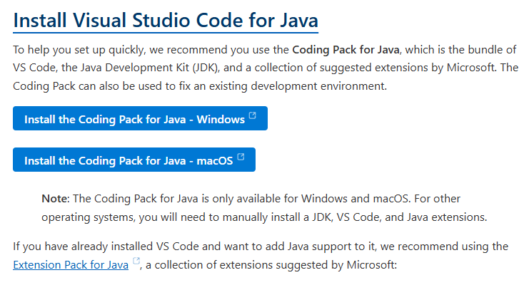
Install VS Code with Java
https://code.visualstudio.com/docs/languages/java

Slide 3
Java Fundamentals And Project Setup
JDK, JRE, JVM, Compilation and Execution
main method, variables, data types and operators.
if, switch, loops and console output
Create the project and display the library menu.

Slide 4
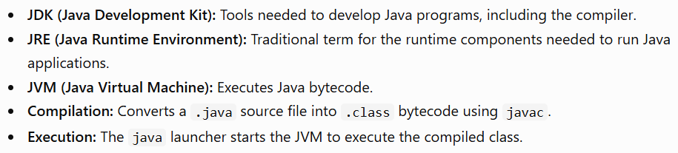
Java Fundamentals

Slide 5
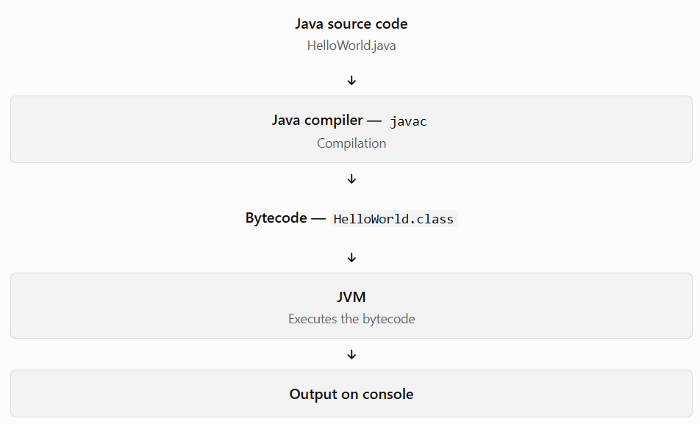
Java Fundamentals

Slide 6
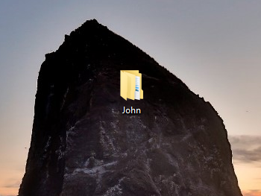
Create Workspace Folder in Desktop

Slide 7
Java Program Structure
Workspace Folder
Java Project
Java Package
Java Class{
Data Type variable1;
Data Type variable2;
Data Type variableN;
Method1(){
statement1;
statement2;
statementN;
}
Method2(){}
MethodN(){}
}

Slide 8

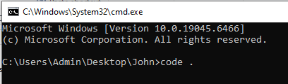
Open Command Prompt from Workspace folder
Open VS Code from Command Prompt

Slide 9

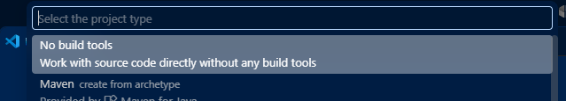
Create New Java Project
Ctrl + Shift + P
No Build Tools

Slide 10
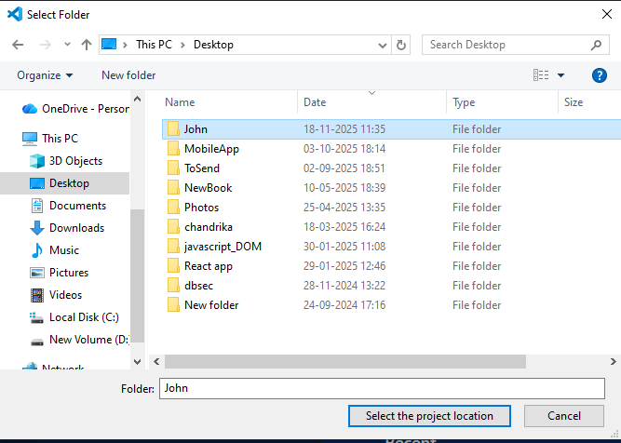
Select Project Location Folder

Slide 11

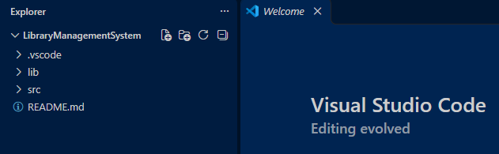
Project Name

Slide 12
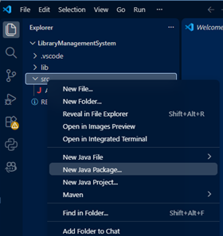

Create Java Package (base)

Slide 13
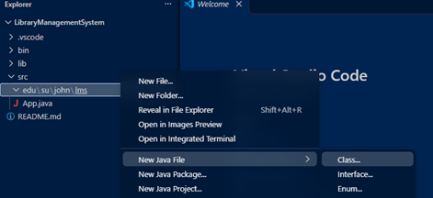

Create Java Class

Slide 14
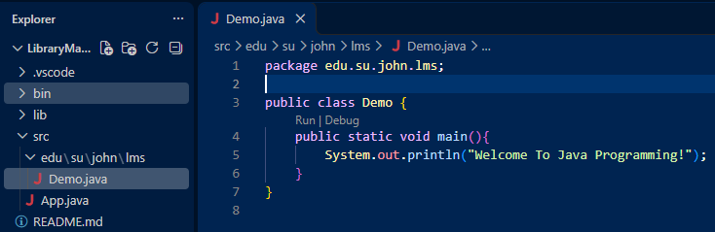
Java Class with main method

Slide 15
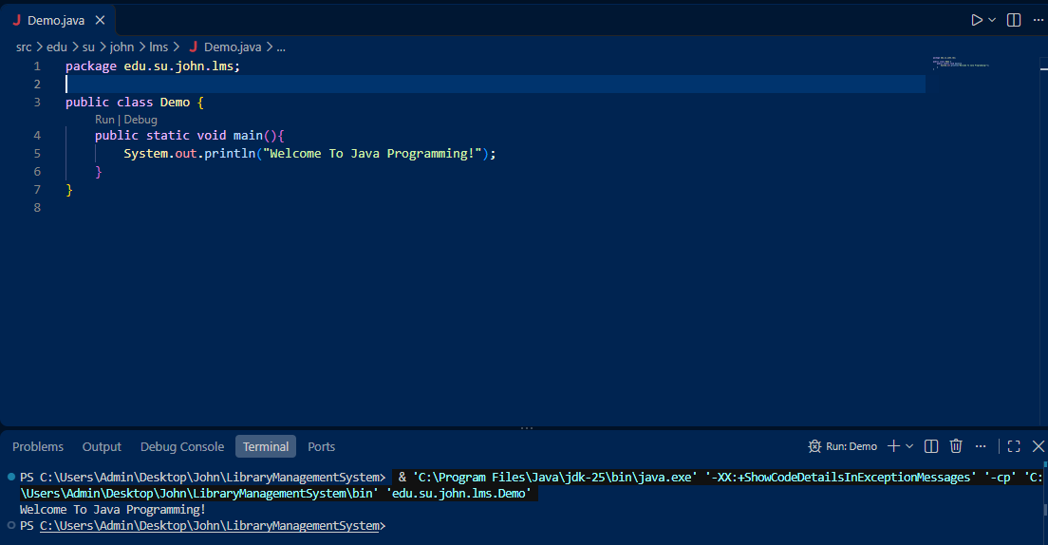
Run and check the output in terminal / console

Slide 16
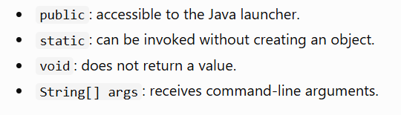
main method

Slide 17
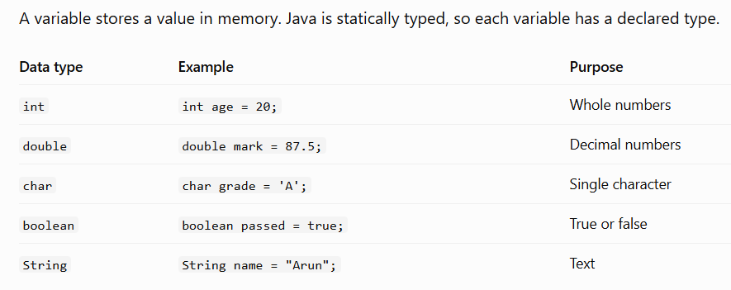
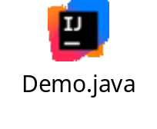
Variable and Data type

Slide 18
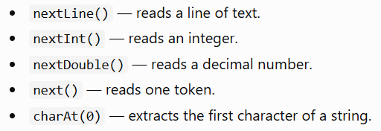
Scan different data types

Slide 19
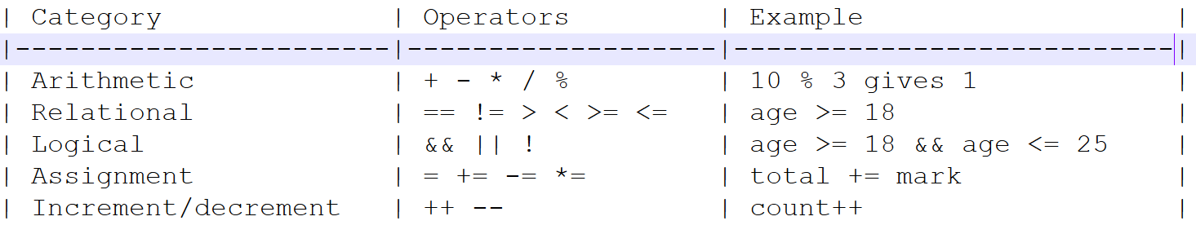
Student task: Modify the program to calculate the square and cube of a number.
Operators

Slide 20
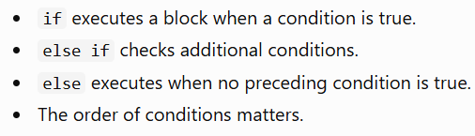
Conditional Statements

Slide 21
switch and break
the switch statement provides a way to execute different code blocks based on the value of an expression.
The break keyword is used inside a switch block to immediately terminate execution and exit the structure
Student task: Create a switch program that accepts a number from 1 to 7 and displays the corresponding weekday.

Slide 22
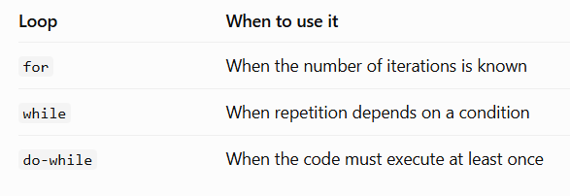
Looping Statements
loops repeat a block of code while a condition permits it.

Slide 23
Student Tasks
Print numbers from 1 to 50 using a for loop.
Find the factorial of a number using a while loop.
Keep asking the user to enter a number until they enter 0.
Print all even numbers between 1 and 100.
Develop a Java console application that accepts a student's name and marks in three subjects. Calculate the total and average, determine the grade, and display the result.
Modify the program to accept five subjects and display PASS only if the student scores at least 50 in every subject. Otherwise, display FAIL.

Slide 24
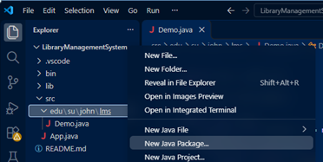

model package

Slide 25
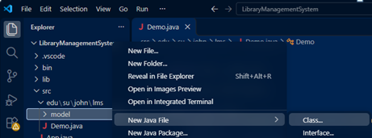

create class Book

Slide 26
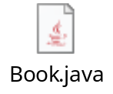
class Book
package edu.su.john.lms.model;
public class Book {
public int id;
public String title;
public String author;
public String category;
public Double price;
public int totalCopies;
public int availableCopies;
}

Slide 27
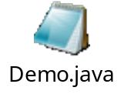
class Demo
Create 3 book objects.
Set values for 3 books.
Print heading
Get 3 book values and print as rows.

Slide 28
class Demo - Formatted output
Use System.out.printf to format the output.

Slide 29

class Book - Access Specifiers – Public and Private
Change all public properties to private properties in class Book.
Generate Getters and Setters.

Slide 30
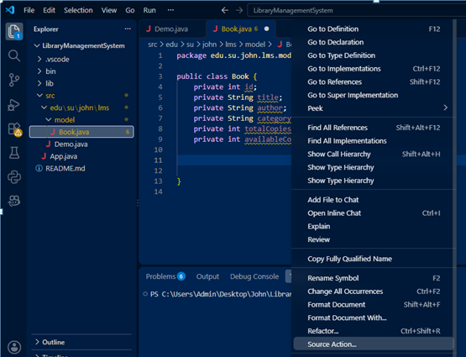
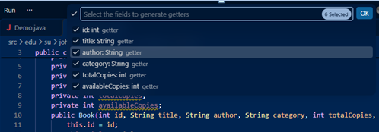
Right Click –> Source Action -> Generate Getters & Setters -> Select All

Slide 31
class Demo - main method
Modify program by using setters and getters.
Run the program.

Slide 32
class Book – toString()
Right click -> Source Action -> Generate toString() -> Ok
Modify the overrided toString method()

Slide 33
class Demo – print objects
Modify the main function.
Run the program.

Slide 34
class Book – static method to print Heading.
Add a static method ‘printHeading’ in class Book.
Call the static method in main method.

Slide 35
class Book – instance method to scan data for object.
Add a new instance method scanBook in class Book.
Call the scanBook method in main method.
Run the program.

Slide 36
Constructors
Right Click -> Source Action -> Generate Constructors. Don’t select Scanner.
Generate Default and Parameterized constructors in class Book.
Modify main method to use book constructors to create objects.
Run the program.

Slide 37
Auto Generation
Create and initialize static member in class Book.
Create parameterized constructor without id and scanner fields.
Both constructors include this.id = nextId++;
Also include in scanBook method.
In the main method, create objects without id.
Run the program.

Slide 38
Array of Objects
Create Book array of size 5 in main method.
Create 5 book objects and assign to each element of the array.
Modify any book object value.
Print heading and print the array of objects.
For Loop – print array of objects

Slide 39
Arraylist
Create a Arraylist Container books.
Create book objects and add to books.
Update any book object in books container.
Delete any book object in books container.
Read all book objects from books container.

Slide 40
HashMap
Create a Hashmap Container books.
Create book objects and add to books.
Update any book object in books container.
Delete any book object in books container.
Read all book objects from books container.

Slide 41
HashSet
Create a HashSet Container books.
Create book objects and add to books.
Update any book object in books container.
Delete any book object in books container.
Read all book objects from books container.

Slide 42
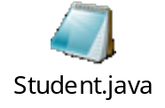
class Student
Create class Student.
Generate toString(), Getters & Setters, Constructors.
Create printHeading function and scanStudent static function.
Implement Auto Increment feature.
In the main method, create Student Objects, update, delete and read all.

Slide 43

Library Menu - class LibraryService
Create a new package service.
Create a new class LibraryService under the package service.
In the main method, call the Library services in repeated menu.
Run the program.

Slide 44
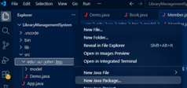

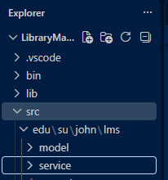
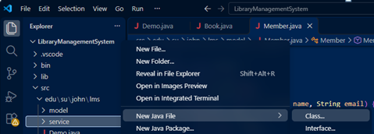

class LibraryService
package service

Slide 45
List, Add and Search Books
Implement the display, add and search books functionalities in class LibraryService.
Run the program and test those methods.

Slide 46
List, Add and Search Students
Implement the display, add and search students functionalities in class LibraryService.
Run the program and test those methods.

Slide 47
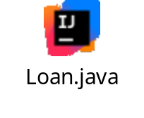
class Loan
Create class Loan.
Generate toString(), Getters & Setters, Constructors.
Create printHeading function.
Implement Auto Increment feature.
Include isReturned method.

Slide 48
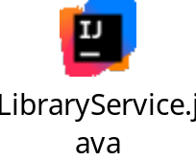
class LibraryService - issueBook
Write methods findBookById, findStudentById, findLoanById and issueBook.

Slide 49
class LibraryService - returnBook
Write the methods displayActiveLoans, displayOverdueLoans and returnBook

