Slide 1
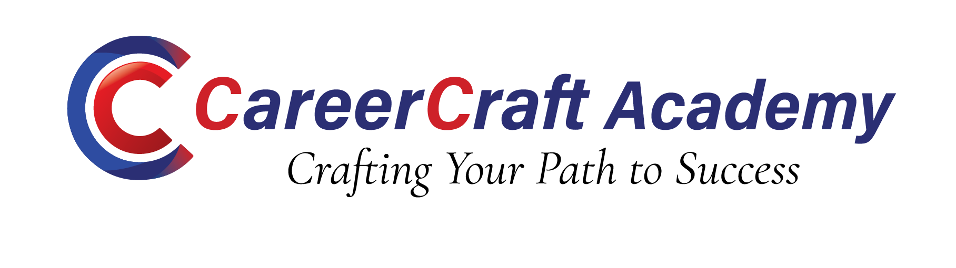
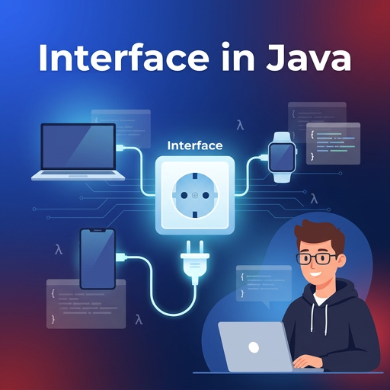
Java Interfaces
Unit II — Functional Interfaces and Stream API
www.careercraftacademy.com

Slide 2



Learning Objectives
Define and create functional interfaces
On completing this unit, the learner will be able to:
Use collectors to group and summarise data
Use Predicate, Function, Consumer and Supplier
Build stream pipelines with filter, map and reduce
Compare functional interfaces with other interface types
www.careercraftacademy.com

Slide 3


Topic Coverage
S.no | Topic List
1 | Interfaces: basics and evolution
2 | Functional interfaces
3 | Built-in functional interfaces
4 | Method references
5 | Comparison with other interfaces
6 | Stream API: basics and pipeline
7 | Intermediate and terminal operations
8 | Collectors and case study
www.careercraftacademy.com

Slide 4


Discussion Points
Instructions
Where have you used Runnable or Comparator?
Why were default methods added in Java 8?
Can a lambda replace every anonymous class?
How is a stream different from a collection?
Work in groups of four.
Discuss each point for two minutes.
Write one small lambda or stream example.
One member presents the group answer.
Objective: link OOP knowledge to functional-style Java.
www.careercraftacademy.com

Slide 5
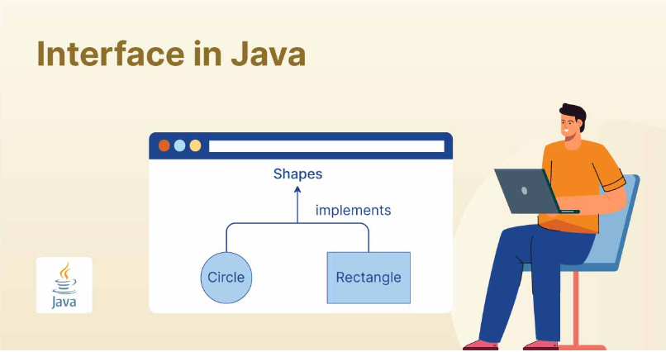
What is an Interface?
An interface defines what a class must do, not how
A contract of method signatures
Declared with interface, implemented with implements
Methods are public abstract; fields are public static final
Cannot be instantiated
A class can implement many interfaces
interface Vehicle {
void start();
}
class Car implements Vehicle {
public void start() {
System.out.println("Go");
}
}
Why use interfaces?
Loose coupling, abstraction, polymorphism and callbacks
www.careercraftacademy.com

Slide 6
Evolution of Interfaces
Interfaces gained new capabilities in Java 8 and Java 9
1
2
3
Before Java 8
Java 8
Java 9
Abstract methods only
default and static methods
private methods
void run();
default void log() { }
private void helper() { }
Why default methods?
Diamond rule
New methods can be added to old interfaces, like Collection.stream(), safely.
Two interfaces with the same default method? The class must override it.
www.careercraftacademy.com

Slide 7
Functional Interface
Exactly one abstract method, the target type for lambdas
Single Abstract Method (SAM)
@FunctionalInterface
interface Greeting {
void sayHello(String name);
}
Greeting g = n ->
System.out.println("Hi " + n);
g.sayHello("Java");
Exactly one abstract method
Object methods such as equals() do not count
default, static and private methods are allowed
@FunctionalInterface makes the compiler check the rule
JDK examples: Runnable, Callable, Comparator
www.careercraftacademy.com

Slide 8
Custom Functional Interface
Generics make a functional interface reusable
A generic functional interface
Compile-time error
@FunctionalInterface
interface Converter<T, R> {
R convert(T input);
}
Converter<String, Integer> toInt =
Integer::parseInt;
toInt.convert("123"); // 123
@FunctionalInterface
interface Wrong {
void a();
void b(); // ERROR
}
Two abstract methods: the annotation makes the compiler reject it.
www.careercraftacademy.com

Slide 9
Built-in Functional Interfaces
Package java.util.function: the Big Four
Interface | Method | Example lambda
Predicate<T> | boolean test(T t) | n -> n % 2 == 0
Function<T, R> | R apply(T t) | s -> s.length()
Consumer<T> | void accept(T t) | s -> System.out.println(s)
Supplier<T> | T get() | () -> Math.random()
Predicate checks · Function converts · Consumer uses · Supplier gives
www.careercraftacademy.com

Slide 10
Other Functional Interfaces
Variants for two inputs, same-type operations and primitives
Interface | Description
BiPredicate<T, U> | Two inputs, returns boolean
BiFunction<T, U, R> | Two inputs, one result
BiConsumer<T, U> | Two inputs, no result
UnaryOperator<T> | Function<T, T>: same input and output type
BinaryOperator<T> | Two inputs of type T, result of type T
IntPredicate, IntFunction | Primitive versions that avoid boxing
www.careercraftacademy.com

Slide 11
Combining Functions
Default methods chain small functions into bigger ones
Predicate: and(), or(), negate()
Predicate<Integer> positive = n -> n > 0;
Predicate<Integer> even = n -> n % 2 == 0;
positive.and(even).test(8); // true
positive.negate().test(5); // false
Function: andThen(), compose()
Function<Integer, Integer> twice = x -> x * 2;
Function<Integer, Integer> square = x -> x * x;
twice.andThen(square).apply(3); // (3*2)^2 = 36
twice.compose(square).apply(3); // (3^2)*2 = 18
www.careercraftacademy.com

Slide 12
Method References
A shorter lambda when you only call an existing method
Type | Syntax | Equivalent lambda
Static method | Integer::parseInt | s -> Integer.parseInt(s)
Particular object | System.out::println | x -> System.out.println(x)
Arbitrary object | String::toUpperCase | s -> s.toUpperCase()
Constructor | ArrayList::new | () -> new ArrayList<>()
Use a method reference when the lambda only calls one existing method.
www.careercraftacademy.com

Slide 13
Normal vs Functional Interface
Comparing a general interface with a functional one
Feature | Normal interface | Functional interface
Abstract methods | Any number | Exactly one
Lambda support | Not with several abstract methods | Yes
@FunctionalInterface | Not applicable | Allowed and recommended
Purpose | A full contract or abstraction | A single behaviour
Examples | List, Collection | Runnable, Predicate
Every functional interface is an interface, but not every interface is functional.
www.careercraftacademy.com

Slide 14
Functional vs Abstract Class
Same idea, different tools: behaviour versus shared state
Feature | Functional interface | Abstract class
Abstract methods | Exactly one | Any number
State | Constants only | Instance variables
Constructors | No | Yes
Inheritance | Many interfaces | One class only
Lambda support | Yes | No
Use when | Passing behaviour, callbacks | Sharing state and code
www.careercraftacademy.com

Slide 15
Two More Comparisons
Marker interfaces and anonymous classes
Marker vs functional interface
Anonymous class vs lambda
Marker | Functional
No methods | One abstract method
Tags a capability | Represents a function
Serializable, Cloneable | Runnable, Comparator
Anonymous class | Lambda
Creates a separate .class file | No extra class file
Works with any interface | Functional interfaces only
this is the anonymous object | this is the enclosing class
www.careercraftacademy.com

Slide 16
Introduction to Stream API
A pipeline for processing data declaratively
Package java.util.stream
Does not store data or change its source
Lazy: runs only at a terminal operation
Single use: cannot be reused
Parallel with parallelStream()
Feature | Collection | Stream
Stores data | Yes | No
Iteration | External loops | Internal
Reuse | Reusable | Single use
Size | Finite | Can be infinite
www.careercraftacademy.com

Slide 17
Stream Pipeline
Source, then intermediate operations, then one terminal operation
Source
list.stream()
filter()
keep matches
map()
transform
collect()
gather result
Source
Intermediate operations (lazy)
Terminal (eager)
names.stream() // source
.filter(n -> n.startsWith("a")) // intermediate
.map(String::toUpperCase) // intermediate
.forEach(System.out::println); // terminal
Output: ASHA, ANU
www.careercraftacademy.com

Slide 18
Creating Streams
Streams come from collections, arrays, generators and files
Collections and arrays
Infinite, range and file streams
list.stream();
list.parallelStream();
Arrays.stream(arr);
Stream.of(1, 2, 3);
Stream.iterate(1, n -> n + 1).limit(5);
Stream.generate(Math::random).limit(3);
IntStream.rangeClosed(1, 5);
Files.lines(Path.of("data.txt"));
IntStream, LongStream and DoubleStream avoid boxing and are faster for numbers.
www.careercraftacademy.com

Slide 19
Intermediate Operations
Lazy: nothing runs until a terminal operation is called
Operation | Purpose | Uses
filter() | Keep matching elements | Predicate
map() | Transform each element | Function
distinct() | Remove duplicates | -
sorted() | Sort elements | Comparator
limit(n), skip(n) | Truncate or skip elements | -
peek() | Inspect elements while debugging | Consumer
www.careercraftacademy.com

Slide 20
map() vs flatMap()
flatMap flattens the nesting that map keeps
[[1, 2], [3, 4], [5]]
map(l -> l.stream())
Stream<Stream<Integer>>
still nested
[[1, 2], [3, 4], [5]]
flatMap(List::stream)
Stream<Integer>
1, 2, 3, 4, 5 (flat)
map: one input gives one output.
flatMap: one input gives zero or more outputs, flattened into one stream.
www.careercraftacademy.com

Slide 21
Terminal Operations
They start the pipeline; short-circuit ones stop early
Operation | Purpose
forEach() | Perform an action on each element
collect() | Gather into a List, Set or Map
reduce() | Combine all elements into one value
count(), min(), max() | Simple aggregates
anyMatch(), allMatch(), noneMatch() | Boolean checks
findFirst(), findAny() | Return an Optional
www.careercraftacademy.com

Slide 22
Collectors
collect() gathers stream results into useful structures
Employees per department
Collector | Result
toList(), toSet() | A List or a Set
toMap() | A key-value Map
joining(", ") | One String
groupingBy() | A Map of groups
partitioningBy() | Two groups: true, false
counting() | A count inside each group
Map<String, Long> byDept =
emps.stream().collect(
Collectors.groupingBy(
Employee::getDept,
Collectors.counting()));
www.careercraftacademy.com

Slide 23
Case Study: Employee Data
Names of the top 3 highest-paid IT employees
List<String> top3 = employees.stream()
.filter(e -> e.getDept().equals("IT"))
.sorted(Comparator
.comparingDouble(Employee::getSalary)
.reversed())
.limit(3)
.map(Employee::getName)
.collect(Collectors.toList());
What it uses
filter() Predicate
sorted() Comparator
map() Function
collect() Collector
Old way: loops, temporary lists and manual sorting, about 15 lines.
Stream way: one readable pipeline.
www.careercraftacademy.com

Slide 24
Summary
Key takeaways
01 A functional interface has exactly one abstract method.
02 Predicate, Function, Consumer and Supplier are the core built-ins.
03 It differs from normal, abstract and marker interfaces in purpose.
04 A stream pipeline is Source, Intermediate (lazy), Terminal (eager).
05 Method references and collectors keep stream code short and clean.
www.careercraftacademy.com

Slide 25





www.careercraftacademy.com info@careercraftacademy.com +91-9442639366 , +91-9600344633

