Slide 1
Django Project
John Philip

Slide 2
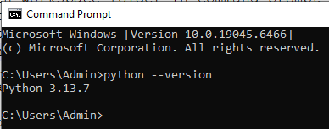
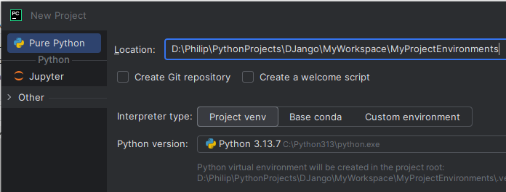
Python and Pycharm Installations, Workspace and Project creations

Slide 3
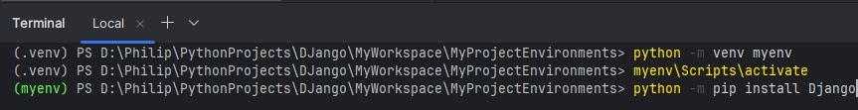
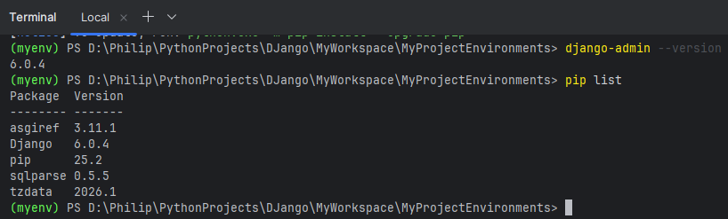
Install and Activate Django in Virtual Environment

Slide 4
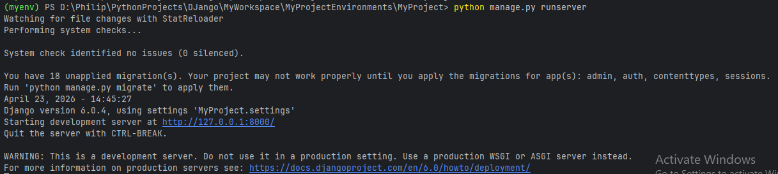
Create Django Project and Run on Server. Ctrl + c to Stop Server

Slide 5
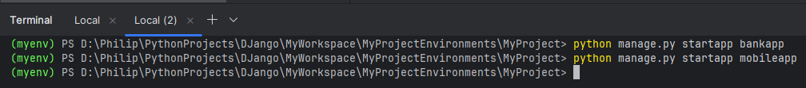
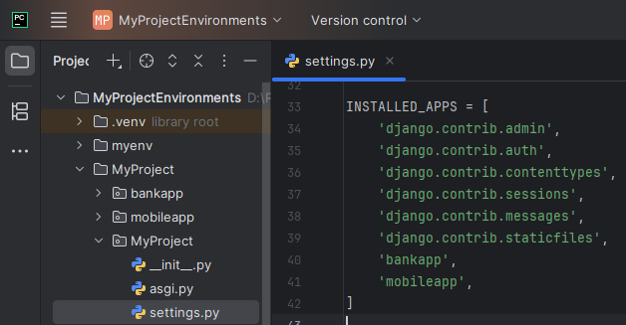
Create Django Application and Add to Project

Slide 6
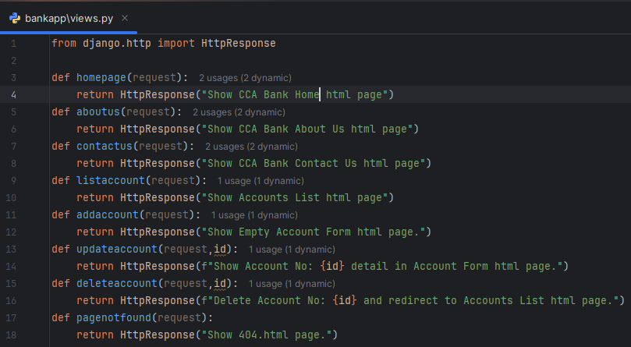
bankapp/views.py

Slide 7
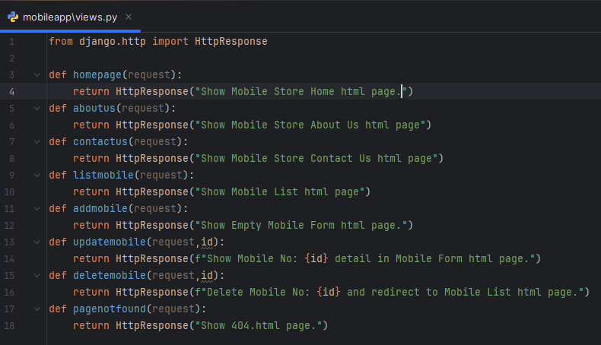
mobileapp/views.py

Slide 8
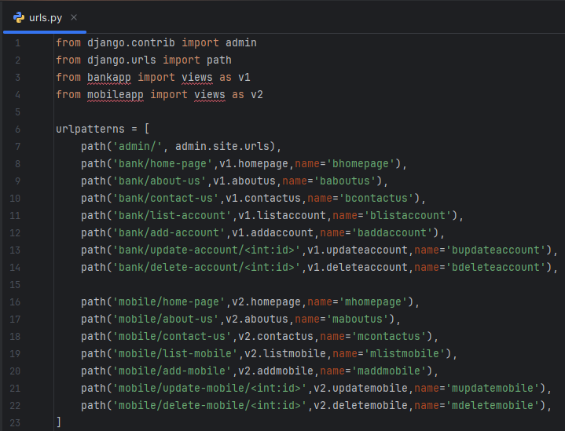
MyProject/urls.py

Slide 9
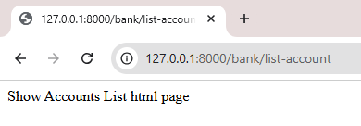
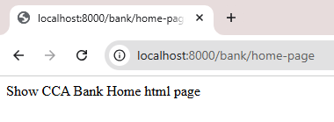
Run and Check the output in browser

Slide 10
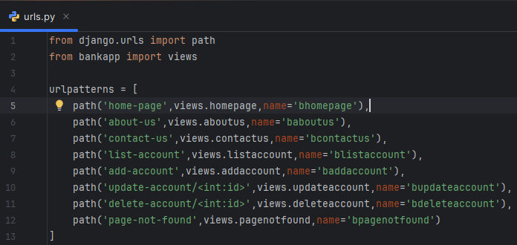
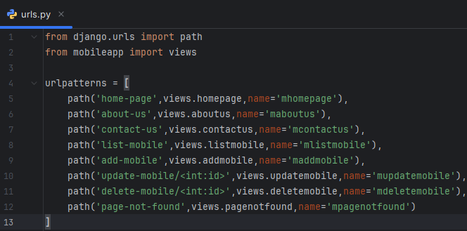
bankapp/urls.py
mobileapp/urls.py

Slide 11
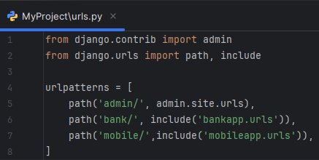
MyProject/urls.py
Run and Check the output in the Browser

Slide 12
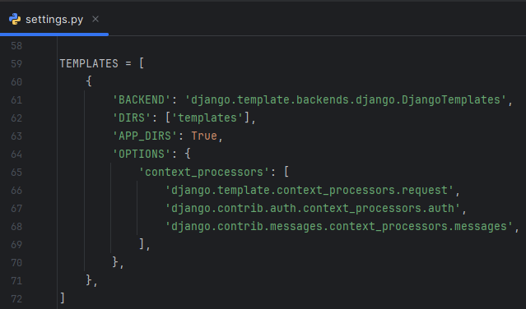
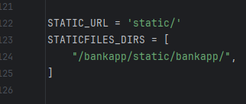
MyProject/settings.py

Slide 13
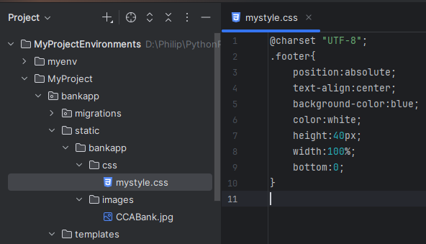
Create ‘static’ and ‘templates’ folders in bankapp.
Create ‘bankapp’ folder in ‘static’ folder.
Create ‘css’ and ‘images’ folders in ‘bankapp’ folder.
Create ‘mystyle.css’ in ‘css’ folder.
Create ‘CCABank.jpg’ in ‘images’ folder.

Slide 14
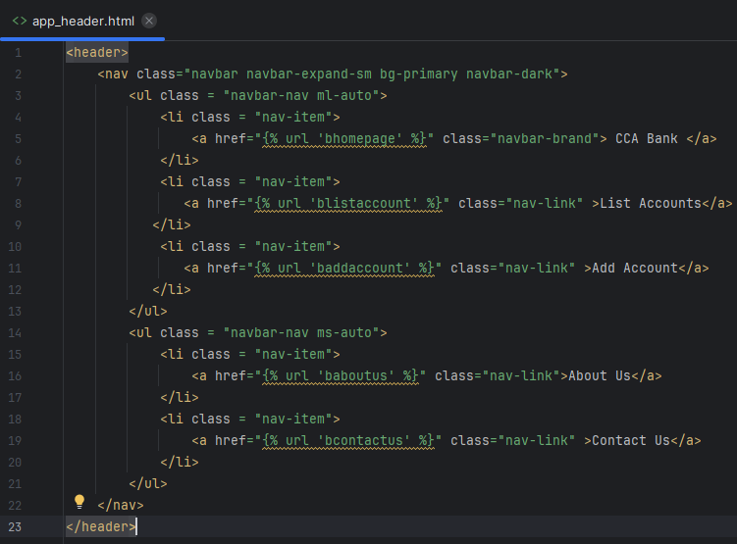
bankapp/templates/app_header.html

Slide 15
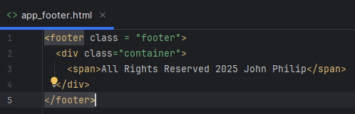
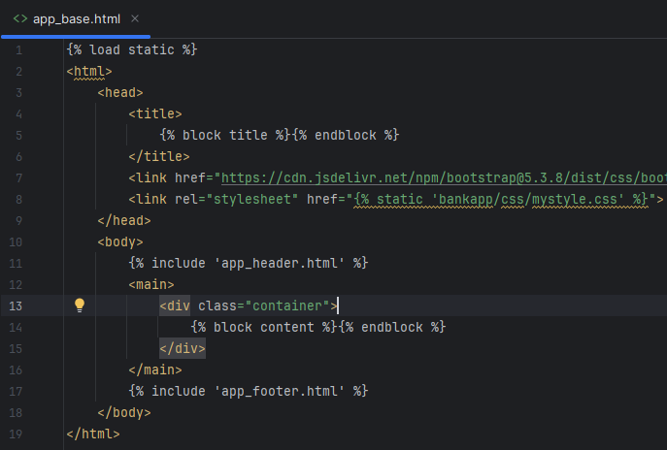
app_footer.html and app_base.html

Slide 16
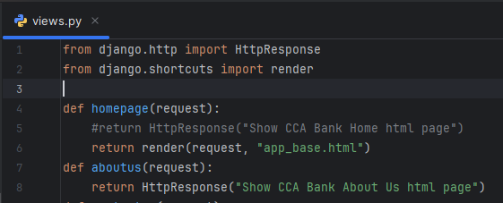
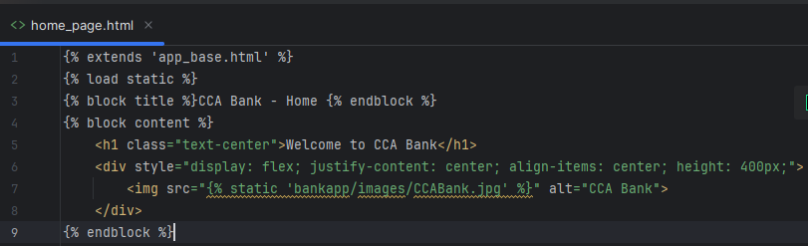
bankapp/views.py
Templates/home_page.html

Slide 17
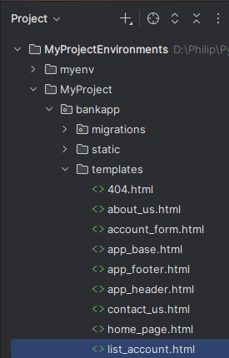
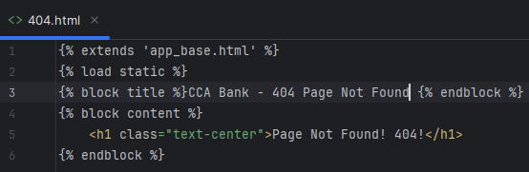
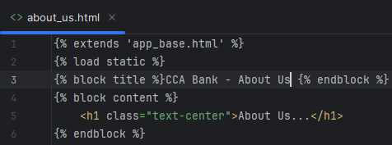
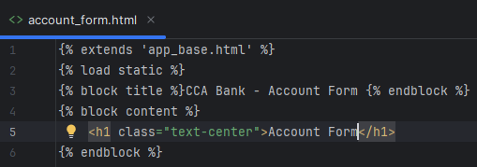
html files in templates folder

Slide 18
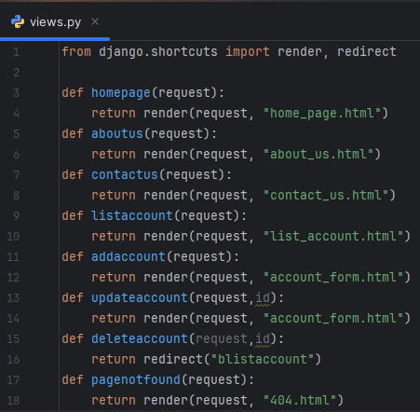
bankapp/views.py

Slide 19
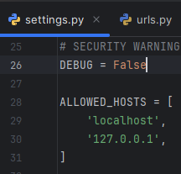
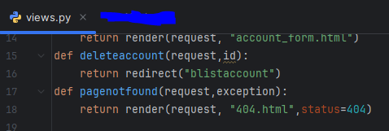
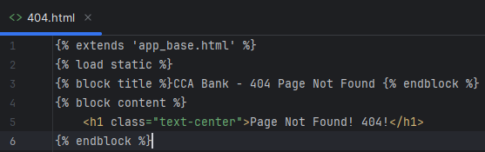
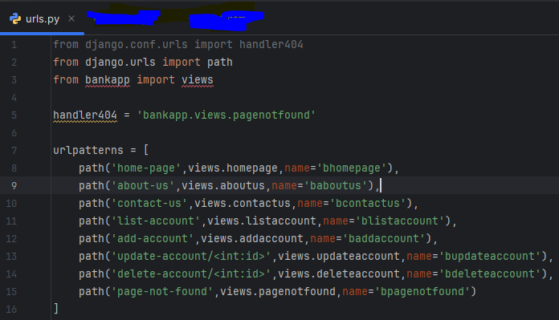
Error Page 404

Slide 20
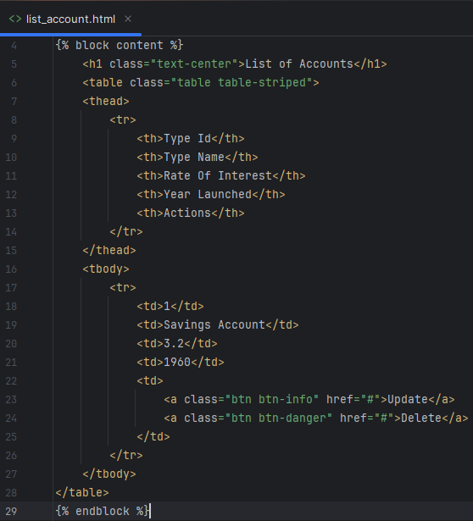
list_account.html

Slide 21
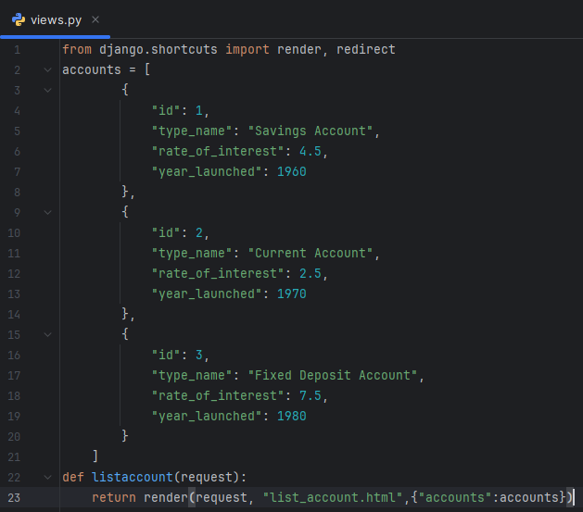
bankapp/views

Slide 22
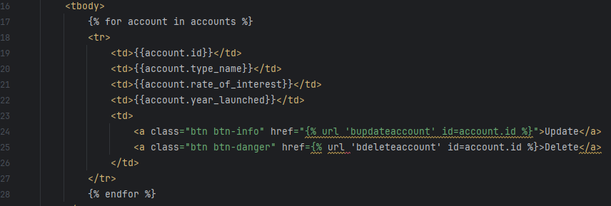

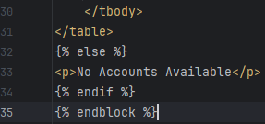
list_account.html

Slide 23
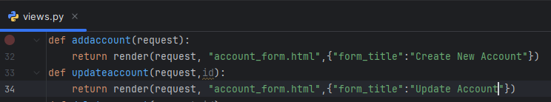
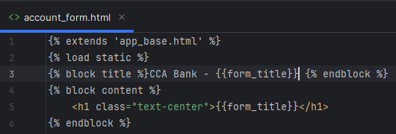
Dynamic form title

Slide 24
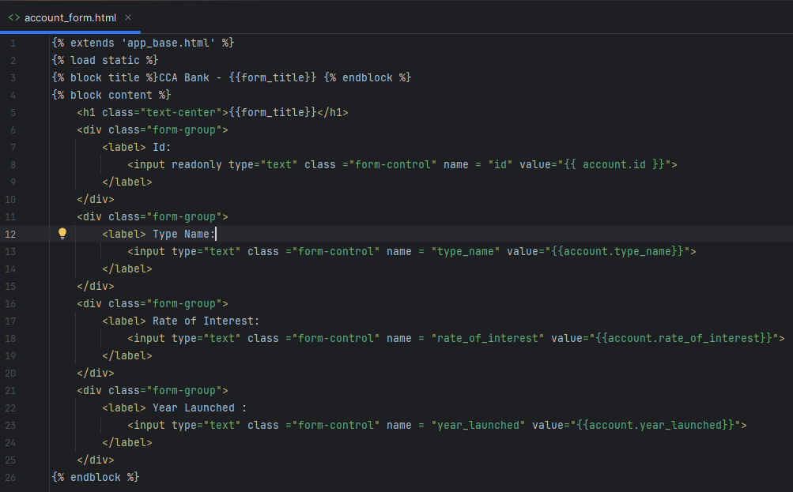
account_form.html

Slide 25
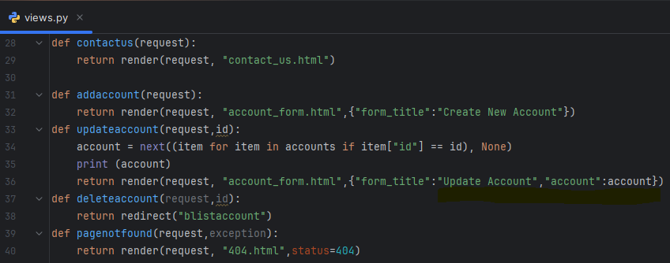
bankapp/views.py

Slide 26
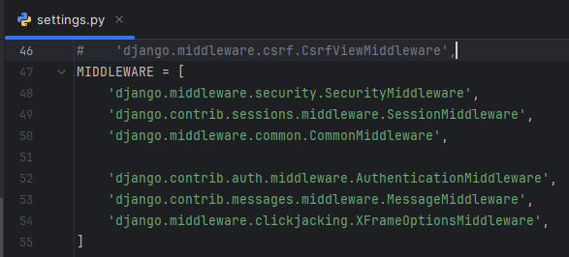
Disable CSRF

Slide 27
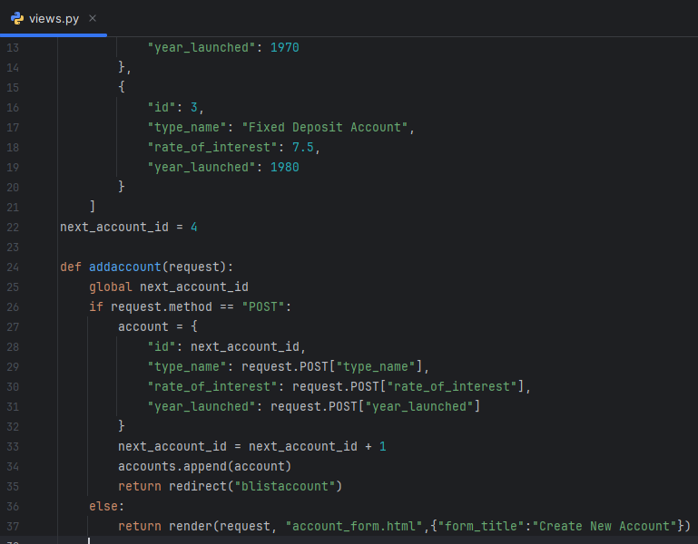
addaccount

Slide 28
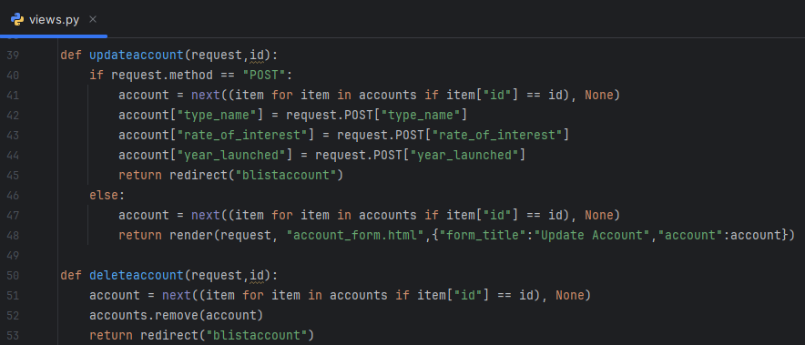
updateaccount and deleteaccount

Slide 29
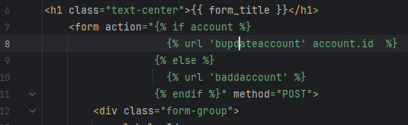

account_form.html

Slide 30
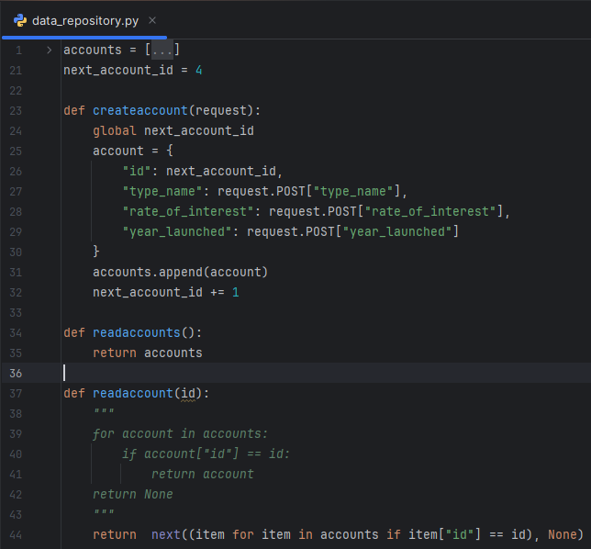
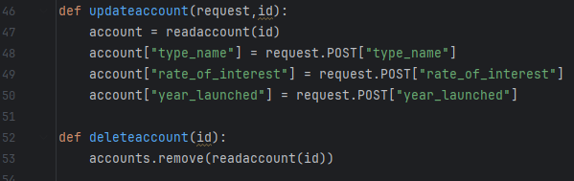
bankapp/data_repository.py

Slide 31
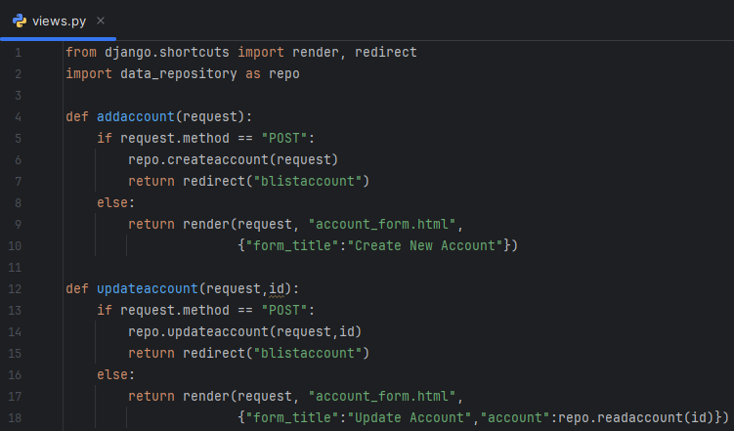
bankapp/views.py

Slide 32
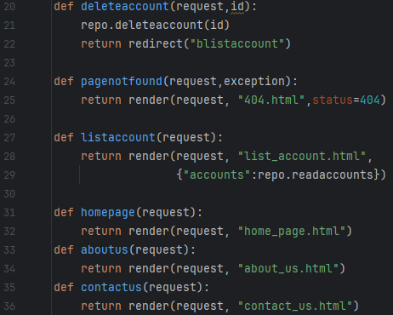
bankapp/views.py

Slide 33
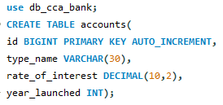
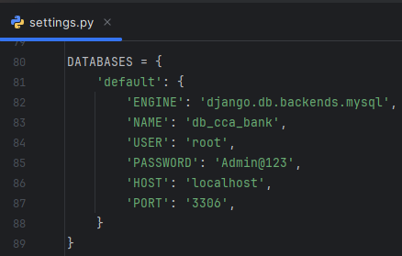
MySql Database

Slide 34

bankapp/db_repository.py

Slide 35

bankapp/db_repository.py

Slide 36
Authentication and Authorization
CREATE TABLE roles (
role_id BIGINT PRIMARY KEY AUTO_INCREMENT,
role_name VARCHAR(30)
);
CREATE TABLE users (
user_id BIGINT PRIMARY KEY AUTO_INCREMENT,
login_name VARCHAR(40),
login_password VARCHAR(40)
);
CREATE TABLE user_role (
id BIGINT PRIMARY KEY AUTO_INCREMENT,
user_id BIGINT,
role_id BIGINT,
FOREIGN KEY (user_id) REFERENCES users(user_id),
FOREIGN KEY (role_id) REFERENCES roles(role_id)
);
CREATE TABLE sessions (
session_id VARCHAR(100) PRIMARY KEY,
user_id BIGINT,
created_at TIMESTAMP DEFAULT CURRENT_TIMESTAMP,
FOREIGN KEY (user_id) REFERENCES users(user_id)
);

Slide 37
Authentication and Authorization
INSERT INTO roles (role_name) VALUES ('ROLE_ADMIN');
INSERT INTO roles (role_name) VALUES ('ROLE_CUSTOMER');
INSERT INTO users (login_name,login_password) VALUES ('JohnPhilip','john');
INSERT INTO users (login_name,login_password) VALUES ('BalaMurugan','bala');
INSERT INTO users (login_name,login_password) VALUES ('DonyFranklin','dony');
INSERT INTO users (login_name,login_password) VALUES ('Rajesh','rajesh');
INSERT INTO users (login_name,login_password) VALUES ('Saraswathy','sara');
INSERT INTO users (login_name,login_password) VALUES ('Subashini','suba');
INSERT INTO users (login_name,login_password) VALUES ('Nikhila','niki');
INSERT INTO user_role (user_id,role_id) SELECT
(SELECT user_id FROM users WHERE login_name = 'JohnPhilip'),
(SELECT role_id FROM roles WHERE role_name = 'ROLE_ADMIN');
INSERT INTO user_role (user_id,role_id) SELECT
(SELECT user_id FROM users WHERE login_name = 'BalaMurugan'),
(SELECT role_id FROM roles WHERE role_name = 'ROLE_CUSTOMER');
INSERT INTO user_role (user_id,role_id) SELECT
(SELECT user_id FROM users WHERE login_name = 'DonyFranklin'),
(SELECT role_id FROM roles WHERE role_name = 'ROLE_CUSTOMER');
INSERT INTO user_role (user_id,role_id) SELECT
(SELECT user_id FROM users WHERE login_name = 'Rajesh'),
(SELECT role_id FROM roles WHERE role_name = 'ROLE_CUSTOMER');
INSERT INTO user_role (user_id,role_id) SELECT
(SELECT user_id FROM users WHERE login_name = 'Saraswathy'),
(SELECT role_id FROM roles WHERE role_name = 'ROLE_CUSTOMER');
INSERT INTO user_role (user_id,role_id) SELECT
(SELECT user_id FROM users WHERE login_name = 'Subashini'),
(SELECT role_id FROM roles WHERE role_name = 'ROLE_CUSTOMER');
INSERT INTO user_role (user_id,role_id) SELECT
(SELECT user_id FROM users WHERE login_name = 'Nikhila'),
(SELECT role_id FROM roles WHERE role_name = 'ROLE_CUSTOMER');

