Slide 1
Capstone Fall 2013 Project: SGPIA
John Rowley

Slide 2
What is SGPIA?
SGPIA is a:
Strategy Game Playing Intelligent Agent
SGPIA is an Intelligent Agent that learns how to play strategy games and recognize patterns in gameplay.

Slide 3
Environment
The entire project is coded up using the .NET framework and the C# language.
The game was created in a console application, but was later integrated with WPF to form a visual board.
Apart from allowing AIs to train and play against themselves, the game allows humans to play against different types of AI, such as a state based AI, random AI, and learning AI.

Slide 4
Why SGPIA is better
Compared to SGPIA traditional state based AIs have problems with:
Being repetitive
Learning
Being easy to beat once AI’s strategy is learned
Playing like human players

Slide 5
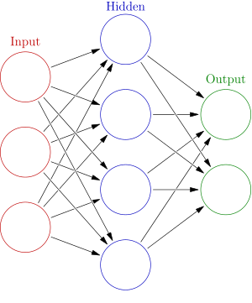
Structure
The structure of SGPIA is similar to the structure of an Artificial Neural Network.
The calculations and move types act as the input nodes.
Each territory acts as a hidden node and receives input from other nodes either from the calculation or the other territory.
The weights are fine tuned by a learning algorithm.
The decision whether to attack, retreat, reinforce, etc. are represented as output nodes.

Slide 6
How SGPIA learns
SGPIA uses a genetic algorithm to learn over time and adapt to new strategies.
Each choice such as Attacking and Reinforcing have multiple calculations each with a weight.
The winning AI’s weights are averaged together and are mutated, these weights are then passed onto the winner’s children.

Slide 7
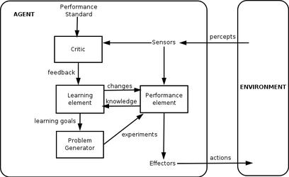
Why a genetic algorithm?
The reason I chose to use a genetic algorithm for SGPIA is for these reasons:
Fulfilled many parts of a general learning agent.
Will correct itself if a calculation is exaggerated.
Because of the Artificial Neural Network structure and genetic algorithm, this AI can play and learn most strategy games.

Slide 8
Problems with SGPIA
When testing out genetic algorithm implementation, the AI would sometimes find loopholes in the Risk game and exploit them.
When SGPIA played against only learning AIs, SGPIA would become exceptionally good against itself and nothing else. Playing against a mix of random, default, and learning AIs fixed this.

Slide 9
Questions?

