Slide 1

Porcine bone mapping
Preliminary results

Slide 2
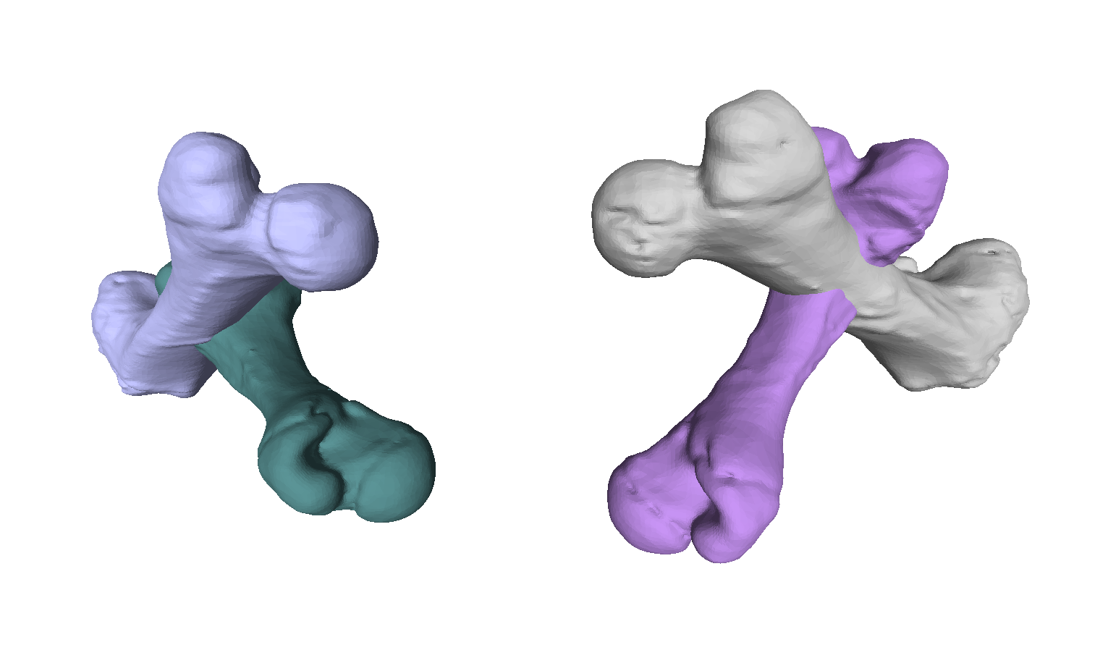
The bones
Bones are scanned at random positions and orientations in space.
Contralateral and ipsilateral sides pre and post intervention.
Ipsilateral Post
Contralateral Post
Ipsilateral Pre
Contralateral Pre

Slide 3
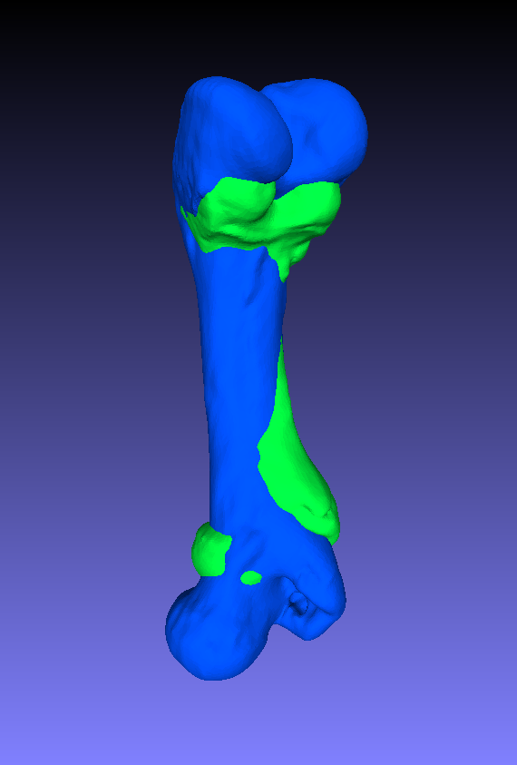
Initial registration
Post
Initially, the bones are aligned
We see that the pre bone is smaller than the post bone
Pre

Slide 4

Hypothesis 1:
Undisturbed growth is similar to a linear mapping from one bone to another.

Slide 5
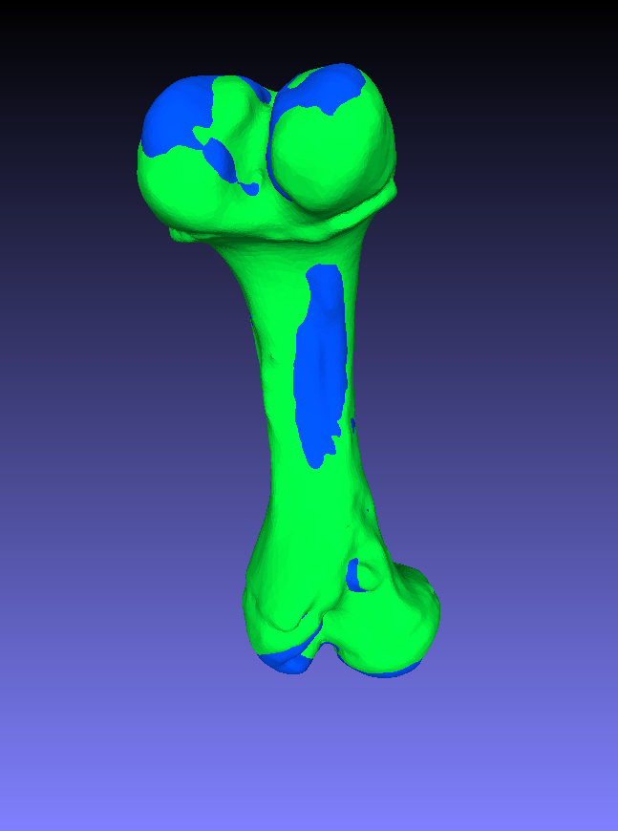
Contralateral (right) side
Fitting by simple scaling for the contralateral side supports hypothesis 1
The scaled pre bone is very similar to the grown post bone.

Slide 6
Hypothesis 2:
disturbed growth on the ipsilateral side is not as well represented by a linear mapping.

Slide 7
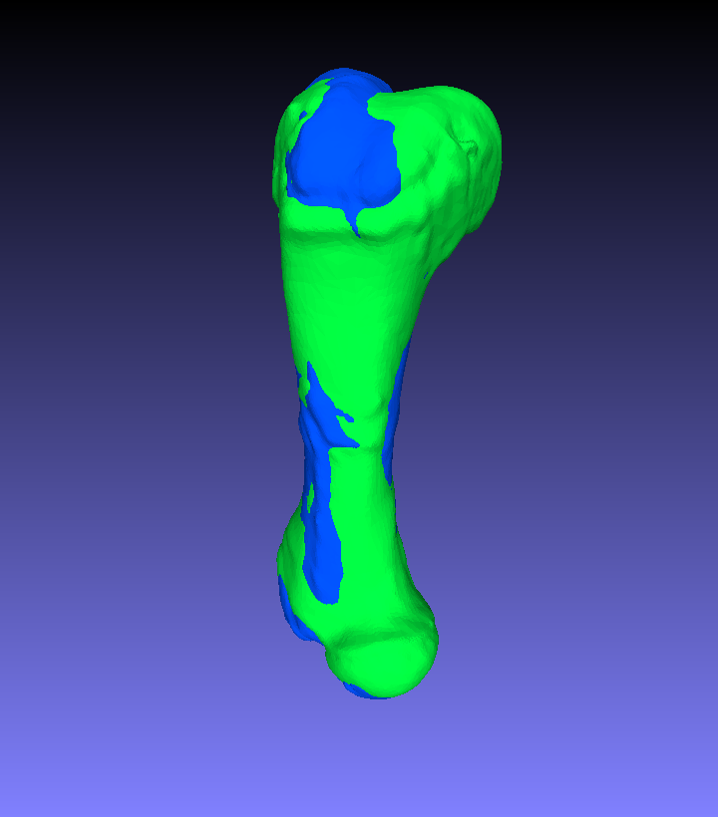
Ipsilateral (left) side
Simply scaling appears to also fit the bones well on the ipsilateral side.
In terms of quantification, the fit is 35% worse for the ipsilateral side, but this is measured on very small numbers and can be coincident.
Confirming hypothesis 2 requires more data.

Slide 8
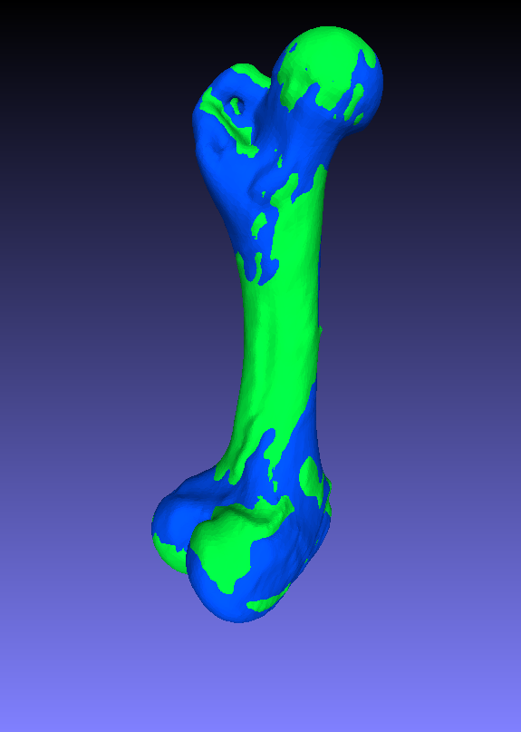
Ipsilateral vs. contralateral
If we compare ipsi- and contralateral sides with mirroring, it turns out that they are very similar.
We conclude that the intervention had very little effect.
The pig grew symmetrically despite the intervention.

Slide 9
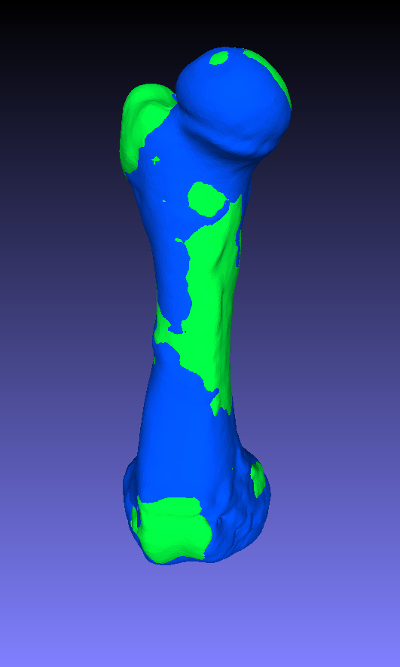
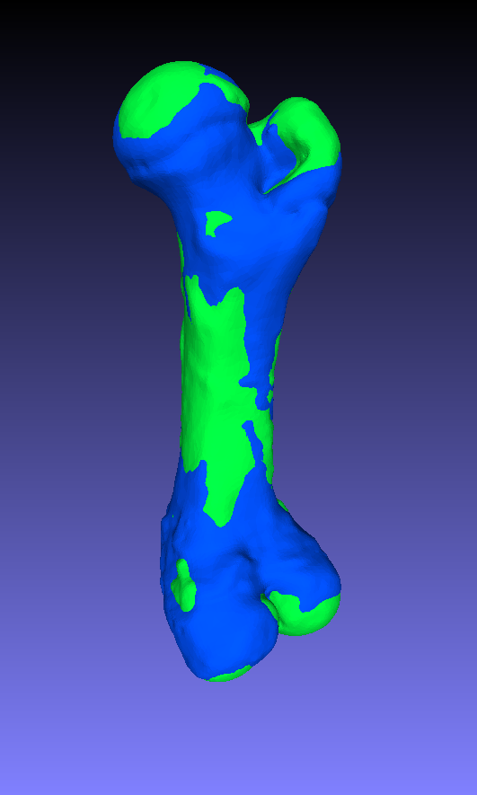
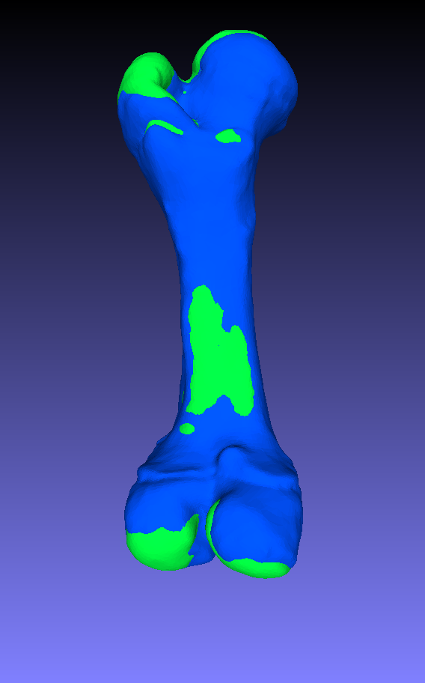
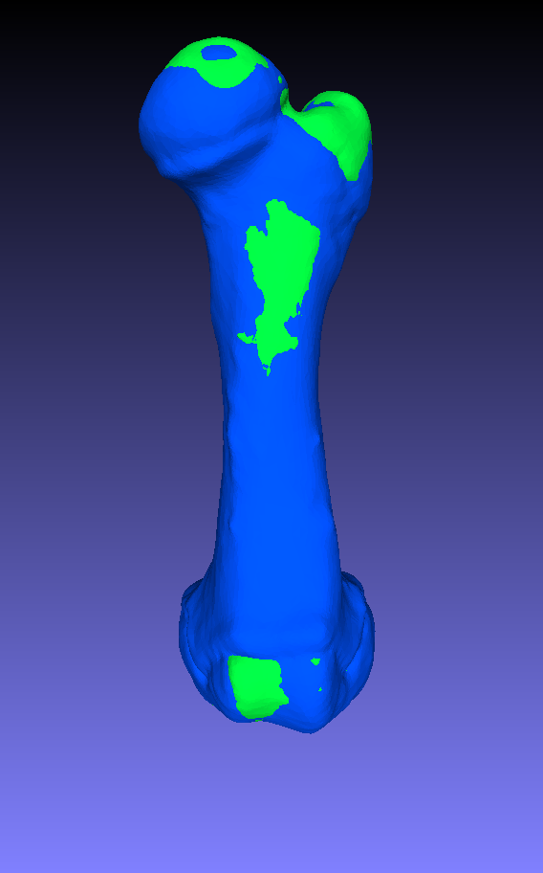
Pig 4, pre vs. post
Left
Right

Slide 10
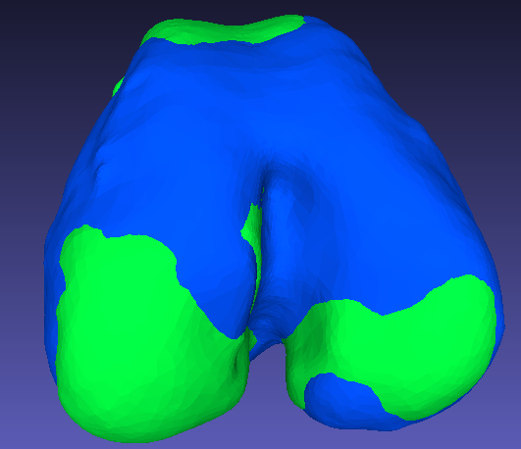
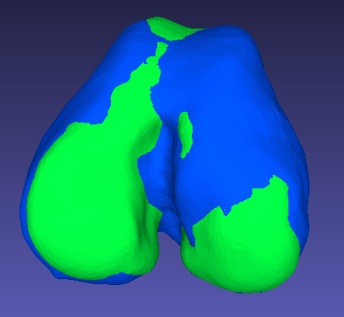
Pig 4, pre vs. post
Left
Right

Slide 11
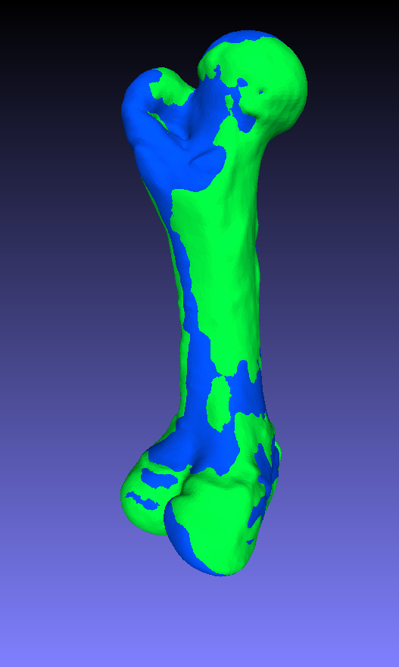
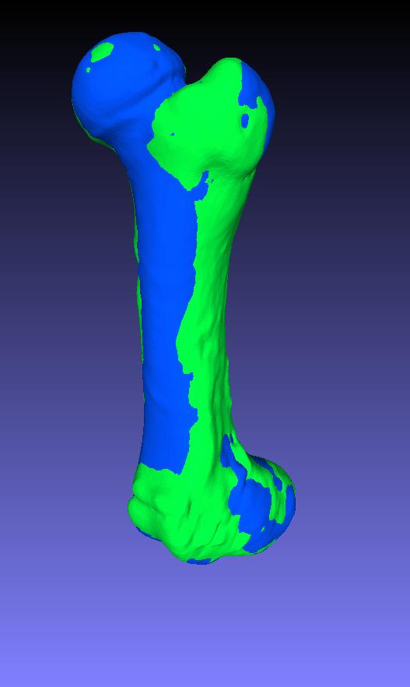
Pig 4, post, ipsi vs. contra

