Slide 1

Registration of meshes

Slide 2
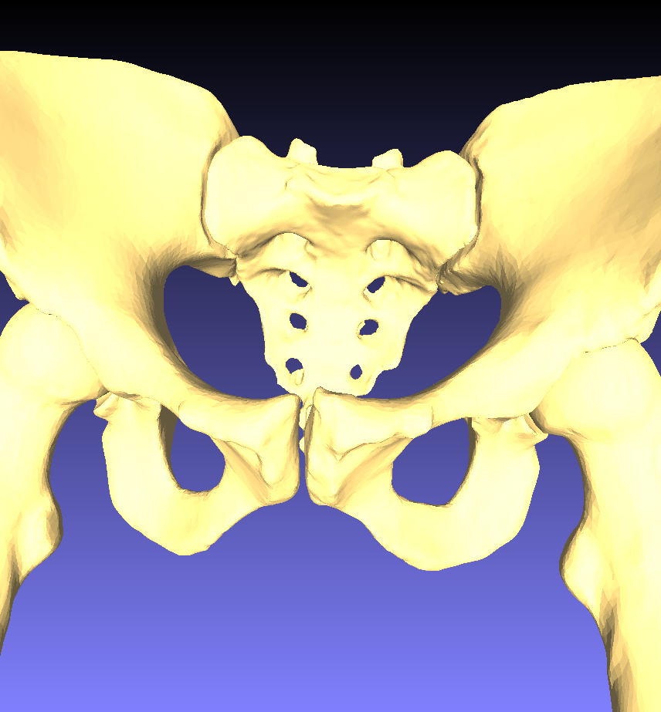
Background
Geometry description by surface meshes is extensively used in medical informatics, virtual reality, robotics, computer vision and many other fields. It interfaces well with 3D scanning, additive manufacturing and many other technologies.
Mesh representation is particularly well-suited for biological and geological shapes without clearly defined shape features, such as bones, skin, rocks, cells, plants, fabrics, etc.
Because its importance, mesh modeling attracts much interest from the computer graphics field, so there is much prior work in the field.
A mesh can mathematically be perceived as a graph of vertices, edges and faces.

Slide 3
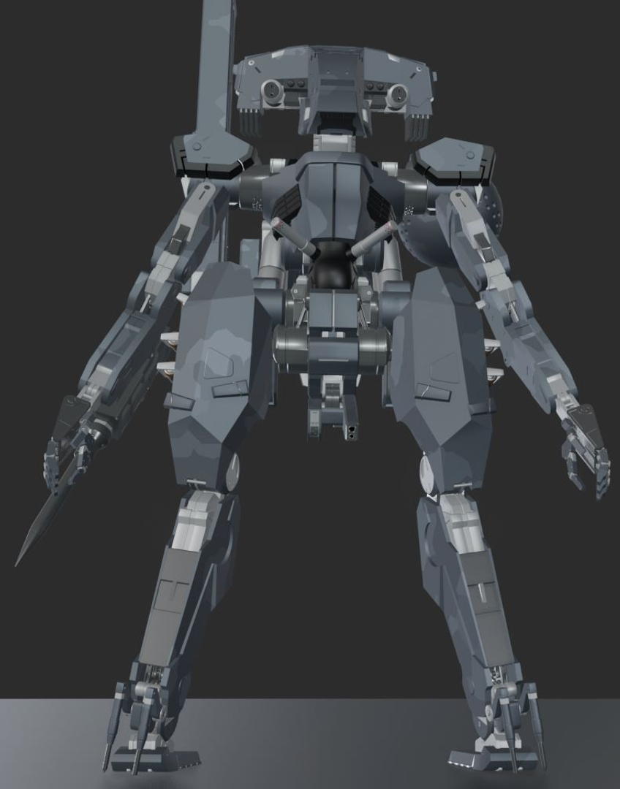
State-of-the-art
Manipulation of meshes has undergone an enormous development from the field of computer graphics.
Mesh-based geometry manipulation seems to be infringing even on the field of feature-based modeling, for instance Blender versus SolidWorks.
Blender model

Slide 4
State-of-the-art (software)
Many software projects are open source.
Examples:
Pymeshlab
Open3d
trimesh
Even blender exposes its API in open source.
trimesh
Appears to be the more mature but also older package.
Contains many algorithms that appear to be useful for our purpose.

Slide 5
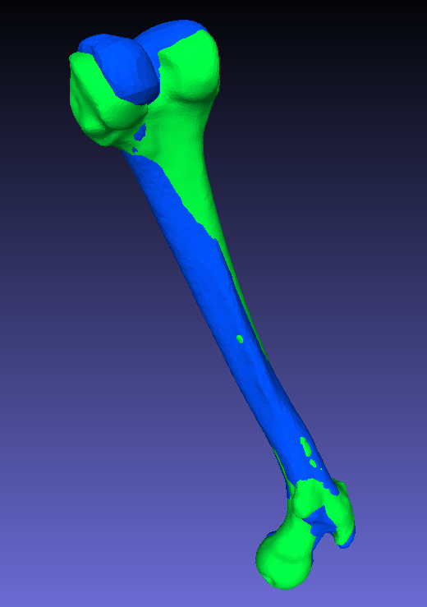
Registration
The fitting of one mesh to another is called “registration”.
Registration can include rigid body translations and rotations, but also linear and nonlinear transformations,
The output-of-interest is often the mapping that performs the registration rather than the result of the mapping.
The mapping is useful for:
Metrics, which are important for object classifications, automated diagnostics, etc.
For subsequent mapping of associated data, for instance muscle insertion points on a bone or joint axes.
The fundamental problem of registration is that the two meshes are topologically different. This means that two similar shapes can be completely different in their graph representations and no smooth mapping exists between them.
Registration by trimesh.

Slide 6
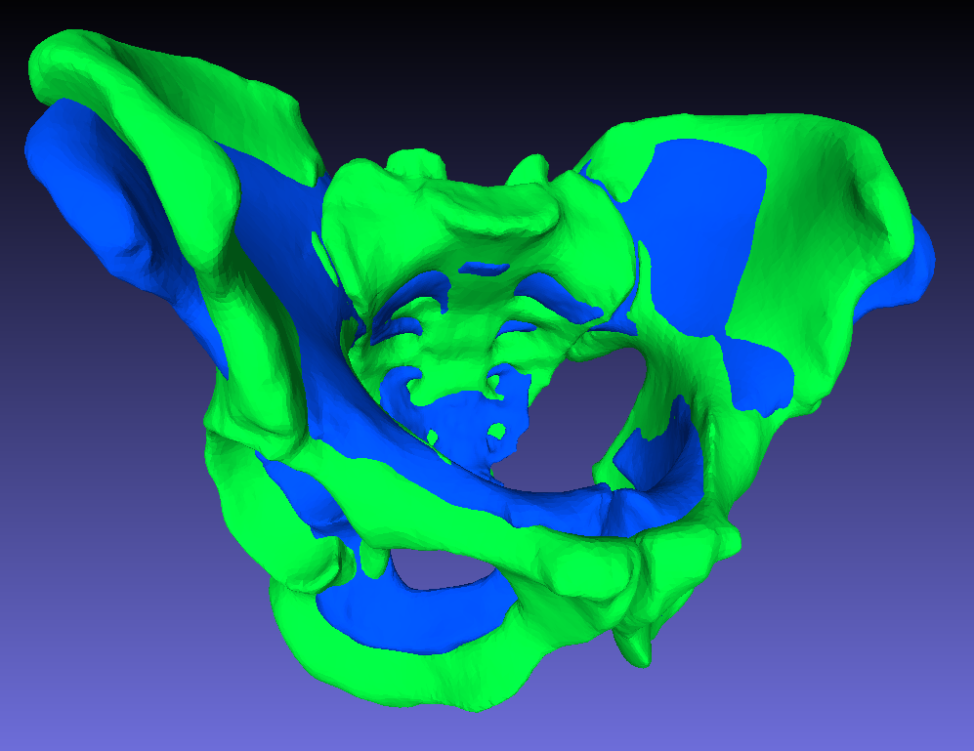
Affine mapping
Registration of male and female pelvises by affine mapping
The goto method for registration appears to be affine mapping.
A 4x4 matrix can represent:
Rigid-body translation
Rigid-body rotation
Scaling
Skewing
Typically solved as a (nonconvex) optimization problem.
Remaining differences can be attributed to “inherent” differences, for instance male or female bones, pathologies, or the difference between a bicycle and a car.
Standard method in any decent library.

Slide 7
Projection-type mapping
Vertices on the source geometry are projected to the triangulated target geometry surface.
Can work well for small adjustments.
Not robust for large adjustments.
A closed-form mapping will have to be identified post-hoc by another method, for instance RBF mapping.

Slide 8
RBF mapping
Radial basis functions can form the link between incompatible meshes.
Key points (or all vertices) are projected.
Displacements are blended in space between the displaced points by radial basis functions.

Slide 9
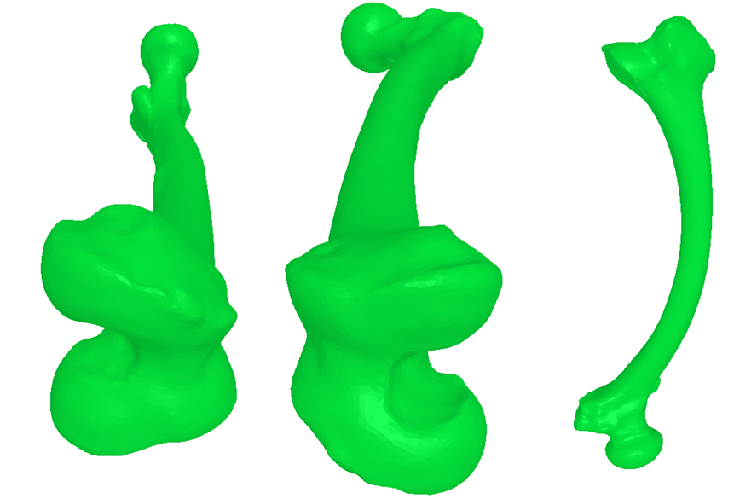

Global, metric tensor-like mappings
Ad-hoc mapping: Twisting and bending of a femur
$ℝ^{3}\overset{→}{}ℝ^{3}$ mapping of the bounding box of the source geometry.
Examples
3D Fourier series
3D wavelet series
Hermite polynomial products
Ad-hoc mappings like position-dependent rotations or scaling
Advantages:
Variable set of independent parameters.
Mesh-independence
Disadvantages:
Optimization problem requiring a numerically efficient and mesh-independent objective function.
General space mappings (e.g. Fourier) requires many free variables (multiple of 18).

Slide 10
Gauss divergence theorem metrics
Transforms volume integrals to surface integrals.
Surface integrals are extremely efficient to compute for a mesh
Volume, moment of inertia, etc.
Optimization requires # of metrics ≥ # of free variables
Sensitivity to local shape features may be low

Slide 11


Gauss divergence metrics
Volume: $\iiint_{V}{1 dV}=\iint_{S}{\left\{\begin{matrix}x \\ 0 \\ 0\end{matrix}\right\}⋅n }ds$
Moment of inertia: $\iiint_{V}{x^{2} dV}=\iint_{S}{\frac{1}{3}\left\{\begin{matrix}x^{3} \\ 0 \\ 0\end{matrix}\right\}⋅n }ds$
Etc., as many as we want

Slide 12
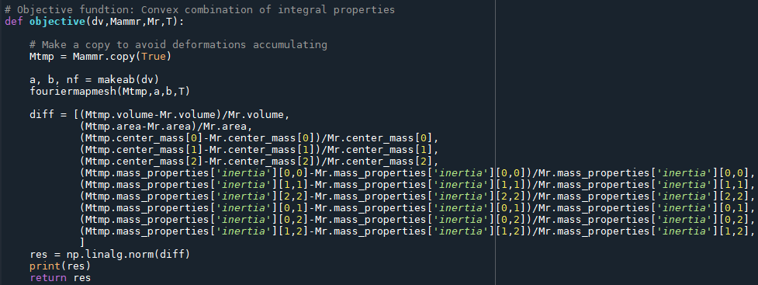
Implementation

Slide 13
Set-like metrics
Given meshes A and B
Vol(A \ B)
Vol(B \ A)
Vol(A \ B)² + Vol(B \ A)²
Problems:
Computationally costly
Non-smoothness due to discretization.
Probably very non-convex

