Slide 1
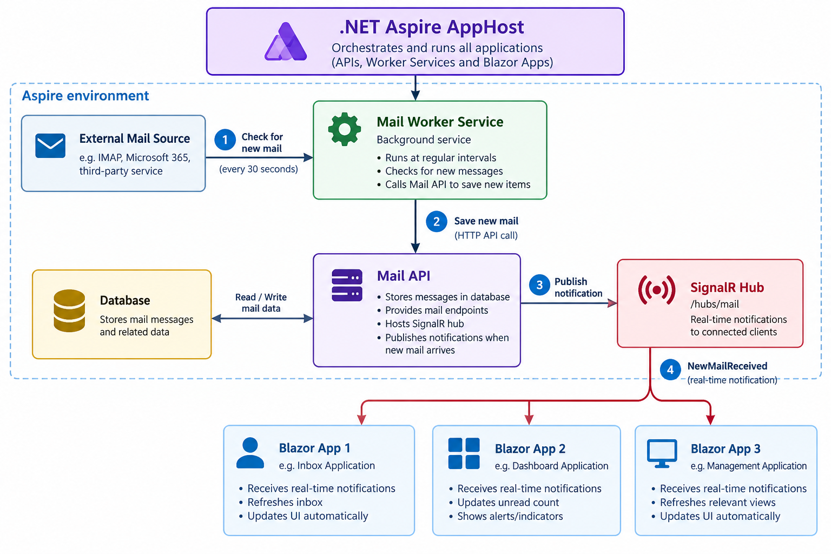

Slide 2
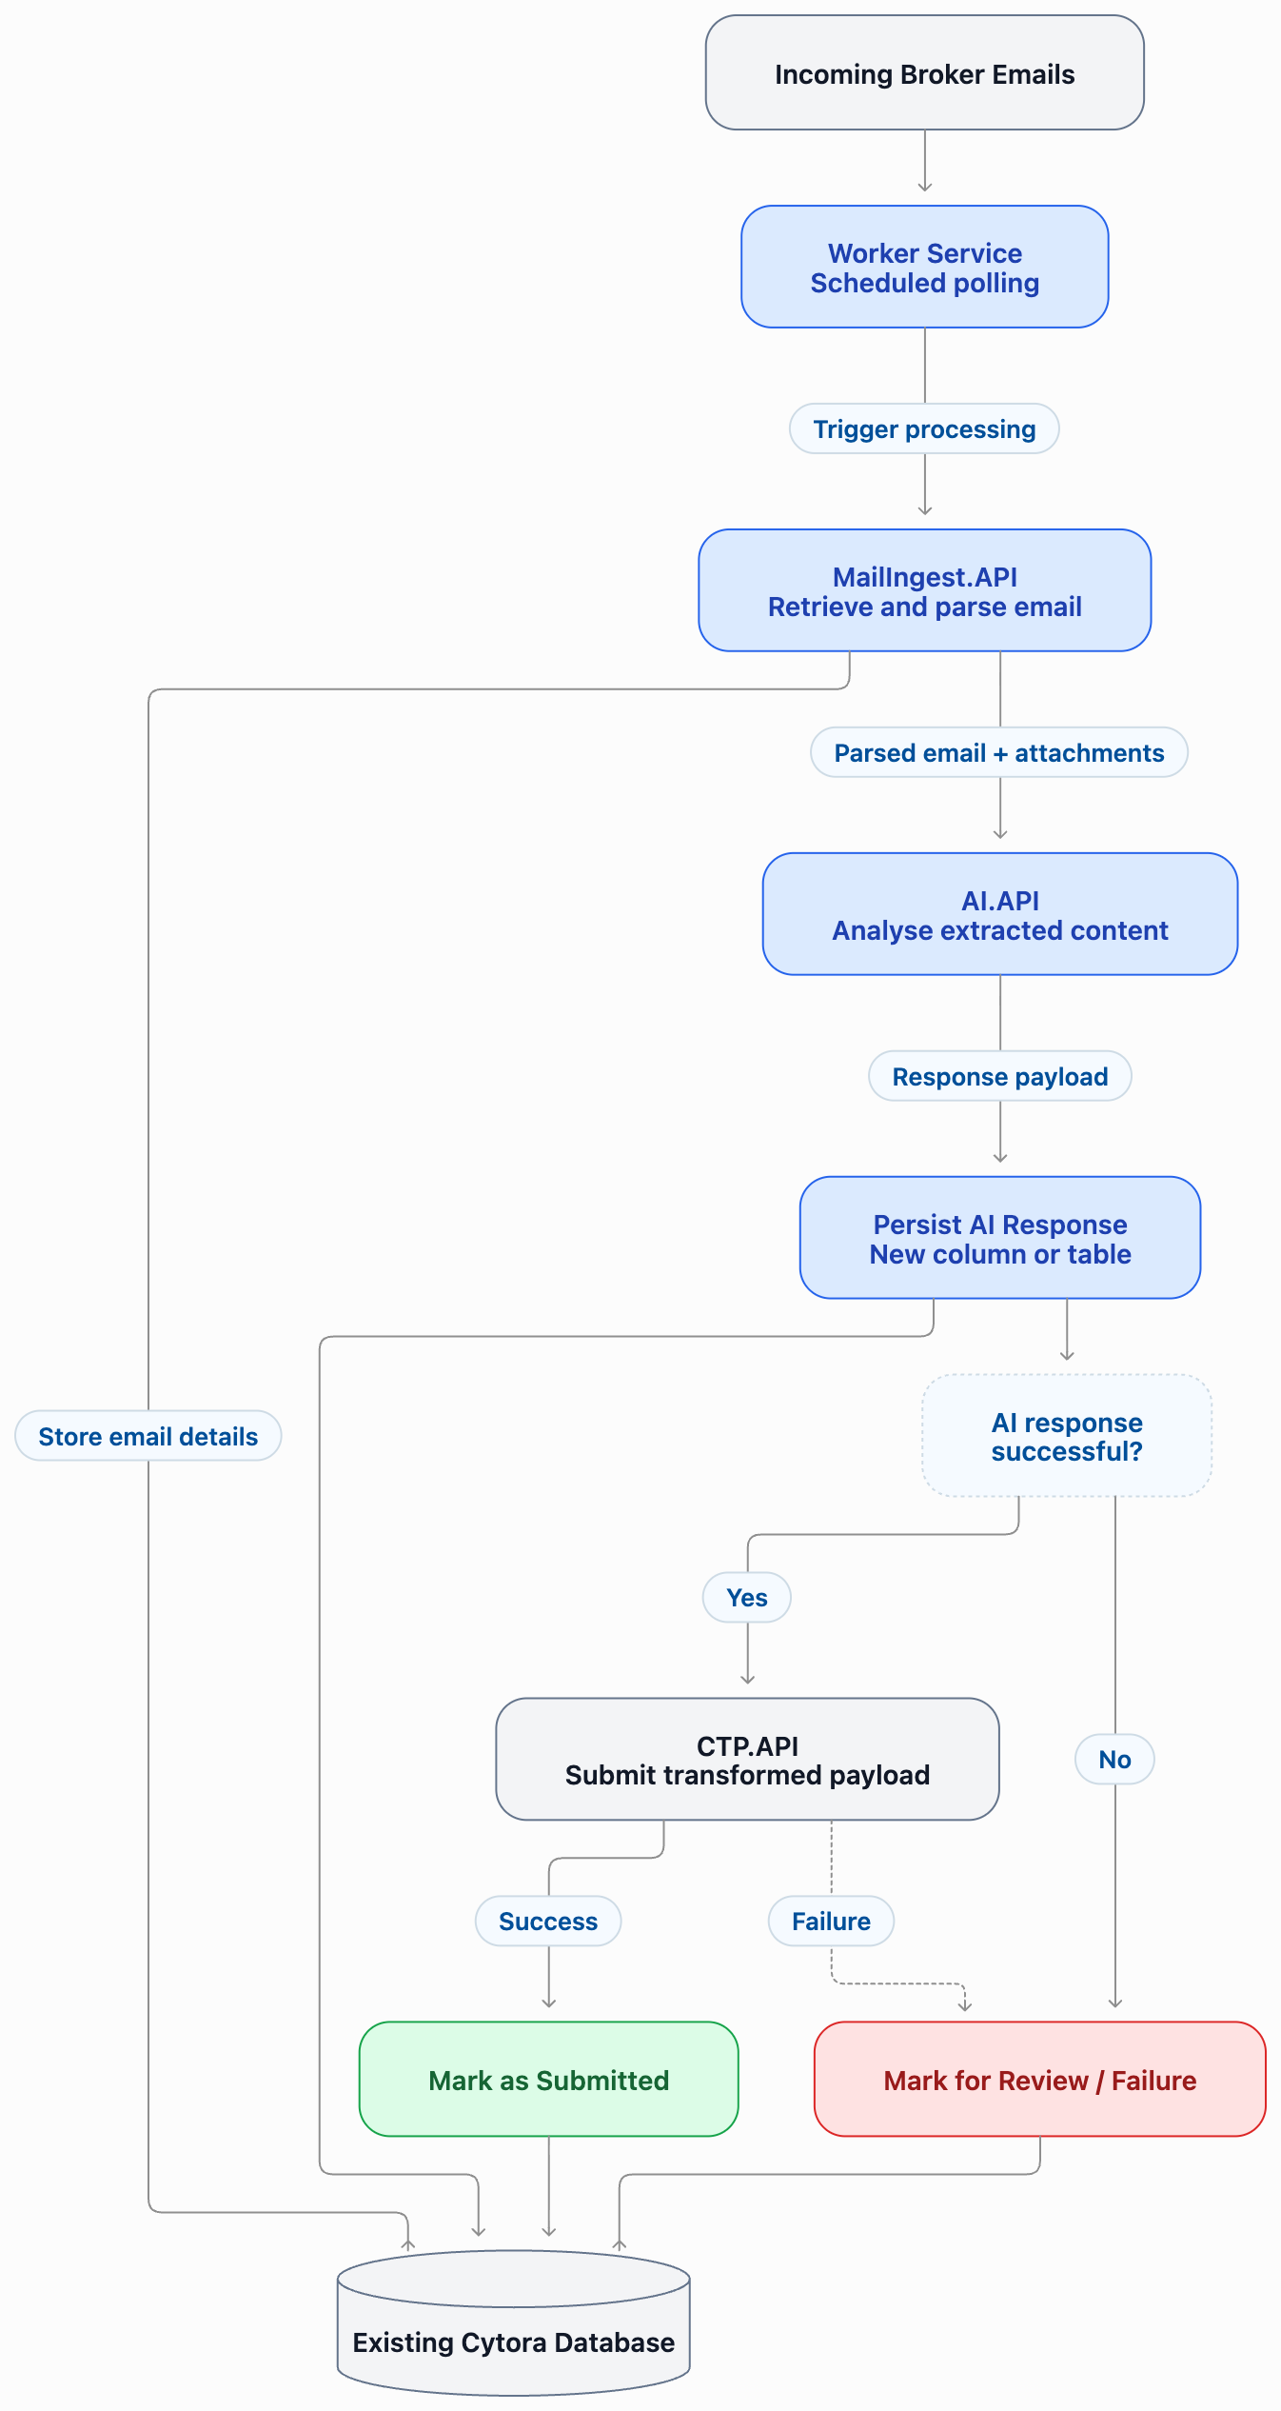

Slide 3
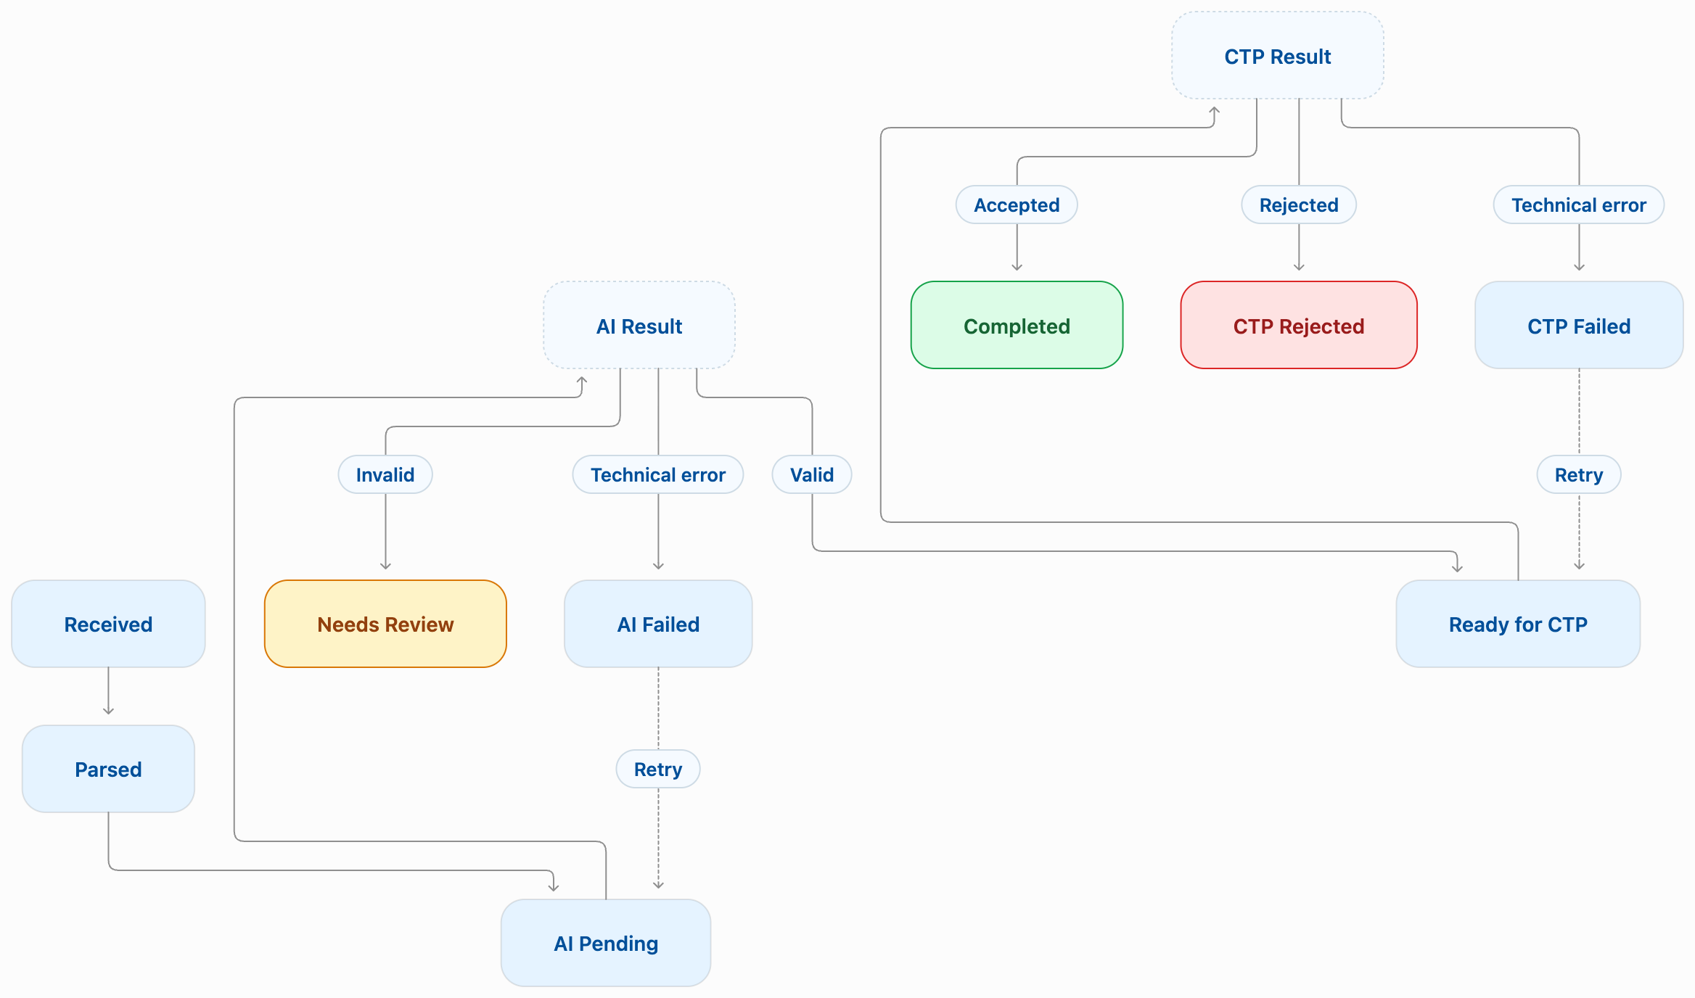

Slide 4
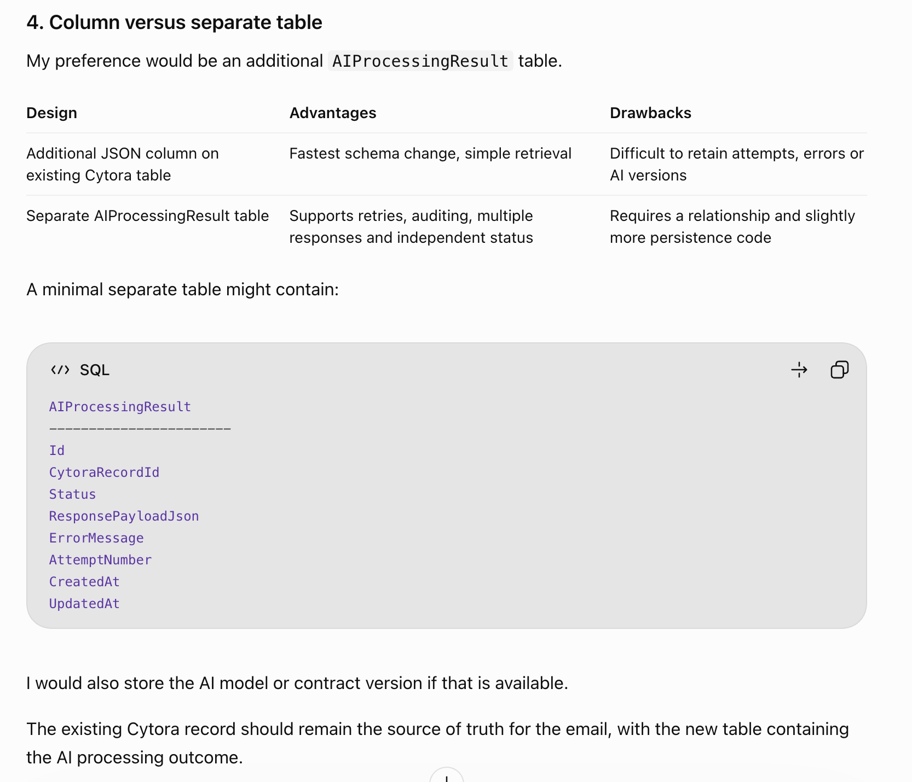

Slide 5
Discussion
Trigger for kicking off processing
Do we create separate table or columns
Do we hold off CTP
I need to find a salesforce record to see what is stored
I need to see flow of stuff

