Slide 1
Components to make figure 1

Slide 2
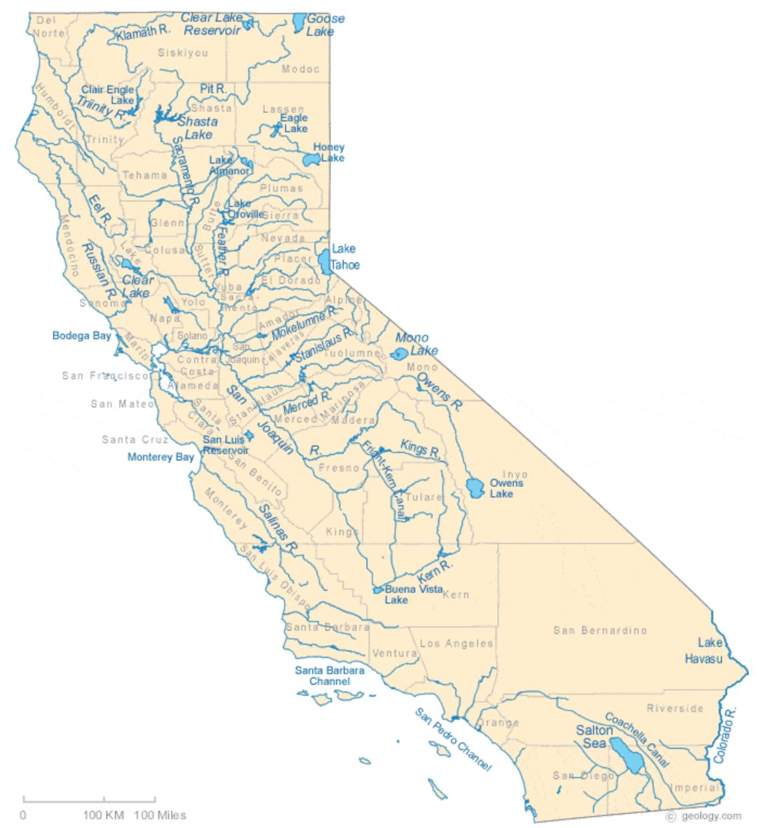
SHA
ORO
BUL
FOL
Gains (Consumnes, Calaveras, Mokelumne)
D_in
NML
D_out
DNP
EXC
Exports
MIL

Slide 3
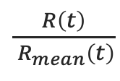
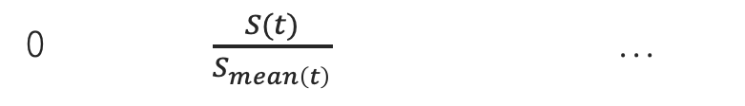
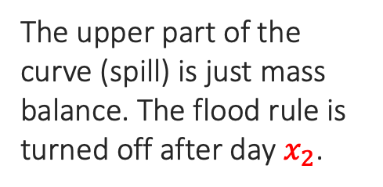
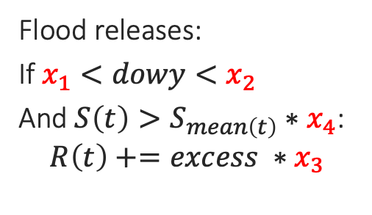
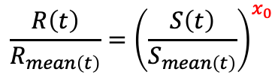
Reservoir release policy (5 parameters)
Exponential hedging rule:
$$\frac{R\left(t\right)}{R_{mean\left(t\right)}}={\left(\frac{S\left(t\right)}{S_{mean\left(t\right)}}\right)}^{x_{0}}$$
$\frac{R\left(t\right)}{{ R}_{mean}\left(t\right)}$
Flood releases:
If $x_{1}<dowy<x_{2}$
And $S\left(t\right)>S_{mean\left(t\right)}∗x_{4}$:
$$R\left(t\right)+=excess ∗x_{3}$$
1.0
The upper part of the curve (spill) is just mass balance. The flood rule is turned off after day $x_{2}$.
0
0 $\frac{S(t)}{S_{mean\left(t\right)}}$ …

Slide 4
Reservoir | CDEC ID | R² | CALFEWS
New Bullards Bar | BUL | 0.80 | 0.87
Don Pedro | DNP | 0.90 | 0.97
Folsom | FOL | 0.82 | 0.86
Exchequer | EXC | 0.79 | 0.93
Millerton | MIL | 0.66 | 0.56
New Melones | NML | 0.91 | 0.96
Oroville | ORO | 0.75* | 0.94
Shasta | SHA | 0.86 | 0.92
Total Delta Exports (Weekly Pumping) | HRO+TRP | 0.63 | 0.62
* Our comparison period is Oct 1997-Sept 2021. CALFEWS is Oct 1996-Sept 2016. The Oroville result is impacted by the unpredictable operations after the spillway failure in Feb 2017.

