Slide 1
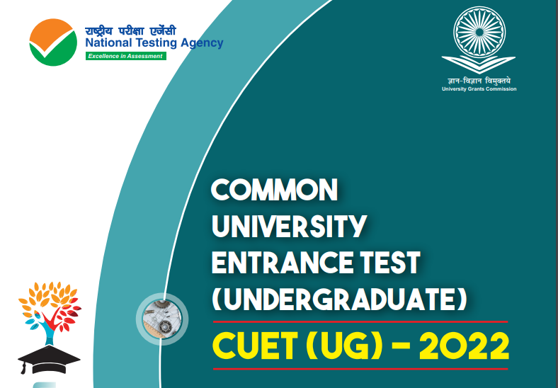

Slide 2

IMPORTANT INFORMATION AND DATES AT A GLANCE
Events | Details
Online submission of Application Form | 06 April to 06 May, 2022 (up to 5:00 pm)
Last date of successful transaction of Examination Fee | 06 May, 2022 (up to 11:50 pm)
Correction in the particulars of Application Form on Website only | To be announced later on the website
Downloading of Admit Card from NTA Website | To be announced later on the website
Date(s) of Examination | First and second week of July, 2022
Duration of Examination | Slot 1: *195 minutes (3:15 hours) Slot 2: *225 minutes (3:45 hours)
Timing of Examination | Slot 1: 09.00 AM to 12.15 PM (IST) Slot 2: 03.00 PM to 06.45 PM (IST)
Centre, Date, Tests/Subjects and timing of Examination | As indicated on the Admit Card
Display of Recorded Responses and Provisional Answer Keys on the Website | To be announced later on the website
Declaration of Result on the NTA Website | To be announced later on the website
Website(s) | https://cuet.samarth.ac.in

Slide 3
Broad features of CUET (UG) - 2022
Sections | Subjects/ Tests | Questions to be Attempted | Question Type | Duration
Section IA - Languages | There are 13 different languages. Any of these languages may be chosen | 40 questions out of 50 in each language 40 questions out of 50 in each subject | Language to be tested through Reading Comprehension (based on different types of passages–Factual, Literary and Narrative, [Literary Aptitude and Vocabulary] MCQ Based Questions • Input text can be used for MCQ Based Questions • MCQs based on syllabus given on NTA website | 45 Minutes for each
Section IB - Languages Section II - Domain | There are 20 Languages. Any other language apart from those offered in Section I A may be chosen. There are 27 Domains specific Subjects being offered under this Section. A candidate may choose a maximum of Six (06) Domains as desired by the applicable University/ Universities.
 |  |  |  | 45 Minutes for each Domain Specific Subjects
Cont’d

Slide 4
Sections | Subjects/ Tests | Questions to be Attempted | Question Type | Duration
Section III General Test | For any such undergraduate programme/ programmes being offered by Universities where a General Test is being used for admission. | 60 questions out of 75 | • Input text can be used for MCQ Based Questions • General Knowledge, Current Affairs, General Mental Ability, Numerical Ability, Quantitative Reasoning (Simple application of basic mathematical concepts arithmetic/algebra geometry/mensuration /stat taught till Grade 8), Logical and Analytical Reasoning | 60 Minutes

Slide 5
Examination Structure
Slot 1 (Morning Session)
Sr No. | Tests/Subjects | No. of questions to be attempted | Marks per question | Total marks | Duration
1 | Language (any one of the 13 languages opted in Section IA) | 40 out of 50 | 5 | 200 | 45 minutes per language
2 | Domain Specific Subjects (Max. 2 subjects) | 40 out of 50 | 5 | 200 | 45 minutes per subject (Max. duration can go upto 90 minutes for 2 subjects)
3 | General Test | 60 out of 75 | 5 | 300 | 60 minutes
Note: One mark will be deducted for a wrong answer. Unanswered/Marked for Review will be given no mark (0).

Slide 6
Examination Structure
Slot 2 (Afternoon Session)
Sr No. | Tests/Subjects | No. of questions to be attempted | Marks per question | Total marks | Duration
1 | Language (any one of the remaining 12 languages opted in Section IA (if one already taken in slot 1) and 1 from Section IB - as applicable) OR as applicable per note below | 40 out of 50 | 5 | 200 | 45 minutes per language
2 | Domain Specific Subjects (Max. 4 subjects) | 40 out of 50 | 5 | 200 | 45 minutes per subject (Max. duration can go upto 90 minutes for 2 subjects)
Note: One mark will be deducted for a wrong answer. Unanswered/Marked for Review will be given no mark (0).

Slide 7
EXAMINATION SCHEME
Mode of Examination: CUET (UG) - 2022 will be conducted in Computer Based Test (CBT) mode.
Pattern of Question Paper: Objective type Multiple Choice Questions (MCQs).
Tests Design: There are three Sections in the design of the test:
Section IA - 13 Languages (As a medium and “Language”)
Section IB - 20 Languages
Section II - 27 Domain Specific Subjects
Section III - General Test

Slide 8
Fee Payable by candidates (CUET (UG) - 2022 ) in INR@
Slot: Timing of Examination | No. of Tests/ Subjects | UG/UI and Part time Programmes
 |  | Centres in India |  |  | Centres Out Side India
 |  | General (Unreserved) | OBC (NCL)*/ EWS** | SC/ST/ Third gender/ PwBD
Slot-1 : 09.00 a.m. to 12.15 p.m. (IST) | Upto 4 | ₹ 650/- | ₹ 600/- | ₹ 550/- | ₹ 3000/-
Slot-2 : 03.00 p.m. to 06.45 p.m. (IST) | Upto 5 | ₹ 650/- | ₹ 600/- | ₹ 550/- | ₹ 3000/-
@Processing charges and Goods & Service Taxes (GST) are to be paid by the candidate, as applicable

Slide 9
RESERVATIONS
In the case of the Central Universities, the reservation policy of the respective University shall be applicable.

Slide 10
For any queries/ clarifications, candidates can also Email / call at the NTA Helpdesk:
Email ID | cuet-ug@nta.ac.in
Contact Number | 011- 40759000 / 011-69227700
Website | https://cuet.samarth.ac.in https://nta.ac.in

Slide 11
THANK YOU

