Slide 1

Matchmaker
John Sauter
Rachel Williams

Slide 2

Elevator Pitch
Drawing on both long folk history of third-party matchmakers as well as one of the earliest uses of commercial computing, Matchmaker combines high tech and high touch to facilitate matches between compatible people.

Slide 3
Description
Seekers enter both demographic and free-form information about themselves and preferences for a match and pay a fee to be matched. Matchmaker automatically filters user demographic data for compatibility, then presents anonymized potential matches to a human matchmaker. The matchmaker reviews the free-form “About Me” data, rates options on a scale of 1-10, then forwards the anonymized choices to the user. The user then has the option to choose one match. Once the user has chosen a match, an email is sent to both parties and their contact information is provided to both. A user may reject a previously chosen match, in which case, confirmation emails are again sent to both parties. The user is invited to try again, but only after paying the fee once more.

Slide 4
User Story
Drawing on both long folk history of third-party matchmakers as well as one of the earliest uses of commercial computing, Matchmaker combines high tech and high touch to facilitate matches between compatible people.

Slide 5
Elevator Pitch
Drawing on both long folk history of third-party matchmakers as well as one of the earliest uses of commercial computing, Matchmaker combines high tech and high touch to facilitate matches between compatible people.

Slide 6
Technologies Used
React
GraphQL
Node.js
Express.js server
MongoDB
Mongoose ODM
JWT for authentication.
Nodemailer
Stripe

Slide 7
Tasks and Roles
John
Logic
UI
Stripe
Rachel
Models
Typedefs
Seed data
Nodemailer
React forms
Stripe

Slide 8
Challenges and Successes
Losing a team member
Getting details right with GraphQL
Learning to debug GraphQL
Regrouping to complete project

Slide 9
Challenges Successes
Content
Add text, images, art, and videos.
Add transitions, animations, and motion.
Save to OneDrive, to get to your presentations from your computer, tablet, or phone.
This PowerPoint theme uses its own unique set of colors, fonts, and effects to create the overall look and feel of these slides.
PowerPoint has tons of themes to give your presentation just the right personality.

Slide 10

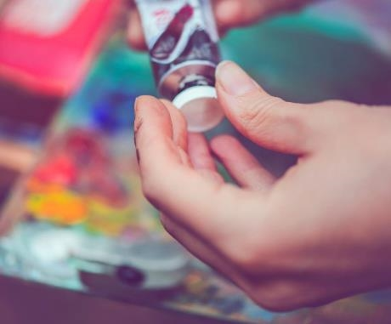


Agenda
Topic one
Topic two
Topic three
Topic four
Topic five

Slide 11


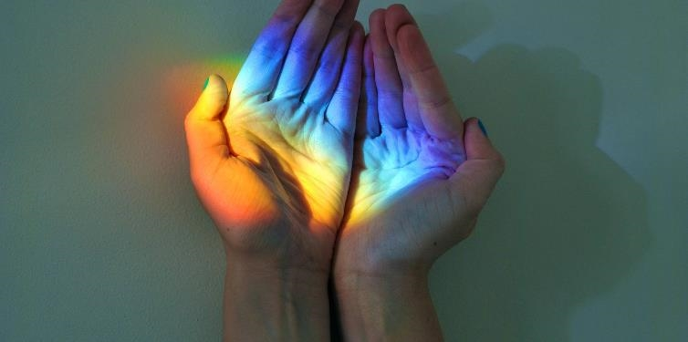
Introduction
With PowerPoint, you can create presentations and share your work with others, wherever they are. Type the text you want here to get started. You can also add images, art, and videos on this template. Save to OneDrive and access your presentations from your computer, tablet, or phone.

Slide 12
Chart

Slide 13
Table
 | Category 1 | Category 2 | Category 3 | Category 4
Item 1 | 4.5 | 2.3 | 1.7 | 5
Item 2 | 3.2 | 5.1 | 4.4 | 3
Item 3 | 2.1 | 1.7 | 2.5 | 2.8
Item 4 | 4.5 | 2.2 | 1.7 | 7

Slide 14

The way to get started is to quit talking and begin doing.
Walt Disney

Slide 15

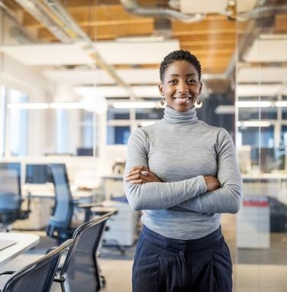


Team
Name
Name
Name
Name
Title
Title
Title
Title

Slide 16
Timeline
Title
To start a presentation, go to the Slide Show tab, and select From Beginning.
Title
To display Presenter view, in Slide Show view, on the control bar at the bottom left select the three dots, and then Show Presenter View.
Title
During your presentation, the speaker notes are visible on your monitor, but aren't visible to the audience.
Title
Title
The Notes pane is a box that appears below each slide. Tap it to add notes.
If you don’t see the Notes pane or it is completely minimized, click Notes on the task bar across the bottom of the PowerPoint window.

Slide 17

Thank you
Presenter name
Email address
Website address

