Slide 1
Plant Selector and Planner
Haley Gustafson, John Sauter, Ash Carruth
Notes:
For an optimal viewing experience please install the Merienda font from the presentation file. Simply open the zip file and double click on Merienda-Regular.ttf and Merienda-Bold.ttf and install each using the button at the top

Slide 2
01
Introduction
Notes:
Nursery managers waste a lot of time dealing with customers who have only a vague idea of what plants they want for their garden. Much time could be saved if the gardener could first look through a catalogue of suitable plants and choose the ones needed.
This application fills that need by providing a gardener with a list of plants, searchable by various desirable qualities, such as hardiness and sunlight requirements. The resulting list can be sent to the nursery manager or carried to the nursery by the gardener.

Slide 3
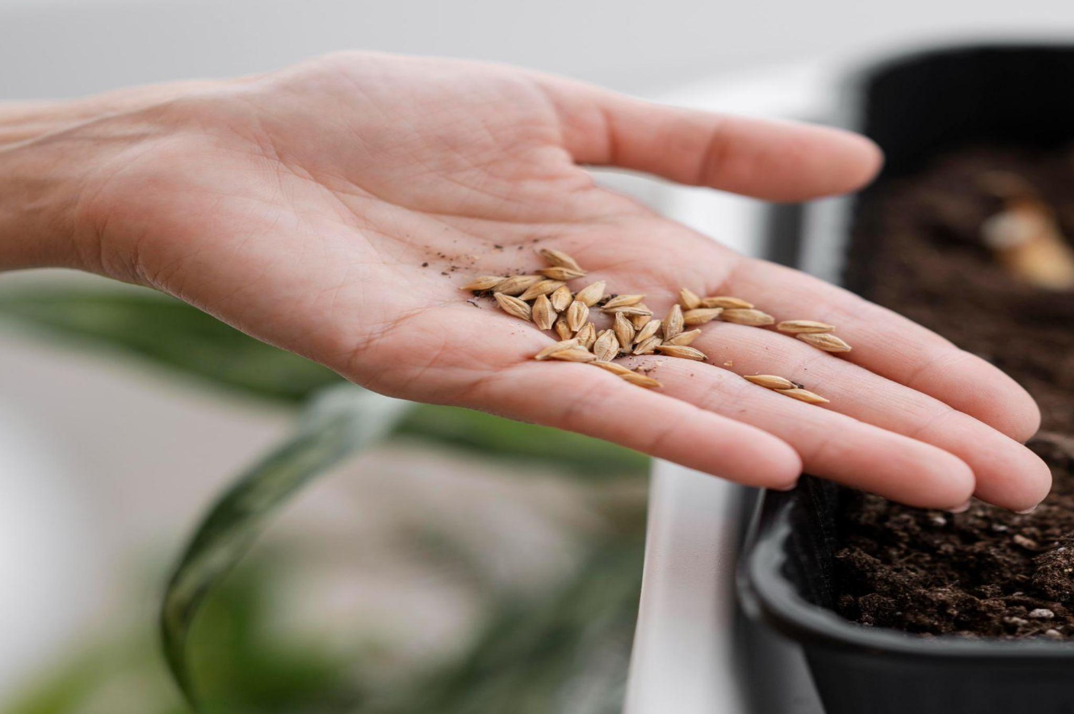
Concept
Description
Why we chose this
User Story
Notes:
Description
A plant database searcher in which a user can retrieve a list of plants that fall under desired criteria – hardiness zone, sun exposure, herbaceous/shrub/tree, evergreen/deciduous (for woody shrubs/trees), and bloom time. The user can then add plants to a personal collection that they can print and take on a trip to a nursery.
Motivation for Development
Amateur gardeners often go to plant nurseries and ask for plants that meet certain criteria. It can be difficult to narrow down the immense number of choices at a nursery while meeting all desired criteria. If a gardener were able to search a list of plants by desired criteria and develop a list of plants that meet their needs, they could take their list to a nursery and ask if their desired plants are available, rather than asking the nursery to narrow their choices down for them, expediting the process for everyone.
User Stories
As a gardener, / I want to search for plants filtered by certain criteria
So that I can choose plants that suit my gardening needs
As a user, / I want to add plants to a personal collection
So that I can print that list to take with me to a nursery
As a Nursery Manager, / I want to provide my customers with the plants that meet their needs without wasting a lot of time.

Slide 4
Process
Technologies Used: Foundation for Sites, Node.js, Express.js, Handlebars.js, MySQL, GitHub, Heroku, JawsDB, Sequelize, and nodemailer
Breakdown of tasks and Roles: See notes.
Challenges: We were unable to locate an API for garden plant data, so we created the database by hand.
Successes: The secrecy requirements of nodemailer provided us an opportunity to learn how to keep information that is not API key confidential.
Notes:
Technologies Used:
Foundation for Sites, Node.js, Express.js, Handlebars.js, MySQL, GitHub, Heroku, JawsDB, Sequelize, and nodemailer
Breakdown of Tasks and Roles:
1. Design user flows: what pages will each type of user see, and what actions can be taken on each
2. Design data structures to support the user actions
3. Populate the plant database
4. Design and code the server: this includes specifying the paths
5. Construct and lay out the user pages based on the user flow design, using the paths to the server
6. Test and debug
7. Deploy to Heroku
8. Present the application to the class
Challenges:
We were unable to locate an API for garden plant data, so we created the database by hand.
Successes:
The secrecy requirements of nodemailer provided us an opportunity to learn how to keep information that is not API key confidential.

Slide 5
02
Demo
Notes:
1. Sign up a nursery manager, he adds a plant, logs off.
2. Sign up a gardener, she searches for plants, finds the plant added, sends email.
3. Log in the nursery manager, he views the gardener’s selection.

Slide 6
Directions for Future Development
Expansion
Support
Eye Candy!
More Info
Get in the Zone
Expansion of the plant database and selection criteria.
Adding support for multiple nurseries.
Addition of plant pictures
Addition of plant location and number available at the nursury
Addition of garden zones and the number of each kind of plant needed in each zone.
Notes:
Expansion of the plant database and selection criteria.
Support of multiple nurseries.
Addition of plant pictures.
Addition of plant location and number available in a nursery.
Addition of garden zones and the number of each kind of plant needed in each zone.

Slide 7
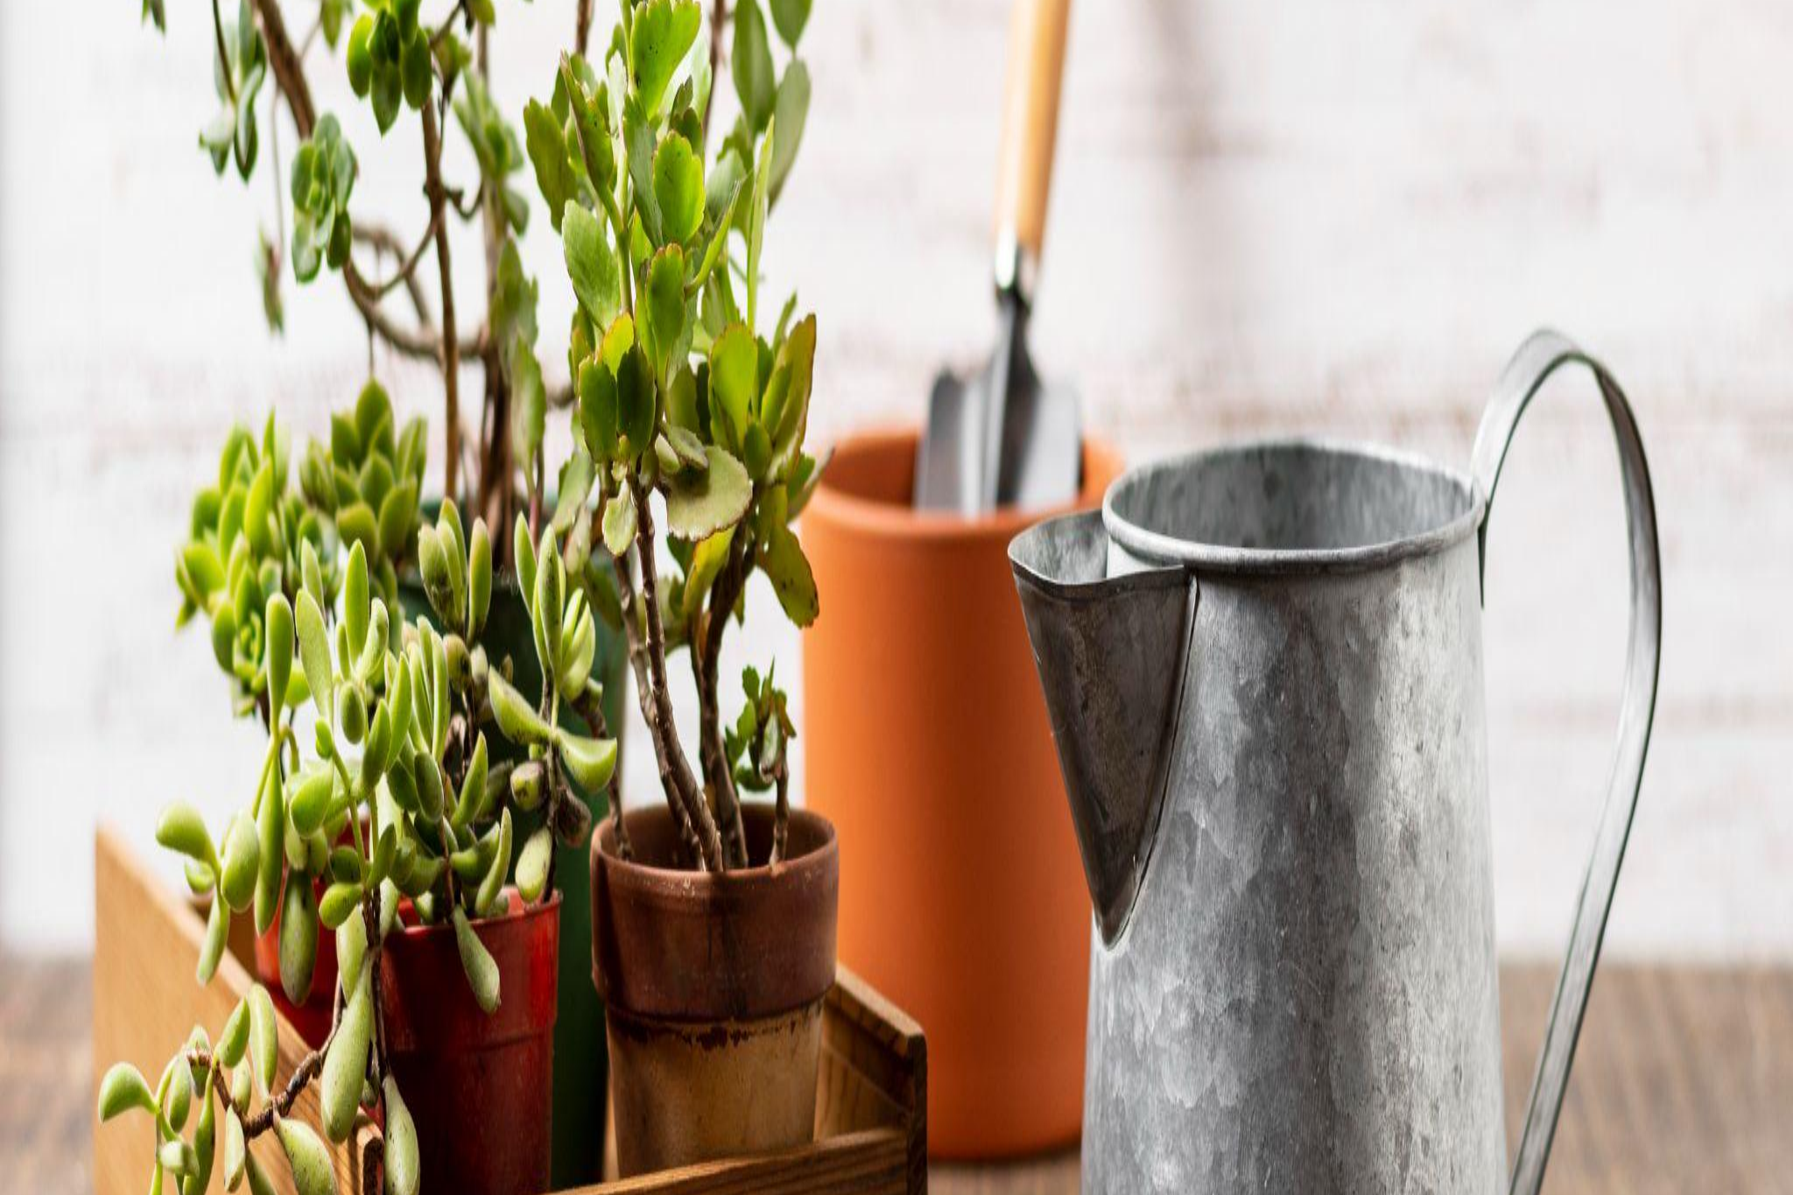
Links
Deployed: https://beautiful-yosemite-29690.herokuapp.com/
GitHub repo: https://github.com/JohnSauter/plant_selection_planner
Notes:
Heroku:
https://beautiful-yosemite-29690.herokuapp.com/
Github repro:
https://github.com/JohnSauter/plant_selection_planner

Slide 8
Thanks!
Do you have any questions?
hgustafson17@gmail.com
John_Sauter@systemeyescomputerstore.com
ashcarruth@gmail.com
Please keep this slide for attribution

