Slide 1
GENERIC SOLUTION DEMONSTRATION
Case document extraction
THE PROBLEM
THE SOLUTION
Long case PDFs leave investigators re-keying facts and searching manually for evidence.
Select records and fields, analyze the documents, and inspect structured results before any downstream handoff.
PRODUCTS AND PLATFORM
Azure AI Document Intelligence | Azure OpenAI GPT-4.1 | Azure AI Search | Blob Storage | Logic Apps
Captured: document/field selection and extraction results. Excel and registry automation are described, not shown executing. Hosting and deployment are not verified.
Notes:
Problem: Long case PDFs leave investigators re-keying facts and searching manually for evidence.
Solution: Select records and fields, analyze the documents, and inspect structured results before any downstream handoff.
Products: Azure AI Document Intelligence | Azure OpenAI GPT-4.1 | Azure AI Search | Blob Storage | Logic Apps
Evidence status: Captured: document/field selection and extraction results. Excel and registry automation are described, not shown executing. Hosting and deployment are not verified.
Customer branding, organization labels and resource identifiers have been generalized. Screenshots are edited historical captures; no service results were rerun.

Slide 2
SOLUTION ARCHITECTURE
How the solution fits together
LOGICAL FLOW / REFERENCE VIEW
01
02
03
04
Analyst web UI
Document Intelligence
Azure OpenAI + Search
Review + export
Choose PDFs and fields
OCR and layout extraction
Interpret and retrieve facts
Human verification
Reference design includes Blob and Logic Apps. Excel/registry automation is a proposed extension; source diagrams differ on App Service versus Static Web Apps.
Generic labels and edited screenshots | Historical results are illustrative, not rerun
START TOUR >
Notes:
Architecture: [['Analyst web UI', 'Choose PDFs and fields'], ['Document Intelligence', 'OCR and layout extraction'], ['Azure OpenAI + Search', 'Interpret and retrieve facts'], ['Review + export', 'Human verification']]
Boundary: Reference design includes Blob and Logic Apps. Excel/registry automation is a proposed extension; source diagrams differ on App Service versus Static Web Apps.
This is a logical diagram, not a verified deployment inventory. Arrows show the conceptual information flow.
Customer names, logos and resource identifiers in subsequent captured screens have been generalized. Service brands and the solution's core workflow remain.

Slide 3



Presented by your Microsoft State and Local Government Team

Slide 4
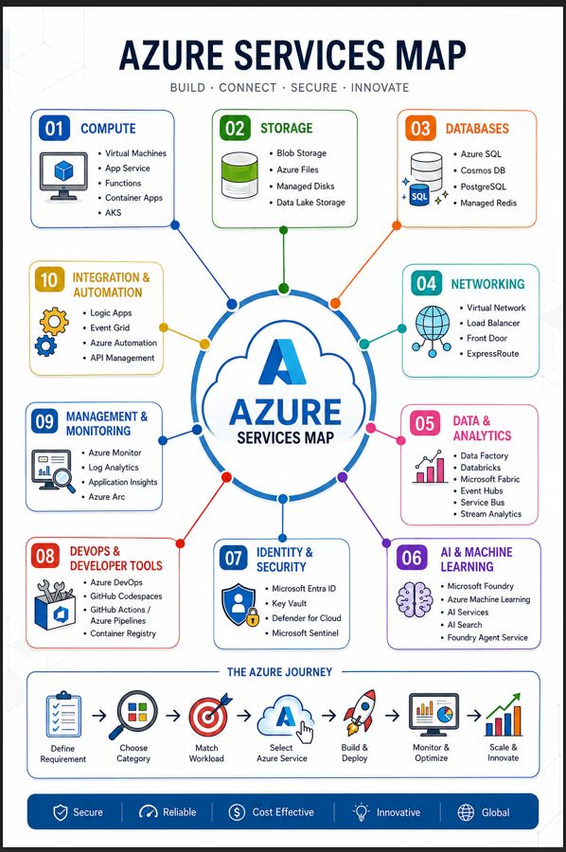
Notes:
🔍 Challenges of the Manual Process
1. Time & Throughput Constraints
Reviewing 100-page documents manually is inherently slow (often 1–3 hours per document depending on complexity).
Data entry into Excel adds additional overhead (15–30+ minutes per document).
Re-keying data again into NamUs creates duplication of effort.
Overall throughput is severely limited → case backlog grows continuously.
👉 Result: Investigators spend more time processing data than analyzing it.
2. Human Error & Data Quality Risks
Manual extraction leads to:
Missed fields (especially buried in long reports)
Misinterpretation of ambiguous language
Typographical errors during entry
Re-entry into multiple systems compounds error probability.
Inconsistent formatting across documents leads to non-standardized data.
👉 Result: Poor data quality reduces effectiveness of downstream analysis and matching.
3. Cognitive Load & Fatigue
Reviewing long, repetitive documents causes:
Attention degradation over time
Increased likelihood of missing critical clues
Investigators must context-switch between:
Reading reports
Extracting data
Entering into Excel
Navigating external systems
👉 Result: Mental fatigue → lower accuracy and slower decision-making.
4. Lack of Searchability & Insight
Data locked in documents is:
Not easily searchable
Not cross-referenced across cases
Excel files become static repositories rather than intelligence tools.
👉 Result: Investigators cannot easily identify patterns, trends, or connections across cases.
5. Inefficient System Interaction
Manual navigation of the NAMUS system:
Repetitive form entry
No automation of workflows
No integration between document data and system inputs.
👉 Result: High friction in moving from data → action.

Slide 5
Azure provides the building blocks for secure, scalable digital solutions
Think of it as one cloud platform with specialist services you combine as needed.
Compute & containers
Apps & integration
Virtual Machines • AKS
AZURE
CLOUD
App Service • Functions • APIs
Data & storage
AI & analytics
Azure SQL • Cosmos DB • Storage
Azure AI • Machine Learning
Networking
Security & management
Virtual Network • Load Balancer
Entra ID • Defender • Monitor
Start with the business need — then combine only the services you need.
Notes:
🔍 Challenges of the Manual Process
1. Time & Throughput Constraints
Reviewing 100-page documents manually is inherently slow (often 1–3 hours per document depending on complexity).
Data entry into Excel adds additional overhead (15–30+ minutes per document).
Re-keying data again into NamUs creates duplication of effort.
Overall throughput is severely limited → case backlog grows continuously.
👉 Result: Investigators spend more time processing data than analyzing it.
2. Human Error & Data Quality Risks
Manual extraction leads to:
Missed fields (especially buried in long reports)
Misinterpretation of ambiguous language
Typographical errors during entry
Re-entry into multiple systems compounds error probability.
Inconsistent formatting across documents leads to non-standardized data.
👉 Result: Poor data quality reduces effectiveness of downstream analysis and matching.
3. Cognitive Load & Fatigue
Reviewing long, repetitive documents causes:
Attention degradation over time
Increased likelihood of missing critical clues
Investigators must context-switch between:
Reading reports
Extracting data
Entering into Excel
Navigating external systems
👉 Result: Mental fatigue → lower accuracy and slower decision-making.
4. Lack of Searchability & Insight
Data locked in documents is:
Not easily searchable
Not cross-referenced across cases
Excel files become static repositories rather than intelligence tools.
👉 Result: Investigators cannot easily identify patterns, trends, or connections across cases.
5. Inefficient System Interaction
Manual navigation of the NAMUS system:
Repetitive form entry
No automation of workflows
No integration between document data and system inputs.
👉 Result: High friction in moving from data → action.

Slide 6





Azure AI Foundry
Foundry Models
Cloud
Copilot
Studio
Azure
Visual
Studio
Foundry Agent Service
Azure Arc
GitHub
Azure AI
Search
Azure AI
Services
Azure
Machine Learning
Azure AI
Content Safety
Foundry Local
Foundry
SDK
Foundry Observability
Edge
Security & Governance
Control
Azure Kubernetes Service
Azure App Service
Azure Container Apps
Azure Functions
Serverless
Notes:
🔍 Challenges of the Manual Process
1. Time & Throughput Constraints
Reviewing 100-page documents manually is inherently slow (often 1–3 hours per document depending on complexity).
Data entry into Excel adds additional overhead (15–30+ minutes per document).
Re-keying data again into NamUs creates duplication of effort.
Overall throughput is severely limited → case backlog grows continuously.
👉 Result: Investigators spend more time processing data than analyzing it.
2. Human Error & Data Quality Risks
Manual extraction leads to:
Missed fields (especially buried in long reports)
Misinterpretation of ambiguous language
Typographical errors during entry
Re-entry into multiple systems compounds error probability.
Inconsistent formatting across documents leads to non-standardized data.
👉 Result: Poor data quality reduces effectiveness of downstream analysis and matching.
3. Cognitive Load & Fatigue
Reviewing long, repetitive documents causes:
Attention degradation over time
Increased likelihood of missing critical clues
Investigators must context-switch between:
Reading reports
Extracting data
Entering into Excel
Navigating external systems
👉 Result: Mental fatigue → lower accuracy and slower decision-making.
4. Lack of Searchability & Insight
Data locked in documents is:
Not easily searchable
Not cross-referenced across cases
Excel files become static repositories rather than intelligence tools.
👉 Result: Investigators cannot easily identify patterns, trends, or connections across cases.
5. Inefficient System Interaction
Manual navigation of the NAMUS system:
Repetitive form entry
No automation of workflows
No integration between document data and system inputs.
👉 Result: High friction in moving from data → action.

Slide 7
🔍 Challenges of the Manual Process
1. Time & Throughput Constraints
👉 Result: Investigators spend more time processing data than analyzing it.
2. Human Error & Data Quality Risks
👉 Result: Poor data quality reduces effectiveness of downstream analysis and matching.
3. Cognitive Load & Fatigue
👉 Result: Mental fatigue → lower accuracy and slower decision-making.
4. Lack of Searchability & Insight
👉 Result: Investigators cannot easily identify patterns, trends, or connections across cases.
5. Inefficient System Interaction
👉 Result: High friction in moving from data → action.
Notes:
🔍 Challenges of the Manual Process
1. Time & Throughput Constraints
Reviewing 100-page documents manually is inherently slow (often 1–3 hours per document depending on complexity).
Data entry into Excel adds additional overhead (15–30+ minutes per document).
Re-keying data again into NamUs creates duplication of effort.
Overall throughput is severely limited → case backlog grows continuously.
👉 Result: Investigators spend more time processing data than analyzing it.
2. Human Error & Data Quality Risks
Manual extraction leads to:
Missed fields (especially buried in long reports)
Misinterpretation of ambiguous language
Typographical errors during entry
Re-entry into multiple systems compounds error probability.
Inconsistent formatting across documents leads to non-standardized data.
👉 Result: Poor data quality reduces effectiveness of downstream analysis and matching.
3. Cognitive Load & Fatigue
Reviewing long, repetitive documents causes:
Attention degradation over time
Increased likelihood of missing critical clues
Investigators must context-switch between:
Reading reports
Extracting data
Entering into Excel
Navigating external systems
👉 Result: Mental fatigue → lower accuracy and slower decision-making.
4. Lack of Searchability & Insight
Data locked in documents is:
Not easily searchable
Not cross-referenced across cases
Excel files become static repositories rather than intelligence tools.
👉 Result: Investigators cannot easily identify patterns, trends, or connections across cases.
5. Inefficient System Interaction
Manual navigation of the NAMUS system:
Repetitive form entry
No automation of workflows
No integration between document data and system inputs.
👉 Result: High friction in moving from data → action.

Slide 8
⚡ Benefits of the Automated Solution
1. Massive Time Savings
👉 Impact: Investigators can process 10–20x more cases.
2. Improved Accuracy & Consistency
👉 Impact: More reliable data → better case matching and analytics.
3. Intelligent Search & Retrieval
👉 Impact: Faster discovery of connections between cases.
4. End-to-End Automation of Workflows
👉 Impact: Removes repetitive administrative work entirely
5. Natural Language Interaction with Data
👉 Impact: Democratizes access to insights for all users.
6. Scalability & Continuous Improvement
👉 Impact: Future-proof solution for growing case loads.
.
Notes:
⚡ Benefits of the Automated Solution
1. Massive Time Savings
Azure Document Intelligence automatically extracts structured data from long documents.
Azure OpenAI Service interprets context and normalizes outputs.
End-to-end processing reduced from hours → minutes per document.
👉 Impact: Investigators can process 10–20x more cases.
2. Improved Accuracy & Consistency
AI-driven extraction ensures:
Standardized field mapping
Reduced human transcription errors
Validation logic and structured outputs improve data quality.
👉 Impact: More reliable data → better case matching and analytics.
3. Intelligent Search & Retrieval
Azure AI Search enables:
Full-text search across all processed documents
Semantic search (finding meaning, not just keywords)
Investigators can instantly locate relevant cases, patterns, or entities.
👉 Impact: Faster discovery of connections between cases.
4. End-to-End Automation of Workflows
Microsoft Power Automate:
Automatically populates Excel
Eliminates manual data entry steps
Desktop automation:
Interacts directly with NAMUS
Submits extracted data without manual input
👉 Impact: Removes repetitive administrative work entirely.
5. Natural Language Interaction with Data
Microsoft Copilot Studio enables:
Conversational queries like:
“Show me cases with similar physical descriptions”
“Find reports mentioning specific locations or conditions”
Grounded in customer data → accurate, context-aware responses.
👉 Impact: Democratizes access to insights for all users.
6. Scalability & Continuous Improvement
System improves over time:
Better extraction models
Expanded data coverage
Can handle increasing document volume without adding staff.
👉 Impact: Future-proof solution for growing case loads.

Slide 9
🎯 Alignment to the Ultimate Goal: Solving Cold Cases: How This Directly Helps Investigations
1. More Cases Processed
👉 Backlog reduction → more historical cases digitized and searchable
2. Better Pattern Recognition
👉 AI + search enables:
  Cross-case comparisons
  Identification of similarities that humans may miss
3. Faster Time to Insight
👉 Investigators move from:
  Manual processing → Immediate analysis
4. Higher Data Integrity
👉 Accurate, structured data improves:
  Matching algorithms
  Case linking
5. Focus on Investigation, Not Administration
👉 Investigators spend time on:
  Analysis
  Decision-making
  Collaboration

Slide 10
Executive Summary
Before:
Labor-intensive
Error-prone
Slow
Data siloed and underutilized
After:
Automated ingestion and extraction
High-quality structured data
Intelligent search and AI insights
Seamless system integration
Conversational access to knowledge
🚀 Bottom Line
This solution transforms the process from document handling to intelligence generation.
👉 The real value isn’t just efficiency—it’s enabling investigators to:
Surface hidden connections
Act faster
Increase the probability of identifying victims and suspects
Ultimately: more cold cases solved, faster, with higher confidence.

Slide 11
DEMO Flow and resources used.

Slide 12
Day in the life: operational flow
1
8:30 - Select case file
Investigator chooses a cold case PDF in the internal UI.
2
8:31 - Extract and analyze
Azure Document Intelligence extracts text; AI maps it to required fields and emits JSON.
3
8:32 - Trigger automation
Output landing in Azure storage triggers the cloud automation.
4
8:33 - Populate workbook
Automation writes values into the correct Excel columns for case tracking and NAMUS prep.
5
8:35 - Run NAMUS search
Desktop automation opens the NAMUS site: direct lookup if a NAMUS ID exists, otherwise criteria-based search.
6
8:38 - Review leads
Investigator reviews likely matches and the supervisor prioritizes follow-up.

Slide 13
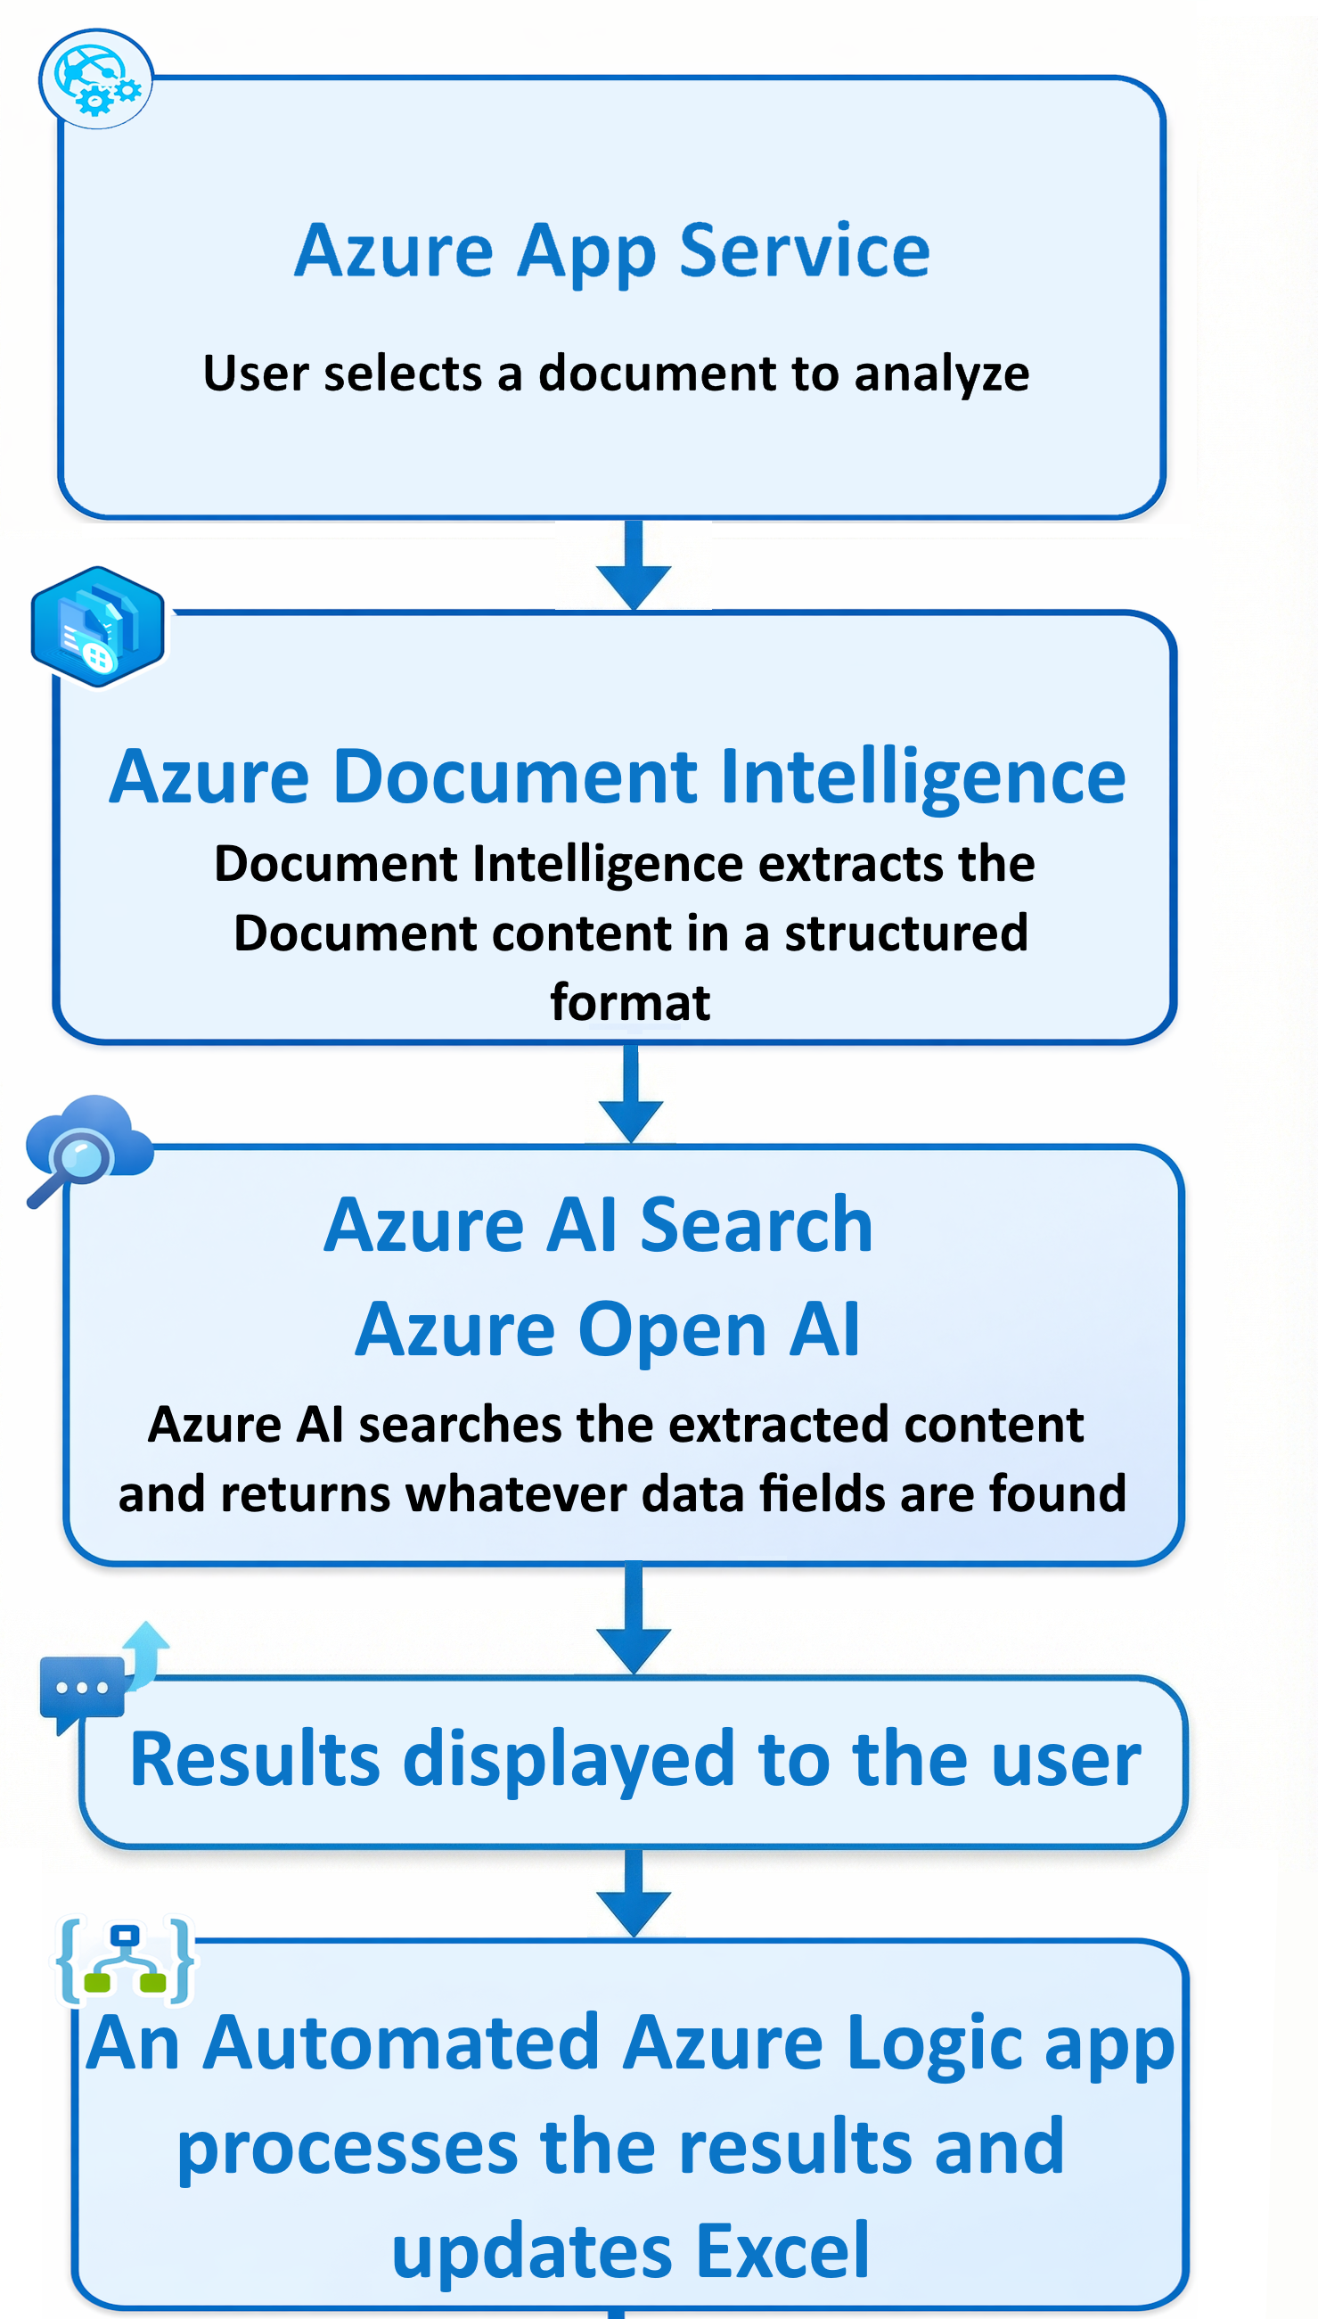

Slide 14
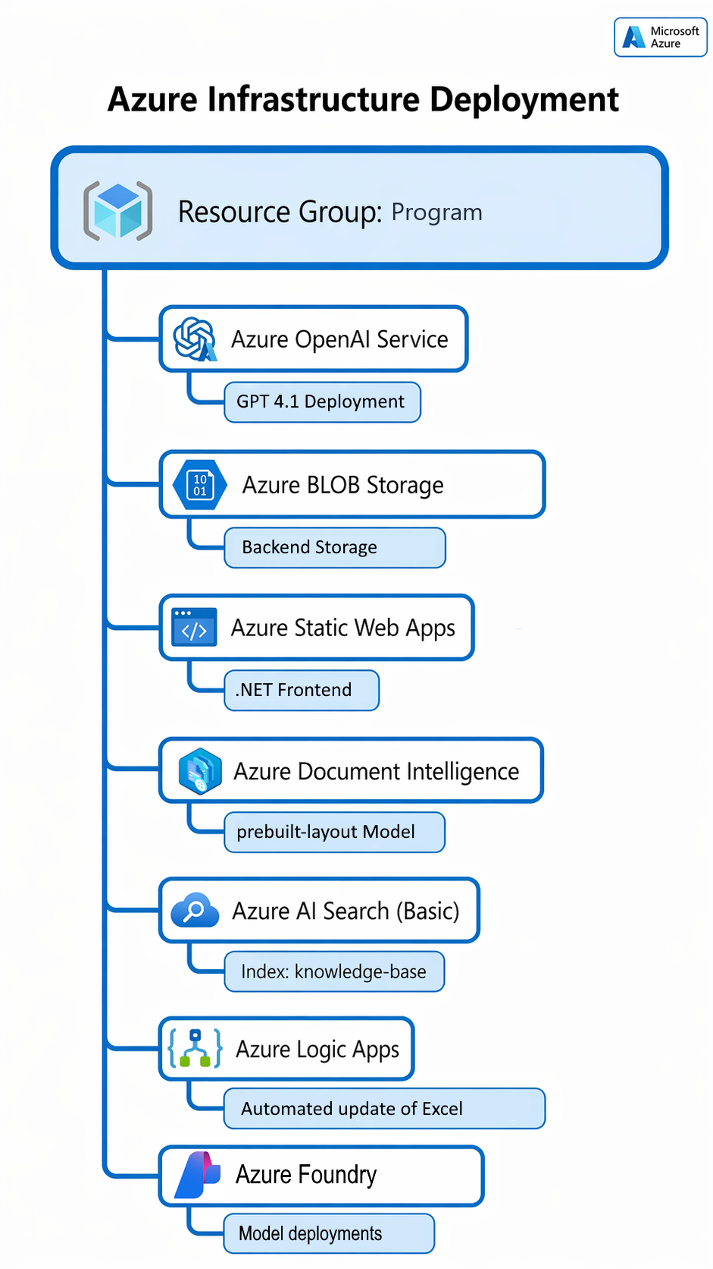

Slide 15
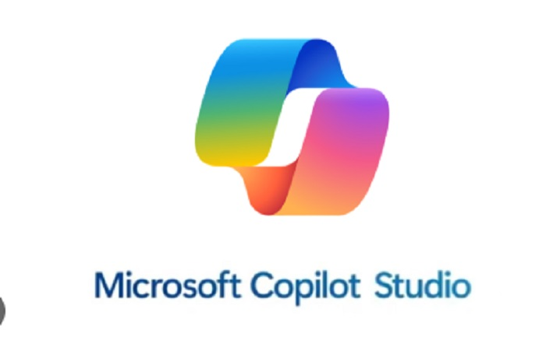
A Microsoft CoPilot Agent was built grounded with the ME Office documents to enable Users to interactively perform queries.

Slide 16
DEMO

Slide 17
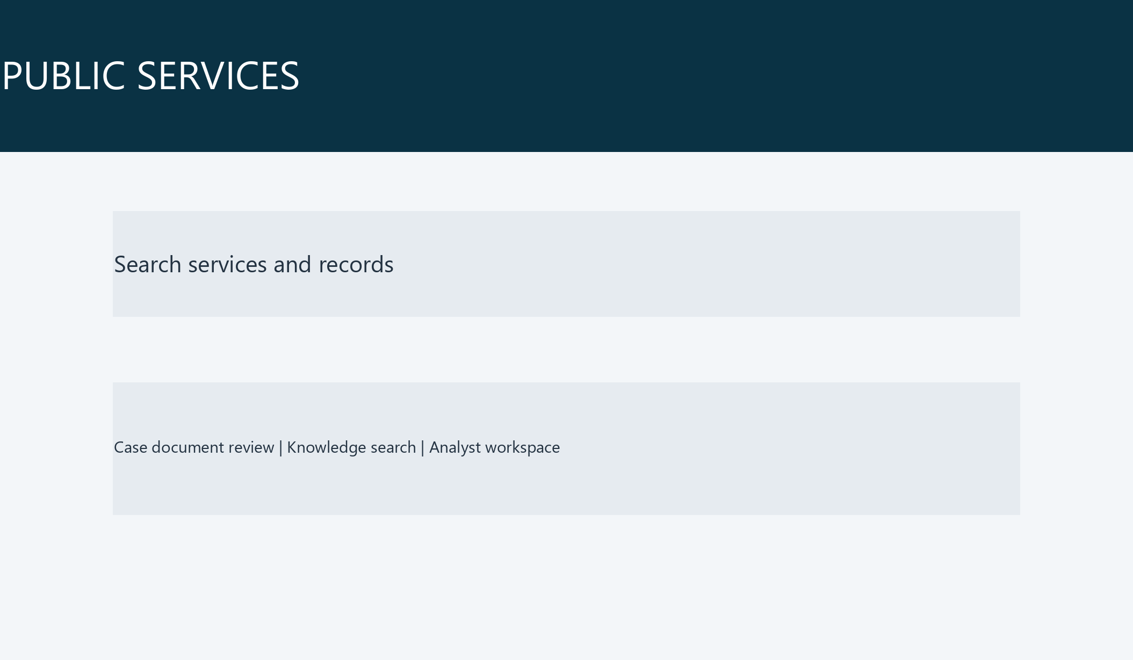

Slide 18
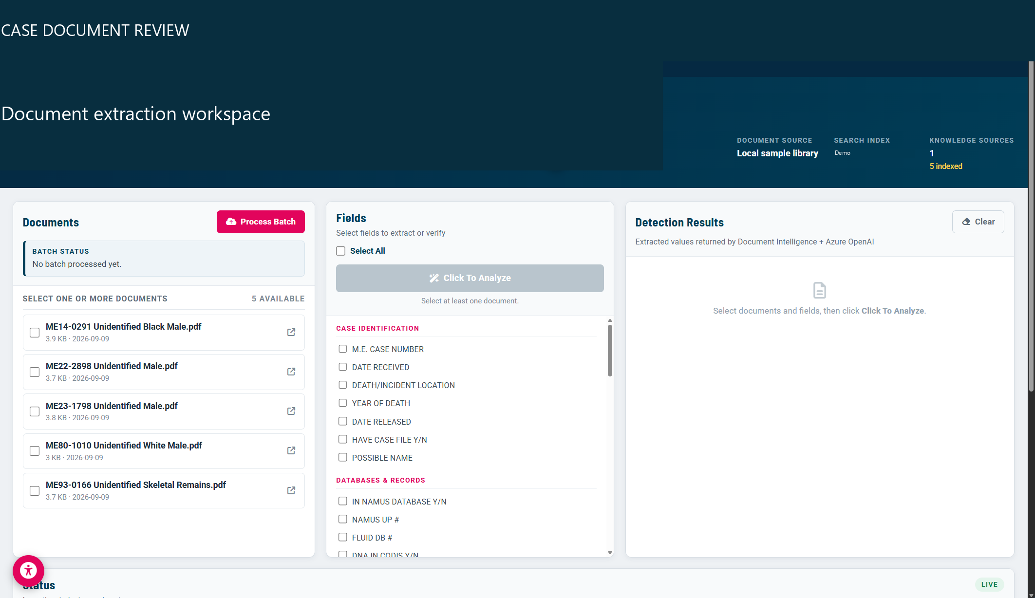

Slide 19
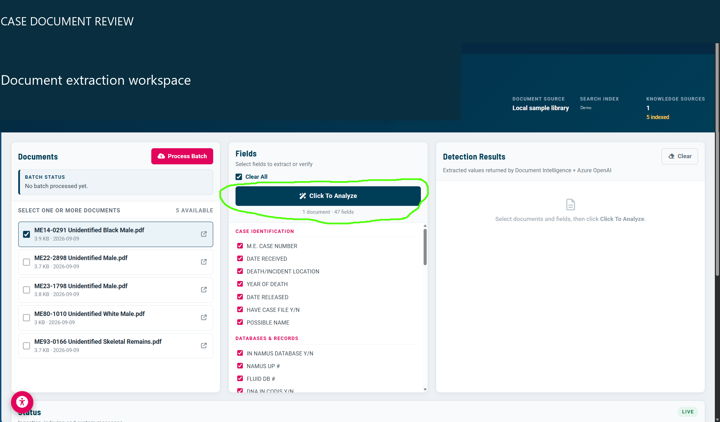

Slide 20
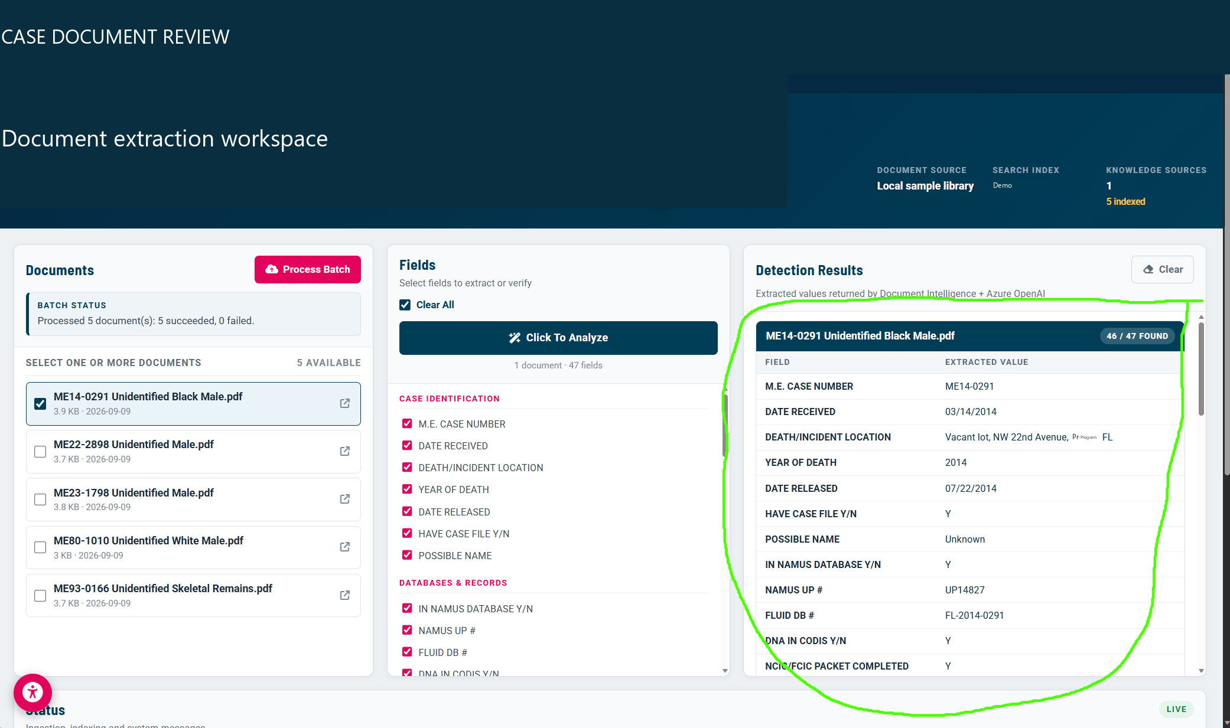

Slide 21
