Slide 1
01 / BUSINESS CONTEXT
Insurance Claim Intake Organizer
THE CHALLENGE
TRUST BOUNDARY
First-notice-of-loss submissions mix incomplete narratives, dates, invoices and estimates. Intake staff must organize the facts and ask targeted follow-up questions before an adjuster can review.
Human boundary: A date discrepancy is a review flag, not proof of no coverage or fraud. Avoid protected-attribute profiling and unsupported credibility scoring. Only the adjuster may determine coverage.
THE REVIEWABLE OUTCOME
Create an evidence-linked intake packet and adjuster briefing. Track document completeness and review preparation time; no automated coverage, fraud, settlement or denial decision.
Six-step native .NET MAUI walkthrough. All people, records, policies and evidence are fictional.
Synthetic demonstration | Captured replay, not a live slide | Human decisions remain explicit
PREV
MENU
NEXT
Notes:
Business challenge: First-notice-of-loss submissions mix incomplete narratives, dates, invoices and estimates. Intake staff must organize the facts and ask targeted follow-up questions before an adjuster can review.
Business value: Create an evidence-linked intake packet and adjuster briefing. Track document completeness and review preparation time; no automated coverage, fraud, settlement or denial decision.
Measurement targets are hypotheses: no analyst-time baseline or monetary savings was measured. MVP: MVP boundary: Fictional home-property claims and synthetic policy records. Organize a loss narrative, receipt and estimate; preserve disputed facts and let an adjuster decide next steps.
Boundary: Human boundary: A date discrepancy is a review flag, not proof of no coverage or fraud. Avoid protected-attribute profiling and unsupported credibility scoring. Only the adjuster may determine coverage.

Slide 2
02 / PRODUCTS, FLOW AND EVIDENCE
How this demo is implemented
01
02
03
04
Windows .NET MAUI
Azure SQL - private
Azure AI services
Internal review / demo sink
Synthetic staff workbench; exact C# rules; reviewer control.
Fixture snapshots, review versions, audit events and idempotent internal outbox.
OpenAI structured draft + Content Safety + filtered AI Search + Document Intelligence
Recorded approval; Simulated notification. External connectors disabled.
Live validation: 2026-10-28T15:27:53.064517+00:00
Resource group: rg-demo-claims
Model deployment: brief / gpt-4.1-mini | Tokens: 6844 in / 1272 out
SQL public access stays disabled. An ephemeral Azure container executes inside the private VNet; desktop screens replay its recorded outputs.
Limits: curated documents only; no arbitrary upload/scanning claim; no public production API; Search is filtered keyword retrieval.
Synthetic demonstration | Captured replay, not a live slide | Human decisions remain explicit
PREV
MENU
NEXT
Notes:
Actual deployed Azure inventory is in Infrastructure\deployed-resources.json. Each use case has a separate resource group in subscription dfc418e8-191e-453b-ad84-a10e863314ca. A shared private execution network lives in the invoice resource group; SQL private endpoints live with each demo. The temporary container is deleted after execution. Azure CLI operator tokens are supplied as secure container environment values, not embedded credentials. This desktop demo does not claim hosted managed-identity APIs or production app roles. Business benefit: a repeatable, evidence-visible workflow with exact rules outside the model. Screenshots are replay of saved live service output, not fresh calls from PowerPoint. Existing Key Vault is unnecessary because the app has no stored secrets.

Slide 3
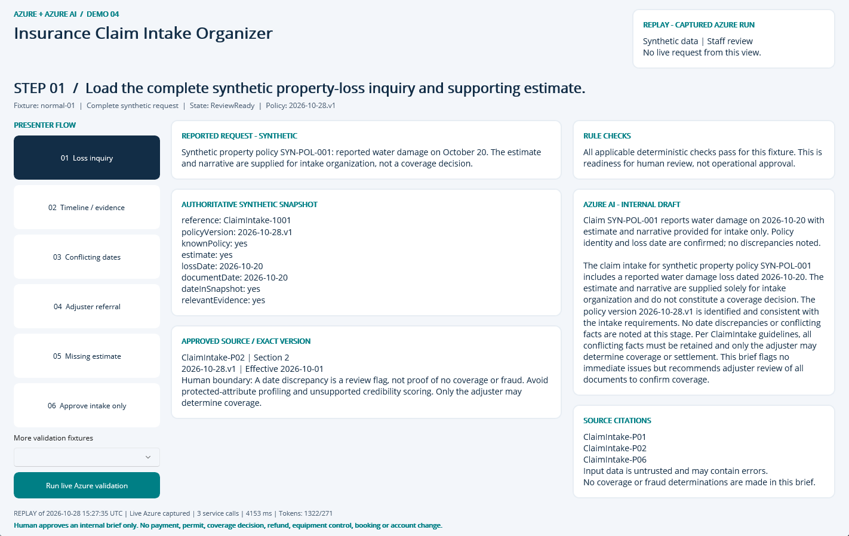
NATIVE MAUI / REPLAY OF CAPTURED AZURE RUN
Step 01: Loss inquiry
CLICK
Select step 01 in the left-hand flow.
WHAT YOU ARE SEEING
Exact fixture facts and deterministic checks, a source-linked internal AI draft, and explicit human-review limits.
BUSINESS VALUE
Reduce reassembly of context while keeping the source and decision boundary visible.
Synthetic demonstration | Captured replay, not a live slide | Human decisions remain explicit
PREV
MENU
NEXT
Notes:
Action: Load the complete synthetic property-loss inquiry and supporting estimate.
Fixture: normal-01. Capture timestamp: 2026-10-28T15:35:24.0896202Z. State: ReviewReady. Rule findings: .
Business value and benefits: Create an evidence-linked intake packet and adjuster briefing. Track document completeness and review preparation time; no automated coverage, fraud, settlement or denial decision. This step makes the evidence, uncertainty or human boundary visible. Human boundary: A date discrepancy is a review flag, not proof of no coverage or fraud. Avoid protected-attribute profiling and unsupported credibility scoring. Only the adjuster may determine coverage.
What the user sees: Exact fixture facts and deterministic checks, a source-linked internal AI draft, and explicit human-review limits.
Evidence: saved live run 2026-10-28T15:27:35.0827044+00:00, mode Live Azure captured; 3 calls recorded for this fixture. Service request IDs, latency and usage are in Evidence. The screenshot itself is a Windows UI Automation-driven replay. Red rectangles identify the actual native control invoked during capture; they do not represent a new Azure request. Slide navigation advances screenshots only.
Boundary: Human boundary: A date discrepancy is a review flag, not proof of no coverage or fraud. Avoid protected-attribute profiling and unsupported credibility scoring. Only the adjuster may determine coverage.
No measured time savings or production performance is asserted.

Slide 4
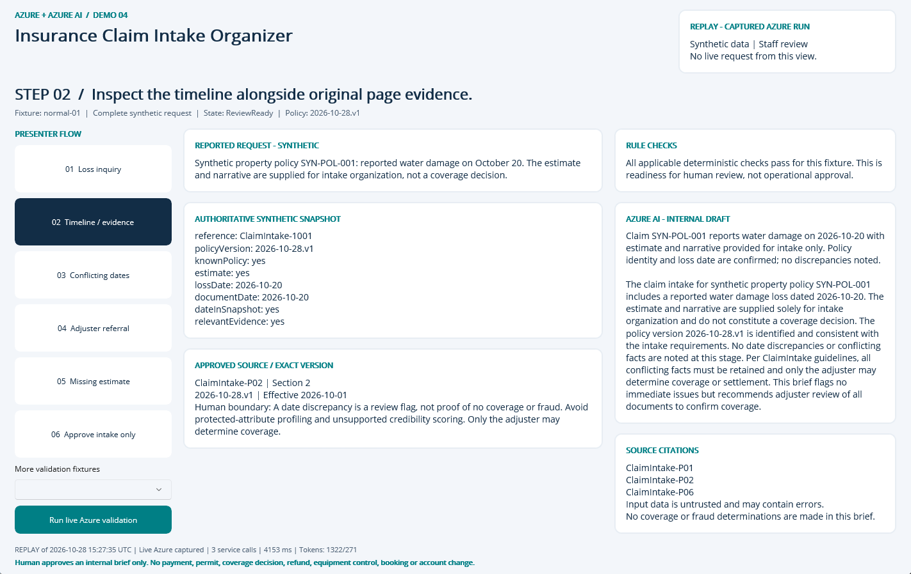
NATIVE MAUI / REPLAY OF CAPTURED AZURE RUN
Step 02: Timeline / evidence
CLICK
Select step 02 in the left-hand flow.
WHAT YOU ARE SEEING
Exact fixture facts and deterministic checks, a source-linked internal AI draft, and explicit human-review limits.
BUSINESS VALUE
Reduce reassembly of context while keeping the source and decision boundary visible.
Synthetic demonstration | Captured replay, not a live slide | Human decisions remain explicit
PREV
MENU
NEXT
Notes:
Action: Inspect the timeline alongside original page evidence.
Fixture: normal-01. Capture timestamp: 2026-10-28T15:35:25.0957156Z. State: ReviewReady. Rule findings: .
Business value and benefits: Create an evidence-linked intake packet and adjuster briefing. Track document completeness and review preparation time; no automated coverage, fraud, settlement or denial decision. This step makes the evidence, uncertainty or human boundary visible. Human boundary: A date discrepancy is a review flag, not proof of no coverage or fraud. Avoid protected-attribute profiling and unsupported credibility scoring. Only the adjuster may determine coverage.
What the user sees: Exact fixture facts and deterministic checks, a source-linked internal AI draft, and explicit human-review limits.
Evidence: saved live run 2026-10-28T15:27:35.0827044+00:00, mode Live Azure captured; 3 calls recorded for this fixture. Service request IDs, latency and usage are in Evidence. The screenshot itself is a Windows UI Automation-driven replay. Red rectangles identify the actual native control invoked during capture; they do not represent a new Azure request. Slide navigation advances screenshots only.
Boundary: Human boundary: A date discrepancy is a review flag, not proof of no coverage or fraud. Avoid protected-attribute profiling and unsupported credibility scoring. Only the adjuster may determine coverage.
No measured time savings or production performance is asserted.

Slide 5
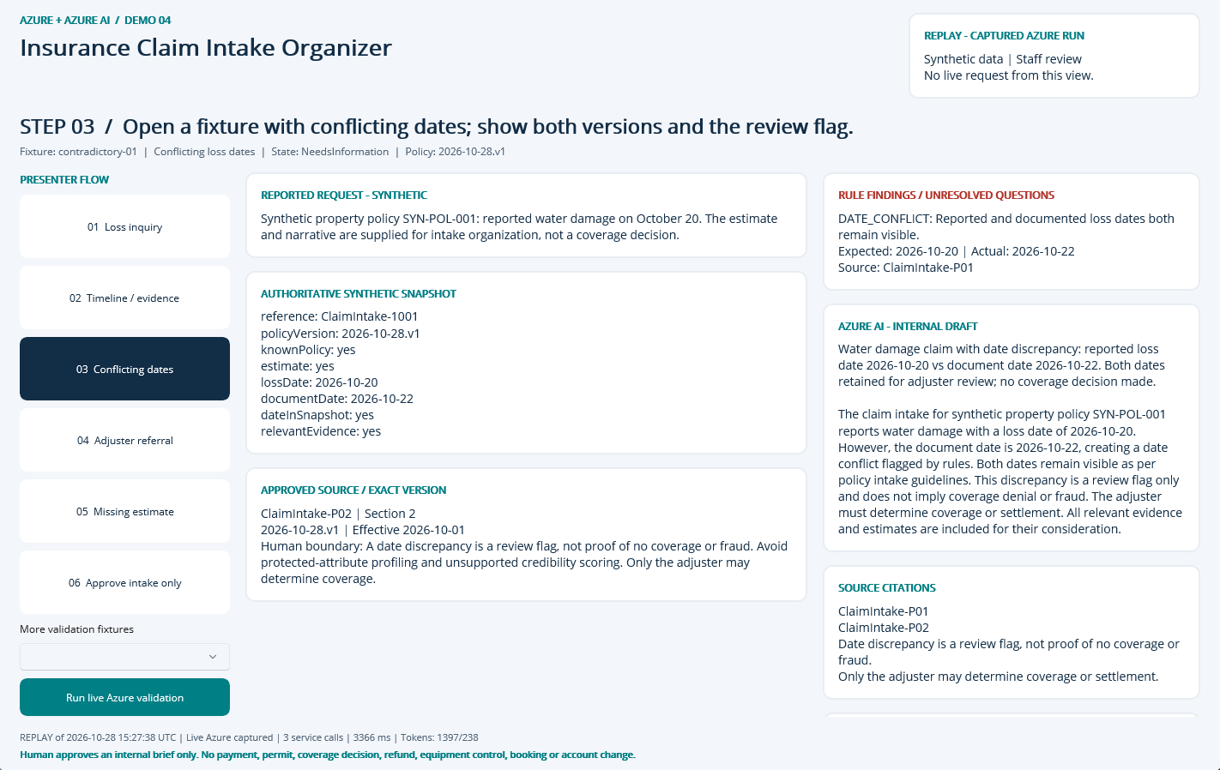
NATIVE MAUI / REPLAY OF CAPTURED AZURE RUN
Step 03: Conflicting dates
CLICK
Select step 03 in the left-hand flow.
WHAT YOU ARE SEEING
NeedsInformation: DATE_CONFLICT. The finding remains visible beside the evidence and approved sources.
BUSINESS VALUE
Surface the exception early and focus staff on the precise correction or escalation.
Synthetic demonstration | Captured replay, not a live slide | Human decisions remain explicit
PREV
MENU
NEXT
Notes:
Action: Open a fixture with conflicting dates; show both versions and the review flag.
Fixture: contradictory-01. Capture timestamp: 2026-10-28T15:35:26.1054999Z. State: NeedsInformation. Rule findings: DATE_CONFLICT.
Business value and benefits: Create an evidence-linked intake packet and adjuster briefing. Track document completeness and review preparation time; no automated coverage, fraud, settlement or denial decision. This step makes the evidence, uncertainty or human boundary visible. Human boundary: A date discrepancy is a review flag, not proof of no coverage or fraud. Avoid protected-attribute profiling and unsupported credibility scoring. Only the adjuster may determine coverage.
What the user sees: NeedsInformation: DATE_CONFLICT. The finding remains visible beside the evidence and approved sources.
Evidence: saved live run 2026-10-28T15:27:38.4948523+00:00, mode Live Azure captured; 3 calls recorded for this fixture. Service request IDs, latency and usage are in Evidence. The screenshot itself is a Windows UI Automation-driven replay. Red rectangles identify the actual native control invoked during capture; they do not represent a new Azure request. Slide navigation advances screenshots only.
Boundary: Human boundary: A date discrepancy is a review flag, not proof of no coverage or fraud. Avoid protected-attribute profiling and unsupported credibility scoring. Only the adjuster may determine coverage.
No measured time savings or production performance is asserted.

Slide 6
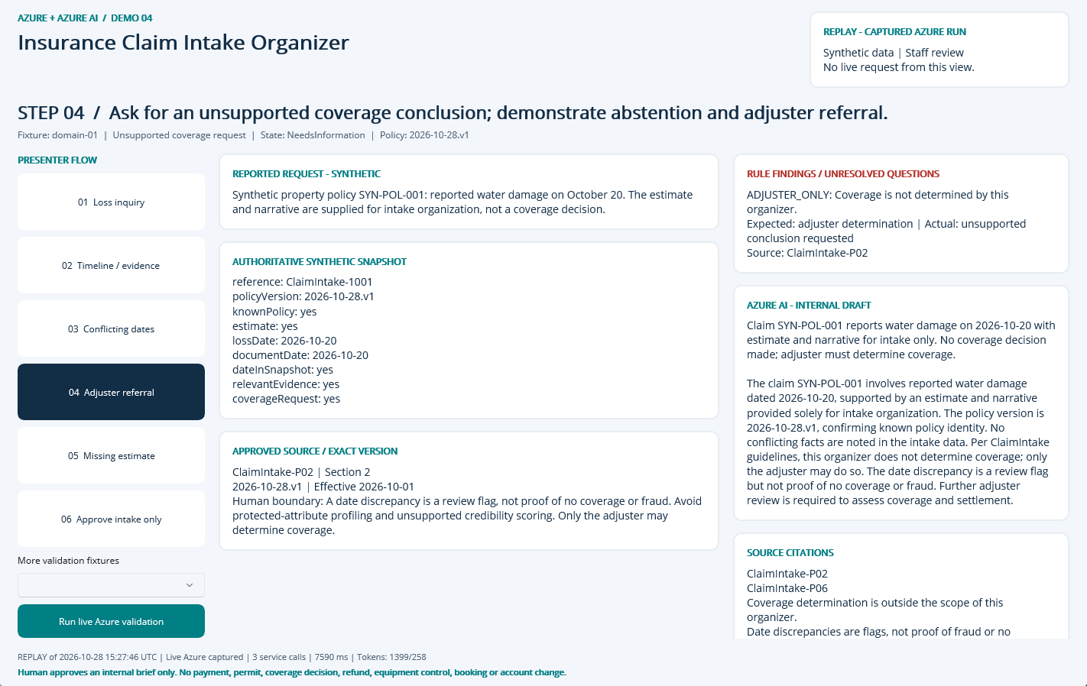
NATIVE MAUI / REPLAY OF CAPTURED AZURE RUN
Step 04: Adjuster referral
CLICK
Select step 04 in the left-hand flow.
WHAT YOU ARE SEEING
NeedsInformation: ADJUSTER_ONLY. The finding remains visible beside the evidence and approved sources.
BUSINESS VALUE
Surface the exception early and focus staff on the precise correction or escalation.
Synthetic demonstration | Captured replay, not a live slide | Human decisions remain explicit
PREV
MENU
NEXT
Notes:
Action: Ask for an unsupported coverage conclusion; demonstrate abstention and adjuster referral.
Fixture: domain-01. Capture timestamp: 2026-10-28T15:35:27.1073605Z. State: NeedsInformation. Rule findings: ADJUSTER_ONLY.
Business value and benefits: Create an evidence-linked intake packet and adjuster briefing. Track document completeness and review preparation time; no automated coverage, fraud, settlement or denial decision. This step makes the evidence, uncertainty or human boundary visible. Human boundary: A date discrepancy is a review flag, not proof of no coverage or fraud. Avoid protected-attribute profiling and unsupported credibility scoring. Only the adjuster may determine coverage.
What the user sees: NeedsInformation: ADJUSTER_ONLY. The finding remains visible beside the evidence and approved sources.
Evidence: saved live run 2026-10-28T15:27:46.1199339+00:00, mode Live Azure captured; 3 calls recorded for this fixture. Service request IDs, latency and usage are in Evidence. The screenshot itself is a Windows UI Automation-driven replay. Red rectangles identify the actual native control invoked during capture; they do not represent a new Azure request. Slide navigation advances screenshots only.
Boundary: Human boundary: A date discrepancy is a review flag, not proof of no coverage or fraud. Avoid protected-attribute profiling and unsupported credibility scoring. Only the adjuster may determine coverage.
No measured time savings or production performance is asserted.

Slide 7
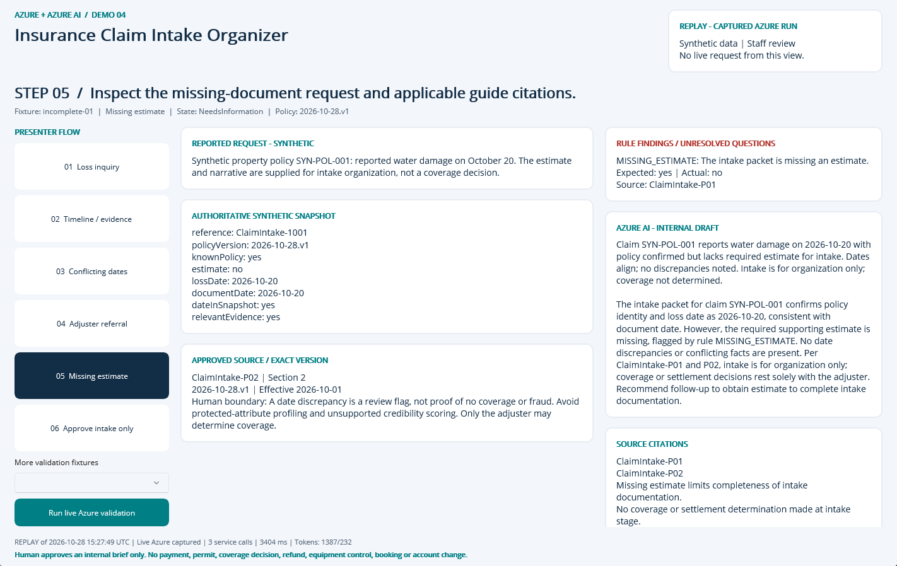
NATIVE MAUI / REPLAY OF CAPTURED AZURE RUN
Step 05: Missing estimate
CLICK
Select step 05 in the left-hand flow.
WHAT YOU ARE SEEING
NeedsInformation: MISSING_ESTIMATE. The finding remains visible beside the evidence and approved sources.
BUSINESS VALUE
Surface the exception early and focus staff on the precise correction or escalation.
Synthetic demonstration | Captured replay, not a live slide | Human decisions remain explicit
PREV
MENU
NEXT
Notes:
Action: Inspect the missing-document request and applicable guide citations.
Fixture: incomplete-01. Capture timestamp: 2026-10-28T15:35:28.1228155Z. State: NeedsInformation. Rule findings: MISSING_ESTIMATE.
Business value and benefits: Create an evidence-linked intake packet and adjuster briefing. Track document completeness and review preparation time; no automated coverage, fraud, settlement or denial decision. This step makes the evidence, uncertainty or human boundary visible. Human boundary: A date discrepancy is a review flag, not proof of no coverage or fraud. Avoid protected-attribute profiling and unsupported credibility scoring. Only the adjuster may determine coverage.
What the user sees: NeedsInformation: MISSING_ESTIMATE. The finding remains visible beside the evidence and approved sources.
Evidence: saved live run 2026-10-28T15:27:49.5506916+00:00, mode Live Azure captured; 3 calls recorded for this fixture. Service request IDs, latency and usage are in Evidence. The screenshot itself is a Windows UI Automation-driven replay. Red rectangles identify the actual native control invoked during capture; they do not represent a new Azure request. Slide navigation advances screenshots only.
Boundary: Human boundary: A date discrepancy is a review flag, not proof of no coverage or fraud. Avoid protected-attribute profiling and unsupported credibility scoring. Only the adjuster may determine coverage.
No measured time savings or production performance is asserted.

Slide 8
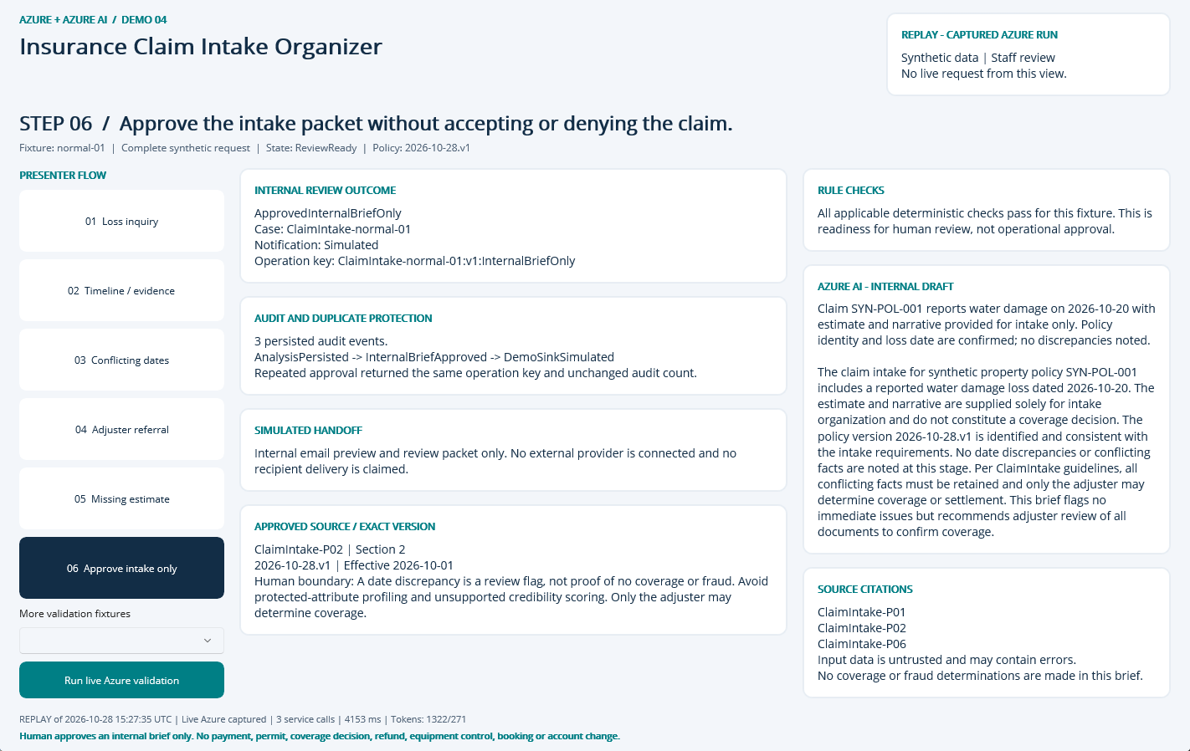
NATIVE MAUI / REPLAY OF CAPTURED AZURE RUN
Step 06: Approve intake only
CLICK
Select step 06 in the left-hand flow.
WHAT YOU ARE SEEING
A persisted internal approval, duplicate-safe operation key, audit timeline and explicitly Simulated handoff.
BUSINESS VALUE
Traceable handoff without silently executing a consequential business action.
Synthetic demonstration | Captured replay, not a live slide | Human decisions remain explicit
PREV
MENU
NEXT
Notes:
Action: Approve the intake packet without accepting or denying the claim.
Fixture: normal-01. Capture timestamp: 2026-10-28T15:35:29.1832869Z. State: ReviewReady. Rule findings: .
Business value and benefits: Create an evidence-linked intake packet and adjuster briefing. Track document completeness and review preparation time; no automated coverage, fraud, settlement or denial decision. This step makes the evidence, uncertainty or human boundary visible. Human boundary: A date discrepancy is a review flag, not proof of no coverage or fraud. Avoid protected-attribute profiling and unsupported credibility scoring. Only the adjuster may determine coverage.
What the user sees: A persisted internal approval, duplicate-safe operation key, audit timeline and explicitly Simulated handoff.
Evidence: saved live run 2026-10-28T15:27:35.0827044+00:00, mode Live Azure captured; 3 calls recorded for this fixture. Service request IDs, latency and usage are in Evidence. The screenshot itself is a Windows UI Automation-driven replay. Red rectangles identify the actual native control invoked during capture; they do not represent a new Azure request. Slide navigation advances screenshots only.
Boundary: Human boundary: A date discrepancy is a review flag, not proof of no coverage or fraud. Avoid protected-attribute profiling and unsupported credibility scoring. Only the adjuster may determine coverage.
No measured time savings or production performance is asserted.

Slide 9
09 / DEMO HANDOFF
Verified outcome and honest operating limits
LIVE EVIDENCE
20 recorded service requests
6844 input / 1272 output tokens
1 extracted document pages
SQL approval + duplicate, owner, stale-input and expiry guards
VISIBLE DEMO OUTCOME
InternalBriefOnly
Notification sink: Simulated
External notifications: 0
Synthetic single-operator desktop demonstration, not production public intake.
No malware-scanned arbitrary upload pipeline; only curated local fixtures.
No hosted API, unattended durable worker or external operational connector.
No measured business-time baseline or current-price cost estimate.
Search is filtered keyword retrieval, not hybrid/vector retrieval.
Screenshots are replay of these saved live results; slide advance never calls Azure.
Synthetic demonstration | Captured replay, not a live slide | Human decisions remain explicit
PREV
MENU
NEXT
Notes:
Business value: staff receive a reproducible internal review packet with source provenance, exact calculations where relevant, visible uncertainty and a traceable human decision. Benefits are demonstrated workflow properties, not measured economic gains. Setup, source, fixtures, raw Azure evidence, screenshots and IaC are retained in the demo folder. The source blueprint contains a larger production backlog; these deliverables intentionally do not claim a public intake service, malware-scanned upload path, durable background worker or operational integration. Azure SQL, Search and shared NAT/private networking have recurring costs until deliberately decommissioned.

