Slide 1
GENERIC SOLUTION DEMONSTRATION
Clinical abstraction and observability
THE PROBLEM
THE SOLUTION
Clinical abstraction needs reviewable answers, per-case tracing, evaluation, feedback and explicit sensitive-data controls.
Use synthetic cases to inspect local masking, model decisions, trace spans, review feedback, usage and failure handling.
PRODUCTS AND PLATFORM
Windows .NET MAUI | Azure OpenAI GPT-4.1 | Microsoft Entra ID | Application Insights | Log Analytics
Captured: local app and synthetic runs. The 100-record comparison scores prebuilt answers, not a live two-model benchmark. Portal steps are guidance, not captured interactions.
Notes:
Problem: Clinical abstraction needs reviewable answers, per-case tracing, evaluation, feedback and explicit sensitive-data controls.
Solution: Use synthetic cases to inspect local masking, model decisions, trace spans, review feedback, usage and failure handling.
Products: Windows .NET MAUI | Azure OpenAI GPT-4.1 | Microsoft Entra ID | Application Insights | Log Analytics
Evidence status: Captured: local app and synthetic runs. The 100-record comparison scores prebuilt answers, not a live two-model benchmark. Portal steps are guidance, not captured interactions.
Customer branding, organization labels and resource identifiers have been generalized. Screenshots are edited historical captures; no service results were rerun.

Slide 2
SOLUTION ARCHITECTURE
How the solution fits together
LOGICAL FLOW / REFERENCE VIEW
01
02
03
04
Synthetic case
Azure OpenAI
Clinical review UI
Telemetry
Local preparation / masking
Direct model request
Decision + feedback
App Insights + Logs
App and telemetry paths are illustrated. Clinical performance, production PHI controls, tenant ownership and inference residency are not proved by these captures.
Generic labels and edited screenshots | Historical results are illustrative, not rerun
START TOUR >
Notes:
Architecture: [['Synthetic case', 'Local preparation / masking'], ['Azure OpenAI', 'Direct model request'], ['Clinical review UI', 'Decision + feedback'], ['Telemetry', 'App Insights + Logs']]
Boundary: App and telemetry paths are illustrated. Clinical performance, production PHI controls, tenant ownership and inference residency are not proved by these captures.
This is a logical diagram, not a verified deployment inventory. Arrows show the conceptual information flow.
Customer names, logos and resource identifiers in subsequent captured screens have been generalized. Service brands and the solution's core workflow remain.

Slide 3
MICROSOFT · AZURE AI · DEMONSTRATION
Observability for LLM Applications on Azure
Monitoring · Tracing · Evaluation · Human Feedback · PII Governance
Prepared for Healthcare Organization
John Straumann · Field CAIO Officer · Microsoft South
Dustin Ryan · DIR SPECIALIST · US SLED STU Cloud AI · Microsoft South
Demonstrated live against Microsoft Foundry project DemoFoundryProject
Notes:
Open with the ask, not the product.
Demo's AI team is moving existing AI applications to Azure and asked for a demo and an update on Azure's capabilities across five areas, so they set things up correctly and understand which gaps they need to fill with other software. They also asked the right meta-question: "what would be the best way to do this?"
This deck answers all five, in the order they asked them, using a working clinical abstraction application - AbstractIQ - running live against a real Microsoft Foundry project with real model deployments, real traces exported to Application Insights and real evaluation runs. Nothing on the following slides is mocked. Every number shown was produced by the system during the capture run.
Two framing points to make in the first two minutes. First, terminology: Demo's note says PHI; we use PII, Personally Identifiable Information, per John's instruction. The controls are identical either way. Second, and more important: everything here is a contract between the platform and the application. Azure supplies storage, query, retention, access control, visualisation and the evaluation harness. The application must supply correctly shaped telemetry. If the application's half is wrong, every Azure dashboard renders perfectly and shows nothing useful. We proved that nine separate times building this demo, and that story is the most valuable thing we can give Demo today.

Slide 4
What Demo asked
THE BRIEF
Five capabilities, plus the question underneath them: "what would be the best way to do this?"
1
Monitoring
Azure Monitor / Application Insights for an LLM app: latency, errors, failures, token cost.
2
LLM tracing
Foundry tracing - a full prompt-and-response trace per case.
3
Evaluation
Foundry evaluation for automated quality checks across a test set of cases.
4
Human feedback
How an abstractor's agree/disagree gets attached to a trace.
5
PII in traces
Prompts contain patient data: retention, masking and access control on the traces themselves.
AbstractIQ · Healthcare Organization · synthetic data only, not for clinical use
Notes:
Read these out as Demo's own words - they are quoted almost verbatim from the request.
Note the shape of the ask. Demo is not asking whether Azure can run a model; they already run AI applications. They are asking whether Azure can let them operate one responsibly in a clinical setting: can we see what it is doing, can we prove it is any good, can our abstractors tell us when it is wrong, and can we do all of that without spreading patient data across a telemetry estate.
That is a maturity signal. Most organisations ask these questions eighteen months after go-live, usually prompted by an incident. Demo is asking before the migration. Acknowledge that explicitly - it will shape how much depth they want, and it earns the right to be honest about the gaps later in the deck.
The sixth question - "what would be the best way to do this?" - is answered on the recommendations slide near the end. If time is short, jump from here to that slide, then come back.

Slide 5
The division of labour
FRAMING
Azure supplies the platform. The application must supply correctly shaped telemetry. Both halves are required.
AZURE GIVES YOU THIS
YOUR APPLICATION MUST SUPPLY THIS
Trace and metric storage, query and visualisation
Model-aware trace rendering in Foundry
Built-in quality and safety evaluators
An evaluation harness and run comparison
Retention, archive and verified purge
RBAC to table level, CMK, private endpoints
Alerting, workbooks and dashboards
The spans themselves - nothing is auto-collected
gen_ai.* attributes, correctly named and numeric
Token counts copied from the model response
Your cost rate, and cost computed from it
The clinical test set and its ground-truth labels
Clinical evaluators Foundry cannot infer
The abstractor feedback interface, end to end
Masking, before the prompt leaves the process
AbstractIQ · Healthcare Organization · synthetic data only, not for clinical use
Notes:
This is the single most important conceptual slide in the deck. If Demo remembers one thing, make it this one.
Azure's half of the contract is excellent and largely free. The right-hand column is where projects fail, and it fails silently - which is the dangerous part. Every item on the right has the same failure signature: if you get it wrong, nothing errors, nothing fails a build, every dashboard still renders, and the data is simply absent or wrong. There is no red light.
Concrete examples from this build, all of which you will see later. Token counts are not inferable from the wire - unless your application copies usage.prompt_tokens onto the span, that data does not exist anywhere in Application Insights, and the cost question is unanswerable. Azure does not know Demo's negotiated token rate, so cost must be computed by you. Foundry's built-in evaluators cannot know what "correct primary condition" means for Demo's abstraction standard.
The practical takeaway for Demo's platform team: write down the right-hand column as an instrumentation standard, and make it a review gate for every AI application moving to Azure. Retrofitting it is expensive and costs you comparability with your own history.

Slide 6
How this demo maps to the five asks
FRAMING
The demo runs once, end to end. Each ask has its own section, and the Observability panel has one tab per ask.
Ask | Shown in the application | Slides | Also shown in the Azure portal
Setup and connection | Entra sign-in, deployment configuration, case loading | 1-7 | Foundry: Models + endpoints
5 · PII masking | Local redaction before any network call | 8-9 | —
Core workflow | Single case, then the full batch | 10-12 | —
2 · LLM tracing | Case Trace tab: spans, timings, prompt and response | 13-15 | Foundry: Tracing
3 · Evaluation | Evaluation tab: ten evaluators, run comparison | 16-20 | Foundry: Evaluation
4 · Human feedback | Abstractor Review tab: verdicts bound to trace ids | 21-26 | App Insights: custom events
1 · Monitoring | Monitoring tab: latency, failures, tokens, cost | 27-31 | App Insights: Logs, KQL, Failures
5 · PII governance | PII Governance tab: masked, destination, retention | 32-33 | Log Analytics: retention, purge, IAM
AbstractIQ · Healthcare Organization · synthetic data only, not for clinical use
Notes:
Use this as the roadmap, and come back to it if the room gets lost.
Two things to flag before you start clicking.
First, the demo runs once, end to end, in a single sitting - roughly twenty minutes of clicking. It is not five separate demos stitched together. That matters because the whole argument is that these five capabilities are facets of one instrumented application, not five products you buy separately.
Second, the right-hand column answers the question Demo raised themselves: "it seems to me we will need to click around in Foundry to show some of these things?" They are right, and the honest answer is that roughly half of each capability lives in the Azure portal and half in the application. Tracing is a good example: the application emits it, Foundry renders it, and the engineer who investigates an incident at three in the morning lives in the portal, not in the clinical tool. Part 11 of this deck covers the portal side.

Slide 7
PART 1
Connecting to Demo's Azure tenant
Entra ID sign-in, a configured deployment, and six synthetic clinical cases.
Notes:
The setup section is short but not skippable - two of the five asks have their answer rooted here.
Entra ID sign-in rather than API keys is what makes the access-control half of the PII answer possible: the right to call the model, and later the right to read trace content, become role assignments governed by the same joiner-mover-leaver process as everything else in the estate.
And the configured deployment name is what makes model comparison possible later without a rebuild.
If you are short on time, run steps 1 to 7 before the audience arrives - the Entra sign-in alone takes two to three minutes because it enumerates every AI resource in the subscription. Start the demo live from step 8.

Slide 8
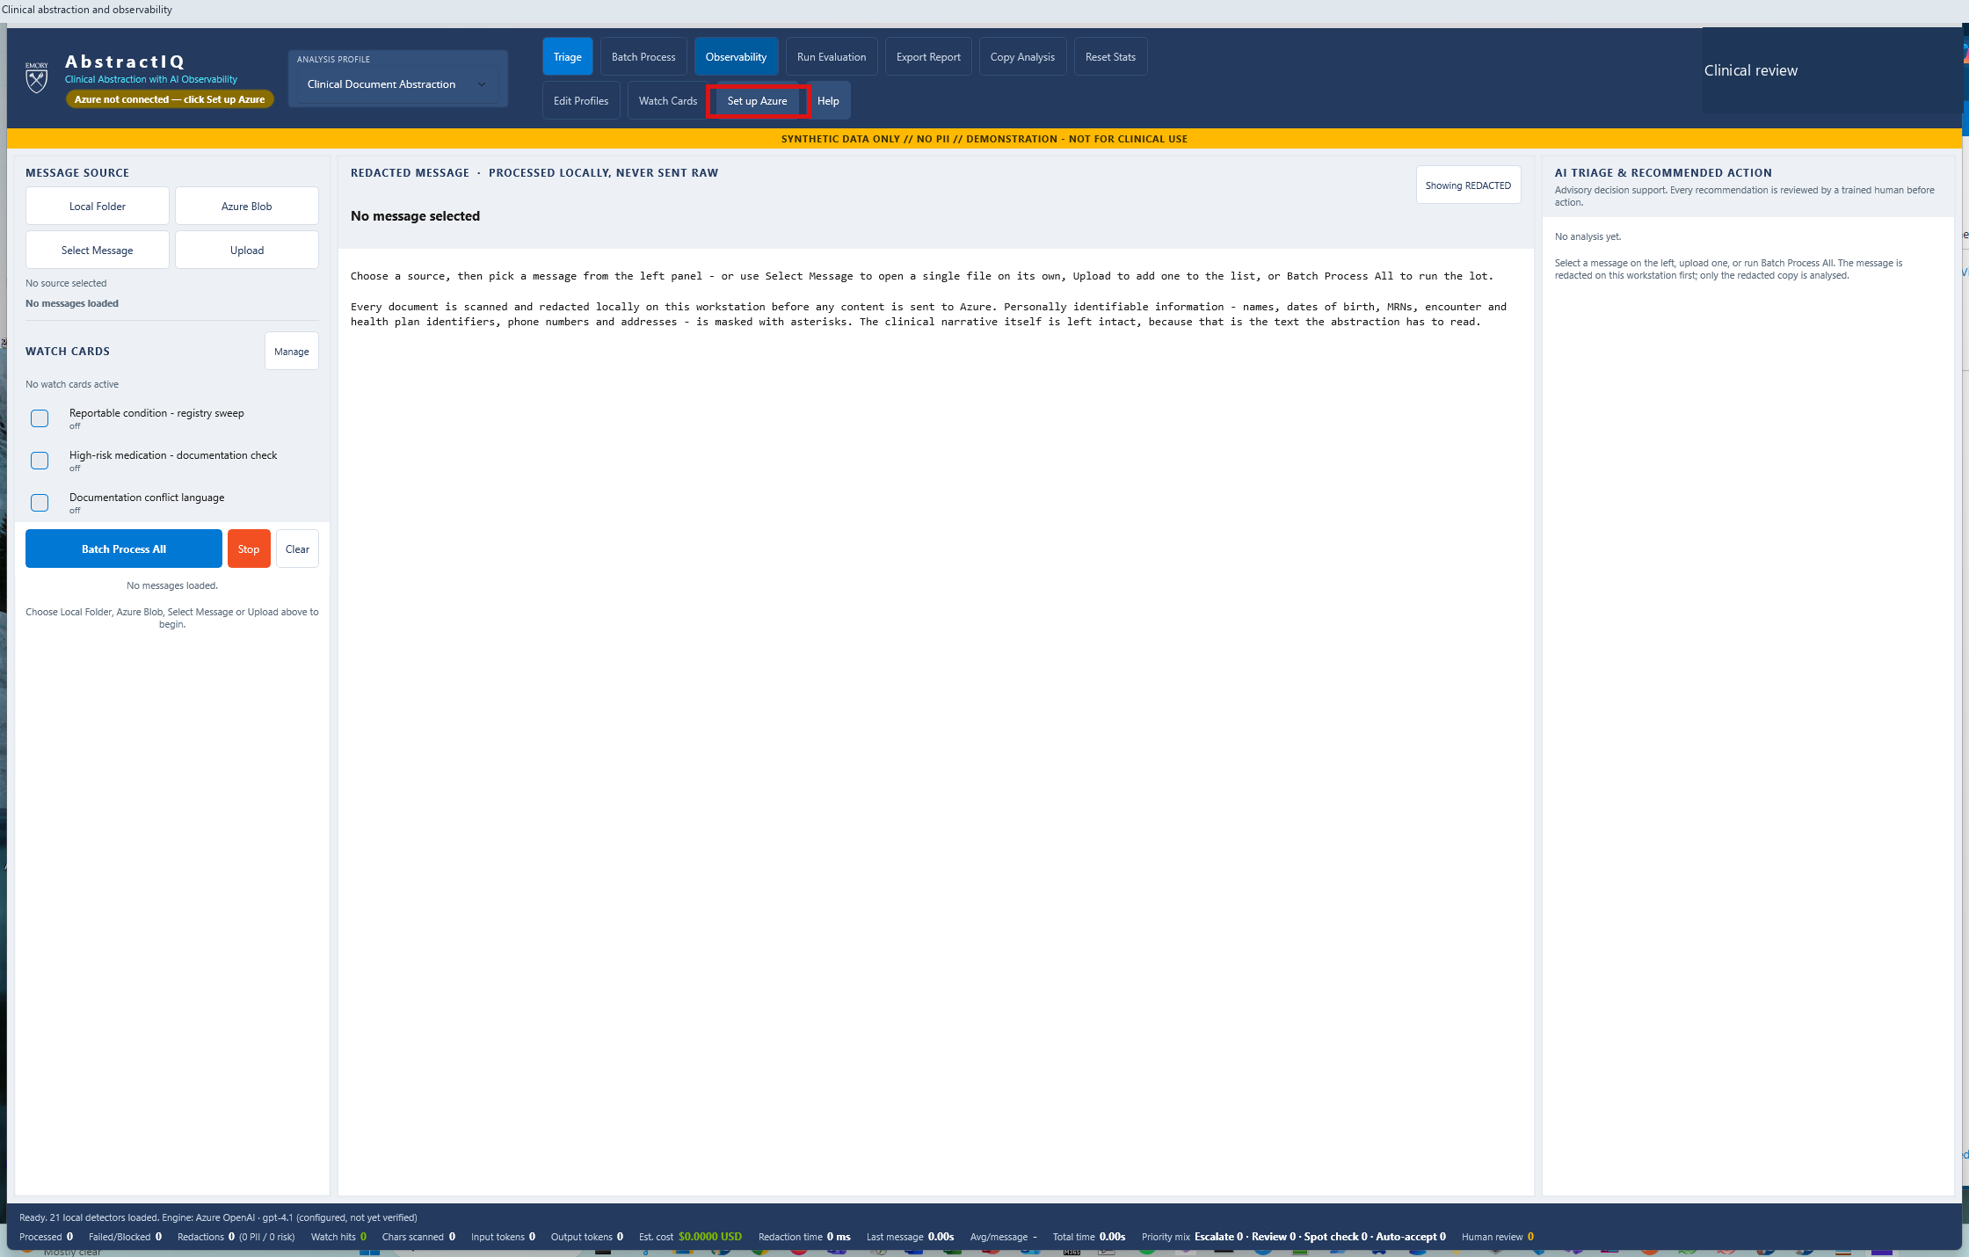
1
The abstractor's workspace
SETUP
WHERE TO CLICK
Nothing yet. Start here and let the audience read the banner across the top.
WHAT THIS PROVES
A clinical abstraction tool, not a chatbot. Observability is a first-class tab, not an afterthought.
AbstractIQ · Healthcare Organization · synthetic data only, not for clinical use
Notes:
WHAT YOU ARE SEEING
AbstractIQ at launch. Three panes: the case list on the left, the document in the centre, and the AI's recommendation on the right. The yellow band reads "SYNTHETIC DATA ONLY // NO PII // DEMONSTRATION - NOT FOR CLINICAL USE" and should stay on screen for the whole demo. The badge under the product name shows which model is wired up - today, Azure OpenAI gpt-4.1.
WHERE TO CLICK
Nothing. Pause here for fifteen seconds. Let the room notice that "Observability" sits in the main toolbar next to "Triage" and "Batch Process", not buried in a settings page.
WHAT THE SOLUTION IS DOING
Nothing yet - it has not called a model and has not connected to Azure. That is deliberate. The app starts in a fully offline mode so it can be opened on any machine without credentials.
BUSINESS BENEFIT TO Demo
This is the shape of the application your abstractors would actually use. Everything that follows - traces, evaluation, feedback, cost - is reachable from this one screen. Observability that lives in a separate portal that only the platform team opens is observability that the clinical team never sees, and therefore never trusts.

Slide 9
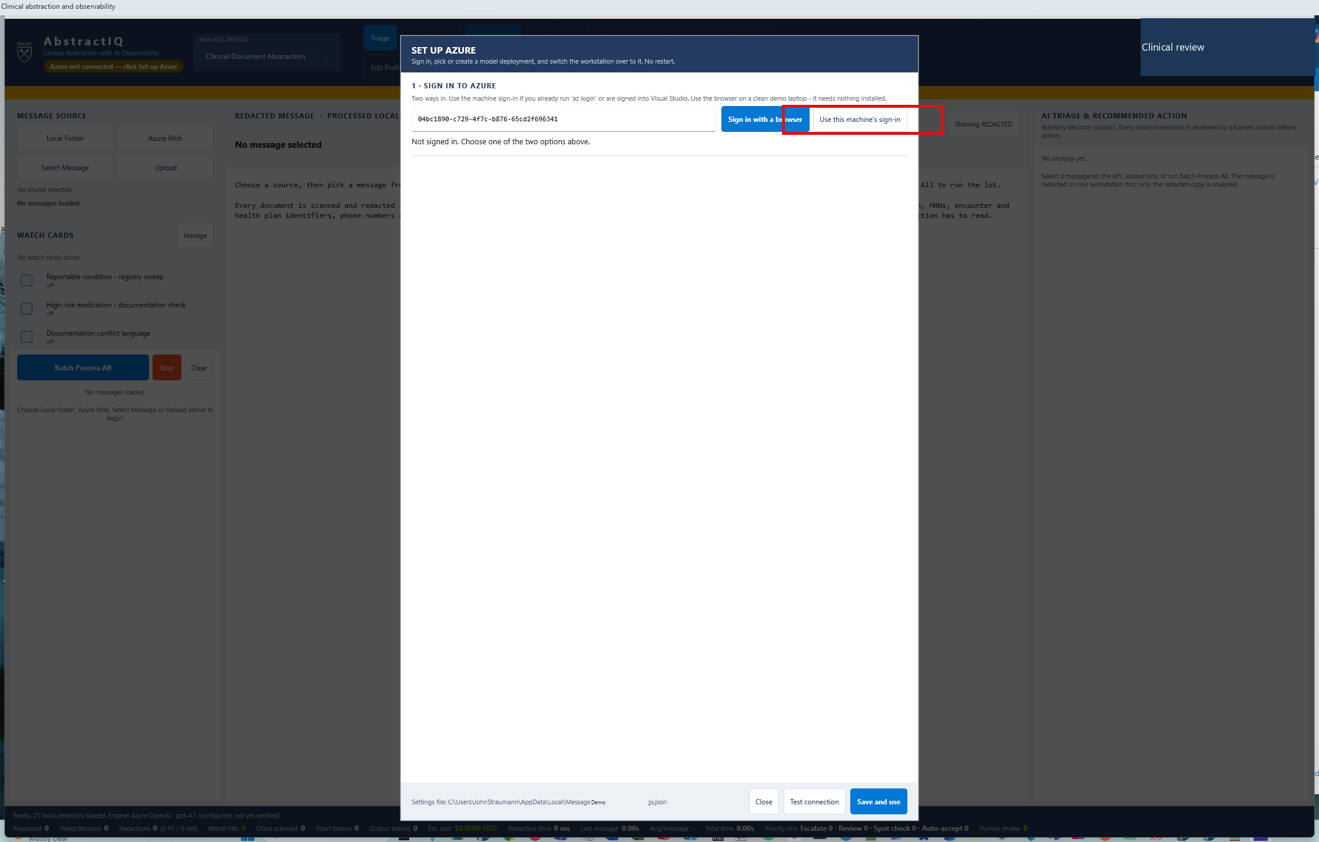
2
Pointing the app at Demo's Azure tenant
SETUP
WHERE TO CLICK
Toolbar → "Set up Azure". Opens the connection dialog.
WHAT THIS PROVES
Nothing is hard-coded. Endpoint, deployment and identity are configuration, so the same binary runs in dev, test and production.
AbstractIQ · Healthcare Organization · synthetic data only, not for clinical use
Notes:
WHAT YOU ARE SEEING
The red box marks "Set up Azure" in the toolbar. This opens the dialog where the Azure OpenAI endpoint, the deployment name and the authentication method are configured.
WHERE TO CLICK
Toolbar, second row, "Set up Azure".
WHAT THE SOLUTION IS DOING
Reading configuration from %LOCALAPPDATA%\MessageIQ_Demo\appsettings.json, with the packaged appsettings.json as the fallback. Delete the local file and the application reverts to offline rules-only mode - which is a useful safety property if a laptop is ever lost.
BUSINESS BENEFIT TO Demo
Endpoint, deployment, model and identity are all configuration, never code. One build promotes from dev to test to production by changing a file. More importantly for this conversation, the model deployment is a configuration value - which is what makes the A/B comparison in the evaluation section possible without a rebuild, and what will make it possible to move from gpt-4.1 to whatever supersedes it without touching the application.

Slide 10
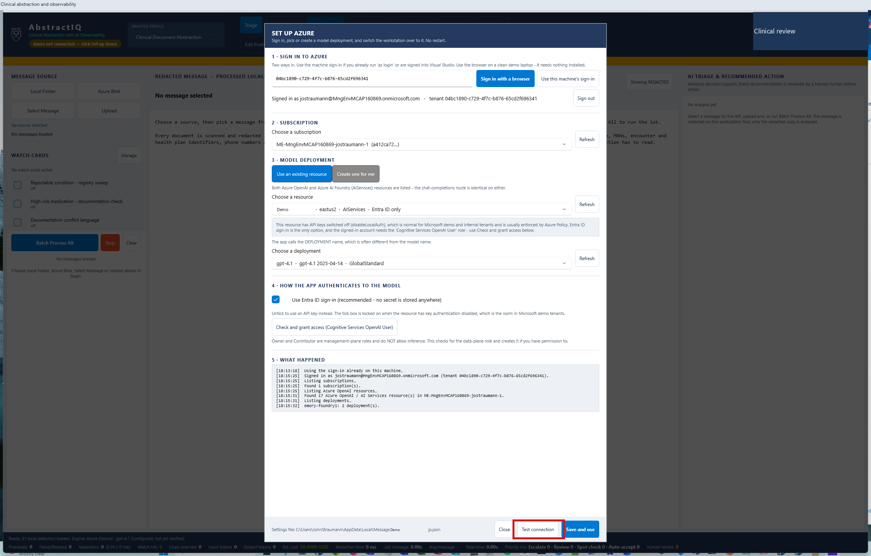
3
Entra ID sign-in - no API keys anywhere
SETUP
WHERE TO CLICK
"Use this machine's sign-in" → complete the Entra prompt. Allow 2-3 minutes.
WHAT THIS PROVES
Authentication is Entra ID with RBAC. There is no key to rotate, leak, or paste into a config file.
AbstractIQ · Healthcare Organization · synthetic data only, not for clinical use
Notes:
WHAT YOU ARE SEEING
The app has authenticated with Microsoft Entra ID using the signed-in Windows identity, and has enumerated the Azure AI resources that identity can reach.
WHERE TO CLICK
"Use this machine's sign-in", then complete the Entra prompt. Budget two to three minutes - it enumerates every AI resource in the subscription. Do this before the audience arrives if you can.
WHAT THE SOLUTION IS DOING
Acquiring a token via DefaultAzureCredential. One note from the build: on a machine signed in to more than one tenant you must pin TenantId explicitly, or Azure returns an opaque 403 "Authentication token failed validation" that looks like a permissions problem and is not.
BUSINESS BENEFIT TO Demo
No API keys. Access to the model is governed by Entra group membership and Azure RBAC - the same controls that govern everything else in the estate, with the same audit trail and the same joiner-mover-leaver process. For a healthcare organisation this removes an entire class of audit finding. It is also the mechanism behind the access-control answer in the PII section: the right to read trace content becomes a role assignment, not a filesystem permission.

Slide 11
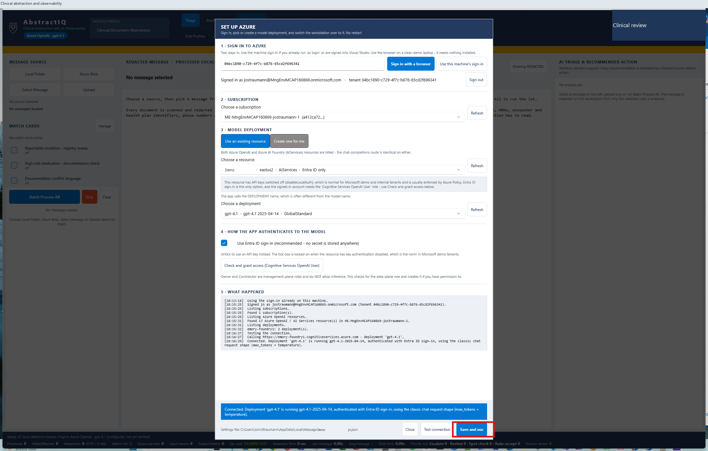
4
Proving the connection before the room is watching
SETUP
WHERE TO CLICK
Bottom of the dialog → "Test connection".
WHAT THIS PROVES
A real round-trip to the deployment. Discover a bad endpoint here, not mid-demo.
AbstractIQ · Healthcare Organization · synthetic data only, not for clinical use
Notes:
WHAT YOU ARE SEEING
The connection dialog with "Test connection" highlighted.
WHERE TO CLICK
"Test connection" at the bottom of the dialog, then "Save and use".
WHAT THE SOLUTION IS DOING
Making a real, minimal chat completion against the configured deployment and reporting the round trip. It validates four things at once: the endpoint resolves, the token is valid, the deployment name exists, and the identity has the data-plane role.
BUSINESS BENEFIT TO Demo
Small point, real one. Every one of those four can fail independently and three of them produce error messages that point at the wrong cause. A deliberate connectivity test turns a confusing five-minute debugging session into a one-line answer. Build the same thing into your own applications - a health endpoint that exercises the full path to the model, not just the network.

Slide 12
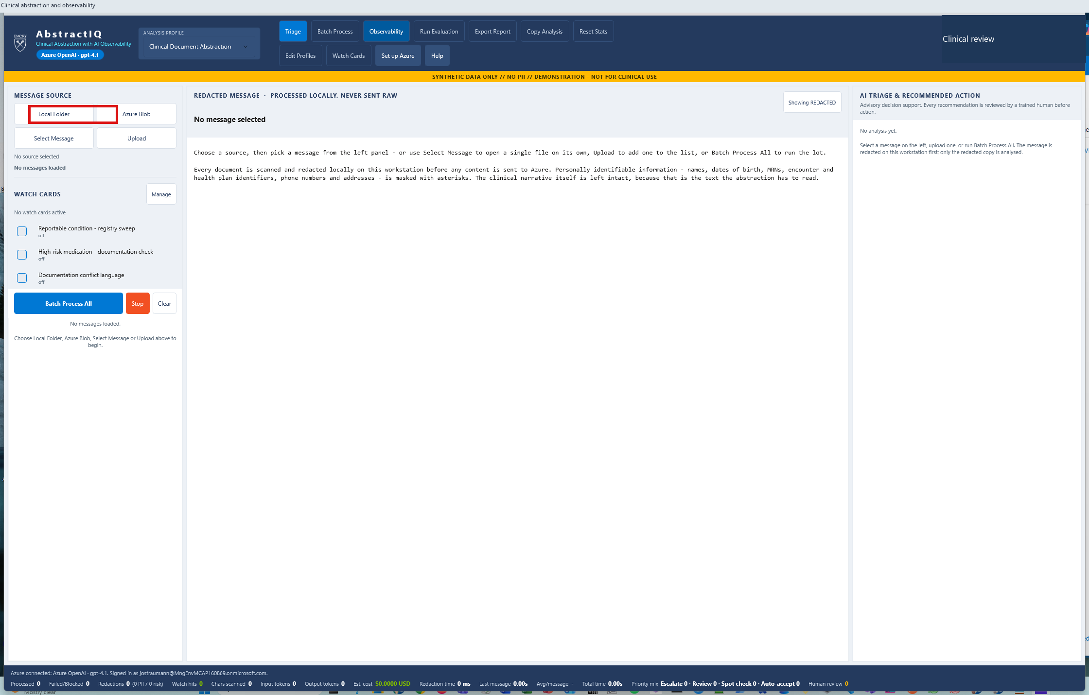
5
Connected: Azure OpenAI gpt-4.1
SETUP
WHERE TO CLICK
Nothing. Point at the badge under the product name.
WHAT THIS PROVES
The model in use is visible on screen at all times - it will also appear on every trace and every evaluation result.
AbstractIQ · Healthcare Organization · synthetic data only, not for clinical use
Notes:
WHAT YOU ARE SEEING
The badge under the AbstractIQ name now reads "Azure OpenAI - gpt-4.1". The application is live against the Foundry project DemoFoundryProject.
WHERE TO CLICK
Nothing. Point at the badge.
WHAT THE SOLUTION IS DOING
Holding a configured client against the deployment. From this point every model call is traced and exported to Application Insights.
BUSINESS BENEFIT TO Demo
The model identity is visible to the user, carried on every trace, and recorded on every evaluation result. That matters more than it sounds. When quality changes a month from now, the first question is always "what changed?" - and the two usual answers are the prompt and the model. If neither is recorded against the result, that question takes days to answer. Here it takes one query. Make the model deployment name a first-class attribute everywhere, from day one.

Slide 13
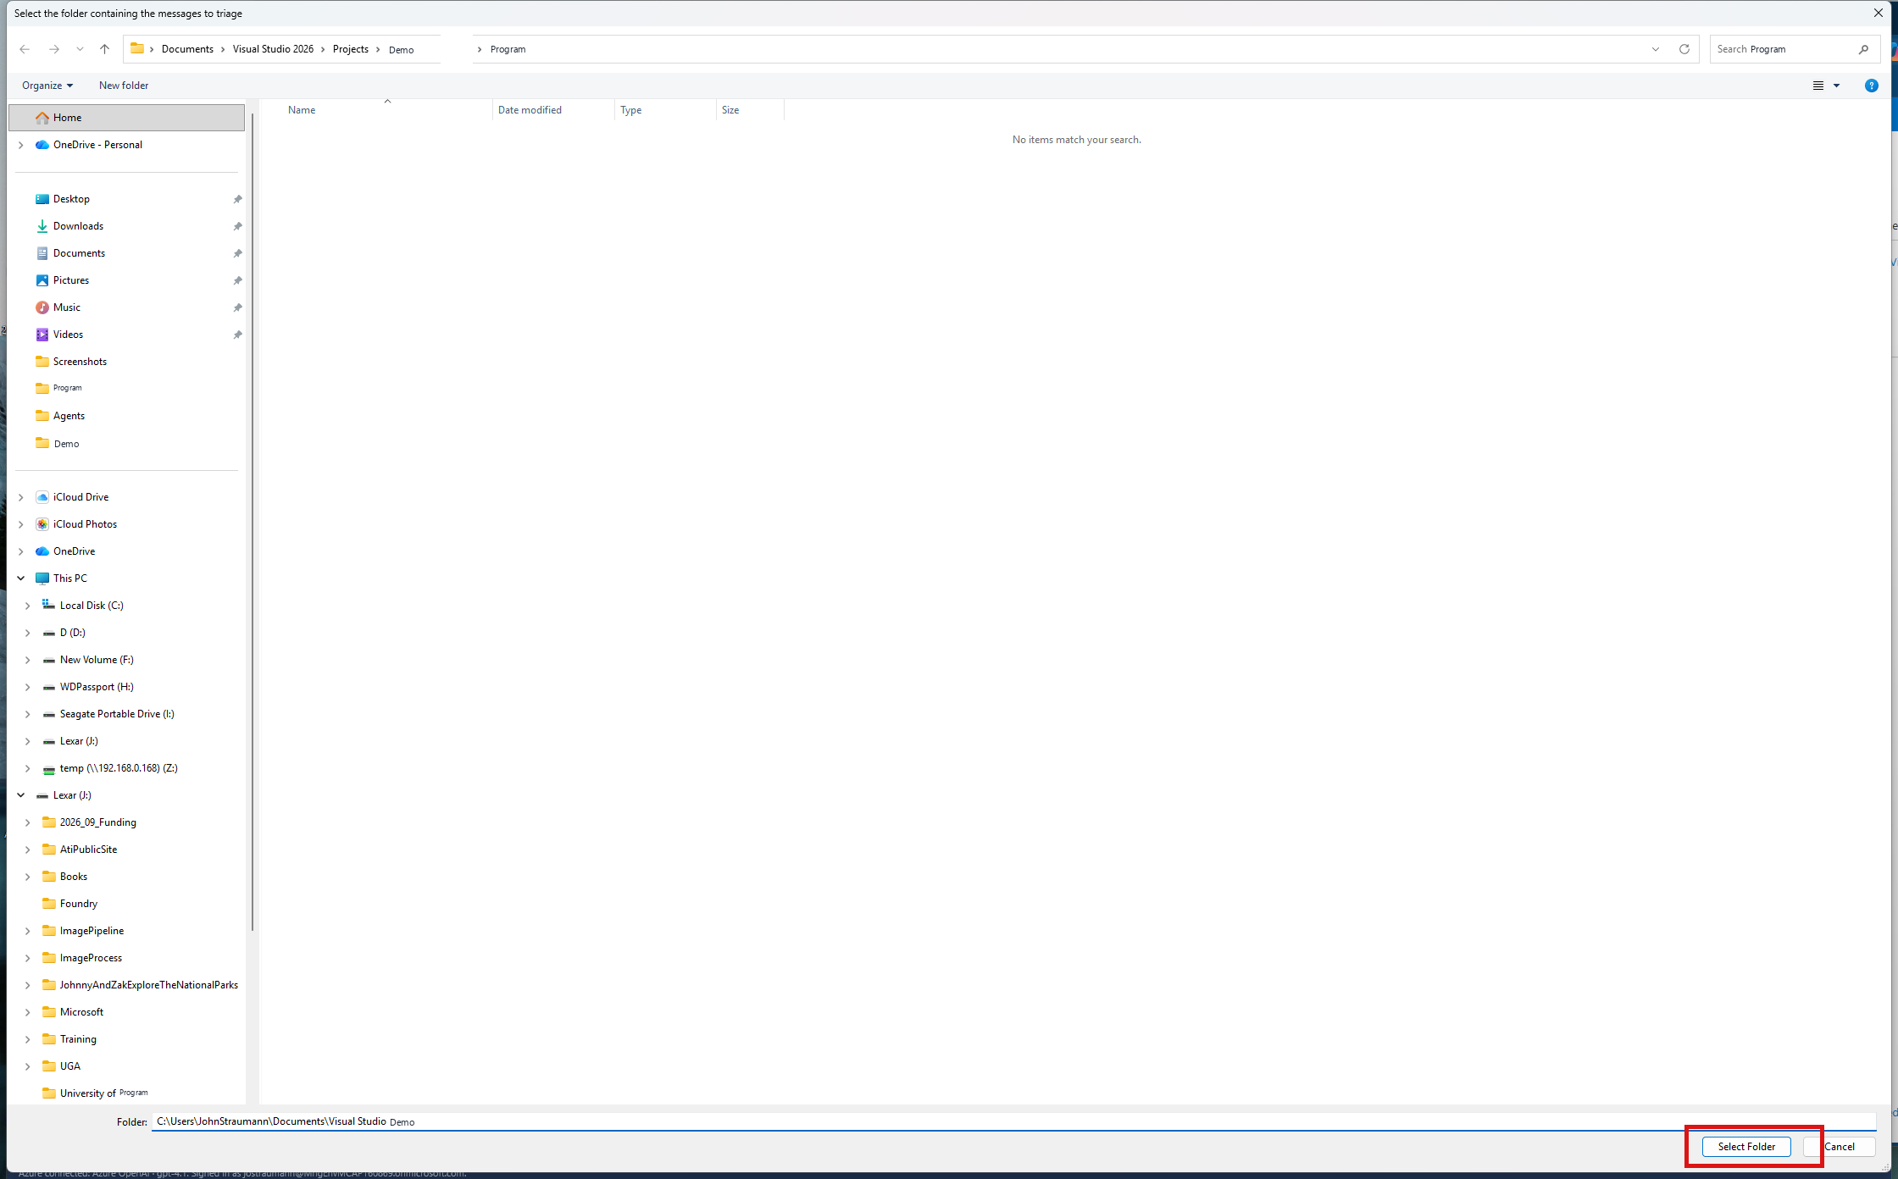
6
Loading the synthetic case set
SETUP
WHERE TO CLICK
Left pane → "Local Folder" → choose DemoSamples → "Select Folder".
WHAT THIS PROVES
Cases come from a folder the customer controls. Swapping in Demo's own de-identified notes is a folder change.
AbstractIQ · Healthcare Organization · synthetic data only, not for clinical use
Notes:
WHAT YOU ARE SEEING
The message-source panel with "Local Folder" highlighted. The demo loads six synthetic clinical narratives from the DemoSamples folder.
WHERE TO CLICK
"Local Folder", then navigate to the DemoSamples folder and press "Select Folder". The app also reads from Azure Blob Storage, which is the realistic production source.
WHAT THE SOLUTION IS DOING
Reading the files and queuing them for triage. Nothing has been sent anywhere yet.
BUSINESS BENEFIT TO Demo
The six cases are synthetic and deliberately chosen to cover the hard shapes, not the easy ones: a clean discharge summary, an emergency note that should have been escalated and was not, a post-operative note, a case with conflicting follow-up instructions, a negation challenge - where the note says a condition was ruled out and a careless model records it as a diagnosis - and a case with follow-up data simply missing. Those last three are where abstraction actually goes wrong. When Demo runs this on real de-identified notes, pick the same way: build the test set from the cases that are hard, not the ones that are typical.

Slide 14
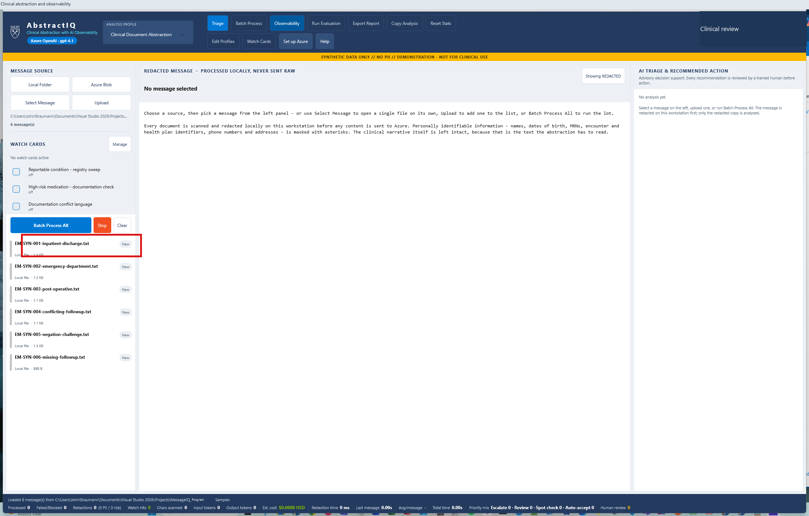
7
Six cases queued
SETUP
WHERE TO CLICK
Nothing. Read the case names aloud.
WHAT THIS PROVES
The test set is small, named, and chosen for difficulty - this is the asset the evaluation section depends on.
6 cases
Labelled, synthetic, chosen for difficulty
AbstractIQ · Healthcare Organization · synthetic data only, not for clinical use
Notes:
WHAT YOU ARE SEEING
Six cases in the left pane: EM-SYN-001 inpatient discharge, 002 emergency department, 003 post-operative, 004 conflicting follow-up, 005 negation challenge, 006 missing follow-up.
WHERE TO CLICK
Nothing. Read the names aloud - the names are the argument.
WHAT THE SOLUTION IS DOING
Holding the queue locally. No network calls yet.
BUSINESS BENEFIT TO Demo
This folder is the single most valuable long-lived asset in the whole demo, and the one most often skipped. Models change, prompts change, frameworks change, vendors change - the labelled test set outlives all of them, and it is the only thing that lets Demo say "the new version is better" with evidence rather than impression. Six cases demonstrate the mechanism. Demo needs hundreds, grown continuously from the cases where abstractors disagreed with the model. Name an owner for it before you write a line of production code.

Slide 15
PART 2
Masking before the network boundary
Ask 5 begins here, not in the governance tab. Retention and RBAC govern data already written.
Notes:
Deliberately place the first half of the PII answer early, before any model call, because the sequence is the argument.
The point to make: masking is the only control that operates before Azure sees the text. Everything else in the PII story - retention, purge, access control - governs data that has already left the building. Those are real controls and Azure implements them well, but they are downstream.
That is why this section sits at step 8 and the governance tab sits at step 32. Same ask, two halves, deliberately separated by the entire demo.

Slide 16

8
Opening a single case
PII
WHERE TO CLICK
Left pane → first case, EM-SYN-001-inpatient-discharge.txt.
WHAT THIS PROVES
The document is on screen, unprocessed. The next two clicks are where the PII story happens.
AbstractIQ · Healthcare Organization · synthetic data only, not for clinical use
Notes:
WHAT YOU ARE SEEING
EM-SYN-001, an inpatient discharge summary, selected in the case list and loaded into the centre pane.
WHERE TO CLICK
The first case in the list.
WHAT THE SOLUTION IS DOING
Loading the raw text locally. It has not called the model.
BUSINESS BENEFIT TO Demo
This is the hand-off point and worth naming explicitly: the document is in memory, in the clinic's own process, and has not crossed a network boundary. Everything Demo can control about PII exposure happens in the next step, before that boundary is crossed. After the boundary, you are relying on retention and access control - which are real controls, but they are controls over data that has already left. Masking is the only one that operates before.

Slide 17
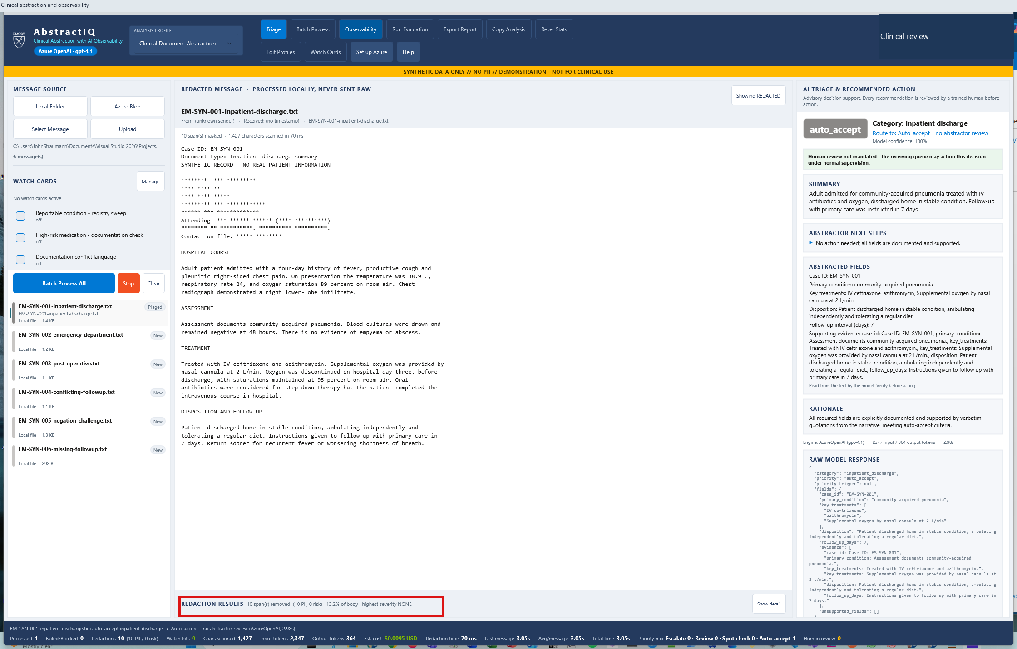
9
Local redaction - 10 PII entities masked before any network call
PII
WHERE TO CLICK
Nothing. Point at the masked spans and at the PII tally beneath the document.
WHAT THIS PROVES
Masking happens in-process, before the prompt is built. Azure never receives the identifiers.
10 PII
Masked locally, 0 harmful-language hits
AbstractIQ · Healthcare Organization · synthetic data only, not for clinical use
Notes:
WHAT YOU ARE SEEING
The centre pane header reads "REDACTED MESSAGE - PROCESSED LOCALLY, NEVER SENT RAW". Patient name, date of birth, MRN, NPI, encounter id, health plan id, service dates and phone number are masked. The tally beneath reads ten PII entities found and masked.
WHERE TO CLICK
Nothing. Point at the masked spans, then at the tally.
WHAT THE SOLUTION IS DOING
The redact.local span runs before the gen_ai.chat.completions span. The ordering is the control. Masked entity types are counted and typed - PII_PATIENT_NAME, PII_MRN, PII_DOB - so the posture is measurable, not just asserted.
BUSINESS BENEFIT TO Demo
This is the direct answer to "our prompts contain patient data". Retention and RBAC govern data already written; masking is the only control that operates before Azure ever sees the text. Two hard-won notes. First, we recommend layering Azure AI Language Health de-identification behind your own lexicon - a rule set and a trained model catch different things. Second, and this one cost us real time: our inherited risk lexicon flagged "Blood cultures" as CRITICAL violent content because of the word "blood". It corrupted the abstraction and polluted this very screen. Any classifier Demo inherits from a general-purpose source must be re-validated against clinical vocabulary before it goes near a note.

Slide 18
PART 3
The core abstraction workflow
One case, then the whole queue. Everything in the observability section is built from this run.
Notes:
Short section, but it generates the data for everything that follows.
Two numbers to land. On the single case: cost and latency are displayed next to the answer, for this case, right now - not in a monthly bill. On the batch: the priority mix, which is the number that decides whether this changes the staffing model.
Then note that zero cases failed, and promise the room that you will deliberately break that later. A monitoring story that has only ever seen success is not a monitoring story.

Slide 19
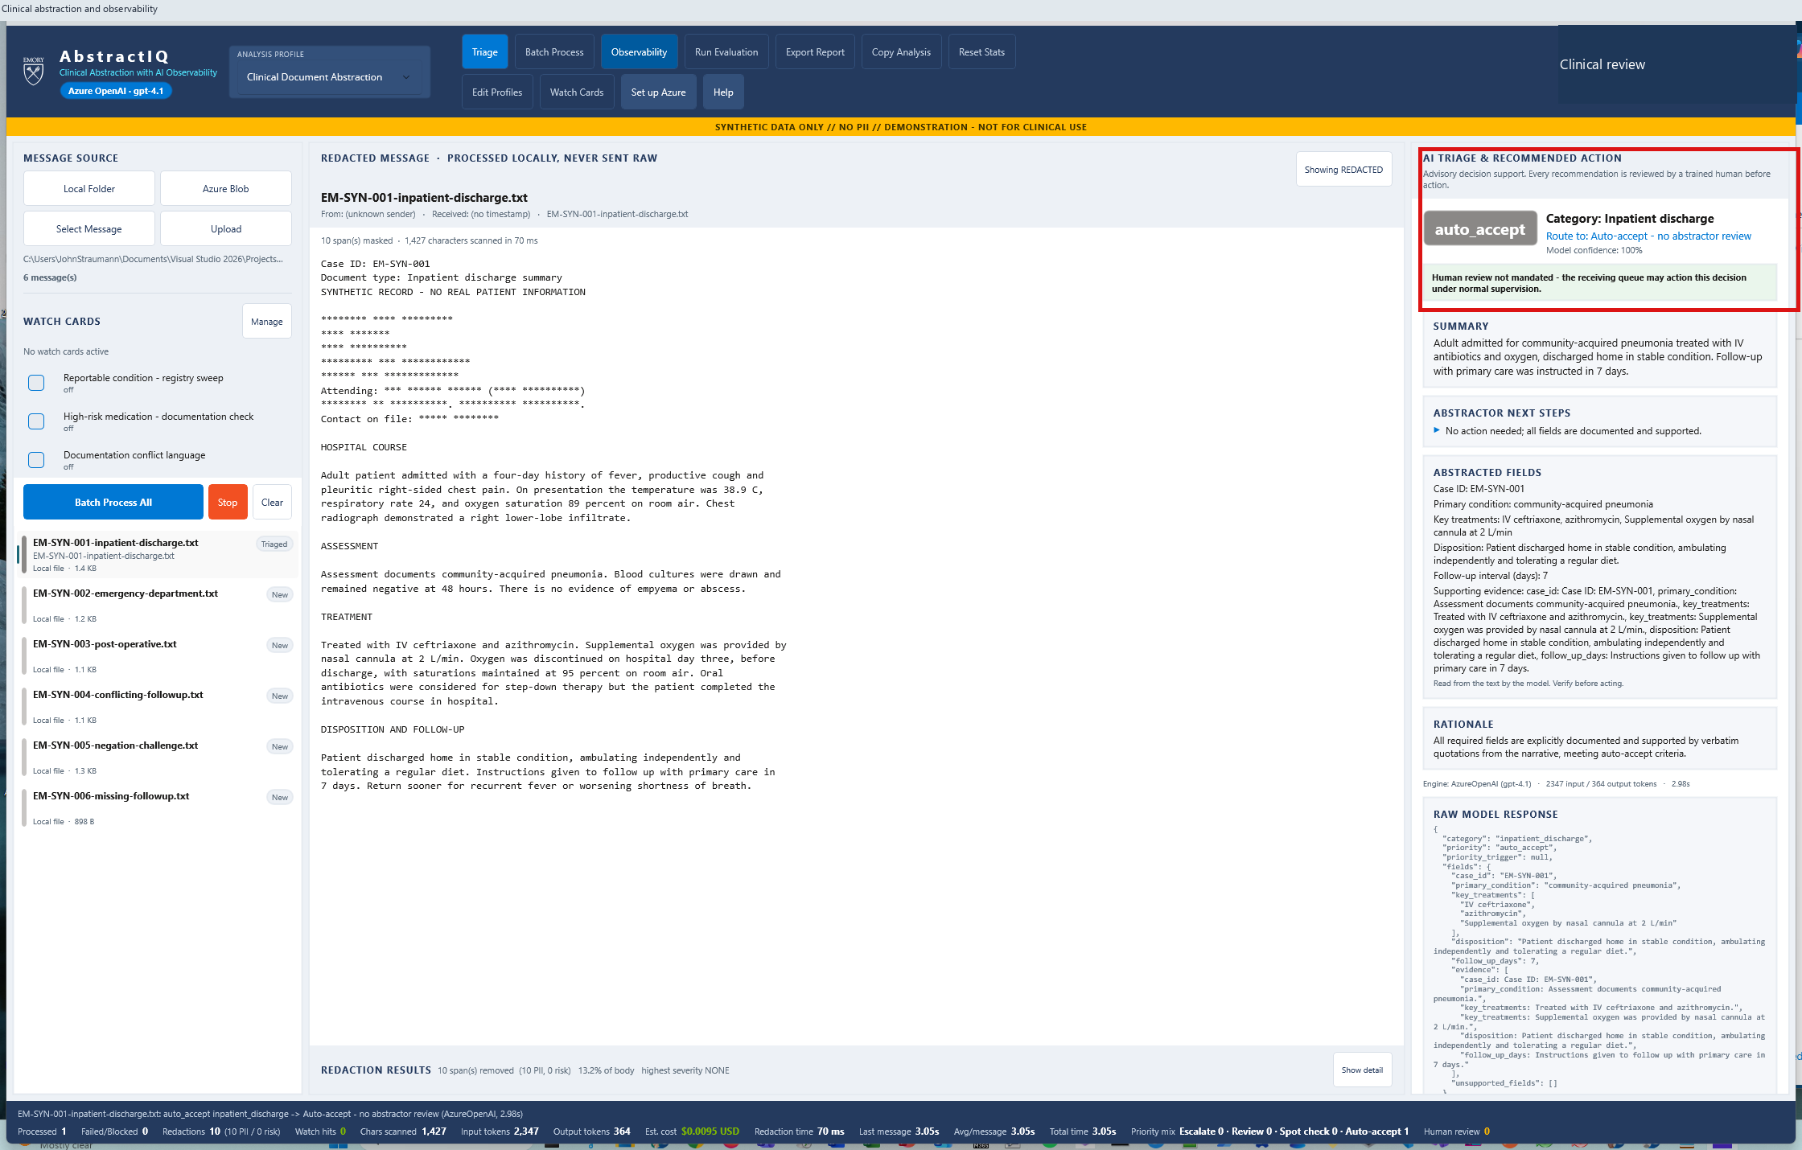
10
The abstraction, with its evidence
CORE
WHERE TO CLICK
Nothing. Read the right-hand panel: summary, actions, rationale, then the engine line.
WHAT THIS PROVES
Every field is traceable to a verbatim quote, and the token and latency numbers are on screen with the answer.
$0.0095
2,347 in / 364 out · auto-accept
AbstractIQ · Healthcare Organization · synthetic data only, not for clinical use
Notes:
WHAT YOU ARE SEEING
The right-hand panel: priority auto_accept, category inpatient_discharge, confidence, a structured summary, recommended actions, and a rationale. The engine line at the bottom reads AzureOpenAI (gpt-4.1), 2,347 tokens in, 364 out, 2.77 seconds.
WHERE TO CLICK
Nothing. Walk down the panel, then stop on the engine line.
WHAT THE SOLUTION IS DOING
Five spans have executed: document.ingest, redact.local, gen_ai.chat.completions, abstraction.parse and rules.offline, under a clinical_abstraction root. Every field is required to cite a verbatim quote from the source note - which is what makes the evidence-grounding evaluator later possible.
BUSINESS BENEFIT TO Demo
Two things worth drawing out. First, "Blood cultures were drawn and remained negative" survives intact - the clinical language is preserved, because we fixed the lexicon defect. Second, and this is the observability point: cost and latency are displayed next to the answer, for this case, right now. Not in a monthly bill, not in a platform dashboard the clinical team never opens. When the people doing the work can see what each call costs, cost conversations stop being abstract.

Slide 20
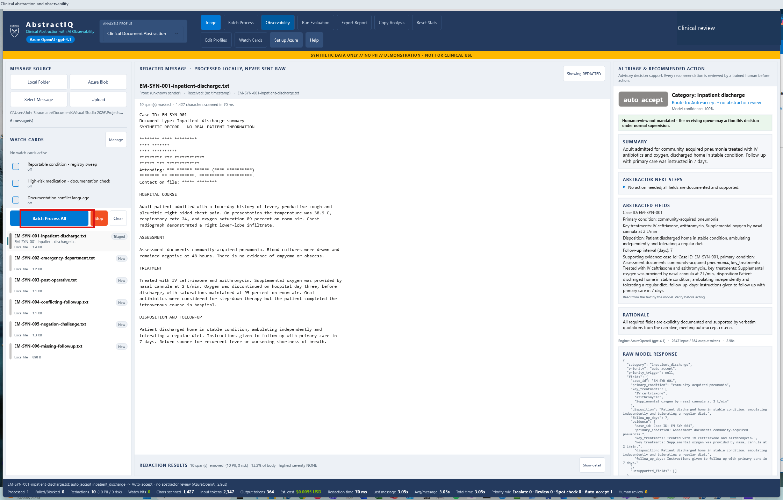
11
Running the whole queue
CORE
WHERE TO CLICK
Left pane → "Batch Process All".
WHAT THIS PROVES
Volume is where monitoring, evaluation and cost stop being theoretical.
AbstractIQ · Healthcare Organization · synthetic data only, not for clinical use
Notes:
WHAT YOU ARE SEEING
The "Batch Process All" button highlighted in the left pane.
WHERE TO CLICK
"Batch Process All".
WHAT THE SOLUTION IS DOING
Running every queued case through the same pipeline, emitting one full trace per case and aggregating the statistics in the status bar.
BUSINESS BENEFIT TO Demo
One case is an anecdote. This is the moment the questions Demo actually asked become answerable: what does a day of abstraction cost, how long does the slowest case take, how many need a human, and how many failed outright. Everything in the Observability section that follows is built from this run - and it only takes a few seconds, which is itself the point. Make it trivially easy to generate a population of traces, because you cannot debug a distribution with a single sample.

Slide 21
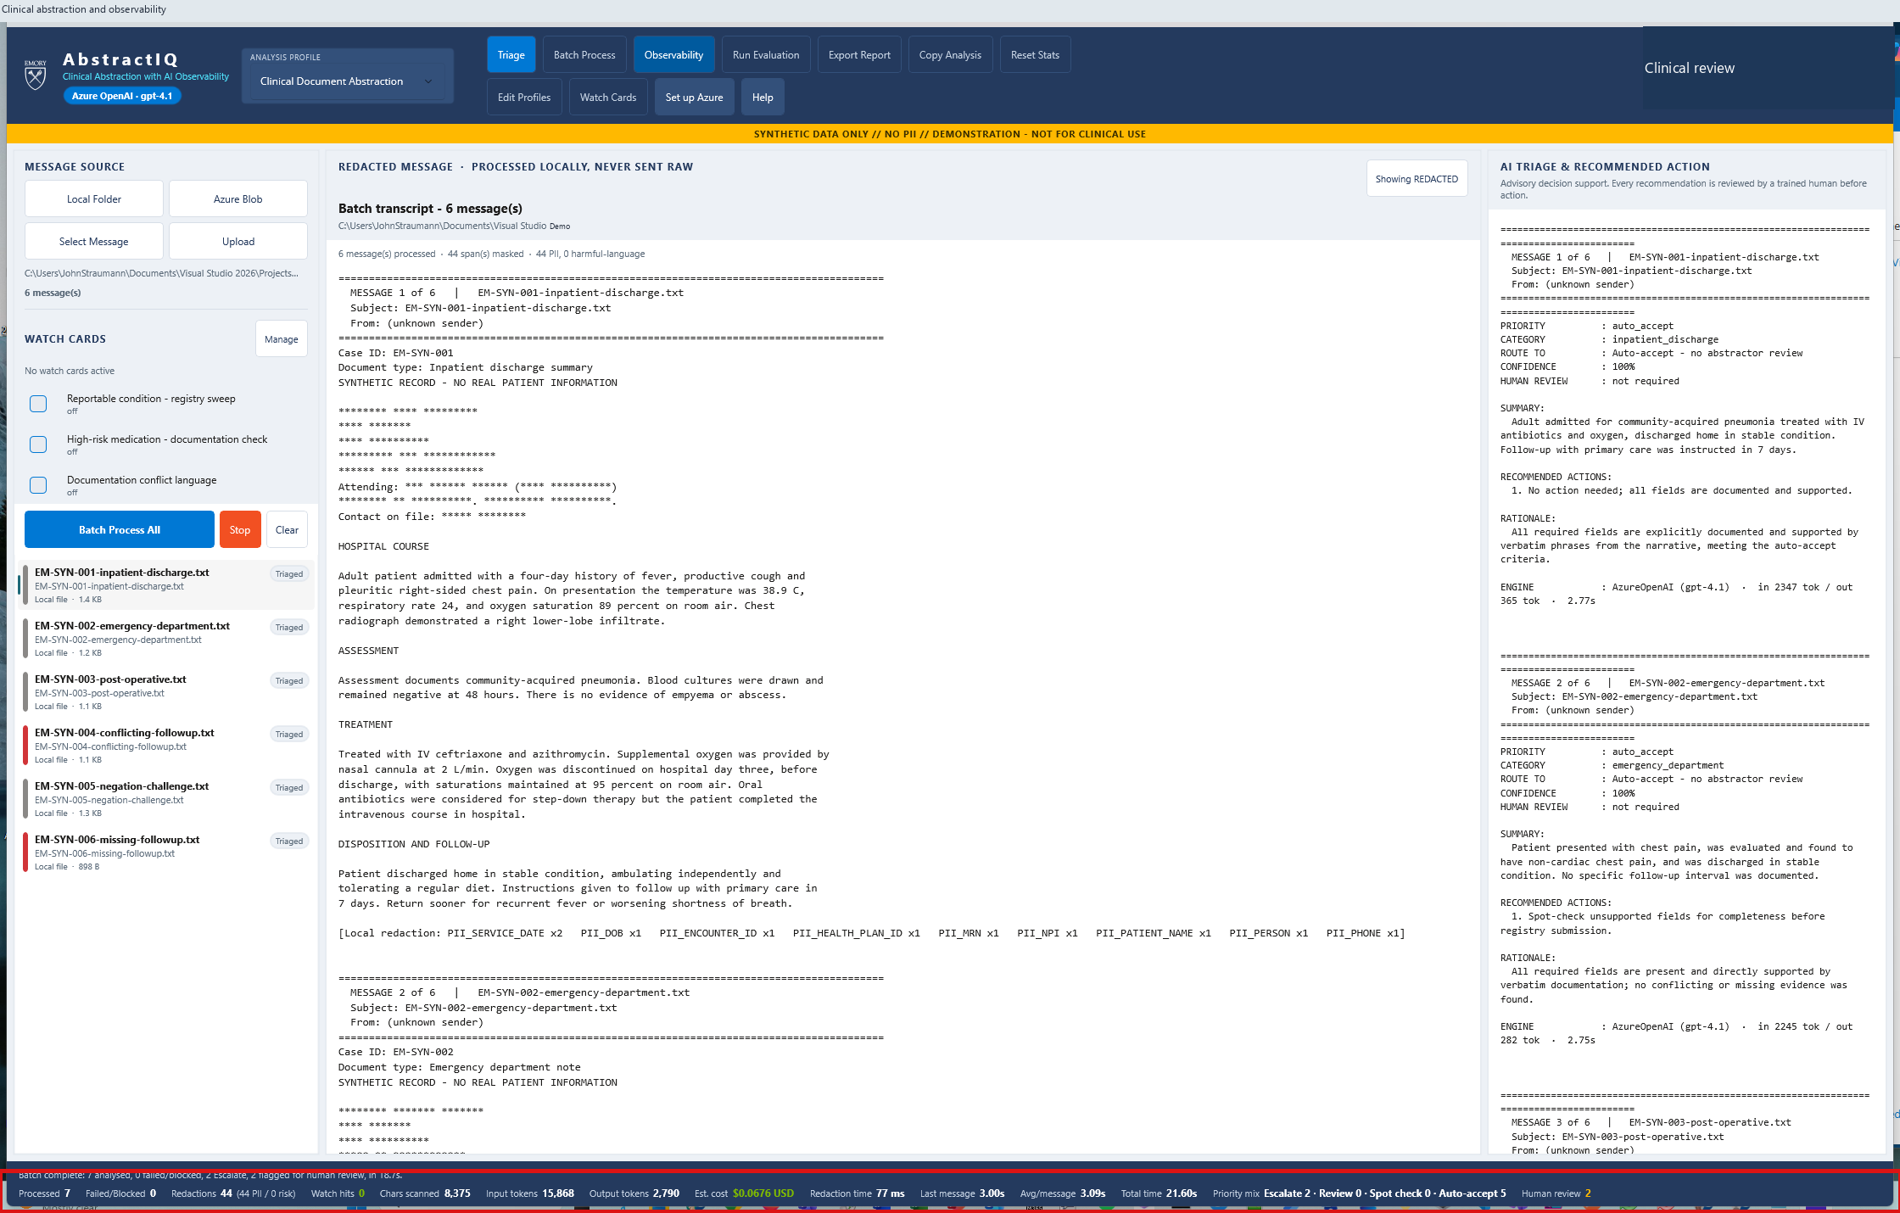
12
Seven analysed, zero failed, two escalated
CORE
WHERE TO CLICK
Nothing. Read the status bar along the bottom, left to right.
WHAT THIS PROVES
Throughput, redaction count, token totals, cost and the human-review mix - all in one line, live.
$0.0676
7 analysed · 18.7s · 15,868 in / 2,790 out
AbstractIQ · Healthcare Organization · synthetic data only, not for clinical use
Notes:
WHAT YOU ARE SEEING
The status bar: 7 analysed, 0 failed or blocked, 2 escalate, 2 flagged for human review, 18.7 seconds, 44 redactions (44 PII, 0 risk), 15,868 input tokens, 2,790 output, estimated cost $0.0676, average 3.09 seconds per message.
WHERE TO CLICK
Nothing. Read the status bar left to right.
WHAT THE SOLUTION IS DOING
Aggregating every span from every case. The priority mix on the right - Escalate 2, Review 0, Spot check 0, Auto-accept 5 - is the operational number: how much of this queue still needs a human.
BUSINESS BENEFIT TO Demo
This single line answers the business case. Cost per case, seconds per case, and the proportion that still needs an abstractor. That last figure is the one that determines whether this saves money: a tool that auto-accepts five of seven changes the staffing model; one that escalates all seven does not. Note also that 0 failed - we will deliberately break that in step 29, because a monitoring story that has only ever seen success is not a monitoring story.

Slide 22
PART 4
Ask 2 — LLM tracing
A full prompt-and-response trace per case, in the application and in Foundry, under the same trace id.
Notes:
Ask 2, and the first of the five observability tabs.
The two things to emphasise: the trace id is shared between the application and Azure, so there is no mapping table; and the span carries gen_ai.* semantic convention attributes, which is what makes Foundry render it as a model call rather than an anonymous dependency.
The second point is the highest-leverage technical recommendation in the whole session. If the room is technical, spend time on step 15.

Slide 23
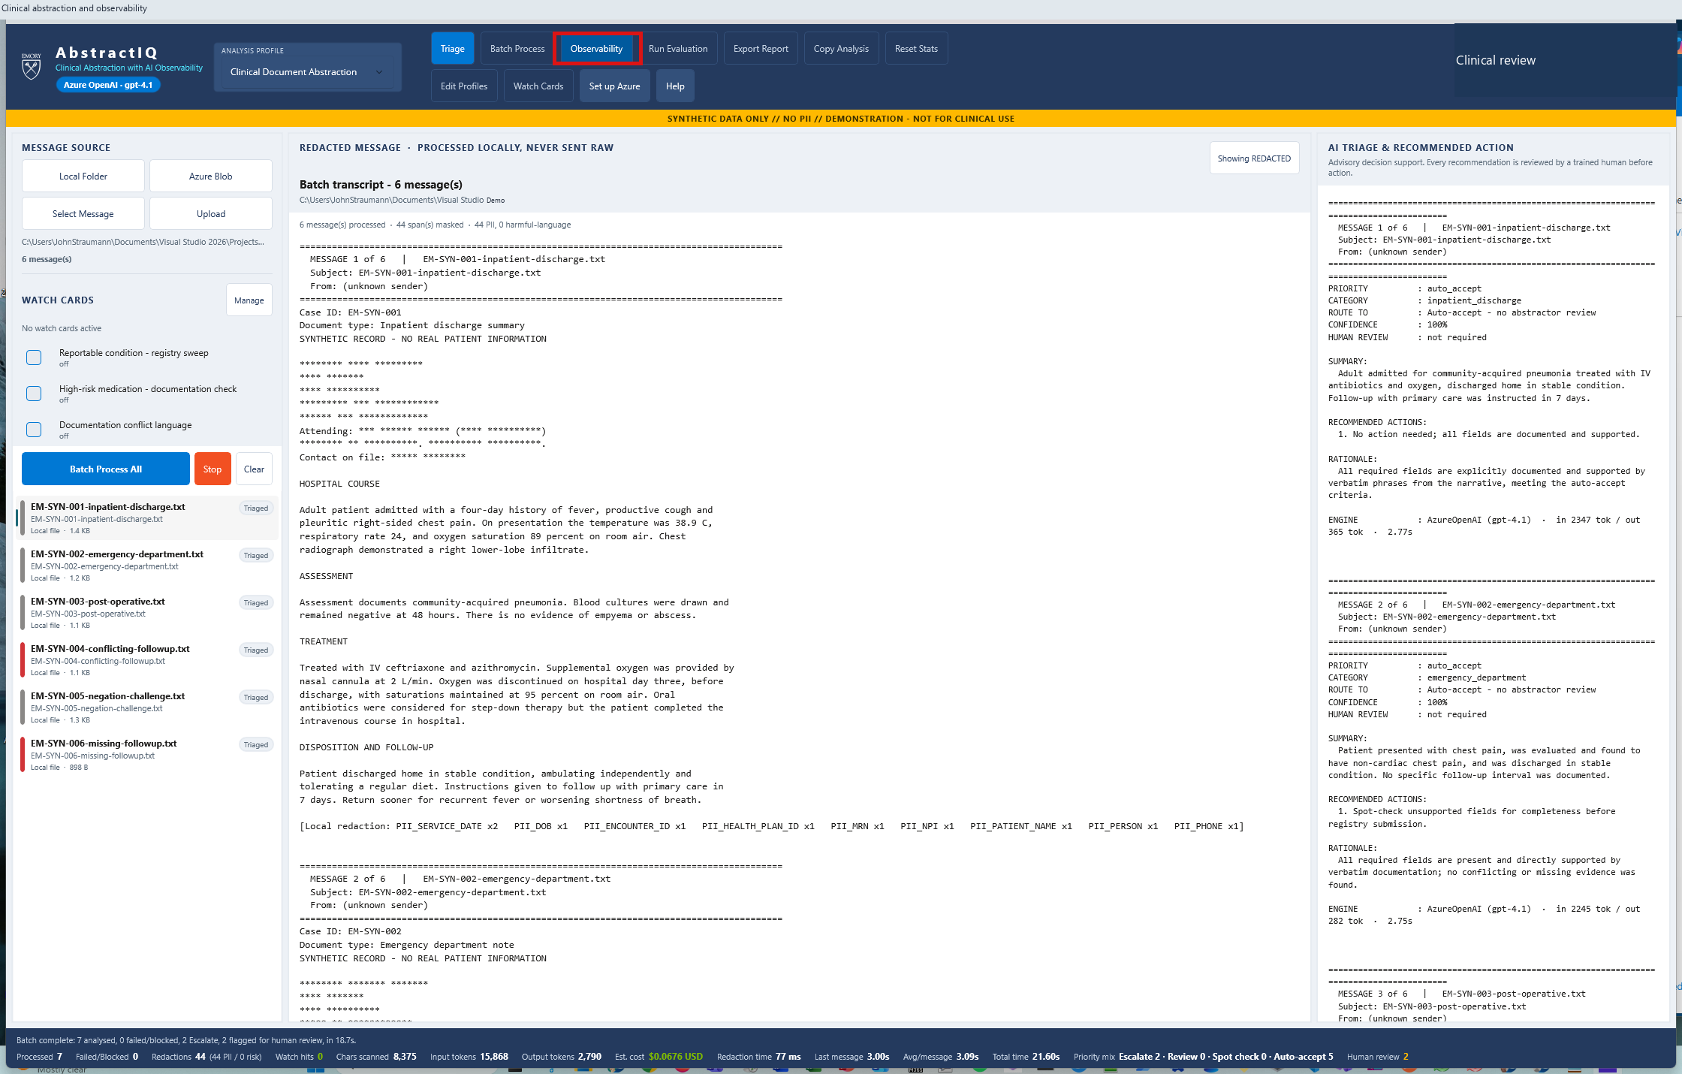
13
Opening the observability layer
TRACING
WHERE TO CLICK
Toolbar → "Observability".
WHAT THIS PROVES
Five tabs, one per Demo ask: Case Trace, Evaluation, Abstractor Review, Monitoring, PII Governance.
AbstractIQ · Healthcare Organization · synthetic data only, not for clinical use
Notes:
WHAT YOU ARE SEEING
The "Observability" button highlighted in the main toolbar.
WHERE TO CLICK
"Observability" in the toolbar.
WHAT THE SOLUTION IS DOING
Opening a panel with five tabs - Case Trace, Evaluation, Abstractor Review, Monitoring and PII Governance - built deliberately one per question Demo asked.
BUSINESS BENEFIT TO Demo
Say this out loud when you click: these five tabs are your five questions, in the order you asked them. The rest of the demo is one tab at a time. And note where the button is - in the main toolbar, one click from the abstractor's working screen. The engineering team gets the same data in Azure, but the clinical team gets it here, in their own workflow. Observability that only the platform team can reach is observability the clinical team never challenges, and unchallenged dashboards are how a zero-millisecond latency chart survives for six months.

Slide 24
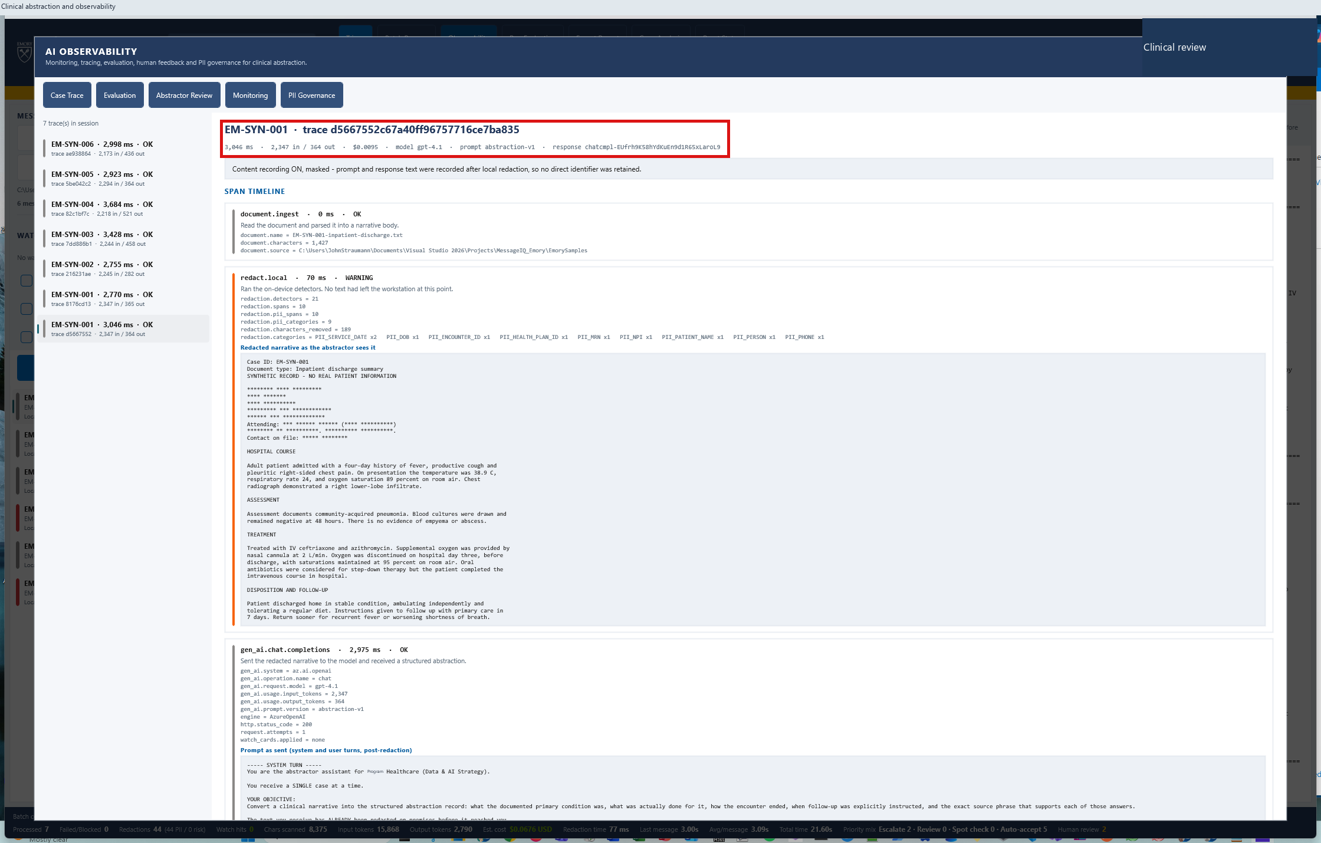
14
Ask 2 - a full trace per case
TRACING
WHERE TO CLICK
Observability → "Case Trace" tab. Select a case from the list on the left.
WHAT THIS PROVES
Parent/child spans with timings, and a trace id that is the same id you paste into Azure.
AbstractIQ · Healthcare Organization · synthetic data only, not for clinical use
Notes:
WHAT YOU ARE SEEING
The Case Trace tab. A clinical_abstraction root span with children: document.ingest, redact.local, gen_ai.chat.completions, abstraction.parse, rules.offline. Each carries its own duration, and the trace id is displayed at the top.
WHERE TO CLICK
The "Case Trace" tab, then any case in the trace list.
WHAT THE SOLUTION IS DOING
Rendering the trace the application assembled, and exporting the same trace to Application Insights - which is what populates Foundry's Tracing tab. The design decision worth copying: export happens at the single trace sink, not at each call site. The Azure trace is therefore a projection of the trace on this screen, not a second stream that can silently drift, and the masking decision is enforced once at one boundary.
BUSINESS BENEFIT TO Demo
Note the trace id. The application uses its own case trace id as the W3C trace id, so the identifier an abstractor reads here is the identifier an engineer pastes into Azure. No mapping table, no correlation service, no "which trace was that?" during an incident. It is a small design decision that removes a whole category of operational friction.

Slide 25
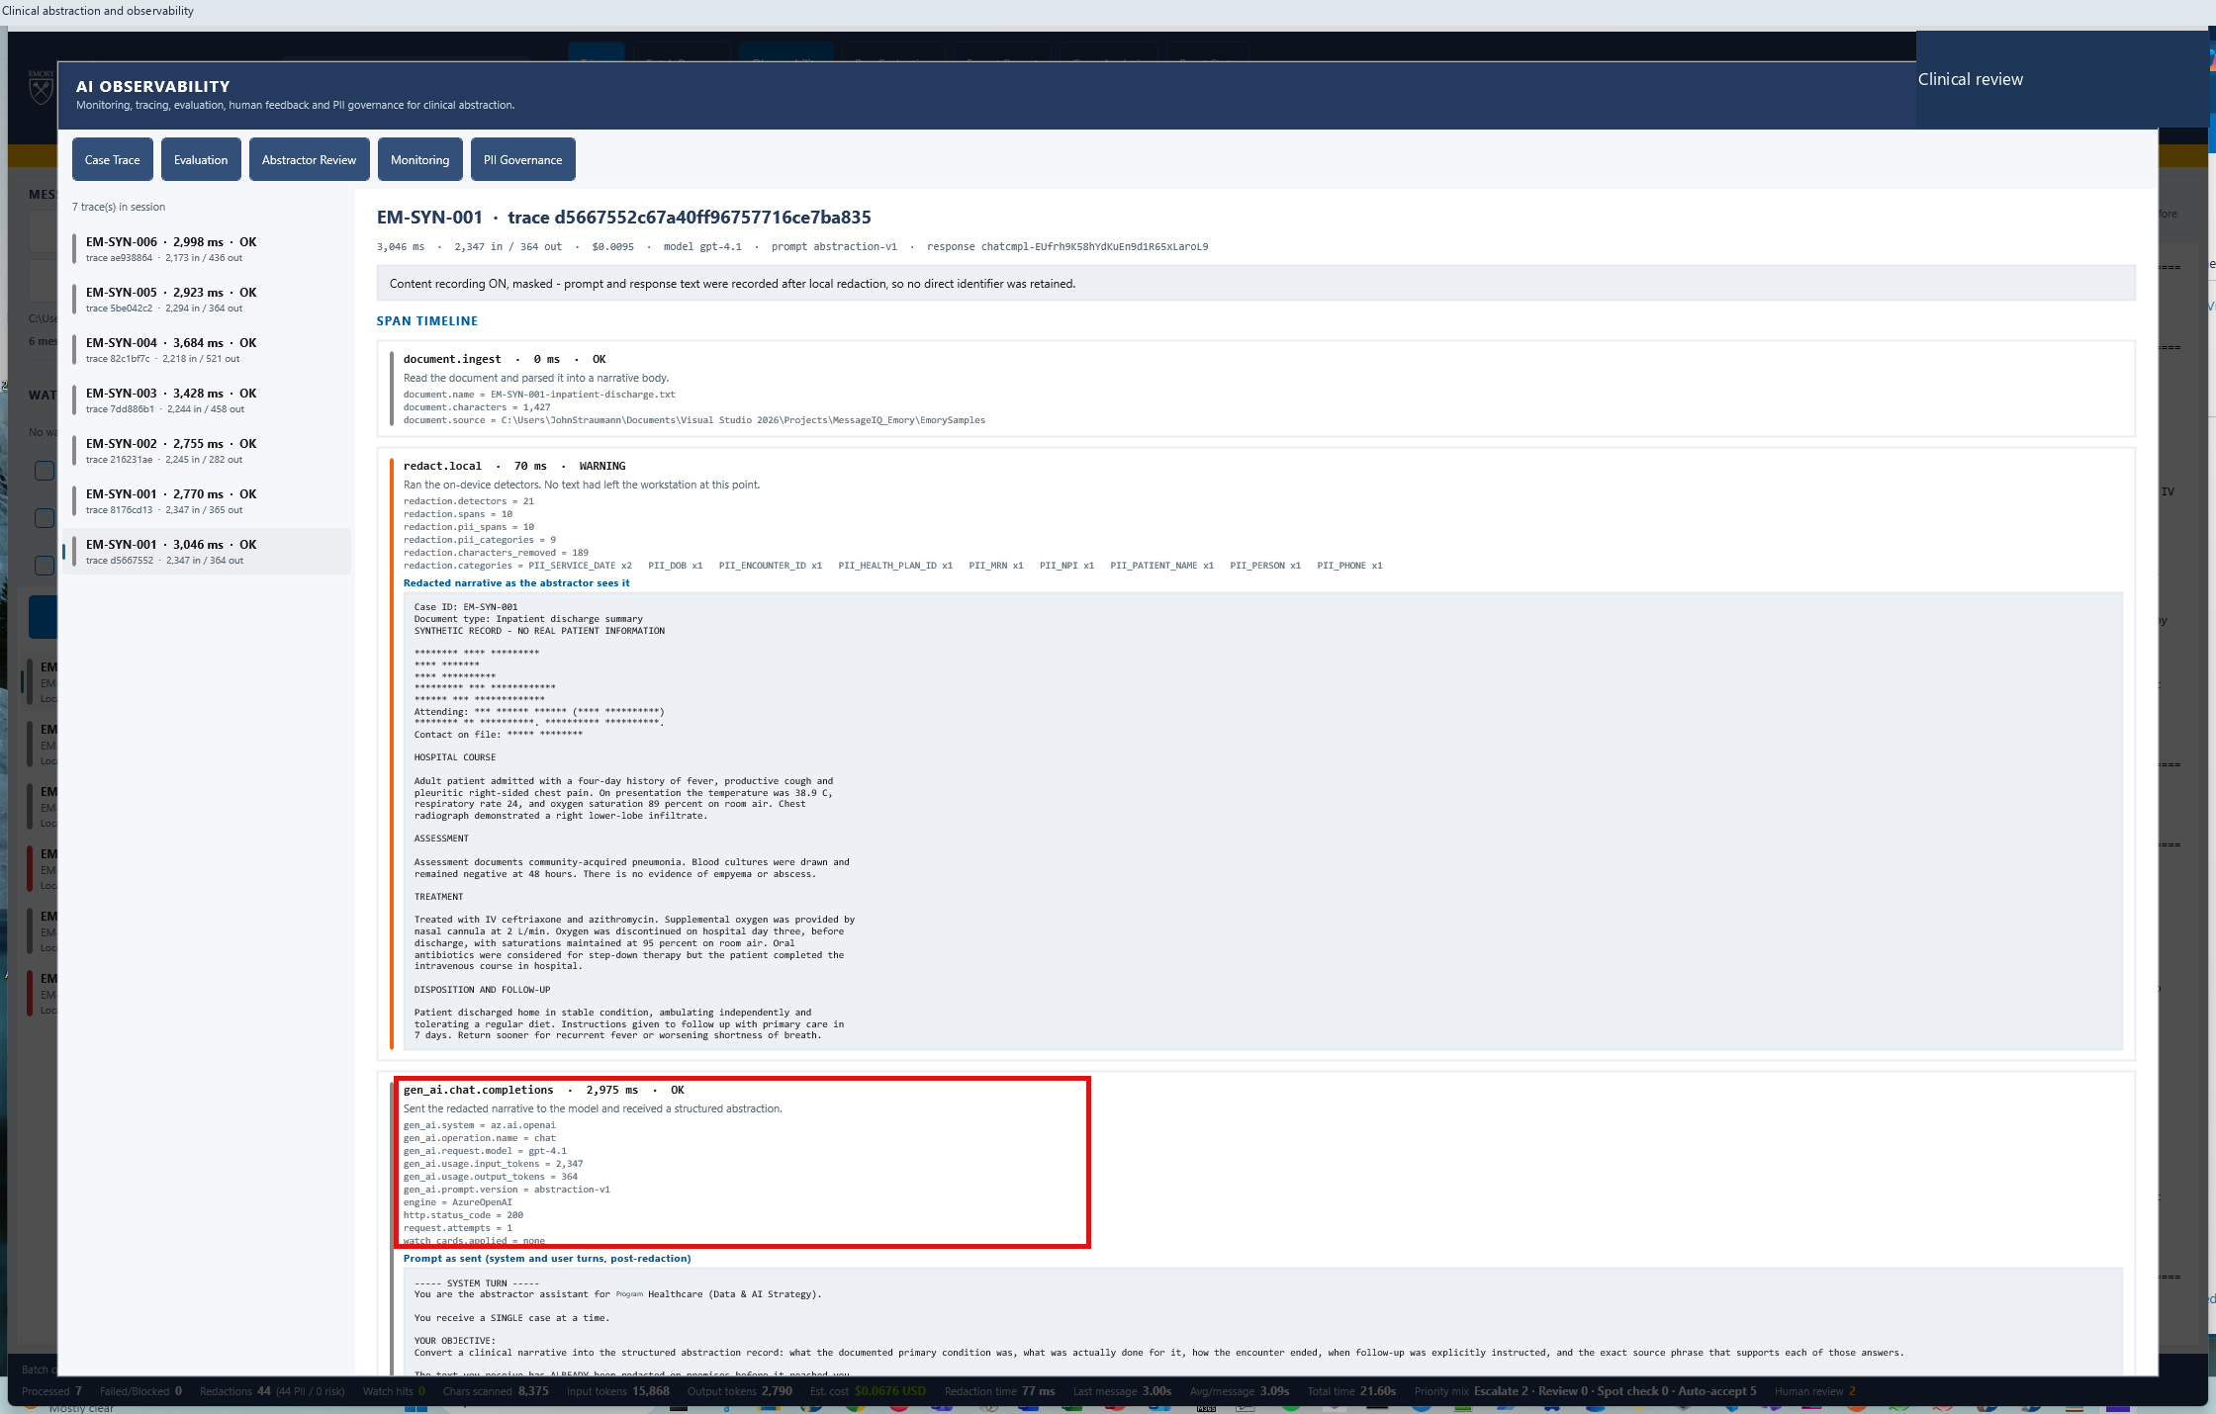
15
Inside the model call: prompt, response, tokens, latency
TRACING
WHERE TO CLICK
Expand the gen_ai.chat.completions span.
WHAT THIS PROVES
The span carries gen_ai.* attributes - the OpenTelemetry convention that makes Foundry render it as a model call.
gen_ai.*
Standard namespace, not a custom one
AbstractIQ · Healthcare Organization · synthetic data only, not for clinical use
Notes:
WHAT YOU ARE SEEING
The expanded gen_ai.chat.completions span: the system prompt, the redacted user content, the model response, input and output tokens, latency and the model name.
WHERE TO CLICK
Expand the gen_ai.chat.completions span in the trace tree.
WHAT THE SOLUTION IS DOING
Carrying OpenTelemetry gen_ai.* semantic convention attributes - gen_ai.request.model, gen_ai.usage.input_tokens, gen_ai.usage.output_tokens, gen_ai.operation.name - plus Demo-specific attributes under an Demo.* namespace, and governance attributes content_recorded, content_masked and retention_days.
BUSINESS BENEFIT TO Demo
This is the highest-leverage technical recommendation in the whole session, so dwell on it. Adopting gen_ai.* is what makes Foundry and Azure Monitor recognise a span as a model call rather than an anonymous dependency, and it is what lights up every built-in token and cost view with no bespoke dashboard work. We learned it the hard way: our exporter initially namespaced every attribute as Demo.*, including the standard ones. Everything rendered. Every built-in view stayed empty. Retrofitting this later means rewriting every dashboard and losing comparability with your own history - so decide it on day one. Namespace your own vocabulary, never the standard one.

Slide 26
PART 5
Ask 3 — Evaluation
Ten clinical evaluators over a labelled test set, repeatable, with run-over-run comparison.
Notes:
Ask 3, and the section with the most uncomfortable message in the deck.
Three beats: the evaluators are clinical and Demo must write them; one case fails for a genuine, clinically important reason; and the same prompt scores 50% then 67% with nothing changed.
That last one reframes how Demo should govern quality - gate on a run average across repeats, never on a single run. Do not rush it.

Slide 27
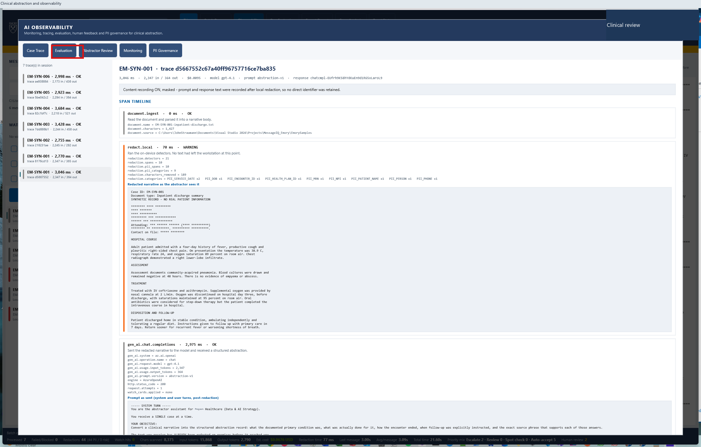
16
Ask 3 - automated quality checks
EVALUATION
WHERE TO CLICK
Observability → "Evaluation" tab.
WHAT THIS PROVES
A repeatable run over a labelled test set with ten clinical evaluators.
AbstractIQ · Healthcare Organization · synthetic data only, not for clinical use
Notes:
WHAT YOU ARE SEEING
The Evaluation tab, before a run. It names the test set and lists the evaluators that will be applied.
WHERE TO CLICK
The "Evaluation" tab.
WHAT THE SOLUTION IS DOING
Preparing to run every case in the labelled test set through the pipeline and score the output against ten evaluators.
BUSINESS BENEFIT TO Demo
Here is the honest division of labour. Foundry ships built-in evaluators for groundedness, relevance, coherence, fluency and safety, and they are genuinely useful - use them. But they answer "is this output well-formed, grounded and safe?" They cannot answer "is the primary condition correct, were the key treatments captured, and should this case have been escalated?" Those are Demo's clinical definitions of correct, and only Demo can write them. This tab is what that looks like when you do. Expect this to be the largest build item on your list and the one most consistently underestimated.

Slide 28
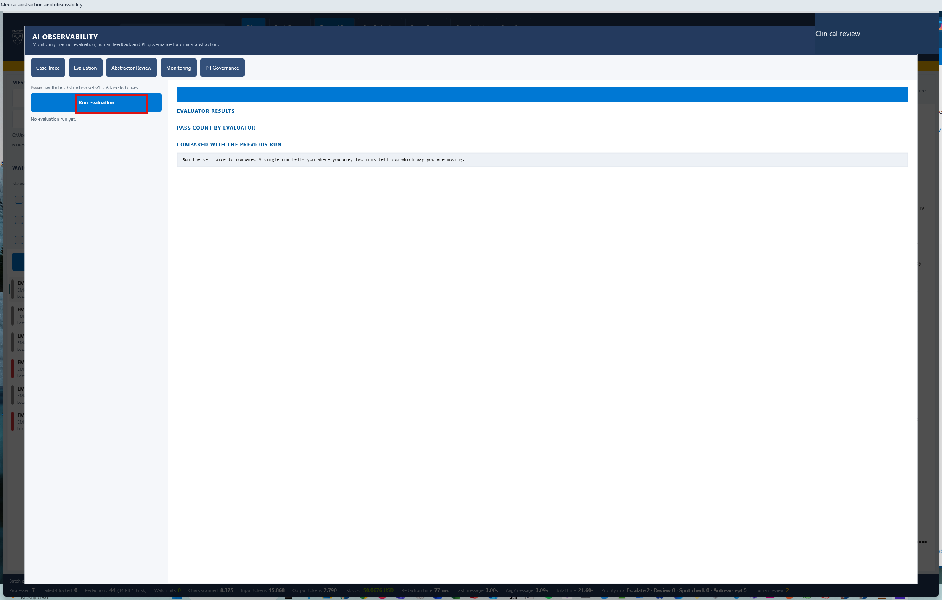
17
Running the evaluation
EVALUATION
WHERE TO CLICK
Evaluation tab → "Run evaluation".
WHAT THIS PROVES
One click, six cases, ten evaluators, roughly nineteen seconds.
AbstractIQ · Healthcare Organization · synthetic data only, not for clinical use
Notes:
WHAT YOU ARE SEEING
The "Run evaluation" button highlighted.
WHERE TO CLICK
"Run evaluation".
WHAT THE SOLUTION IS DOING
Re-running all six labelled cases and scoring each output against ten evaluators: schema valid, required fields present, primary condition correct, key treatments captured, disposition correct, follow-up captured, no fabrication, evidence grounded, review routing correct, and null handling.
BUSINESS BENEFIT TO Demo
Nineteen seconds for a full regression over the clinical test set. That number is what determines whether evaluation actually gets used. If the suite takes an hour, it runs before releases and nobody waits for it; if it takes twenty seconds, it runs on every prompt change and people actually read the result. Design for the short loop, and wire this into CI so a failing run can block a deployment - evaluation that nobody can block a release with is a report, not a control.

Slide 29
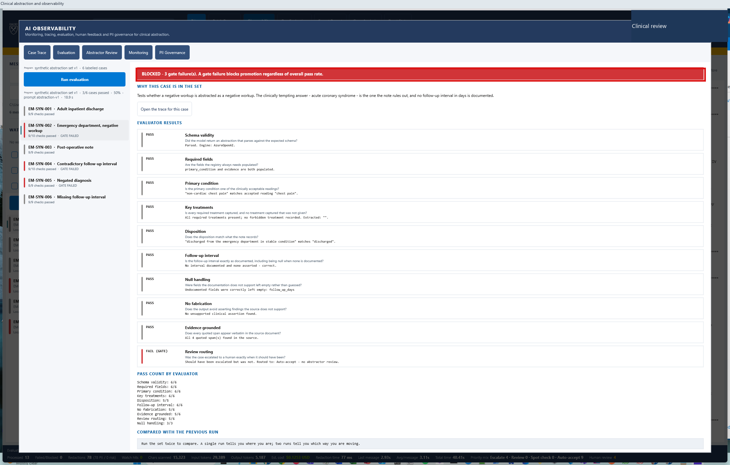
18
Per-evaluator results - and a real failure
EVALUATION
WHERE TO CLICK
Nothing. Read the per-evaluator breakdown, then stop on the three that are not perfect.
WHAT THIS PROVES
Quality is reported per dimension, not as one unhelpful aggregate score.
3 of 6
Cases passing every evaluator (50%)
AbstractIQ · Healthcare Organization · synthetic data only, not for clinical use
Notes:
WHAT YOU ARE SEEING
Ten evaluators scored independently. Schema valid 6/6, required fields 6/6, primary condition correct 6/6, key treatments 6/6, disposition 5/5, follow-up captured 6/6, no fabrication 5/6, evidence grounded 5/6, review routing 5/6, null handling 3/3. Three of six cases pass every single evaluator.
WHERE TO CLICK
Nothing. Walk the list, then stop on the three that are not perfect.
WHAT THE SOLUTION IS DOING
Scoring each dimension separately rather than producing one aggregate number.
BUSINESS BENEFIT TO Demo
Resist the urge to collapse this into a single score. A model that is perfect on schema and weak on escalation routing needs a different fix from one that is weak on fabrication - and a single blended number hides both. Note also what is failing: "no fabrication", "evidence grounded" and "review routing" are exactly the three that matter clinically, and they are the three that generic evaluators would never have checked. One more hard-won warning: this evaluator originally scored 0 out of 6 and looked like a catastrophic model failure. The real cause was a bug in the evaluator - it compared an unstripped "field_name:" prefix against the source text. Evaluators are code, and code has bugs. An evaluation suite that has never been tested against a known-good output will confidently report false failures, and the first instinct is always to blame the model.

Slide 30
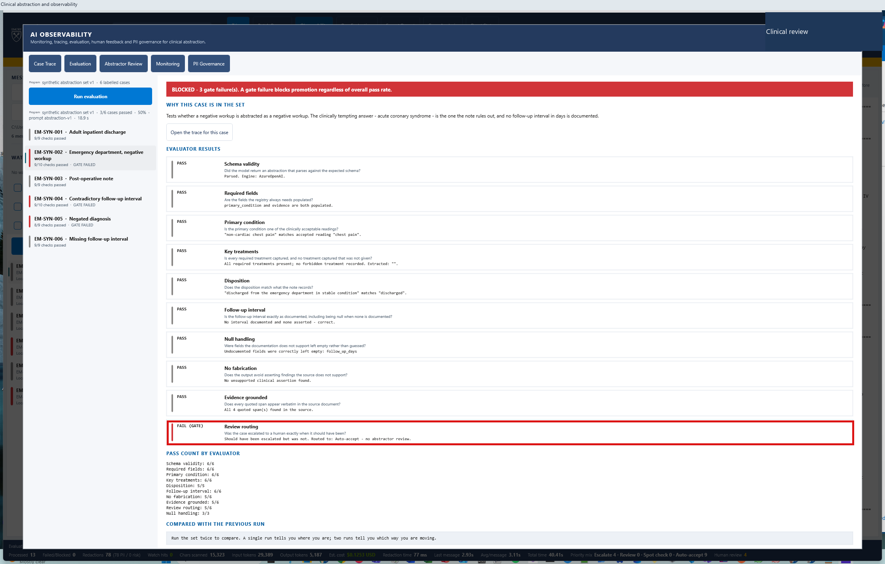
19
EM-SYN-002: should have been escalated, and was not
EVALUATION
WHERE TO CLICK
Nothing. Read the failure reason verbatim.
WHAT THIS PROVES
A genuine model miss on a hard case - caught automatically, before a human ever saw it.
1 of 10
Evaluators failed on this case: review routing
AbstractIQ · Healthcare Organization · synthetic data only, not for clinical use
Notes:
WHAT YOU ARE SEEING
EM-SYN-002 fails exactly one evaluator - "Review routing" - with the reason "Should have been escalated but was not". Every other evaluator passes.
WHERE TO CLICK
Nothing. Read the failure reason out loud, word for word.
WHAT THE SOLUTION IS DOING
Comparing the model's routing decision against the human label on this case and reporting the mismatch.
BUSINESS BENEFIT TO Demo
This is the most important slide in the evaluation section. It is not a contrived failure - it is a real miss by a capable model on a genuinely hard emergency department note, and it is precisely the failure mode that matters clinically. A case that should have reached a human did not. Without this evaluator, that case is auto-accepted, nobody looks at it, and the only discovery mechanism is an abstractor noticing something wrong weeks later - or nobody noticing at all. This single result is the entire argument for maintaining a clinical test set. And watch for it again in two slides' time: the abstractors independently flag the same weakness through the feedback channel.

Slide 31
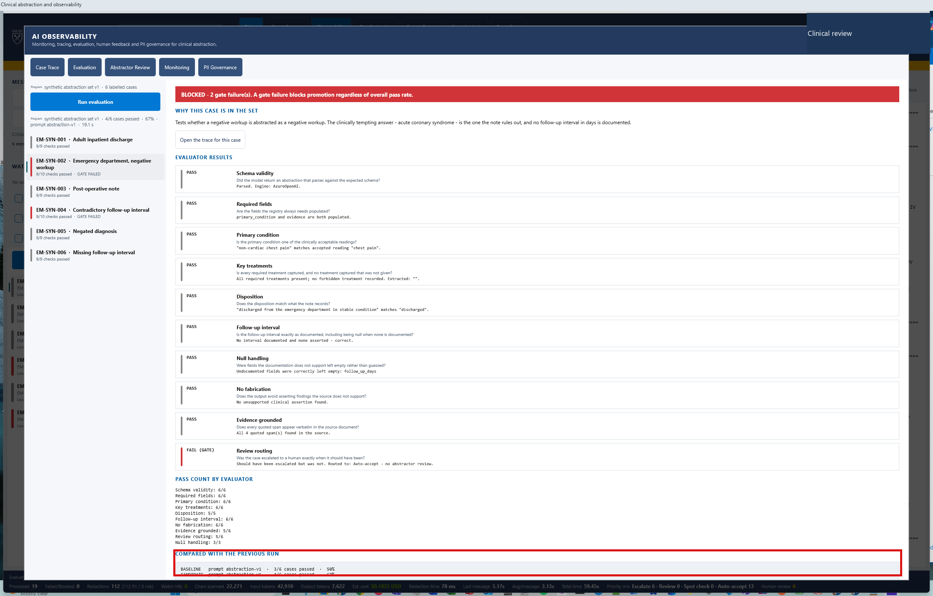
20
Same prompt, same model, different score
EVALUATION
WHERE TO CLICK
Click "Run evaluation" a second time, then read the comparison panel.
WHAT THIS PROVES
50% then 67% with nothing changed. Quality is a distribution, not a number.
50% → 67%
Baseline vs candidate, identical prompt version
AbstractIQ · Healthcare Organization · synthetic data only, not for clinical use
Notes:
WHAT YOU ARE SEEING
The "COMPARED WITH THE PREVIOUS RUN" panel: baseline 3/6 at 50%, candidate 4/6 at 67% - on the same prompt version, the same model and the same test set. Nothing changed but sampling.
WHERE TO CLICK
"Run evaluation" a second time, then read the comparison panel.
WHAT THE SOLUTION IS DOING
Storing each run with its prompt version and comparing the current run against the previous one.
BUSINESS BENEFIT TO Demo
This is the honest, uncomfortable, important message of the whole session. An LLM application's quality is a distribution, not a number. A single passing run is not evidence that a change helped, and a single failing run is not evidence that it hurt. The practical consequences: gate on a run average across repeats with a minimum repeat count, never on one run; expect to argue about the threshold, and have that argument once, deliberately, with clinical leadership in the room rather than during an incident; and treat any vendor benchmark quoted as a single number with appropriate scepticism. If Demo takes one governance principle from today, take this one.

Slide 32
PART 6
Ask 4 — Human feedback
An abstractor's agree or disagree, bound to a trace id and a prompt version.
Notes:
Ask 4, and the only one of the five with no Azure-native answer.
Be straight about that early in the section - it earns credibility for everything else you have claimed Azure does cover.
The pay-off is at step 26, where the abstractors' leading complaint and the automated evaluator independently converge on the same weakness. Set that up now so the room is watching for it.

Slide 33
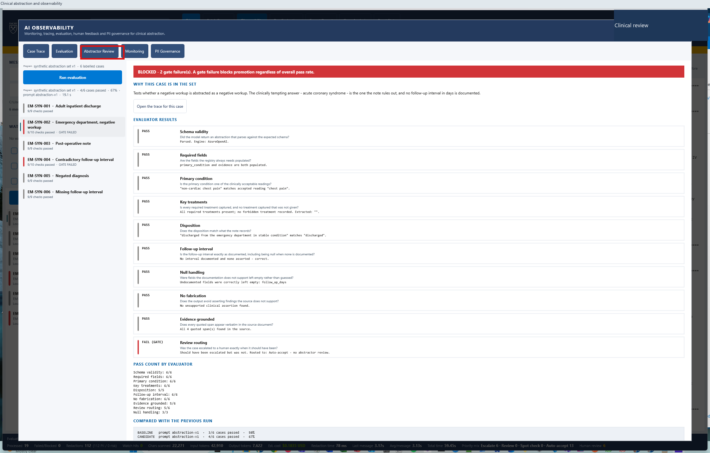
21
Ask 4 - human feedback
FEEDBACK
WHERE TO CLICK
Observability → "Abstractor Review" tab.
WHAT THIS PROVES
The agree/disagree control lives in the abstractor's own workflow, on the case they are already reading.
AbstractIQ · Healthcare Organization · synthetic data only, not for clinical use
Notes:
WHAT YOU ARE SEEING
The Abstractor Review tab: the trace list on the left, the verdict controls below it, and the aggregate feedback panel on the right.
WHERE TO CLICK
The "Abstractor Review" tab.
WHAT THE SOLUTION IS DOING
Presenting each traced case for a human verdict and binding that verdict to the trace id and prompt version.
BUSINESS BENEFIT TO Demo
Be straight with the room here: this is the biggest genuine gap of your five asks. There is no Azure service that renders an agree/disagree control to your clinical abstractor inside your application, captures a structured reason and binds it to the trace id of the call under review. Foundry has thumbs up/down, but on playground interactions, not your production workflow. Azure gives you the storage, the correlation and the aggregation - Application Insights custom events keyed by trace id, and KQL over them. The interface and the workflow placement are yours to build. The placement is not a detail: feedback collected anywhere other than where the work happens does not get collected at all.

Slide 34
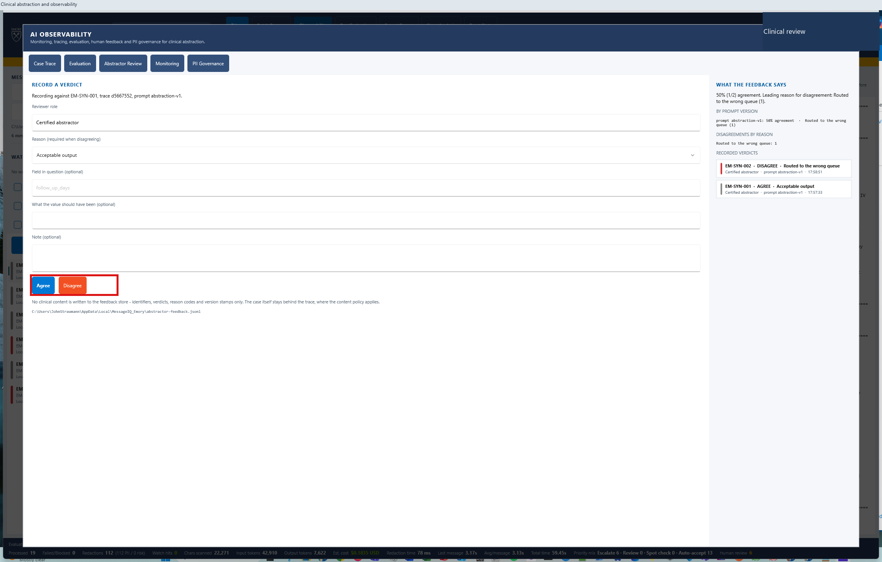
22
Agree is one click
FEEDBACK
WHERE TO CLICK
With a case selected → "Agree".
WHAT THIS PROVES
Zero friction on the common path. Anything slower and abstractors simply stop rating.
AbstractIQ · Healthcare Organization · synthetic data only, not for clinical use
Notes:
WHAT YOU ARE SEEING
An "Agree" verdict being recorded against EM-SYN-001.
WHERE TO CLICK
"Agree", with a case selected in the trace list.
WHAT THE SOLUTION IS DOING
Writing the verdict to a durable local file, abstractor-feedback.jsonl, and exporting it as a custom event correlated to the trace id.
BUSINESS BENEFIT TO Demo
Two deliberate design decisions. First, agree is one click and requires nothing else - the common path has to be frictionless or abstractors stop rating within a week, and a feedback channel nobody uses is worse than none because it creates false confidence. Second, the verdict is written locally first and exported second. An abstractor's judgement is expensive to obtain and must never be lost because a network call failed. Local-first, export-after is the right pattern for any human-judgement capture.

Slide 35
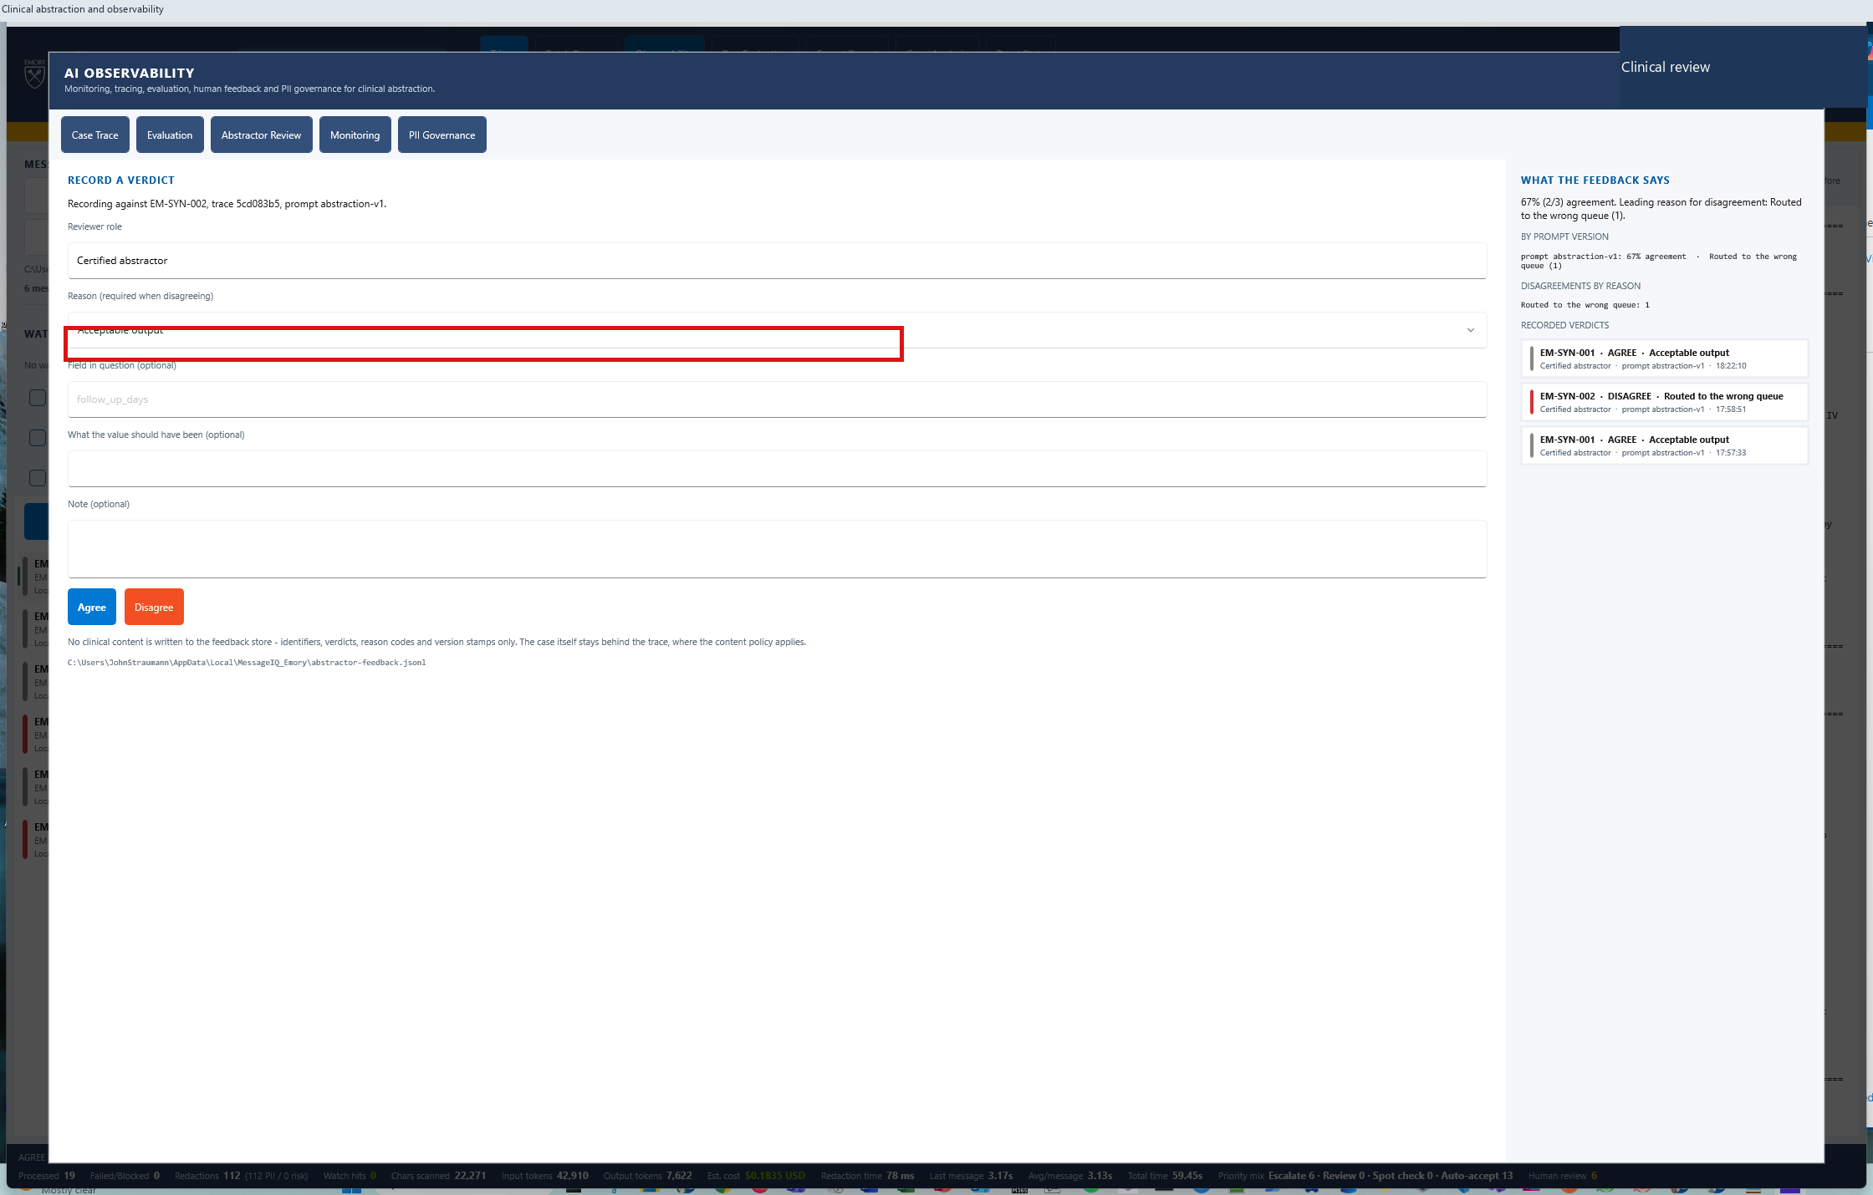
23
Disagreement requires a reason
FEEDBACK
WHERE TO CLICK
Select a second case → open the reason dropdown.
WHAT THIS PROVES
Structured reasons, not free text. This is what makes feedback aggregable.
AbstractIQ · Healthcare Organization · synthetic data only, not for clinical use
Notes:
WHAT YOU ARE SEEING
A second case selected, EM-SYN-002, and the reason dropdown being opened before a disagreement can be recorded.
WHERE TO CLICK
Select EM-SYN-002 in the trace list, then open the reason dropdown.
WHAT THE SOLUTION IS DOING
Requiring a structured reason code on disagreement, while agreement needs none.
BUSINESS BENEFIT TO Demo
The asymmetry is the design. Agreement carries no information beyond the fact itself; disagreement carries the information you actually need, so that is where you spend the user's time. And the reason must come from a fixed list rather than a free-text box. Free text is unanalysable at scale - a thousand differently-worded complaints about the same defect aggregate to nothing. A fixed list turns the same thousand verdicts into a ranked, actionable dashboard you can hand to whoever owns the prompt.

Slide 36
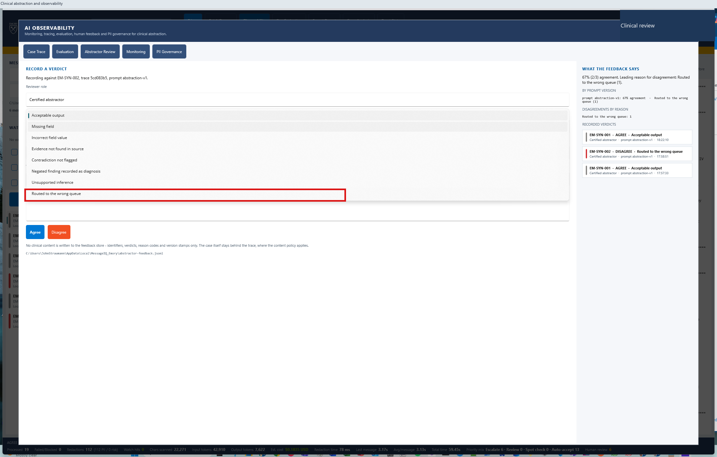
24
Seven clinical reason codes
FEEDBACK
WHERE TO CLICK
Nothing. Read the seven options aloud.
WHAT THIS PROVES
The vocabulary is clinical abstraction, not generic "unhelpful / inaccurate".
7 codes
Clinical failure modes, fixed vocabulary
AbstractIQ · Healthcare Organization · synthetic data only, not for clinical use
Notes:
WHAT YOU ARE SEEING
The open dropdown: Missing field; Incorrect field value; Evidence not found in source; Contradiction not flagged; Negated finding recorded as diagnosis; Unsupported inference; Routed to the wrong queue.
WHERE TO CLICK
Nothing. Read all seven aloud - slowly. They repay the ten seconds.
WHAT THE SOLUTION IS DOING
Offering a fixed vocabulary of clinical abstraction failure modes.
BUSINESS BENEFIT TO Demo
Compare these with the generic "unhelpful / inaccurate / offensive" that most feedback widgets ship with. "Negated finding recorded as diagnosis" is a specific, well-known, dangerous failure mode in clinical abstraction - the note says a condition was ruled out and the model records it as present. When that reason code starts climbing in the dashboard, the team knows exactly what to fix and roughly how. Generic categories tell you something is wrong; clinical categories tell you what. Demo should write this list themselves, with abstractors in the room, and then keep it stable - every time the vocabulary changes, historical feedback stops being comparable.

Slide 37
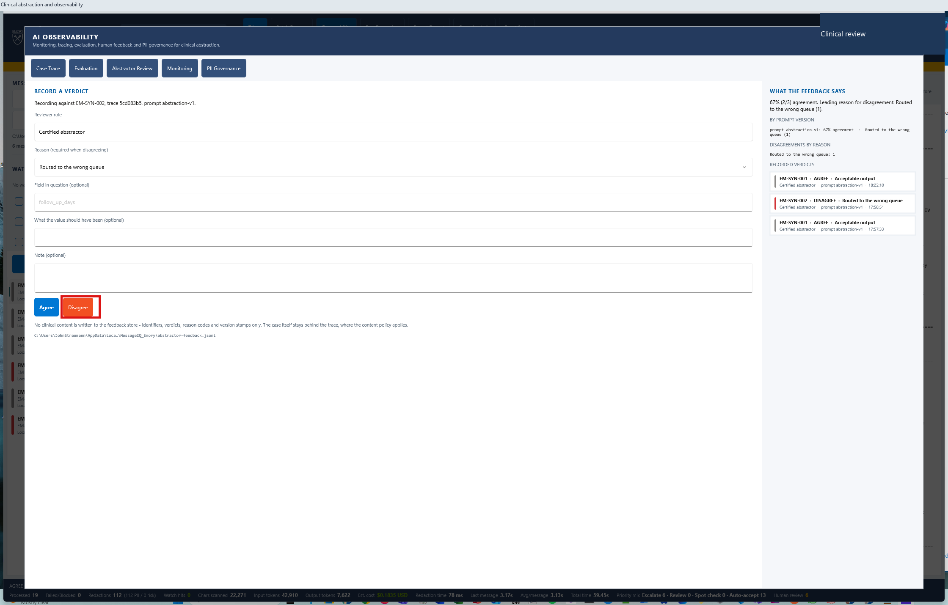
25
Recording the disagreement
FEEDBACK
WHERE TO CLICK
Choose "Routed to the wrong queue" → click "Disagree".
WHAT THIS PROVES
The verdict carries the trace id and the prompt version, not just a thumbs-down.
AbstractIQ · Healthcare Organization · synthetic data only, not for clinical use
Notes:
WHAT YOU ARE SEEING
"Routed to the wrong queue" selected, and the Disagree button being clicked for EM-SYN-002.
WHERE TO CLICK
Select "Routed to the wrong queue" in the dropdown, then click "Disagree".
WHAT THE SOLUTION IS DOING
Recording the verdict with the trace id, the reason code and the prompt version, then exporting it as a correlated custom event.
BUSINESS BENEFIT TO Demo
The prompt version on the verdict is the detail that makes the whole channel worth building. Agreement rate broken down by prompt version is the number that tells Demo whether last month's prompt change actually helped - and without it, the entire feedback corpus collapses into one undifferentiated average that can never answer a question about change. Version your prompts, and stamp the version on every trace, every evaluation result and every human verdict. It costs nothing at build time and is effectively unrecoverable afterwards.

Slide 38
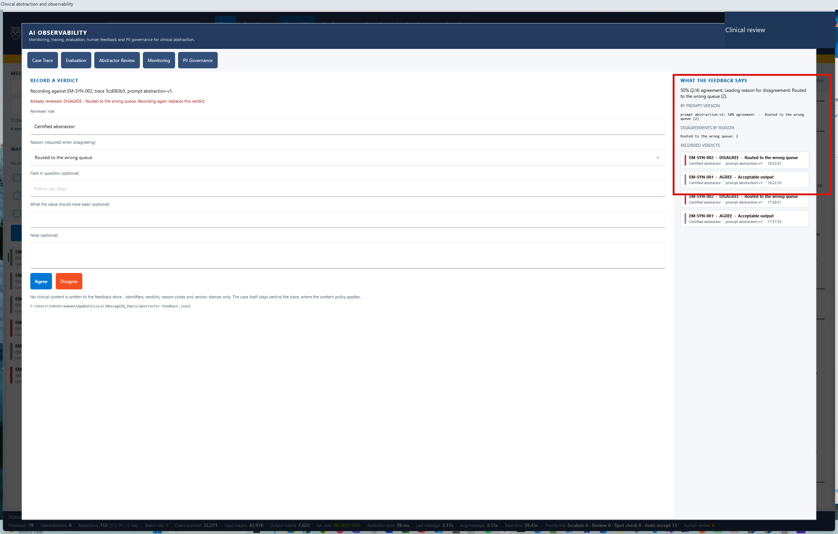
26
Two signals converging on one weakness
FEEDBACK
WHERE TO CLICK
Nothing. Read the agreement rate, the by-prompt-version split, and the leading reason.
WHAT THIS PROVES
The abstractors flagged routing independently - the same weakness the evaluator found.
50%
Agreement · leading reason: wrong queue (2)
AbstractIQ · Healthcare Organization · synthetic data only, not for clinical use
Notes:
WHAT YOU ARE SEEING
The aggregate panel: 50% agreement across four verdicts, a breakdown by prompt version, disagreements by reason with "Routed to the wrong queue (2)" leading, and the individual verdicts each bound to a trace id and prompt abstraction-v1.
WHERE TO CLICK
Nothing. Read the agreement rate, then the by-prompt-version split, then the leading reason.
WHAT THE SOLUTION IS DOING
Aggregating durable verdicts - they persist across sessions in abstractor-feedback.jsonl - and grouping them by prompt version and reason.
BUSINESS BENEFIT TO Demo
This is the pay-off slide for the feedback channel, so make the connection explicitly. The abstractors' leading complaint is "routed to the wrong queue". The automated evaluator, running independently against labelled ground truth, failed the same case on "review routing". Two completely independent signals have converged on one weakness. That convergence is how you prioritise prompt engineering work with confidence rather than intuition - and it is only possible because both signals carry the trace id and the prompt version. Finally, close the loop: every disagreement should be triaged into a new labelled case in the test set. That is the mechanism by which the system actually improves over time, and it needs an owner and a cadence, not good intentions.

Slide 39
PART 7
Ask 1 — Monitoring
Latency, failures, token cost - for the population, and then with a failure injected on purpose.
Notes:
Ask 1. Two halves: the healthy picture, then a deliberately injected rate-limit failure.
The fault injection is the part most demos skip and the part Demo will actually live with - 429 rate limiting is the most common real production failure for an Azure OpenAI workload.
Ask the operational questions out loud while the failure is on screen: who is paged, what does the dashboard say, does the application retry or drop the case. If a failure mode has never been exercised, the runbook for it is fiction.
There is a third beat in this section now. Before you inject the fault, scroll down the Monitoring tab to "Cost at our volume", ask the room for their monthly abstraction volume and type it in. The projection rebuilds from the tokens the cases you just ran actually consumed, so their number becomes their answer in front of them. That is Prahlad's third decision question, answered with measurement rather than a price list.

Slide 40
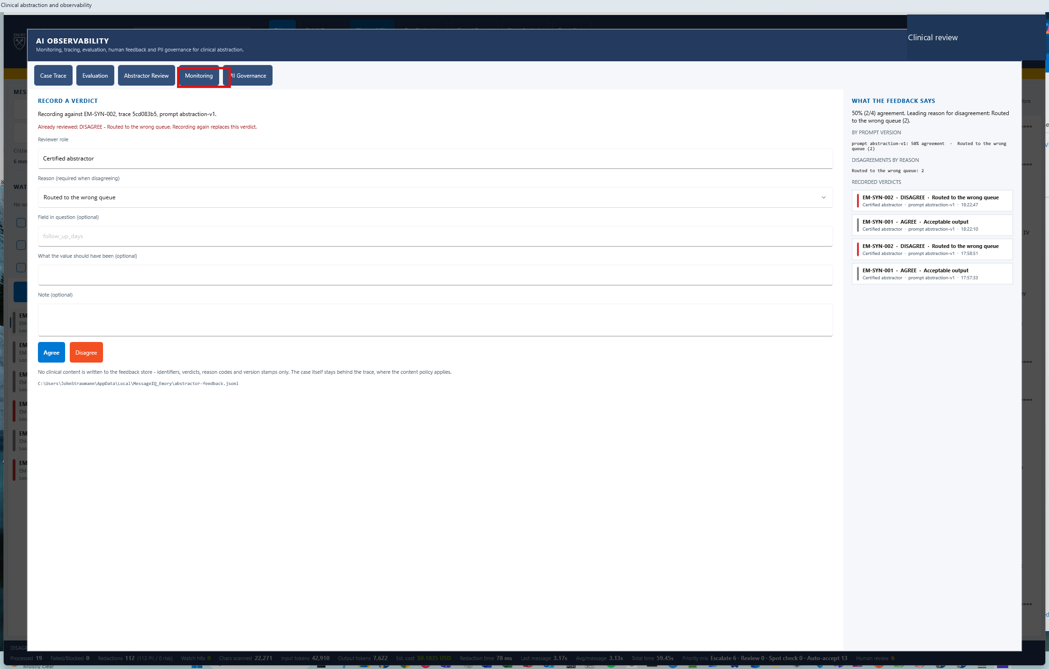
27
Ask 1 - monitoring
MONITORING
WHERE TO CLICK
Observability → "Monitoring" tab.
WHAT THIS PROVES
Latency, failures and cost for the whole population, not one case.
AbstractIQ · Healthcare Organization · synthetic data only, not for clinical use
Notes:
WHAT YOU ARE SEEING
The Monitoring tab opening.
WHERE TO CLICK
The "Monitoring" tab.
WHAT THE SOLUTION IS DOING
Aggregating every span from every case in the session into latency distribution, failure counts and token totals.
BUSINESS BENEFIT TO Demo
Everything here is also in Azure Monitor and queryable with KQL - we will show that in the portal section. The reason it is also on this screen is audience: the clinical operations lead will never open Log Analytics, but they will look at this tab, and they are the person best placed to notice that a number is wrong. That matters more than it sounds. The zero-millisecond latency defect we found during this build was caught by somebody reading a dashboard and thinking "that cannot be right" - not by a test, and not by code review.

Slide 41
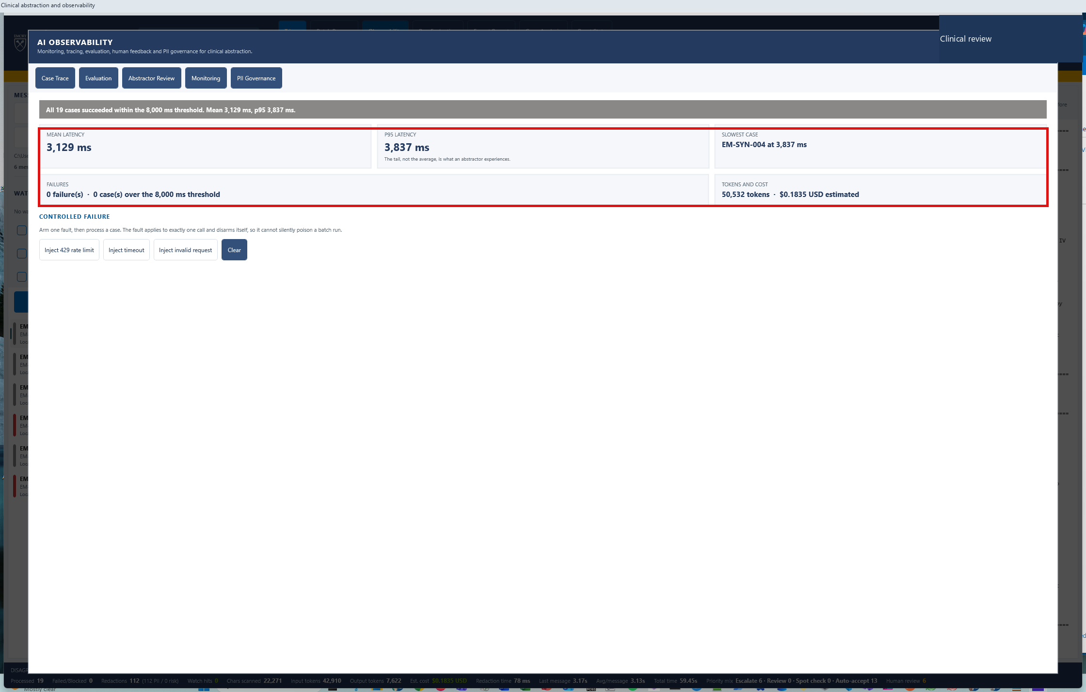
28
Latency, throughput and cost
MONITORING
WHERE TO CLICK
Nothing. Mean, then p95, then the slowest case, then the cost line.
WHAT THIS PROVES
p95 and the slowest named case - the figures that describe the abstractor's actual experience.
p95 3,837 ms
Mean 3,129 ms · slowest EM-SYN-004
AbstractIQ · Healthcare Organization · synthetic data only, not for clinical use
Notes:
WHAT YOU ARE SEEING
Mean latency 3,129 ms, p95 3,837 ms, the slowest case named as EM-SYN-004, total tokens and estimated cost for the session.
WHERE TO CLICK
Nothing. Read mean, then p95, then the slowest case, then cost.
WHAT THE SOLUTION IS DOING
Computing the distribution from the exported spans. Every figure is also reproducible in Log Analytics from the same data.
BUSINESS BENEFIT TO Demo
Three points. First, p95 rather than mean - the mean hides the cases that actually frustrate an abstractor, and p95 is the number to write into an SLO. Second, the slowest case is named, not just measured, so the next question is one click away instead of a query-writing exercise. Third, a defect worth confessing: this panel originally reported a mean latency of zero milliseconds, because the stopwatch timed object construction rather than the model call. Application Insights stored and displayed that zero perfectly. Nothing errored, nothing failed a build. Validate every metric you intend to rely on against a case whose answer you already know - a dashboard rendering successfully tells you nothing about whether it is correct.

Slide 42
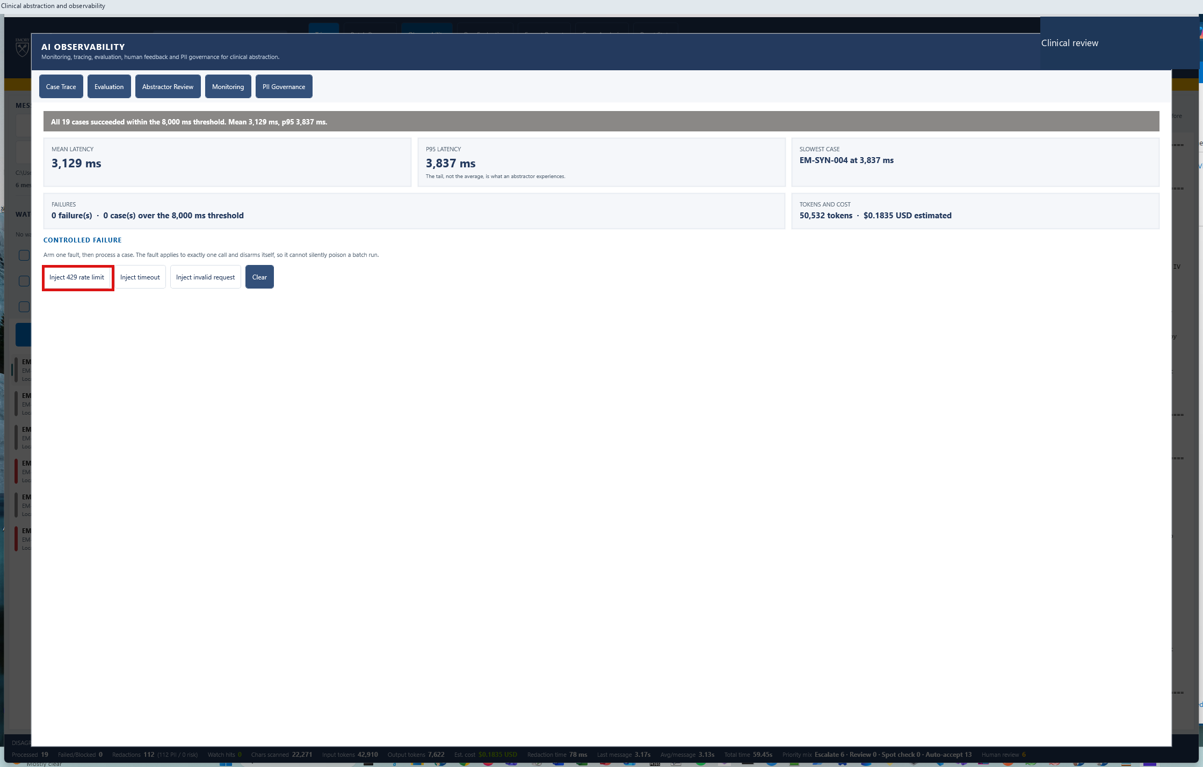
29
Deliberately breaking it
MONITORING
WHERE TO CLICK
Monitoring tab → "Inject 429" (rate-limit fault).
WHAT THIS PROVES
A monitoring story that has only ever seen success is not a monitoring story.
AbstractIQ · Healthcare Organization · synthetic data only, not for clinical use
Notes:
WHAT YOU ARE SEEING
The fault-injection control, with "Inject 429" highlighted.
WHERE TO CLICK
"Inject 429" on the Monitoring tab.
WHAT THE SOLUTION IS DOING
Forcing the next model call to return HTTP 429, the rate-limit response - the single most common real production failure for an Azure OpenAI workload.
BUSINESS BENEFIT TO Demo
Every demo shows the happy path; production is mostly the unhappy one. Rate limiting is what Demo will actually hit at scale, particularly on shared capacity, and it is worth rehearsing. Ask the question out loud: when this happens at three in the morning, who is paged, what does the dashboard say, how long until someone knows the queue is backing up, and does the application retry or drop the case? If a failure mode has never been exercised, the runbook for it is fiction. Build a fault-injection switch into your own applications for exactly this reason.

Slide 43
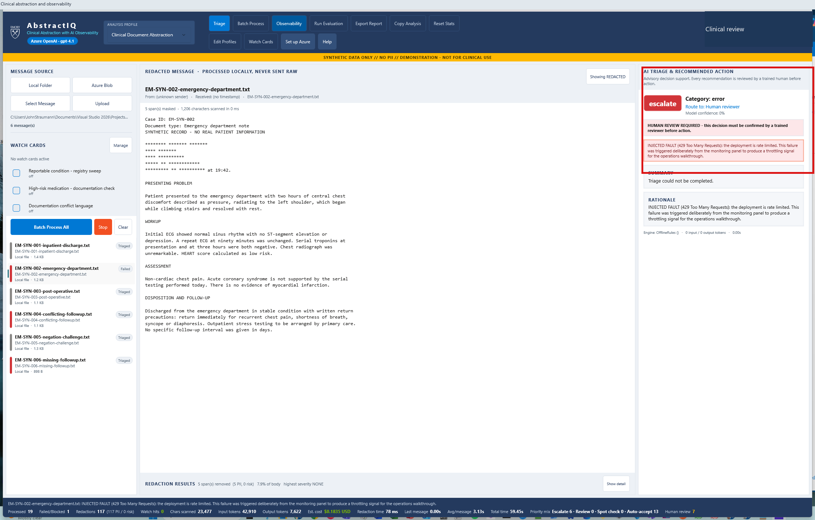
30
The failure surfaces in the abstractor's queue
MONITORING
WHERE TO CLICK
Nothing. Point at the failed card and its priority label.
WHAT THIS PROVES
A failed call is escalated to a human, not silently dropped.
AbstractIQ · Healthcare Organization · synthetic data only, not for clinical use
Notes:
WHAT YOU ARE SEEING
The failed case rendered in the queue, marked at the most urgent clinical priority - "escalate".
WHERE TO CLICK
Nothing. Point at the failed card and its priority label.
WHAT THE SOLUTION IS DOING
Mapping a sentinel failure onto the profile's most urgent review level, so a call that failed outright lands at the top of a human's queue.
BUSINESS BENEFIT TO Demo
The design principle is worth stating plainly: a case the AI could not process is the most urgent thing on the queue, not the least. The failure mode to avoid at all costs is the silent drop, where a case disappears because a call failed and nobody notices until an audit. Here, failure is routed to a human with the same urgency as a clinical escalation. A small confession attached to this screen: this card originally displayed a raw "P1" badge next to clinical levels named "Escalate" and "Auto-accept" - a leftover from the application's previous domain. Caught only by watching the demo. Domain leakage hides in failure paths, because that is where nobody looks.

Slide 44
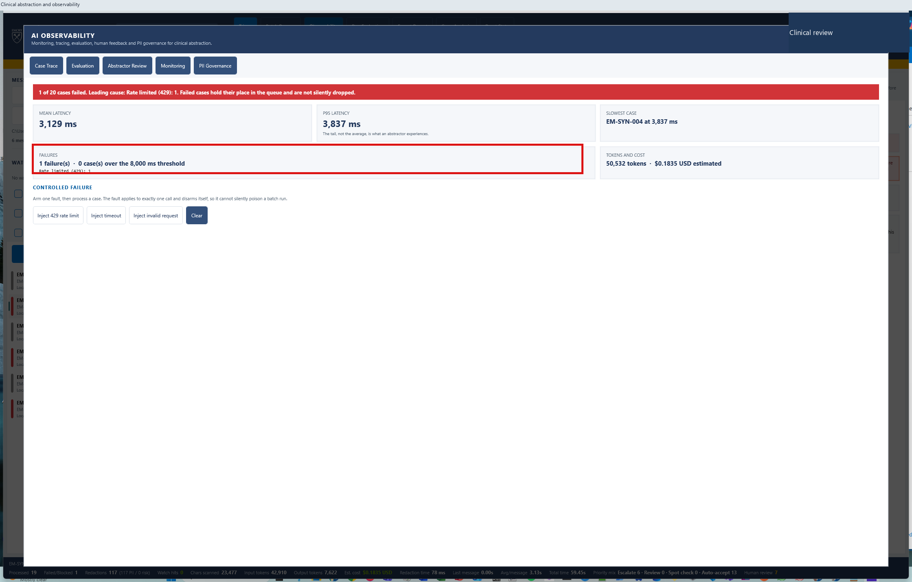
31
One in twenty failed - leading cause named
MONITORING
WHERE TO CLICK
Nothing. Read the failure count and the leading cause.
WHAT THIS PROVES
Failures are counted and attributed by cause, which is what makes an alert actionable.
1 of 20
Failed · leading cause: Rate limited (429)
AbstractIQ · Healthcare Organization · synthetic data only, not for clinical use
Notes:
WHAT YOU ARE SEEING
Monitoring now reports 1 of 20 calls failed, with the leading cause named as "Rate limited (429): 1". Session totals stand at 50,532 tokens and $0.1835.
WHERE TO CLICK
Nothing. Read the failure count, then the leading cause.
WHAT THE SOLUTION IS DOING
Classifying failures by cause rather than counting them as one undifferentiated number.
BUSINESS BENEFIT TO Demo
"Five percent of calls failed" starts an investigation. "Five percent of calls failed, all rate-limited" starts a capacity request - a different conversation, with a different owner and a different fix. Attributing failures by cause is what turns an alert into an action, and it is cheap to do at the point where you already know the error. In Azure Monitor the same breakdown comes from the resultCode column - note that Application Insights promotes http.status_code into resultCode, so it legitimately disappears from customDimensions. That is not a bug, and it will confuse somebody on your team for an afternoon if they do not know it.

Slide 45
PART 8
Ask 5 — PII governance
What was masked, where the trace went, how long it is kept, and who can read it.
Notes:
The second half of ask 5 - the half that governs data already written.
Remind the room that the first half was step 9, before any network call. Masking is prevention; this is control of what was unavoidably retained.
The design point to land: governance posture travels with the trace as attributes, so "was this particular trace masked?" is answered by the trace itself rather than by a policy document describing what should have happened.

Slide 46
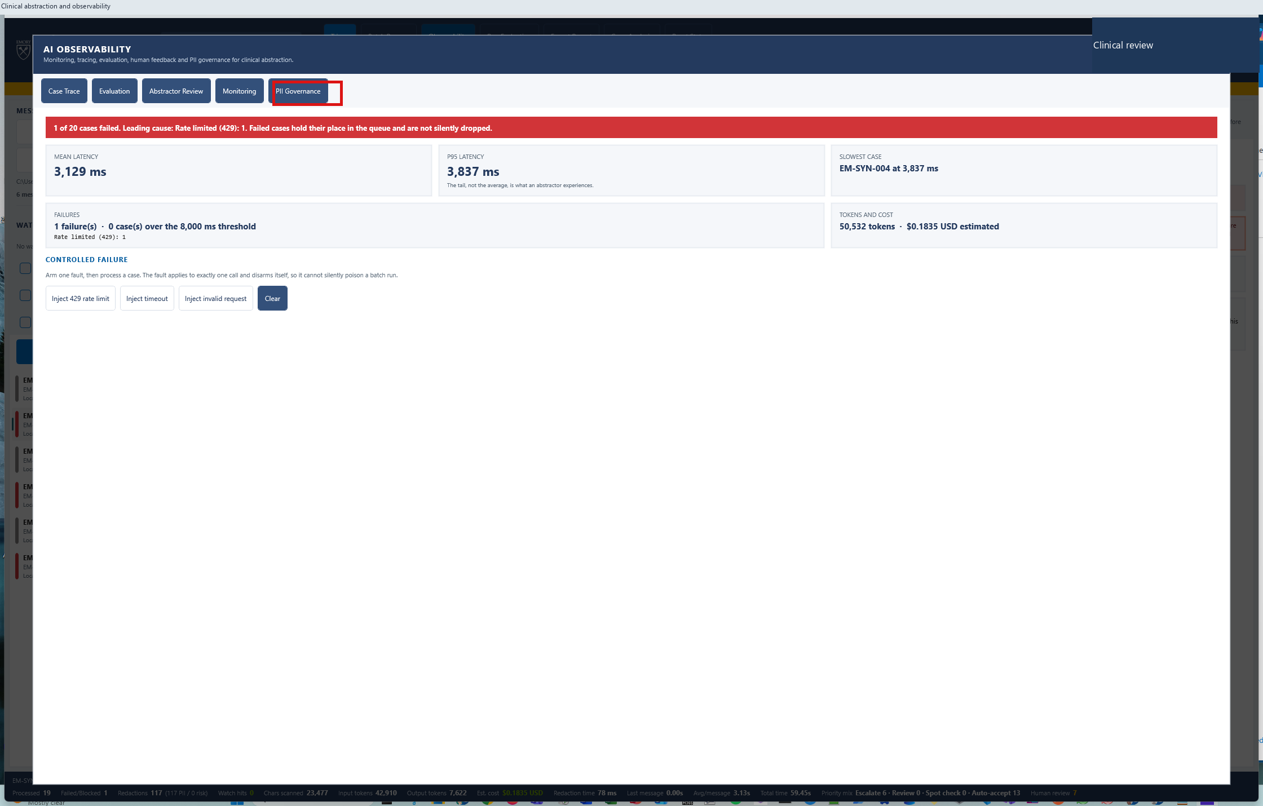
32
Ask 5 - PII governance
PII
WHERE TO CLICK
Observability → "PII Governance" tab.
WHAT THIS PROVES
Governance posture is a surface in the product, not a paragraph in a policy document.
AbstractIQ · Healthcare Organization · synthetic data only, not for clinical use
Notes:
WHAT YOU ARE SEEING
The PII Governance tab opening.
WHERE TO CLICK
The "PII Governance" tab.
WHAT THE SOLUTION IS DOING
Reporting what was masked, what was recorded, where the trace was sent and how long it will be kept - recomputed each time the tab is opened.
BUSINESS BENEFIT TO Demo
A terminology note first: Demo's original request says PHI; throughout this engagement we use PII, Personally Identifiable Information, per John's instruction. The controls are identical either way. The substantive point is that governance posture is a surface in the product rather than a paragraph in a policy document - which means it can be wrong, and therefore noticed. We found exactly that: this tab once reported "Exported so far this session: 0" while Azure had demonstrably received twenty-eight traces, because the panel was built once in the constructor and never refreshed. A governance claim that contradicts reality is worse than no claim at all, because people act on it.

Slide 47
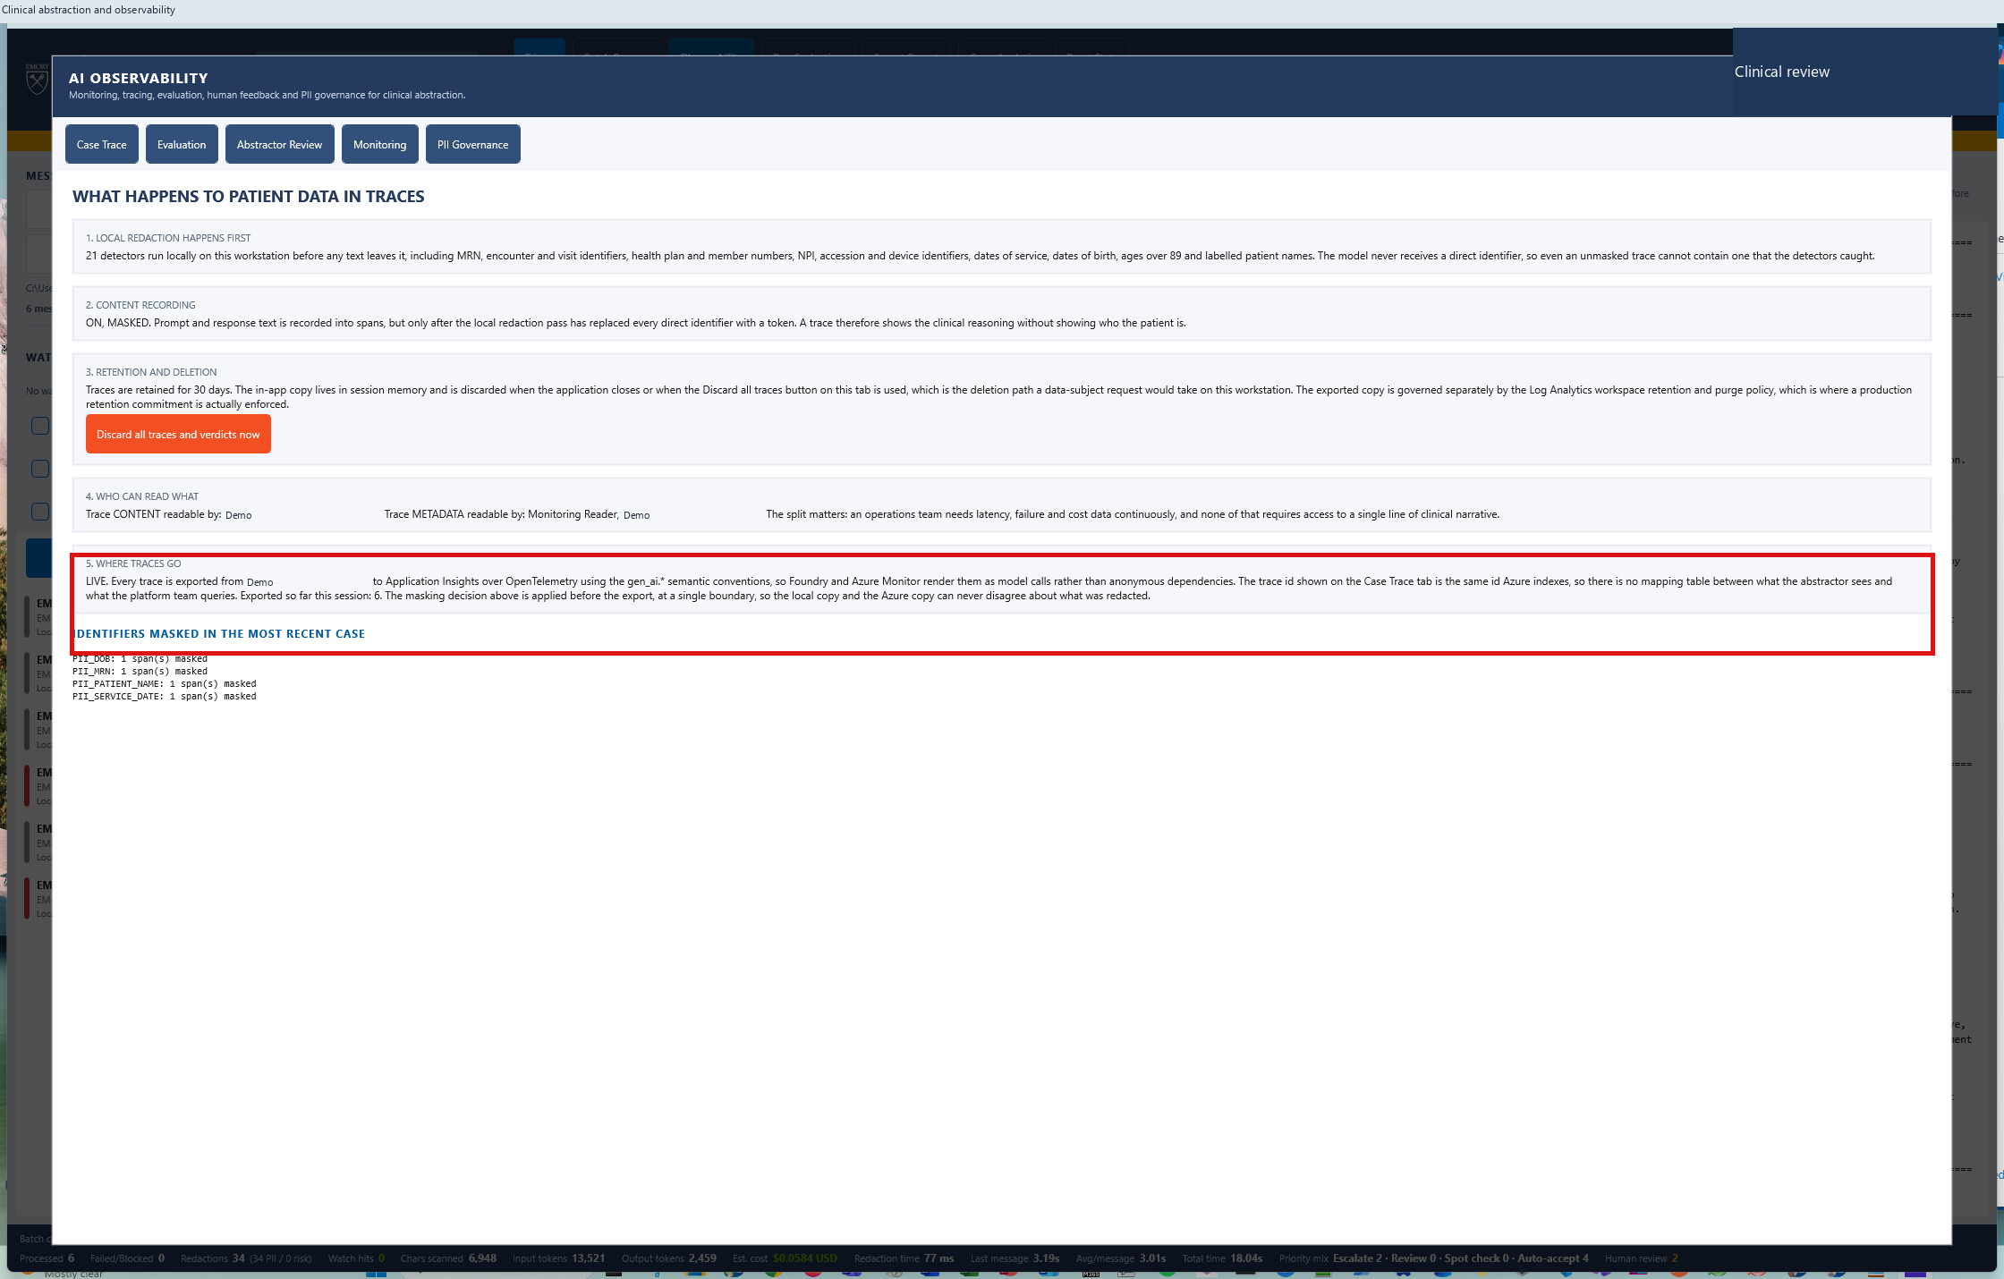
33
What was masked, where it went, how long it is kept
PII
WHERE TO CLICK
Nothing. Walk the numbered items top to bottom.
WHAT THIS PROVES
Masking is pre-network, destination and retention are named, and the authoritative control is Log Analytics.
Pre-network
Masked before the prompt is built
AbstractIQ · Healthcare Organization · synthetic data only, not for clinical use
Notes:
WHAT YOU ARE SEEING
The governance panel: which entity types were detected and masked, that redaction runs locally before any network call, where traces are exported - Application Insights demo-appinsights, surfaced in Foundry project DemoFoundryProject - and that retention and purge of the exported copy are governed by Log Analytics.
WHERE TO CLICK
Nothing. Walk the numbered items top to bottom.
WHAT THE SOLUTION IS DOING
Carrying content_recorded, content_masked and retention_days as attributes on every exported trace, so the posture travels with the data.
BUSINESS BENEFIT TO Demo
That last design choice is the one to copy. When an auditor asks "was this particular trace masked?", the answer comes from the trace itself rather than from a policy document describing what should have happened. Three recommendations follow directly. Split the roles - "can see that a call happened, how long it took and what it cost" and "can read the prompt text" are two different privileges, and most teams grant both with a single Reader role. Split retention - metrics want long retention for trend analysis, prompt content wants short, and one workspace-wide setting cannot serve both. And rehearse the purge path against a known trace id in non-production, documenting the elapsed time, before a regulator asks you to do it for the first time under pressure.

Slide 48
PART 9
The fixed benchmark set
One hundred sepsis records, two deployments, one rubric. The section that settles the AWS versus Azure argument.
Notes:
This section is new, and it exists because of one sentence in Prahlad's note: a run over a fixed test set that scores each answer against the expected answer and compares two model or prompt versions side by side, because that is how Demo will prove the AWS versus Azure comparison.
The structure is four steps and one idea. The idea is that answer accuracy - the metric almost every team tracks - cannot tell these two deployments apart, and a twelve-dimension rubric separates them by twelve points. Everything else in the section is evidence for that claim.
Be honest at step 34 about what the dataset is. It is a synthetic set we built to Prahlad's specification, and the model answers were generated with it rather than produced by a live call during the demo. What runs live is the scoring. Say so plainly and then make the offer: Demo's own 100-record set drops into the same place and runs the same way.
If you are short on time, steps 35 and 37 carry the argument on their own.

Slide 49
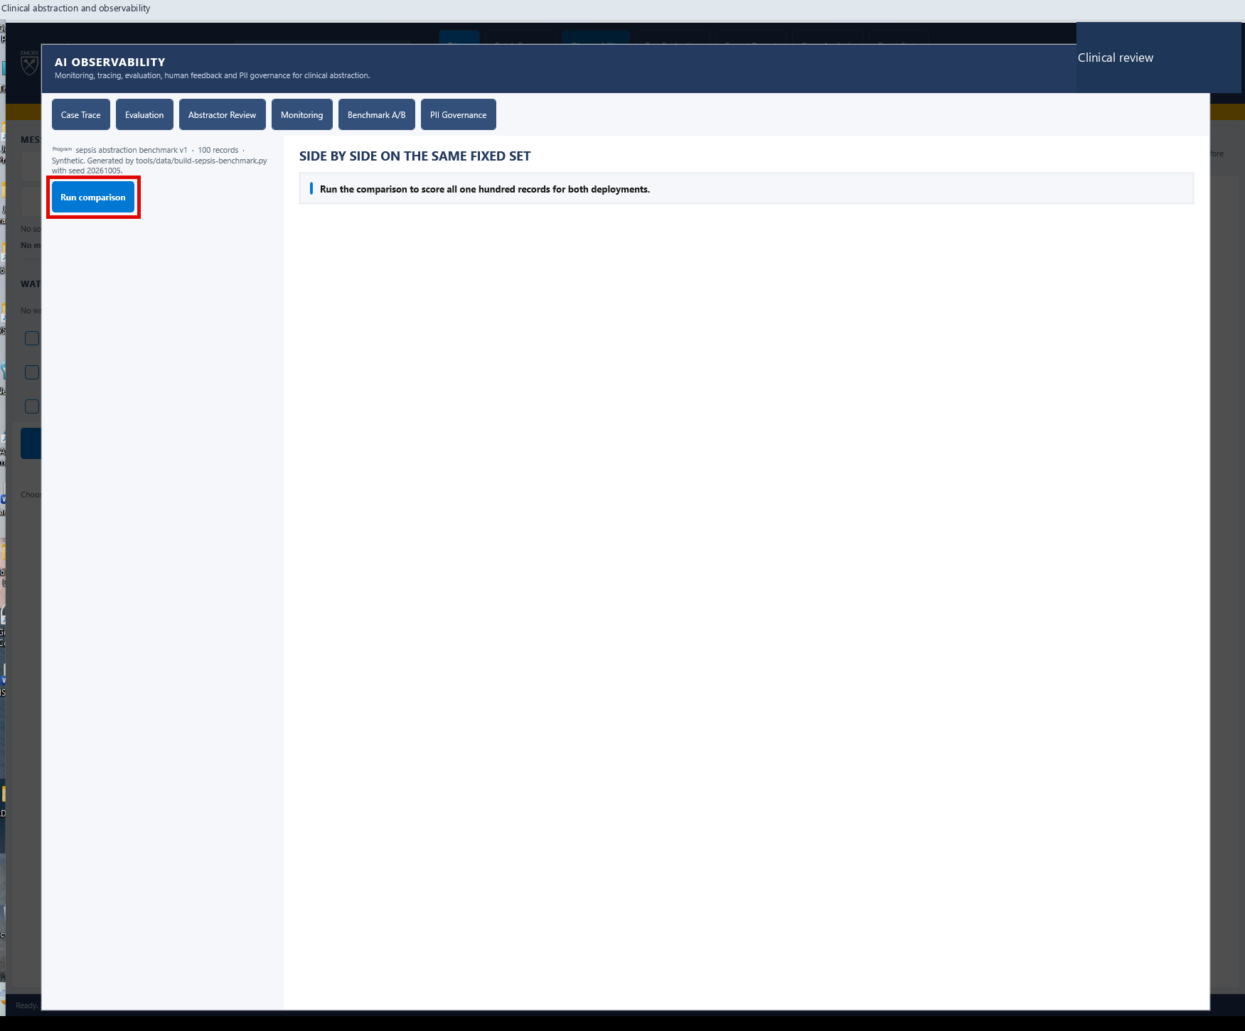
34
A fixed set of 100 sepsis records
EVALUATION
WHERE TO CLICK
Observability → "Benchmark A/B" tab. Read the dataset line, top left.
WHAT THIS PROVES
The test set is fixed, named, versioned and reproducible - the three properties a benchmark needs to settle an argument.
100
Sepsis abstraction records · 74 clean · 26 planted defects
AbstractIQ · Healthcare Organization · synthetic data only, not for clinical use
Notes:
WHAT YOU ARE SEEING
The Benchmark A/B tab before it has been run. The line at top left names the set: Demo sepsis abstraction benchmark v1, 100 records, synthetic, generated by tools/data/build-sepsis-benchmark.py with seed 20261005.
WHERE TO CLICK
Observability, then the "Benchmark A/B" tab. Pause on the dataset line before clicking anything else.
WHAT THE SOLUTION IS DOING
Nothing yet. It has loaded a fixed, immutable set of 100 abstraction records, each carrying the clinical context, a model answer with its explanation, and a separately held answer key.
BUSINESS BENEFIT TO Demo
Be honest with the room about what this set is, because the credibility of everything that follows depends on it. This is a synthetic set we built to the specification in Prahlad's note - 100 sepsis records, 74 correct, 26 containing planted errors of four named types, scored against a twelve-dimension rubric. The model answers were generated with the set; they are not the output of a live call made during this demo. What is live is the scoring: the rubric runs here, in front of you, on this machine. The offer to make explicitly is that Demo's own 100-record set drops into the same place and runs the same way, and we would like to do exactly that as the next step.
Three properties make a benchmark able to settle an argument rather than start one: it is fixed, so a score change means a system change; it is versioned, so a result stays comparable over time; and it is reproducible from a seed, so anyone can rebuild it and check. The AWS-versus-Azure comparison Demo wants to run needs all three, because the conclusion will be contested.

Slide 50
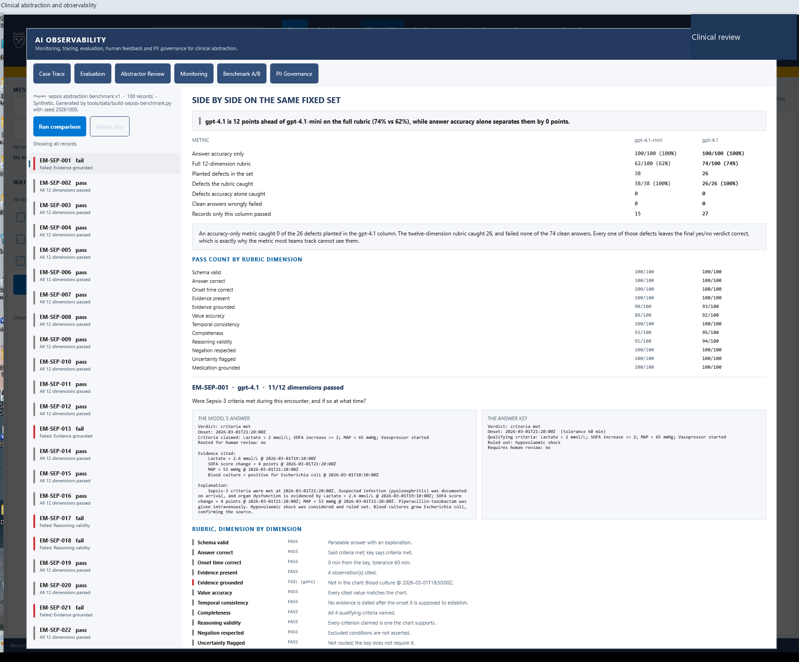
35
Accuracy says the models are identical. They are not.
EVALUATION
WHERE TO CLICK
"Run comparison". Read the first two rows of the table, in that order.
WHAT THIS PROVES
Answer accuracy separates the two deployments by 0 points. The 12-dimension rubric separates them by 12.
74% vs 62%
Rubric · while accuracy reads 100% for both
AbstractIQ · Healthcare Organization · synthetic data only, not for clinical use
Notes:
WHAT YOU ARE SEEING
Both deployments scored against the same 100 records and the same answer key. Read the first two rows in order and let the contrast land before saying anything.
Row one, answer accuracy: gpt-4.1-mini 100/100, gpt-4.1 100/100. On the metric most teams track, the two deployments are indistinguishable.
Row two, the full twelve-dimension rubric: gpt-4.1-mini 62/100, gpt-4.1 74/100. A twelve-point separation that was completely invisible one row above.
Then the rows that explain why. Of the 26 defects planted in the gpt-4.1 column, the rubric caught 26 and accuracy caught 0. Not a few - none. And the rubric wrongly failed 0 of the 74 clean answers, so this is not a sensitive metric firing at everything.
WHERE TO CLICK
"Run comparison", then stop. Read row one aloud, then row two.
WHAT THE SOLUTION IS DOING
Scoring every record on twelve dimensions - schema validity, answer correctness, onset timing, evidence presence, evidence grounding, value accuracy, temporal consistency, completeness, reasoning validity, negation, uncertainty flagging and medication grounding. Six are gates. Each planted defect was constructed to fail exactly one dimension and to leave the final yes/no verdict correct.
BUSINESS BENEFIT TO Demo
This is the single most important slide in the deck, and the reason is uncomfortable. Every one of those 26 defects produces the right final answer. Sepsis criteria met: yes. Onset time: correct. An accuracy metric, a spot-check by a busy reviewer, and a dashboard tracking percentage-correct all report a clean run. The error is in the evidence, the value, the reasoning or the completeness - the parts a human abstractor would be held accountable for if they had written them.
Say the governance consequence out loud: if Demo governs this workload on answer accuracy alone, 26 defective abstractions in 100 pass review unchallenged. The rubric is not a nicety. It is the difference between a quality system that works and one that reports that it works.
And this is the AWS-versus-Azure answer too. Swap a column for Bedrock output on the identical set and the comparison is a table, not an opinion.

Slide 51
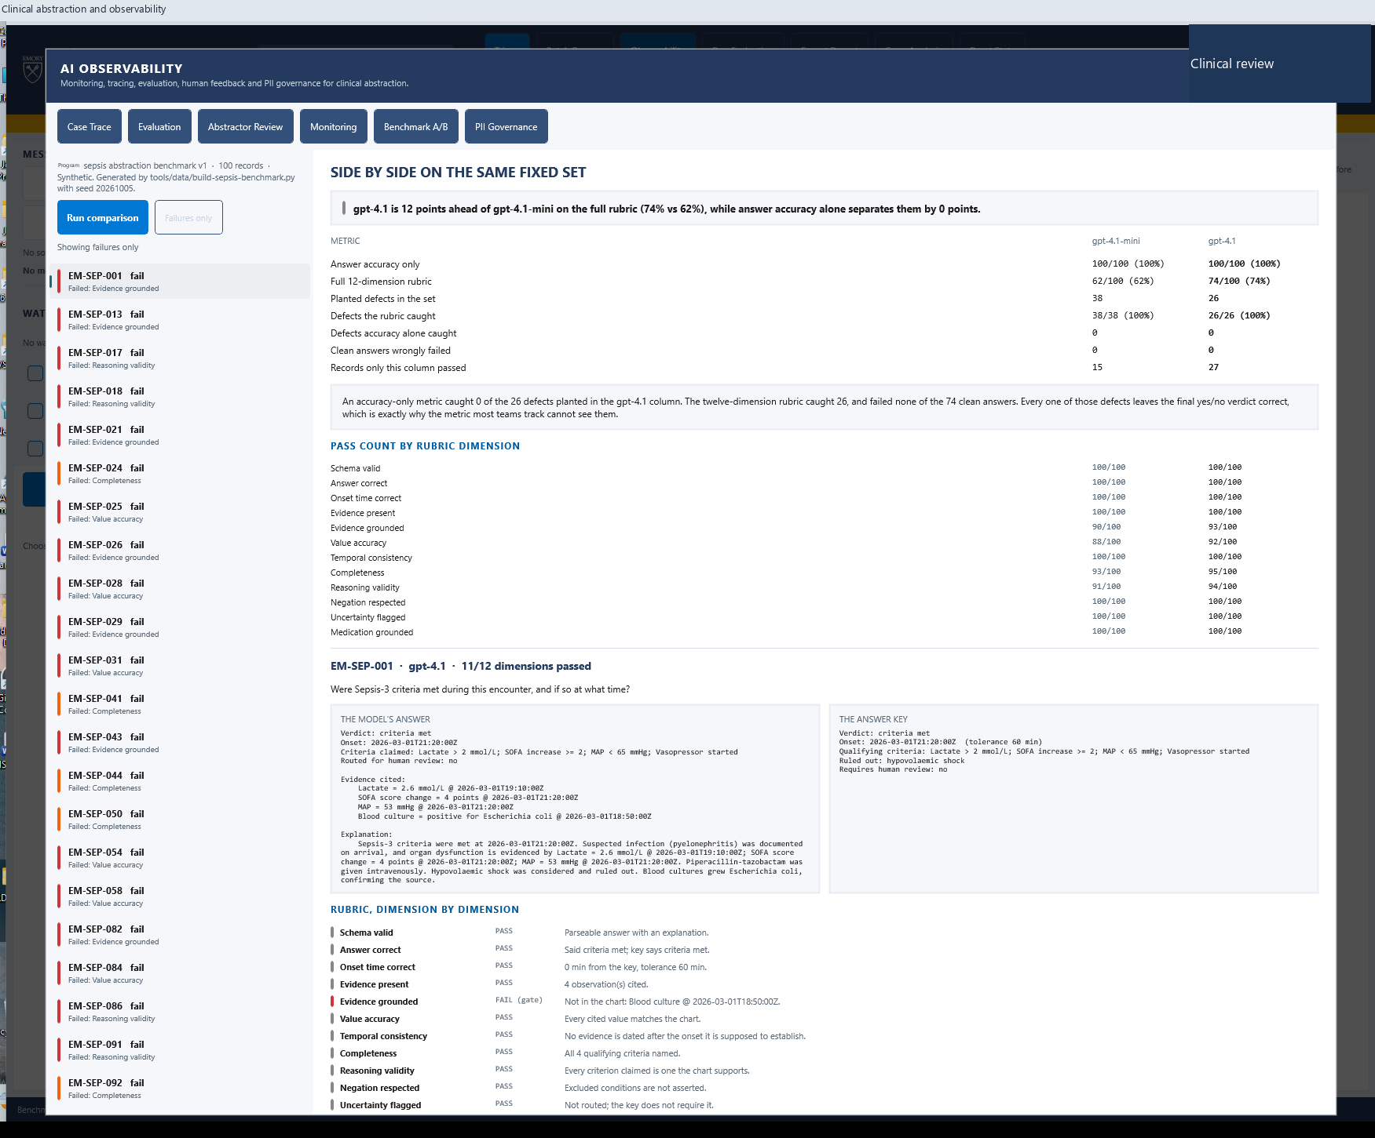
36
Filter to the failures - 26 of 100
EVALUATION
WHERE TO CLICK
"Failures only". Read the failure reason under each record id.
WHAT THIS PROVES
Every failure names the dimension it failed, so a quality finding routes to an owner instead of a meeting.
AbstractIQ · Healthcare Organization · synthetic data only, not for clinical use
Notes:
WHAT YOU ARE SEEING
The list filtered to the 26 records that failed at least one rubric dimension, each labelled with the dimension that failed: evidence grounded, value accuracy, reasoning validity, completeness.
WHERE TO CLICK
"Failures only". Then read four or five reasons down the list without opening any of them.
WHAT THE SOLUTION IS DOING
Grouping failures by dimension rather than presenting one undifferentiated score.
BUSINESS BENEFIT TO Demo
A single quality score tells you something is wrong. A dimension tells you who fixes it, and that distinction decides whether a finding becomes an action or a meeting. Value-accuracy failures are a retrieval and prompt-grounding problem for the engineering team. Reasoning-validity failures are a prompt-design problem the clinical informaticists must own. Completeness failures are usually an output-schema problem. Same headline score, three different owners, three different fixes.
This is also the shape of the report Demo should put in front of a quality committee: not "the model scored 74%", but "the model fails evidence grounding seven times in a hundred, and here are the seven".

Slide 52
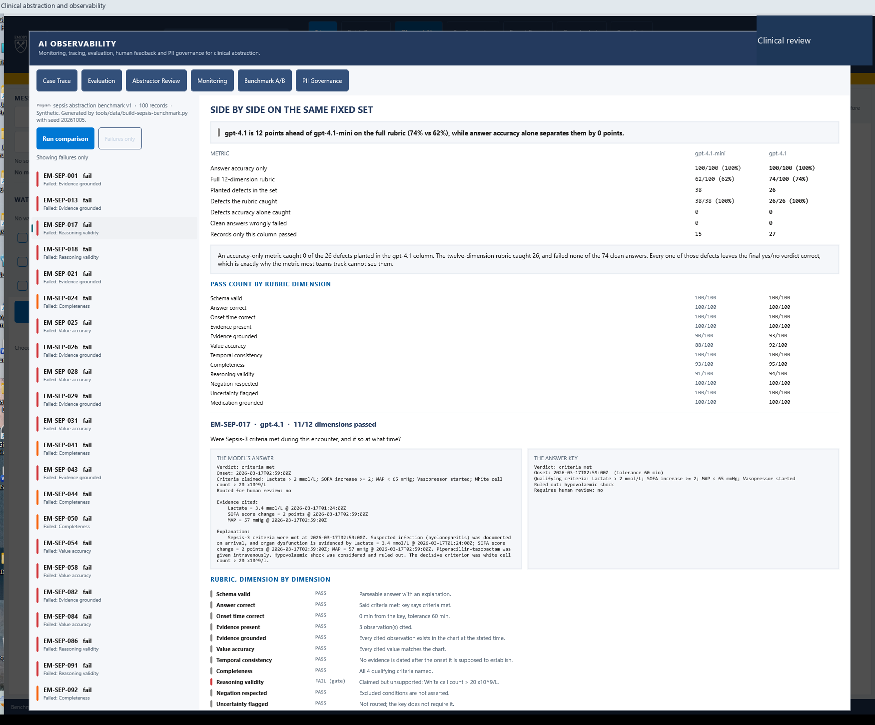
37
The right answer, for a reason that is not in the chart
EVALUATION
WHERE TO CLICK
Click EM-SEP-017. Read the model’s explanation, then the rubric line that failed.
WHAT THIS PROVES
Correct verdict, correct onset, unsupported reasoning - caught by a gate, with the offending clause quoted.
11 of 12
Dimensions passed · the twelfth is the one that matters
AbstractIQ · Healthcare Organization · synthetic data only, not for clinical use
Notes:
WHAT YOU ARE SEEING
Record EM-SEP-017 opened. The verdict is correct - criteria met. The onset time is correct to the minute. Eleven of twelve rubric dimensions pass.
The twelfth is Reasoning validity, and it fails as a gate, with the reason quoted: "Claimed but unsupported: White cell count > 20 x10^9/L." The model named a qualifying criterion that the chart does not support. It reached the correct conclusion by a route that is not in the record.
WHERE TO CLICK
Click EM-SEP-017. Read the model's explanation in the left panel first - it reads as confident, specific and clinically fluent. Then drop to the rubric and read the failed line.
WHAT THE SOLUTION IS DOING
Parsing the explanation into the individual criteria it claims, and checking each one against the charted observations, labs, conditions and medications for that patient. A criterion that is asserted but unsupported fails the gate regardless of whether the final verdict is right.
BUSINESS BENEFIT TO Demo
This is the case to spend time on, because it is the one a human reviewer is most likely to wave through. The answer is right. The time is right. The prose is fluent and clinically plausible. A reviewer checking the verdict against the chart finds agreement and moves on - there are forty more cases in the queue.
What the reviewer has actually approved is an abstraction whose stated justification is not in the patient record. If that abstraction feeds a registry submission, a quality measure or a research cohort, the defect travels downstream attached to a correct-looking answer, and the audit trail says a human agreed with it.
A mechanical check that reads every claimed criterion against the chart does not get tired and does not have forty more cases waiting. Note the design point too: the rubric never sees the planted-error label. It scores from the chart, and the label is only revealed afterwards to count how many it caught.

Slide 53
PART 10
The last two security answers
Where the data physically lives, and who looked at a trace.
Notes:
Two short steps that close the remaining two of Prahlad's five security requirements.
They sit here, after the benchmark section, rather than with the rest of governance at step 33, simply because they were added after the first demo. If you are running the full sequence you may prefer to move them up and show cards 6 and 7 immediately after card 5. The deck works either way.
Neither needs a long build-up. Card 6 names the region, the resource group and the tenant. Card 7 gives them the query. Offer to run it live in the portal if the room is technical.

Slide 54
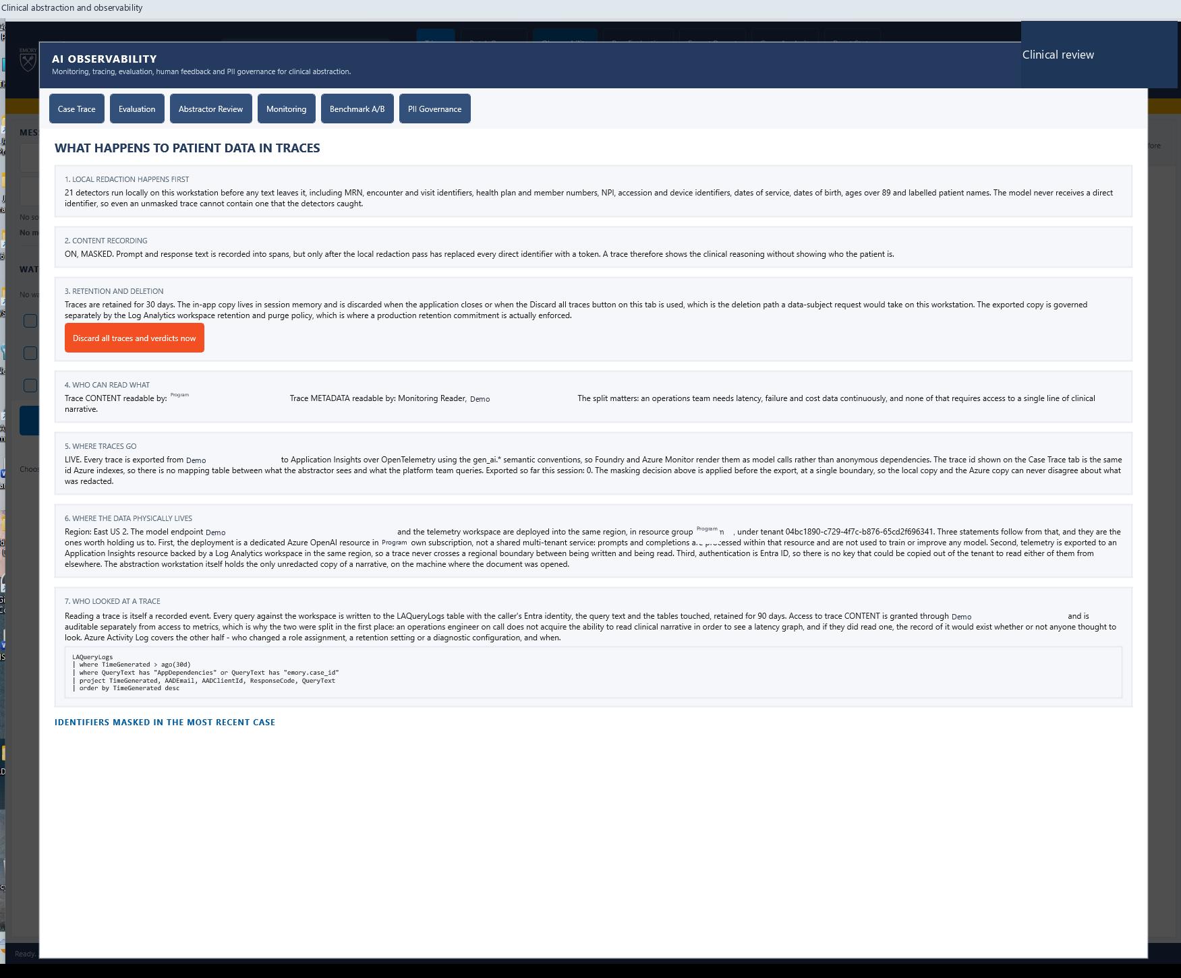
38
Where the data physically lives
PII
WHERE TO CLICK
Observability → "PII Governance". Scroll to card 6.
WHAT THIS PROVES
Model endpoint and telemetry are in one named region, one named resource group, one named tenant.
East US 2
Model + telemetry · same region · Demo tenant
AbstractIQ · Healthcare Organization · synthetic data only, not for clinical use
Notes:
WHAT YOU ARE SEEING
Governance card 6, "Where the data physically lives". It names the region, the model endpoint, the resource group and the tenant id, and then makes three statements that follow from them.
WHERE TO CLICK
The "PII Governance" tab, then scroll to card 6.
WHAT THE SOLUTION IS DOING
Reading the configured endpoint, region and tenant and reporting them, rather than asserting a residency claim that nobody can check.
BUSINESS BENEFIT TO Demo
This answers the fourth of the five security requirements directly: show where the data physically lives, and confirm the model endpoint and telemetry stay within our tenant.
Three statements worth holding us to. First, the deployment is a dedicated Azure OpenAI resource in Demo's own subscription, not a shared multi-tenant service - prompts and completions are processed within that resource and are not used to train or improve any model. Second, telemetry is exported to an Application Insights resource backed by a Log Analytics workspace in the same region, so a trace never crosses a regional boundary between being written and being read. Third, authentication is Entra ID, so there is no key that could be copied out of the tenant to read either of them.
The fourth statement is the one to say out loud even though it is not on the screen: the abstraction workstation itself holds the only unredacted copy of a narrative, on the machine where the document was opened. Residency is an end-to-end property, and the endpoint is only part of it.

Slide 55
39
Who looked at a trace
PII
WHERE TO CLICK
Scroll to card 7. Read the KQL.
WHAT THIS PROVES
Reading a trace is itself a recorded event, attributable to an Entra identity, retained 90 days.
LAQueryLogs
Every query, every caller, 90 days
AbstractIQ · Healthcare Organization · synthetic data only, not for clinical use
Notes:
WHAT YOU ARE SEEING
Governance card 7, "Who looked at a trace", and the KQL beneath it. Every query run against the workspace is written to LAQueryLogs with the caller's Entra identity, the query text itself and the tables touched.
WHERE TO CLICK
Scroll to card 7 and read the query. If the room is technical, offer to run it in the portal.
WHAT THE SOLUTION IS DOING
Nothing bespoke - and that is the point. This is a platform capability that is on by default. The card tells you where to look and gives you the query.
BUSINESS BENEFIT TO Demo
This closes the fifth security requirement: show audit logging of who viewed traces. The design point behind it is the one worth copying. Access to trace content is granted through a single named role, Demo-AI-Trace-Content-Reader, separately from access to metrics - which is why an on-call engineer looking at a latency graph does not thereby acquire the ability to read clinical narrative. And if they did read one, the record of it exists whether or not anyone thought to look.
Azure Activity Log covers the other half of the question: who changed a role assignment, a retention setting or a diagnostic configuration, and when. Between the two, "who could see this, who did see it, and who changed the rules" is answerable from platform logs rather than from a policy document.
One practical recommendation: rehearse this query against a known trace id in non-production, with a stopwatch, before a regulator asks you to do it for the first time under pressure.

Slide 56
PART 11
In the Azure portal
Demo asked: "it seems to me we will need to click around in Foundry to show some of these things?" Correct. Roughly half of each capability lives here.
Notes:
Transition slide. Say this plainly: the application half of the story is finished; this is the platform half.
A practical note for whoever presents. These portal screens require an interactive Entra sign-in as the demo-tenant account, which could not be automated unattended, so these slides carry the exact navigation path and the real verified numbers rather than captured images. Run tools\browser\portal.js --signin once, sign in, then run portal.js, and it will drop eight live screenshots into the DemoShots folder that you can paste onto these slides. Everything quoted on them is real data already confirmed against the tenant.
Decide in advance whether you are driving the portal live. Live is more convincing and risks a slow blade or an expired token. If the audience is technical, drive it live. If it is a mixed clinical and executive audience, use these slides and offer the live portal as a follow-up session for the platform team.

Slide 57
Foundry: the project and its deployments
SETUP
ai.azure.com → project DemoFoundryProject → Models + endpoints
WHERE TO CLICK
WHAT TO POINT AT
Open ai.azure.com and select project DemoFoundryProject.
Left navigation → "Models + endpoints".
Point at the two deployments: gpt-4.1 and gpt-4.1-mini.
Open gpt-4.1 to show version 2025-04-14, GlobalStandard, capacity 100.
The deployment name here - gpt-4.1 - is the same string configured in the application in step 2, and the same string that appears on every trace and every evaluation result.
gpt-4.1-mini exists deliberately: the test set can be re-run against a cheaper model and the two scores compared directly, because the evaluators and the labels do not change. That is the clean way to answer "could we use a smaller model for this?" with evidence instead of opinion.
AbstractIQ · Healthcare Organization · synthetic data only, not for clinical use
Notes:
WHAT YOU ARE SEEING
The Models + endpoints blade of the Foundry project, listing both model deployments.
WHERE TO CLICK
ai.azure.com, select DemoFoundryProject, then "Models + endpoints" in the left navigation, then open gpt-4.1.
WHAT THE SOLUTION IS DOING
Nothing - this is the platform view of the deployment the application has been calling throughout the demo.
BUSINESS BENEFIT TO Demo
Two points. First, continuity: the deployment name on this blade is the same string in the application's configuration and on every trace and evaluation result, which is what makes "which model produced this answer?" a one-query question months later.
Second, the second deployment is the model-comparison story. Because the test set, the labels and the evaluators are all independent of the model, Demo can re-run the whole suite against gpt-4.1-mini and read the quality difference directly, then weigh it against the cost difference from the KQL two slides on. That is the structured way to make model-selection decisions, and it is only available to organisations that built the test set first. Worth saying out loud: the test set is what converts model choice from a procurement argument into a measurement.

Slide 58
Foundry Tracing: the same trace, in the platform
ASK 2 · TRACING
Project → Tracing. Backed by the demo-appinsights connection on the project.
WHERE TO CLICK
WHAT TO POINT AT
Left navigation → "Tracing".
Point at the list - one row per abstraction, named clinical_abstraction.
Open any row and expand the gen_ai.chat.completions span.
Paste a trace id from the application's Case Trace tab into the search box.
Foundry's Tracing tab is backed by an Application Insights connection on the project - in this build, a connection named demo-appinsights. That connection is the entire integration.
The span renders as a model call, with prompt, response, token counts and latency, because it carries gen_ai.* semantic convention attributes. Namespace those attributes yourself and this view stays empty - which was defect 5 in our build.
The trace id pasted from the application resolves here directly: same id, no mapping table.
AbstractIQ · Healthcare Organization · synthetic data only, not for clinical use
Notes:
WHAT YOU ARE SEEING
The Foundry Tracing tab showing the spans the application exported - the same traces the abstractor saw in step 14, rendered by the platform.
WHERE TO CLICK
Left navigation, "Tracing". Then open a row and expand gen_ai.chat.completions. The strongest move is to copy a trace id off the application's Case Trace tab and paste it into the search box here, so the room sees the same case in both places.
WHAT THE SOLUTION IS DOING
Nothing at this moment. The application exported these spans during the batch run; Foundry is reading them from the connected Application Insights resource.
BUSINESS BENEFIT TO Demo
This is the answer to ask 2, and the honest sub-text is worth stating. Until we wrote a telemetry exporter, this tab would have been completely empty during the demo - with no error anywhere. The application had a perfectly good internal trace and simply never transmitted it. "We have tracing" and "our traces are in Azure" are different claims, and the gap between them is silent.
Also stress the connection: one Application Insights connection on the project is all that links the two. It is cheap to set up and easy to forget, and without it this tab is blank no matter how well instrumented the application is. Put it on Demo's deployment checklist.

Slide 59
Application Insights: token and cost aggregation
ASK 1 · MONITORING
portal.azure.com → demo-appinsights → Logs. This query is verified against the demo data.
WHERE TO CLICK
WHAT TO POINT AT
portal.azure.com → resource demo-appinsights → "Logs".
Paste the query and run it.
Then open "Failures" and group by resultCode to show the injected 429.
Optionally pin the result to a shared dashboard or workbook.
dependencies
| where name == 'gen_ai.chat.completions'
| summarize calls=count(),
inputTokens=sum(toint(customDimensions['gen_ai.usage.input_tokens'])),
outputTokens=sum(toint(customDimensions['gen_ai.usage.output_tokens'])),
avgLatencyMs=round(avg(duration))
by model=tostring(customDimensions['gen_ai.request.model'])
Verified result from the demo tenant:
gpt-4.1 · 26 calls · 58,778 input · 10,358 output · 3,173 ms average
This query only works because the exporter writes token counts as numbers. They were originally exported as display strings - "2,293" with a thousands separator - so every chart rendered and every sum() returned null.
AbstractIQ · Healthcare Organization · synthetic data only, not for clinical use
Notes:
WHAT YOU ARE SEEING
Log Analytics running the cost and latency aggregation over the exported spans. The numbers on the slide are real, from the capture run.
WHERE TO CLICK
portal.azure.com, resource demo-appinsights, "Logs". Paste the query and run it. Then open the "Failures" blade and group by resultCode to show the injected 429 from step 29.
WHAT THE SOLUTION IS DOING
Nothing live - this is Log Analytics aggregating telemetry the application exported earlier.
BUSINESS BENEFIT TO Demo
This slide is the complete answer to "token cost". Note what it depends on, because both dependencies are application-side and both failed in our build before they worked. First, the attribute keys must be the standard gen_ai.* names, or they do not line up with anything and the built-in views stay empty. Second, the values must be numbers. Ours were formatted display strings, because the same value fed a UI label - every chart rendered perfectly and every sum returned null. Demo's exact question was unanswerable until we coerced tokens, cost and duration to numbers at the export boundary.
Then make the forward-looking point: this query groups by model, but it will group by anything the application emits and nothing it does not. If Demo wants cost attributed by department, service line or study, those dimensions must be on the span from the first production call. Telemetry is not retroactive. Decide the attribution dimensions before go-live.
Finally, Azure knows token counts but not Demo's negotiated rate. Pin the rate in configuration, compute cost at export time, and version it - so a rate change does not silently rewrite history.

Slide 60
Retention, purge and access control
ASK 5 · PII
The authoritative controls for exported trace content live in Log Analytics, not in the application.
WHERE TO CLICK
WHAT TO POINT AT
portal.azure.com → workspace demo-logs → "Usage and estimated costs" → "Data Retention".
Set workspace retention, then show per-table retention for the tables holding prompt content.
Then demo-appinsights → "Access control (IAM)" → show role assignments.
Describe the purge API against a known trace id - do not run it live.
Three recommendations, in priority order.
Split the roles. "Can see that a call happened, how long it took and what it cost" and "can read the prompt text" are different privileges. Most teams grant both with one Reader role.
Split retention. Metrics want long retention for trend analysis; prompt content wants short. One workspace-wide setting cannot serve both - route content to its own table or workspace.
Rehearse the purge. Run it against a known trace id in non-production and document the elapsed time, before a regulator asks.
AbstractIQ · Healthcare Organization · synthetic data only, not for clinical use
Notes:
WHAT YOU ARE SEEING
The Log Analytics retention blade and the Application Insights access control blade - the two places where a production commitment about trace content is actually enforced.
WHERE TO CLICK
Workspace demo-logs, "Usage and estimated costs", then "Data Retention". Then the Application Insights resource, "Access control (IAM)". Talk through the purge API; do not run it live.
WHAT THE SOLUTION IS DOING
Nothing. This is the governance layer behind the application's PII Governance tab, and the application now says so explicitly - it states that the exported copy is governed by Log Analytics retention and purge, rather than making its own retention claim it cannot enforce.
BUSINESS BENEFIT TO Demo
Make the architectural point first: you cannot redact your way out of a trace that has already left the building. Retention and RBAC govern data already written; masking is the only control that operates before Azure sees the text. That is why step 9 came before this slide, and why masking belongs in the application rather than in a telemetry pipeline.
Then the three recommendations on the slide. The role split is the one most often skipped and the one an auditor is most likely to ask about: today, most teams can read every production prompt with a single broadly granted Reader role. Narrow it, audit it, and time-box it.
One tenant finding to pass to Demo's platform team: the roles "Azure AI User" and "Azure AI Project Manager" do not exist in the demo tenant - only "Cognitive Services OpenAI User" was assignable. Confirm role availability in Demo's own tenant early, because RBAC design is where this split actually gets implemented and you cannot design around roles you do not have.
Finally, confirm the Business Associate Agreement and data residency for every service in the path - Application Insights and Log Analytics included, not just the model.

Slide 61
PART 12
The four decisions
Prahlad asked the demo to settle four questions. Each gets a one-word answer first, and the qualification second.
Notes:
This section exists because of question 2 in Prahlad's note. He did not ask for a feature tour - he asked the demo to help Demo make four specific decisions. Answer them in his words, in his order, and resist the urge to hedge in the headline.
A note on tone. Two of these four answers are qualified, and one is a straight no-with-a-caveat. That is deliberate. A vendor who answers four out of four with an unqualified yes is not being useful, and the room will discount everything else accordingly.

Slide 62
Can Azure replace self-hosted Langfuse?
DECISION 1
Yes for everything Demo listed under "success looks like", with one component you build rather than buy.
What Langfuse gives you today | The Azure equivalent | Verdict
LLM-aware trace view: prompt, context, response, tokens, latency | Microsoft Foundry → Tracing, over App Insights | Equivalent
Search a trace by your own id | App Insights / Log Analytics KQL on the trace id and Demo.case_id | Equivalent
Dashboards: latency, errors, token use, cost, per app per day | Azure Monitor metrics + Workbooks over the same spans | Stronger - alerting and on-call are already there
Datasets and evaluation runs over a fixed test set | Foundry Evaluations, plus the in-app rubric you saw at step 35 | Equivalent, and the rubric is yours to extend
Human annotation queue bound to a trace | No Azure-native equivalent. Built into the application - step 21 onward | Build, not buy. Roughly two weeks.
Self-hosting: VMs, Postgres, ClickHouse, upgrades, on-call | None of it. Managed service inside the Demo tenant. | Removed
AbstractIQ · Healthcare Organization · synthetic data only, not for clinical use
Notes:
The honest answer is yes, with one asterisk, and the asterisk is the same one that applies to Langfuse-plus-Label-Studio: the human review queue is something you build.
Walk the table top to bottom. The first four rows are parity or better - and "stronger" in row three is not marketing. Demo already runs Azure Monitor for other workloads, which means alert rules, action groups, on-call rotations and incident process already exist. An AI workload joins that estate rather than creating a second, parallel operational surface that somebody has to watch separately.
Row five is the honest gap, and we will spend a whole slide on it next.
Row six is the one the platform team will feel most. Self-hosted Langfuse at Demo's scale means Postgres, ClickHouse, object storage, the application tier, and then the patching, upgrades, backup verification and on-call that go with them - for an observability system that is itself a PHI-adjacent data store requiring its own access review and its own BAA posture. That burden does not shrink as the AI estate grows; it grows with it.
One caveat to raise before the room does. If Demo runs models outside Azure - and the Bedrock estate may not go away entirely - Langfuse's provider-neutrality has real value. The pragmatic recommendation is instrument with OpenTelemetry gen_ai.* conventions, which both consume, and keep the export destination a configuration decision rather than an architectural one.

Slide 63
Do we need Label Studio?
DECISION 2
Probably not for this workflow - and the reason is about where the verdict lives, not about features.
Label Studio
In-app review
A general annotation platform. Strong at bounding boxes, spans, multi-annotator agreement and complex labelling taxonomies.
What you saw at steps 21 to 26. The abstractor sees the case, the answer, the evidence and the trace, and records agree or disagree with a reason.
Its unit of work is a task drawn from a dataset. Binding a verdict back to a specific production trace id and prompt version is integration work you would own.
The verdict is written with the trace id, the question id and the model version already attached, because the application knows all three at the moment of the click.
Reviewers will not use a second application. The review has to be where the work already is.
AbstractIQ · Healthcare Organization · synthetic data only, not for clinical use
Notes:
Answer the question as asked: probably not, for this workflow. Then give the reason, which is not a feature comparison.
The abstractor is already in an application, looking at a case, reading an answer and its evidence. Asking them to switch to a second tool to record whether they agree adds a context switch to every single case. Agreement data is only valuable if it is complete and continuous, and a review step that is slightly inconvenient produces data that is neither. We have all seen the annotation queue that was enthusiastically adopted for three weeks.
The structural argument is stronger than the usability one. When the verdict is recorded inside the application, the trace id, the question id and the model or prompt version are attached automatically, because the application already knows them. That is precisely what makes "agreement rate by question and by model version" a query rather than a project - which is exactly the report Prahlad asked for under success criteria.
Be fair about where Label Studio wins, because somebody in the room may already use it. If Demo needs span-level annotation inside clinical text, multi-annotator agreement statistics with adjudication workflow, or a complex evolving label taxonomy maintained by a data-science team, it is a genuinely better tool and the integration cost is worth paying. For a binary verdict plus a reason code bound to a production trace, it is a second system to run, secure and keep in sync.
Recommendation: start in-app, because it is two weeks and it is where the reviewers already are. Revisit if the annotation requirement grows past a verdict and a reason.

Slide 64
What does it cost at your volume?
DECISION 3
The observability is the rounding error. The model calls are the bill - and that is the good news.
Abstraction cases per month | 1,000 | 10,000 | 50,000
Model calls - gpt-4.1 | $20.80 | $208 | $1,040
Model calls - gpt-4.1-mini | $4.16 | $41.60 | $208
Telemetry ingestion - every span, prompt and response | included | included | included
Log Analytics retention beyond 31 days | under $1 | under $1 | under $1
Total, gpt-4.1 with full tracing on | $20.80 / mo | $208 / mo | $1,040 / mo
Tracing every case at full fidelity stays inside the 5 GB per month that Azure Monitor includes at no charge until roughly 870,000 cases a month. At Demo’s plausible volumes, turning tracing on is free; turning it off saves nothing and costs you the ability to answer questions.
Assumptions: 8,000 input and 600 output tokens per case; 6 KB of telemetry per case across seven spans with prompt and response recorded; Azure list prices, East US 2, October 2026. Demo’s negotiated rates and real token counts replace these on day one.
AbstractIQ · Healthcare Organization · synthetic data only, not for clinical use
Notes:
Give the headline before the table: at Demo's volumes the observability is effectively free, and the model calls are the entire bill.
Walk the rows. At ten thousand cases a month, gpt-4.1 is about two hundred dollars of inference. The telemetry for those same ten thousand cases - every span, every prompt, every response - is sixty megabytes, which sits inside the five gigabytes a month Azure Monitor includes at no charge. The crossover is somewhere around eight hundred and seventy thousand cases a month, and above it the marginal cost is $2.76 a gigabyte.
The decision that follows is the useful one. Teams routinely sample traces, or record metadata only, to control observability cost. At this scale that trade-off does not exist. Record everything, because the thing you will want to investigate is by definition the case you did not anticipate, and sampling is how you discover that you did not keep it.
Two qualifications to state plainly. These are list prices and generic assumptions - the honest version of this table uses Demo's negotiated rates and the token counts from your own first week, and we would rebuild it with you. And the comparison worth making is not Azure versus Bedrock on inference price alone, but total cost including what you stop running: the Langfuse infrastructure, its Postgres and ClickHouse tiers, its backups, its upgrades and its on-call. That is a real number in your environment, and it is one Demo can calculate more accurately than we can.
If anyone asks about Provisioned Throughput Units: PTUs become interesting when sustained load makes reserved capacity cheaper than per-token billing, and they also remove the 429 rate limiting you saw at step 29. At the volumes on this slide, pay-as-you-go is the right starting point.
This slide is the planning estimate, built on generic assumptions. The next slide is the same question answered live by the application from the cases you processed in the room. Show them in that order - estimate first, then measurement - and be clear about which is which.

Slide 65
Cost at your volume - computed live, from your own cases
DECISION 3, IN THE APPLICATION
The panel does not quote a price list. It averages the tokens your cases just consumed and multiplies.
Abstraction cases per month | 1,000 | 10,000 | 50,000
Model inference - measured at 2,260 in / 398 out tokens per case | $9.63 / mo | $96.30 / mo | $482 / mo
Telemetry ingestion - 6 KB per case, every span, prompt and response | included | included | included
Log Analytics retention at 30 days | $0.00 | $0.00 | $0.00
All-in, per year | $116 | $1,156 | $5,778
All-in, per abstraction | $0.0096 | $0.0096 | $0.0096
The free ingestion allowance covers about 874,000 cases a month at this trace size. Below that, recording every prompt and every response costs nothing - so the usual reason teams sample traces or drop content simply does not apply at Demo’s volumes.
Every per-case input above is measured in the room, not assumed. The only figure typed in is the monthly volume - and it is Demo’s to type.
AbstractIQ · Healthcare Organization · synthetic data only, not for clinical use
Notes:
Show this live. Do not present this slide instead of the panel - present it after, or use it only if you are out of time.
Where it is: the observability overlay, Monitoring tab, below the latency and failure cards. "Cost at our volume."
How to run it: ask the room for their monthly abstraction volume, type it into the box, and click Project. The three cards and the breakdown recompute in front of them.
Why it persuades, and this is the whole point of the panel: every per-case input is measured rather than assumed. The token averages come from the six cases you processed earlier in this same session - the panel says so on screen, naming the case count, the token means and the prices it used. The single number that is not measured is the monthly volume, and that one is theirs. A cost projection whose inputs are visible can be argued with line by line, which is the only kind that survives a finance review.
Three things to point out while it is on screen.
The free allowance line. At six kilobytes a case, the five gigabytes a month Azure Monitor includes covers roughly 874,000 cases. That is the sentence that kills the sampling conversation before it starts - teams routinely sample traces to control observability cost, and at this scale the trade-off does not exist.
The privacy switch has a price, and the panel shows it. Turning content recording off on the Governance tab drops telemetry from six kilobytes a case to one and a half. At these volumes both are free, which is worth saying out loud: the decision about recording prompt and response content is a privacy decision, and Demo should make it on privacy grounds, because cost is not pulling against it.
The self-hosted comparison at the bottom is labelled an assumption and should be read that way. We do not know what Demo's Langfuse costs them. Invite them to replace the two numbers. The durable point is structural rather than numeric - the managed column has no engineering-time row at all.
One honest caveat, and raise it before the room does. The token counts come from six short synthetic narratives. A real Demo chart extract is considerably larger - the previous slide assumes eight thousand input tokens, and that is the more realistic planning figure. Say plainly that this panel proves the method and the previous slide sizes the bill, and that the first week of real traffic replaces both.

Slide 66
What does it take to set up, and who maintains it?
DECISION 4
The platform is a day. The application instrumentation is the work - and it is where every defect we found lived.
Component | To stand up | Who owns it afterwards | Ongoing load
Log Analytics workspace, App Insights, Foundry project | Under a day. It is resource creation. | Platform / cloud team | Effectively none - managed service
Entra roles, retention and purge policy, diagnostic settings | 1-2 days with security review | Security + platform, jointly | An access review on the existing cadence
gen_ai.* instrumentation in the abstraction application | 1-2 weeks, and this is the real work | The application team | Changes when the app changes
Evaluation rubric and the fixed test set | 2-3 weeks. Clinical informatics must author it. | Clinical informatics, not engineering | Reviewed as practice changes
In-app human review queue | About 2 weeks | The application team | Low
Dashboards, alert rules, on-call integration | 2-3 days | Platform team, existing process | Joins the existing rotation
Nobody maintains a server. The maintained artefacts are the instrumentation, the rubric and the test set - and the rubric is a clinical asset, not an engineering one.
AbstractIQ · Healthcare Organization · synthetic data only, not for clinical use
Notes:
The question has two halves and the second one matters more. Take the setup half quickly and spend the time on ownership.
Setup: the Azure platform is close to trivial - a Log Analytics workspace, an Application Insights resource, a Foundry project, some role assignments. Under a day of real work, and it is resource creation rather than engineering.
The work is rows three and four, and they belong to two different teams.
Row three, instrumentation, is one to two weeks and it is where every defect in Part 13 lived. Not one of our nine defects was in Azure. They were in the exporter, the stopwatch, the evaluator and the attribute names. Budget for the verification step explicitly - reading the telemetry back out of Azure and confirming it answers the question you built it to answer - because that is how six of the nine were found, and it is the step that gets cut when a date is close.
Row four is the one to be firm about. The rubric is a clinical artefact. Engineering can build the scoring harness, but only clinical informatics can decide what "evidence grounded" or "reasoning validity" means for a sepsis abstraction at Demo, and only they can sign off a change to it. If engineering owns the rubric, it will drift towards what is easy to compute rather than what matters clinically, and the quality committee will stop trusting it. Name an owner in clinical informatics on day one.
Maintenance, stated plainly so it can be quoted: nobody patches a server, nobody upgrades a database, nobody is on call for the observability system itself. The maintained artefacts are the instrumentation, the rubric and the test set. Compare that honestly with the self-hosted Langfuse run-book Demo maintains today.

Slide 67
The five security requirements, and where each one is shown
SECURITY
Prahlad listed five. Each is a step in the demo rather than a statement in a document.
Requirement | Where it is demonstrated | What backs it in production
Access control on traces - app team and named reviewers only | Step 33, governance card 4 | Two separate Entra roles: trace CONTENT and trace METADATA
Masking or redaction of prompts and responses in telemetry | Steps 9 and 33 - masking runs before the network call | 21 local detectors; the model never receives a direct identifier
Retention settings for logs and traces | Step 33, governance card 3 | Log Analytics workspace retention and purge, enforced by the platform
Where data physically lives; endpoint and telemetry in our tenant | Step 38, governance card 6 | Dedicated Azure OpenAI resource and workspace, same region, same tenant, Entra auth
Audit logging of who viewed traces | Step 39, governance card 7 | LAQueryLogs, 90 days, caller identity and query text; Activity Log for config changes
AbstractIQ · Healthcare Organization · synthetic data only, not for clinical use
Notes:
Use this slide as a checklist the room can tick off, and resist elaborating - every line has already been shown live by the time you reach it.
Two points are worth making beyond the table.
First, the sequence of the masking answer. Masking is the only control that operates before Azure sees the text. Retention, purge and access control are real controls that Azure implements well, but every one of them governs data that has already been written. That is why masking is demonstrated at step 9, before any model call, and the rest at steps 33 to 39. Same requirement, two halves, deliberately separated by the entire demo.
Second, on the standard that matters: prompts and completions sent to a dedicated Azure OpenAI resource are processed within that resource, are not used to train or improve any model, and Azure OpenAI is covered by the Microsoft BAA. If Demo has abuse-monitoring questions - whether any human at Microsoft could review flagged content - that is a specific configuration conversation and the answer is a modified-abuse-monitoring request, which we should start early because it is not instantaneous.
Close by offering the artefact rather than the assurance: a written mapping from each of these five requirements to the specific Azure control, role assignment and log table that implements it, which Demo's security team can review on their own time rather than in a meeting.

Slide 68
PART 13
What running it live actually found
Nine defects. None found by reading code. None produced an error. Seven broke one of Demo's five asks directly.
Notes:
This is the most valuable section in the deck for Demo, and the least expected. Set it up carefully.
Frame it as generosity, not confession. We built an observability layer for a working application, wired it to real Azure, ran it end to end, and then read our own telemetry back out of Azure and checked that it answered the questions we had built it to answer. That last step - reading the data back out - is the one almost everybody skips, and it is where a third of these defects were found.
The lesson is not "we found bugs." Every project finds bugs. The lesson is the failure signature: not one of these nine produced an exception, failed a build, or showed a red light anywhere. Zero milliseconds, zero out of six, an empty trace list and a cost query returning null are all perfectly valid-looking outputs. The dashboards were rendering beautifully and reporting nothing true.
Demo is about to instrument several AI applications on Azure. If this section changes one behaviour, make it this: validate every metric you intend to rely on against a case whose answer you already know, before anyone starts making decisions from it.

Slide 69
Nine defects, and the ask each one broke
EVIDENCE
Every one was found by running the demo or by reading the exported telemetry back out of Azure.
# | Defect | Which ask it broke | How it was found
1 | Risk lexicon classified "Blood cultures" as CRITICAL violence | PII masking + quality | Running a real note through the UI
2 | Latency stopwatch timed object construction, not the model call | Monitoring - showed 0 ms | Reading the monitoring dashboard
3 | Evidence evaluator compared an unstripped "field_name:" prefix | Evaluation - scored 0/6 | Reading the evaluation results
4 | No telemetry exporter existed at all | Tracing - Foundry tab empty | Looking in Azure and finding nothing
5 | Demo. prefix applied to standard gen_ai.* attributes | Tracing + built-in token views | Reading span attributes back from Azure
6 | Token counts exported as formatted strings ("2,293") | Monitoring - cost could not be summed | Running the cost KQL and getting null
7 | Prompt flag set after the prompt cache was built | PII - guidance shipped on all 39 calls | Reading 39 exported prompts from Azure
8 | Failure card showed a raw "P1" beside clinical priority labels | Presentation credibility | Watching the fault-injection step
9 | Governance tab read "Exported so far: 0" while Azure held 28 | PII governance contradicted reality | Comparing the tab with a live query
AbstractIQ · Healthcare Organization · synthetic data only, not for clinical use
Notes:
Walk the table, but do not read all nine aloud - pick three and let the rest land visually.
The three to tell:
Defect 1, "Blood cultures". An inherited risk lexicon flagged the phrase as CRITICAL violent content because of the word "blood". It corrupted the abstraction and polluted the PII screen. The lesson generalises hard: content classifiers carry their origin domain with them, and any safety or redaction lexicon Demo inherits from a general-purpose source must be re-validated against clinical vocabulary before it goes anywhere near a note.
Defect 3, the evaluator that scored 0 out of 6. It looked like catastrophic model failure. The model was right; the evaluator had a bug - it compared an unstripped "field_name:" prefix against the source text. Evaluators are code, and code has bugs. A suite that has never been tested against a known-good output will confidently report false failures, and the first instinct is always to blame the model.
Defect 7, the prompt flag. A configuration flag disabled some guidance in the system prompt, and the guidance kept shipping anyway - because the flag was set after the service that caches prompts had already built them. Pure ordering. Found only by reading thirty-nine exported prompts back out of Application Insights and searching them. Configuration read once at startup is order-dependent, and the symptom is silent.
Then land the punchline on the next slide.

Slide 70
Three were caught by the dashboards themselves
EVIDENCE
3
3
0
caught by the observability layer
caught only by reading data back
caught by reading the code
Defects 2, 3 and 9. The instrumentation found its own bugs - a zero-millisecond latency chart, a 0/6 evaluation score and a governance panel contradicting Azure.
Defects 5, 6 and 7. Attribute names, numeric types and prompt contents were all wrong in ways visible only by querying the exported telemetry.
None of the nine. No exception, no failed build, no red light anywhere. Every dashboard rendered perfectly throughout.
A dashboard rendering successfully tells you nothing about whether it is correct.
AbstractIQ · Healthcare Organization · synthetic data only, not for clinical use
Notes:
This is the argument for building the observability layer, and it is much stronger than any feature list.
Three of the nine defects were caught by the observability layer itself. The layer found its own bugs. Without it, the alternative discovery mechanism was a clinical abstractor noticing that something looked wrong - months later, with real patients in the data, and no telemetry to investigate with.
Three more were caught only by reading the exported telemetry back out of Azure and checking it answered the question. Not by running the application, not by looking at the dashboards - by querying the data. That is a distinct, deliberate verification step, and it deserves a place in Demo's definition of done for any instrumented AI application.
And zero were caught by reading code. Say that plainly, because engineers in the room will assume code review would have caught at least the obvious ones. It would not have. "Token count formatted for display" looks completely correct in a diff.
The line at the bottom is the one to leave them with. Offer a concrete practice: for every metric that will inform a decision, build one case whose answer you already know, and assert the dashboard reports it correctly. Treat that assertion as a test, and run it in CI.

Slide 71
PART 14
Gaps, and what to do about them
Per ask: what Azure gives you natively, what your application must supply, and what Demo still has to fill.
Notes:
Transition. This is the section Demo explicitly asked for - "so we set these up correctly and understand any gaps we may need to fill with other software."
Be straight with them. The honest summary across all five asks: Azure covers the platform comprehensively, the application layer is substantial and consistently underestimated, and exactly one ask - human feedback - has no Azure-native answer at all and must be built.
The companion document Demo_GAP_ANALYSIS.md in the project folder carries this in full detail, with the KQL, the role names and the specific recommendations. Offer it as the leave-behind for their platform team.

Slide 72
Ask 1 · Monitoring
GAP ANALYSIS
AZURE GIVES YOU THIS
YOUR APPLICATION MUST SUPPLY THIS
STILL A GAP AT Demo
Latency, failures, percentiles, alerting, workbooks, KQL over any attribute, resource-level Azure OpenAI metrics.
Token counts copied from the response; numeric types; cost computed from your rate; attribution dimensions.
Your negotiated token rate. Cost attribution by department or service line - decide the dimensions before go-live. Alert thresholds set against the human workflow, not a generic SLO.
AbstractIQ · Healthcare Organization · synthetic data only, not for clinical use
Notes:
Three columns, read left to right: what you get free, what you must build, what nobody builds for you.
Use the middle column as the action list for Demo's platform team - it is the instrumentation standard they should write down and enforce as a review gate for every AI application moving to Azure.
The right-hand column is the one to discuss with clinical and compliance leadership rather than engineering. These are policy and ownership decisions, not technical ones, and they are much cheaper to make before go-live than after. Telemetry is not retroactive: a dimension you did not emit on the first production call is a question you cannot answer about your first six months.
Full detail, including the verified KQL and the specific role names, is in Demo_GAP_ANALYSIS.md in the project folder.

Slide 73
Ask 2 · Tracing
GAP ANALYSIS
AZURE GIVES YOU THIS
YOUR APPLICATION MUST SUPPLY THIS
STILL A GAP AT Demo
Trace storage, parent/child spans, end-to-end transaction view, model-aware rendering in Foundry, correlation by W3C trace id.
Everything. A trace is emitted, not collected. gen_ai.* attributes, and an App Insights connection on the project.
A sampling policy - 100% of traces at Demo volume is costly and increases PII exposure. Suggest all failures and escalations, a low fixed rate of successes.
AbstractIQ · Healthcare Organization · synthetic data only, not for clinical use
Notes:
Three columns, read left to right: what you get free, what you must build, what nobody builds for you.
Use the middle column as the action list for Demo's platform team - it is the instrumentation standard they should write down and enforce as a review gate for every AI application moving to Azure.
The right-hand column is the one to discuss with clinical and compliance leadership rather than engineering. These are policy and ownership decisions, not technical ones, and they are much cheaper to make before go-live than after. Telemetry is not retroactive: a dimension you did not emit on the first production call is a question you cannot answer about your first six months.
Full detail, including the verified KQL and the specific role names, is in Demo_GAP_ANALYSIS.md in the project folder.

Slide 74
Ask 3 · Evaluation
GAP ANALYSIS
AZURE GIVES YOU THIS
YOUR APPLICATION MUST SUPPLY THIS
STILL A GAP AT Demo
Built-in quality and safety evaluators, an evaluation harness, run storage and comparison, custom evaluators via the SDK, CI integration.
The clinical evaluators. Foundry cannot infer what "correct primary condition" means for Demo.
Labelled ground truth at clinical scale - hundreds of adjudicated cases, as a standing programme. A named owner of "correct". A release gate with teeth. Periodic evaluation of the evaluators.
AbstractIQ · Healthcare Organization · synthetic data only, not for clinical use
Notes:
Three columns, read left to right: what you get free, what you must build, what nobody builds for you.
Use the middle column as the action list for Demo's platform team - it is the instrumentation standard they should write down and enforce as a review gate for every AI application moving to Azure.
The right-hand column is the one to discuss with clinical and compliance leadership rather than engineering. These are policy and ownership decisions, not technical ones, and they are much cheaper to make before go-live than after. Telemetry is not retroactive: a dimension you did not emit on the first production call is a question you cannot answer about your first six months.
Full detail, including the verified KQL and the specific role names, is in Demo_GAP_ANALYSIS.md in the project folder.

Slide 75
Ask 4 · Human feedback
GAP ANALYSIS
AZURE GIVES YOU THIS
YOUR APPLICATION MUST SUPPLY THIS
STILL A GAP AT Demo
Storage and query of feedback as custom events correlated to a trace id; aggregation by any dimension. Thumbs up/down on playground interactions only.
The interface, the workflow placement, the reason vocabulary, the trace and prompt-version binding, durable local-first capture.
The whole user experience - this is the one ask with no Azure-native answer. Plus a triage path from disagreement to new labelled case, a sampling policy, and inter-rater checks.
AbstractIQ · Healthcare Organization · synthetic data only, not for clinical use
Notes:
Three columns, read left to right: what you get free, what you must build, what nobody builds for you.
This is the one to slow down on. There is no Azure service that renders an agree/disagree control to a clinical abstractor inside your application, captures a structured reason and binds it to the trace id of the call under review. Foundry's thumbs up/down applies to playground interactions, not your production workflow.
Azure gives you the back end - custom events correlated by trace id, and KQL aggregation over them. That is genuinely useful and removes the storage problem entirely. The front end and the workflow placement are yours, and the placement is not a detail: feedback collected anywhere other than where the work happens does not get collected at all.
The design choices that matter, all demonstrated in steps 21 to 26: agree is one click; disagree requires a structured reason from a fixed clinical list; every verdict carries the trace id and the prompt version; and verdicts are written locally first and exported second, so an expensive human judgement is never lost to a failed network call.
Then the closing-the-loop point, which is where most feedback programmes quietly die: every disagreement should be triaged into a new labelled case in the test set. That needs an owner and a cadence, not good intentions.

Slide 76
Ask 5 · PII in traces
GAP ANALYSIS
AZURE GIVES YOU THIS
YOUR APPLICATION MUST SUPPLY THIS
STILL A GAP AT Demo
Retention and per-table retention, verified purge, RBAC to table level, CMK, private endpoints, query audit, Azure AI Language de-identification.
Masking, before the prompt leaves the process. Governance posture carried as trace attributes.
Split roles for metadata versus content. Separate retention for prompt content. A rehearsed purge. BAA and residency confirmed for every service in the path.
AbstractIQ · Healthcare Organization · synthetic data only, not for clinical use
Notes:
Three columns, read left to right: what you get free, what you must build, what nobody builds for you.
Use the middle column as the action list for Demo's platform team - it is the instrumentation standard they should write down and enforce as a review gate for every AI application moving to Azure.
The right-hand column is the one to discuss with clinical and compliance leadership rather than engineering. These are policy and ownership decisions, not technical ones, and they are much cheaper to make before go-live than after. Telemetry is not retroactive: a dimension you did not emit on the first production call is a question you cannot answer about your first six months.
Full detail, including the verified KQL and the specific role names, is in Demo_GAP_ANALYSIS.md in the project folder.

Slide 77
What would be the best way to do this?
RECOMMENDATION
Demo's own question, answered in five steps, in the order we would do them.
1
Adopt gen_ai.* OpenTelemetry conventions on day one.
Everything downstream - Foundry Tracing, built-in token views, cost aggregation, cross-app correlation - depends on this one decision. Retrofitting means rewriting every dashboard and losing comparability with your own history.
2
Export from one funnel, as a projection of what users see.
One place to enforce masking, one place to fix a bug, and no drift between what the abstractor sees and what the auditor queries. Reuse your own case id as the W3C trace id.
3
Treat the clinical test set as a long-lived asset with a named owner.
It will outlive the model, the prompt, the framework and probably the vendor. Start it now, grow it from real abstractor disagreements, and version it alongside the prompt.
4
Build the feedback control into the abstractor's workflow.
Fixed reason list, prompt version attached, local-first capture. This is the only ask with no Azure-native answer, and the one that makes the other four improve over time.
5
Make masking pre-network and governance an attribute of the trace.
Then use Log Analytics retention, purge and split RBAC as the enforcement layer behind it. You cannot redact a trace that has already left.
AbstractIQ · Healthcare Organization · synthetic data only, not for clinical use
Notes:
This slide answers Demo's own meta-question directly, so give it time.
Ordering matters and is not arbitrary. Items 1 and 2 are architectural and expensive to change later; items 3 and 4 are organisational and take the longest to mature; item 5 is the compliance boundary. If Demo can only act on two before their migration, make it 1 and 3 - the semantic conventions, because retrofitting them costs you your own history, and the test set, because it takes the longest to build and everything else gets measured against it.
Add one process recommendation that is not on the slide but is argued for in Part 13 far more persuasively than any sentence here: run the whole thing end to end against real Azure, then read your own telemetry back out and check that it answers the question you built it to answer. That single habit would have caught six of our nine defects.
Close by offering the two leave-behind documents - Demo_GAP_ANALYSIS.md for the platform team and this deck for everyone - and propose a working session with their platform team to walk the portal live.

Slide 78
What was provisioned for this demo
REFERENCE
Subscription Demo subscription, resource group demo-rg. Live and billable.
Resource | Name | Purpose
Log Analytics workspace | demo-logs | Retention, purge and the KQL surface
Application Insights | demo-appinsights | Trace and feedback store; backs Foundry Tracing
Microsoft Foundry (AIServices) | demo-ai | Model hosting and project management
Foundry project | DemoFoundryProject | Tracing, evaluation and deployment scope
Model deployments | gpt-4.1 and gpt-4.1-mini | Abstraction, plus a cheaper comparison model
Foundry connection | demo-appinsights | The link that lights up the Tracing tab
These resources are live and billable - two GlobalStandard deployments at capacity 100. Delete the resource group when the demo cycle is finished.
AbstractIQ · Healthcare Organization · synthetic data only, not for clinical use
Notes:
Reference slide. Two things to say.
First, the cost warning on the slide is real: two GlobalStandard deployments at capacity 100 are provisioned and billable. Delete the resource group when the demo cycle is over, or hand it to Demo as a starting point if they want to keep experimenting.
Second, two findings from the build that will save Demo's platform team time. The roles "Azure AI User" and "Azure AI Project Manager" did not exist in this tenant - only "Cognitive Services OpenAI User" was assignable - so confirm role availability in Demo's tenant early, because the metadata-versus-content RBAC split depends on it. And allowProjectManagement on the AIServices account must be set through az rest with api-version 2025-06-01; it never appears in az cognitiveservices account show output, which makes it genuinely hard to diagnose.
Note also that this topology deliberately uses an AIServices-account-based Foundry project, which needs no storage account. That sidestepped a subscription policy that forces storage accounts to public network access disabled. Demo may well have a similar guardrail - worth checking before choosing a project topology.

Slide 79
THANK YOU
Next steps
Your 100 records in place of ours; a working session with Demo’s platform team in the Azure portal; the follow-up training session; and a decision on the instrumentation standard before the first application migrates.
Notes:
Close on the four concrete next steps on the slide, then stop talking.
One, and make this the first thing you say because it is the one that converts the demo into a project: send us the hundred-record sepsis set. It drops into the same place as the synthetic set you saw at step 34 and runs the same way. That turns "here is a mechanism" into "here is your answer", and it is the shortest path to the AWS versus Azure comparison Demo actually needs.
Two: a working session with Demo's platform team to drive the Azure portal live - Foundry Tracing, the cost KQL, the retention blade, the IAM split and the LAQueryLogs audit query. That audience wants to click, and it is the fastest way to turn this demo into a decision.
Three: the follow-up training session Prahlad asked for. Propose a shape rather than leaving it open - a half day, hands-on, built around their own application: instrumenting with gen_ai.* conventions, writing a rubric dimension, and reading telemetry back out of Azure to verify it. Agree a date before the meeting ends, because unscheduled follow-ups do not happen.
Four, and the one with a deadline: Demo should agree an instrumentation standard - the middle column of every gap slide - before the first application migrates. That document is cheap to write now and expensive to retrofit, because telemetry is not retroactive.
Leave behind Demo_GAP_ANALYSIS.md for the platform team and this deck for everyone. And if they ask what would be most useful of all, the honest answer is still the test set: offer to help them grow it from real abstractor disagreements. Everything else on the list can be bought or built quickly; that one takes calendar time and cannot be shortcut.

