Slide 1
GENERIC SOLUTION DEMONSTRATION
Reviewable document evidence
THE PROBLEM
THE SOLUTION
A fluent extraction can hide missing, negated or conflicting facts unless reviewers can trace every field to the source.
Compare independent layout and schema-based extraction paths, inspect page evidence, record review verdicts and export reusable data.
PRODUCTS AND PLATFORM
Azure AI Document Intelligence | Azure AI Content Understanding | GPT-4.1 | Local browser/Python review UI
Captured: 24 synthetic PDFs, 48 successful service analyses and 259/264 field checks. Five mismatches remain visible; this is not clinical validation.
Notes:
Problem: A fluent extraction can hide missing, negated or conflicting facts unless reviewers can trace every field to the source.
Solution: Compare independent layout and schema-based extraction paths, inspect page evidence, record review verdicts and export reusable data.
Products: Azure AI Document Intelligence | Azure AI Content Understanding | GPT-4.1 | Local browser/Python review UI
Evidence status: Captured: 24 synthetic PDFs, 48 successful service analyses and 259/264 field checks. Five mismatches remain visible; this is not clinical validation.
Customer branding, organization labels and resource identifiers have been generalized. Screenshots are edited historical captures; no service results were rerun.

Slide 2
SOLUTION ARCHITECTURE
How the solution fits together
LOGICAL FLOW / REFERENCE VIEW
01
02
03
04
Synthetic PDFs
Parallel extraction
Evidence review
Local outputs
Shared source corpus
DI layout / CU schema
Fields + page polygons
JSON / CSV / feedback
The browser replays captured Azure results; clicking does not call Azure. Label Studio-compatible exports are shown, not a hosted import or live model A/B test.
Generic labels and edited screenshots | Historical results are illustrative, not rerun
START TOUR >
Notes:
Architecture: [['Synthetic PDFs', 'Shared source corpus'], ['Parallel extraction', 'DI layout / CU schema'], ['Evidence review', 'Fields + page polygons'], ['Local outputs', 'JSON / CSV / feedback']]
Boundary: The browser replays captured Azure results; clicking does not call Azure. Label Studio-compatible exports are shown, not a hosted import or live model A/B test.
This is a logical diagram, not a verified deployment inventory. Arrows show the conceptual information flow.
Customer names, logos and resource identifiers in subsequent captured screens have been generalized. Service brands and the solution's core workflow remain.

Slide 3
Healthcare Organization / 23 OCTOBER 2026
From clinical documents
to reviewable evidence
Azure Document Intelligence + Content Understanding
24
48
21
synthetic PDFs
pages per service
click-through screens
SYNTHETIC DATA ONLY | NOT FOR CLINICAL USE
1
Notes:
PURPOSE
This is a document-evidence extraction demonstration tailored to Demo's clinical abstraction workflow. It is not an attempt to relabel Label Studio as an extraction service, and it does not replace the original observability demonstration.
WHAT IS REAL
24 fictional two-page PDFs were submitted separately to live Azure Document Intelligence and Content Understanding APIs. Raw results, operation logs and typed exports are included. Screenshot slides show a custom local demo application displaying those results, not Azure portal or studio screens. Review submission was exercised through the local server and persisted.
SAFETY
All identifiers and observations in the PDFs are invented. No patient data was used. No clinical diagnosis, SEP-1 decision or HIPAA determination is demonstrated.
PRESENTATION
Start Slide Show. Follow the red boxes for next-step hotspots; use the small Back and Map links to navigate. Business value and limitations are in each slide's notes.
Prepared for Healthcare Organization by John Straumann, Microsoft South.

Slide 4
Demo / DOCUMENT EXTRACTION
The ask was broader than extraction
Demo asked
Microsoft provided
Still not established
Bedrock-to-Azure migration
Monitoring + full case traces
Fixed-set evaluation + review
Clinical-content governance
AbstractIQ + Azure resources
77-slide walkthrough
Six-case extraction flow
Evaluation + feedback concepts
v3 / 32-error evaluation
Real Bedrock / Azure A/B
Multi-reviewer gold labels
Production control evidence
SYNTHETIC DATA ONLY | NOT FOR CLINICAL USE
2
Notes:
SOURCE REVIEW
Reviewed the original request in DemoAsk.txt, workflow and decisions in InputFromEmory.txt, October 19 corrections in 10_19_Demo_Questions.txt, the Word plans/runbooks/executive documents, Clinical abstraction walkthrough including notes, Demo_CHECKPOINT.md, Demo_GAP_ANALYSIS.md, Demo_DEMO_SCRIPT.md, NewDemo.md, Prompt.txt, the workbook, and historical backup copies. The package includes a hashed source inventory.
WHAT Demo WANTS
The core workflow reads timestamped clinical evidence, answers abstraction questions, persists a result and lets abstractors review it. The decisions are whether Azure observability/evaluation can replace Langfuse, whether a review platform such as Label Studio is needed, costs at volume and operating ownership.
WHAT WE PROVIDED
Local documents describe a working AbstractIQ fork and demo resources, correlated telemetry, a six-case extraction flow, clinical evaluator examples and durable feedback. These are historical documented claims, not a fresh verification of that separate application.
CONFLICTS
ExecutiveOverview.docx reports a 24-of-26 error catch result on supplied records. The deck's benchmark notes describe a generated proxy, and October 19 explicitly says v3 remains outstanding. No associated raw re-judge artifacts are in this folder; do not present these conflicting figures as independently verified current v3 performance. Cost, tenant, residency, automatic audit and maintenance promises in the older summaries are also broader than demonstrated evidence.
BUSINESS VALUE
A clear evidence boundary avoids a product decision based on a persuasive but noncomparable benchmark.

Slide 5
Demo / DOCUMENT EXTRACTION
The workbook tests review of AI answers
100
74 / 26
12
review records
correct / planted errors
rubric dimensions
Use the records directly
Do not confuse dataset versions
Question + context + model answer + reasoning
SIRS / infection / antibiotic / organ dysfunction: 25 records each
Local file: 26 errors / rubric v1.0
October 19 request: v3 / 32 errors / corrected SIRS logic
SYNTHETIC DATA ONLY | NOT FOR CLINICAL USE
3
Notes:
WORKBOOK FINDINGS
Demo-AI-Evaluation-Dataset.xlsx has six sheets: Start here, Records, Answer key, Error taxonomy, Rubric and What to measure. The Records sheet contains 100 examples across four families. The Answer key identifies 74 Correct, 9 Wrong value, 8 Hallucinated detail, 7 Right answer wrong reason and 2 Incomplete. The rubric is version 1.0 and has 12 review dimensions.
DIRECT ANSWER
Both current DI layout and CU document input support Excel files. That does not make either a turnkey AI-answer review platform. Loading structured rows directly as evaluation/review tasks is simpler, cheaper and less lossy than exporting to PDF and extracting the same data again. The package provides 100 blind Label Studio tasks and a matching 12-dimension configuration; no answer-key values or planted-error labels are in those reviewer imports.
IMPORTANT LIMITS
The workbook says its synthetic source has no sepsis cases, no lactate, no IV broad-spectrum antibiotics and no clinician-written notes; it is designed to test the review platform, not validate Demo's own clinical abstraction system. The later v3 request is not satisfied by this local file.
BUSINESS VALUE
Preserve the review benchmark for the problem it was designed to test, while adding a separate document-evidence corpus for extraction.
REFERENCES
Workbook Start here, Records, Rubric, What to measure; 10_19_Demo_Questions.txt.
https://learn.microsoft.com/en-us/azure/ai-services/document-intelligence/prebuilt/layout?view=doc-intel-4.0.0
https://learn.microsoft.com/en-us/azure/ai-services/content-understanding/service-limits

Slide 6
Demo / DOCUMENT EXTRACTION
Three complementary jobs, not three clones
Capability | Label Studio | Document Intelligence | Content Understanding
Primary job | Human annotation / AI-output review | Document OCR, structure and extraction | Schema-driven content understanding
Core artifacts | Tasks, labels and annotations | Text, tables, fields and coordinates | Typed fields, classifications and summaries
Model / reviewer | Human workflow + model integrations | Prebuilt / trained document models | Extract / classify / generate methods
Demo fit | Rubric review, adjudication and gold labels | Recover clinical document evidence | Normalize candidate evidence for abstraction
Not proven here | Edition-specific workflow and branching | Clinical correctness or SEP-1 logic | Full review/adjudication programme
SYNTHETIC DATA ONLY | NOT FOR CLINICAL USE
4
Notes:
PRODUCT FIT
Label Studio is an annotation and human-review platform supporting text, documents, images, audio, video and AI evaluation. Model-generated predictions can be imported as candidates for human review. Feature depth, assignment, consensus/adjudication and enterprise governance vary by edition and configuration and must be tested.
DI is a document-analysis service: OCR, layout, tables and selection marks, specialist prebuilt document models and custom document models/classification. CU accepts multiple content modalities and supports custom typed schemas, extraction, classification and generation; document field source grounding/confidence can be requested. This demo exercised DI layout and one CU PDF analyzer, not every listed product capability.
RECOMMENDATION
If source evidence arrives as PDF, use an extraction layer upstream. If evidence is already structured in an application or spreadsheet, bypass redundant OCR. Use Foundry/custom evaluation for automated answer-quality checks and Label Studio or a sufficiently capable integrated review application for the human programme.
BUSINESS VALUE
Avoid buying an extraction service expecting it to supply reviewer assignment, adjudication, gold-label governance and complex questionnaire workflows.
SOURCES
https://labelstud.io/
https://labelstud.io/guide/predictions
https://learn.microsoft.com/en-us/azure/ai-services/document-intelligence/prebuilt/layout?view=doc-intel-4.0.0
https://learn.microsoft.com/en-us/azure/ai-services/content-understanding/tutorial/create-custom-analyzer
https://learn.microsoft.com/en-us/azure/ai-services/content-understanding/service-limits

Slide 7
Demo / DOCUMENT EXTRACTION
Click through the captured end-to-end flow
RED = click next
GOLD = inspect result
A real API run, replayed
Know the UI boundary
Source PDF → DI layout/OCR → CU fields and evidence → exception review → quality checks → usable exports
Screenshots are the custom demo application—not Azure Studio. Its buttons reveal captured results; Azure calls run from the included Python harness.
START THE WALKTHROUGH
SYNTHETIC DATA ONLY | NOT FOR CLINICAL USE
5
Notes:
HOW TO PRESENT
Use Slide Show mode. Click the red-bordered next action on each screenshot. A gold outline highlights the evidence panel to discuss. The top-right Back/Map links are internal PowerPoint navigation, not cloud links. The final screen's restart hotspot returns to the first demo screen; a Results link proceeds to the measured-results appendix.
HONEST REPLAY BOUNDARY
Each screenshot is captured from a working browser app. The values were produced by Azure during the recorded corpus run. Most app navigation reveals captured evidence rather than submitting a new Azure request. To perform new live calls, use run_extraction.py --record EM-DOC-001 --force. Feedback submission through RunDemo.ps1 writes a durable local JSONL record; the PowerPoint itself is a screenshot replay and does not submit feedback.
BUSINESS VALUE
The offline click-through avoids sign-in or network problems during a customer presentation while keeping the underlying raw Azure outputs available for inspection.

Slide 8
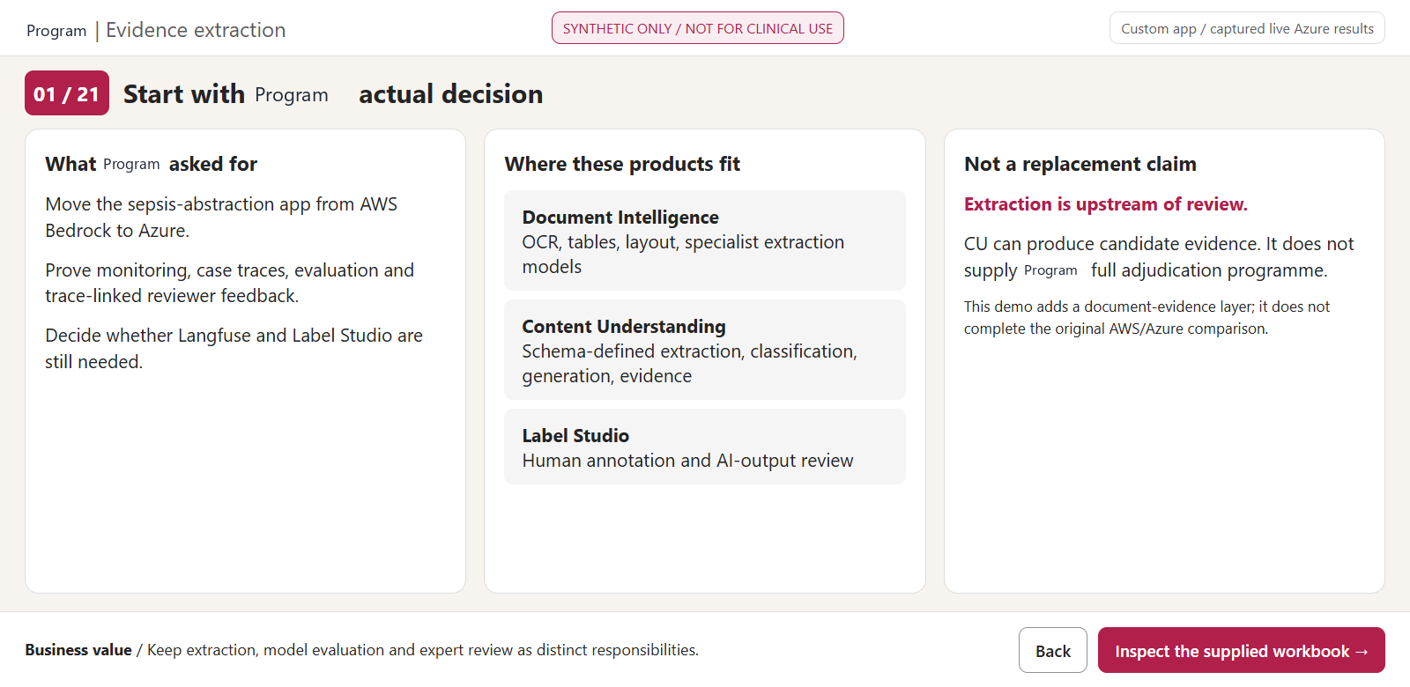
01 Start with Demo's actual decision
BACK
MAP
CUSTOM DEMO APP | CAPTURED LIVE AZURE OUTPUT | RED: CLICK / GOLD: INSPECT
6
Notes:
WHAT YOU ARE SEEING
Start with Demo's actual decision. A real browser screenshot of the custom local demo app, populated from captured live Azure API responses. Gold outline: the evidence panel to inspect.
WHERE TO CLICK
Red rectangle: "Inspect the supplied workbook". In this PowerPoint it is an internal next-screen hyperlink. Back returns to the prior screen; Map returns to the navigation legend.
WHAT THE SOLUTION IS DOING
Connect the product question to the original migration decision. A document extractor creates candidate evidence; a review platform governs what subject-matter experts do with model outputs. Demo's requirements include review against ground truth, not merely highlighting text.
BUSINESS VALUE FOR Demo
Keep extraction, model evaluation and expert review as distinct responsibilities. This addresses product fit and benchmark integrity.
EVIDENCE
Source PDFs: Documents\.
Raw results: Demo\data\raw\di\ and cu\.
Normalized exports: Demo\exports\.
Operation correlation: Demo\data\operations.json.
Schema: Demo\analyzer.json.
REFERENCES
https://learn.microsoft.com/en-us/azure/ai-services/document-intelligence/prebuilt/layout?view=doc-intel-4.0.0

Slide 9
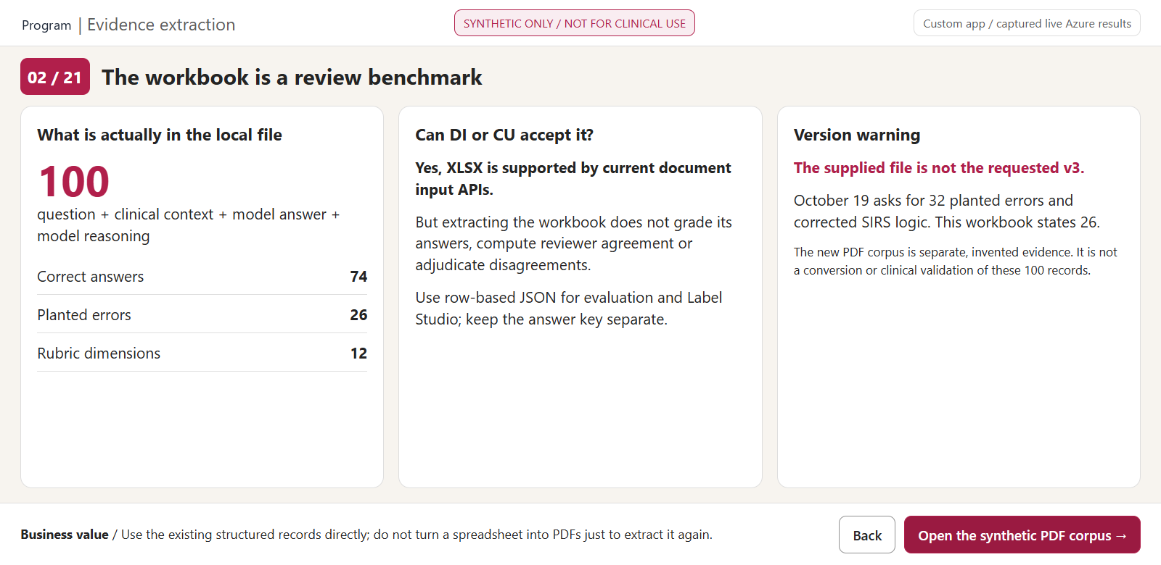
02 The workbook is a review benchmark
BACK
MAP
CUSTOM DEMO APP | CAPTURED LIVE AZURE OUTPUT | RED: CLICK / GOLD: INSPECT
7
Notes:
WHAT YOU ARE SEEING
The workbook is a review benchmark. A real browser screenshot of the custom local demo app, populated from captured live Azure API responses. Gold outline: the evidence panel to inspect.
WHERE TO CLICK
Red rectangle: "Open the synthetic PDF corpus". In this PowerPoint it is an internal next-screen hyperlink. Back returns to the prior screen; Map returns to the navigation legend.
WHAT THE SOLUTION IS DOING
The workbook's own introduction says the pilot is assessing a platform for subject-matter review of AI outputs. Export records as tasks, keep the answer key out of the reviewer view, preserve record and encounter identifiers and rubric version. The 89-node / 215-branch questionnaire requirement is an acceptance test, not something this flat demo claims to implement.
BUSINESS VALUE FOR Demo
Use the existing structured records directly; do not turn a spreadsheet into PDFs just to extract it again. This addresses product fit and benchmark integrity.
EVIDENCE
Source PDFs: Documents\.
Raw results: Demo\data\raw\di\ and cu\.
Normalized exports: Demo\exports\.
Operation correlation: Demo\data\operations.json.
Schema: Demo\analyzer.json.
REFERENCES
https://learn.microsoft.com/en-us/azure/ai-services/document-intelligence/prebuilt/layout?view=doc-intel-4.0.0
https://learn.microsoft.com/en-us/azure/ai-services/content-understanding/service-limits

Slide 10
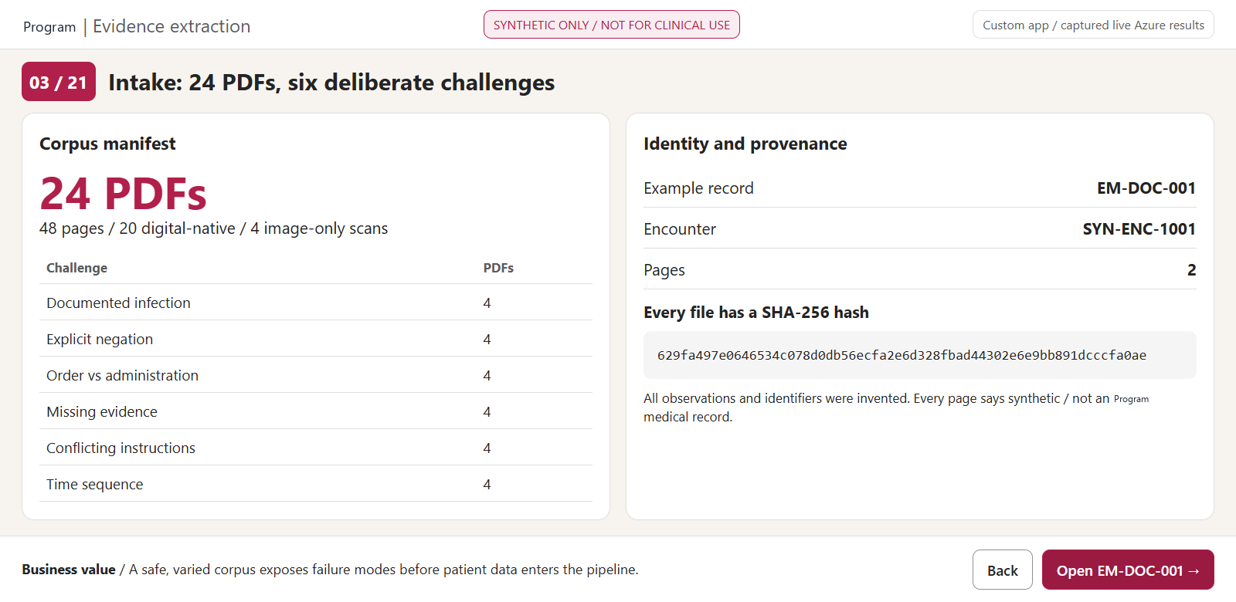
03 Intake: 24 PDFs, six deliberate challenges
BACK
MAP
CUSTOM DEMO APP | CAPTURED LIVE AZURE OUTPUT | RED: CLICK / GOLD: INSPECT
8
Notes:
WHAT YOU ARE SEEING
Intake: 24 PDFs, six deliberate challenges. A real browser screenshot of the custom local demo app, populated from captured live Azure API responses. Gold outline: the evidence panel to inspect.
WHERE TO CLICK
Red rectangle: "Open EM-DOC-001". In this PowerPoint it is an internal next-screen hyperlink. Back returns to the prior screen; Map returns to the navigation legend.
WHAT THE SOLUTION IS DOING
The 24 files represent 24 independent fictional encounters, each with two pages. Six scenarios are repeated with different identifiers and timestamps. Four PDFs are image-only scans. The generated corpus deliberately adds lactate and administration examples absent from the original review workbook; it is not derived from real patients or a disguised v3 dataset.
BUSINESS VALUE FOR Demo
A safe, varied corpus exposes failure modes before patient data enters the pipeline. This addresses the evidence intake and traceability foundation.
EVIDENCE
Source PDFs: Documents\.
Raw results: Demo\data\raw\di\ and cu\.
Normalized exports: Demo\exports\.
Operation correlation: Demo\data\operations.json.
Schema: Demo\analyzer.json.
REFERENCES
https://learn.microsoft.com/en-us/azure/ai-services/document-intelligence/prebuilt/layout?view=doc-intel-4.0.0

Slide 11
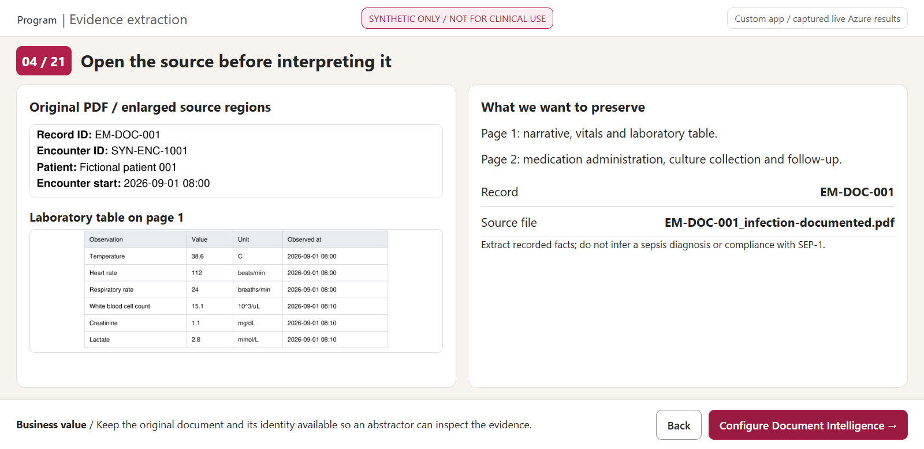
04 Open the source before interpreting it
BACK
MAP
CUSTOM DEMO APP | CAPTURED LIVE AZURE OUTPUT | RED: CLICK / GOLD: INSPECT
9
Notes:
WHAT YOU ARE SEEING
Open the source before interpreting it. A real browser screenshot of the custom local demo app, populated from captured live Azure API responses. Gold outline: the evidence panel to inspect.
WHERE TO CLICK
Red rectangle: "Configure Document Intelligence". In this PowerPoint it is an internal next-screen hyperlink. Back returns to the prior screen; Map returns to the navigation legend.
WHAT THE SOLUTION IS DOING
Show the synthetic banner and document identity before discussing values. The two pages preserve narrative, lab units, observations, medication status and timing. A downstream abstraction must cite these facts rather than infer an undocumented diagnosis.
BUSINESS VALUE FOR Demo
Keep the original document and its identity available so an abstractor can inspect the evidence. This addresses the evidence intake and traceability foundation.
EVIDENCE
Source PDFs: Documents\.
Raw results: Demo\data\raw\di\ and cu\.
Normalized exports: Demo\exports\.
Operation correlation: Demo\data\operations.json.
Schema: Demo\analyzer.json.
REFERENCES
https://learn.microsoft.com/en-us/azure/ai-services/document-intelligence/prebuilt/layout?view=doc-intel-4.0.0

Slide 12
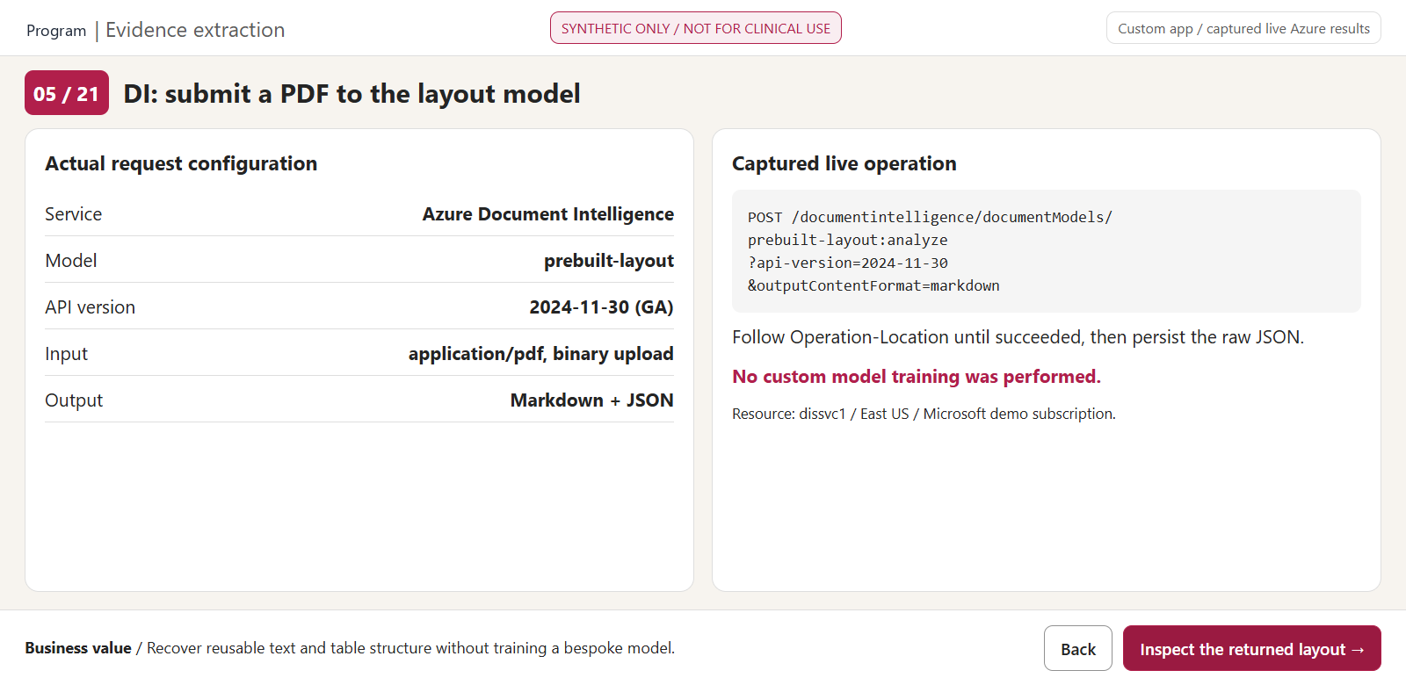
05 DI: submit a PDF to the layout model
BACK
MAP
CUSTOM DEMO APP | CAPTURED LIVE AZURE OUTPUT | RED: CLICK / GOLD: INSPECT
10
Notes:
WHAT YOU ARE SEEING
DI: submit a PDF to the layout model. A real browser screenshot of the custom local demo app, populated from captured live Azure API responses. Gold outline: the evidence panel to inspect.
WHERE TO CLICK
Red rectangle: "Inspect the returned layout". In this PowerPoint it is an internal next-screen hyperlink. Back returns to the prior screen; Map returns to the navigation legend.
WHAT THE SOLUTION IS DOING
This is the actual DI layout REST request configuration used in the harness. It uses Entra authorization, binary PDF upload and the GA 2024-11-30 API. Operation-Location polling is explicit, failures raise errors and raw responses are retained. No custom DI model was trained, and no specialist healthcare model is claimed.
BUSINESS VALUE FOR Demo
Recover reusable text and table structure without training a bespoke model. This addresses the evidence intake and traceability foundation.
EVIDENCE
Source PDFs: Documents\.
Raw results: Demo\data\raw\di\ and cu\.
Normalized exports: Demo\exports\.
Operation correlation: Demo\data\operations.json.
Schema: Demo\analyzer.json.
REFERENCES
https://learn.microsoft.com/en-us/azure/ai-services/document-intelligence/prebuilt/layout?view=doc-intel-4.0.0

Slide 13
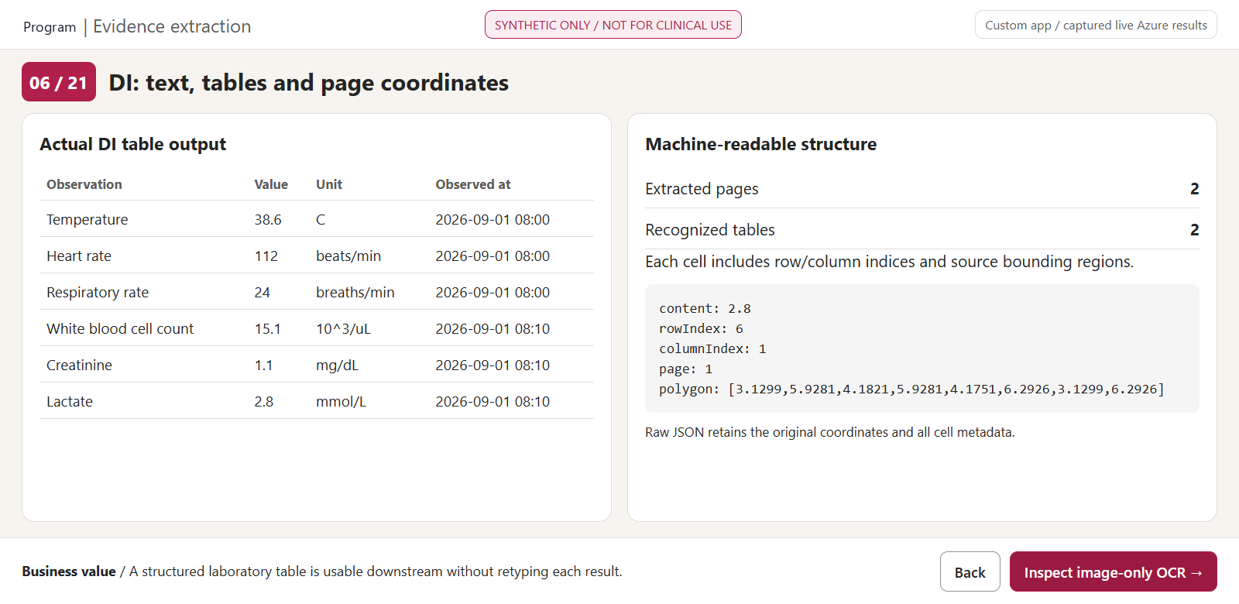
06 DI: text, tables and page coordinates
BACK
MAP
CUSTOM DEMO APP | CAPTURED LIVE AZURE OUTPUT | RED: CLICK / GOLD: INSPECT
11
Notes:
WHAT YOU ARE SEEING
DI: text, tables and page coordinates. A real browser screenshot of the custom local demo app, populated from captured live Azure API responses. Gold outline: the evidence panel to inspect.
WHERE TO CLICK
Red rectangle: "Inspect image-only OCR". In this PowerPoint it is an internal next-screen hyperlink. Back returns to the prior screen; Map returns to the navigation legend.
WHAT THE SOLUTION IS DOING
The table is rendered from actual DI cells, not from the generator's expected values. Explain row/column indices, text and bounding regions. DI recovers document structure; it does not decide whether a clinical rule is satisfied. CU is called separately in this demonstration, not fed this DI response.
BUSINESS VALUE FOR Demo
A structured laboratory table is usable downstream without retyping each result. This addresses the evidence intake and traceability foundation.
EVIDENCE
Source PDFs: Documents\.
Raw results: Demo\data\raw\di\ and cu\.
Normalized exports: Demo\exports\.
Operation correlation: Demo\data\operations.json.
Schema: Demo\analyzer.json.
REFERENCES
https://learn.microsoft.com/en-us/azure/ai-services/document-intelligence/prebuilt/layout?view=doc-intel-4.0.0

Slide 14
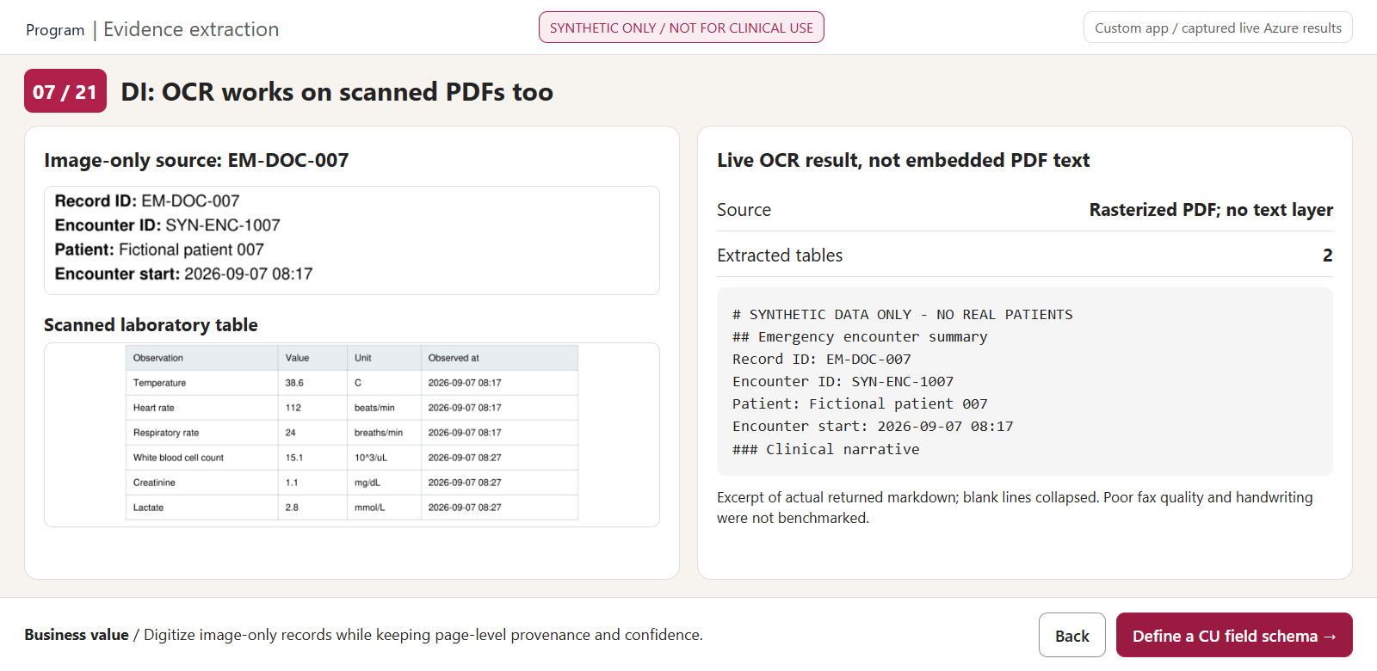
07 DI: OCR works on scanned PDFs too
BACK
MAP
CUSTOM DEMO APP | CAPTURED LIVE AZURE OUTPUT | RED: CLICK / GOLD: INSPECT
12
Notes:
WHAT YOU ARE SEEING
DI: OCR works on scanned PDFs too. A real browser screenshot of the custom local demo app, populated from captured live Azure API responses. Gold outline: the evidence panel to inspect.
WHERE TO CLICK
Red rectangle: "Define a CU field schema". In this PowerPoint it is an internal next-screen hyperlink. Back returns to the prior screen; Map returns to the navigation legend.
WHAT THE SOLUTION IS DOING
EM-DOC-007 has no embedded PDF text layer; its pages were rasterized before submission. The returned markdown and tables demonstrate real OCR. This clean scan says nothing about fax degradation, handwriting, uncommon abbreviations or production chart accuracy.
BUSINESS VALUE FOR Demo
Digitize image-only records while keeping page-level provenance and confidence. This addresses the evidence intake and traceability foundation.
EVIDENCE
Source PDFs: Documents\.
Raw results: Demo\data\raw\di\ and cu\.
Normalized exports: Demo\exports\.
Operation correlation: Demo\data\operations.json.
Schema: Demo\analyzer.json.
REFERENCES
https://learn.microsoft.com/en-us/azure/ai-services/document-intelligence/prebuilt/layout?view=doc-intel-4.0.0

Slide 15
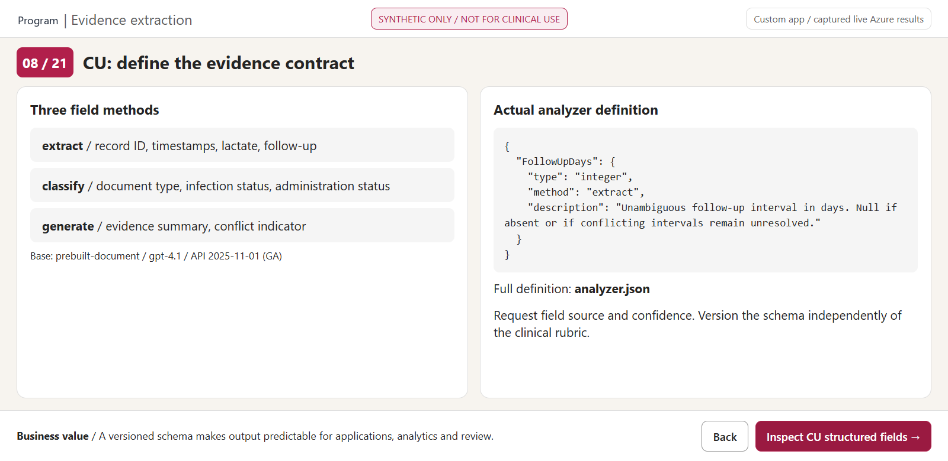
08 CU: define the evidence contract
BACK
MAP
CUSTOM DEMO APP | CAPTURED LIVE AZURE OUTPUT | RED: CLICK / GOLD: INSPECT
13
Notes:
WHAT YOU ARE SEEING
CU: define the evidence contract. A real browser screenshot of the custom local demo app, populated from captured live Azure API responses. Gold outline: the evidence panel to inspect.
WHERE TO CLICK
Red rectangle: "Inspect CU structured fields". In this PowerPoint it is an internal next-screen hyperlink. Back returns to the prior screen; Map returns to the navigation legend.
WHAT THE SOLUTION IS DOING
This is the actual custom analyzer schema, based on prebuilt-document with gpt-4.1 and text-embedding-3-large. Extract fields request recorded values; classify fields use predefined categories; generate fields synthesize a summary/conflict signal. estimateFieldSourceAndConfidence is enabled. The custom schema is an application contract, not a trained clinical diagnostic model.
BUSINESS VALUE FOR Demo
A versioned schema makes output predictable for applications, analytics and review. This addresses the evidence intake and traceability foundation.
EVIDENCE
Source PDFs: Documents\.
Raw results: Demo\data\raw\di\ and cu\.
Normalized exports: Demo\exports\.
Operation correlation: Demo\data\operations.json.
Schema: Demo\analyzer.json.
REFERENCES
https://learn.microsoft.com/en-us/azure/ai-services/content-understanding/tutorial/create-custom-analyzer

Slide 16
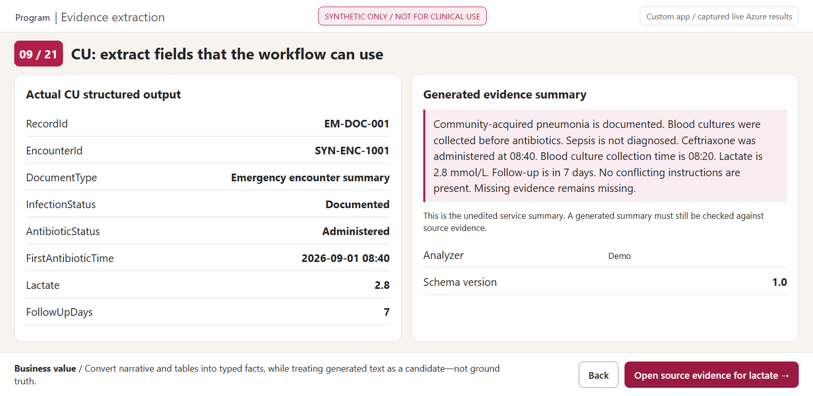
09 CU: extract fields that the workflow can use
BACK
MAP
CUSTOM DEMO APP | CAPTURED LIVE AZURE OUTPUT | RED: CLICK / GOLD: INSPECT
14
Notes:
WHAT YOU ARE SEEING
CU: extract fields that the workflow can use. A real browser screenshot of the custom local demo app, populated from captured live Azure API responses. Gold outline: the evidence panel to inspect.
WHERE TO CLICK
Red rectangle: "Open source evidence for lactate". In this PowerPoint it is an internal next-screen hyperlink. Back returns to the prior screen; Map returns to the navigation legend.
WHAT THE SOLUTION IS DOING
Typed fields and a generated summary are the usable evidence layer. Keep field source objects with the normalized export. The summary shown is unedited service output and may contain boilerplate or unsupported generalization; source evidence and clinician adjudication remain essential. A correct-looking summary is not a released clinical answer.
BUSINESS VALUE FOR Demo
Convert narrative and tables into typed facts, while treating generated text as a candidate—not ground truth. This addresses the evidence intake and traceability foundation.
EVIDENCE
Source PDFs: Documents\.
Raw results: Demo\data\raw\di\ and cu\.
Normalized exports: Demo\exports\.
Operation correlation: Demo\data\operations.json.
Schema: Demo\analyzer.json.
REFERENCES
https://learn.microsoft.com/en-us/azure/ai-services/content-understanding/tutorial/create-custom-analyzer

Slide 17
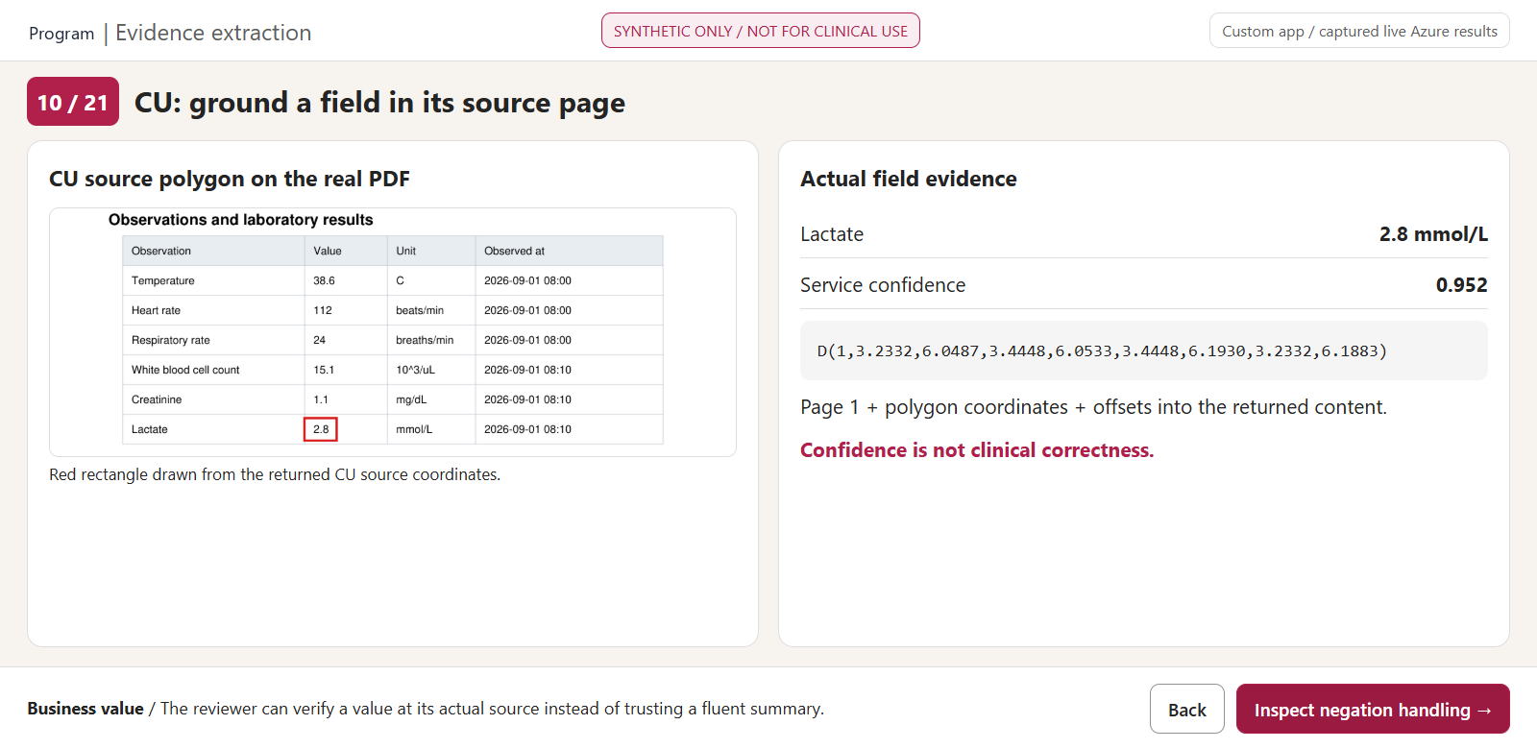
10 CU: ground a field in its source page
BACK
MAP
CUSTOM DEMO APP | CAPTURED LIVE AZURE OUTPUT | RED: CLICK / GOLD: INSPECT
15
Notes:
WHAT YOU ARE SEEING
CU: ground a field in its source page. A real browser screenshot of the custom local demo app, populated from captured live Azure API responses. Gold outline: the evidence panel to inspect.
WHERE TO CLICK
Red rectangle: "Inspect negation handling". In this PowerPoint it is an internal next-screen hyperlink. Back returns to the prior screen; Map returns to the navigation legend.
WHAT THE SOLUTION IS DOING
The red rectangle on the source crop is derived from the CU Lactate field's D(page, polygon) source. The confidence is the actual field confidence returned by Azure. Do not translate it into probability that a diagnosis is correct. A generated summary can have lower confidence than simple extracted fields; policies should be field-specific and clinically validated.
BUSINESS VALUE FOR Demo
The reviewer can verify a value at its actual source instead of trusting a fluent summary. This addresses the evidence intake and traceability foundation.
EVIDENCE
Source PDFs: Documents\.
Raw results: Demo\data\raw\di\ and cu\.
Normalized exports: Demo\exports\.
Operation correlation: Demo\data\operations.json.
Schema: Demo\analyzer.json.
REFERENCES
https://learn.microsoft.com/en-us/azure/ai-services/content-understanding/tutorial/create-custom-analyzer

Slide 18
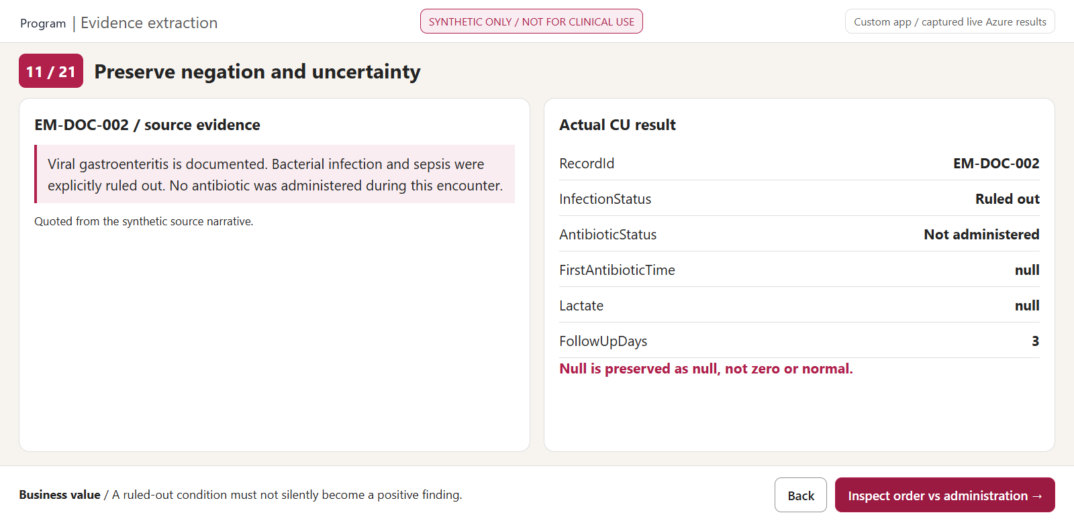
11 Preserve negation and uncertainty
BACK
MAP
CUSTOM DEMO APP | CAPTURED LIVE AZURE OUTPUT | RED: CLICK / GOLD: INSPECT
16
Notes:
WHAT YOU ARE SEEING
Preserve negation and uncertainty. A real browser screenshot of the custom local demo app, populated from captured live Azure API responses. Gold outline: the evidence panel to inspect.
WHERE TO CLICK
Red rectangle: "Inspect order vs administration". In this PowerPoint it is an internal next-screen hyperlink. Back returns to the prior screen; Map returns to the navigation legend.
WHAT THE SOLUTION IS DOING
Show that the service preserves Ruled out and Not administered rather than turning the note into a positive infection/medication record. Null means not documented or inapplicable, not zero. This is an extraction test of a deliberately simple synthetic note, not a clinical negation benchmark.
BUSINESS VALUE FOR Demo
A ruled-out condition must not silently become a positive finding. This addresses safe exception handling and abstractor review.
EVIDENCE
Source PDFs: Documents\.
Raw results: Demo\data\raw\di\ and cu\.
Normalized exports: Demo\exports\.
Operation correlation: Demo\data\operations.json.
Schema: Demo\analyzer.json.
REFERENCES
https://learn.microsoft.com/en-us/azure/ai-services/content-understanding/tutorial/create-custom-analyzer

Slide 19
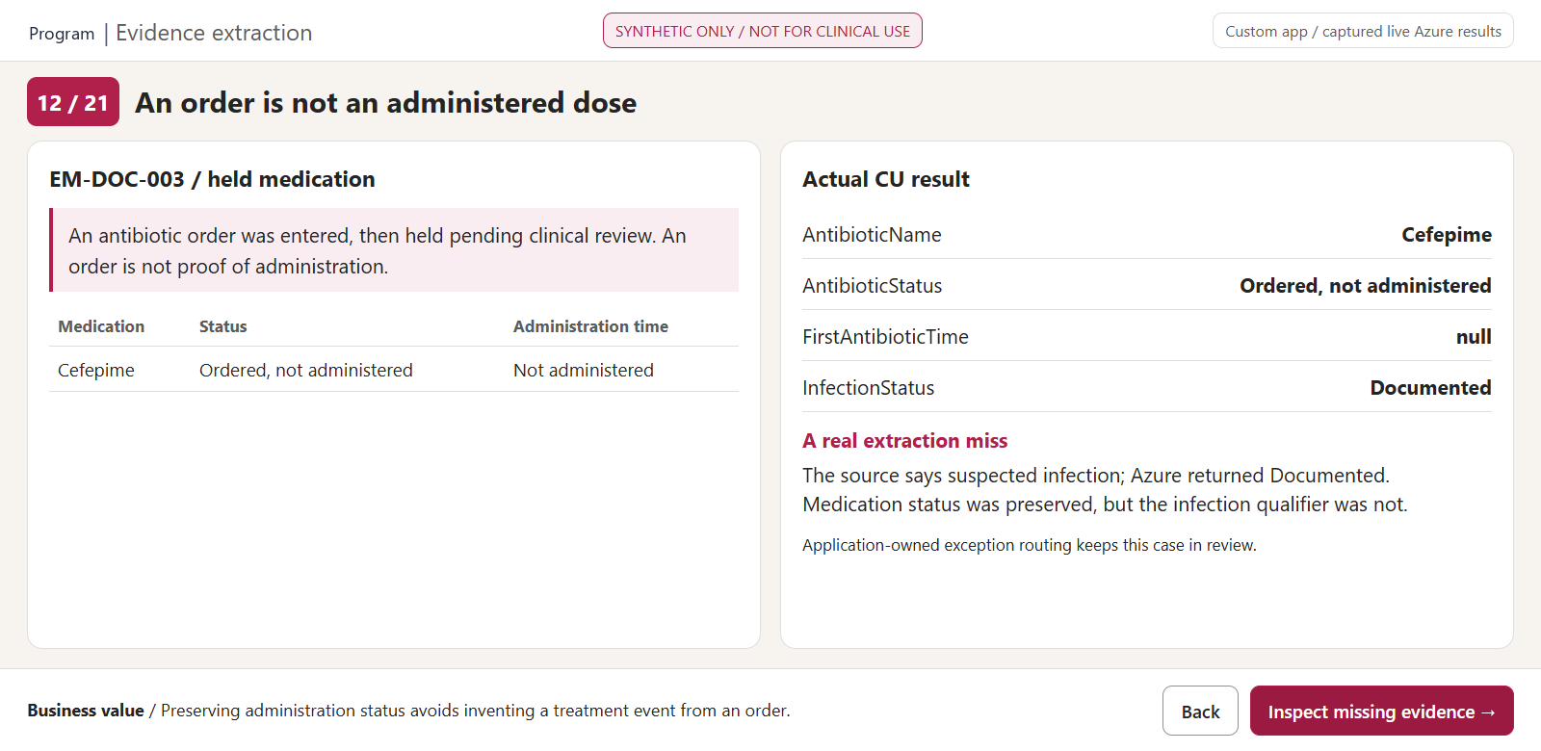
12 An order is not an administered dose
BACK
MAP
CUSTOM DEMO APP | CAPTURED LIVE AZURE OUTPUT | RED: CLICK / GOLD: INSPECT
17
Notes:
WHAT YOU ARE SEEING
An order is not an administered dose. A real browser screenshot of the custom local demo app, populated from captured live Azure API responses. Gold outline: the evidence panel to inspect.
WHERE TO CLICK
Red rectangle: "Inspect missing evidence". In this PowerPoint it is an internal next-screen hyperlink. Back returns to the prior screen; Map returns to the navigation legend.
WHAT THE SOLUTION IS DOING
The MAR states an order was held. The output separates the drug's name from its administration status and retains a null administration timestamp. The same result misclassifies the suspected infection as Documented. That miss repeats in four documents and is intentionally retained, not corrected in the service output. The application's review policy is custom code. This distinction is important for Demo's antibiotic abstraction question and must be validated on authentic workflow data.
BUSINESS VALUE FOR Demo
Preserving administration status avoids inventing a treatment event from an order. This addresses safe exception handling and abstractor review.
EVIDENCE
Source PDFs: Documents\.
Raw results: Demo\data\raw\di\ and cu\.
Normalized exports: Demo\exports\.
Operation correlation: Demo\data\operations.json.
Schema: Demo\analyzer.json.
REFERENCES
https://learn.microsoft.com/en-us/azure/ai-services/content-understanding/tutorial/create-custom-analyzer

Slide 20
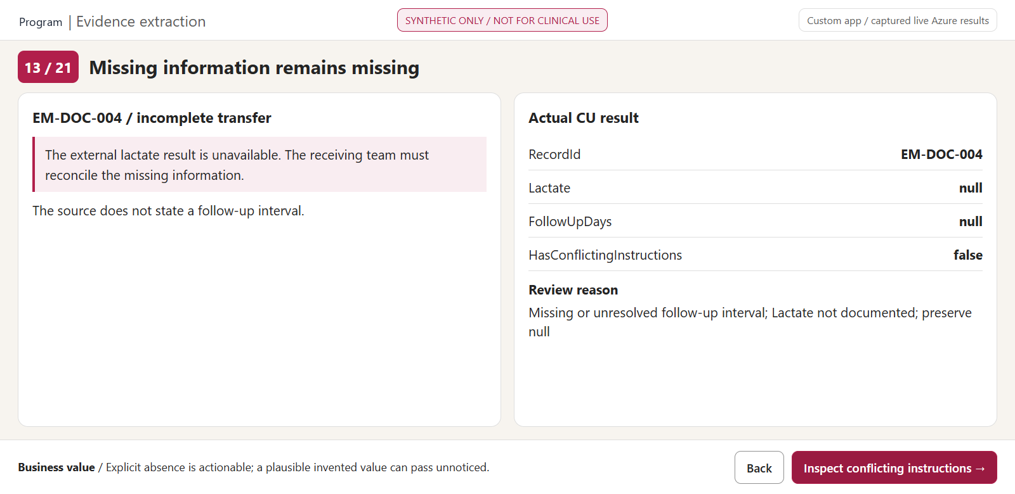
13 Missing information remains missing
BACK
MAP
CUSTOM DEMO APP | CAPTURED LIVE AZURE OUTPUT | RED: CLICK / GOLD: INSPECT
18
Notes:
WHAT YOU ARE SEEING
Missing information remains missing. A real browser screenshot of the custom local demo app, populated from captured live Azure API responses. Gold outline: the evidence panel to inspect.
WHERE TO CLICK
Red rectangle: "Inspect conflicting instructions". In this PowerPoint it is an internal next-screen hyperlink. Back returns to the prior screen; Map returns to the navigation legend.
WHAT THE SOLUTION IS DOING
A missing external lactate result and missing follow-up interval remain null. The local application routes those exceptions to review using explicit rules. Missingness can be essential business information; substituting a plausible normal value would remove the signal an abstractor needs.
BUSINESS VALUE FOR Demo
Explicit absence is actionable; a plausible invented value can pass unnoticed. This addresses safe exception handling and abstractor review.
EVIDENCE
Source PDFs: Documents\.
Raw results: Demo\data\raw\di\ and cu\.
Normalized exports: Demo\exports\.
Operation correlation: Demo\data\operations.json.
Schema: Demo\analyzer.json.
REFERENCES
https://learn.microsoft.com/en-us/azure/ai-services/content-understanding/tutorial/create-custom-analyzer

Slide 21
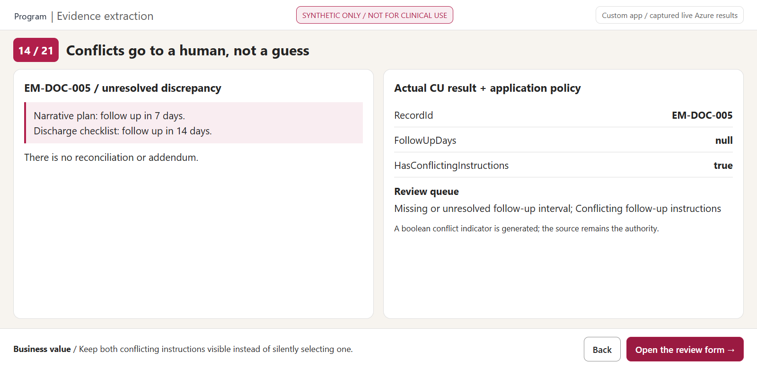
14 Conflicts go to a human, not a guess
BACK
MAP
CUSTOM DEMO APP | CAPTURED LIVE AZURE OUTPUT | RED: CLICK / GOLD: INSPECT
19
Notes:
WHAT YOU ARE SEEING
Conflicts go to a human, not a guess. A real browser screenshot of the custom local demo app, populated from captured live Azure API responses. Gold outline: the evidence panel to inspect.
WHERE TO CLICK
Red rectangle: "Open the review form". In this PowerPoint it is an internal next-screen hyperlink. Back returns to the prior screen; Map returns to the navigation legend.
WHAT THE SOLUTION IS DOING
The source has unresolved seven-versus-fourteen-day follow-up instructions. CU produces a conflict flag and a null interval. The local app combines explicit missing/conflict checks and an illustrative 0.8 confidence threshold. That threshold is not calibrated and cannot justify automatic clinical acceptance.
BUSINESS VALUE FOR Demo
Keep both conflicting instructions visible instead of silently selecting one. This addresses safe exception handling and abstractor review.
EVIDENCE
Source PDFs: Documents\.
Raw results: Demo\data\raw\di\ and cu\.
Normalized exports: Demo\exports\.
Operation correlation: Demo\data\operations.json.
Schema: Demo\analyzer.json.
REFERENCES
https://learn.microsoft.com/en-us/azure/ai-services/content-understanding/tutorial/create-custom-analyzer

Slide 22
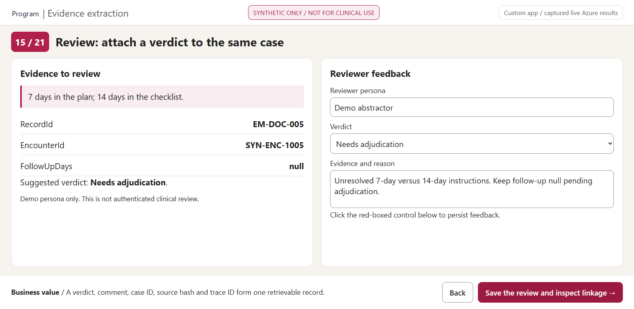
15 Review: attach a verdict to the same case
BACK
MAP
CUSTOM DEMO APP | CAPTURED LIVE AZURE OUTPUT | RED: CLICK / GOLD: INSPECT
20
Notes:
WHAT YOU ARE SEEING
Review: attach a verdict to the same case. A real browser screenshot of the custom local demo app, populated from captured live Azure API responses. Gold outline: the evidence panel to inspect.
WHERE TO CLICK
Red rectangle: "Save the review and inspect linkage". In this PowerPoint it is an internal next-screen hyperlink. Back returns to the prior screen; Map returns to the navigation legend.
WHAT THE SOLUTION IS DOING
Clicking the action on the actual local app submits a reviewer persona, verdict and comment to the loopback server. The server validates the case, derives the original trace and encounter IDs from saved extraction data and fsyncs an append-only JSONL line. In PowerPoint this hotspot advances to the screenshot of the saved outcome, not to the live API.
BUSINESS VALUE FOR Demo
A verdict, comment, case ID, source hash and trace ID form one retrievable record. This addresses safe exception handling and abstractor review.
EVIDENCE
Source PDFs: Documents\.
Raw results: Demo\data\raw\di\ and cu\.
Normalized exports: Demo\exports\.
Operation correlation: Demo\data\operations.json.
Schema: Demo\analyzer.json.
REFERENCES
https://learn.microsoft.com/en-us/azure/ai-services/content-understanding/tutorial/create-custom-analyzer

Slide 23
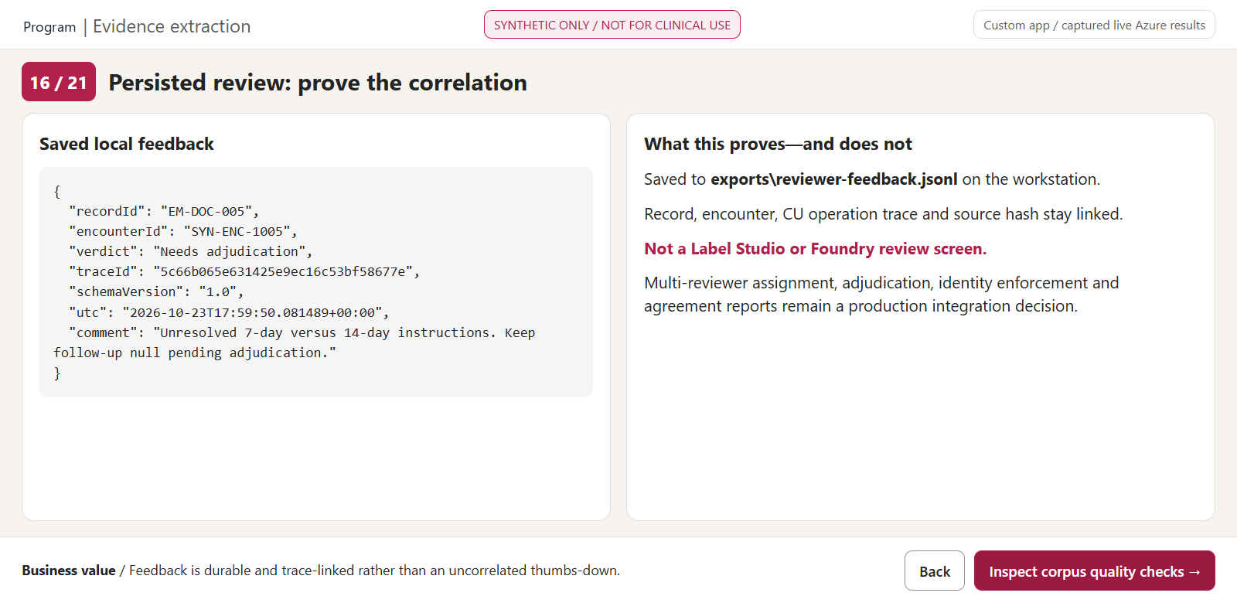
16 Persisted review: prove the correlation
BACK
MAP
CUSTOM DEMO APP | CAPTURED LIVE AZURE OUTPUT | RED: CLICK / GOLD: INSPECT
21
Notes:
WHAT YOU ARE SEEING
Persisted review: prove the correlation. A real browser screenshot of the custom local demo app, populated from captured live Azure API responses. Gold outline: the evidence panel to inspect.
WHERE TO CLICK
Red rectangle: "Inspect corpus quality checks". In this PowerPoint it is an internal next-screen hyperlink. Back returns to the prior screen; Map returns to the navigation legend.
WHAT THE SOLUTION IS DOING
The saved feedback is a real demonstration record from the capture session. It contains record ID, encounter ID, CU operation trace ID, schema version, analyzer ID, timestamp, source hash, verdict and comment. The reviewer is a self-entered demo persona, not an authenticated Entra identity. These local correlation IDs are not proof that a Foundry/Application Insights trace was ingested.
BUSINESS VALUE FOR Demo
Feedback is durable and trace-linked rather than an uncorrelated thumbs-down. This addresses safe exception handling and abstractor review.
EVIDENCE
Source PDFs: Documents\.
Raw results: Demo\data\raw\di\ and cu\.
Normalized exports: Demo\exports\.
Operation correlation: Demo\data\operations.json.
Schema: Demo\analyzer.json.
REFERENCES
https://learn.microsoft.com/en-us/azure/ai-services/content-understanding/tutorial/create-custom-analyzer

Slide 24
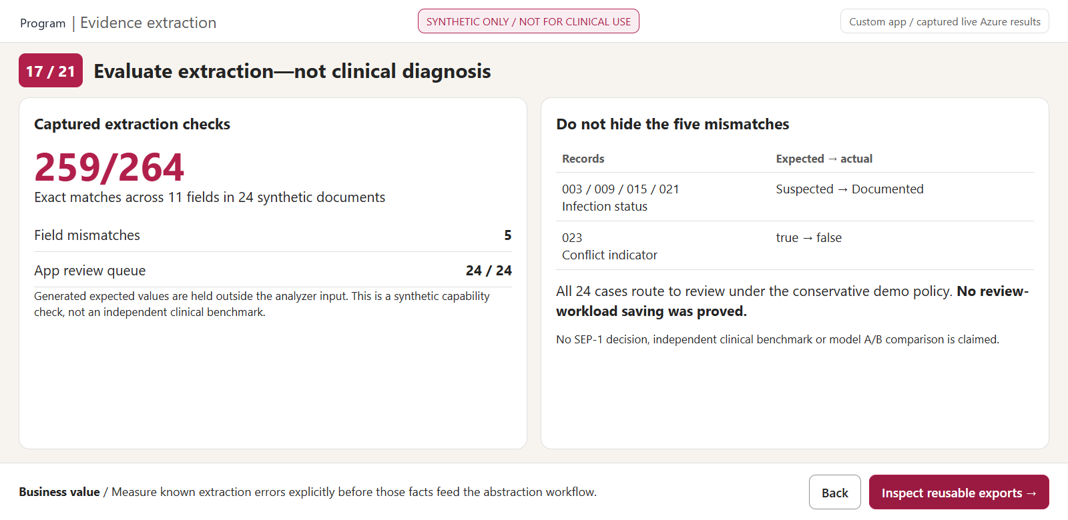
17 Evaluate extraction—not clinical diagnosis
BACK
MAP
CUSTOM DEMO APP | CAPTURED LIVE AZURE OUTPUT | RED: CLICK / GOLD: INSPECT
22
Notes:
WHAT YOU ARE SEEING
Evaluate extraction—not clinical diagnosis. A real browser screenshot of the custom local demo app, populated from captured live Azure API responses. Gold outline: the evidence panel to inspect.
WHERE TO CLICK
Red rectangle: "Inspect reusable exports". In this PowerPoint it is an internal next-screen hyperlink. Back returns to the prior screen; Map returns to the navigation legend.
WHAT THE SOLUTION IS DOING
The evaluation compares actual CU output with separate generator-authored expected values on eleven fields. It explicitly counts nulls and contradictions. The measured result is 259/264, with four Suspected-to-Documented misclassifications and one missed conflict flag on EM-DOC-023. Those misses remain in the raw/normalized outputs and are displayed here. All 24 documents are sent to review by the conservative illustrative policy, so no reduction in reviewer workload was demonstrated. This is not the workbook's 12-dimension answer-quality rubric and not an independent holdout clinical evaluation.
BUSINESS VALUE FOR Demo
Measure known extraction errors explicitly before those facts feed the abstraction workflow. This addresses measurable quality, usable exports and operating economics.
EVIDENCE
Source PDFs: Documents\.
Raw results: Demo\data\raw\di\ and cu\.
Normalized exports: Demo\exports\.
Operation correlation: Demo\data\operations.json.
Schema: Demo\analyzer.json.
REFERENCES
https://learn.microsoft.com/en-us/azure/ai-services/content-understanding/tutorial/create-custom-analyzer

Slide 25
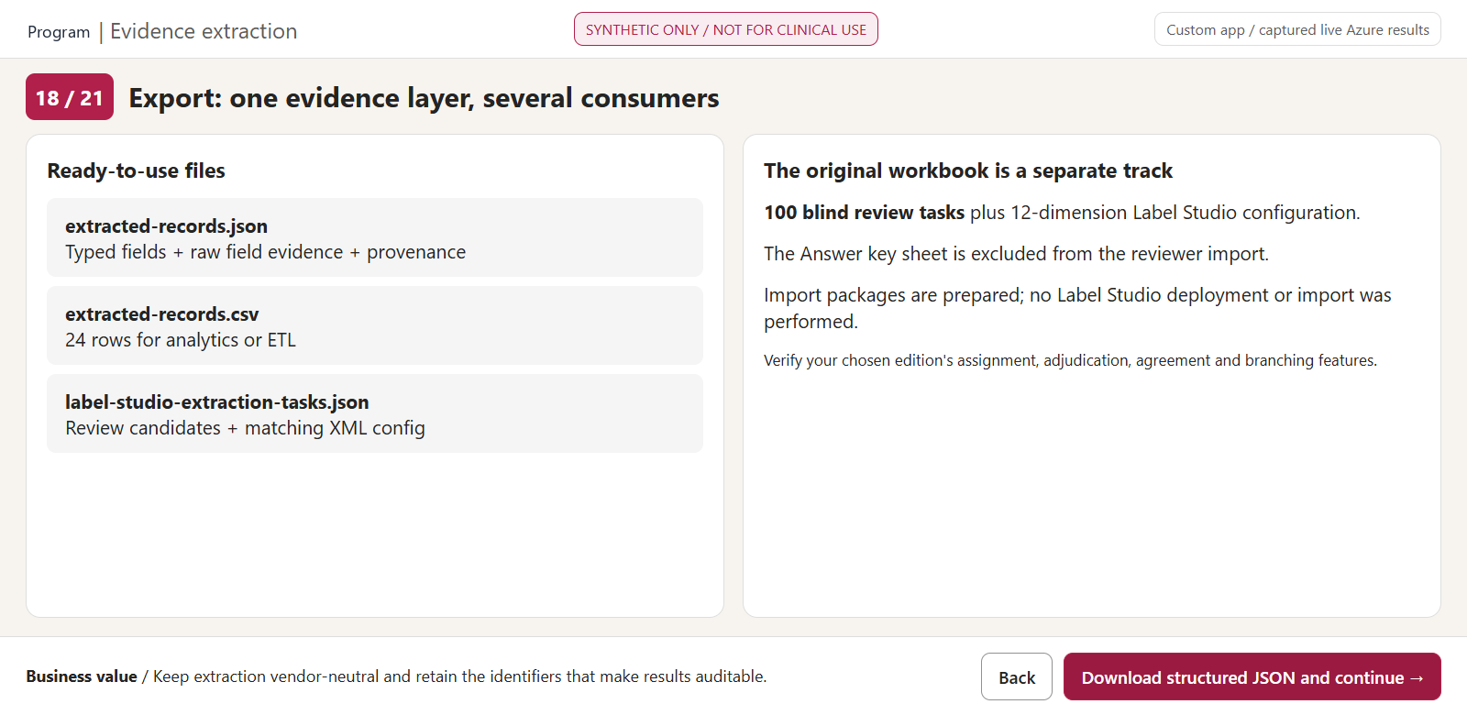
18 Export: one evidence layer, several consumers
BACK
MAP
CUSTOM DEMO APP | CAPTURED LIVE AZURE OUTPUT | RED: CLICK / GOLD: INSPECT
23
Notes:
WHAT YOU ARE SEEING
Export: one evidence layer, several consumers. A real browser screenshot of the custom local demo app, populated from captured live Azure API responses. Gold outline: the evidence panel to inspect.
WHERE TO CLICK
Red rectangle: "Download structured JSON and continue". In this PowerPoint it is an internal next-screen hyperlink. Back returns to the prior screen; Map returns to the navigation legend.
WHAT THE SOLUTION IS DOING
The JSON export retains fieldEvidence, source file hash, trace ID, analyzer ID and schema version. The CSV is a simpler normalized projection for analytics; JSON null becomes an empty CSV cell and the JSON is authoritative for missingness. Separate Label Studio task/config pairs cover the new extraction corpus and the original workbook. No actual Label Studio import, adjudication workflow or questionnaire branching was exercised.
BUSINESS VALUE FOR Demo
Keep extraction vendor-neutral and retain the identifiers that make results auditable. This addresses measurable quality, usable exports and operating economics.
EVIDENCE
Source PDFs: Documents\.
Raw results: Demo\data\raw\di\ and cu\.
Normalized exports: Demo\exports\.
Operation correlation: Demo\data\operations.json.
Schema: Demo\analyzer.json.
REFERENCES
https://learn.microsoft.com/en-us/azure/ai-services/content-understanding/tutorial/create-custom-analyzer
https://labelstud.io/guide/predictions

Slide 26
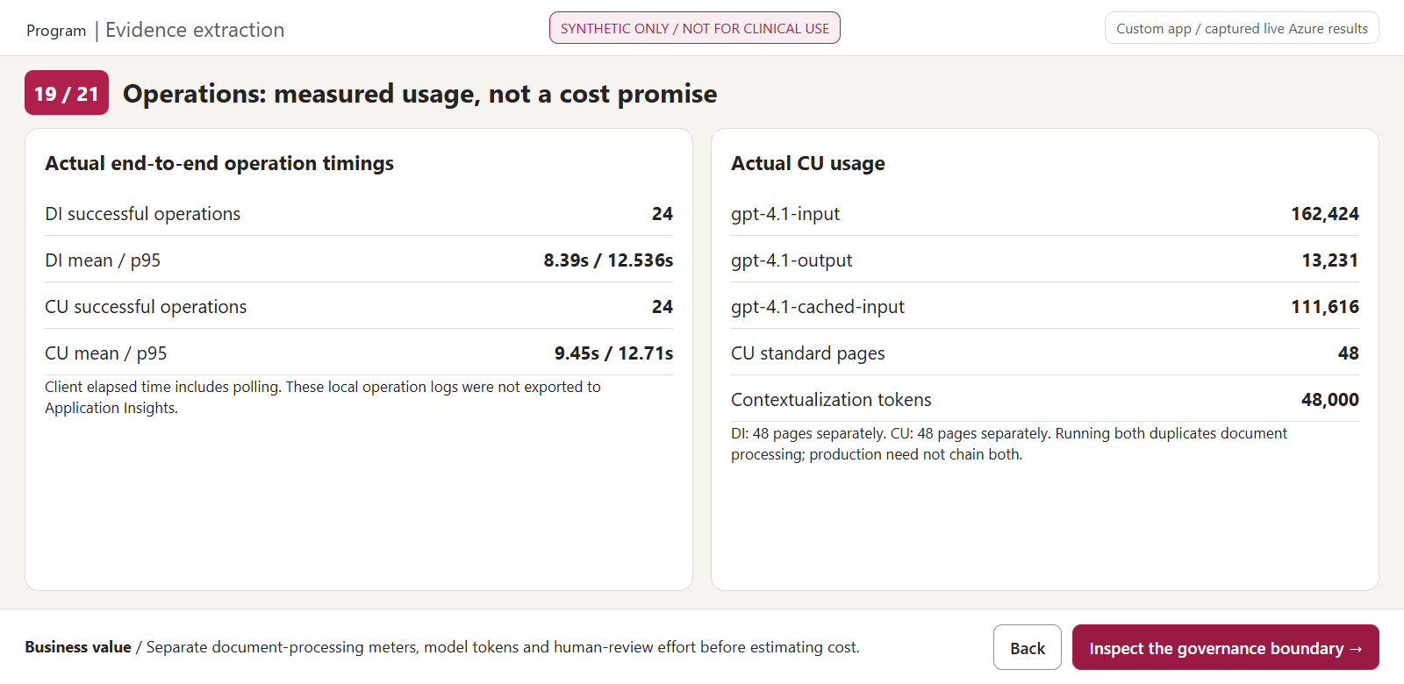
19 Operations: measured usage, not a cost promise
BACK
MAP
CUSTOM DEMO APP | CAPTURED LIVE AZURE OUTPUT | RED: CLICK / GOLD: INSPECT
24
Notes:
WHAT YOU ARE SEEING
Operations: measured usage, not a cost promise. A real browser screenshot of the custom local demo app, populated from captured live Azure API responses. Gold outline: the evidence panel to inspect.
WHERE TO CLICK
Red rectangle: "Inspect the governance boundary". In this PowerPoint it is an internal next-screen hyperlink. Back returns to the prior screen; Map returns to the navigation legend.
WHAT THE SOLUTION IS DOING
Timings are measured client elapsed durations including polling, not pure service compute latency. CU token/page/contextualization meters are taken from service responses. DI page processing is a separate charge. Running both on all files is an educational comparison and duplicates processing; production may choose CU alone or DI plus a separate abstraction/evaluation pipeline. Add storage, telemetry, review labor, failures and support to a cost model and use contracted rates.
BUSINESS VALUE FOR Demo
Separate document-processing meters, model tokens and human-review effort before estimating cost. This addresses measurable quality, usable exports and operating economics.
EVIDENCE
Source PDFs: Documents\.
Raw results: Demo\data\raw\di\ and cu\.
Normalized exports: Demo\exports\.
Operation correlation: Demo\data\operations.json.
Schema: Demo\analyzer.json.
REFERENCES
https://learn.microsoft.com/en-us/azure/ai-services/content-understanding/tutorial/create-custom-analyzer
https://labelstud.io/guide/predictions

Slide 27
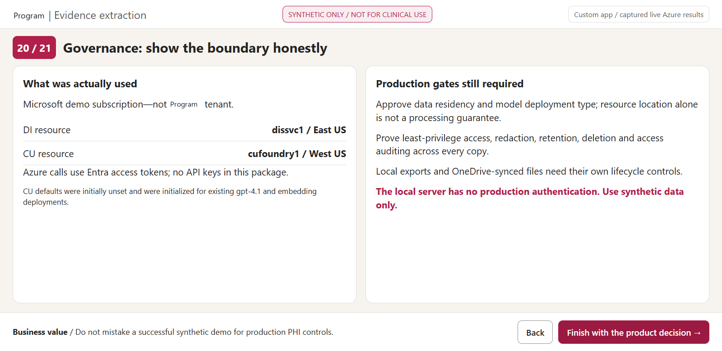
20 Governance: show the boundary honestly
BACK
MAP
CUSTOM DEMO APP | CAPTURED LIVE AZURE OUTPUT | RED: CLICK / GOLD: INSPECT
25
Notes:
WHAT YOU ARE SEEING
Governance: show the boundary honestly. A real browser screenshot of the custom local demo app, populated from captured live Azure API responses. Gold outline: the evidence panel to inspect.
WHERE TO CLICK
Red rectangle: "Finish with the product decision". In this PowerPoint it is an internal next-screen hyperlink. Back returns to the prior screen; Map returns to the navigation legend.
WHAT THE SOLUTION IS DOING
The resources belong to a Microsoft demo subscription, with DI in East US and CU in West US. The original Demo named Foundry resource in the local documents is not used by this extraction run. CU defaults were previously unset and initialized to existing deployments; no existing deployments/default maps were overwritten. The package stores only synthetic content but includes local/OneDrive copies, whose retention is separate from Azure's. No production RBAC, masking, retention, query auditing, private networking or tenant-residency claim is proved by this UI.
BUSINESS VALUE FOR Demo
Do not mistake a successful synthetic demo for production PHI controls. This addresses governance and the platform/review division of responsibility.
EVIDENCE
Source PDFs: Documents\.
Raw results: Demo\data\raw\di\ and cu\.
Normalized exports: Demo\exports\.
Operation correlation: Demo\data\operations.json.
Schema: Demo\analyzer.json.
REFERENCES
https://learn.microsoft.com/en-us/azure/ai-services/content-understanding/tutorial/create-custom-analyzer
https://labelstud.io/guide/predictions

Slide 28
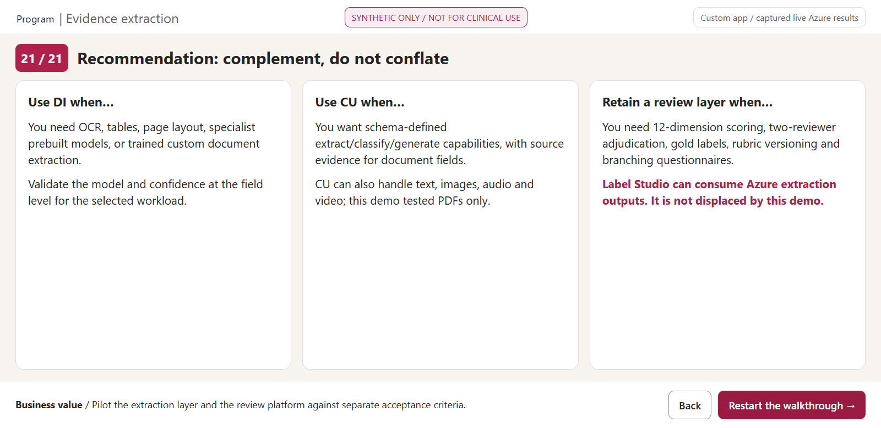
21 Recommendation: complement, do not conflate
BACK
MAP
CUSTOM DEMO APP | CAPTURED LIVE AZURE OUTPUT | RED: CLICK / GOLD: INSPECT
RESULTS
26
Notes:
WHAT YOU ARE SEEING
Recommendation: complement, do not conflate. A real browser screenshot of the custom local demo app, populated from captured live Azure API responses. Gold outline: the evidence panel to inspect.
WHERE TO CLICK
Red rectangle: "Restart the walkthrough". In this PowerPoint it is an internal next-screen hyperlink. Back returns to the prior screen; Map returns to the navigation legend.
WHAT THE SOLUTION IS DOING
Close with a complementary architecture, not a replacement promise. Label Studio should be evaluated against Demo's actual acceptance criteria: two or more reviewers, reviewer/adjudicator disagreement, normalized final gold export, rubric version retention, weighted/per-dimension metrics and the 89-node / 215-branch questionnaire. CU and DI address evidence intake, while the clinical owner defines correctness and release gates.
BUSINESS VALUE FOR Demo
Pilot the extraction layer and the review platform against separate acceptance criteria. This addresses governance and the platform/review division of responsibility.
EVIDENCE
Source PDFs: Documents\.
Raw results: Demo\data\raw\di\ and cu\.
Normalized exports: Demo\exports\.
Operation correlation: Demo\data\operations.json.
Schema: Demo\analyzer.json.
REFERENCES
https://learn.microsoft.com/en-us/azure/ai-services/content-understanding/tutorial/create-custom-analyzer
https://labelstud.io/guide/predictions

Slide 29
Demo / DOCUMENT EXTRACTION
Measured result: an evidence layer, not a verdict
24/24
24/24
259/264
DI operations succeeded
CU operations succeeded
exact-match field checks
Demonstrated
Not demonstrated
OCR on image-only PDFs; text and tables; typed fields; source grounding; missing/conflict handling; durable local reviewer feedback; JSON/CSV exports.
Clinical performance; v3 answer-quality evaluation; Bedrock/Azure A/B; production access and residency controls; full Label Studio adjudication.
SYNTHETIC DATA ONLY | NOT FOR CLINICAL USE
27
Notes:
MEASURED RESULTS
{
"documents": 24,
"pagesPerService": 48,
"scanned": 4,
"checksPassed": 259,
"checksTotal": 264,
"mismatches": [
{
"recordId": "EM-DOC-003",
"field": "InfectionStatus",
"expected": "Suspected",
"actual": "Documented",
"pass": false
},
{
"recordId": "EM-DOC-009",
"field": "InfectionStatus",
"expected": "Suspected",
"actual": "Documented",
"pass": false
},
{
"recordId": "EM-DOC-015",
"field": "InfectionStatus",
"expected": "Suspected",
"actual": "Documented",
"pass": false
},
{
"recordId": "EM-DOC-021",
"field": "InfectionStatus",
"expected": "Suspected",
"actual": "Documented",
"pass": false
},
{
"recordId": "EM-DOC-023",
"field": "HasConflictingInstructions",
"expected": true,
"actual": false,
"pass": false
}
],
"reviewQueue": 24,
"tokens": {
"gpt-4.1-input": 162424,
"gpt-4.1-output": 13231,
"gpt-4.1-cached-input": 111616
},
"contextualizationTokens": 48000,
"documentPagesStandard": 48,
"operations": {
"di": {
"success": 24,
"failed": 0,
"meanSeconds": 8.39,
"p95Seconds": 12.536
},
"cu": {
"success": 24,
"failed": 0,
"meanSeconds": 9.45,
"p95Seconds": 12.71
}
}
}
INTERPRETATION
These checks cover eleven fields per generated document and compare CU results with a separately stored generator-authored expected manifest. Document type, identifiers, categorical statuses, two timestamps, lactate, follow-up and conflict indication are included. No summary prose is exact-match graded. Review routing additionally uses missingness and illustrative confidence; queue size is not a false-positive or clinical-accuracy rate.
FIVE MISSES
Four records with a suspected infection were classified as Documented. EM-DOC-023 missed an unresolved follow-up conflict. All 24 records require review under the conservative policy. No claim of reduced review workload is justified by this run. The original outputs have not been silently repaired.
BUSINESS VALUE
The package is inspectable evidence that the products can recover facts from this corpus and pass them into a review workflow. It is deliberately not presented as a clinically validated system or as evidence that one model outperforms another.

Slide 30
Demo / DOCUMENT EXTRACTION
Production: pick the path, keep the review loop
PDF / scan
DI OR CU
Abstraction
Expert review
→
→
→
Approved document intake
Document evidence
Rules + model + evaluation
Label Studio or integrated UI
Already structured? Skip extraction
Workbook rows / structured clinical APIs → evaluation and human review directly. Carry record + encounter + model/prompt/schema/rubric versions and trace IDs through the entire flow.
SYNTHETIC DATA ONLY | NOT FOR CLINICAL USE
28
Notes:
ARCHITECTURE CHOICE
DI and CU were each called independently on all 24 PDFs to compare capabilities. This is not a recommendation to pay twice for the same OCR in production. CU already performs its own document content extraction. Choose CU for an end-to-end schema-driven content path, or DI for the selected OCR/layout/prebuilt/custom-model document needs and a separate downstream abstraction application.
REVIEW LOOP
Preserve raw source and field evidence. Evaluate generated abstraction answers against expert-defined expected answers and a versioned rubric. Abstractor disagreements should become triaged, adjudicated gold cases in the next test set. Observability wraps every stage; document extraction does not eliminate instrumentation work.
BUSINESS VALUE
A modular path avoids unnecessary conversion, duplicated processing and tool lock-in, while preserving human accountability.

Slide 31
Demo / DOCUMENT EXTRACTION
Pilot acceptance: prove the decisions separately
Clinical / review owner
Engineering owner
Platform / privacy owner
Confirm the v3 dataset
Own the rubric and answer key
Adjudicate reviewer differences
Export final gold + versions
Test representative source files
Run real model / prompt A/B
Link reviews and case traces
Exercise failures and storage
Approve processing geography
Prove allowed + denied access
Verify data lifecycle and audit
Own costs, alerts and support
SYNTHETIC DATA ONLY | NOT FOR CLINICAL USE
29
Notes:
Demo'S ACCEPTANCE TESTS
From the workbook What to measure sheet: final adjudicated gold label exports normalized with record and encounter IDs; rubric version survives export; reviewer/adjudicator disagreement is first-class; the full twelve dimensions support weighting and agreement functions; catch rates are reported by error type; questionnaire skip logic can express the real SEP-1 workflow of 89 nodes and 215 conditional branches.
WHAT TO DO NEXT
Do not assume the locally integrated verdict form meets all these requirements. Evaluate Label Studio's chosen edition and an integrated application against the same acceptance tasks. Run the same approved inputs through actual candidate model/prompt versions, rather than comparing prebuilt proxy outputs.
OWNERSHIP AND COST
Managed services reduce infrastructure maintenance but do not remove instrumentation, clinical rubric, data lifecycle, reviewer integration, evaluator validation or on-call ownership. Do not reuse the previous roughly $96/month estimate as all-in. Use observed document sizes/tokens, Demo's volume and contracted rates, and include processing, model usage, evaluations, storage, telemetry, review labor and support.
BUSINESS VALUE
Assigns each remaining decision to an accountable owner and prevents a technical demonstration from being mistaken for production acceptance.

Slide 32
REFERENCE / CURRENT DOCUMENTATION
Evidence and sources
Local evidence
Reproduce the run
Documents\ : 24 fictional PDFs
Demo\data\raw\ : untouched Azure results
Demo\exports\ : fields, checks and feedback
Demo\screenshots\ : raw and annotated captures
Demo\run_extraction.py : live Azure harness
Demo\analyzer.json : CU field contract
Demo\RunDemo.ps1 : local reviewer workflow
Demo\DemoReviewAndRunbook.docx : guide
Authoritative product links and precise limitations are in the speaker notes.
SYNTHETIC DATA ONLY | NOT FOR CLINICAL USE
30
Notes:
AUTHORITATIVE SOURCES CONSULTED 23 OCTOBER 2026
https://learn.microsoft.com/en-us/azure/ai-services/document-intelligence/prebuilt/layout?view=doc-intel-4.0.0
https://learn.microsoft.com/en-us/azure/ai-services/content-understanding/tutorial/create-custom-analyzer
https://learn.microsoft.com/en-us/azure/ai-services/content-understanding/service-limits
https://labelstud.io/
https://labelstud.io/guide/predictions
https://learn.microsoft.com/en-us/azure/ai-services/content-understanding/pricing-explainer
LOCAL SOURCES
10_19_Demo_Questions.txt
DemoInstructions.docx
Demo-AI-Evaluation-Dataset.xlsx
DemoAsk.txt
DemoDemo.docx
Clinical abstraction walkthrough
DemoDemo_backup_20261005-100933.docx
DemoInitialDemo.docx
Demo_CHECKPOINT.md
Demo_DEMO_SCRIPT.md
Demo_GAP_ANALYSIS.md
ExecutiveOverview.docx
InputFromEmory.txt
NewDemo.md
Prompt.txt
backup-20261005-095329\DemoInstructions.docx
backup-20261005-095329\DemoDemo.docx
backup-20261005-095329\Clinical abstraction walkthrough
IMPORTANT BOUNDARIES
Synthetic-only corpus, Microsoft demo resources, custom local app, real captured Azure responses. The extracted values and measured usage are from this run; prior application/deck metrics are historical documented claims and were not revalidated here. No original customer document was edited. No real patient information was submitted. Label Studio files are prepared imports, not proof of a successful import or deployed clinical review programme.
REPLAY AND LIVE
The PowerPoint is self-contained and advances through clickable screenshot hotspots. The HTML embeds captured data and is viewable locally; feedback requires the included loopback server. The Python harness can issue fresh billable Azure requests; credentials remain in memory via Azure CLI sign-in.

