Slide 1
GENERIC SOLUTION DEMONSTRATION
Document knowledge assistant
THE PROBLEM
THE SOLUTION
Nontechnical staff need to add documents and receive cited answers without managing the Azure portal.
Upload documents through an app library, refresh the search index, and retrieve grounded answers with source references.
PRODUCTS AND PLATFORM
Windows .NET MAUI | Blob Storage | Azure AI Search | Azure OpenAI GPT-4.1 | text-embedding-3-small | Entra ID
The chat shell is captured. Upload/reindex proof is a presenter sequence; implementation exists, but packaged-stack deployment is not verified.
Notes:
Problem: Nontechnical staff need to add documents and receive cited answers without managing the Azure portal.
Solution: Upload documents through an app library, refresh the search index, and retrieve grounded answers with source references.
Products: Windows .NET MAUI | Blob Storage | Azure AI Search | Azure OpenAI GPT-4.1 | text-embedding-3-small | Entra ID
Evidence status: The chat shell is captured. Upload/reindex proof is a presenter sequence; implementation exists, but packaged-stack deployment is not verified.
Customer branding, organization labels and resource identifiers have been generalized. Screenshots are edited historical captures; no service results were rerun.

Slide 2
SOLUTION ARCHITECTURE
How the solution fits together
LOGICAL FLOW / REFERENCE VIEW
01
02
03
04
App Library
Search indexer
Hybrid retrieval
Grounded chat
Multi-file upload to Blob
Chunk + embed + refresh
Semantic / vector Search
Direct OpenAI + citations
The implemented RAG path uses direct model calls, not Foundry Agent Service. Web hosting and SharePoint ingestion are alternative patterns, not the UI captured.
Generic labels and edited screenshots | Historical results are illustrative, not rerun
START TOUR >
Notes:
Architecture: [['App Library', 'Multi-file upload to Blob'], ['Search indexer', 'Chunk + embed + refresh'], ['Hybrid retrieval', 'Semantic / vector Search'], ['Grounded chat', 'Direct OpenAI + citations']]
Boundary: The implemented RAG path uses direct model calls, not Foundry Agent Service. Web hosting and SharePoint ingestion are alternative patterns, not the UI captured.
This is a logical diagram, not a verified deployment inventory. Arrows show the conceptual information flow.
Customer names, logos and resource identifiers in subsequent captured screens have been generalized. Service brands and the solution's core workflow remain.

Slide 3
Organization DOCUMENT KNOWLEDGE ASSISTANT
Make trusted guidance
as easy to use as chat.
The Organization ask
Familiar intake
01
Let non-technical users select or drop documents without signing in to the Azure portal.
A basic MVP that removes Azure complexity from the end-user experience while keeping answers grounded in Organization-controlled documents.
Automatic knowledge refresh
02
Upload once, then index, chunk, vectorize, and make the content searchable.
Grounded answers
03
Ask natural-language questions and receive concise answers with source citations.
MVP principle: simple for users, governed by Azure.

Slide 4
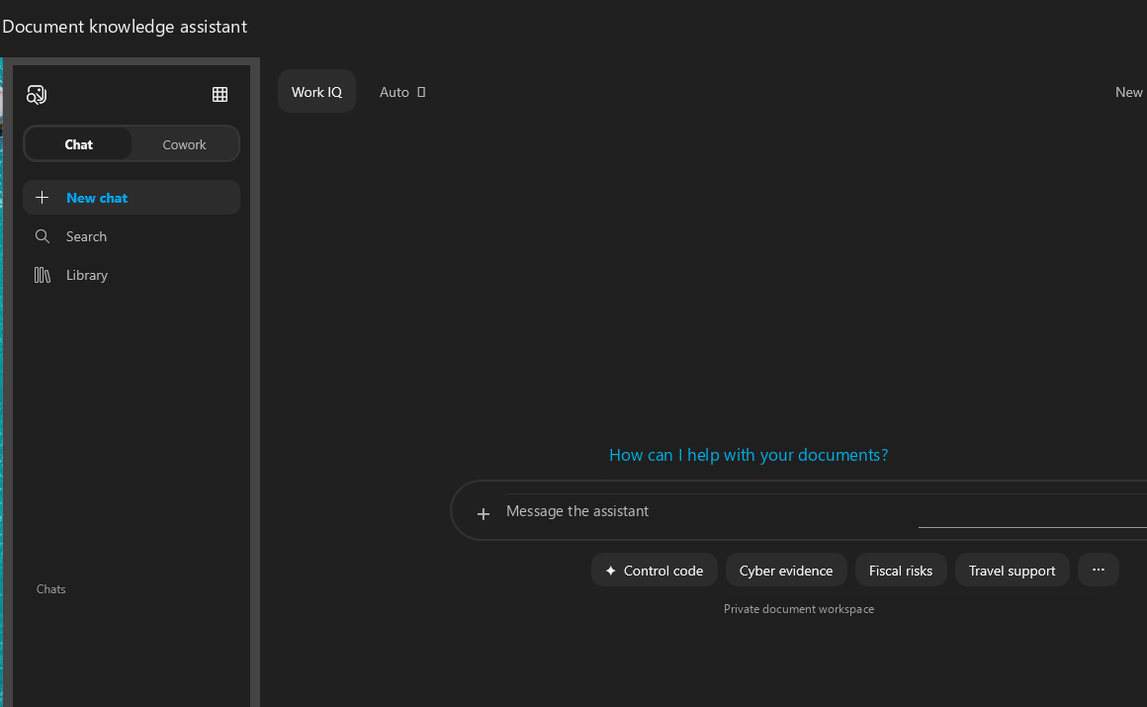
What we built
WORKING MVP
A working, reusable path from document upload to cited AI response.
Knowledge Assistant app
01
Private Windows chat UI with suggested prompts, citations, and multi-file Library upload.
Automated document pipeline
02
Blob Storage feeds an Azure AI Search indexer, integrated chunking, and vectorization.
Grounded AI response
03
Hybrid semantic/vector retrieval supplies relevant passages to GPT-4.1 for cited answers.
Secure customer handoff
04
Entra ID, RBAC, cloud-aware PowerShell deployment, sample data, and a full build guide.
Windows .NET MAUI experience: Chat + Library upload
Deliverables: guide | scripts | 15 synthetic PDFs | application source

Slide 5
Knowledge Assistant reference architecture
Two simple user journeys share the same governed Azure foundation.
DOCUMENT INGESTION
APP
Library
STO
Blob Storage
IDX
AI Search indexer
VEC
Vector + semantic index
Multi-file picker for Organization users
Organization-controlled source documents
Extracts, chunks, and enriches
Searchable passages and source metadata
Foundry model deployments
text-embedding-3-small | GPT-4.1
QUESTION + ANSWER
APP
Chat
RAG
Hybrid retrieval
GPT
GPT-4.1
ANS
Answer + citations
Natural-language question
Vector + keyword + semantic ranking
Grounded answer from retrieved passages
Filename and source path returned to the user
Microsoft Entra ID + Azure RBAC provide passwordless access across the app, Storage, Search, and Foundry.

Slide 6
VALUE TO Organization
A practical foundation for trusted,
repeatable document intelligence.
The MVP proves the workflow without forcing document contributors to become Azure operators.
01
Simple adoption
02
Faster discovery
03
Traceable answers
Library upload and conversational search fit familiar user behavior.
Staff locate relevant guidance across many documents in seconds.
Citations keep the original source visible and reviewable.
04
Identity-first security
05
Reusable platform
Entra ID and RBAC avoid embedded keys and shared credentials.
Scripts, configuration, and sample data accelerate the next environment.
LIVE MVP PROOF
1
Upload PDF
2
Reindex
3
Ask BLUE-CYPRESS-27
4
Receive cited fact
Customer-ready package: deployment guide, automation scripts, synthetic corpus, and source code.

