Slide 1
GENERIC SOLUTION DEMONSTRATION
Microsoft Foundry platform tour
THE PROBLEM
THE SOLUTION
Teams need a clear route from project access to model selection, agent configuration and operational review.
Follow a portal-oriented guide to discover models, build or code an agent, inspect endpoints and find project controls.
PRODUCTS AND PLATFORM
Microsoft Foundry | Model catalog and deployments | Foundry Agent Service | Microsoft Entra ID
A guided platform tour using saved portal views and presenter instructions. Most clicks and end-to-end execution are not captured.
Notes:
Problem: Teams need a clear route from project access to model selection, agent configuration and operational review.
Solution: Follow a portal-oriented guide to discover models, build or code an agent, inspect endpoints and find project controls.
Products: Microsoft Foundry | Model catalog and deployments | Foundry Agent Service | Microsoft Entra ID
Evidence status: A guided platform tour using saved portal views and presenter instructions. Most clicks and end-to-end execution are not captured.
Customer branding, organization labels and resource identifiers have been generalized. Screenshots are edited historical captures; no service results were rerun.

Slide 2
SOLUTION ARCHITECTURE
How the solution fits together
LOGICAL FLOW / REFERENCE VIEW
01
02
03
04
Identity + project
Model catalog
Agent development
Operate
Authorized project access
Choose / deploy a model
Configure or write code
Endpoints + governance
This is a conceptual platform path, not evidence that a specific agent, evaluation, tracing pipeline or hosted application was deployed.
Generic labels and edited screenshots | Historical results are illustrative, not rerun
START TOUR >
Notes:
Architecture: [['Identity + project', 'Authorized project access'], ['Model catalog', 'Choose / deploy a model'], ['Agent development', 'Configure or write code'], ['Operate', 'Endpoints + governance']]
Boundary: This is a conceptual platform path, not evidence that a specific agent, evaluation, tracing pipeline or hosted application was deployed.
This is a logical diagram, not a verified deployment inventory. Arrows show the conceptual information flow.
Customer names, logos and resource identifiers in subsequent captured screens have been generalized. Service brands and the solution's core workflow remain.

Slide 3
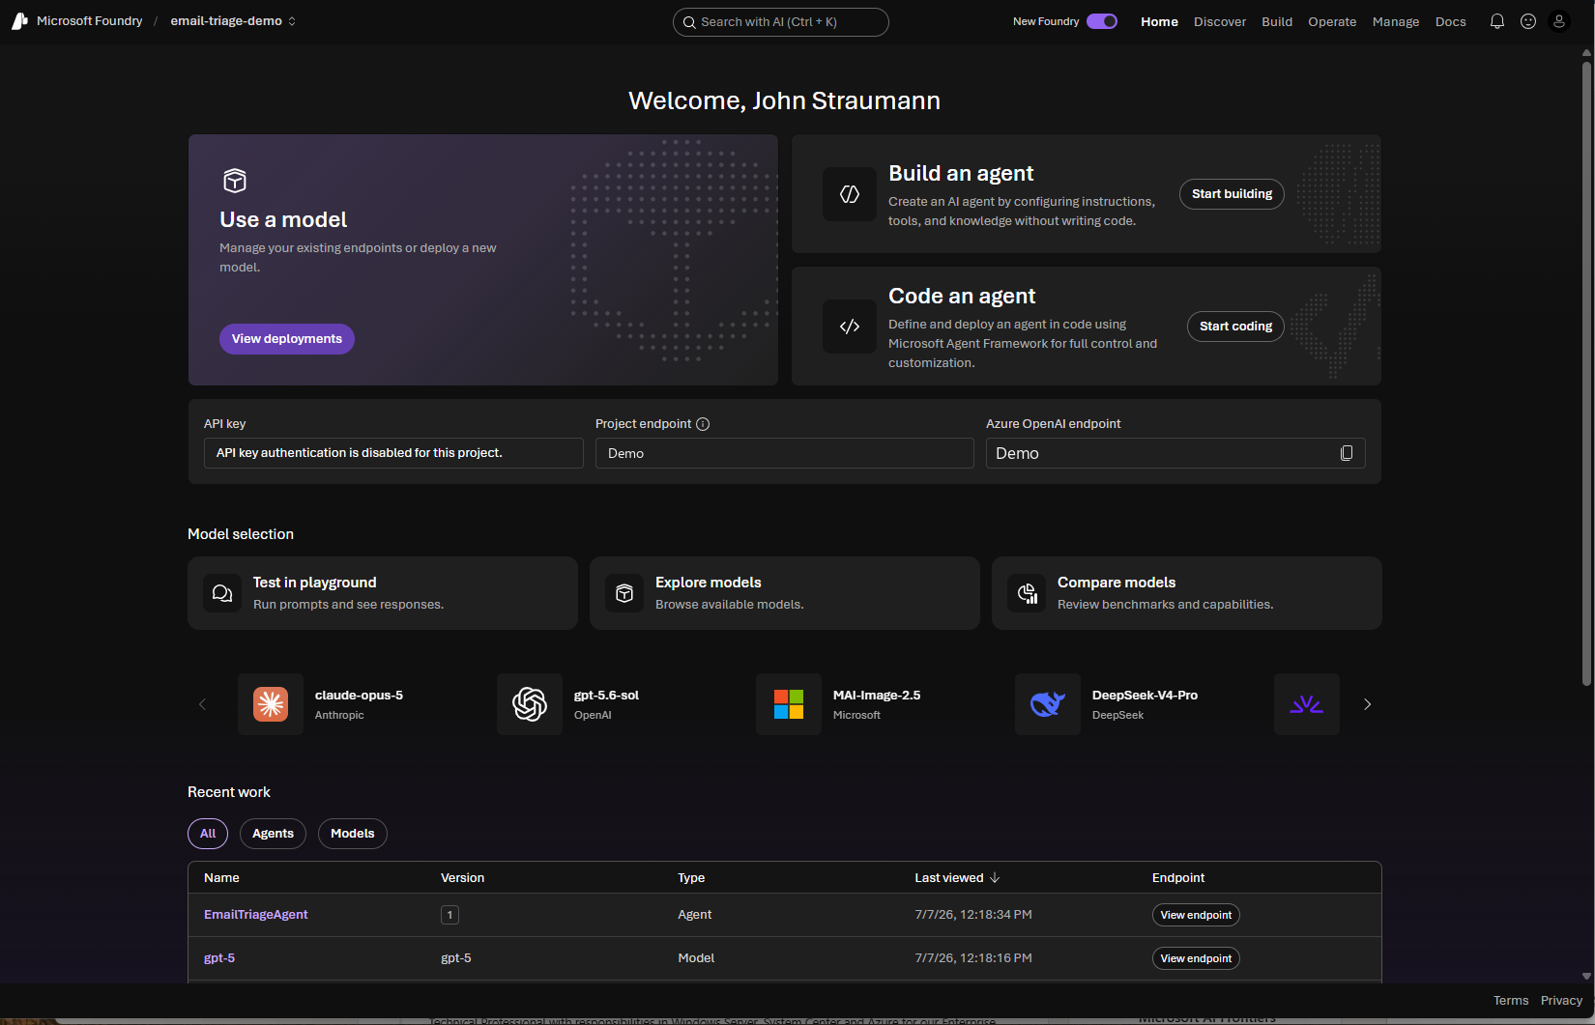
MICROSOFT FOUNDRY
General Overview
Demo Guide
A presenter-ready tour from model discovery to enterprise operations
Prepared September 2, 2026
Microsoft Foundry | General overview demo
01
Notes:
CLICK STEPS
1. Open the Foundry portal at ai.azure.com.
2. Select the email-triage-demo project.
3. Confirm the New Foundry toggle is on.
SPEAKER NOTES
Set the expectation that this is a broad platform tour, not a deep technical build. Microsoft Foundry brings models, agents, tools, evaluations, tracing, monitoring, security, and governance into one lifecycle. The sales message is speed with control: teams can prototype quickly and retain an enterprise path to production.

Slide 4
DEMO FRAMING
The story: one governed AI lifecycle
1
2
3
4
Discover
Build
Operate
Manage
Find models, tools, templates, and playgrounds.
Create agents, deploy models, add knowledge, and evaluate.
Observe quality, usage, health, cost, and compliance.
Control project resources, quota, access, and connectivity.
HOME accelerates the first action. DOCS keeps guidance one click away.
Microsoft Foundry | General overview demo
02
Notes:
CLICK STEPS
1. Point across the top navigation from Discover to Manage.
2. Explain that Home is the launchpad and Docs is contextual help.
3. Return to Home to begin the detailed tour.
SPEAKER NOTES
Frame the portal around the customer lifecycle rather than a list of features. Discover reduces selection risk, Build shortens development, Operate makes AI behavior measurable, and Manage applies enterprise controls. This structure helps technical and business stakeholders see how experimentation can mature into an operational service without switching platforms.

Slide 5
ORIENTATION
Home screen at a glance
1
2
3
9
1
Project context
2
AI search
4
3
Global navigation
4
Start actions
5
5
Endpoints
6
Model selection
6
7
Featured models
7
8
Recent work
9
Notifications & profile
8
Supplied Foundry Home screen
Microsoft Foundry | General overview demo
03
Notes:
CLICK STEPS
1. Pause on Home without clicking.
2. Scan from the top banner to the start-action cards.
3. Scroll slightly to show Model selection and Recent work.
SPEAKER NOTES
Home is a role-friendly launchpad. It exposes the fastest paths for common jobs: use a model, build an agent without code, code an agent with full control, copy endpoints, compare models, and reopen recent assets. The page lowers time-to-first-value while keeping the current project and enterprise context visible.

Slide 6

GLOBAL CONTROL
Foundry and project selector
Top-left project context
What it is
What it does
Business value
The Foundry application title and currently selected project establish the working scope.
Switch among recent projects, view all projects, create a project, or access legacy resources. Project-scoped pages update when the selection changes.
Projects isolate use cases, assets, endpoints, and access. A clear scope reduces accidental cross-project changes and supports environment or business-unit separation.
Microsoft Foundry | General overview demo
04
Notes:
CLICK STEPS
1. Select the project name email-triage-demo.
2. Show recent projects and the options to view all or create a project.
3. Close the selector without changing context.
SPEAKER NOTES
Explain that a project is the working container for an AI use case. Home, Discover, Build, and Manage are shown in the selected project context, while Operate can aggregate across projects. The selector is the first place to confirm before deploying or modifying an asset.

Slide 7

GLOBAL CONTROL
Search with AI
What it is
What it does
Business value
A keyboard-accessible global search entry point. The shortcut shown is Ctrl+K.
Helps locate models, tools, portal destinations, and relevant experiences without navigating every menu manually.
Improves discoverability and reduces training overhead, especially as the catalog and platform capabilities expand.
Search with AI (Ctrl+K)
Microsoft Foundry | General overview demo
05
Notes:
CLICK STEPS
1. Select Search with AI or press Ctrl+K.
2. Enter a capability, model name, or task such as compare models.
3. Open a result, then use the browser Back command to return.
SPEAKER NOTES
Position search as the fastest path when a user knows the outcome but not the portal location. It is especially useful during a live demo: search can recover quickly if menu labels differ slightly by tenant or release wave.

Slide 8
GLOBAL CONTROL
Experience switch and global actions
New Foundry, navigation, notifications, feedback, and profile
What it is
What it does
Business value
The New Foundry toggle changes between new and classic portal experiences. Global icons provide notifications, feedback/settings surfaces, and profile access.
The experience switch preserves current context when possible. Notifications surface service or resource events; profile controls identity and sign-out.
Supports transition from legacy workflows while keeping operators informed and identity-aware. Customers can adopt new capabilities without losing continuity for classic-only scenarios.
Microsoft Foundry | General overview demo
06
Notes:
CLICK STEPS
1. Point to New Foundry and keep it enabled.
2. Select the notification bell to show recent notices.
3. Point to the feedback/settings icon and profile menu; close each panel.
SPEAKER NOTES
Do not toggle experiences during the main demo unless a classic-only workflow is required. Explain that the new portal is the focus of ongoing investment, while classic remains available for unsupported resource types or migration scenarios. Notification labels can vary by release.

Slide 9
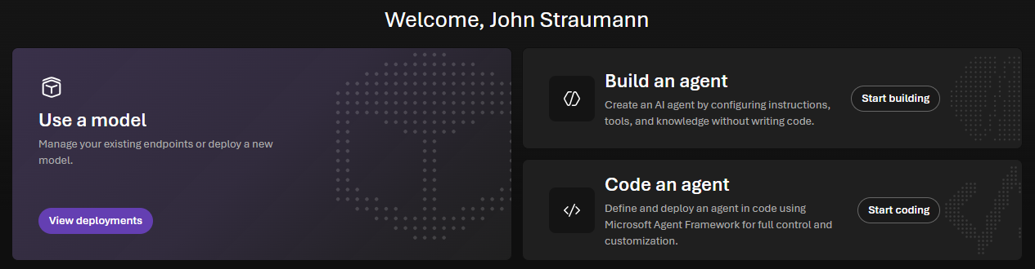
TOP-LEVEL NAVIGATION
Home
The Home launchpad
What it is
What it does
Business value
The project launchpad for the most common model and agent actions.
Provides direct starts for deployments, no-code agent creation, code-first agent development, endpoint access, model exploration, and recent assets.
Shortens onboarding and keeps users focused on outcomes rather than portal structure. Different personas can choose a no-code, code-first, or model-only path.
Microsoft Foundry | General overview demo
07
Notes:
CLICK STEPS
1. Select Home in the top navigation.
2. Point to the three primary cards: Use a model, Build an agent, and Code an agent.
3. Scroll to show endpoints, model selection, featured models, and recent work.
SPEAKER NOTES
Use Home as the hub between demo segments. It demonstrates that Foundry supports multiple maturity levels: business technologists can configure agents, developers can bring code, and app teams can consume model endpoints directly.

Slide 10
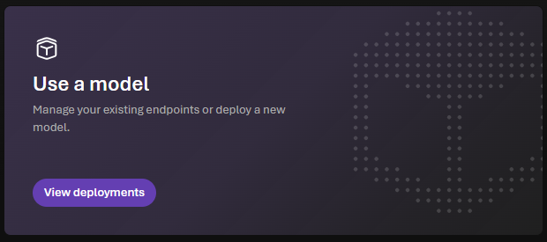
HOME COMPONENT
Use a model
What it is
A direct path to existing model deployments and new model deployment.
What it does
View deployments, open endpoint details, test deployed models, or begin selecting and deploying a new model.
Business value
Lets application teams consume AI without building an agent when a direct inference call is sufficient. This avoids unnecessary orchestration and accelerates simple scenarios.
Use a model and View deployments
Microsoft Foundry | General overview demo
08
Notes:
CLICK STEPS
1. On Home, select View deployments.
2. Review the deployed-model list.
3. Open one deployment to show its playground, endpoint, and code access; return Home.
SPEAKER NOTES
Clarify the distinction between a model and an agent. A model responds to prompts. An agent combines a model with instructions, tools, knowledge, and potentially memory to complete work. Start model-only when the workload does not require tool use or orchestration.

Slide 11
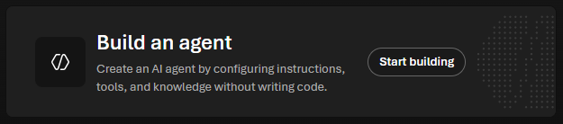
HOME COMPONENT
Build an agent
What it is
What it does
Business value
A portal-first path to create a prompt agent by configuring instructions, a model, tools, and knowledge.
Launches Agent Builder, where users can prototype behavior, attach enterprise data or actions, test conversations, version the agent, and publish supported experiences.
Enables rapid prototyping without managing runtime code or containers. Teams can validate a use case with stakeholders before investing in deeper engineering.
No-code / low-code agent entry point
Microsoft Foundry | General overview demo
09
Notes:
CLICK STEPS
1. On Home, select Start building.
2. Create or select a prompt agent.
3. Show model, instructions, tools/knowledge, test chat, and version/publish controls.
SPEAKER NOTES
Describe a prompt agent as the managed, declarative option. Foundry hosts the agent runtime, while the maker focuses on instructions and capabilities. Business value comes from compressing the prototype-feedback cycle and providing a governed path to deployment.

Slide 12
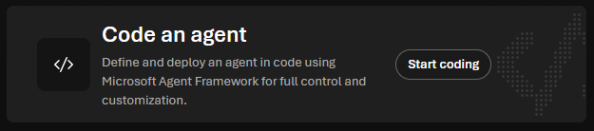
HOME COMPONENT
Code an agent
Full-control developer entry point
What it is
What it does
Business value
The code-first path for agents that need custom logic, frameworks, packages, or orchestration.
Guides developers toward Microsoft Agent Framework and hosted-agent patterns, with managed endpoints, identity, scaling, versioning, and observability.
Preserves developer control while offloading production hosting concerns. Existing agent code can gain enterprise deployment and operations capabilities.
Microsoft Foundry | General overview demo
10
Notes:
CLICK STEPS
1. On Home, select Start coding.
2. Review the available code-first guidance or scaffold path.
3. Explain where source code, containers, deployment, and traces fit in the lifecycle.
SPEAKER NOTES
Contrast this with Build an agent. The code-first route is appropriate when custom dependencies, orchestration, or open-source frameworks are essential. The customer retains code flexibility while Foundry provides the managed service boundary around deployment and operations.

Slide 13
HOME COMPONENT
Authentication and endpoints
What it is
What it does
Business value
Connection information for integrating applications and SDKs with the selected project and Azure OpenAI-compatible endpoint.
Displays the project endpoint, Azure OpenAI endpoint, authentication state, information help, and copy controls. API-key availability depends on project policy and feature.
Moves a validated prototype into application code quickly. Microsoft Entra ID and RBAC provide stronger enterprise permission granularity than shared keys.
Project and Azure OpenAI endpoints
Microsoft Foundry | General overview demo
11
Notes:
CLICK STEPS
1. Point to API key status.
2. Use the copy icon beside Project endpoint.
3. Point to the Azure OpenAI endpoint and explain compatibility; do not expose or copy secrets during a public demo.
SPEAKER NOTES
Emphasize that endpoints are the bridge from portal experimentation to production applications. In this project, API key authentication is disabled, which is a useful governance talking point: identity-based access supports role-based controls and avoids distributing long-lived secrets.

Slide 14
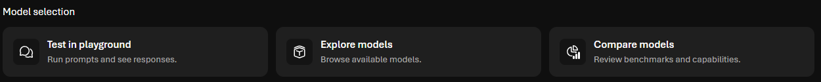
MODEL SELECTION
Test in playground
Model selection quick actions
What it is
What it does
Business value
An interactive environment for sending prompts and seeing model responses in real time.
Supports prompt iteration, system instructions, parameter tuning, tool use where supported, safety controls, code samples, and transition from a model test to an agent.
Reduces the cost and time of experimentation. Teams can validate behavior before writing integration code or committing to a model choice.
Microsoft Foundry | General overview demo
12
Notes:
CLICK STEPS
1. Select Test in playground.
2. Choose a deployed model if prompted.
3. Enter a representative prompt, review the response, then show setup and Code tabs.
SPEAKER NOTES
Use a realistic customer prompt rather than a generic joke or poem. Explain that the playground is a controlled test bench, not the production user experience. It helps teams tune prompts and understand behavior before implementation.

Slide 15
MODEL SELECTION
Explore models
What it is
What it does
Business value
The gateway to the Foundry model catalog, covering Microsoft, OpenAI, Anthropic, Meta, DeepSeek, and other providers.
Browse model cards, modalities, task fit, regions, deployment options, provider terms, benchmarks, and availability. Foundry documents a catalog of more than 10,000 models.
Avoids locking teams into one model prematurely. A broad governed catalog allows fit-for-purpose choices across quality, latency, cost, modality, and deployment requirements.
Browse available models
Microsoft Foundry | General overview demo
13
Notes:
CLICK STEPS
1. Select Explore models.
2. Filter by task, provider, modality, or deployment option.
3. Open a model card and point out capabilities, benchmarks, region availability, and Deploy.
SPEAKER NOTES
Model choice is a business decision as well as a technical one. The best model balances task quality, safety, latency, cost, data requirements, and regional availability. Encourage customers to evaluate with their own prompts and data rather than choosing by brand alone.

Slide 16
MODEL SELECTION
Compare models
Benchmark and side-by-side comparison
What it is
What it does
Business value
A side-by-side way to review model benchmarks and test multiple deployed models with synchronized prompts.
Compare quality, safety, performance, and cost benchmarks. In playground compare mode, run the same prompt across up to three models and inspect responses and latency together.
Turns model selection from opinion into evidence. Side-by-side testing helps prevent overpaying for capability or accepting a lower-quality model for a critical task.
Microsoft Foundry | General overview demo
14
Notes:
CLICK STEPS
1. Select Compare models.
2. Choose models or a leaderboard scenario.
3. Run the same representative prompt across selected models and discuss response quality, latency, and cost tradeoffs.
SPEAKER NOTES
Explain the difference between published benchmarks and workload-specific evaluation. Benchmarks narrow the field; customer prompts and evaluation datasets establish whether a model is suitable for the actual scenario.

Slide 17

HOME COMPONENT
Featured model carousel
What it is
What it does
Business value
A rotating set of highlighted models from multiple providers, surfaced for quick exploration.
Opens model details directly and exposes the breadth of the catalog without requiring a search. Carousel arrows reveal additional highlighted options.
Helps customers discover newly available or strategically relevant models and makes provider choice visible from the first screen.
Highlighted models from multiple providers
Microsoft Foundry | General overview demo
15
Notes:
CLICK STEPS
1. Point to the provider and model names.
2. Use the right carousel arrow to reveal more models.
3. Open one model card, then return Home.
SPEAKER NOTES
Use the carousel to reinforce model choice and avoid implying that every workload should use the same flagship model. Availability and featured selections change over time, which is why a live model card is the authoritative place for current details.

Slide 18
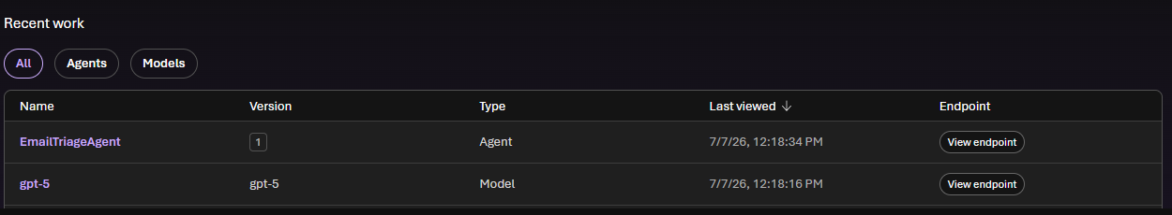
HOME COMPONENT
Recent work
Recently viewed project assets
What it is
What it does
Business value
A project-scoped list of recently viewed agents and model deployments.
Filter by All, Agents, or Models; sort by last viewed; reopen an asset; or jump directly to its endpoint.
Reduces navigation time for active projects and makes the handoff between prototyping and endpoint consumption fast.
Microsoft Foundry | General overview demo
16
Notes:
CLICK STEPS
1. Select the Agents filter, then Models, then All.
2. Point to Name, Version, Type, Last viewed, and Endpoint.
3. Open EmailTriageAgent or select View endpoint; return Home.
SPEAKER NOTES
The Recent work table is a practical productivity feature. It also illustrates asset versioning and the distinction between agents and models. During a demo, it provides a reliable way to return to a prepared asset without recreating it.

Slide 19

TOP-LEVEL NAVIGATION
Discover
Find the right building blocks before you commit engineering effort.
GA
GA
GA
Models
Tools
Solution templates
Search and filter the model catalog; review cards, capabilities, providers, regions, and deployment choices.
Discover tools and services that extend agents with actions, retrieval, content processing, and external systems.
Start from reference architectures and deployable examples for common AI scenarios.
GA / PREVIEW
PREVIEW
GA
Playgrounds
Leaderboards
Search
Experiment with model, agent, image, and supported video experiences before building an application.
Compare models by quality, safety, performance, cost, and scenario-specific benchmarks.
Locate catalog assets and experiences by task, provider, or capability.
Preview status can vary by capability, region, and release wave.
Microsoft Foundry | General overview demo
17
Notes:
CLICK STEPS
1. Select Discover in the top navigation.
2. Walk through Models, Tools, Solution templates, Playgrounds, and leaderboards if visible.
3. Open a model card and show the deploy or playground action.
SPEAKER NOTES
Discover reduces selection risk. It centralizes models, tools, templates, and experimentation so teams can compare options before writing code. The business value is faster architecture decisions with fewer disconnected vendor evaluations. Point out preview labels and verify regional availability for production planning.

Slide 20
TOP-LEVEL NAVIGATION
Build
Turn selected models and tools into testable, deployable AI solutions.
CORE GA
GA
GA*
Agents
Models
Tools & toolboxes
Create prompt agents or host code-based agents; configure instructions, tools, knowledge, versions, and publishing.
Deploy models, open playgrounds, manage endpoint settings, and access inference code.
Connect governed actions and reusable tool endpoints to agents.
MIXED
GA*
MIXED
Knowledge & data
Evaluation & red teaming
Tracing, guardrails & tuning
Ground responses with project data, retrieval, vector stores, and Foundry IQ capabilities.
Measure quality, safety, groundedness, task completion, and adversarial resilience.
Debug execution, apply safety controls, and customize supported models.
Preview status can vary by capability, region, and release wave.
Microsoft Foundry | General overview demo
18
Notes:
CLICK STEPS
1. Select Build.
2. Open Agents and show a prepared agent.
3. Open Models, Evaluation, Tools, Data/Knowledge, and tracing or guardrail items that are enabled.
SPEAKER NOTES
Build is the primary maker workspace. It connects prototyping with engineering disciplines: versioning, evaluation, safety, grounding, and deployment. The value is not merely creating a demo; it is creating an asset that can be measured, governed, integrated, and operated.

Slide 21
TOP-LEVEL NAVIGATION
Operate
See how AI systems behave across projects after they are deployed.
PREVIEW
PREVIEW
CAPABILITY
Overview
Assets
Monitoring
Cross-project operational view with filters for projects and time range, including usage and estimated cost signals.
Inventory agents and other operational assets; inspect status, ownership, usage, and cost where available.
Track latency, throughput, token consumption, errors, quality scores, and agent health through Azure Monitor integration.
GA / PREVIEW
PREVIEW
CAPABILITY
Tracing
Compliance
Alerts & feedback
Inspect model calls, tool invocations, agent decisions, dependencies, errors, and timing using OpenTelemetry-based traces.
Review governance and compliance posture across the selected operational scope.
Use operational signals and end-user feedback to identify quality, safety, and reliability issues.
Preview status can vary by capability, region, and release wave.
Microsoft Foundry | General overview demo
19
Notes:
CLICK STEPS
1. Select Operate.
2. Set the project and date filters in Overview.
3. Open Assets, then show a prepared agent's monitoring dashboard and one trace if data exists.
SPEAKER NOTES
Operate is where AI becomes accountable. Traditional uptime is not enough; teams need quality, safety, cost, latency, and tool-use visibility. Foundry combines evaluation, monitoring, and tracing so operators can understand both whether an agent succeeded and why it behaved as it did.

Slide 22
TOP-LEVEL NAVIGATION
Manage
Apply the resource, quota, identity, and connectivity controls behind the project.
GA
GA
GA
Project details
Resource details
Quota
Review project identity, endpoints, connected resources, and project-level configuration.
Inspect the backing Foundry resource and open it in Azure portal for broader resource administration.
Review model capacity and regional quota to plan and troubleshoot deployments.
PLATFORM
MIXED
PREVIEW
Access & identity
Networking & policy
AI Gateway
Use Microsoft Entra ID, managed identities, and RBAC to control who and what can access resources.
Apply network isolation, Azure Policy, content controls, and enterprise configuration where supported.
Centralize gateway controls and governance for AI traffic where the preview capability is enabled.
Preview status can vary by capability, region, and release wave.
Microsoft Foundry | General overview demo
20
Notes:
CLICK STEPS
1. Select Manage.
2. Open Project details and Resource details.
3. Show Quota, then point out identity, access, networking, policy, or AI Gateway items available in the tenant.
SPEAKER NOTES
Manage is the enterprise foundation beneath the developer experience. The sales value is centralized control: projects can move quickly while platform teams retain visibility over identity, capacity, network boundaries, and policy. Mention that some controls are completed in Azure portal and some capabilities remain in preview.

Slide 23
TOP-LEVEL NAVIGATION
Docs
Move from portal exploration to repeatable implementation with authoritative guidance.
GA
GA
Concepts
Quickstarts
Understand platform architecture, agents, models, tools, observability, security, and governance.
Complete a first model call, build an agent, deploy a model, or configure a project.
GA
GA*
How-to guides
API & SDK reference
Follow task-oriented procedures for development, evaluation, tracing, monitoring, networking, and deployment.
Use supported Python, C#, JavaScript, Java, REST, CLI, and developer-tool surfaces.
Microsoft Foundry | General overview demo
21
Notes:
CLICK STEPS
1. Select Docs in the top navigation.
2. Search for the feature currently being demonstrated.
3. Open a quickstart or API reference in a new tab, then return to the portal.
SPEAKER NOTES
Docs is part of the product journey, not an afterthought. It gives developers and architects current implementation details, prerequisites, regional notes, and preview status. Because portal labels and capabilities evolve, documentation is the authoritative source for production planning.

Slide 24
SUGGESTED SUMMARY
Close with outcomes, not features
OUTCOME 1
OUTCOME 2
Faster selection
Faster creation
Discover and compare models, tools, and templates.
Build declaratively or with full code control.
OUTCOME 3
OUTCOME 4
Measurable AI
Enterprise control
Evaluate, trace, monitor, and improve behavior.
Apply identity, policy, networking, quota, and governance.
Microsoft Foundry: move from AI idea to governed production on one platform.
Microsoft Foundry | General overview demo
22
Notes:
CLICK STEPS
1. Return to Home.
2. Recap Discover, Build, Operate, and Manage in one sentence each.
3. Open the prepared EmailTriageAgent only if time remains for a scenario-specific follow-up.
SPEAKER NOTES
End on the customer outcome: Foundry reduces the handoffs between experimentation, engineering, operations, and governance. It supports a progressive path from a single model call to a tool-using agent, with the controls required to operate responsibly at enterprise scale. Avoid ending with a long feature list; connect the platform to faster time-to-value and lower operational risk.

