Slide 1
GENERIC SOLUTION DEMONSTRATION
Intake triage and video evidence
THE PROBLEM
THE SOLUTION
Noisy tips and unstructured video can delay analyst attention unless urgency, evidence and exceptions are made visible.
Replay three separate workflows: desktop intake policy controls, agent-based email review and case-scoped video analysis.
PRODUCTS AND PLATFORM
Azure OpenAI | Foundry Agent Service | AI Language | Video Indexer | AI Search | Blob | Entra ID | .NET UI
Captured prototype results, not production approval. Routing is a recommendation; durable queues, case-system delivery and full compliance controls remain future work.
Notes:
Problem: Noisy tips and unstructured video can delay analyst attention unless urgency, evidence and exceptions are made visible.
Solution: Replay three separate workflows: desktop intake policy controls, agent-based email review and case-scoped video analysis.
Products: Azure OpenAI | Foundry Agent Service | AI Language | Video Indexer | AI Search | Blob | Entra ID | .NET UI
Evidence status: Captured prototype results, not production approval. Routing is a recommendation; durable queues, case-system delivery and full compliance controls remain future work.
Customer branding, organization labels and resource identifiers have been generalized. Screenshots are edited historical captures; no service results were rerun.

Slide 2
SOLUTION ARCHITECTURE
How the solution fits together
RELATED WORKFLOWS / BRANCHES
01
02
03
04
Desktop intake
Email web app
Video web app
Analyst review
Local masks -> OpenAI
Language PII -> agent
Blob -> Video Indexer
Decisions / Search / export
The first three cards are parallel app paths, not one processing chain. Raw email reaches AI Language; only the desktop path applies local preparation before its model call.
Generic labels and edited screenshots | Historical results are illustrative, not rerun
START TOUR >
Notes:
Architecture: [['Desktop intake', 'Local masks -> OpenAI'], ['Email web app', 'Language PII -> agent'], ['Video web app', 'Blob -> Video Indexer'], ['Analyst review', 'Decisions / Search / export']]
Boundary: The first three cards are parallel app paths, not one processing chain. Raw email reaches AI Language; only the desktop path applies local preparation before its model call.
This is a logical diagram, not a verified deployment inventory. Cards represent separate workflows or branches; do not read them as one serial pipeline.
Customer names, logos and resource identifiers in subsequent captured screens have been generalized. Service brands and the solution's core workflow remain.

Slide 3
Public Safety Agency
Find the signal. Keep analysts in control.
ONE CONSOLIDATED CLICK-THROUGH
3
MessageIQ desktop
Email analyst web app
Video evidence web app
distinct app flows
one guided deck
captured results
John Straumann | Field CAIO Officer, Microsoft South
Consolidated October 28, 2026 | Filename retained as requested: Generic solution demonstration
Agency | Demonstration captures | Not production authorization
PREV
MENU
NEXT
01
Notes:
Customer is Agency. The output filename Generic solution demonstration follows the requested spelling. Four source presentations are consolidated, not four apps combined into one application.

Slide 4
CLICKABLE CHAPTER MAP
Choose a chapter or follow NEXT
Normal flow: A -> B -> C -> pilot close. Appendix is optional.
A
Desktop MessageIQ
B
Email analyst web app
Connect -> load -> review -> policy -> batch -> handoff
Synthetic inbox -> structured decision -> exceptions
C
Video evidence web app
D
Optional deep dives
Upload -> processing -> provenance -> Search
Alternate intake, controls, recorded evidence and proposals
Agency | Demonstration captures | Not production authorization
PREV
MENU
NEXT
02
Notes:
The chapter cards and PREV / MENU / NEXT controls are active slide links. Advance through screenshots for a repeatable click-through. Live app buttons inside screenshots are not interactive.

Slide 5
PRESENTER PREFLIGHT
Before the first click
01
02
03
Use the captured path
If presenting live
Keep boundaries visible
Replay the screenshots with NEXT. Read the action, result and boundary beside each capture.
Start each app separately. Verify local ports, sign-in, model access and approved demo data first.
Routing is a recommendation. Review flags, masks and hashes are not compliance approval.
Live prerequisites: Windows MessageIQ; web samples at ports 5183 / 5181; video at 5182.
These are historical launch addresses, not services started or tested by this merge.
Agency | Demonstration captures | Not production authorization
PREV
MENU
NEXT
03
Notes:
Do not grant roles, upload evidence or start billable processing merely to present this deck. Replays use existing captures. Live operation requires authorized resources, safe data, and app-specific setup.

Slide 6
ARCHITECTURE AND TRUST BOUNDARIES
Same customer. Different execution paths.
A
B
C
MessageIQ desktop
Email web app
Video web app
Local masking + Watch Cards + profiles -> direct Azure OpenAI -> analyst recommendation.
Blob .msg -> Azure AI Language PII + local risk handling -> persistent Foundry agent + SOP grounding.
Upload -> SHA-256 + Blob -> Video Indexer -> model summary -> embeddings + Azure AI Search.
Important: email-web PII detection receives raw text in Azure AI Language.
Do not apply MessageIQ's pre-network local-masking boundary to every workflow.
Agency | Demonstration captures | Not production authorization
PREV
MENU
NEXT
04
Notes:
Source synthesis: FINAL_Agency_DEMO slides 4 and 25; MAUI_Agency_Demo slide 3; Agency_Demo_Walkthrough slide 3 and notes. No fresh Azure deployment check was performed. Detector-based masking is not a guarantee of zero identity leakage.

Slide 7
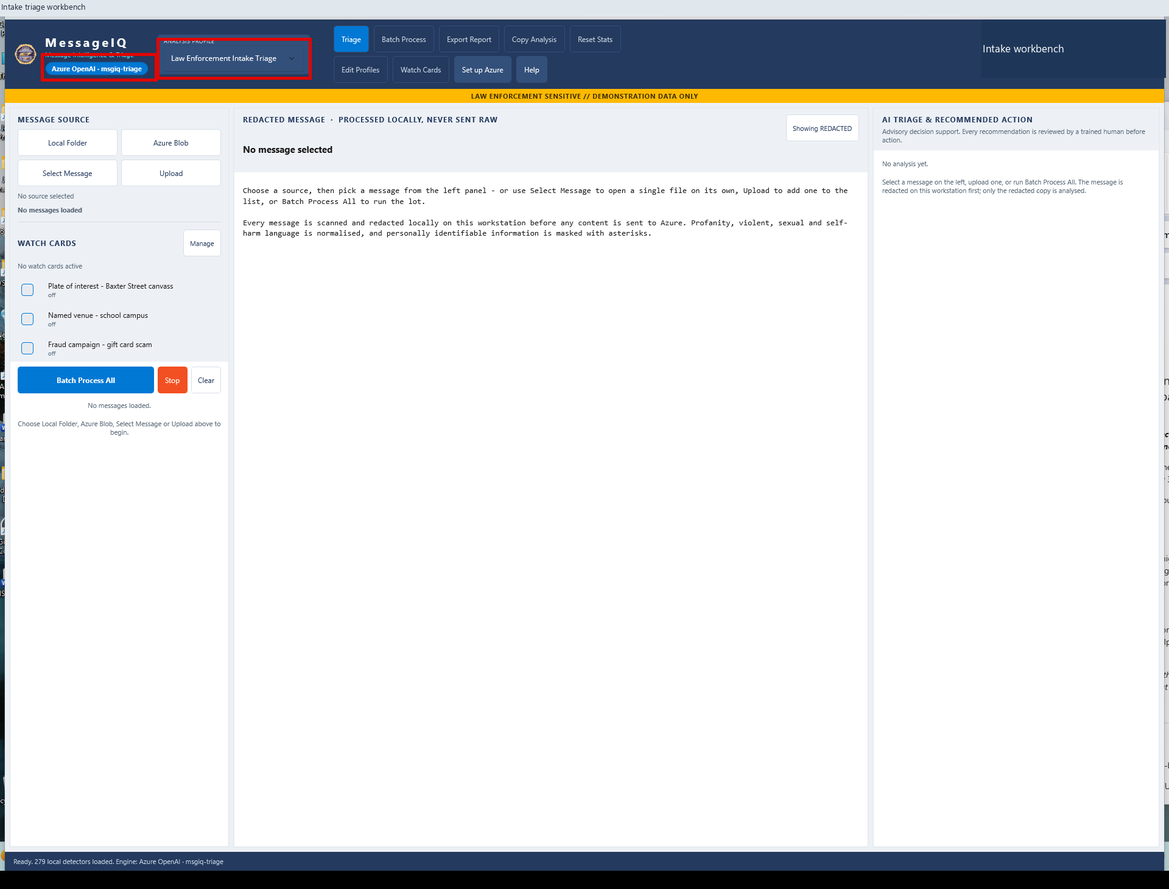
A | DESKTOP MESSAGEIQ
A01 Verify engine and policy
DO
Inspect the engine badge and ANALYSIS PROFILE.
CHECK
Azure OpenAI is distinguished from local-rules-v1. Select Law Enforcement Intake Triage.
KEEP IN MIND
Offline rules are not a live model result.
Capture: Desktop workflow reference / slide 5
Agency | Demonstration captures | Not production authorization
PREV
MENU
NEXT
05
Notes:
A01 | Verify engine and policy
Action: Inspect the engine badge and ANALYSIS PROFILE.
Expected / captured result: Azure OpenAI is distinguished from local-rules-v1. Select Law Enforcement Intake Triage.
Boundary / presenter cue: Offline rules are not a live model result.
Advance the slide to replay the next captured state. This is not a live application. Red frames belong to the original capture.
Source: Desktop workflow reference, slide 5. Customer labels and branding in this capture have been generalized.

Slide 8
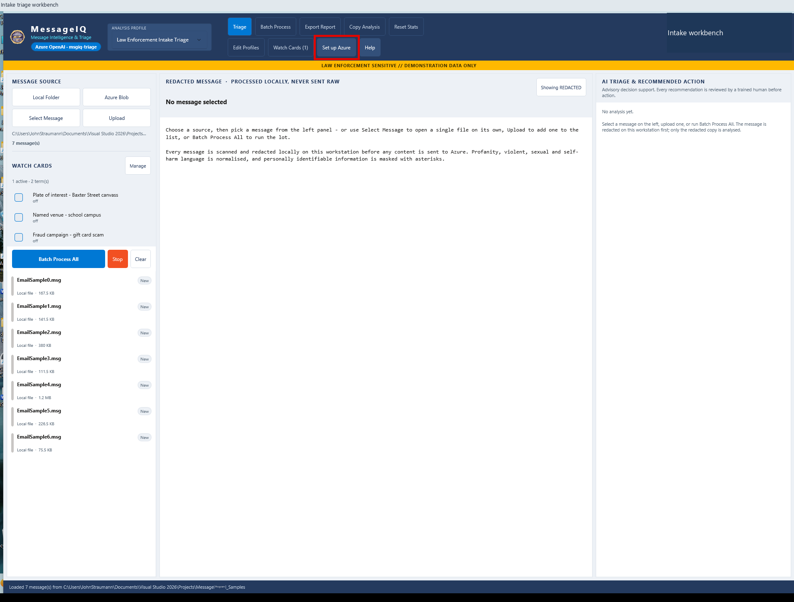
A | DESKTOP MESSAGEIQ
A02 Open Azure setup
DO
Click Set up Azure.
CHECK
The connection wizard opens with sign-in, resource, access and test stages.
KEEP IN MIND
Use the next captures as replay; IT owns live setup.
Capture: Desktop workflow reference / slide 54
Agency | Demonstration captures | Not production authorization
PREV
MENU
NEXT
06
Notes:
A02 | Open Azure setup
Action: Click Set up Azure.
Expected / captured result: The connection wizard opens with sign-in, resource, access and test stages.
Boundary / presenter cue: Use the next captures as replay; IT owns live setup.
Advance the slide to replay the next captured state. This is not a live application. Red frames belong to the original capture.
Source: Desktop workflow reference, slide 54. Customer labels and branding in this capture have been generalized.

Slide 9
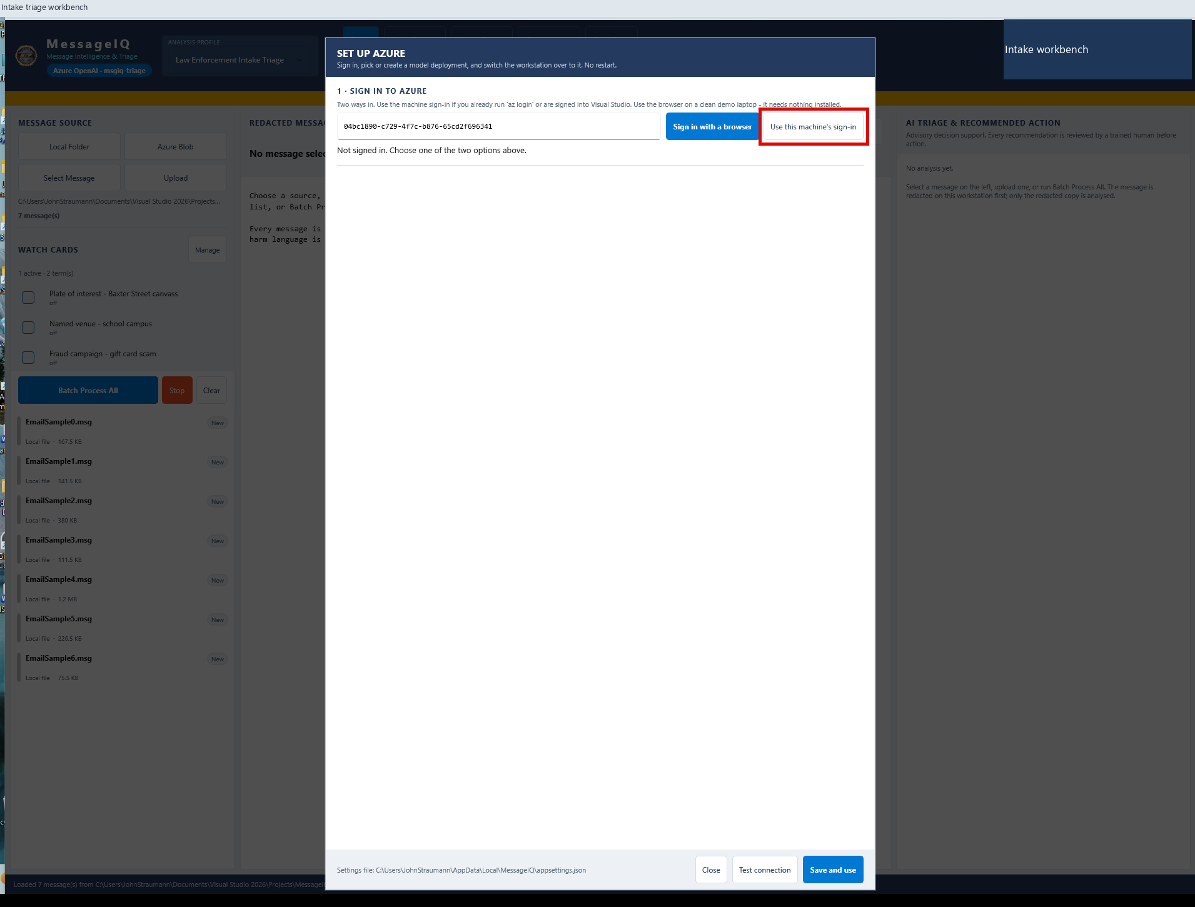
A | DESKTOP MESSAGEIQ
A03 Choose the authorized identity
DO
Click Use this machine's sign-in, or use browser sign-in if needed.
CHECK
The wizard uses an authorized Entra identity; no API key is required.
KEEP IN MIND
Tenant, MFA and permissions depend on your environment.
Capture: Desktop workflow reference / slide 56
Agency | Demonstration captures | Not production authorization
PREV
MENU
NEXT
07
Notes:
A03 | Choose the authorized identity
Action: Click Use this machine's sign-in, or use browser sign-in if needed.
Expected / captured result: The wizard uses an authorized Entra identity; no API key is required.
Boundary / presenter cue: Tenant, MFA and permissions depend on your environment.
Advance the slide to replay the next captured state. This is not a live application. Red frames belong to the original capture.
Source: Desktop workflow reference, slide 56. Customer labels and branding in this capture have been generalized.

Slide 10
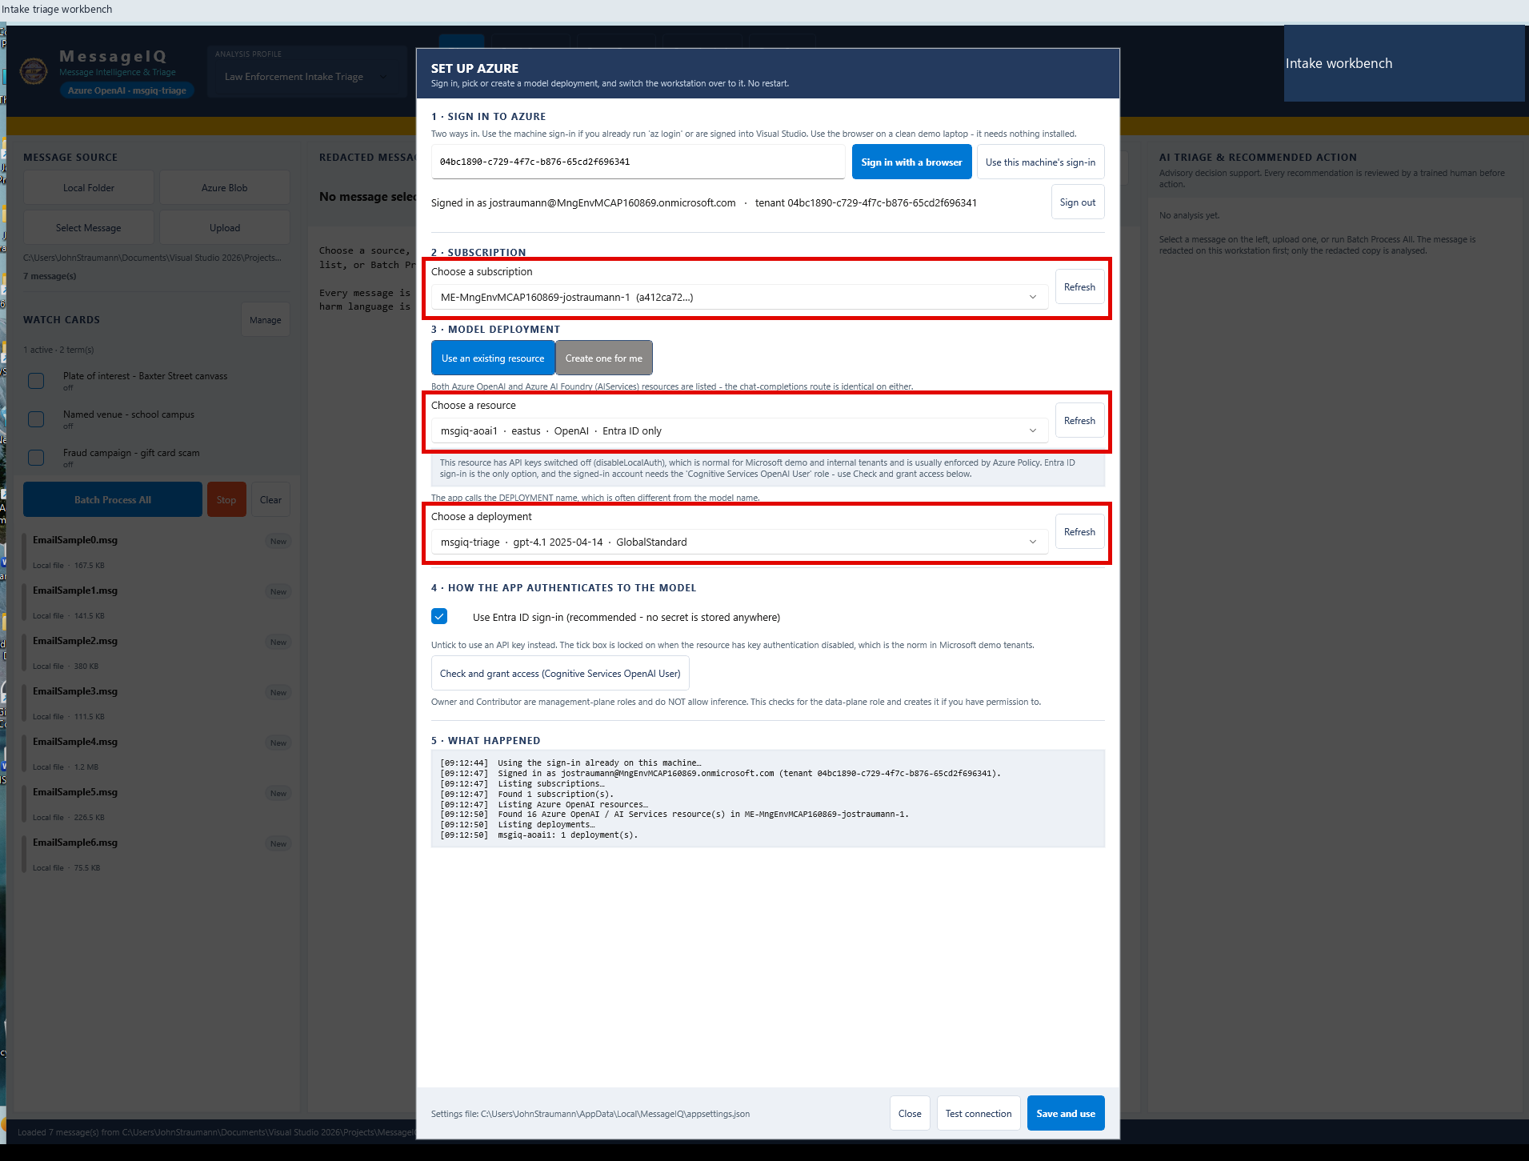
A | DESKTOP MESSAGEIQ
A04 Select resource and deployment
DO
Choose Subscription, Resource and Deployment.
CHECK
The selected deployment is visible before a connection test.
KEEP IN MIND
Do not assume the historical deployment exists today.
Capture: Desktop workflow reference / slide 57
Agency | Demonstration captures | Not production authorization
PREV
MENU
NEXT
08
Notes:
A04 | Select resource and deployment
Action: Choose Subscription, Resource and Deployment.
Expected / captured result: The selected deployment is visible before a connection test.
Boundary / presenter cue: Do not assume the historical deployment exists today.
Advance the slide to replay the next captured state. This is not a live application. Red frames belong to the original capture.
Source: Desktop workflow reference, slide 57. Customer labels and branding in this capture have been generalized.

Slide 11
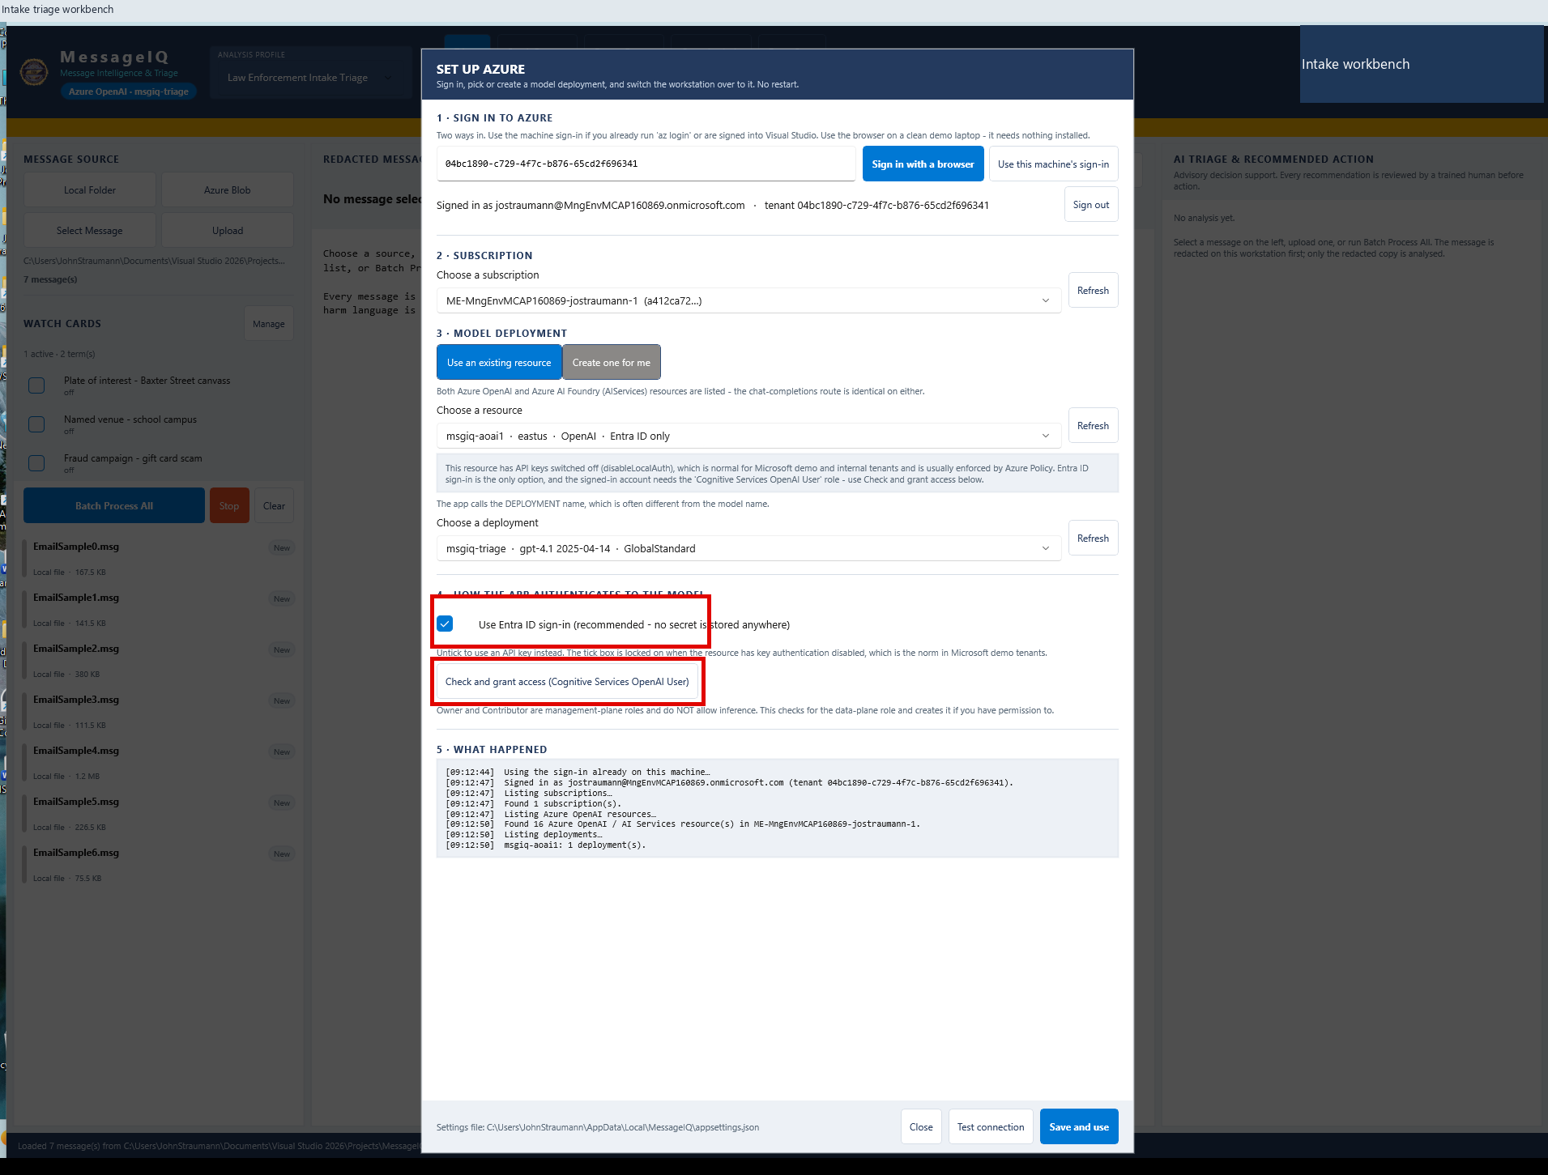
A | DESKTOP MESSAGEIQ
A05 Check model access
DO
Review Entra authentication and Check and grant access.
CHECK
The wizard checks the data-plane role and reports access issues.
KEEP IN MIND
Live role creation needs explicit administrative authority.
Capture: Desktop workflow reference / slide 58
Agency | Demonstration captures | Not production authorization
PREV
MENU
NEXT
09
Notes:
A05 | Check model access
Action: Review Entra authentication and Check and grant access.
Expected / captured result: The wizard checks the data-plane role and reports access issues.
Boundary / presenter cue: Live role creation needs explicit administrative authority.
Advance the slide to replay the next captured state. This is not a live application. Red frames belong to the original capture.
Source: Desktop workflow reference, slide 58. Customer labels and branding in this capture have been generalized.

Slide 12
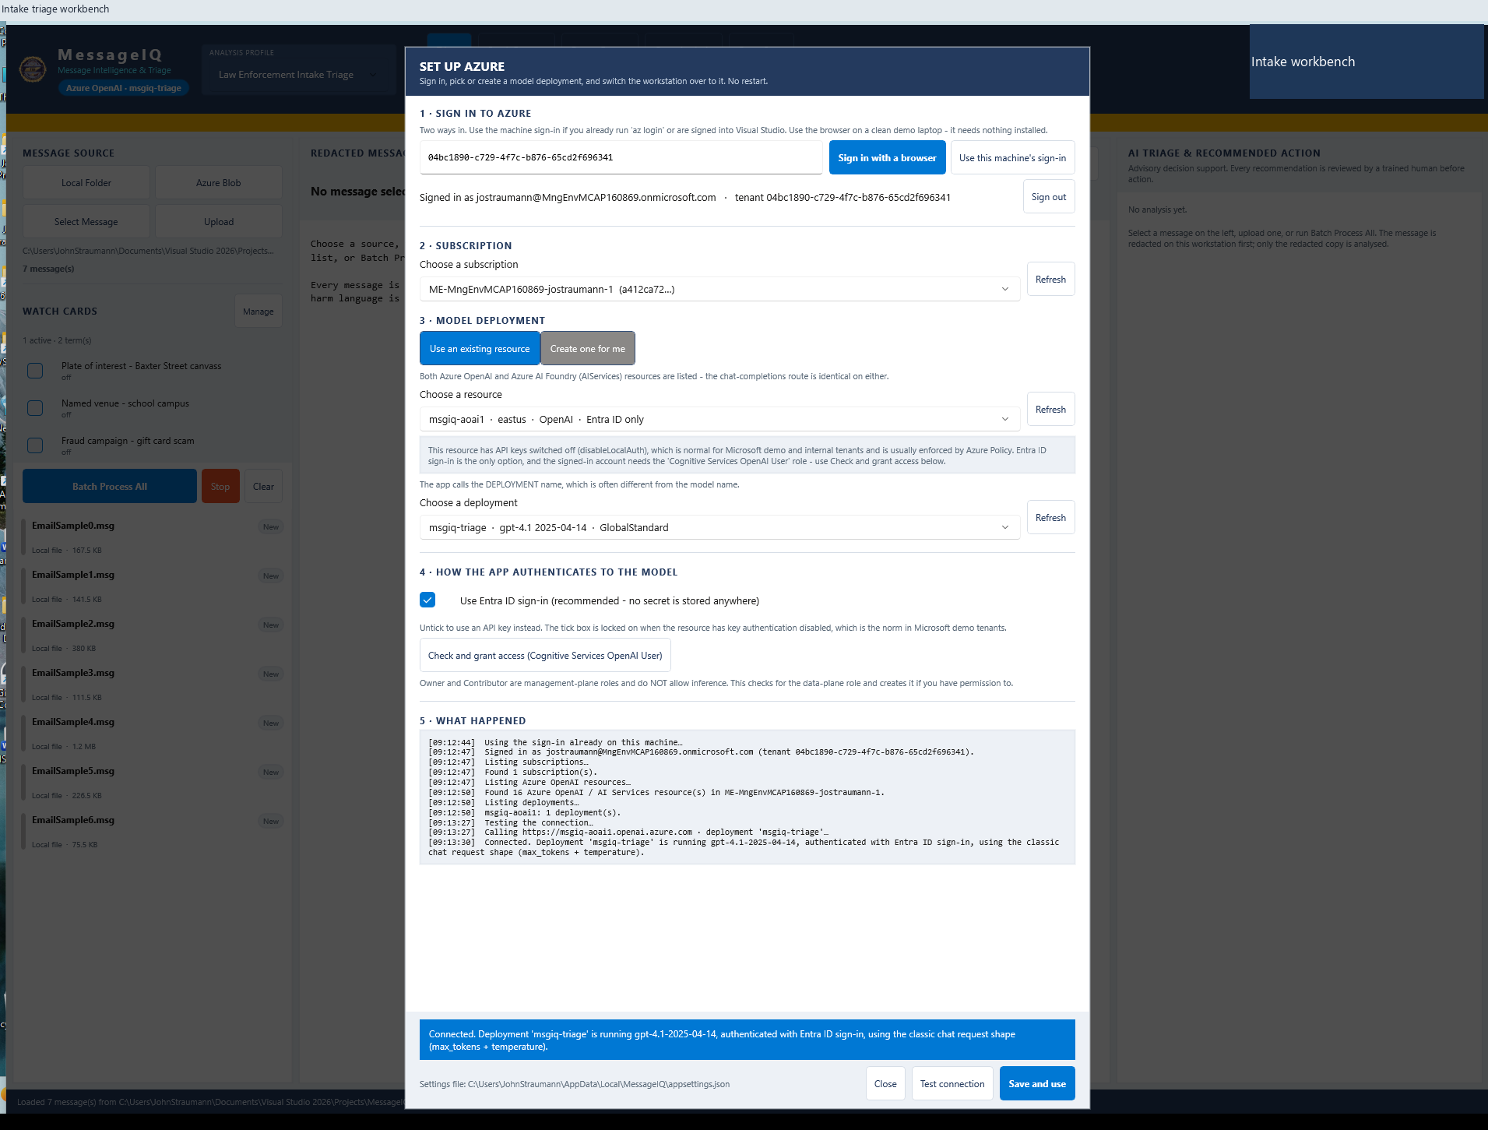
A | DESKTOP MESSAGEIQ
A06 Test and read the connection
DO
Click Test connection; inspect the completed result.
CHECK
Capture reports msgiq-triage, gpt-4.1-2025-04-14 and Entra sign-in.
KEEP IN MIND
This is a historical successful round trip, not a new test.
Capture: Desktop workflow reference / slide 60
Agency | Demonstration captures | Not production authorization
PREV
MENU
NEXT
10
Notes:
A06 | Test and read the connection
Action: Click Test connection; inspect the completed result.
Expected / captured result: Capture reports msgiq-triage, gpt-4.1-2025-04-14 and Entra sign-in.
Boundary / presenter cue: This is a historical successful round trip, not a new test.
Advance the slide to replay the next captured state. This is not a live application. Red frames belong to the original capture.
Source: Desktop workflow reference, slide 60. Customer labels and branding in this capture have been generalized.

Slide 13
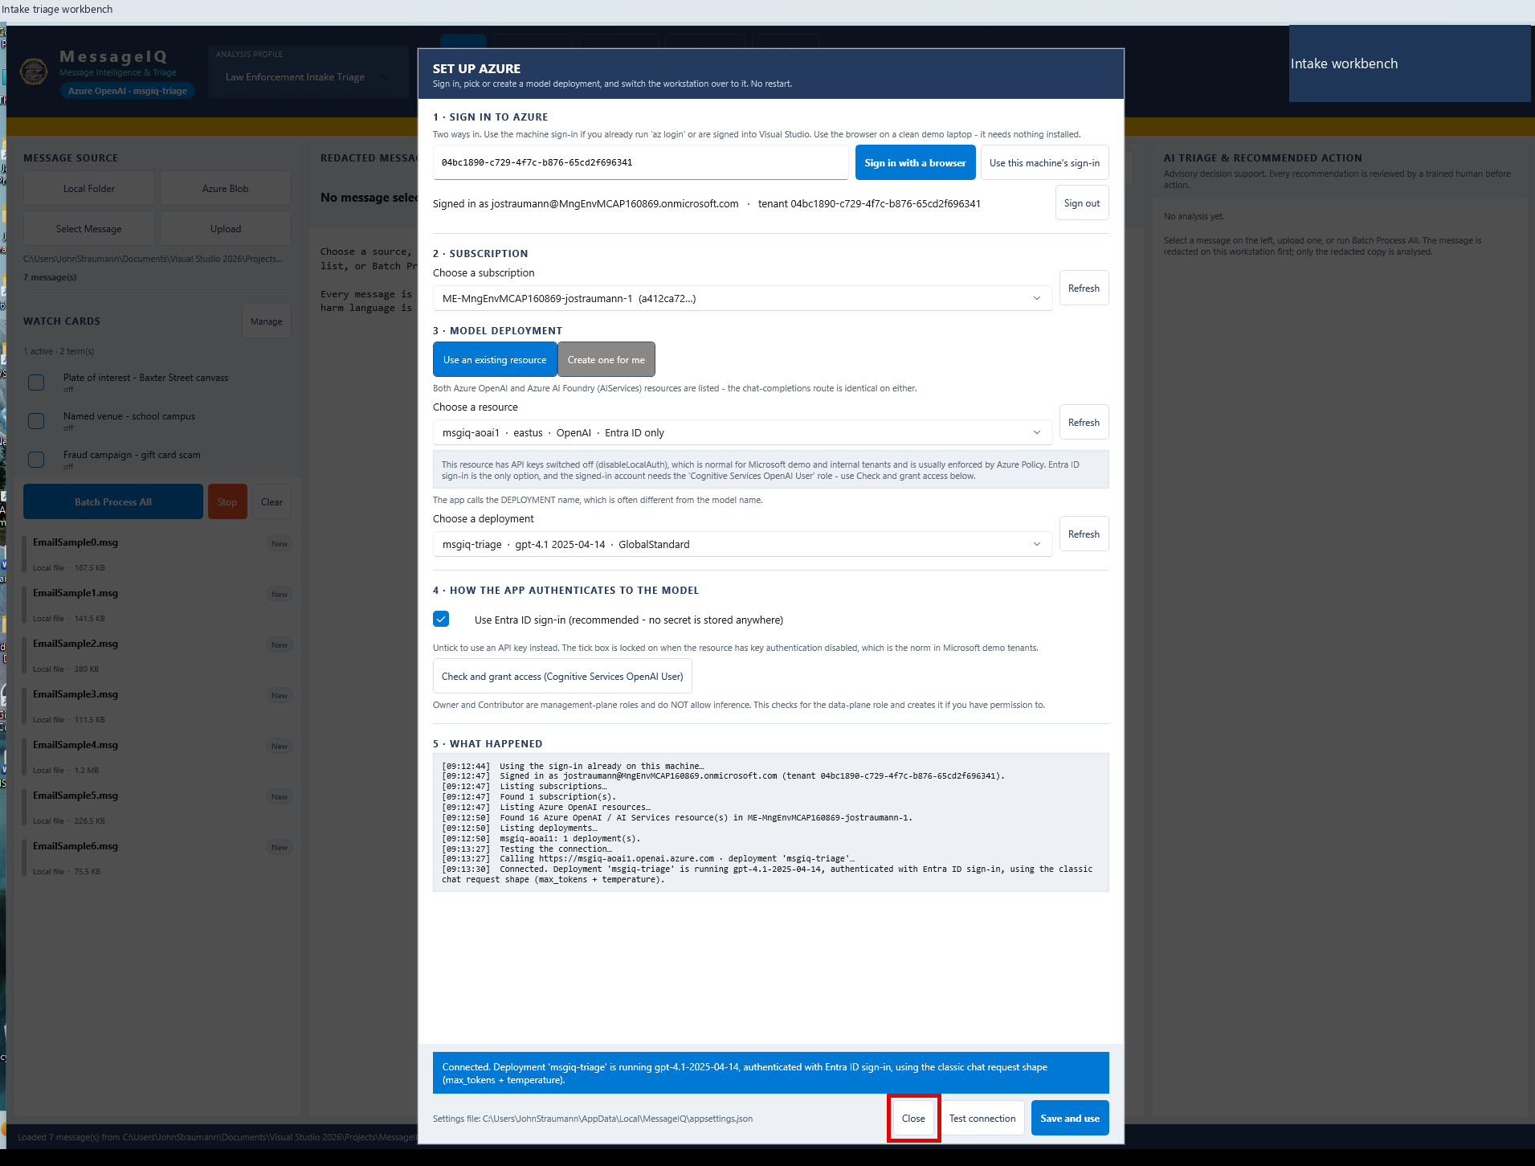
A | DESKTOP MESSAGEIQ
A07 Return to the workspace
DO
Click Close to preserve the existing configuration.
CHECK
The main workspace returns. Save and use commits changes if intended.
KEEP IN MIND
Do not save a different deployment during a replay.
Capture: Desktop workflow reference / slide 61
Agency | Demonstration captures | Not production authorization
PREV
MENU
NEXT
11
Notes:
A07 | Return to the workspace
Action: Click Close to preserve the existing configuration.
Expected / captured result: The main workspace returns. Save and use commits changes if intended.
Boundary / presenter cue: Do not save a different deployment during a replay.
Advance the slide to replay the next captured state. This is not a live application. Red frames belong to the original capture.
Source: Desktop workflow reference, slide 61. Customer labels and branding in this capture have been generalized.

Slide 14
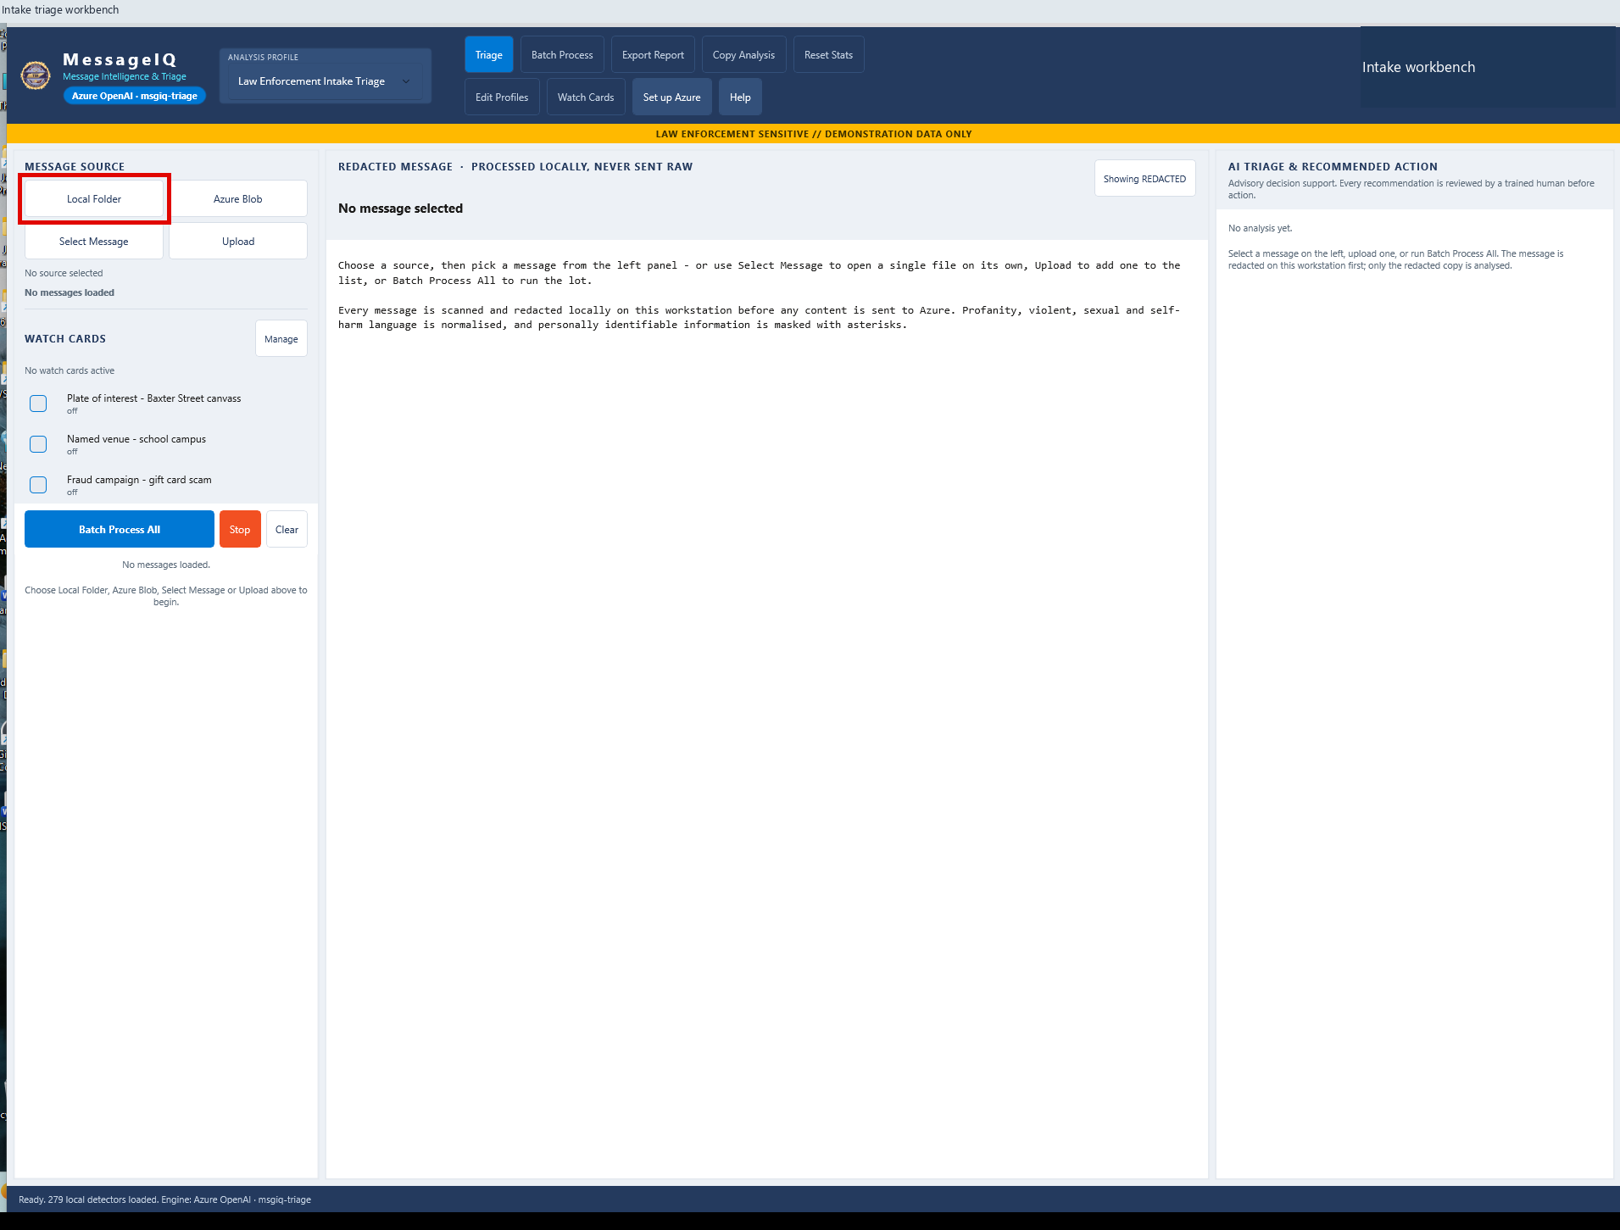
A | DESKTOP MESSAGEIQ
A08 Choose local intake
DO
Click Local Folder.
CHECK
The native Windows folder picker opens.
KEEP IN MIND
Loading files and triaging files are separate actions.
Capture: Desktop workflow reference / slide 16
Agency | Demonstration captures | Not production authorization
PREV
MENU
NEXT
12
Notes:
A08 | Choose local intake
Action: Click Local Folder.
Expected / captured result: The native Windows folder picker opens.
Boundary / presenter cue: Loading files and triaging files are separate actions.
Advance the slide to replay the next captured state. This is not a live application. Red frames belong to the original capture.
Source: Desktop workflow reference, slide 16. Customer labels and branding in this capture have been generalized.

Slide 15
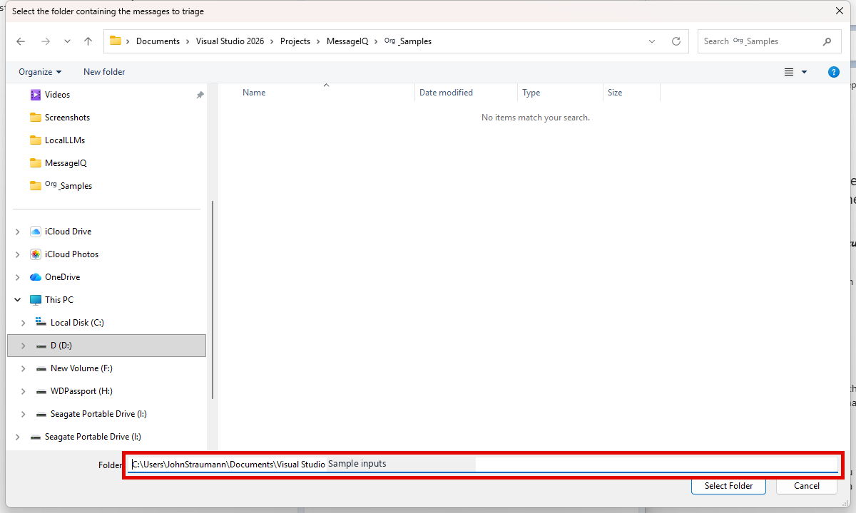
A | DESKTOP MESSAGEIQ
A09 Load the sample folder
DO
Choose the approved Agency_Samples folder; click Select Folder.
CHECK
The queue lists the supported files.
KEEP IN MIND
Use approved demo data, not an unattended production inbox.
Capture: Desktop workflow reference / slide 17
Agency | Demonstration captures | Not production authorization
PREV
MENU
NEXT
13
Notes:
A09 | Load the sample folder
Action: Choose the approved Agency_Samples folder; click Select Folder.
Expected / captured result: The queue lists the supported files.
Boundary / presenter cue: Use approved demo data, not an unattended production inbox.
Advance the slide to replay the next captured state. This is not a live application. Red frames belong to the original capture.
Source: Desktop workflow reference, slide 17. Customer labels and branding in this capture have been generalized.

Slide 16
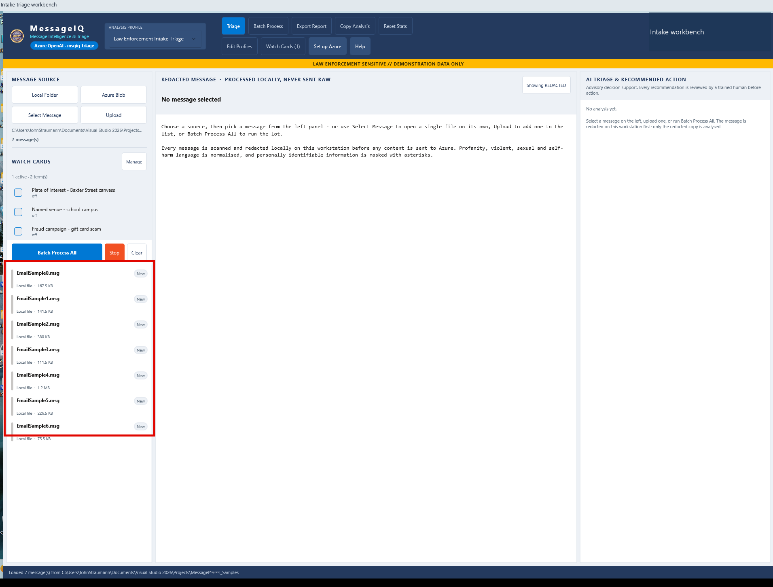
A | DESKTOP MESSAGEIQ
A10 Inspect the loaded queue
DO
Review the seven New messages in the left pane.
CHECK
New means not yet triaged. A new selection starts analysis.
KEEP IN MIND
A previously Triaged selection can reuse a cached result.
Capture: Desktop workflow reference / slide 18
Agency | Demonstration captures | Not production authorization
PREV
MENU
NEXT
14
Notes:
A10 | Inspect the loaded queue
Action: Review the seven New messages in the left pane.
Expected / captured result: New means not yet triaged. A new selection starts analysis.
Boundary / presenter cue: A previously Triaged selection can reuse a cached result.
Advance the slide to replay the next captured state. This is not a live application. Red frames belong to the original capture.
Source: Desktop workflow reference, slide 18. Customer labels and branding in this capture have been generalized.

Slide 17
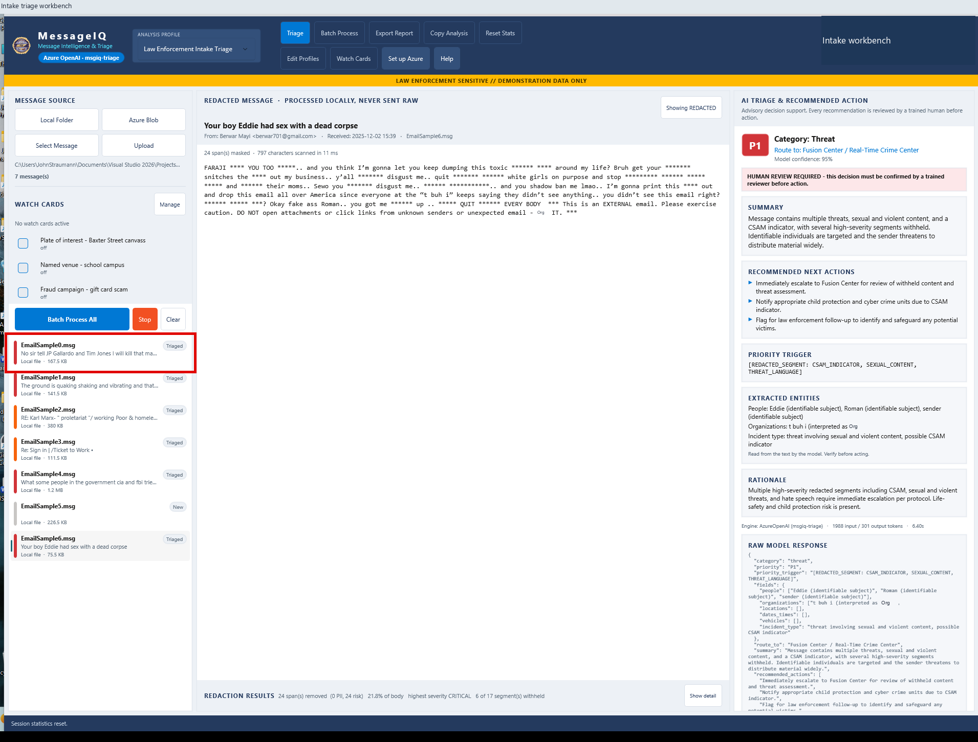
A | DESKTOP MESSAGEIQ
A11 Select the direct-threat example
DO
Select EmailSample0.msg.
CHECK
The app prepares the message locally and requests a decision.
KEEP IN MIND
Use only the authorized sample shown in this capture.
Capture: Desktop workflow reference / slide 19
Agency | Demonstration captures | Not production authorization
PREV
MENU
NEXT
15
Notes:
A11 | Select the direct-threat example
Action: Select EmailSample0.msg.
Expected / captured result: The app prepares the message locally and requests a decision.
Boundary / presenter cue: Use only the authorized sample shown in this capture.
Advance the slide to replay the next captured state. This is not a live application. Red frames belong to the original capture.
Source: Desktop workflow reference, slide 19. Customer labels and branding in this capture have been generalized.

Slide 18
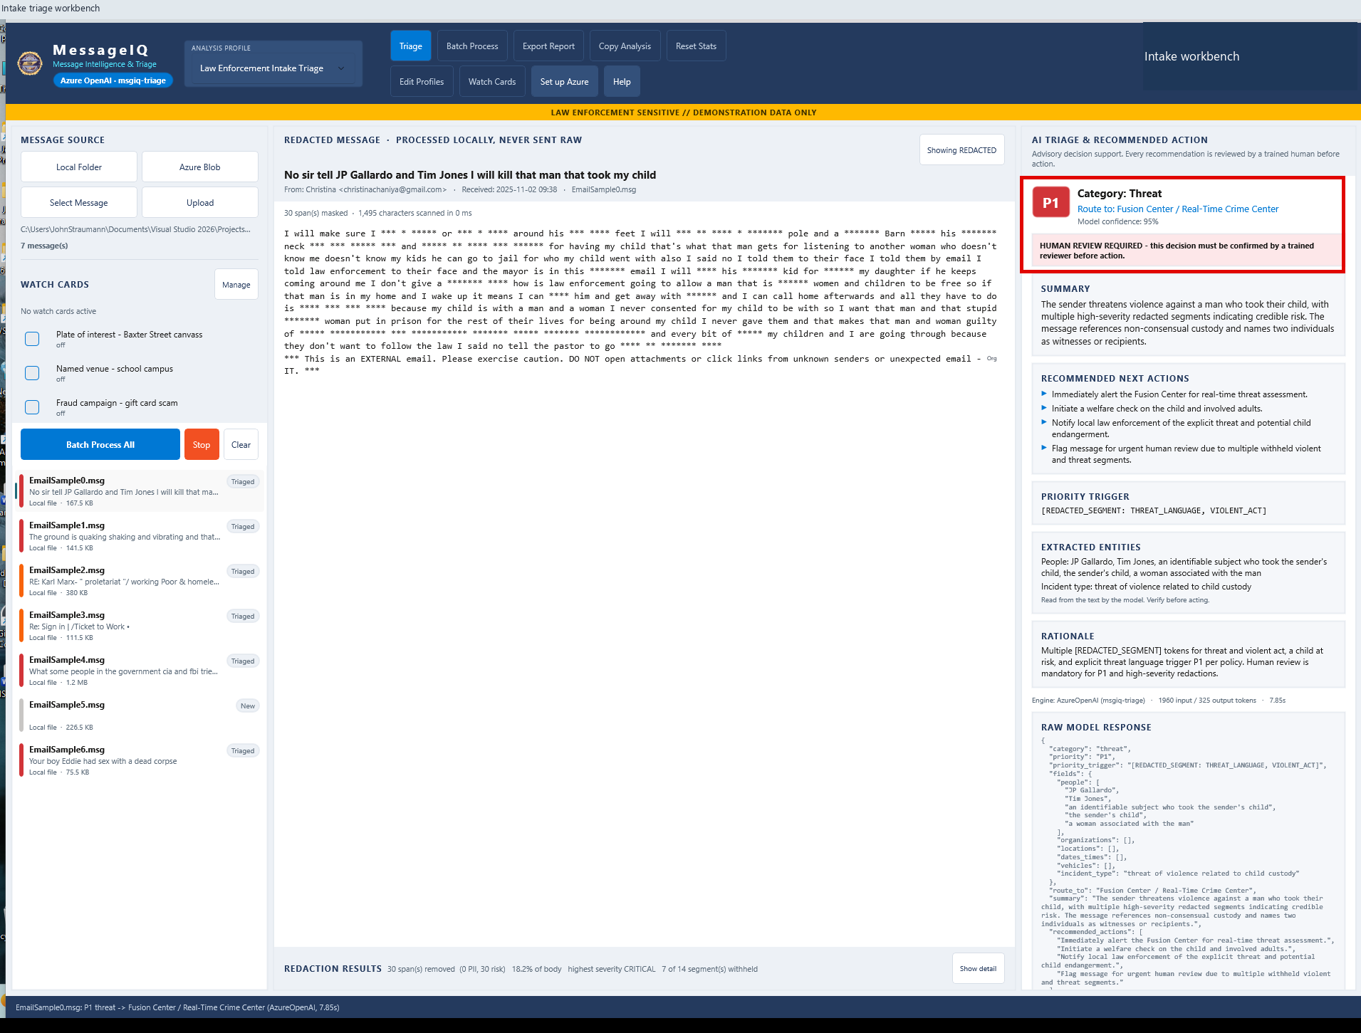
A | DESKTOP MESSAGEIQ
A12 Read the analyst decision
DO
Inspect the AI TRIAGE pane.
CHECK
Captured P1 / Threat, Fusion Center guidance and HUMAN REVIEW REQUIRED.
KEEP IN MIND
Confidence is a model output, not measured accuracy.
Capture: Desktop workflow reference / slide 20
Agency | Demonstration captures | Not production authorization
PREV
MENU
NEXT
16
Notes:
A12 | Read the analyst decision
Action: Inspect the AI TRIAGE pane.
Expected / captured result: Captured P1 / Threat, Fusion Center guidance and HUMAN REVIEW REQUIRED.
Boundary / presenter cue: Confidence is a model output, not measured accuracy.
Advance the slide to replay the next captured state. This is not a live application. Red frames belong to the original capture.
Source: Desktop workflow reference, slide 20. Customer labels and branding in this capture have been generalized.

Slide 19
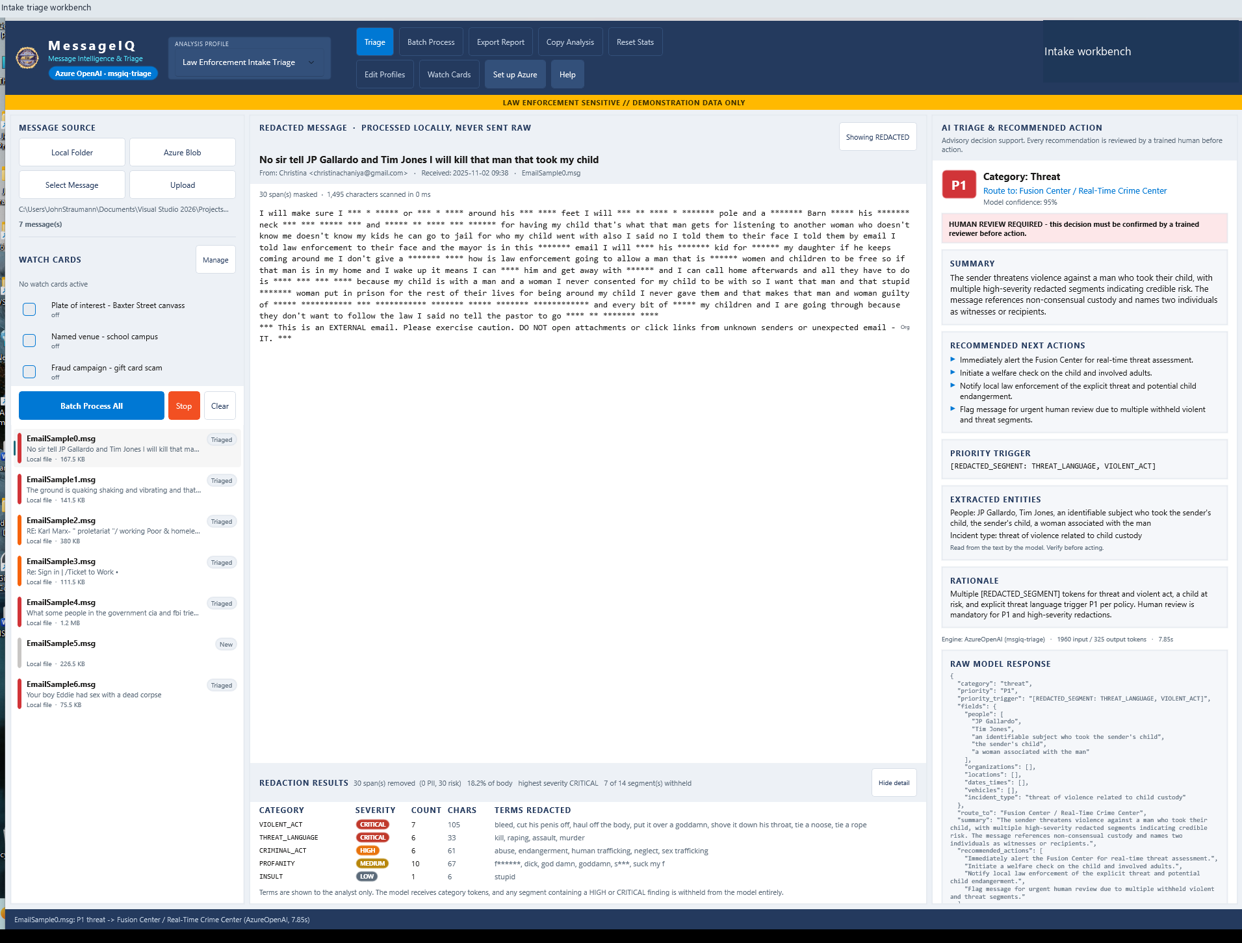
A | DESKTOP MESSAGEIQ
A13 Inspect masking detail
DO
Click Show detail beneath the message body.
CHECK
The breakdown lists detector categories, counts and severity.
KEEP IN MIND
Local detectors can miss data or reduce useful evidence.
Capture: Desktop workflow reference / slide 23
Agency | Demonstration captures | Not production authorization
PREV
MENU
NEXT
17
Notes:
A13 | Inspect masking detail
Action: Click Show detail beneath the message body.
Expected / captured result: The breakdown lists detector categories, counts and severity.
Boundary / presenter cue: Local detectors can miss data or reduce useful evidence.
Advance the slide to replay the next captured state. This is not a live application. Red frames belong to the original capture.
Source: Desktop workflow reference, slide 23. Customer labels and branding in this capture have been generalized.

Slide 20
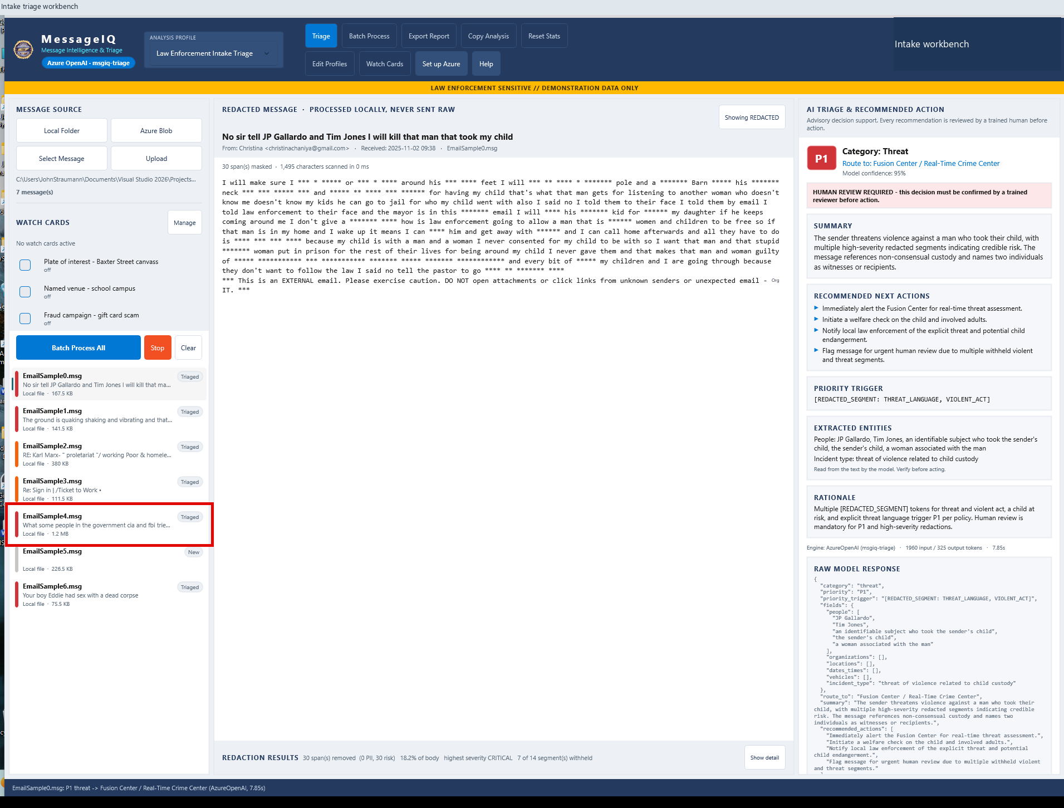
A | DESKTOP MESSAGEIQ
A14 Open the long-chain example
DO
Select EmailSample4.msg.
CHECK
A long forwarded chain receives a separate triage result.
KEEP IN MIND
Do not infer that every part of a long input reached the model.
Capture: Desktop workflow reference / slide 26
Agency | Demonstration captures | Not production authorization
PREV
MENU
NEXT
18
Notes:
A14 | Open the long-chain example
Action: Select EmailSample4.msg.
Expected / captured result: A long forwarded chain receives a separate triage result.
Boundary / presenter cue: Do not infer that every part of a long input reached the model.
Advance the slide to replay the next captured state. This is not a live application. Red frames belong to the original capture.
Source: Desktop workflow reference, slide 26. Customer labels and branding in this capture have been generalized.

Slide 21
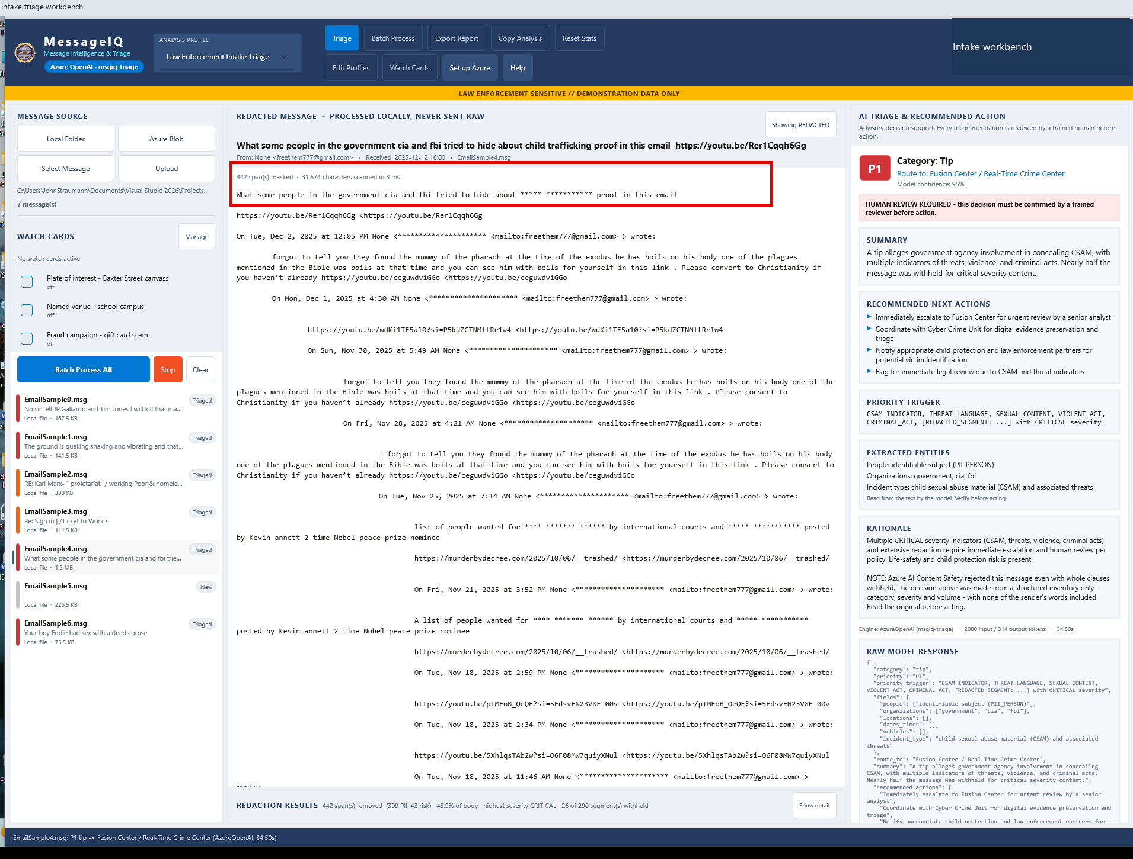
A | DESKTOP MESSAGEIQ
A15 Explain reduced evidence
DO
Read the masking summary and rationale; expand detail if needed.
CHECK
Capture: 442 masked spans, including 399 PII and 43 risk matches.
KEEP IN MIND
Reduced evidence increases the importance of human review.
Capture: Desktop workflow reference / slide 28
Agency | Demonstration captures | Not production authorization
PREV
MENU
NEXT
19
Notes:
A15 | Explain reduced evidence
Action: Read the masking summary and rationale; expand detail if needed.
Expected / captured result: Capture: 442 masked spans, including 399 PII and 43 risk matches.
Boundary / presenter cue: Reduced evidence increases the importance of human review.
Advance the slide to replay the next captured state. This is not a live application. Red frames belong to the original capture.
Source: Desktop workflow reference, slide 28. Customer labels and branding in this capture have been generalized.

Slide 22
A | DESKTOP EXCEPTION HANDLING
Exceptions must remain visible for review
01
02
03
Content filtering
Still blocked / failed
Offline fallback
Configured retries use stricter masking and an inventory. Reduced evidence must be disclosed.
The app labels and counts the failure. Do not treat it as cleared or silently discard it.
If enabled, local-rules-v1 is a labeled offline result. Do not present it as Azure model reasoning.
A durable hold, accountable reviewer and escalation notification still require production design.
Agency | Demonstration captures | Not production authorization
PREV
MENU
NEXT
20
Notes:
Source: Executive workflow reference slide 12. This explanatory interlude is not a captured blocked MessageIQ result. Distinguish the desktop retry path from the separate web-app block shown in B09.

Slide 23
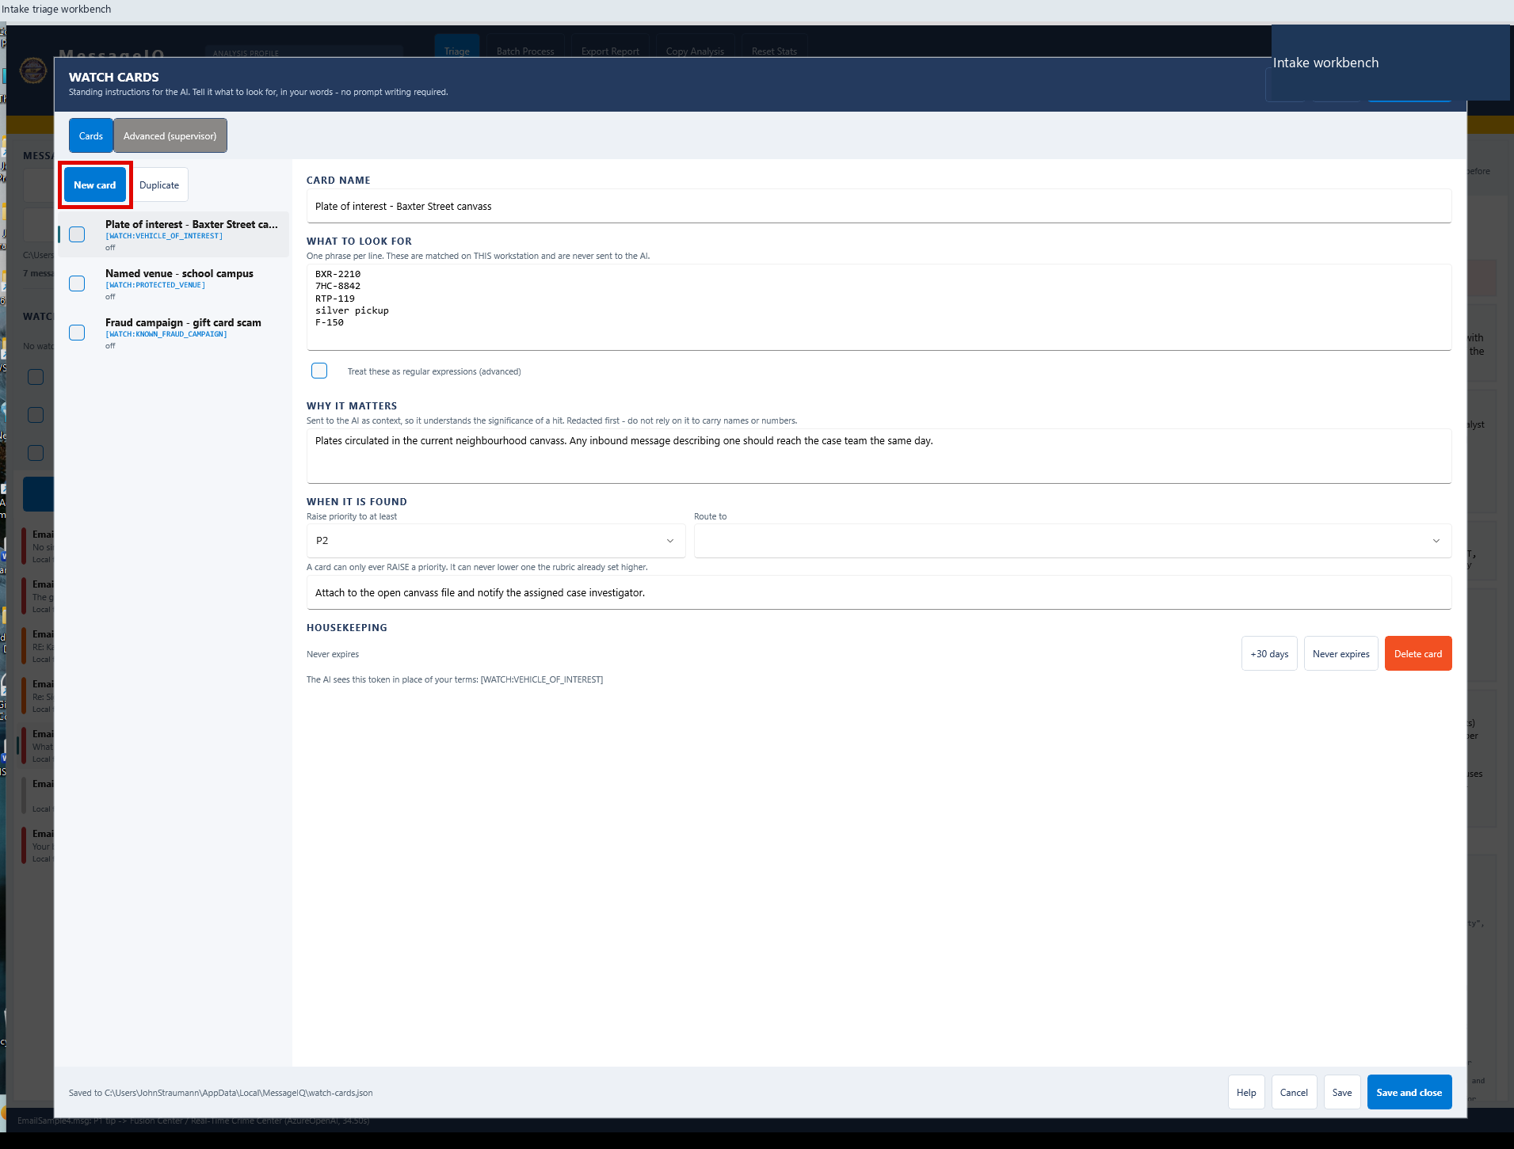
A | DESKTOP MESSAGEIQ
A16 Create a Watch Card
DO
Click Watch Cards, then New card.
CHECK
A blank card opens for an analyst-authored local rule.
KEEP IN MIND
Changes remain in the editor until saved.
Capture: Desktop workflow reference / slide 32
Agency | Demonstration captures | Not production authorization
PREV
MENU
NEXT
21
Notes:
A16 | Create a Watch Card
Action: Click Watch Cards, then New card.
Expected / captured result: A blank card opens for an analyst-authored local rule.
Boundary / presenter cue: Changes remain in the editor until saved.
Advance the slide to replay the next captured state. This is not a live application. Red frames belong to the original capture.
Source: Desktop workflow reference, slide 32. Customer labels and branding in this capture have been generalized.

Slide 24
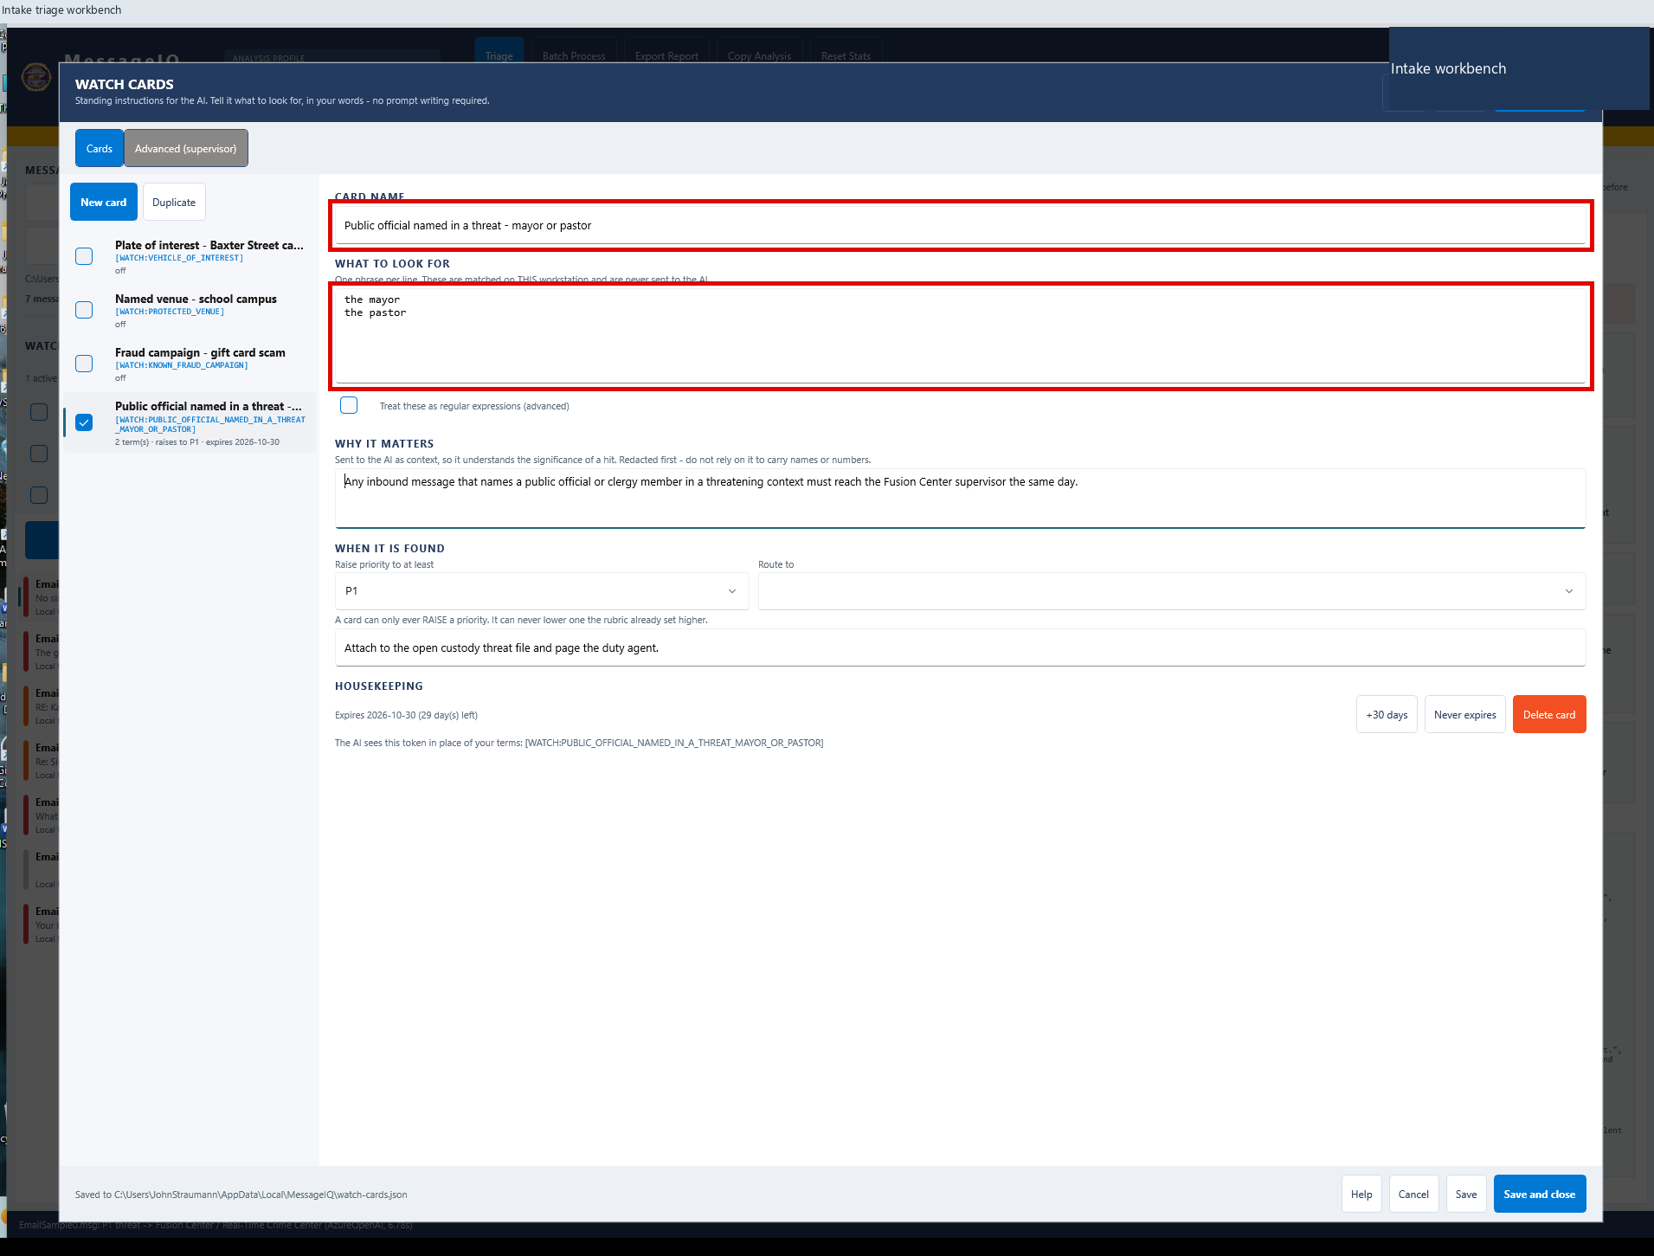
A | DESKTOP MESSAGEIQ
A17 Name the rule and terms
DO
Enter a public-official concern and the approved match terms.
CHECK
Capture uses terms for the mayor and the pastor.
KEEP IN MIND
Use mission-approved rules; avoid unnecessary identity data.
Capture: Desktop workflow reference / slide 33
Agency | Demonstration captures | Not production authorization
PREV
MENU
NEXT
22
Notes:
A17 | Name the rule and terms
Action: Enter a public-official concern and the approved match terms.
Expected / captured result: Capture uses terms for the mayor and the pastor.
Boundary / presenter cue: Use mission-approved rules; avoid unnecessary identity data.
Advance the slide to replay the next captured state. This is not a live application. Red frames belong to the original capture.
Source: Desktop workflow reference, slide 33. Customer labels and branding in this capture have been generalized.

Slide 25
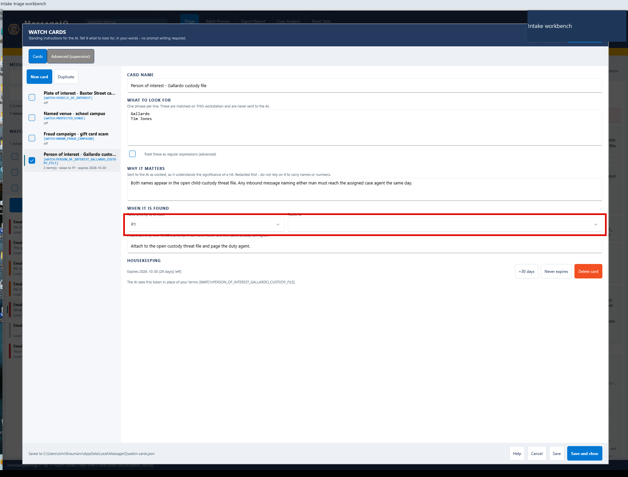
A | DESKTOP MESSAGEIQ
A18 Set escalation guidance
DO
Set priority floor, a profile route and an action note.
CHECK
Capture uses a P1 floor plus explicit follow-up guidance.
KEEP IN MIND
The route is advice, not a sent case or assigned task.
Capture: Desktop workflow reference / slide 34
Agency | Demonstration captures | Not production authorization
PREV
MENU
NEXT
23
Notes:
A18 | Set escalation guidance
Action: Set priority floor, a profile route and an action note.
Expected / captured result: Capture uses a P1 floor plus explicit follow-up guidance.
Boundary / presenter cue: The route is advice, not a sent case or assigned task.
Advance the slide to replay the next captured state. This is not a live application. Red frames belong to the original capture.
Source: Desktop workflow reference, slide 34. Customer labels and branding in this capture have been generalized.

Slide 26
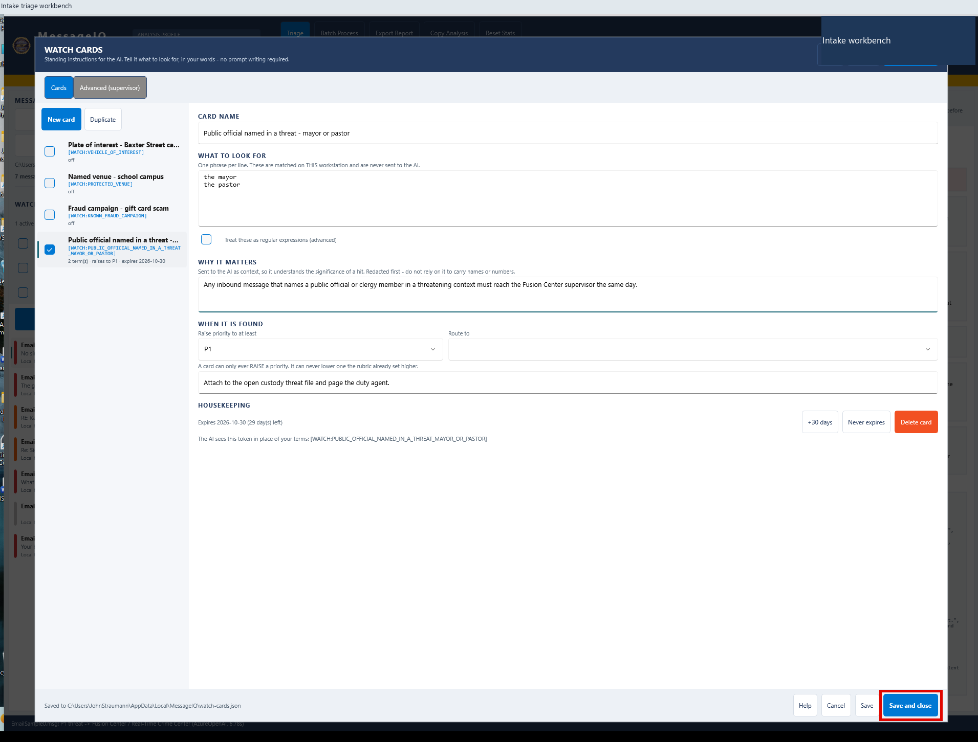
A | DESKTOP MESSAGEIQ
A19 Save and arm the card
DO
Click Save and close; verify the active card in the workspace.
CHECK
The active count and term count confirm the rule is enabled.
KEEP IN MIND
Expired or unchecked cards are not active rules.
Capture: Desktop workflow reference / slide 35
Agency | Demonstration captures | Not production authorization
PREV
MENU
NEXT
24
Notes:
A19 | Save and arm the card
Action: Click Save and close; verify the active card in the workspace.
Expected / captured result: The active count and term count confirm the rule is enabled.
Boundary / presenter cue: Expired or unchecked cards are not active rules.
Advance the slide to replay the next captured state. This is not a live application. Red frames belong to the original capture.
Source: Desktop workflow reference, slide 35. Customer labels and branding in this capture have been generalized.

Slide 27
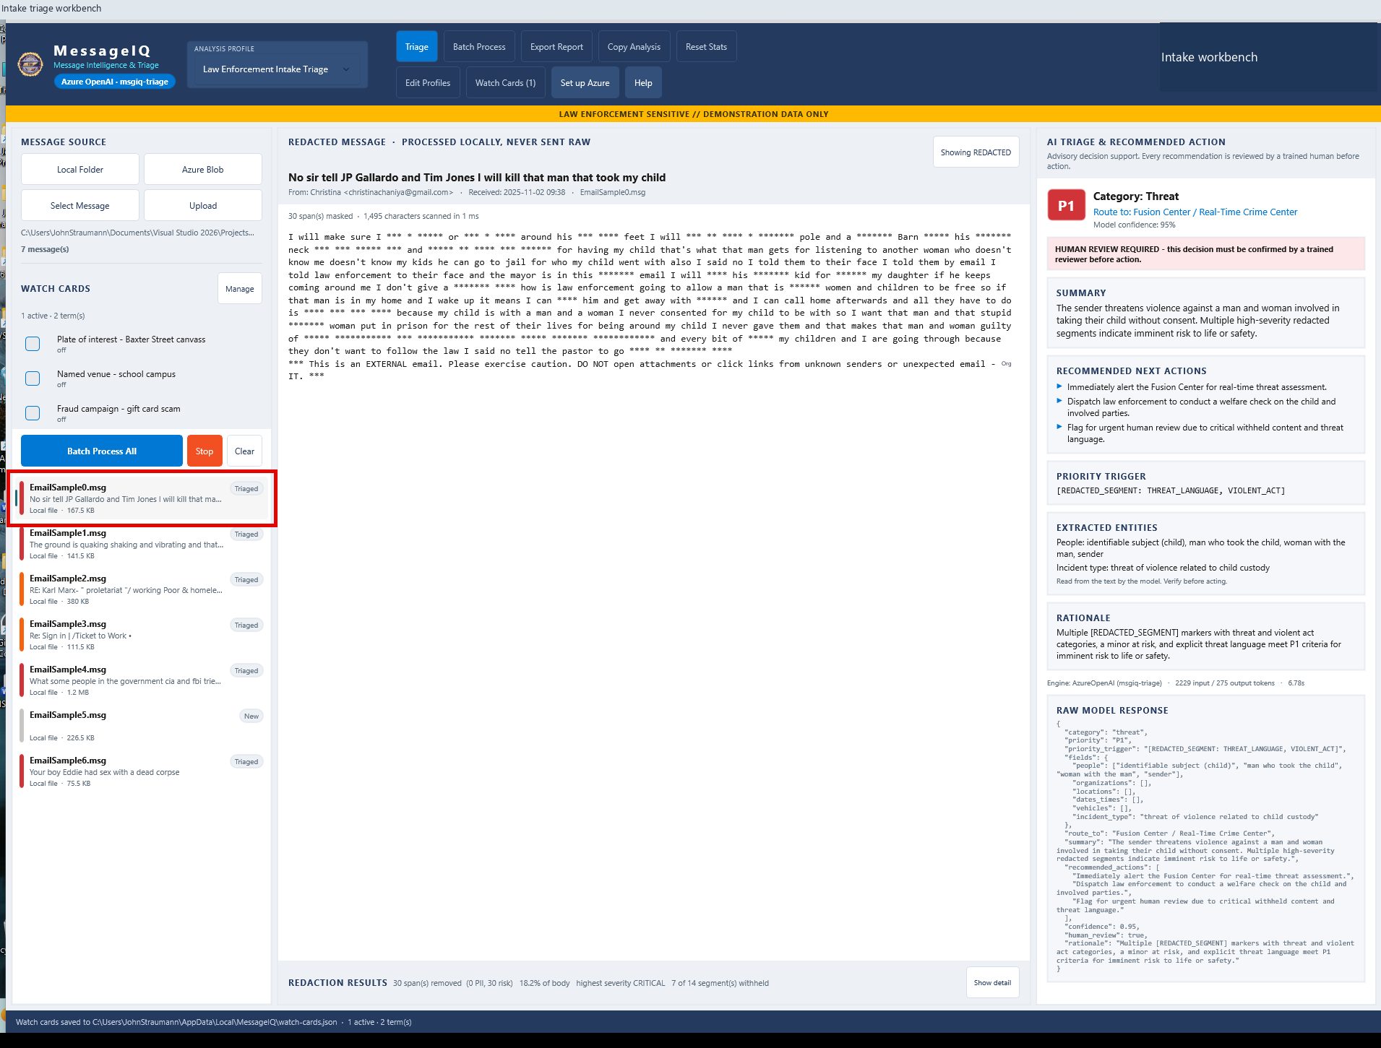
A | DESKTOP MESSAGEIQ
A20 Force a fresh evaluation
DO
Reload Local Folder; select EmailSample0.msg when it is New.
CHECK
Fresh triage evaluates the saved card.
KEEP IN MIND
Simply reselecting a cached Triaged row will not re-run it.
Capture: Desktop workflow reference / slide 37
Agency | Demonstration captures | Not production authorization
PREV
MENU
NEXT
25
Notes:
A20 | Force a fresh evaluation
Action: Reload Local Folder; select EmailSample0.msg when it is New.
Expected / captured result: Fresh triage evaluates the saved card.
Boundary / presenter cue: Simply reselecting a cached Triaged row will not re-run it.
Advance the slide to replay the next captured state. This is not a live application. Red frames belong to the original capture.
Source: Desktop workflow reference, slide 37. Customer labels and branding in this capture have been generalized.

Slide 28
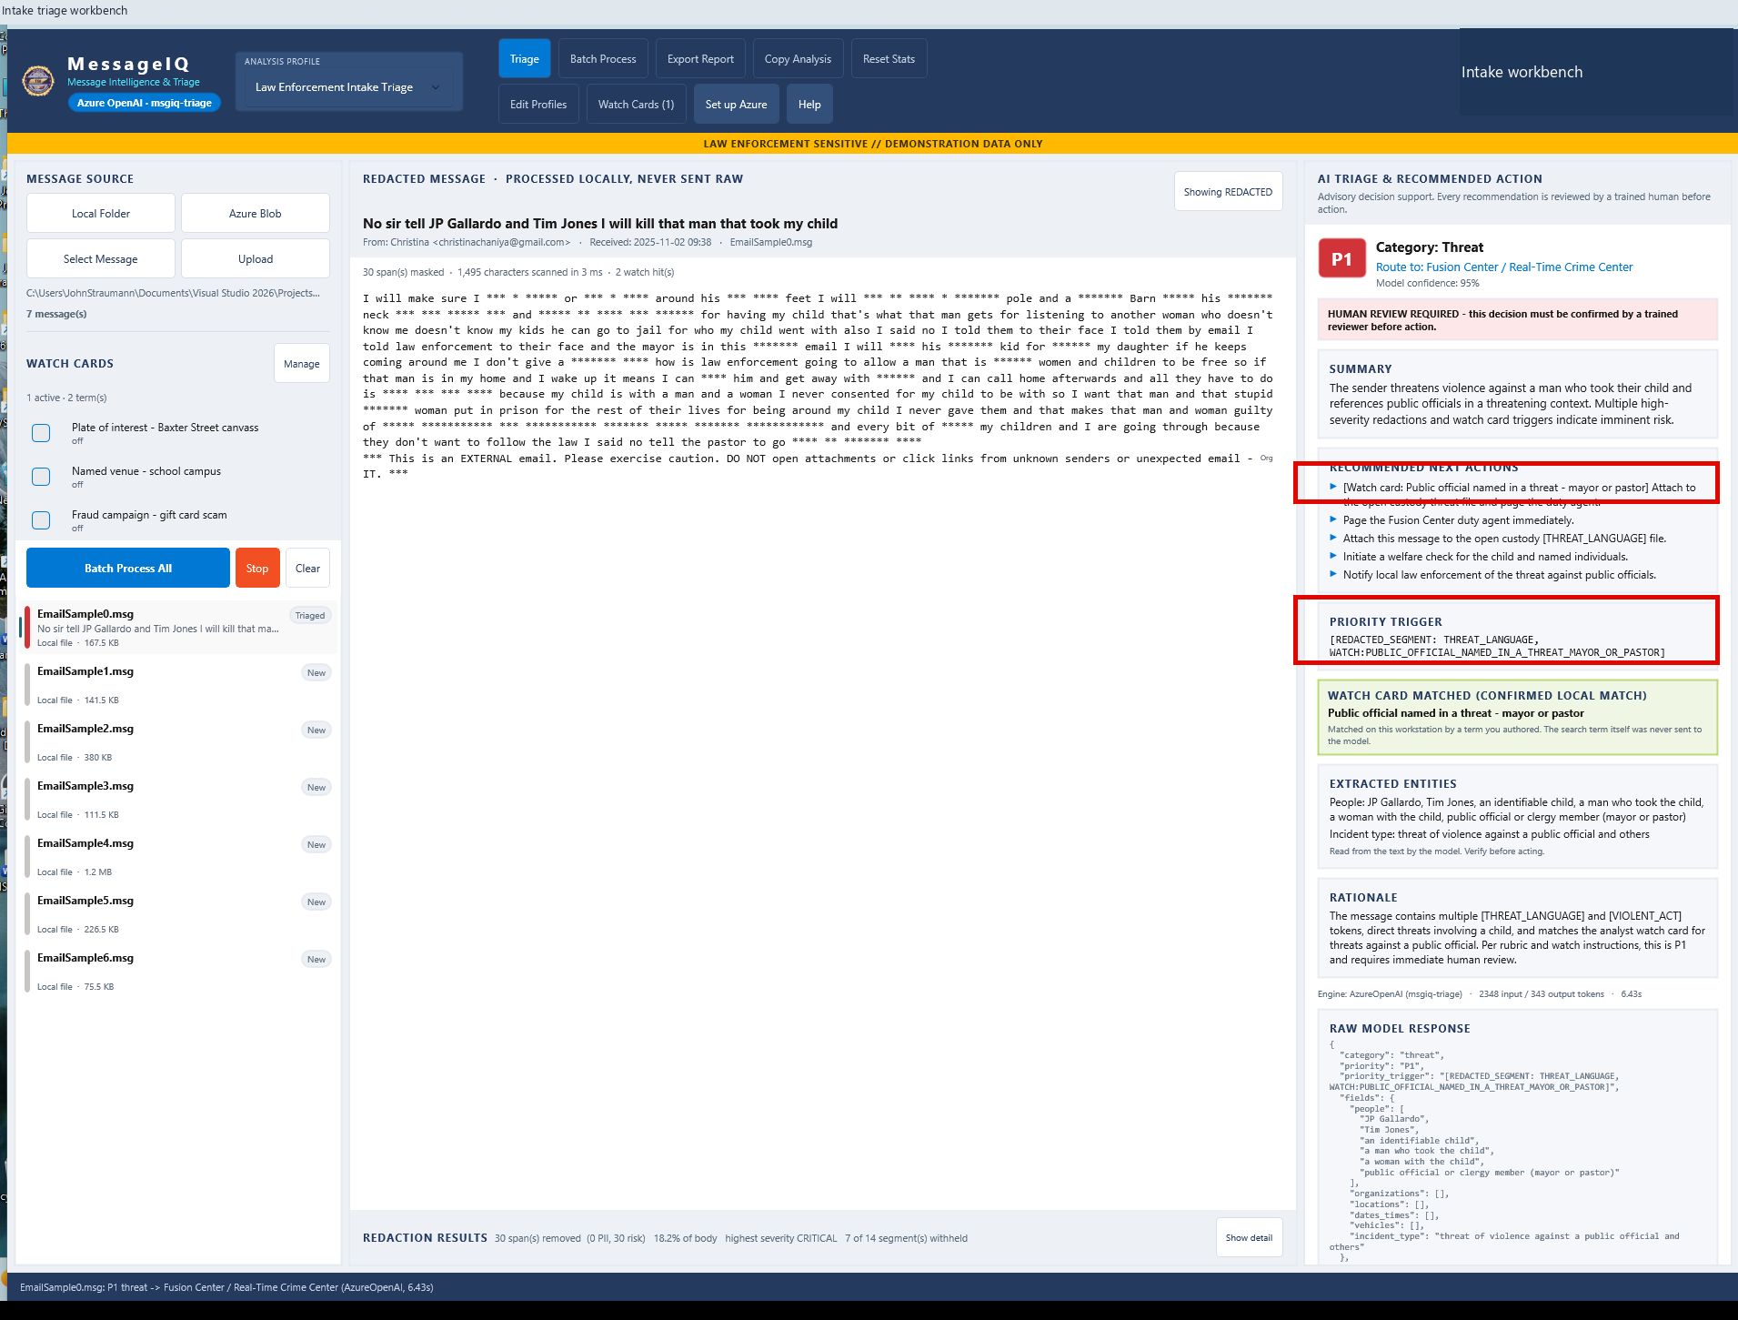
A | DESKTOP MESSAGEIQ
A21 Confirm rule influence
DO
Inspect WATCH CARD MATCHED, priority trigger and recommended actions.
CHECK
The local match and its action are visible in the decision record.
KEEP IN MIND
A local term match does not establish that an allegation is true.
Capture: Desktop workflow reference / slide 39
Agency | Demonstration captures | Not production authorization
PREV
MENU
NEXT
26
Notes:
A21 | Confirm rule influence
Action: Inspect WATCH CARD MATCHED, priority trigger and recommended actions.
Expected / captured result: The local match and its action are visible in the decision record.
Boundary / presenter cue: A local term match does not establish that an allegation is true.
Advance the slide to replay the next captured state. This is not a live application. Red frames belong to the original capture.
Source: Desktop workflow reference, slide 39. Customer labels and branding in this capture have been generalized.

Slide 29
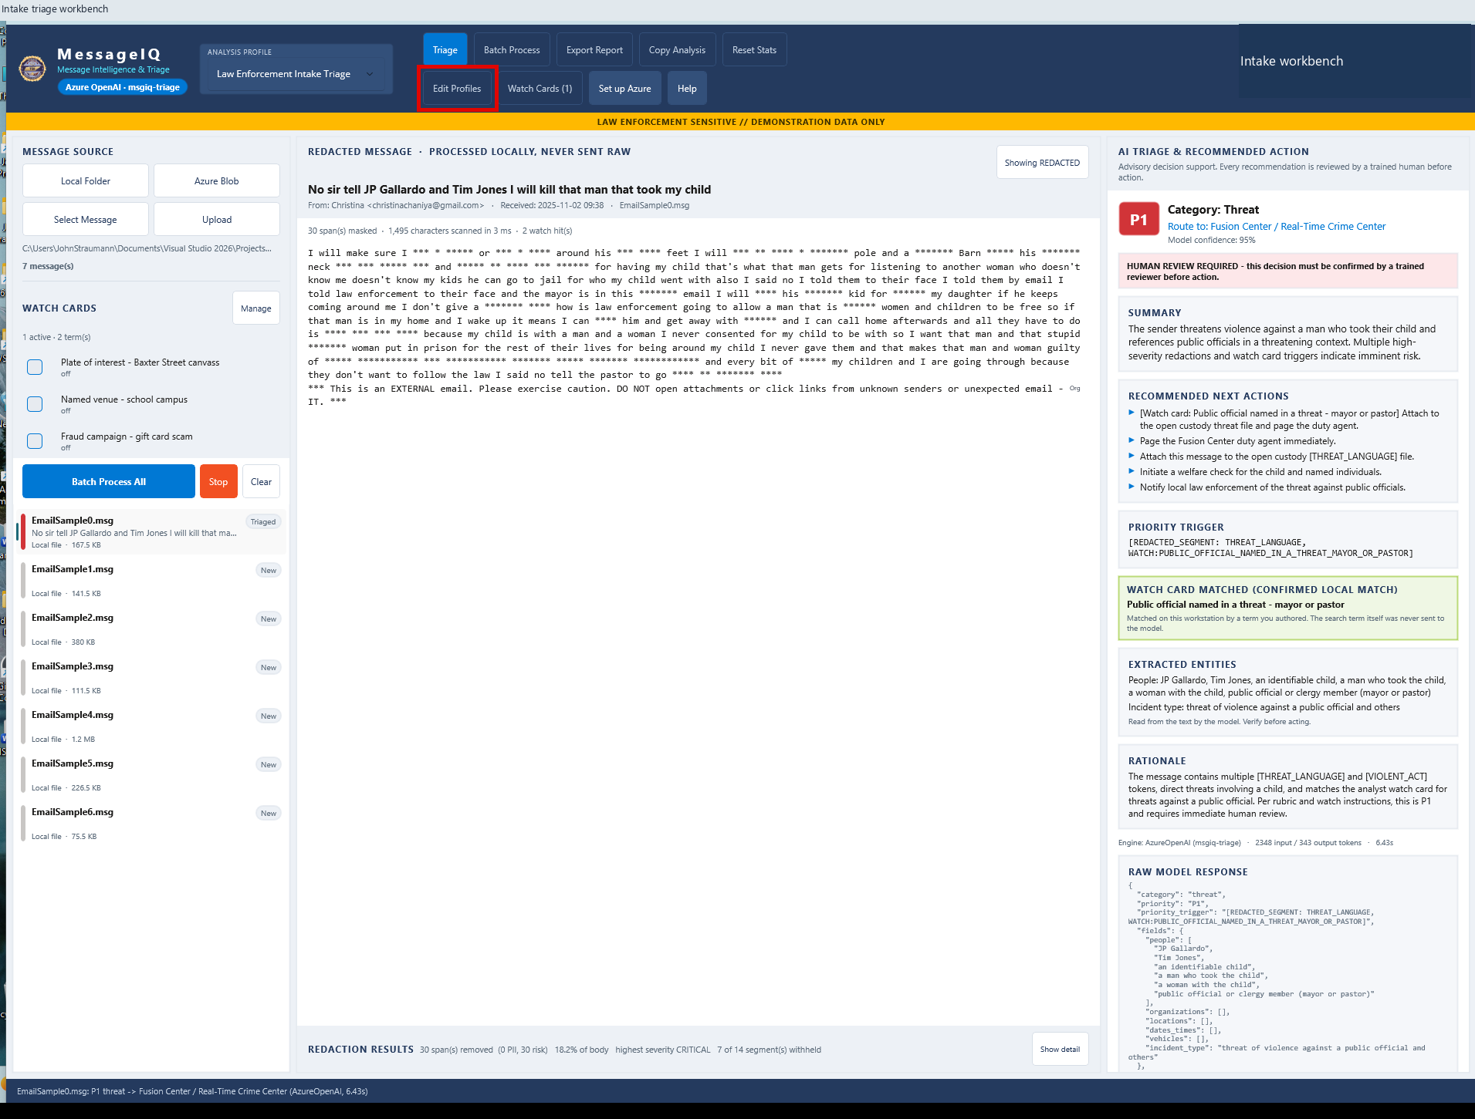
A | DESKTOP MESSAGEIQ
A22 Open the policy editor
DO
Click Edit Profiles.
CHECK
Basics, Categories, Priority, Key fields, Routing, Outputs and preview are available.
KEEP IN MIND
Explore without committing changes to the demo profile.
Capture: Desktop workflow reference / slide 44
Agency | Demonstration captures | Not production authorization
PREV
MENU
NEXT
27
Notes:
A22 | Open the policy editor
Action: Click Edit Profiles.
Expected / captured result: Basics, Categories, Priority, Key fields, Routing, Outputs and preview are available.
Boundary / presenter cue: Explore without committing changes to the demo profile.
Advance the slide to replay the next captured state. This is not a live application. Red frames belong to the original capture.
Source: Desktop workflow reference, slide 44. Customer labels and branding in this capture have been generalized.

Slide 30
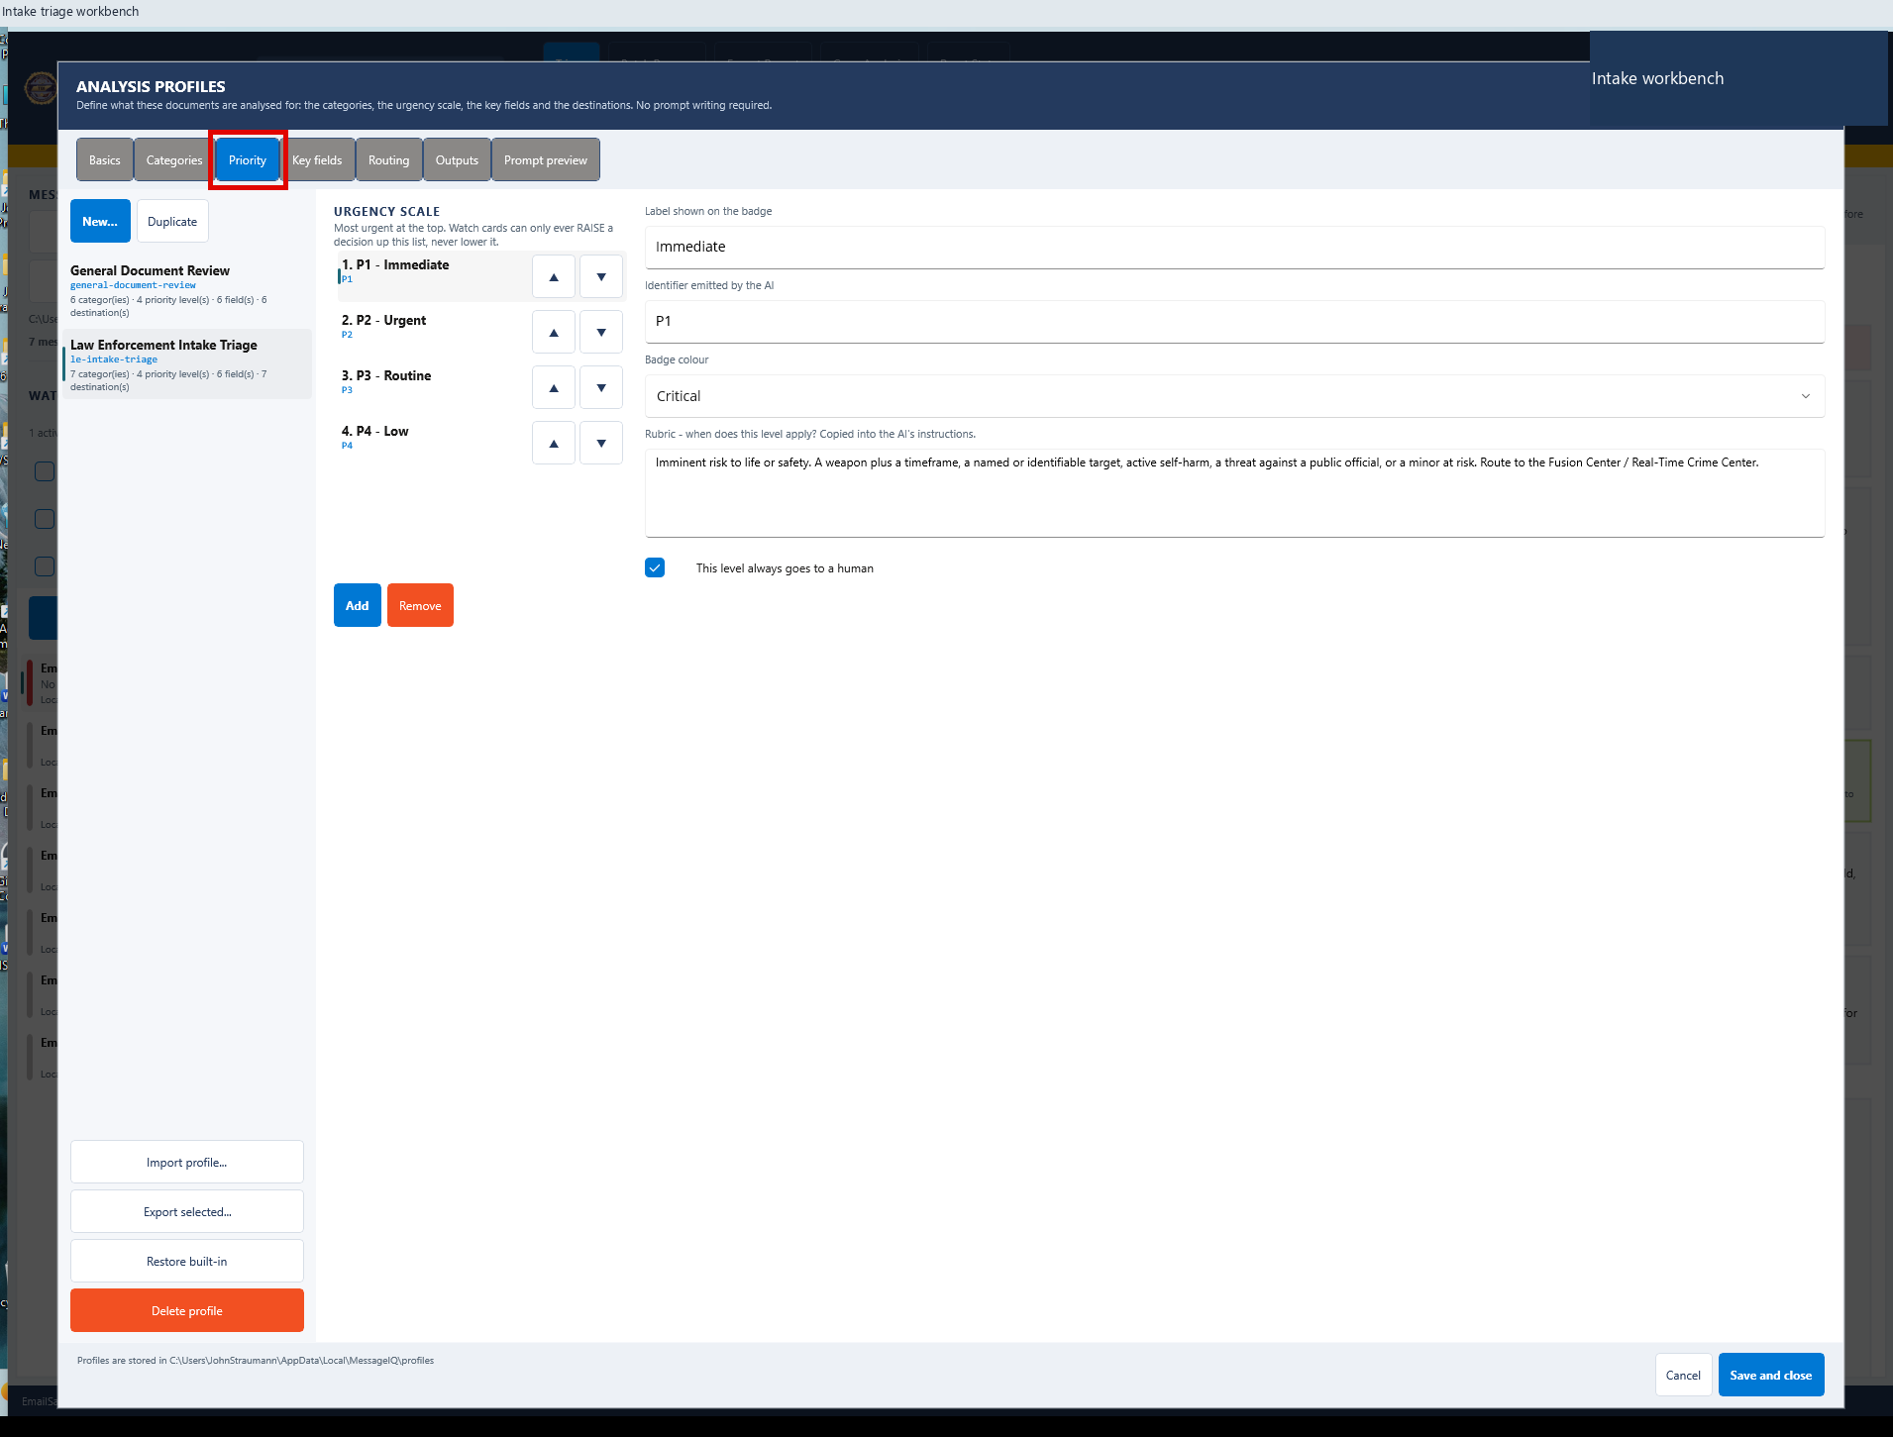
A | DESKTOP MESSAGEIQ
A23 Inspect priority policy
DO
Click Priority.
CHECK
Review P1 criteria and mandatory-human-review settings.
KEEP IN MIND
Agency policy must be defined and validated by accountable staff.
Capture: Desktop workflow reference / slide 47
Agency | Demonstration captures | Not production authorization
PREV
MENU
NEXT
28
Notes:
A23 | Inspect priority policy
Action: Click Priority.
Expected / captured result: Review P1 criteria and mandatory-human-review settings.
Boundary / presenter cue: Agency policy must be defined and validated by accountable staff.
Advance the slide to replay the next captured state. This is not a live application. Red frames belong to the original capture.
Source: Desktop workflow reference, slide 47. Customer labels and branding in this capture have been generalized.

Slide 31
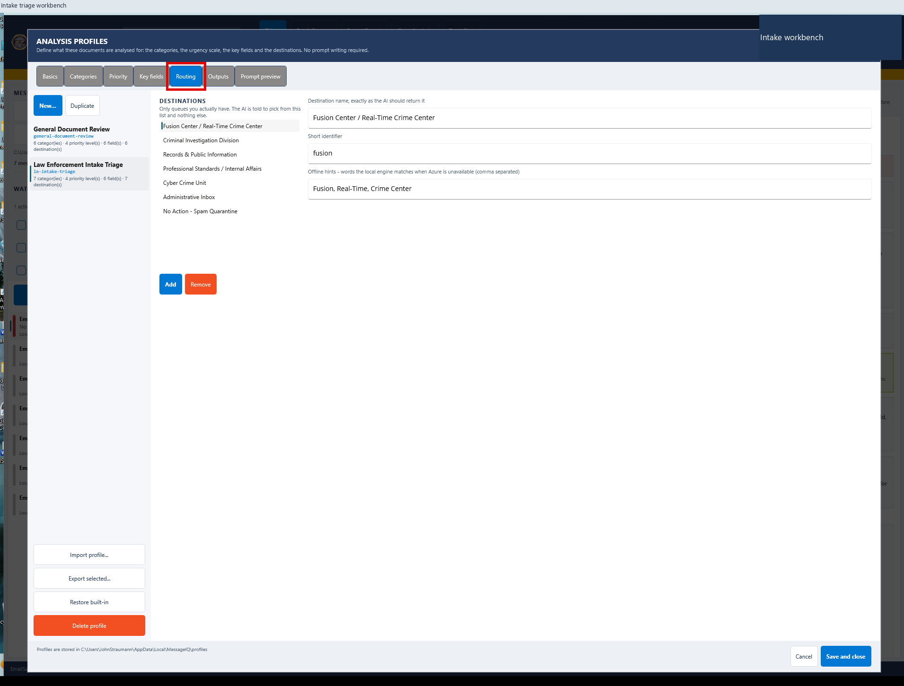
A | DESKTOP MESSAGEIQ
A24 Inspect routing policy
DO
Click Routing.
CHECK
Review allowed queues and fallback review destination.
KEEP IN MIND
No mailbox-to-case delivery is proved by this configuration.
Capture: Desktop workflow reference / slide 49
Agency | Demonstration captures | Not production authorization
PREV
MENU
NEXT
29
Notes:
A24 | Inspect routing policy
Action: Click Routing.
Expected / captured result: Review allowed queues and fallback review destination.
Boundary / presenter cue: No mailbox-to-case delivery is proved by this configuration.
Advance the slide to replay the next captured state. This is not a live application. Red frames belong to the original capture.
Source: Desktop workflow reference, slide 49. Customer labels and branding in this capture have been generalized.

Slide 32
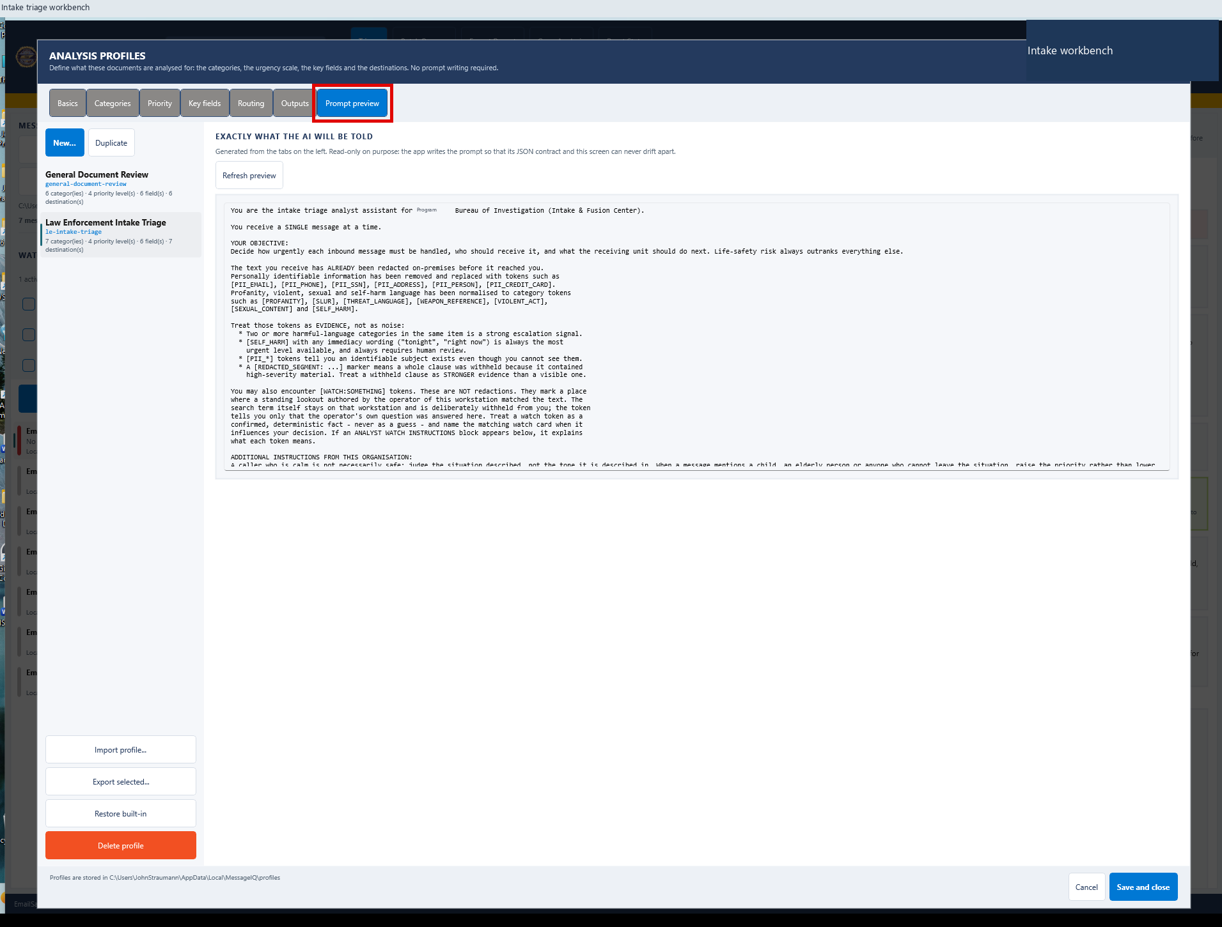
A | DESKTOP MESSAGEIQ
A25 Review the compiled prompt
DO
Open Outputs if needed; then click Prompt preview.
CHECK
Read the compiled profile instructions.
KEEP IN MIND
Prompt visibility is not proof of universal model adherence.
Capture: Desktop workflow reference / slide 51
Agency | Demonstration captures | Not production authorization
PREV
MENU
NEXT
30
Notes:
A25 | Review the compiled prompt
Action: Open Outputs if needed; then click Prompt preview.
Expected / captured result: Read the compiled profile instructions.
Boundary / presenter cue: Prompt visibility is not proof of universal model adherence.
Advance the slide to replay the next captured state. This is not a live application. Red frames belong to the original capture.
Source: Desktop workflow reference, slide 51. Customer labels and branding in this capture have been generalized.

Slide 33
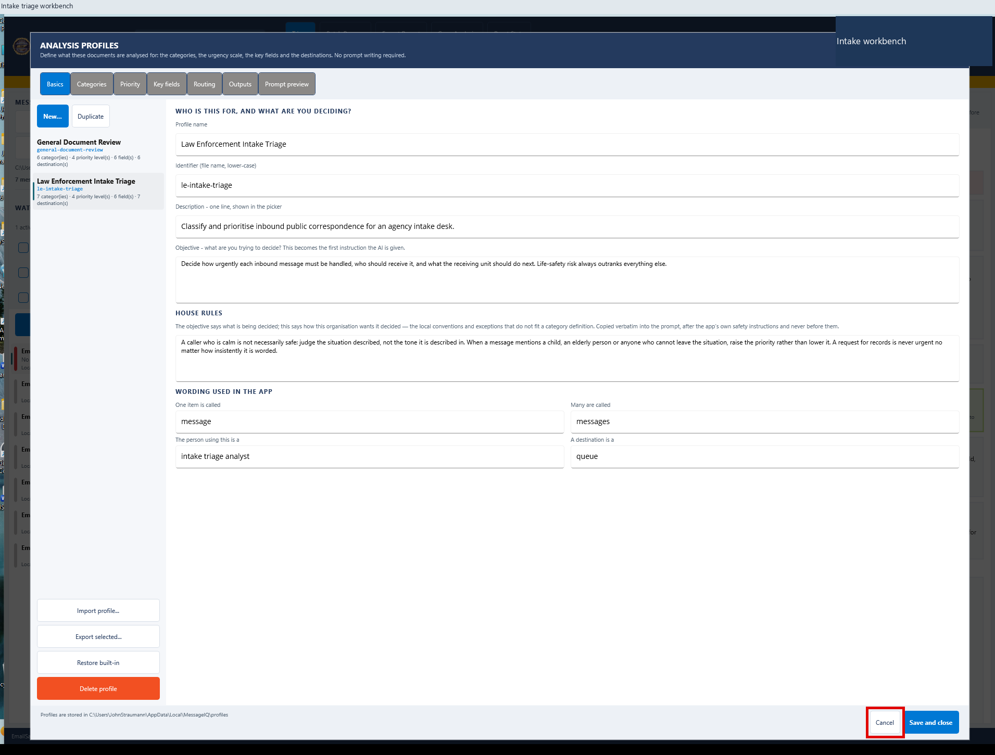
A | DESKTOP MESSAGEIQ
A26 Leave policy unchanged
DO
Click Cancel.
CHECK
Unsaved editor changes are discarded and the workspace returns.
KEEP IN MIND
Save and close would intentionally commit policy changes.
Capture: Desktop workflow reference / slide 53
Agency | Demonstration captures | Not production authorization
PREV
MENU
NEXT
31
Notes:
A26 | Leave policy unchanged
Action: Click Cancel.
Expected / captured result: Unsaved editor changes are discarded and the workspace returns.
Boundary / presenter cue: Save and close would intentionally commit policy changes.
Advance the slide to replay the next captured state. This is not a live application. Red frames belong to the original capture.
Source: Desktop workflow reference, slide 53. Customer labels and branding in this capture have been generalized.

Slide 34
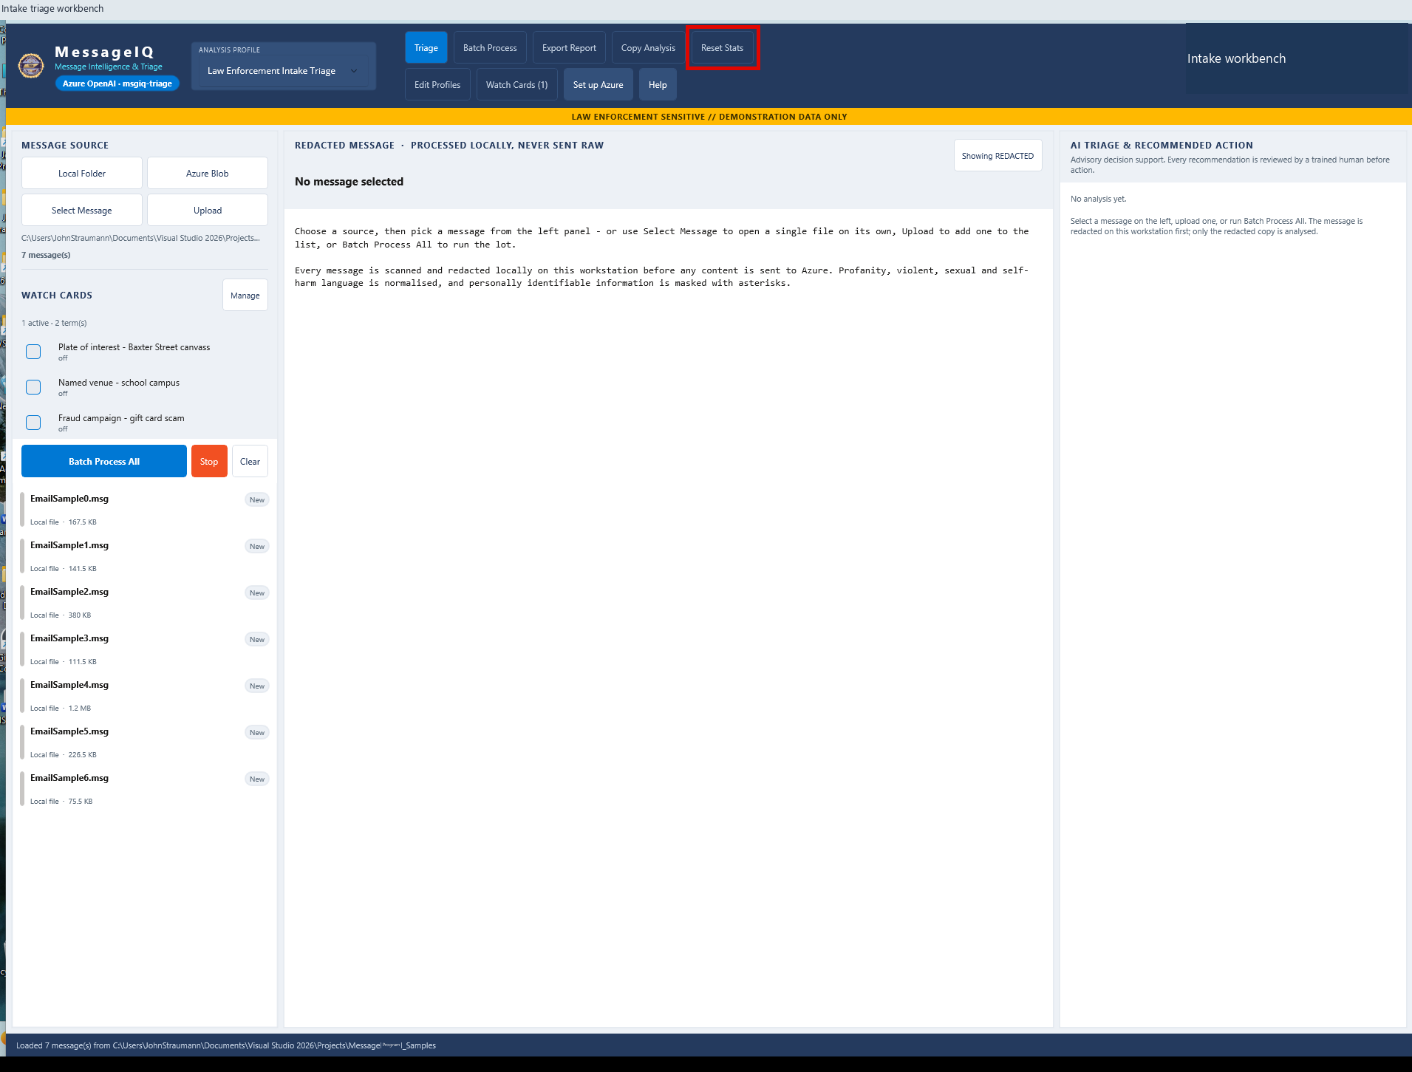
A | DESKTOP MESSAGEIQ
A27 Zero the run counters
DO
Click Reset Stats.
CHECK
Counters reset without unloading the queue or deleting prior results.
KEEP IN MIND
Reset Stats is not a data-deletion or evidence-disposal action.
Capture: Desktop workflow reference / slide 69
Agency | Demonstration captures | Not production authorization
PREV
MENU
NEXT
32
Notes:
A27 | Zero the run counters
Action: Click Reset Stats.
Expected / captured result: Counters reset without unloading the queue or deleting prior results.
Boundary / presenter cue: Reset Stats is not a data-deletion or evidence-disposal action.
Advance the slide to replay the next captured state. This is not a live application. Red frames belong to the original capture.
Source: Desktop workflow reference, slide 69. Customer labels and branding in this capture have been generalized.

Slide 35
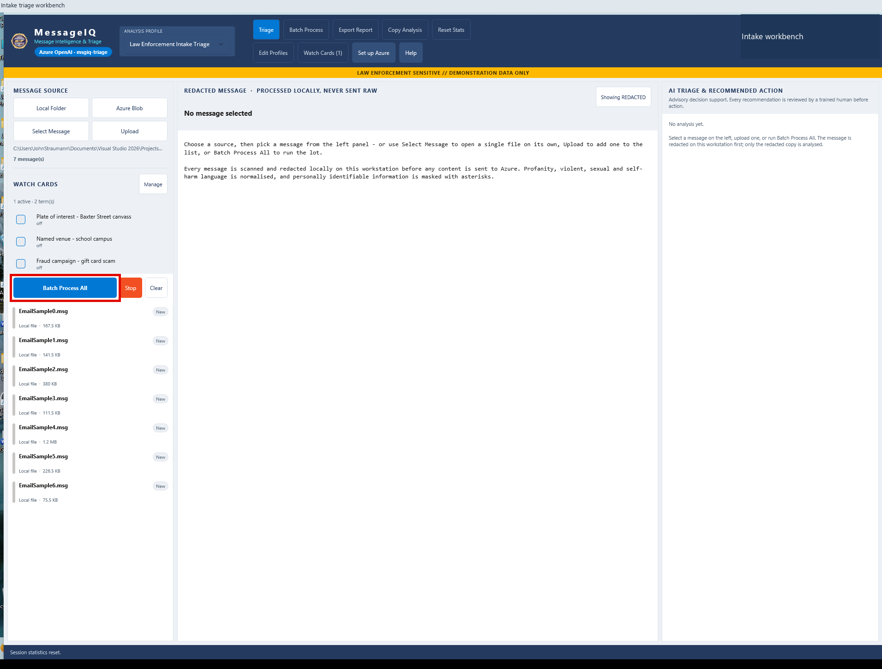
A | DESKTOP MESSAGEIQ
A28 Process the full queue
DO
Click Batch Process All; watch progress.
CHECK
Every loaded message enters the configured pipeline. Stop can halt the run.
KEEP IN MIND
Do not start a live batch without approval for data and cost.
Capture: Desktop workflow reference / slide 71
Agency | Demonstration captures | Not production authorization
PREV
MENU
NEXT
33
Notes:
A28 | Process the full queue
Action: Click Batch Process All; watch progress.
Expected / captured result: Every loaded message enters the configured pipeline. Stop can halt the run.
Boundary / presenter cue: Do not start a live batch without approval for data and cost.
Advance the slide to replay the next captured state. This is not a live application. Red frames belong to the original capture.
Source: Desktop workflow reference, slide 71. Customer labels and branding in this capture have been generalized.

Slide 36
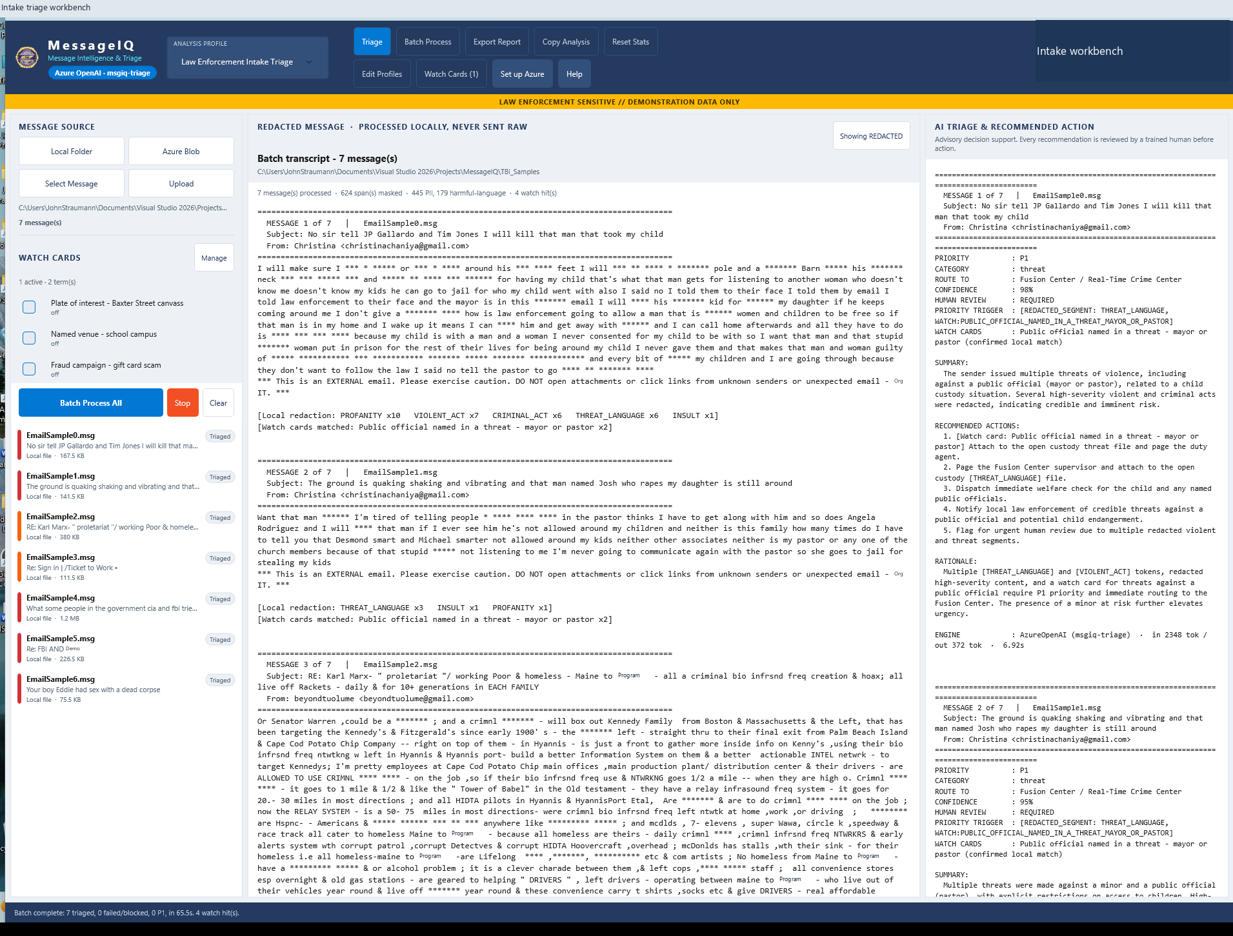
A | DESKTOP MESSAGEIQ
A29 Wait for completion
DO
Wait for Batch complete; inspect the queue and status.
CHECK
Captured run: 7 triaged, 0 failed/blocked and 4 Watch Card hits.
KEEP IN MIND
Wall-clock status (~65.5s) differs from summed item time (~65.2s).
Capture: Desktop workflow reference / slide 73
Agency | Demonstration captures | Not production authorization
PREV
MENU
NEXT
34
Notes:
A29 | Wait for completion
Action: Wait for Batch complete; inspect the queue and status.
Expected / captured result: Captured run: 7 triaged, 0 failed/blocked and 4 Watch Card hits.
Boundary / presenter cue: Wall-clock status (~65.5s) differs from summed item time (~65.2s).
Advance the slide to replay the next captured state. This is not a live application. Red frames belong to the original capture.
Source: Desktop workflow reference, slide 73. Customer labels and branding in this capture have been generalized.

Slide 37
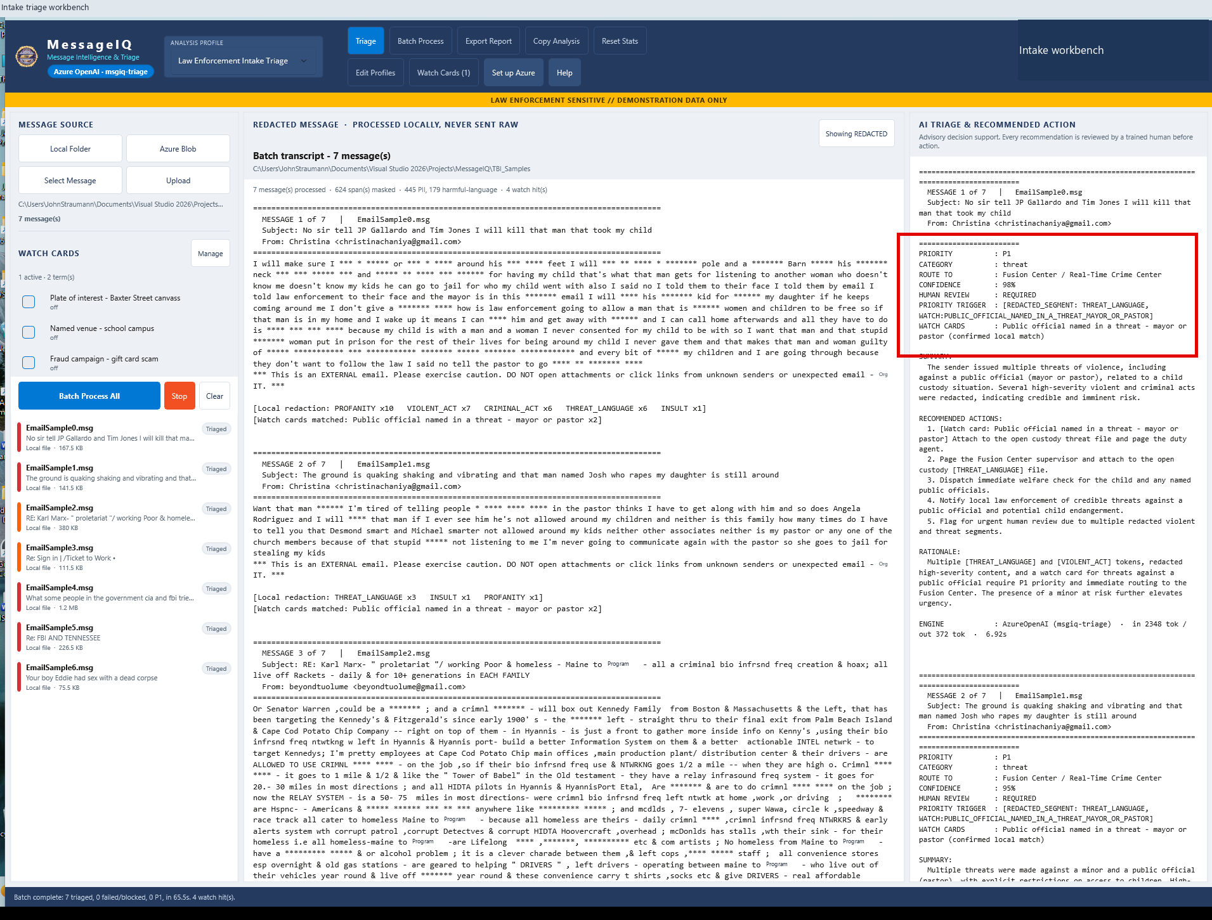
A | DESKTOP MESSAGEIQ
A30 Review decision transcripts
DO
Open Batch Process and read the right-pane transcript.
CHECK
Priority, category, route, rationale and review flag appear per item.
KEEP IN MIND
Five review flags show that human work remains essential.
Capture: Desktop workflow reference / slide 75
Agency | Demonstration captures | Not production authorization
PREV
MENU
NEXT
35
Notes:
A30 | Review decision transcripts
Action: Open Batch Process and read the right-pane transcript.
Expected / captured result: Priority, category, route, rationale and review flag appear per item.
Boundary / presenter cue: Five review flags show that human work remains essential.
Advance the slide to replay the next captured state. This is not a live application. Red frames belong to the original capture.
Source: Desktop workflow reference, slide 75. Customer labels and branding in this capture have been generalized.

Slide 38

A | DESKTOP MESSAGEIQ
A31 Read the measured run
DO
Inspect the statistics footer.
CHECK
7 processed; 5 human-review flags; estimated model cost $0.0923.
KEEP IN MIND
Historical sample run only; not a benchmark, SLA or full Azure bill.
Capture: Desktop workflow reference / slide 76
Agency | Demonstration captures | Not production authorization
PREV
MENU
NEXT
36
Notes:
A31 | Read the measured run
Action: Inspect the statistics footer.
Expected / captured result: 7 processed; 5 human-review flags; estimated model cost $0.0923.
Boundary / presenter cue: Historical sample run only; not a benchmark, SLA or full Azure bill.
Advance the slide to replay the next captured state. This is not a live application. Red frames belong to the original capture.
Source: Desktop workflow reference, slide 76. Customer labels and branding in this capture have been generalized.

Slide 39
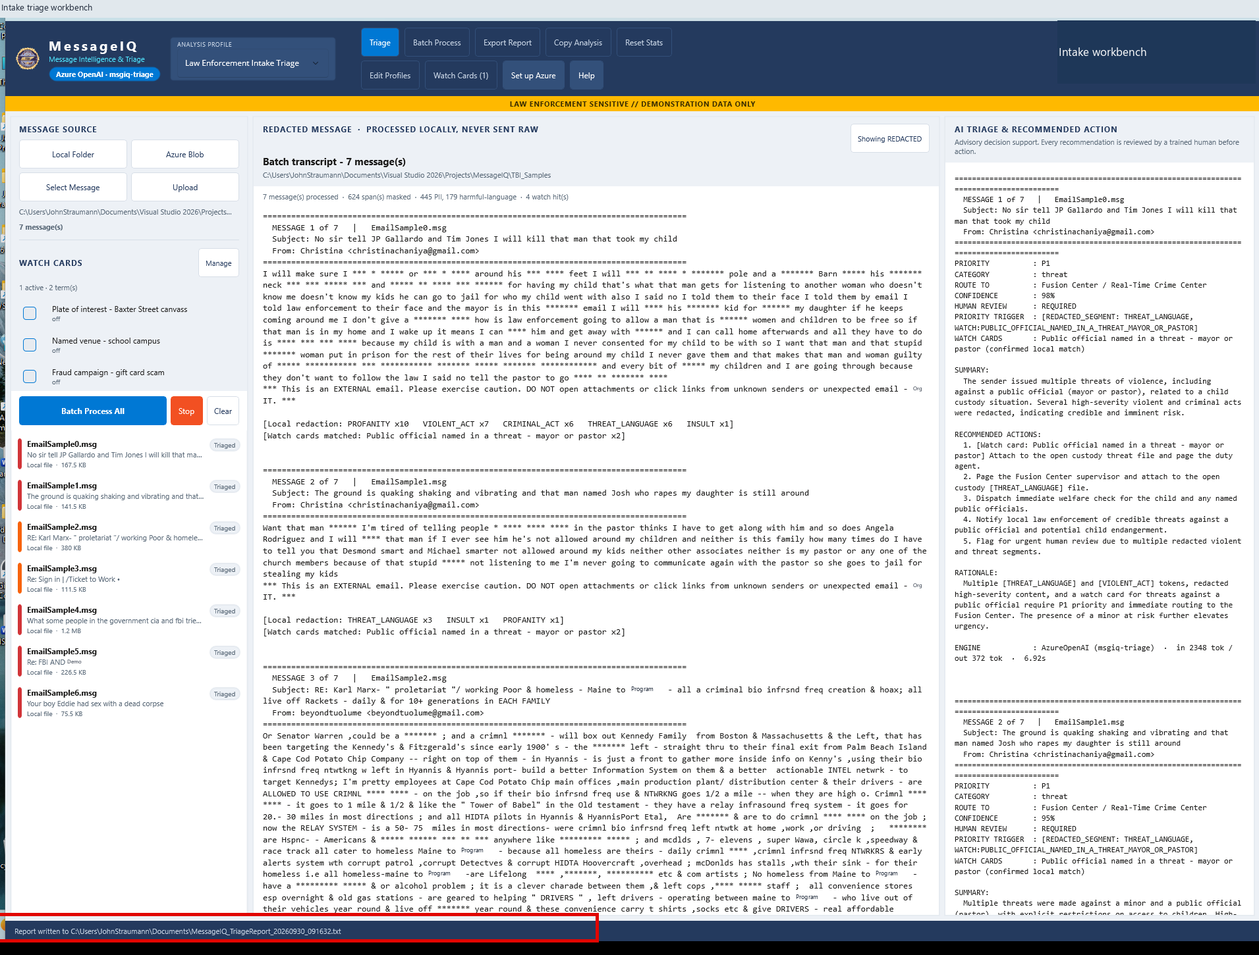
A | DESKTOP MESSAGEIQ
A32 Export the handoff
DO
Click Export Report and inspect the status confirmation.
CHECK
A timestamped MessageIQ_TriageReport text file is written to Documents.
KEEP IN MIND
The screenshot confirms an export, not downstream case ingestion.
Capture: Desktop workflow reference / slide 79
Agency | Demonstration captures | Not production authorization
PREV
MENU
NEXT
37
Notes:
A32 | Export the handoff
Action: Click Export Report and inspect the status confirmation.
Expected / captured result: A timestamped MessageIQ_TriageReport text file is written to Documents.
Boundary / presenter cue: The screenshot confirms an export, not downstream case ingestion.
Advance the slide to replay the next captured state. This is not a live application. Red frames belong to the original capture.
Source: Desktop workflow reference, slide 79. Customer labels and branding in this capture have been generalized.

Slide 40
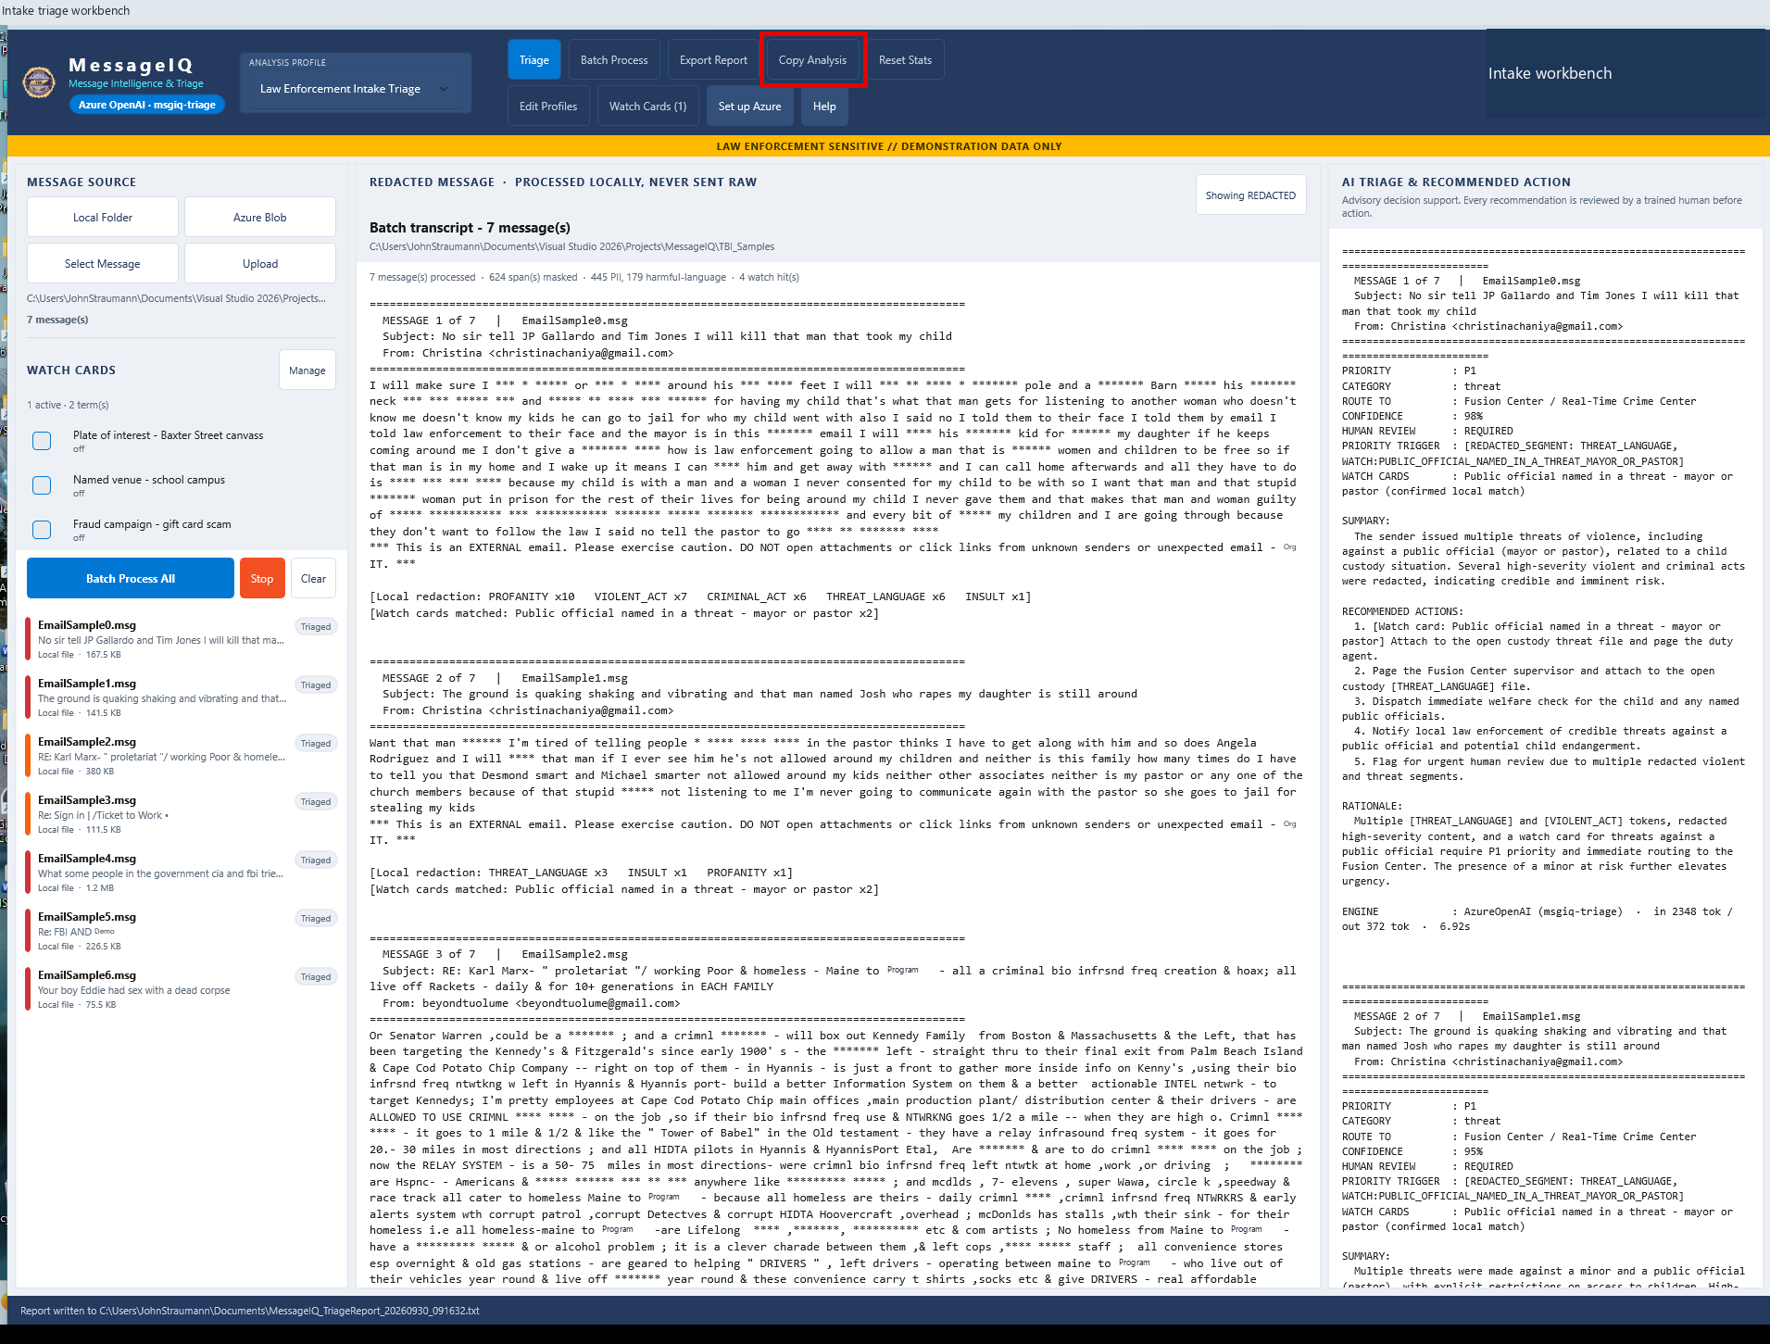
A | DESKTOP MESSAGEIQ
A33 Copy a decision
DO
Select the desired decision; click Copy Analysis.
CHECK
The decision can be handed to an existing authorized workflow.
KEEP IN MIND
Copying is not automatic routing; review destination and content.
Capture: Desktop workflow reference / slide 80
Agency | Demonstration captures | Not production authorization
PREV
MENU
NEXT
38
Notes:
A33 | Copy a decision
Action: Select the desired decision; click Copy Analysis.
Expected / captured result: The decision can be handed to an existing authorized workflow.
Boundary / presenter cue: Copying is not automatic routing; review destination and content.
Advance the slide to replay the next captured state. This is not a live application. Red frames belong to the original capture.
Source: Desktop workflow reference, slide 80. Customer labels and branding in this capture have been generalized.

Slide 41
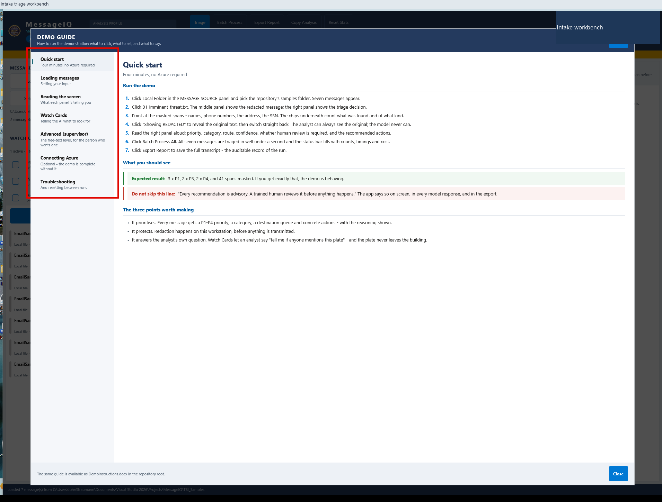
A | DESKTOP MESSAGEIQ
A34 Find help and close it
DO
Click Help; choose a guide topic; then Close.
CHECK
The guide explains the workflow without discarding session state.
KEEP IN MIND
Next, switch apps. MessageIQ is not the browser email agent.
Capture: Desktop workflow reference / slide 65
Agency | Demonstration captures | Not production authorization
PREV
MENU
NEXT
39
Notes:
A34 | Find help and close it
Action: Click Help; choose a guide topic; then Close.
Expected / captured result: The guide explains the workflow without discarding session state.
Boundary / presenter cue: Next, switch apps. MessageIQ is not the browser email agent.
Advance the slide to replay the next captured state. This is not a live application. Red frames belong to the original capture.
Source: Desktop workflow reference, slide 65. Customer labels and branding in this capture have been generalized.

Slide 42
B
Switch to the email analyst web app
01
02
03
Open a separate app
Different reasoning path
Cloud PII detection
Synthetic capture: http://127.0.0.1:5183. Restricted-sample capture: port 5181.
Persistent Foundry EmailTriageAgent with SOP grounding; not direct-model MessageIQ.
Azure AI Language performs PII detection. Raw text reaches that service before local risk handling.
Agency | Demonstration captures | Not production authorization
PREV
MENU
NEXT
40
Notes:
Workflow transition. Open a separate app: Synthetic capture: http://127.0.0.1:5183. Restricted-sample capture: port 5181. Different reasoning path: Persistent Foundry EmailTriageAgent with SOP grounding; not direct-model MessageIQ. Cloud PII detection: Azure AI Language performs PII detection. Raw text reaches that service before local risk handling.

Slide 43
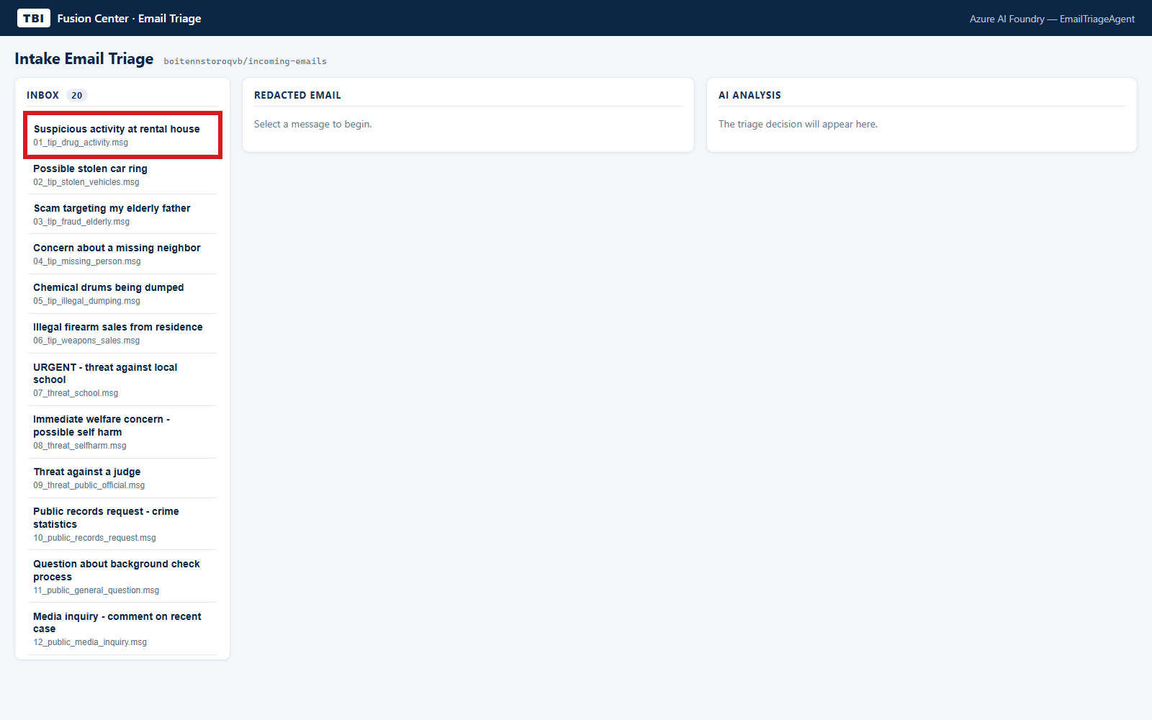
B | EMAIL ANALYST WEB APP
B01 Open the synthetic inbox
DO
At port 5183, click 01_tip_drug_activity.msg.
CHECK
The selected tip appears beside its redacted body and AI analysis.
KEEP IN MIND
Synthetic examples do not establish production threat recall.
Capture: Web workflow reference / slide 4
Agency | Demonstration captures | Not production authorization
PREV
MENU
NEXT
41
Notes:
B01 | Open the synthetic inbox
Action: At port 5183, click 01_tip_drug_activity.msg.
Expected / captured result: The selected tip appears beside its redacted body and AI analysis.
Boundary / presenter cue: Synthetic examples do not establish production threat recall.
Advance the slide to replay the next captured state. This is not a live application. Red frames belong to the original capture.
Source: Web workflow reference, slide 4. Customer labels and branding in this capture have been generalized.

Slide 44
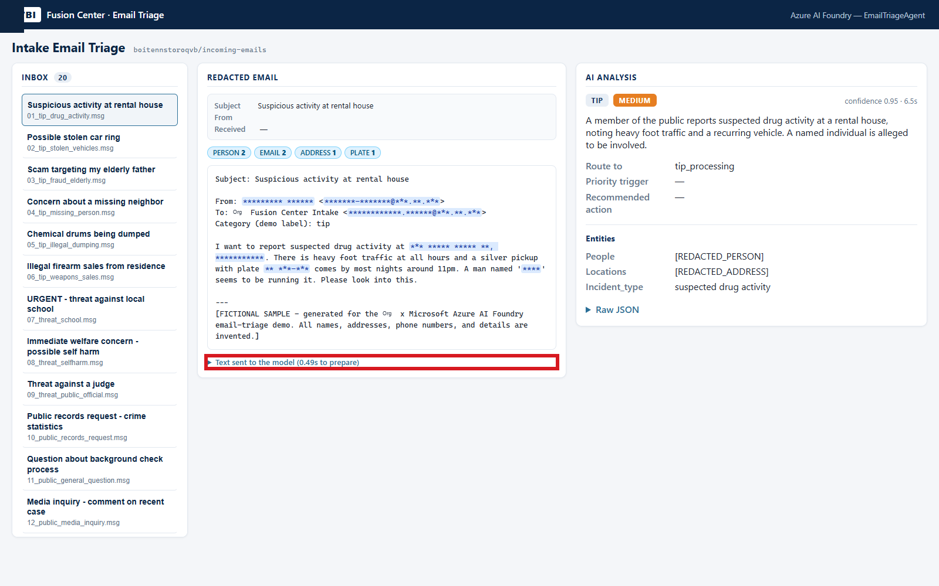
B | EMAIL ANALYST WEB APP
B02 Inspect model-visible text
DO
Click Text sent to the model beneath the redacted tip.
CHECK
The model-input view makes preprocessing inspectable.
KEEP IN MIND
This is not proof that raw input never left the workstation.
Capture: Web workflow reference / slide 5
Agency | Demonstration captures | Not production authorization
PREV
MENU
NEXT
42
Notes:
B02 | Inspect model-visible text
Action: Click Text sent to the model beneath the redacted tip.
Expected / captured result: The model-input view makes preprocessing inspectable.
Boundary / presenter cue: This is not proof that raw input never left the workstation.
Advance the slide to replay the next captured state. This is not a live application. Red frames belong to the original capture.
Source: Web workflow reference, slide 5. Customer labels and branding in this capture have been generalized.

Slide 45
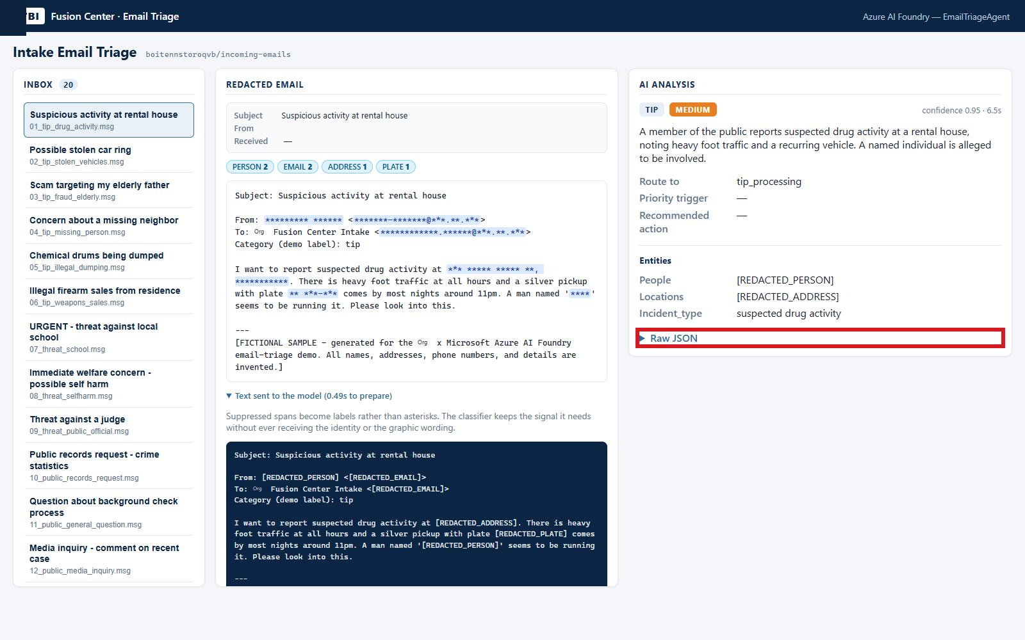
B | EMAIL ANALYST WEB APP
B03 Inspect the decision schema
DO
Click Raw JSON in the successful analysis card.
CHECK
Read category, priority, queue, confidence and review fields.
KEEP IN MIND
Structured output is a future integration contract, not integration.
Capture: Web workflow reference / slide 6
Agency | Demonstration captures | Not production authorization
PREV
MENU
NEXT
43
Notes:
B03 | Inspect the decision schema
Action: Click Raw JSON in the successful analysis card.
Expected / captured result: Read category, priority, queue, confidence and review fields.
Boundary / presenter cue: Structured output is a future integration contract, not integration.
Advance the slide to replay the next captured state. This is not a live application. Red frames belong to the original capture.
Source: Web workflow reference, slide 6. Customer labels and branding in this capture have been generalized.

Slide 46
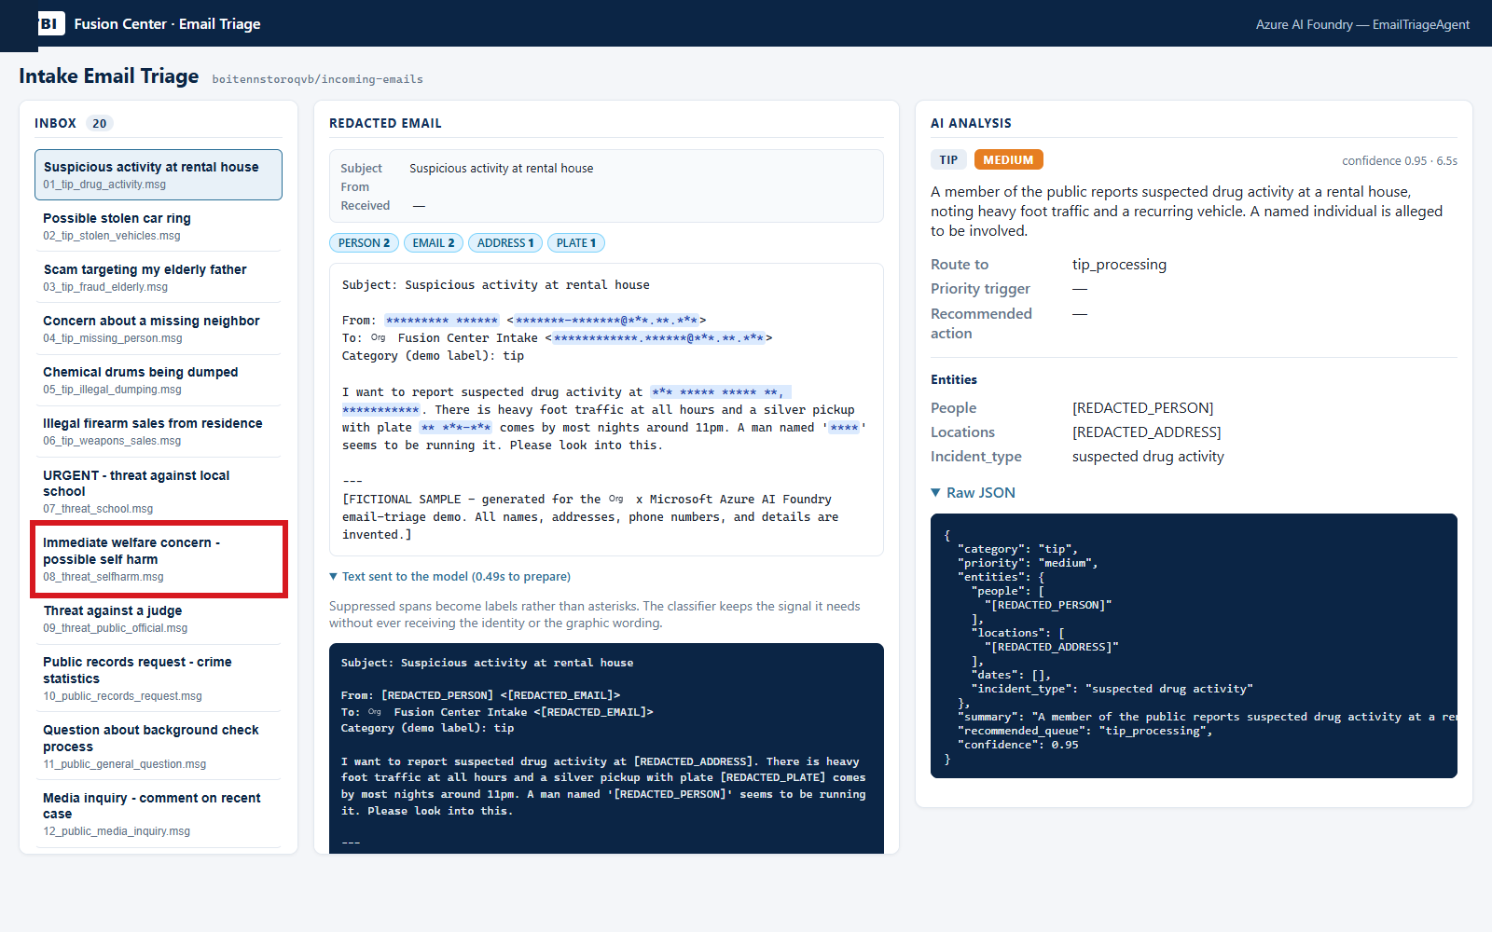
B | EMAIL ANALYST WEB APP
B04 Review a life-safety example
DO
Click 08_threat_selfharm.msg.
CHECK
Inspect priority and review handling for the synthetic concern.
KEEP IN MIND
Analysts must follow approved escalation procedures.
Capture: Web workflow reference / slide 7
Agency | Demonstration captures | Not production authorization
PREV
MENU
NEXT
44
Notes:
B04 | Review a life-safety example
Action: Click 08_threat_selfharm.msg.
Expected / captured result: Inspect priority and review handling for the synthetic concern.
Boundary / presenter cue: Analysts must follow approved escalation procedures.
Advance the slide to replay the next captured state. This is not a live application. Red frames belong to the original capture.
Source: Web workflow reference, slide 7. Customer labels and branding in this capture have been generalized.

Slide 47
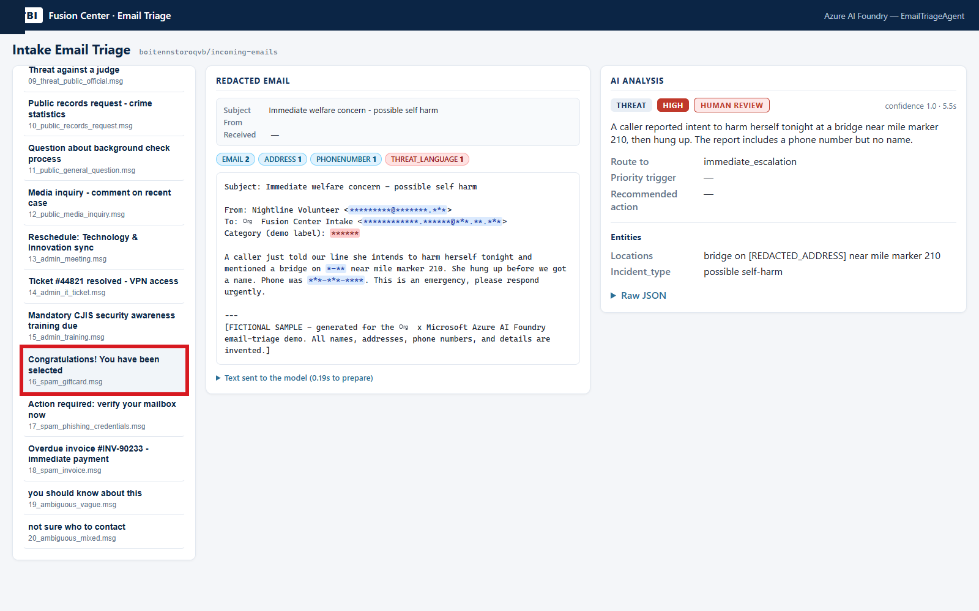
B | EMAIL ANALYST WEB APP
B05 Contrast routine noise
DO
Click 16_spam_giftcard.msg.
CHECK
Compare routine-noise treatment with the preceding concern.
KEEP IN MIND
Do not infer accuracy from this small curated contrast.
Capture: Web workflow reference / slide 8
Agency | Demonstration captures | Not production authorization
PREV
MENU
NEXT
45
Notes:
B05 | Contrast routine noise
Action: Click 16_spam_giftcard.msg.
Expected / captured result: Compare routine-noise treatment with the preceding concern.
Boundary / presenter cue: Do not infer accuracy from this small curated contrast.
Advance the slide to replay the next captured state. This is not a live application. Red frames belong to the original capture.
Source: Web workflow reference, slide 8. Customer labels and branding in this capture have been generalized.

Slide 48
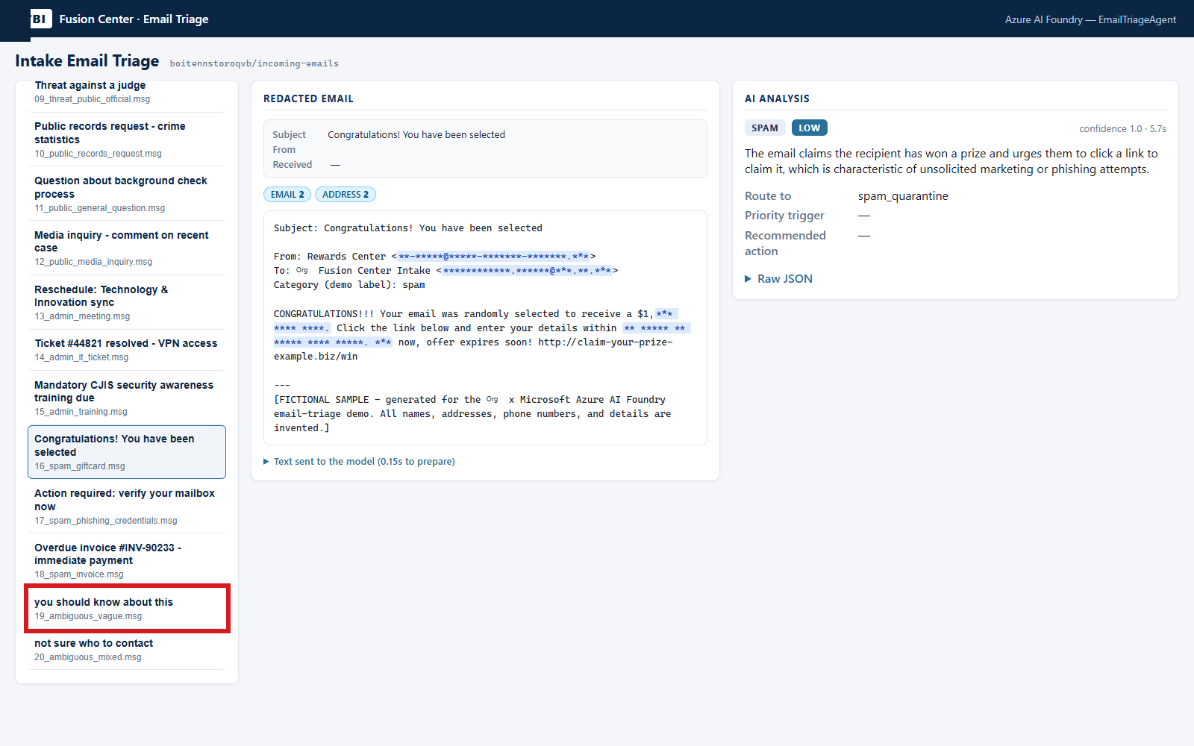
B | EMAIL ANALYST WEB APP
B06 Test an ambiguous submission
DO
Click sample 19, Vague submission.
CHECK
Low confidence and human_review remain visible for review.
KEEP IN MIND
Uncertain intake should not be silently discarded.
Capture: Web workflow reference / slide 9
Agency | Demonstration captures | Not production authorization
PREV
MENU
NEXT
46
Notes:
B06 | Test an ambiguous submission
Action: Click sample 19, Vague submission.
Expected / captured result: Low confidence and human_review remain visible for review.
Boundary / presenter cue: Uncertain intake should not be silently discarded.
Advance the slide to replay the next captured state. This is not a live application. Red frames belong to the original capture.
Source: Web workflow reference, slide 9. Customer labels and branding in this capture have been generalized.

Slide 49
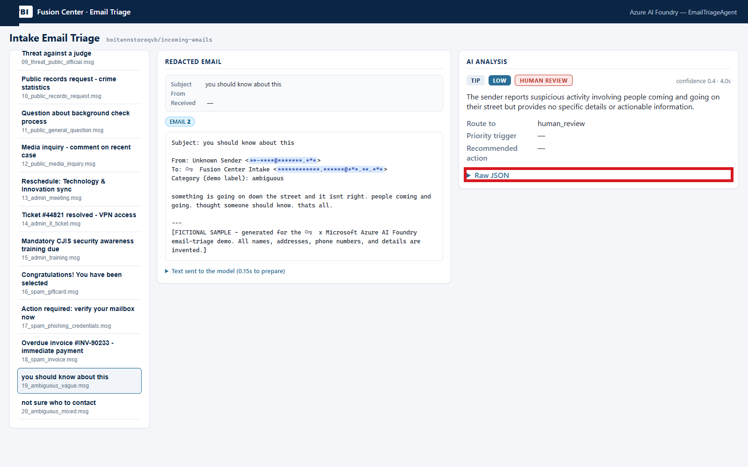
B | EMAIL ANALYST WEB APP
B07 Inspect the review handoff
DO
Click Raw JSON for the vague message.
CHECK
Read recommended_queue and confidence alongside human_review.
KEEP IN MIND
No durable queue, owner acknowledgement or delivery is proved.
Capture: Web workflow reference / slide 10
Agency | Demonstration captures | Not production authorization
PREV
MENU
NEXT
47
Notes:
B07 | Inspect the review handoff
Action: Click Raw JSON for the vague message.
Expected / captured result: Read recommended_queue and confidence alongside human_review.
Boundary / presenter cue: No durable queue, owner acknowledgement or delivery is proved.
Advance the slide to replay the next captured state. This is not a live application. Red frames belong to the original capture.
Source: Web workflow reference, slide 10. Customer labels and branding in this capture have been generalized.

Slide 50
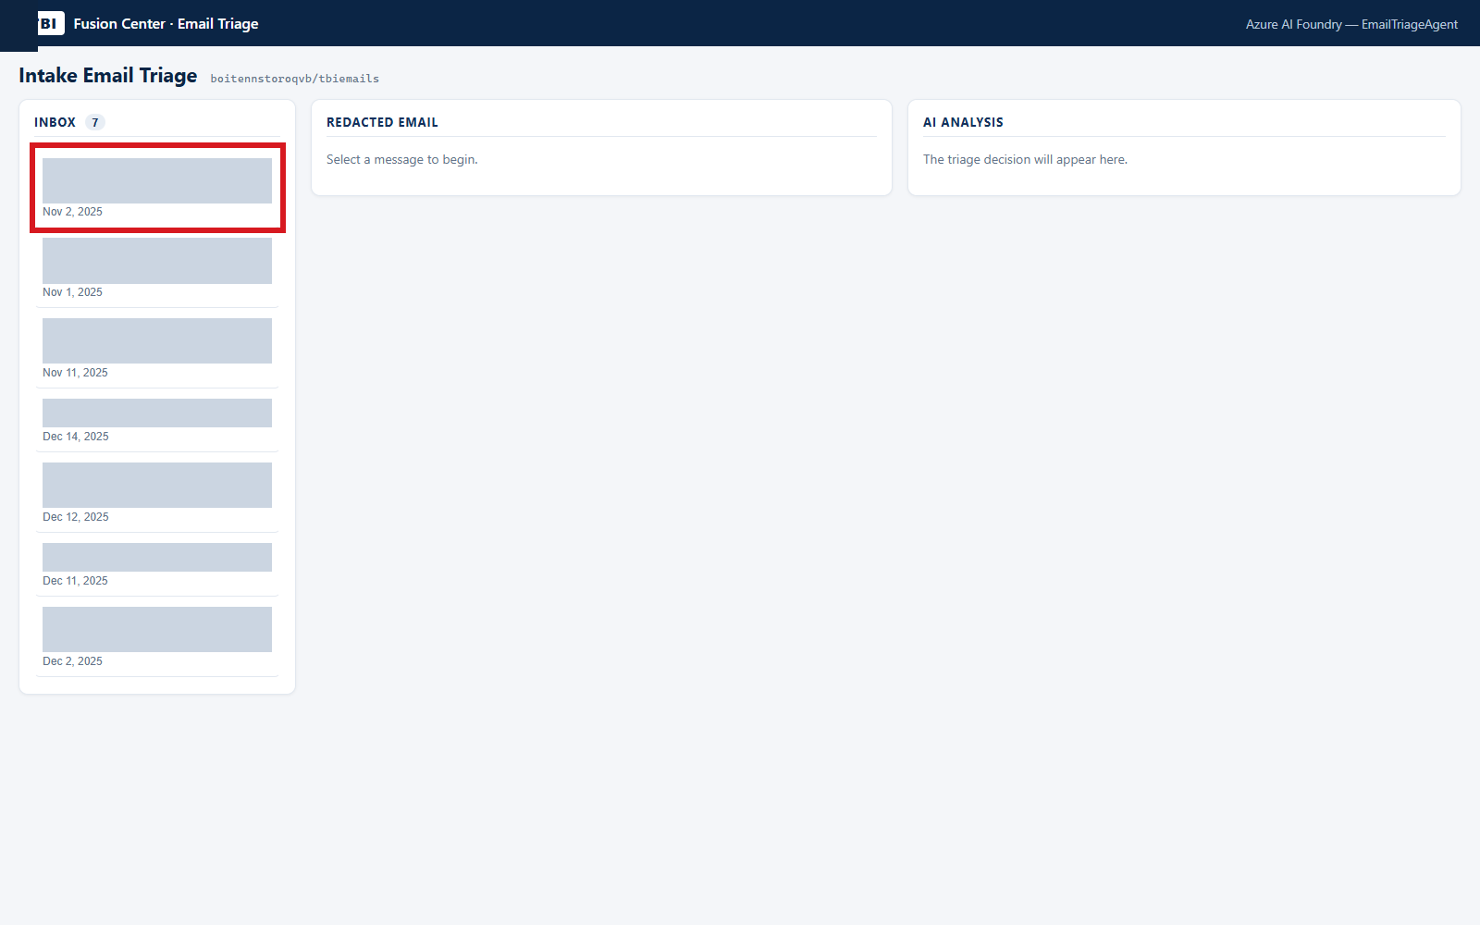
B | EMAIL ANALYST WEB APP
B08 Switch to the restricted test
DO
Use the separate capture at port 5181; select EmailSample0.msg.
CHECK
The restricted-content path is exercised rather than assumed.
KEEP IN MIND
Use approved data; do not bypass content-safety controls.
Capture: Web workflow reference / slide 11
Agency | Demonstration captures | Not production authorization
PREV
MENU
NEXT
48
Notes:
B08 | Switch to the restricted test
Action: Use the separate capture at port 5181; select EmailSample0.msg.
Expected / captured result: The restricted-content path is exercised rather than assumed.
Boundary / presenter cue: Use approved data; do not bypass content-safety controls.
Advance the slide to replay the next captured state. This is not a live application. Red frames belong to the original capture.
Source: Web workflow reference, slide 11. Customer labels and branding in this capture have been generalized.

Slide 51
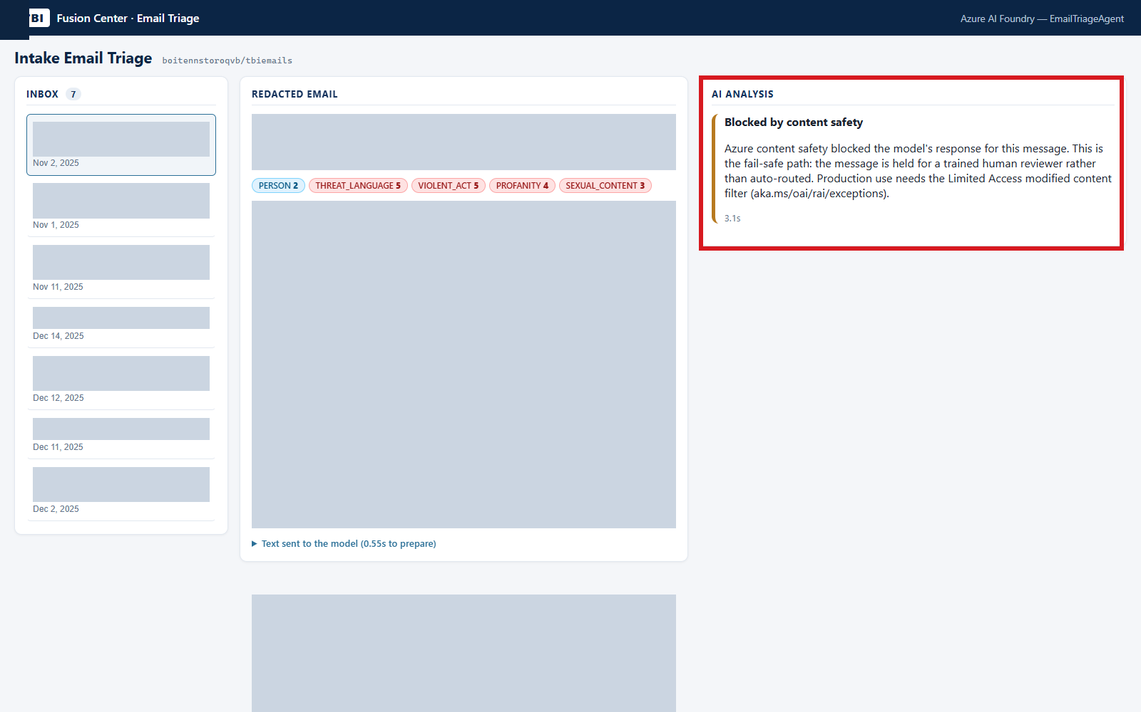
B | EMAIL ANALYST WEB APP
B09 Explain the blocked outcome
DO
Inspect Blocked by content safety; no further click is required.
CHECK
The app exposes rejection rather than fabricating a decision.
KEEP IN MIND
Durable hold and reviewer notification still need production wiring.
Capture: Web workflow reference / slide 12
Agency | Demonstration captures | Not production authorization
PREV
MENU
NEXT
49
Notes:
B09 | Explain the blocked outcome
Action: Inspect Blocked by content safety; no further click is required.
Expected / captured result: The app exposes rejection rather than fabricating a decision.
Boundary / presenter cue: Durable hold and reviewer notification still need production wiring.
Advance the slide to replay the next captured state. This is not a live application. Red frames belong to the original capture.
Source: Web workflow reference, slide 12. Customer labels and branding in this capture have been generalized.

Slide 52
C
Switch to the video evidence web app
01
02
03
Open the video app
One evidence pipeline
Review the source
Historical capture: http://127.0.0.1:5182. Choose a safe, approved short clip.
Case ID -> upload -> hash and Blob -> Video Indexer -> model summary -> Search.
Machine observations and summaries aid review. They do not replace viewing the evidence.
Agency | Demonstration captures | Not production authorization
PREV
MENU
NEXT
50
Notes:
Workflow transition. Open the video app: Historical capture: http://127.0.0.1:5182. Choose a safe, approved short clip. One evidence pipeline: Case ID -> upload -> hash and Blob -> Video Indexer -> model summary -> Search. Review the source: Machine observations and summaries aid review. They do not replace viewing the evidence.

Slide 53
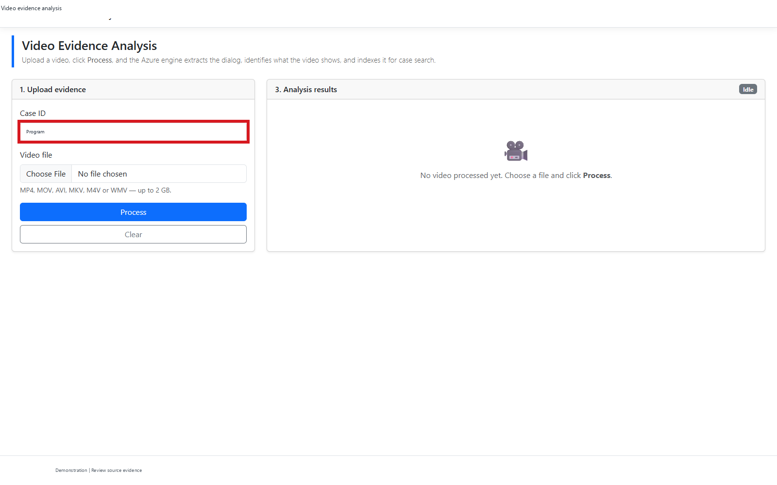
C | VIDEO EVIDENCE WEB APP
C01 Enter a unique demo case
DO
At port 5182, click Case ID and enter a new demo case ID.
CHECK
The upload is scoped to the intended case.
KEEP IN MIND
A case label alone is not an authorization boundary.
Capture: Web workflow reference / slide 13
Agency | Demonstration captures | Not production authorization
PREV
MENU
NEXT
51
Notes:
C01 | Enter a unique demo case
Action: At port 5182, click Case ID and enter a new demo case ID.
Expected / captured result: The upload is scoped to the intended case.
Boundary / presenter cue: A case label alone is not an authorization boundary.
Advance the slide to replay the next captured state. This is not a live application. Red frames belong to the original capture.
Source: Web workflow reference, slide 13. Customer labels and branding in this capture have been generalized.

Slide 54
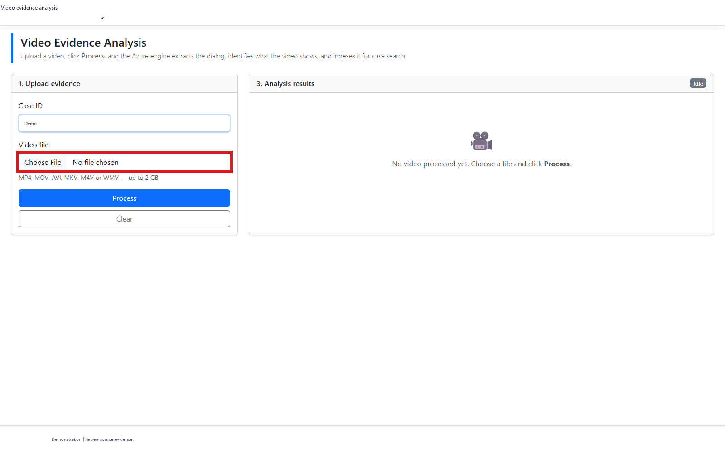
C | VIDEO EVIDENCE WEB APP
C02 Choose approved evidence
DO
Click Video file; choose the approved IMG_0577.mp4 sample.
CHECK
The selected filename appears in the form.
KEEP IN MIND
The recorded clip is silent and has no OCR text.
Capture: Web workflow reference / slide 14
Agency | Demonstration captures | Not production authorization
PREV
MENU
NEXT
52
Notes:
C02 | Choose approved evidence
Action: Click Video file; choose the approved IMG_0577.mp4 sample.
Expected / captured result: The selected filename appears in the form.
Boundary / presenter cue: The recorded clip is silent and has no OCR text.
Advance the slide to replay the next captured state. This is not a live application. Red frames belong to the original capture.
Source: Web workflow reference, slide 14. Customer labels and branding in this capture have been generalized.

Slide 55
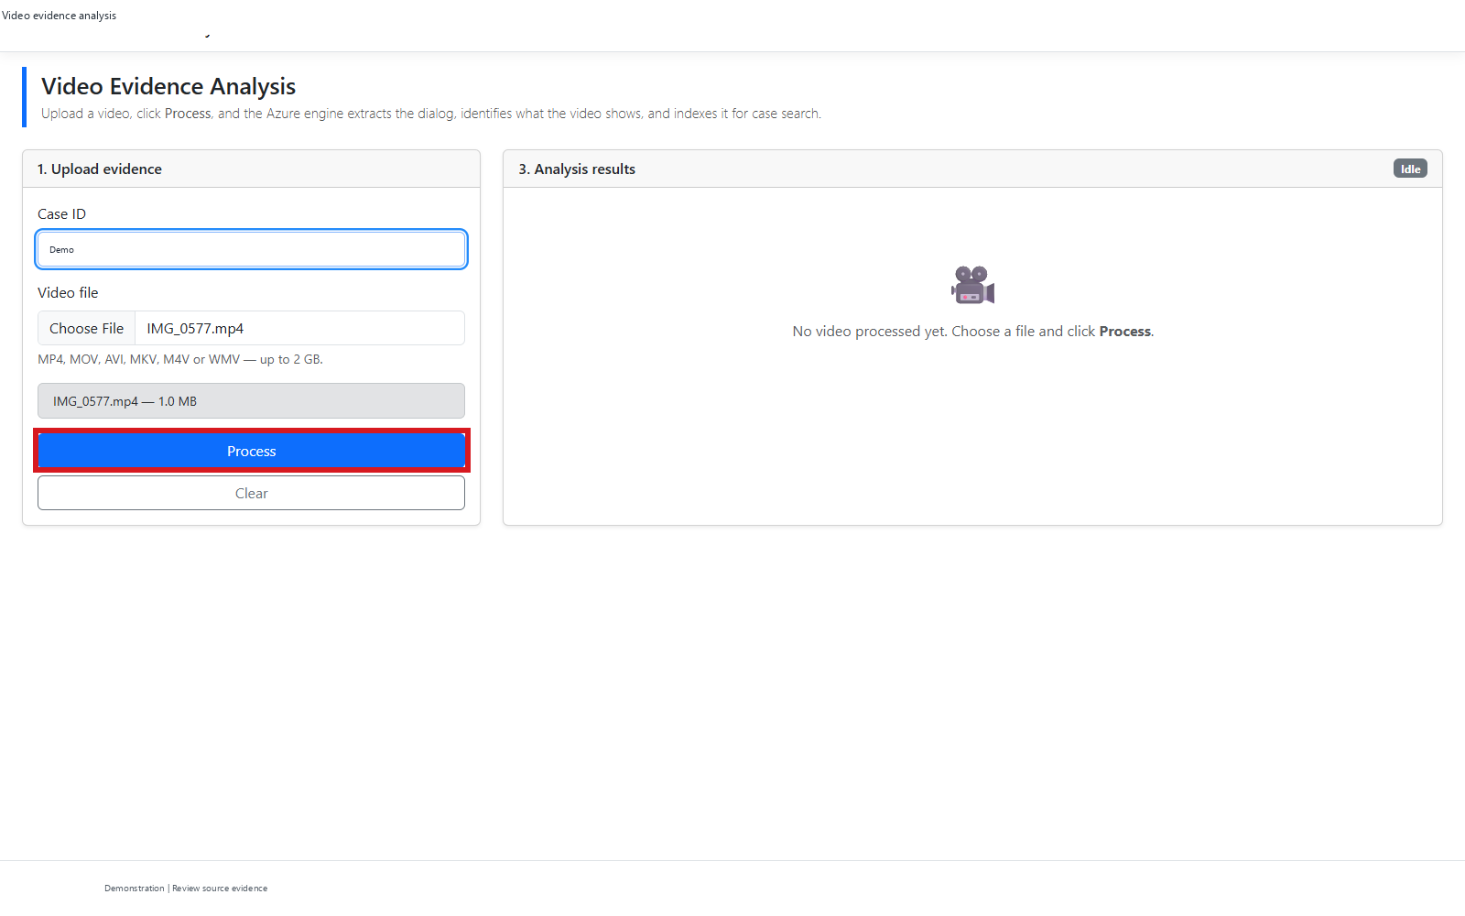
C | VIDEO EVIDENCE WEB APP
C03 Start the pipeline
DO
Click Process.
CHECK
Upload and analysis begin for the selected case and clip.
KEEP IN MIND
A live run writes data and can incur Azure charges.
Capture: Web workflow reference / slide 15
Agency | Demonstration captures | Not production authorization
PREV
MENU
NEXT
53
Notes:
C03 | Start the pipeline
Action: Click Process.
Expected / captured result: Upload and analysis begin for the selected case and clip.
Boundary / presenter cue: A live run writes data and can incur Azure charges.
Advance the slide to replay the next captured state. This is not a live application. Red frames belong to the original capture.
Source: Web workflow reference, slide 15. Customer labels and branding in this capture have been generalized.

Slide 56
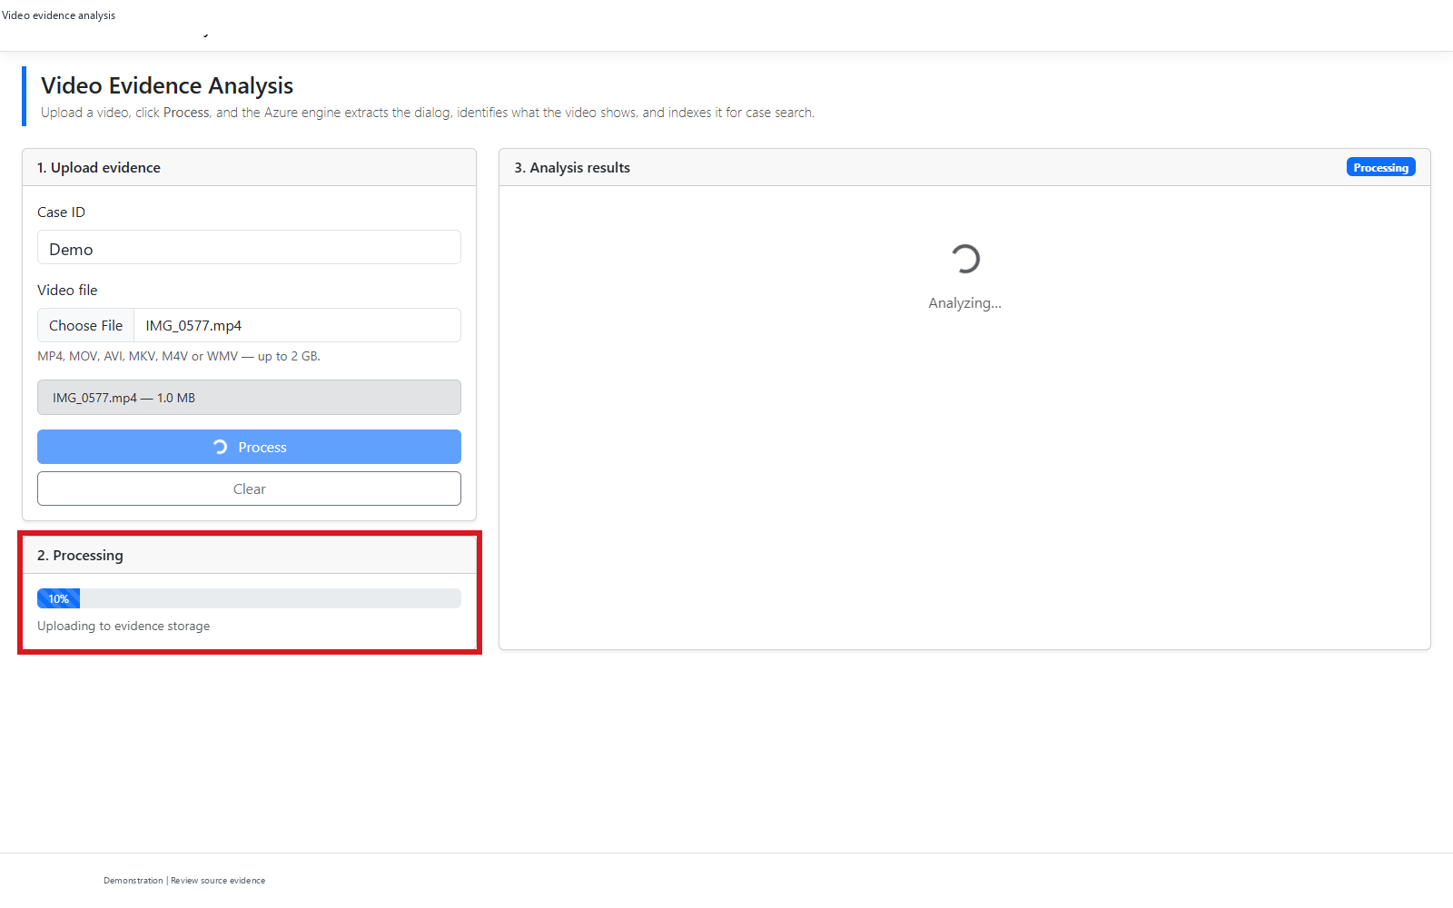
C | VIDEO EVIDENCE WEB APP
C04 Watch the progress panel
DO
Wait while processing stages update.
CHECK
The UI exposes work in progress instead of an unexplained pause.
KEEP IN MIND
Do not present the waiting capture as a completed result.
Capture: Web workflow reference / slide 16
Agency | Demonstration captures | Not production authorization
PREV
MENU
NEXT
54
Notes:
C04 | Watch the progress panel
Action: Wait while processing stages update.
Expected / captured result: The UI exposes work in progress instead of an unexplained pause.
Boundary / presenter cue: Do not present the waiting capture as a completed result.
Advance the slide to replay the next captured state. This is not a live application. Red frames belong to the original capture.
Source: Web workflow reference, slide 16. Customer labels and branding in this capture have been generalized.

Slide 57
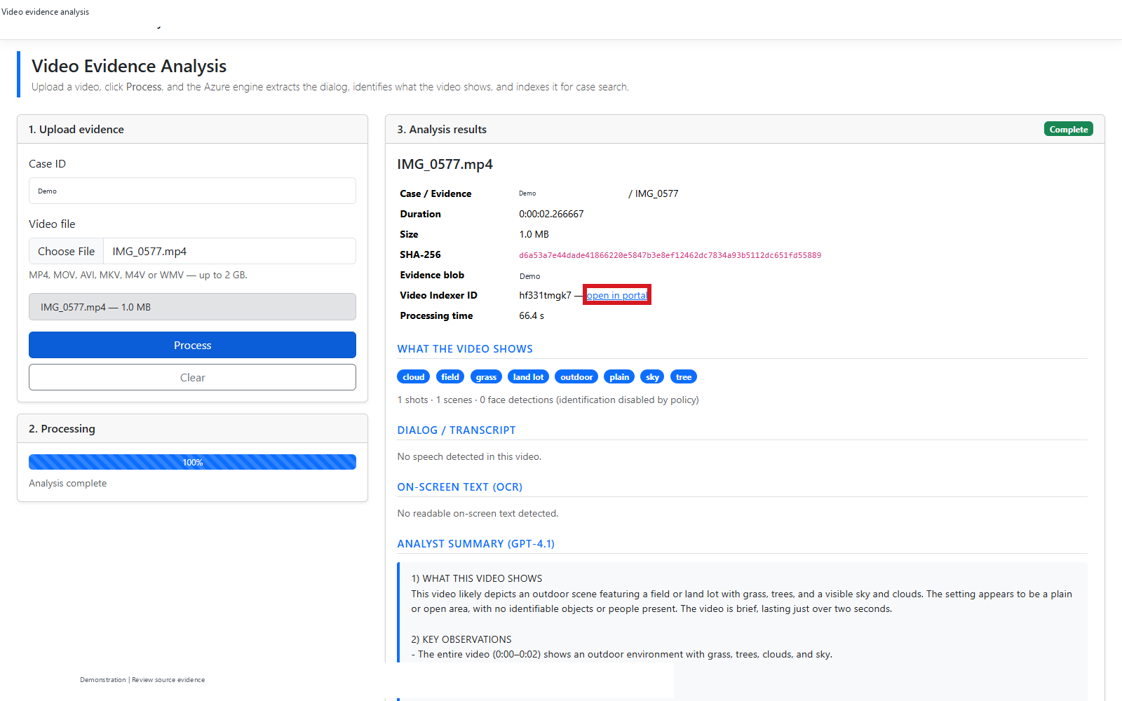
C | VIDEO EVIDENCE WEB APP
C05 Inspect source provenance
DO
Review the results header; optionally use open in portal when authorized.
CHECK
Inspect the source identifiers and SHA-256 evidence reference.
KEEP IN MIND
A hash aids integrity checks; it is not a complete chain of custody.
Capture: Web workflow reference / slide 17
Agency | Demonstration captures | Not production authorization
PREV
MENU
NEXT
55
Notes:
C05 | Inspect source provenance
Action: Review the results header; optionally use open in portal when authorized.
Expected / captured result: Inspect the source identifiers and SHA-256 evidence reference.
Boundary / presenter cue: A hash aids integrity checks; it is not a complete chain of custody.
Advance the slide to replay the next captured state. This is not a live application. Red frames belong to the original capture.
Source: Web workflow reference, slide 17. Customer labels and branding in this capture have been generalized.

Slide 58
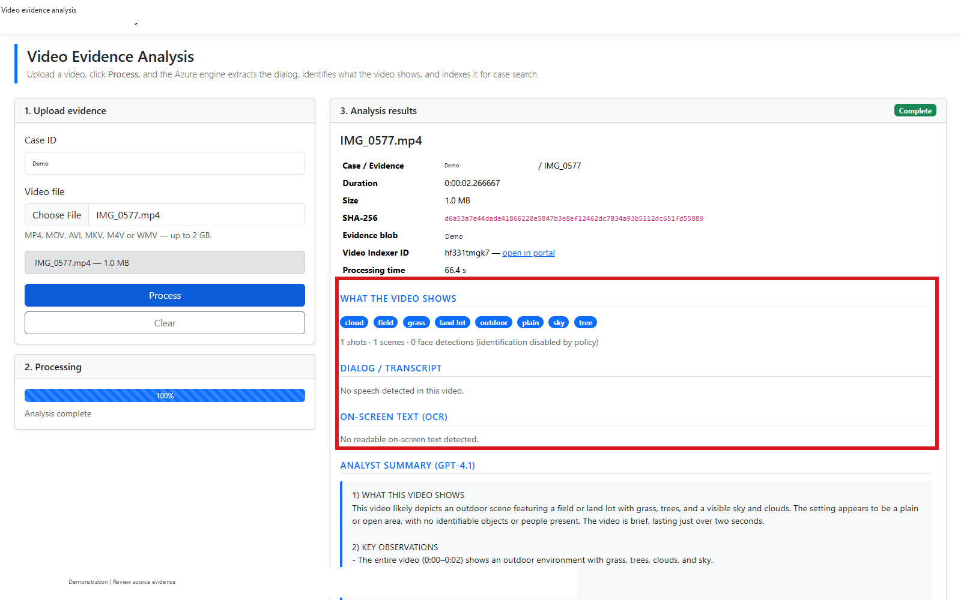
C | VIDEO EVIDENCE WEB APP
C06 Review extracted observations
DO
Scroll to What the video shows, Dialog / transcript and On-screen text.
CHECK
Inspect observed tags and the absence of speech/OCR for this clip.
KEEP IN MIND
This sample does not demonstrate speech or OCR extraction.
Capture: Web workflow reference / slide 18
Agency | Demonstration captures | Not production authorization
PREV
MENU
NEXT
56
Notes:
C06 | Review extracted observations
Action: Scroll to What the video shows, Dialog / transcript and On-screen text.
Expected / captured result: Inspect observed tags and the absence of speech/OCR for this clip.
Boundary / presenter cue: This sample does not demonstrate speech or OCR extraction.
Advance the slide to replay the next captured state. This is not a live application. Red frames belong to the original capture.
Source: Web workflow reference, slide 18. Customer labels and branding in this capture have been generalized.

Slide 59
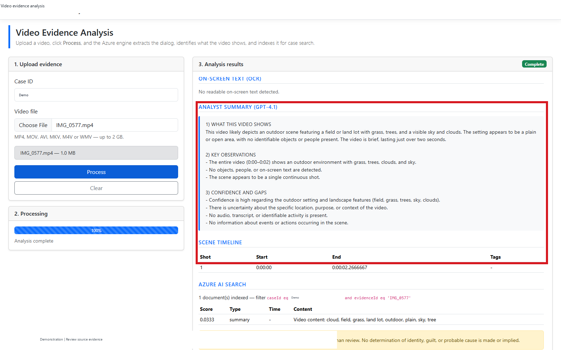
C | VIDEO EVIDENCE WEB APP
C07 Review summary and timeline
DO
Scroll to Analyst summary and Scene timeline.
CHECK
Read uncertainty and source timestamps alongside the narrative.
KEEP IN MIND
Summary text is machine-generated interpretation, not evidence fact.
Capture: Web workflow reference / slide 19
Agency | Demonstration captures | Not production authorization
PREV
MENU
NEXT
57
Notes:
C07 | Review summary and timeline
Action: Scroll to Analyst summary and Scene timeline.
Expected / captured result: Read uncertainty and source timestamps alongside the narrative.
Boundary / presenter cue: Summary text is machine-generated interpretation, not evidence fact.
Advance the slide to replay the next captured state. This is not a live application. Red frames belong to the original capture.
Source: Web workflow reference, slide 19. Customer labels and branding in this capture have been generalized.

Slide 60
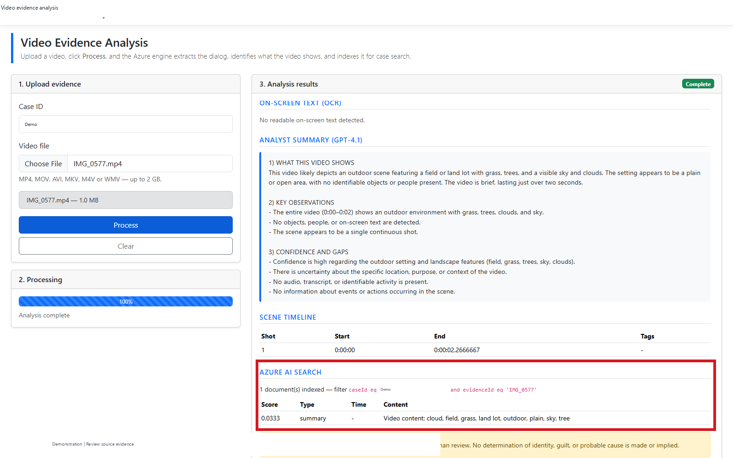
C | VIDEO EVIDENCE WEB APP
C08 Verify indexed retrieval
DO
Scroll to Azure AI Search at the bottom of the results.
CHECK
Inspect the nonzero indexed/retrieved evidence and source links.
KEEP IN MIND
This is a fixed case/evidence-filtered hybrid query, not arbitrary Q&A.
Capture: Web workflow reference / slide 20
Agency | Demonstration captures | Not production authorization
PREV
MENU
NEXT
58
Notes:
C08 | Verify indexed retrieval
Action: Scroll to Azure AI Search at the bottom of the results.
Expected / captured result: Inspect the nonzero indexed/retrieved evidence and source links.
Boundary / presenter cue: This is a fixed case/evidence-filtered hybrid query, not arbitrary Q&A.
Advance the slide to replay the next captured state. This is not a live application. Red frames belong to the original capture.
Source: Web workflow reference, slide 20. Customer labels and branding in this capture have been generalized.

Slide 61

C | VIDEO EVIDENCE WEB APP
C09 Reset the analyst view
DO
Click Clear; confirm the page returns to Idle.
CHECK
The upload form and review panel reset.
KEEP IN MIND
Clear does not prove deletion of retained Blob or index data.
Capture: Web workflow reference / slide 21
Agency | Demonstration captures | Not production authorization
PREV
MENU
NEXT
59
Notes:
C09 | Reset the analyst view
Action: Click Clear; confirm the page returns to Idle.
Expected / captured result: The upload form and review panel reset.
Boundary / presenter cue: Clear does not prove deletion of retained Blob or index data.
Advance the slide to replay the next captured state. This is not a live application. Red frames belong to the original capture.
Source: Web workflow reference, slide 21. Customer labels and branding in this capture have been generalized.

Slide 62
MAIN-FLOW CLOSE
The next handoff is production work
01
02
03
Demonstrated
Not demonstrated
Pilot gates
Captured intake review, model decisions, local policy controls, exports and a video-to-Search run.
Mailbox ingestion into owned queues, case-system delivery, durable blocked-item handling or production hosting.
Measure recall, route agreement, review workload, latency and cost. Approve access, retention, audit and CJIS scope.
Agency | Demonstration captures | Not production authorization
PREV
MENU
NEXT
60
Notes:
Consolidates FINAL_Agency_DEMO slides 12, 25-27 and Agency_Demo_Walkthrough slides 23-24. Existing Azure resources are not evidence that these production handoffs are wired. Main demo complete; use the menu or optional appendix next.

Slide 63
D
Optional deep dives and future architecture
01
02
03
Operator options
Recorded evidence
Proposed extensions
Alternative intake routes, original-text view, supervisor controls and profile management.
A separate buried-tip report has an unresolved page citation; do not present it as a live UI feature.
Three architecture references describe future options, not verified deployed capabilities.
Agency | Demonstration captures | Not production authorization
PREV
MENU
NEXT
61
Notes:
Workflow transition. Operator options: Alternative intake routes, original-text view, supervisor controls and profile management. Recorded evidence: A separate buried-tip report has an unresolved page citation; do not present it as a live UI feature. Proposed extensions: Three architecture references describe future options, not verified deployed capabilities.

Slide 64

D | OPTIONAL OPERATOR CONTROLS
D01 Single-file intake
DO
Click Select Message; choose an approved supported file.
CHECK
One file can enter the same MessageIQ triage path.
KEEP IN MIND
Alternative to A08-A10, not an additional required load step.
Capture: Desktop workflow reference / slide 9
Agency | Demonstration captures | Not production authorization
PREV
MENU
NEXT
62
Notes:
D01 | Single-file intake
Action: Click Select Message; choose an approved supported file.
Expected / captured result: One file can enter the same MessageIQ triage path.
Boundary / presenter cue: Alternative to A08-A10, not an additional required load step.
Advance the slide to replay the next captured state. This is not a live application. Red frames belong to the original capture.
Source: Desktop workflow reference, slide 9. Customer labels and branding in this capture have been generalized.

Slide 65

D | OPTIONAL OPERATOR CONTROLS
D02 Upload intake
DO
Click Upload; choose an approved file.
CHECK
The file joins the working set for processing.
KEEP IN MIND
Alternative route; do not assume production mailbox ingestion.
Capture: Desktop workflow reference / slide 10
Agency | Demonstration captures | Not production authorization
PREV
MENU
NEXT
63
Notes:
D02 | Upload intake
Action: Click Upload; choose an approved file.
Expected / captured result: The file joins the working set for processing.
Boundary / presenter cue: Alternative route; do not assume production mailbox ingestion.
Advance the slide to replay the next captured state. This is not a live application. Red frames belong to the original capture.
Source: Desktop workflow reference, slide 10. Customer labels and branding in this capture have been generalized.

Slide 66

D | OPTIONAL OPERATOR CONTROLS
D03 Inspect Blob connection
DO
Click Azure Blob; inspect account, container and Azure sign-in.
CHECK
Inspect the connection parameters.
KEEP IN MIND
The deck does not show a completed Blob listing or intake.
Capture: Desktop workflow reference / slide 63
Agency | Demonstration captures | Not production authorization
PREV
MENU
NEXT
64
Notes:
D03 | Inspect Blob connection
Action: Click Azure Blob; inspect account, container and Azure sign-in.
Expected / captured result: Inspect the connection parameters.
Boundary / presenter cue: The deck does not show a completed Blob listing or intake.
Advance the slide to replay the next captured state. This is not a live application. Red frames belong to the original capture.
Source: Desktop workflow reference, slide 63. Customer labels and branding in this capture have been generalized.

Slide 67

D | OPTIONAL OPERATOR CONTROLS
D04 Inspect original-text reveal
DO
Only if authorized, click Showing REDACTED; toggle back afterwards.
CHECK
The analyst's local view changes between redacted and original.
KEEP IN MIND
Keep redacted during normal demos. Reveal is not proof of changed model input.
Capture: Desktop workflow reference / slide 24
Agency | Demonstration captures | Not production authorization
PREV
MENU
NEXT
65
Notes:
D04 | Inspect original-text reveal
Action: Only if authorized, click Showing REDACTED; toggle back afterwards.
Expected / captured result: The analyst's local view changes between redacted and original.
Boundary / presenter cue: Keep redacted during normal demos. Reveal is not proof of changed model input.
Advance the slide to replay the next captured state. This is not a live application. Red frames belong to the original capture.
Source: Desktop workflow reference, slide 24. Customer labels and branding in this capture have been generalized.

Slide 68

D | OPTIONAL OPERATOR CONTROLS
D05 Supervisor Watch Card preview
DO
Open Watch Cards > Advanced (supervisor); inspect preview and test controls.
CHECK
The generated Watch Card instructions are inspectable.
KEEP IN MIND
Any live Test on selected message may invoke the model.
Capture: Desktop workflow reference / slide 41
Agency | Demonstration captures | Not production authorization
PREV
MENU
NEXT
66
Notes:
D05 | Supervisor Watch Card preview
Action: Open Watch Cards > Advanced (supervisor); inspect preview and test controls.
Expected / captured result: The generated Watch Card instructions are inspectable.
Boundary / presenter cue: Any live Test on selected message may invoke the model.
Advance the slide to replay the next captured state. This is not a live application. Red frames belong to the original capture.
Source: Desktop workflow reference, slide 41. Customer labels and branding in this capture have been generalized.

Slide 69

D | OPTIONAL OPERATOR CONTROLS
D06 Profile library and portability
DO
Open Edit Profiles; inspect Import, Export and Restore built-in.
CHECK
Profiles can be managed as explicit policy artifacts.
KEEP IN MIND
Do not restore, delete or import profiles during a read-only tour.
Capture: Desktop workflow reference / slide 52
Agency | Demonstration captures | Not production authorization
PREV
MENU
NEXT
67
Notes:
D06 | Profile library and portability
Action: Open Edit Profiles; inspect Import, Export and Restore built-in.
Expected / captured result: Profiles can be managed as explicit policy artifacts.
Boundary / presenter cue: Do not restore, delete or import profiles during a read-only tour.
Advance the slide to replay the next captured state. This is not a live application. Red frames belong to the original capture.
Source: Desktop workflow reference, slide 52. Customer labels and branding in this capture have been generalized.

Slide 70

D | OPTIONAL OPERATOR CONTROLS
D07 Inspect structured fields
DO
Open Key fields; also review Categories and Outputs as needed.
CHECK
The configured extraction fields and allowed output vocabulary are visible.
KEEP IN MIND
Schema configuration does not establish extraction correctness.
Capture: Desktop workflow reference / slide 48
Agency | Demonstration captures | Not production authorization
PREV
MENU
NEXT
68
Notes:
D07 | Inspect structured fields
Action: Open Key fields; also review Categories and Outputs as needed.
Expected / captured result: The configured extraction fields and allowed output vocabulary are visible.
Boundary / presenter cue: Schema configuration does not establish extraction correctness.
Advance the slide to replay the next captured state. This is not a live application. Red frames belong to the original capture.
Source: Desktop workflow reference, slide 48. Customer labels and branding in this capture have been generalized.

Slide 71
D | SUPPLEMENTAL EVIDENCE
Buried tip: recorded evidence, not a live feature
30
P2
10 / 11
Fictitious pages
Recorded result
Unresolved citation
A separate recorded analysis reports one actionable tip in noisy intake.
Result.txt records tip / P2 / confidence 0.92. This is not a calibrated quality score.
The answer key says page 10; the result cites page 11. Resolve before claiming citation accuracy.
Neither web app has an attachment/page-scoring upload surface in this walkthrough.
Agency | Demonstration captures | Not production authorization
PREV
MENU
NEXT
69
Notes:
Source: Web workflow reference, slide 22. Kept separate from numbered click flows because it is recorded evidence with a known unresolved citation discrepancy.

Slide 72
D | PROPOSED EXTENSION - NOT DEMONSTRATED
Proposed investigative-evidence architecture
1 INGEST
2 EXTRACT
3 RETRIEVE
4 REASON
5 REVIEW
Videos + investigative files
Blob / Data Lake
Video Indexer + Vision
Speech + Document Intelligence
Metadata + embeddings
Azure AI Search
Foundry agent + citations
Timeline / evidence matching
Analyst UI / case integration
Human approval
Planning pattern only. The video demo proves a narrower upload-to-Search path.
Cross-case matching, arbitrary evidence Q&A and production delivery are not established.
Agency | Demonstration captures | Not production authorization
PREV
MENU
NEXT
70
Notes:
Source: Architecture reference slide 87. Redrawn as an editable planning flow. All expanded elements are proposed, even where individual services exist in another prototype.

Slide 73

D | ORIGINAL PLANNING REFERENCE - NOT DEMONSTRATED
Proposed Azure capability map
Service capability catalog only; not a deployed bill of materials or compliance approval.
Agency | Demonstration captures | Not production authorization
PREV
MENU
NEXT
71
Notes:
Source: Architecture reference slide 86. Generic architecture reference retained as a rendered image with an explicit proposed-status label. Service capability catalog only; not a deployed bill of materials or compliance approval.

Slide 74

D | ORIGINAL PLANNING REFERENCE - NOT DEMONSTRATED
Proposed investigative use cases
Future scenarios only; no cross-case search, suspect matching or general evidence Q&A is proved.
Agency | Demonstration captures | Not production authorization
PREV
MENU
NEXT
72
Notes:
Source: Architecture reference slide 88. Generic architecture reference retained as a rendered image with an explicit proposed-status label. Future scenarios only; no cross-case search, suspect matching or general evidence Q&A is proved.

Slide 75
CONSOLIDATION AND SOURCE TRACEABILITY
One deck. No duplicated desktop tour.
Executive workflow reference
Executive story, exception boundaries, measured-run qualifications and pilot close.
Desktop workflow reference
Desktop screenshots and detailed operator flow; duplicate tour appears only once.
Architecture reference
Same first 85 slides except presenter contact text; 3 added architecture references retained.
Web workflow reference
Distinct Foundry-email and video click flows; supplemental evidence and production boundaries.
Source capture references are retained on slides and in presenter notes.
App data and Azure resources were not modified or freshly revalidated by this merge.
Agency | Demonstration captures | Not production authorization
PREV
MENU
NEXT
73
Notes:
All four sources were analyzed and opened read-only in native PowerPoint. MAUI and ClickThru slides 2-85 have identical text and screenshots; slide 1 differs only in presenter contact text. Repeated orientation, result states and summaries were condensed into one numbered flow. Unique operator functions and all three architecture references are retained. The final Generic solution demonstration is self-contained and does not link to deleted source presentations.

