Slide 1
GENERIC SOLUTION DEMONSTRATION
Language access services
THE PROBLEM
THE SOLUTION
Members need translated notices, two-way interpretation and usable transcripts of recorded calls.
Translate digital/scanned documents, replay bilingual hearings, and translate call transcripts with an inserted audio notice.
PRODUCTS AND PLATFORM
Windows .NET MAUI | Azure AI Translator | Azure AI Speech | Azure AI Document Intelligence | Entra ID
Synthetic documents and prerecorded hearing audio. Live-microphone performance and production integration are not established; recognition/session issues are documented.
Notes:
Problem: Members need translated notices, two-way interpretation and usable transcripts of recorded calls.
Solution: Translate digital/scanned documents, replay bilingual hearings, and translate call transcripts with an inserted audio notice.
Products: Windows .NET MAUI | Azure AI Translator | Azure AI Speech | Azure AI Document Intelligence | Entra ID
Evidence status: Synthetic documents and prerecorded hearing audio. Live-microphone performance and production integration are not established; recognition/session issues are documented.
Customer branding, organization labels and resource identifiers have been generalized. Screenshots are edited historical captures; no service results were rerun.

Slide 2
SOLUTION ARCHITECTURE
How the solution fits together
RELATED WORKFLOWS / BRANCHES
01
02
03
04
Documents
Translation
Audio workflows
Review + save
Text extraction or DI OCR
Translator target languages
Speech STT / translation / TTS
Transcript / local WAV splice
These are related scenarios, not a single serial pipeline. OpenAI/Foundry and cloud UI hosting are not required. Blob intake and approval workflow are proposed.
Generic labels and edited screenshots | Historical results are illustrative, not rerun
START TOUR >
Notes:
Architecture: [['Documents', 'Text extraction or DI OCR'], ['Translation', 'Translator target languages'], ['Audio workflows', 'Speech STT / translation / TTS'], ['Review + save', 'Transcript / local WAV splice']]
Boundary: These are related scenarios, not a single serial pipeline. OpenAI/Foundry and cloud UI hosting are not required. Blob intake and approval workflow are proposed.
This is a logical diagram, not a verified deployment inventory. Cards represent separate workflows or branches; do not read them as one serial pipeline.
Customer names, logos and resource identifiers in subsequent captured screens have been generalized. Service brands and the solution's core workflow remain.

Slide 3
STATE OF Example State • DIVISION OF Health Plan
Language Access with Azure AI
Translator, Speech and Document Intelligence — working demonstration
Prepared for the Division of Health Plan
22 October 2026
John Straumann, Field CAIO Officer, Microsoft South
Notes:
TALK TRACK
Thank you for the time. What you are about to see is not a storyboard or a mock-up. It is a working Windows application running against live Azure AI services in a Microsoft demonstration tenant, and every result on screen is produced in real time during this session. We built it directly from the requirements Talley sent through, so the three scenarios map one-to-one onto the three things Health Plan asked about.
WHAT IS HAPPENING
No technology is running yet. This is the framing slide.
CUSTOMER ASK
Sets context for all three Health Plan use cases: member notice translation, live hearing interpretation, and recorded call handling.
AZURE TECHNOLOGY
Azure AI Translator, Azure AI Speech and Azure AI Document Intelligence.
BUSINESS VALUE
Establishes credibility by making clear up front that this is live, not simulated.
DEMO TRANSITION
Move to the Customer Asks slide and confirm that the requirements have been captured correctly before showing anything.

Slide 4
CUSTOMER ASKS
What Health Plan Asked For
Member notices
1
Translate member-facing correspondence on demand
Both digital PDFs and scanned paper; exact layout fidelity is not required
Spanish and Arabic at volume
Vietnamese, Swahili, Burmese, Mandarin and Russian in the long tail
Live hearings
2
Near-real-time, two-way interpretation
Member speaks their language, the hearing officer hears English
The reply is returned to the member spoken aloud
Produces a written bilingual record of the hearing
Recorded calls
3
Transcribe a recorded member call
Produce a translated transcript of it
Place a notice (English) into an English audio recording file
Verify the inserted audio is genuinely present
Notes:
TALK TRACK
Before anything moves on screen, I want to read back what you asked for, because if this list is wrong then nothing that follows matters. Three scenarios. Member notices, including the scanned ones that come back from a vendor as images. Live hearings, two-way and near real time. And recorded calls, where you asked for a translated transcript and, in your own words, for a notice in English to be placed into an English audio recording file. You also told us exact layout fidelity is not required, which is a genuinely useful simplification, and you answered yes to all of the governance questions on privacy, PHI, retention, accessibility and human review.
WHAT IS HAPPENING
No technology is running yet.
CUSTOMER ASK
This slide is a direct restatement of the requirements in the email thread, including the named languages.
AZURE TECHNOLOGY
None yet.
BUSINESS VALUE
Confirming requirements in the customer's own words prevents a demonstration that answers the wrong question.
DEMO TRANSITION
Ask directly whether anything is missing or has changed since the thread, then move on to how each ask maps to a capability.

Slide 5
MAPPING
Requirement to Capability to Value
Customer requirement | Demo capability | Azure capability | Business value
Translate digital member notices | Read the PDF text layer, translate into Spanish and Arabic together | Azure AI Translator | Same-day notices instead of a vendor turnaround
Handle scanned paper with no text layer | OCR the image, then translate the recovered text | Document Intelligence + Translator | Scanned archives stop being a dead end
Support the long-tail languages | Any supported language chosen at the moment of need | Azure AI Translator | Burmese or Swahili costs the same effort as Spanish
Two-way hearing interpretation | Speech in, translated text and speech out, both directions | Azure AI Speech translation and synthesis | Hearings proceed without waiting for an interpreter
Written record of a hearing | Bilingual transcript saved as the session runs | Azure AI Speech to text | An auditable record of what each party actually said
Translated transcript of a call | Recorded call transcribed, then translated into Spanish and Arabic | Azure AI Speech to text and translation | Review and QA without a bilingual staff member
Notice (English) into an English recording | Notice synthesised as English speech and spliced into the audio | Azure AI Speech synthesis | The notice lands inside audio the member already gets
Notes:
TALK TRACK
This is the whole demonstration on one page. Every row starts with something you asked for, in the middle is what you will actually watch happen, and on the right is why it matters operationally. If at any point in the next ten minutes you lose track of why we are showing you something, this is the slide to come back to. Note the third column: there are only three Azure services in play. This is deliberately a small solution.
WHAT IS HAPPENING
No technology is running yet.
CUSTOMER ASK
Covers all seven discrete requirements drawn from the thread.
AZURE TECHNOLOGY
Azure AI Translator, Azure AI Speech, Azure AI Document Intelligence.
BUSINESS VALUE
Shows the customer that nothing was invented and nothing was dropped.
DEMO TRANSITION
Point out that only three services are involved, then move to the slide showing exactly what was deployed.

Slide 6
AZURE RESOURCE INVENTORY
What We Actually Deployed
Resource name | Service | Tier | Purpose in the demo
demo-translator | Azure AI Translator | S1 | Text translation for notices and hearing turns
demo-speech | Azure AI Speech | S0 | Speech to text, speech translation, speech synthesis
demo-docintel | Azure AI Document Intelligence | S0 | OCR for scanned notices with no text layer
Resource group demo-rg, East US. Deployed from Bicep, not by hand.
No API keys
Nothing else deployed
Local authentication is disabled on all three accounts. The application signs in with Microsoft Entra ID and holds the Cognitive Services User role. There is no key to leak because no key will work.
No storage, no key vault, no containers, no Azure OpenAI. Documents and recordings stay on the workstation. We did not deploy services the demonstration does not exercise.
Notes:
TALK TRACK
Three services. That is the entire Azure footprint. I want to draw your attention to the box on the left, because it is the thing your security people will ask about first. Local authentication is switched off on all three accounts, which means the API keys do not merely go unused, they are refused. The application authenticates as me, through Entra ID, with the Cognitive Services User role. And on the right, equally important: we deliberately did not deploy storage accounts, key vaults or anything else that would make the diagram look more impressive than the demonstration actually is.
WHAT IS HAPPENING
No technology is running yet.
CUSTOMER ASK
Addresses the privacy and security questions answered yes in the thread.
AZURE TECHNOLOGY
Microsoft Entra ID role-based access control over Azure AI services.
BUSINESS VALUE
A keyless design removes the most common cause of credential incidents, and a minimal footprint keeps cost and review effort low.
DEMO TRANSITION
Move to the architecture slide and stress that it shows only what exists today.

Slide 7
MVP — WHAT EXISTS TODAY
Architecture as Deployed
PRESENTER WORKSTATION
AZURE — demo-rg, East US
.NET MAUI Windows app
Azure AI Translator
Three scenario pages
Notice and hearing text
Microsoft
Entra ID
Local demo files
Azure AI Speech
Synthetic notices and audio
token
Transcribe, translate, synthesise
Audio splicing
Azure AI Document Intelligence
In-process WAV editing
OCR for scanned notices
Dashed boundary stays on the workstation. No member content is stored in Azure; calls are request and response only.
Notes:
TALK TRACK
This diagram contains no aspiration. Everything on it is deployed and everything on it gets exercised in the next ten minutes. On the left, a .NET MAUI Windows application and the demo files, which never leave the machine. In the middle, Entra ID issues a token. On the right, the three AI services. The important detail is the dashed line: documents and recordings are read locally, the text or audio is sent for processing, and the result comes back. Nothing is persisted in Azure. That matters for your PHI conversation.
WHAT IS HAPPENING
No technology is running yet.
CUSTOMER ASK
Addresses the PHI, retention and privacy questions.
AZURE TECHNOLOGY
Entra ID token issuance, then direct data-plane calls to the three AI services.
BUSINESS VALUE
A small, honest architecture is far easier to get through a security review than a large speculative one.
DEMO TRANSITION
Flag that the next slide shows what would be added beyond the MVP, so nobody confuses the two.

Slide 8
NOT DEPLOYED — FOR DISCUSSION ONLY
Beyond the MVP
MVP
POC
Production
Deployed and demonstrated
Next step, not built
Target state, not built
Translator, Speech, Document Intelligence
Windows desktop application
Local files, nothing persisted
Entra ID, no keys
Synthetic data only
Blob Storage for notice intake
Human review and approval queue
Glossary of Health Plan terminology
Custom Speech for programme names
Integration with the notice system
Private endpoints and network isolation
Customer-managed keys, retention policy
Audit logging and Purview classification
High availability across paired regions
Accessibility conformance testing
Only the left-hand column exists. The other two are recommendations, shown so the demonstration is not mistaken for a production design.
Notes:
TALK TRACK
I want to be careful here. Only the green column exists. The other two columns are where this would go, and I am showing them so that nobody leaves the room thinking a two-day demonstration is a production design. The middle column is what a proof of concept would add, and the one I would highlight is a glossary and Custom Speech, because you will see in a moment that the speech engine does not reliably recognise the word Health Plan. The right-hand column is the production conversation: private networking, retention policy, audit logging and formal accessibility testing.
WHAT IS HAPPENING
No technology is running yet.
CUSTOMER ASK
Addresses retention, accessibility and human review as forward-looking commitments rather than implemented features.
AZURE TECHNOLOGY
None deployed. Services named are recommendations.
BUSINESS VALUE
Honesty about scope protects the relationship and makes the next conversation easier.
DEMO TRANSITION
Switch to the running application. Open the dashboard before saying anything else.

Slide 9
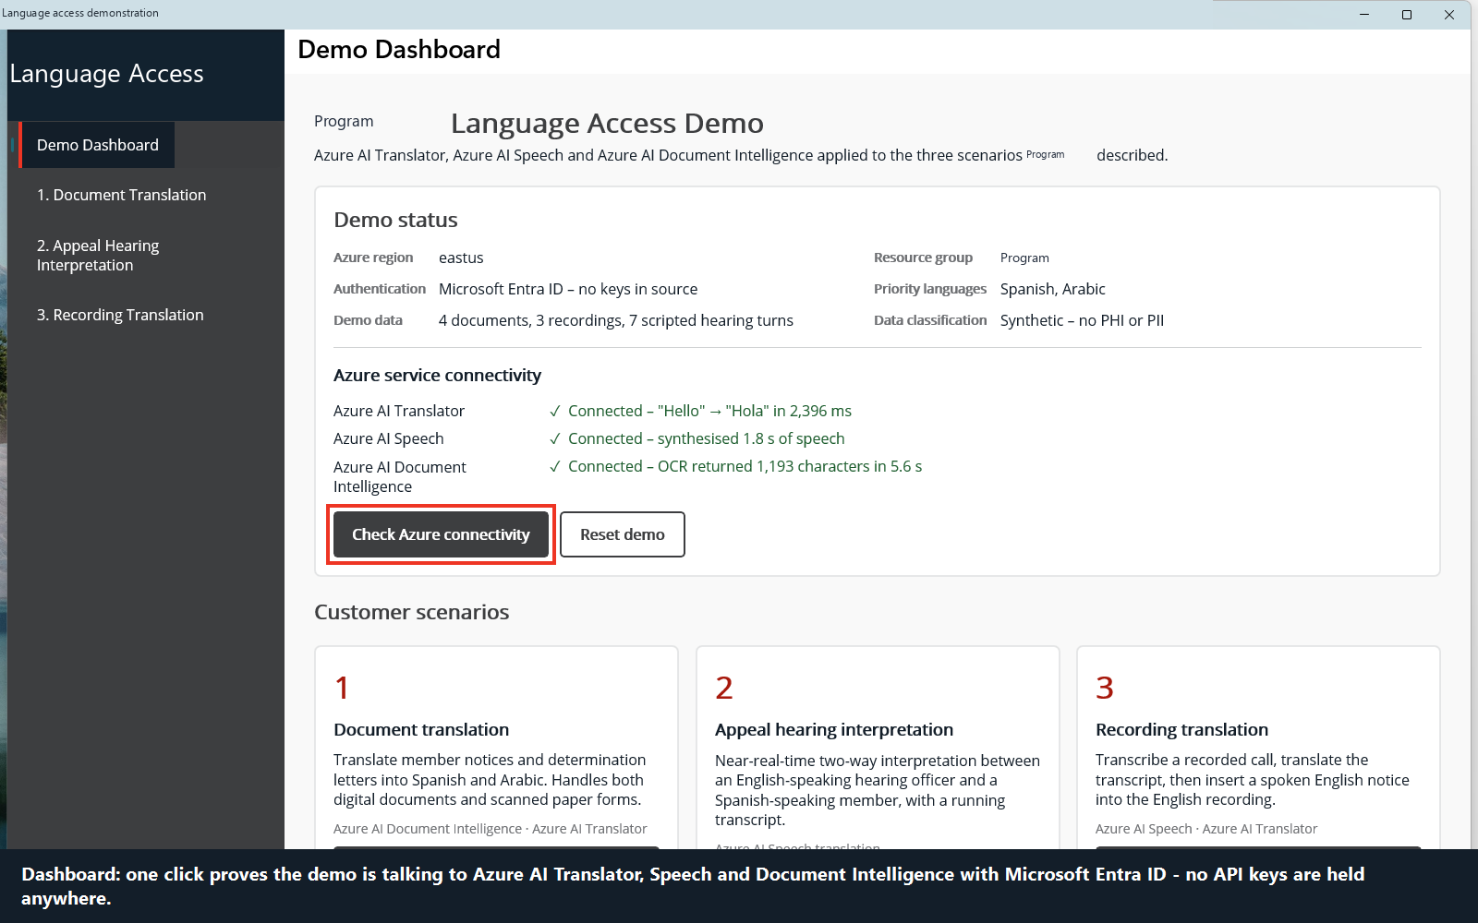
DEMONSTRATION — OPENING
Live Connectivity Check
WHAT IS HAPPENING
One click calls all three services and reports back. Translator returns a language list, Document Intelligence answers a service call, and Speech synthesises a short phrase and reports its real duration.
Each probe acquires an Entra token. No API key exists.
CUSTOMER ASK
Proves the demo is live, not recorded
AZURE TECHNOLOGY
Entra ID token exchange against all three Azure AI services
Notes:
TALK TRACK
Before we translate anything, let me prove this is live. I am clicking Check Azure connectivity, and the application is calling all three services right now. Translator, Document Intelligence and Speech all come back green, and note that Speech reports the actual duration of audio it just generated, so it is not merely reporting that a connection opened. If I were showing you a recording, this button would be the first thing to give me away.
WHAT IS HAPPENING
The application acquires a Microsoft Entra ID access token through DefaultAzureCredential, exchanges it for a Speech authorisation token at the token issuing endpoint, and makes one real data-plane call per service. The Speech probe synthesises a short phrase to a temporary file and measures the resulting WAV, so a green result means audio was genuinely produced.
CUSTOMER ASK
Underpins every requirement by establishing that the session is live.
AZURE TECHNOLOGY
Microsoft Entra ID, Azure AI Translator, Azure AI Speech, Azure AI Document Intelligence.
BUSINESS VALUE
A customer who believes the demonstration is live will believe the results. It also shows the keyless authentication model working in practice.
DEMO TRANSITION
Say that scenario one is the most common day-to-day need, and open the Member Notices page.

Slide 10
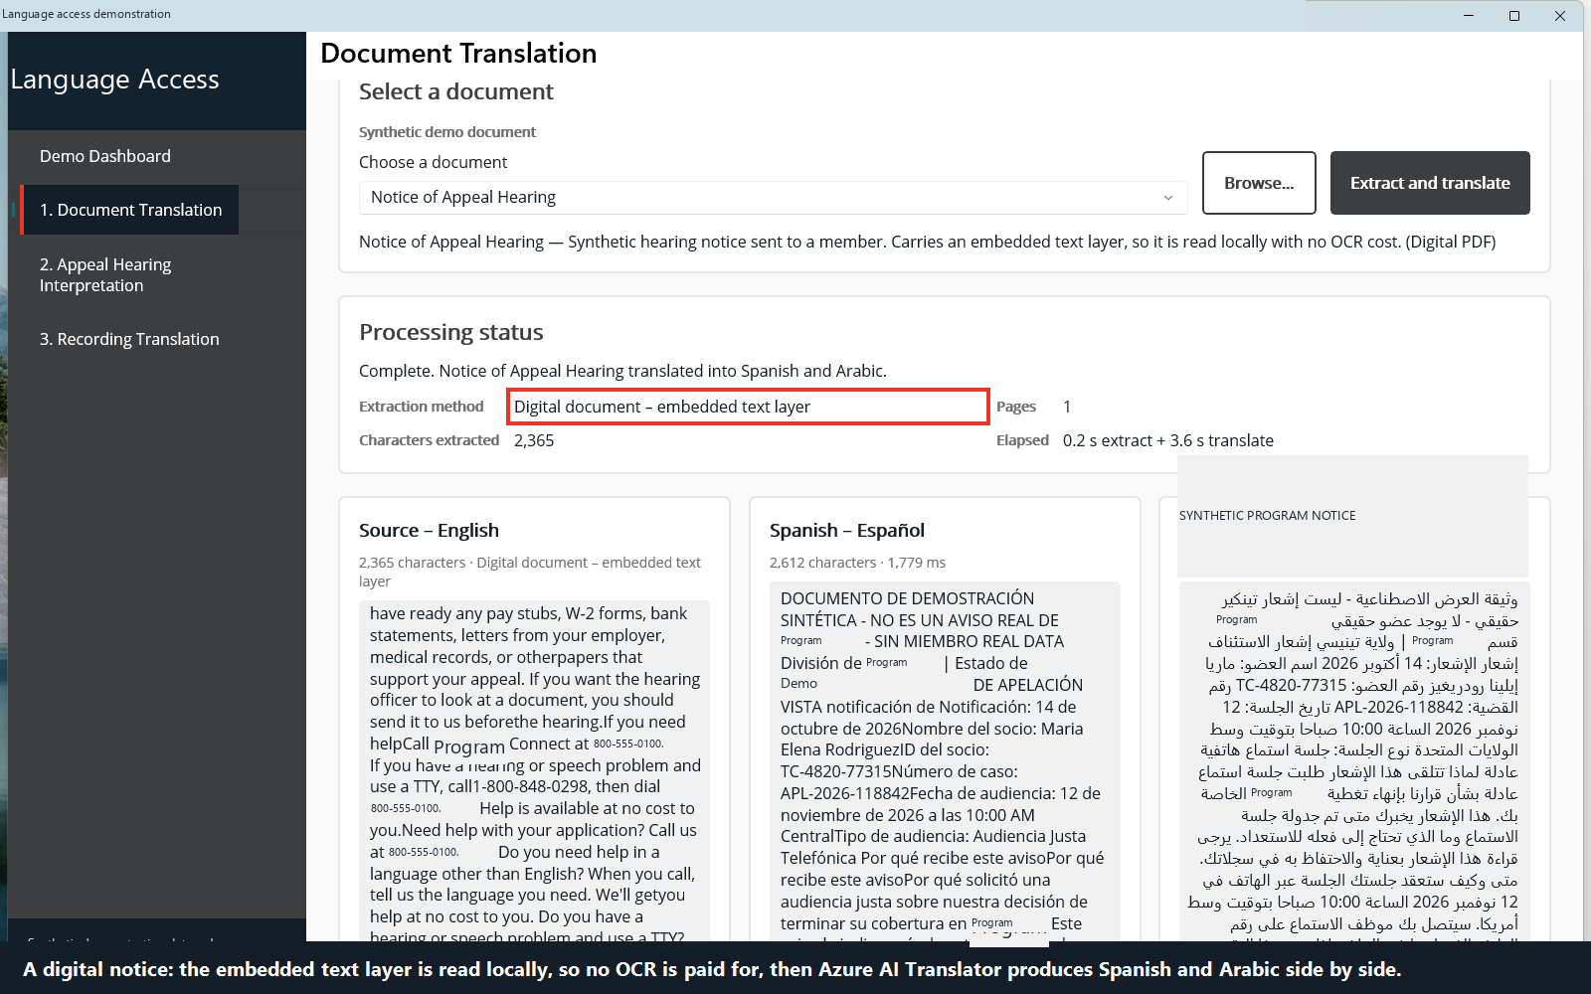
DEMONSTRATION — SCENARIO 1
Translating a Digital Notice
WHAT IS HAPPENING
A synthetic Notice of Appeal Hearing is loaded as a PDF. The application reads the embedded text layer directly, recovering 2,365 characters with no OCR, then translates it into Spanish and Arabic in the same pass.
On demand, in seconds, not a vendor queue.
CUSTOMER ASK
Translate member-facing notices on demand
AZURE TECHNOLOGY
PDF text extraction, then Azure AI Translator
Notes:
TALK TRACK
This is a synthetic Notice of Appeal Hearing, written to look like the correspondence Health Plan actually sends, with a case number, a hearing date and appeal rights. It is a normal digital PDF, so the application reads its text layer directly and recovers about two thousand three hundred characters. No OCR is needed and none is used, which keeps it fast and cheap. I press translate and we get Spanish and Arabic together, in the same pass. Note the Arabic is laid out right to left, which the application handles without any special casing.
WHAT IS HAPPENING
PdfPig extracts the embedded text layer from the PDF locally. The recovered text is sent to Azure AI Translator in a single request carrying both target languages, and the Spanish and Arabic results are rendered alongside the source. The file itself never leaves the workstation; only the extracted text is sent.
CUSTOMER ASK
Translate digital member notices into the member's language on demand, with Spanish and Arabic as the volume languages. The customer confirmed that exact layout fidelity is not required, which is why this returns clean readable text rather than a reconstructed PDF.
AZURE TECHNOLOGY
Azure AI Translator for the translation. PDF text extraction is done locally.
BUSINESS VALUE
A notice can be produced in the member's language the same day rather than waiting on an external translation vendor, which directly affects whether a member responds inside their appeal window.
DEMO TRANSITION
Note that not every document arrives this cleanly, and switch to the scanned example.

Slide 11
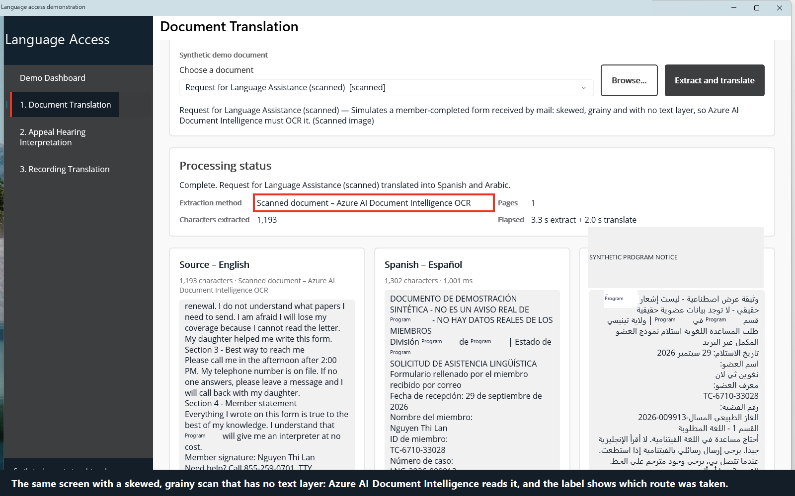
DEMONSTRATION — SCENARIO 1
Reading a Scanned Form
WHAT IS HAPPENING
A member-completed Request for Language Assistance, received by mail and scanned. Skewed, grainy, no text layer at all. Document Intelligence recovers 1,193 characters, which then follow exactly the same translation path.
The scanned archive stops being a dead end.
CUSTOMER ASK
Handle scanned paper with no text layer
AZURE TECHNOLOGY
Azure AI Document Intelligence, then Azure AI Translator
Notes:
TALK TRACK
This is the case you specifically raised. This one is a form the member filled in by hand and posted back, and it has been scanned. It is slightly skewed, the quality is poor, and there is no text in the file at all, just pixels. The application detects that, sends the image to Document Intelligence, and gets the words back. From that point onward it is the identical code path as the digital notice, Spanish and Arabic together. I want to be straight with you about one thing: OCR latency varies. We have measured about three seconds on one run and thirty on another, on this same file. In production you would run this as a background job rather than making a caseworker watch a progress bar.
WHAT IS HAPPENING
The application finds no extractable text layer, so it falls back to Azure AI Document Intelligence. The image is submitted to the read model, the recognised text is reassembled in reading order, and the result is passed to Azure AI Translator exactly as the digital notice was. Measured OCR latency across runs has ranged from roughly 3 to 30 seconds on identical input.
CUSTOMER ASK
Scanned paper, which the customer called out explicitly as something they receive and currently cannot process. Note this one runs the other way round: it is inbound member correspondence rather than an outbound notice, and the same pipeline serves both.
AZURE TECHNOLOGY
Azure AI Document Intelligence for OCR, Azure AI Translator for translation.
BUSINESS VALUE
Scanned correspondence is usually where language access programmes stall. Making it work means the existing paper and imaged archive becomes usable without re-keying.
DEMO TRANSITION
Ask which language they would like to see next, and use the language selector to answer live.

Slide 12
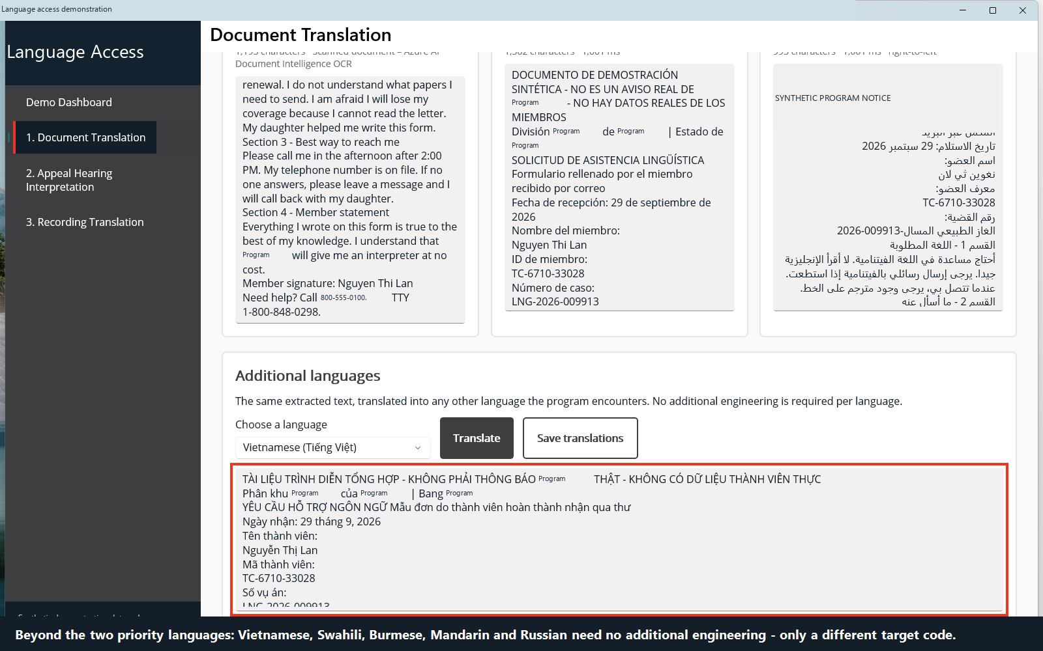
DEMONSTRATION — SCENARIO 1
The Long Tail, On Demand
WHAT IS HAPPENING
The same scanned form translated again, this time into Vietnamese, chosen at the moment of need rather than configured in advance. Nothing was pre-translated and nothing was cached.
A rare language costs the same effort as a common one.
CUSTOMER ASK
Vietnamese, Swahili, Burmese, Mandarin, Russian
AZURE TECHNOLOGY
Azure AI Translator, language chosen at run time
Notes:
TALK TRACK
This is the part that usually changes the conversation. You listed Spanish and Arabic as your volume languages, and you have just seen both produced together. Then you named Vietnamese, Swahili, Burmese, Mandarin and Russian as the long tail. The long tail is where the cost sits today, because a Burmese translation means finding a Burmese translator. Here is the same document, translated into Vietnamese, chosen from a dropdown a moment ago and returned in well under a second. Nothing was pre-translated. If you want to call out a different language now, I will do it live.
WHAT IS HAPPENING
The same source text held in memory is sent to Azure AI Translator with a different target language code. There is no per-language configuration, model or deployment; the language is simply a parameter on the request.
CUSTOMER ASK
The long-tail language list the customer named in the thread. Note that Somali is deliberately absent because the customer did not name it; we did not pad the list.
AZURE TECHNOLOGY
Azure AI Translator.
BUSINESS VALUE
The marginal cost of an additional language is effectively zero, which turns language access from a budgeting problem into an operational one.
DEMO TRANSITION
Say that documents are the easy half, and that the harder requirement is a live conversation. Open the Hearings page.

Slide 13
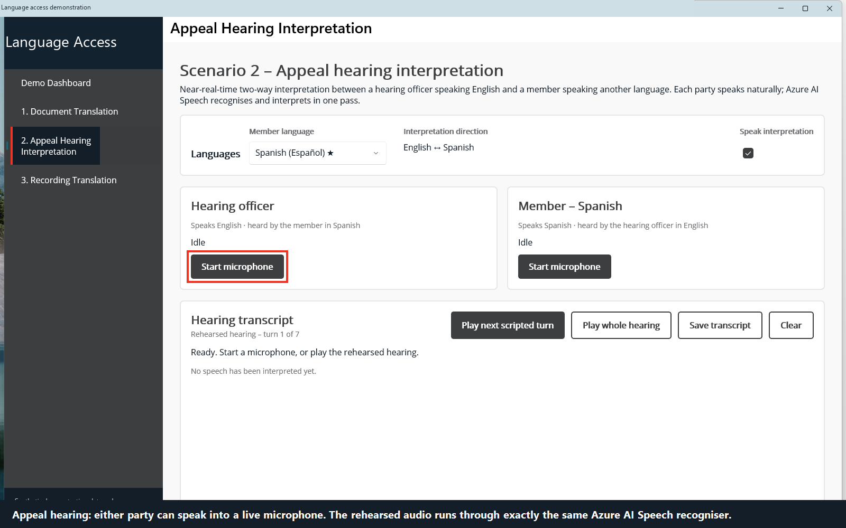
DEMONSTRATION — SCENARIO 2
Setting Up a Live Hearing
WHAT IS HAPPENING
The hearing page before the session begins. The member's language is selected and the hearing officer works in English. Interpretation runs in both directions through a single Azure AI Speech translation session.
The presenter chooses whether output is spoken aloud.
CUSTOMER ASK
Near-real-time, two-way interpretation
AZURE TECHNOLOGY
Azure AI Speech translation recognition
Notes:
TALK TRACK
Now the harder scenario: a live appeal hearing. The member speaks Spanish, the hearing officer speaks English, and neither should have to wait. I select the member's language, and I will leave the speak-aloud option on so you can hear the output. One honest note on the mechanics: this demonstration feeds pre-recorded member audio through the system rather than using a live microphone, because a conference room microphone is not a fair test. Azure does precisely the same work either way; it is the identical speech translation session, with a file as the audio source instead of a microphone.
WHAT IS HAPPENING
The application opens an Azure AI Speech TranslationRecognizer configured with the member's language as the source and English as a target, plus the reverse direction for the officer's turns. Audio is streamed continuously and interim results arrive before the speaker has finished.
CUSTOMER ASK
Near-real-time, two-way interpretation during a hearing.
AZURE TECHNOLOGY
Azure AI Speech continuous translation recognition, with Azure AI Speech synthesis for the spoken reply.
BUSINESS VALUE
Hearings are time sensitive and interpreter availability is the usual constraint. Removing the wait removes a scheduling bottleneck and a cost line.
DEMO TRANSITION
Start the session and let the first two turns play before speaking over it.

Slide 14
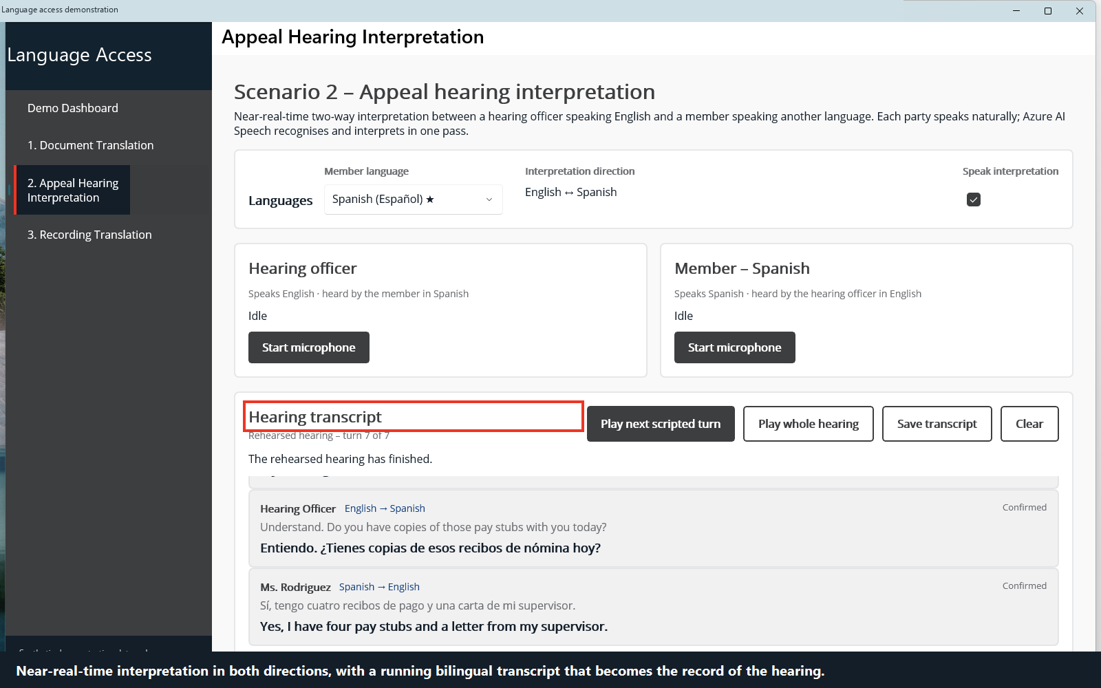
DEMONSTRATION — SCENARIO 2
A Bilingual Record of the Hearing
WHAT IS HAPPENING
Seven turns of a rehearsed appeal hearing, interpreted in both directions and spoken aloud as they are produced. Each turn is captured with the original and the translation, building an auditable bilingual transcript as it goes.
The transcript is saved to disk at the end of the session.
CUSTOMER ASK
Two-way interpretation plus a written record
AZURE TECHNOLOGY
Azure AI Speech translation and synthesis
Notes:
TALK TRACK
Seven turns of an appeal hearing, both directions, and you can see both the original and the translation for every turn. The record builds itself as the hearing runs, so there is no transcription step afterwards. Two things I want to point out honestly. First, look closely and you will see Health Plan transcribed as Tencare and Youth Plan as cover kids. The speech engine does not know your programme names, and the fix is a phrase list or Custom Speech, which is a configuration exercise rather than a research problem. Second, this is one place a human reviewer belongs, which is what you were getting at in the thread.
WHAT IS HAPPENING
Each utterance produces a recognised source transcript and a translated text from the same Azure AI Speech session. The translated text is then synthesised to speech and played. Every turn is appended to an in-memory transcript that is written to disk when the session ends.
CUSTOMER ASK
Two-way interpretation and a written record of the hearing, plus the human-review consideration the customer answered yes to.
AZURE TECHNOLOGY
Azure AI Speech translation recognition and neural speech synthesis.
BUSINESS VALUE
The hearing proceeds at conversational pace and produces its own auditable record, which matters for an appeal that may later be challenged.
DEMO TRANSITION
Say that the third scenario was the most interesting ask in the thread, and open the Recorded Calls page.

Slide 15
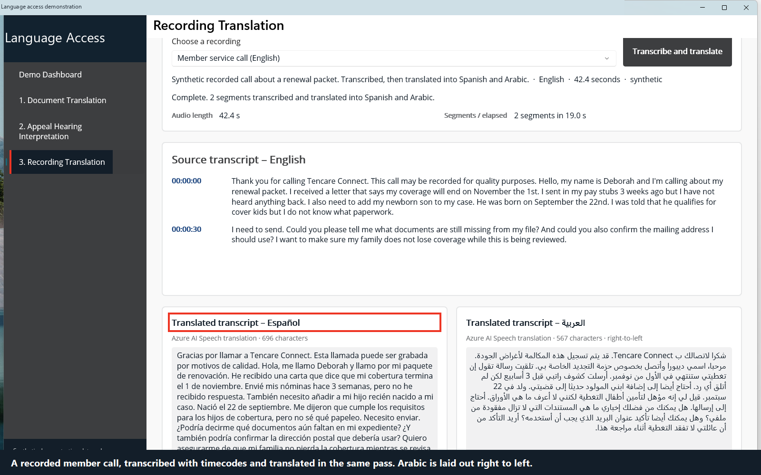
DEMONSTRATION — SCENARIO 3
A Translated Transcript of a Call
WHAT IS HAPPENING
A 42.4 second recorded member service call in English is transcribed with timecodes and translated in the same pass into Spanish and Arabic, shown side by side.
No bilingual reviewer is needed to work the call.
CUSTOMER ASK
Transcribe a call and produce a translated transcript
AZURE TECHNOLOGY
Azure AI Speech transcription and translation
Notes:
TALK TRACK
Scenario three has two halves, and this is the first one. You said you will need a translated transcript. Here is a recorded member service call, just over forty seconds, in English. The application transcribes it with timecodes and translates it in the same pass, into Spanish and Arabic. A reviewer who reads either language can now work this call. One honest detail while it is on screen: look at the first line and you will see Tencare Connect rather than Health Plan Connect. The speech engine does not know your programme names. I will come back to that.
WHAT IS HAPPENING
The WAV file is streamed to Azure AI Speech, which returns a timecoded transcript in the source language together with translations into each configured target language, segment by segment. Segment boundaries and character counts vary slightly from run to run because the service decides where speech pauses fall; read whatever is on screen rather than quoting a figure. The call always processes faster than real time.
CUSTOMER ASK
The customer's words were: we will need a translated transcript. This is that requirement, met directly.
AZURE TECHNOLOGY
Azure AI Speech file-based transcription and translation.
BUSINESS VALUE
Recorded calls become reviewable by staff who do not speak the language, which matters for quality assurance, complaints and audit.
DEMO TRANSITION
Say: the second half of what you asked for was to put a notice into a recording. Then trigger the notice insertion.

Slide 16
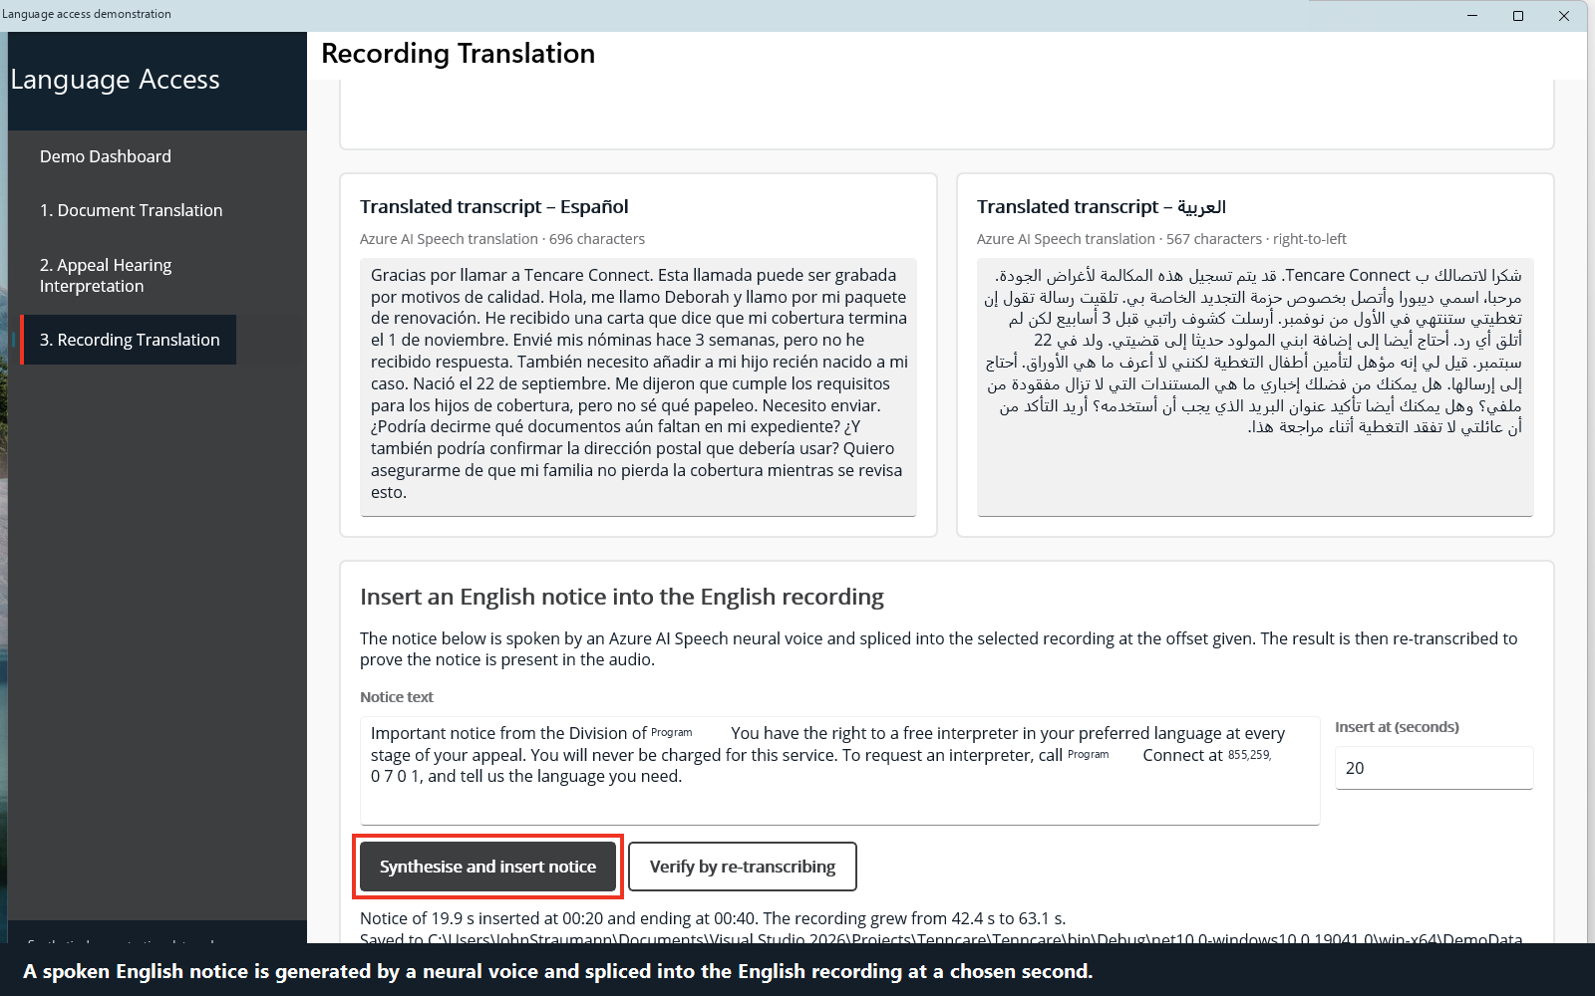
DEMONSTRATION — SCENARIO 3
Inserting a Spoken Notice
WHAT IS HAPPENING
The English notice text is synthesised into 19.9 seconds of natural speech and spliced into the call at 00:20, ending at 00:40. The 42.4 second recording becomes 63.1 seconds.
The splice is local, byte for byte. Nothing is uploaded.
CUSTOMER ASK
A notice (English) placed into an English audio recording
AZURE TECHNOLOGY
Azure AI Speech synthesis, local audio splicing
Notes:
TALK TRACK
And here is the second half of the ask, in your exact words: a notice in English, placed into an English audio recording file. So the notice is synthesised into just under twenty seconds of natural speech and spliced into the call at the twenty second mark, finishing at forty seconds. The recording was forty two point four seconds and is now sixty three point one. The splice is done locally, byte by byte, because both files are the same audio format, so there is no re-encoding and no quality loss. Nothing is uploaded and nothing is stored in Azure. One production note: we insert at a fixed offset here, so it lands mid-sentence. Operationally you would detect a natural pause, which is a small piece of work, not a new capability.
WHAT IS HAPPENING
The English notice text is synthesised to a 16 kHz mono PCM WAV by Azure AI Speech and inserted into the call recording at the chosen offset by rewriting the sample data locally. Both files share the same audio format, so the splice is a byte-range operation with no re-encoding. Duration grows from 42.4 to 63.1 seconds.
CUSTOMER ASK
Verbatim from the thread: we do have some cases where we would like a notice (English) placed into an English audio recording file. Note that this is English into English; the translation requirement for this scenario was the transcript on the previous slide, not the inserted audio.
AZURE TECHNOLOGY
Azure AI Speech neural synthesis. The splice itself is local.
BUSINESS VALUE
A notice delivered inside a recording the member already receives removes a separate outreach step and reaches members who may not read correspondence.
DEMO TRANSITION
Say that the duration changing is not proof, and run the verification step.

Slide 17
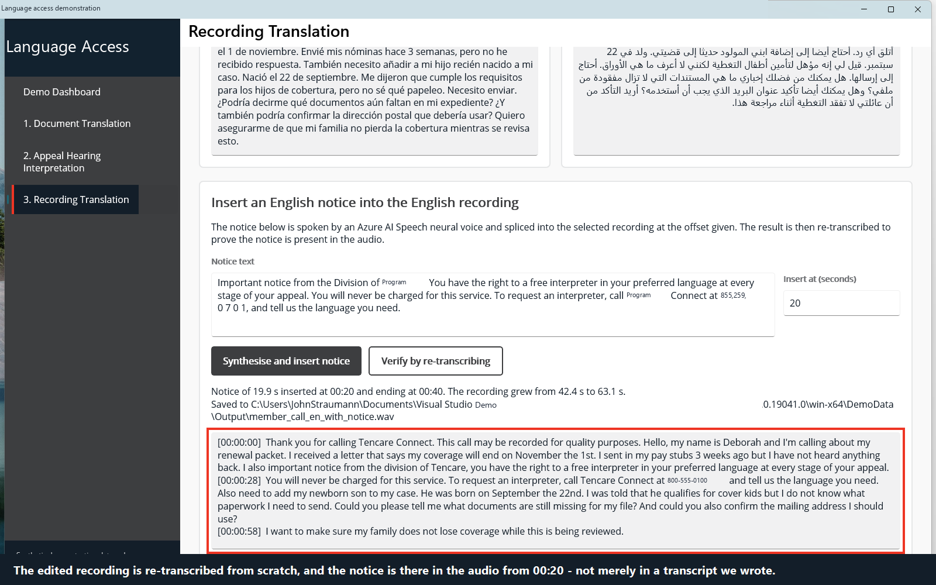
DEMONSTRATION — SCENARIO 3
Proving the Notice Is Really There
WHAT IS HAPPENING
The edited recording is sent back to Azure AI Speech and transcribed from scratch. It returns three segments, at 00:00, 00:28 and 00:58, and the inserted notice is audible in the middle of the call.
The notice is in the audio, not merely in the file length.
CUSTOMER ASK
Verify the inserted audio is genuinely present
AZURE TECHNOLOGY
Azure AI Speech, re-transcribing the edited recording
Notes:
TALK TRACK
A longer file proves nothing; I could have padded it with silence. So we send the edited recording back to Azure AI Speech and transcribe it from scratch, as though we had never seen it before. It comes back as three segments instead of two, and there in the middle you can read the notice: the right to a free interpreter, the right to written materials in your language. The service that read that audio had no knowledge of what we did to it. That is the end of the demonstration.
WHAT IS HAPPENING
The spliced WAV is submitted to Azure AI Speech as a new, unseen file. Continuous recognition re-segments it on natural pauses and returns three segments beginning at 00:00:00, 00:00:28 and 00:00:58, with the inserted notice text appearing inside them.
CUSTOMER ASK
Verification that the inserted audio is genuinely present, closing out the third scenario.
AZURE TECHNOLOGY
Azure AI Speech continuous recognition.
BUSINESS VALUE
Independent verification is what turns a demonstration into evidence. It is also the pattern you would use operationally to confirm a batch of edited recordings is correct.
DEMO TRANSITION
Close the application and return to the deck for the summary of what was proven.

Slide 18
EVIDENCE
What This Proves
28 / 28
3
0
automated tests passing
against live Azure services
Azure AI services,
nothing speculative deployed
API keys. Local authentication
is disabled on every account
Known limitations, stated plainly
Programme names such as Health Plan and Youth Plan are not reliably recognised by speech to text. A phrase list or Custom Speech resolves this.
We have twice seen Azure AI Speech accept a session and return nothing. The application now bounds every file recognition with a timeout and reports it clearly rather than hanging.
OCR latency on scanned documents varied between about three and thirty seconds on identical input. Production should treat this as a background job.
All content is synthetic. No real member data, PHI or PII was used at any point.
Notes:
TALK TRACK
Three numbers and four caveats. Twenty eight automated tests run against the live Azure services, not against mocks, so when something breaks we find out. Three services deployed. And no API keys anywhere, because local authentication is switched off. Then the caveats, and I would rather you hear them from me now than discover them in a pilot. The speech engine does not know your programme names. We have twice seen a speech session accept audio and return nothing, so we put a timeout around it. OCR latency is unpredictable. And everything you saw was synthetic.
WHAT IS HAPPENING
Summary slide.
CUSTOMER ASK
Addresses the PHI and privacy answers directly by confirming synthetic data throughout.
AZURE TECHNOLOGY
All three services, exercised by the test suite.
BUSINESS VALUE
Volunteering limitations early is what separates a demonstration from a sales pitch, and it is what makes the next conversation a technical one.
DEMO TRANSITION
Move to the closing slide and propose the next step.

Slide 19
Where This Could Go Next
1
Pick one notice type
Choose a single high-volume notice and run a measured pilot against real volumes in a Health Plan subscription.
2
Teach it your vocabulary
Build a glossary of Health Plan terminology and a Custom Speech model so programme names are recognised and translated consistently.
3
Design the human review step
Decide where a person signs off, and what they see. This is the control that makes the rest defensible.
4
Take it through security review
Private networking, retention policy, audit logging and accessibility conformance, using this demonstration as the starting point.
John Straumann • Field CAIO Officer, Microsoft South
Notes:
TALK TRACK
Four suggestions, in the order I would do them. Pick one notice type and run it at real volume, because volume is what surfaces the problems a demonstration cannot. Teach the system your vocabulary, which fixes the Health Plan and Youth Plan issue you saw. Design the human review step early, because it is the control that makes everything else defensible to an auditor. And then take it through your security review, using this as the starting point rather than a blank page. What I would like from today is simply to know which of the three scenarios matters most to you, because that determines where we would start.
WHAT IS HAPPENING
Closing slide.
CUSTOMER ASK
Addresses human review, retention and accessibility as the next pieces of work.
AZURE TECHNOLOGY
None.
BUSINESS VALUE
Gives the customer a concrete, low-risk first step rather than an open-ended programme.
DEMO TRANSITION
Hand over to questions.

