Slide 1
GENERIC SOLUTION DEMONSTRATION
Learning roleplay and reflection
THE PROBLEM
THE SOLUTION
A conversation alone is not enough: learners and instructors need visible learning outcomes and reviewable evidence.
Practice with a character, evaluate progress, reflect on the exchange and confirm an instructor-reviewable submission.
PRODUCTS AND PLATFORM
Captured LMS / browser UI | Separate recreation: ASP.NET Core MVC/.NET 10 | Azure OpenAI / Foundry | Blob Storage
Screens come from a recorded course demo. A later Azure-backed recreation is separate; its backend must not be attributed to the original recording.
Notes:
Problem: A conversation alone is not enough: learners and instructors need visible learning outcomes and reviewable evidence.
Solution: Practice with a character, evaluate progress, reflect on the exchange and confirm an instructor-reviewable submission.
Products: Captured LMS / browser UI | Separate recreation: ASP.NET Core MVC/.NET 10 | Azure OpenAI / Foundry | Blob Storage
Evidence status: Screens come from a recorded course demo. A later Azure-backed recreation is separate; its backend must not be attributed to the original recording.
Customer branding, organization labels and resource identifiers have been generalized. Screenshots are edited historical captures; no service results were rerun.

Slide 2
SOLUTION ARCHITECTURE
How the solution fits together
LOGICAL FLOW / REFERENCE VIEW
01
02
03
04
Learner roleplay
Evaluator
Guided reflection
LMS handoff
Character conversation
Outcome progress + evidence
Review the learning
Confirm + instructor report
The diagram describes the captured learning workflow. Its original cloud backend and production LMS API wiring are not verified. Assignment Dropbox is not Dropbox cloud storage.
Generic labels and edited screenshots | Historical results are illustrative, not rerun
START TOUR >
Notes:
Architecture: [['Learner roleplay', 'Character conversation'], ['Evaluator', 'Outcome progress + evidence'], ['Guided reflection', 'Review the learning'], ['LMS handoff', 'Confirm + instructor report']]
Boundary: The diagram describes the captured learning workflow. Its original cloud backend and production LMS API wiring are not verified. Assignment Dropbox is not Dropbox cloud storage.
This is a logical diagram, not a verified deployment inventory. Arrows show the conceptual information flow.
Customer names, logos and resource identifiers in subsequent captured screens have been generalized. Service brands and the solution's core workflow remain.

Slide 3
Learning ONLINE LEARNING AGENT
Roleplay demo
click-by-click
13
click actions
25
Screens captured from the Kaltura recording with synchronized narration excerpts and key automatic transitions.
captured screens
Learning roleplay walkthrough
Prepared 02 Sep 2026

Slide 4
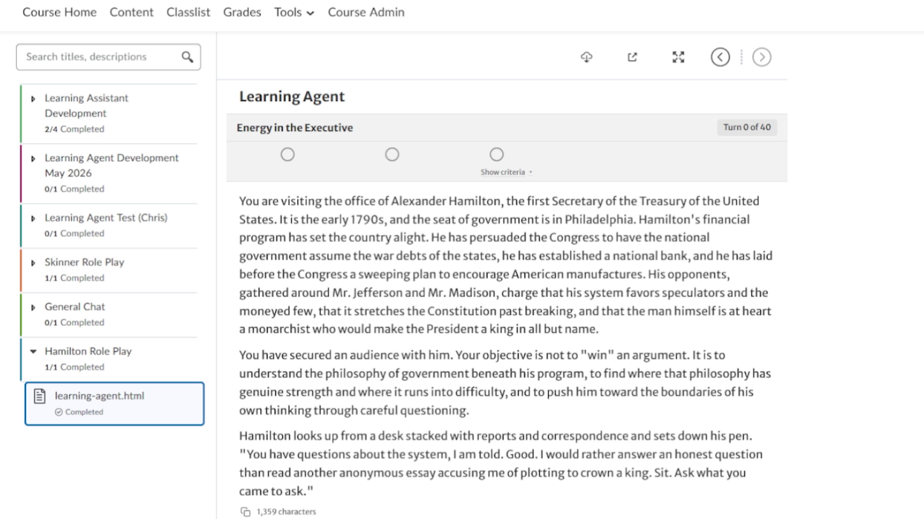
Demo starting point
01 / 00:12
CONTEXT
Action
The learner opens the Hamilton Role Play activity in the course content viewer.
Accompanying narration
"James Castle introduces a student-facing AI roleplay agent configured for a conversation with Alexander Hamilton."
Included to preserve the complete demo flow.

Slide 5
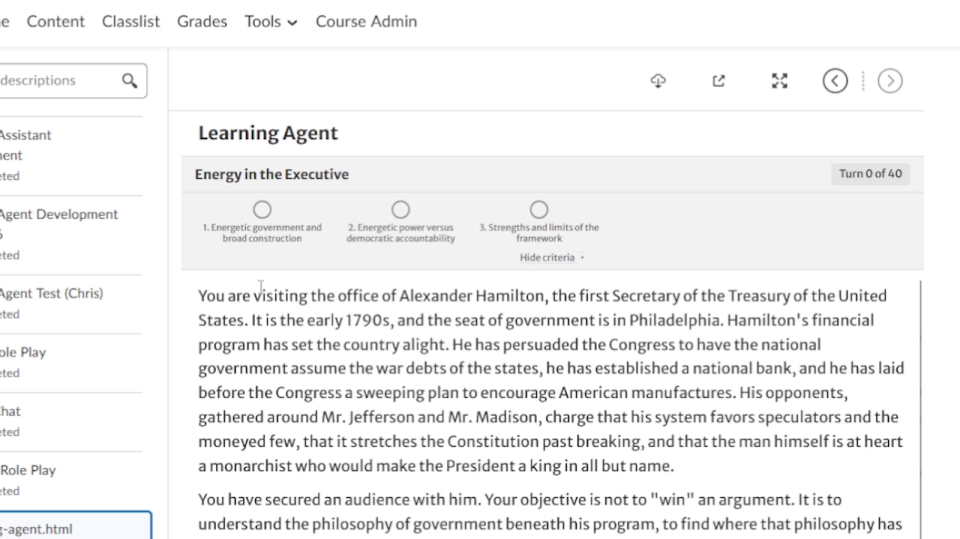
Reveal the learning-outcome criteria
02 / 01:38
CLICK
Action
Click "Show criteria" beneath the three outcome indicators.
Accompanying narration
"The titles of the criteria can be exposed so students understand what they are working toward; instructors can also hide them."
Frame captured immediately before or after the click.

Slide 6
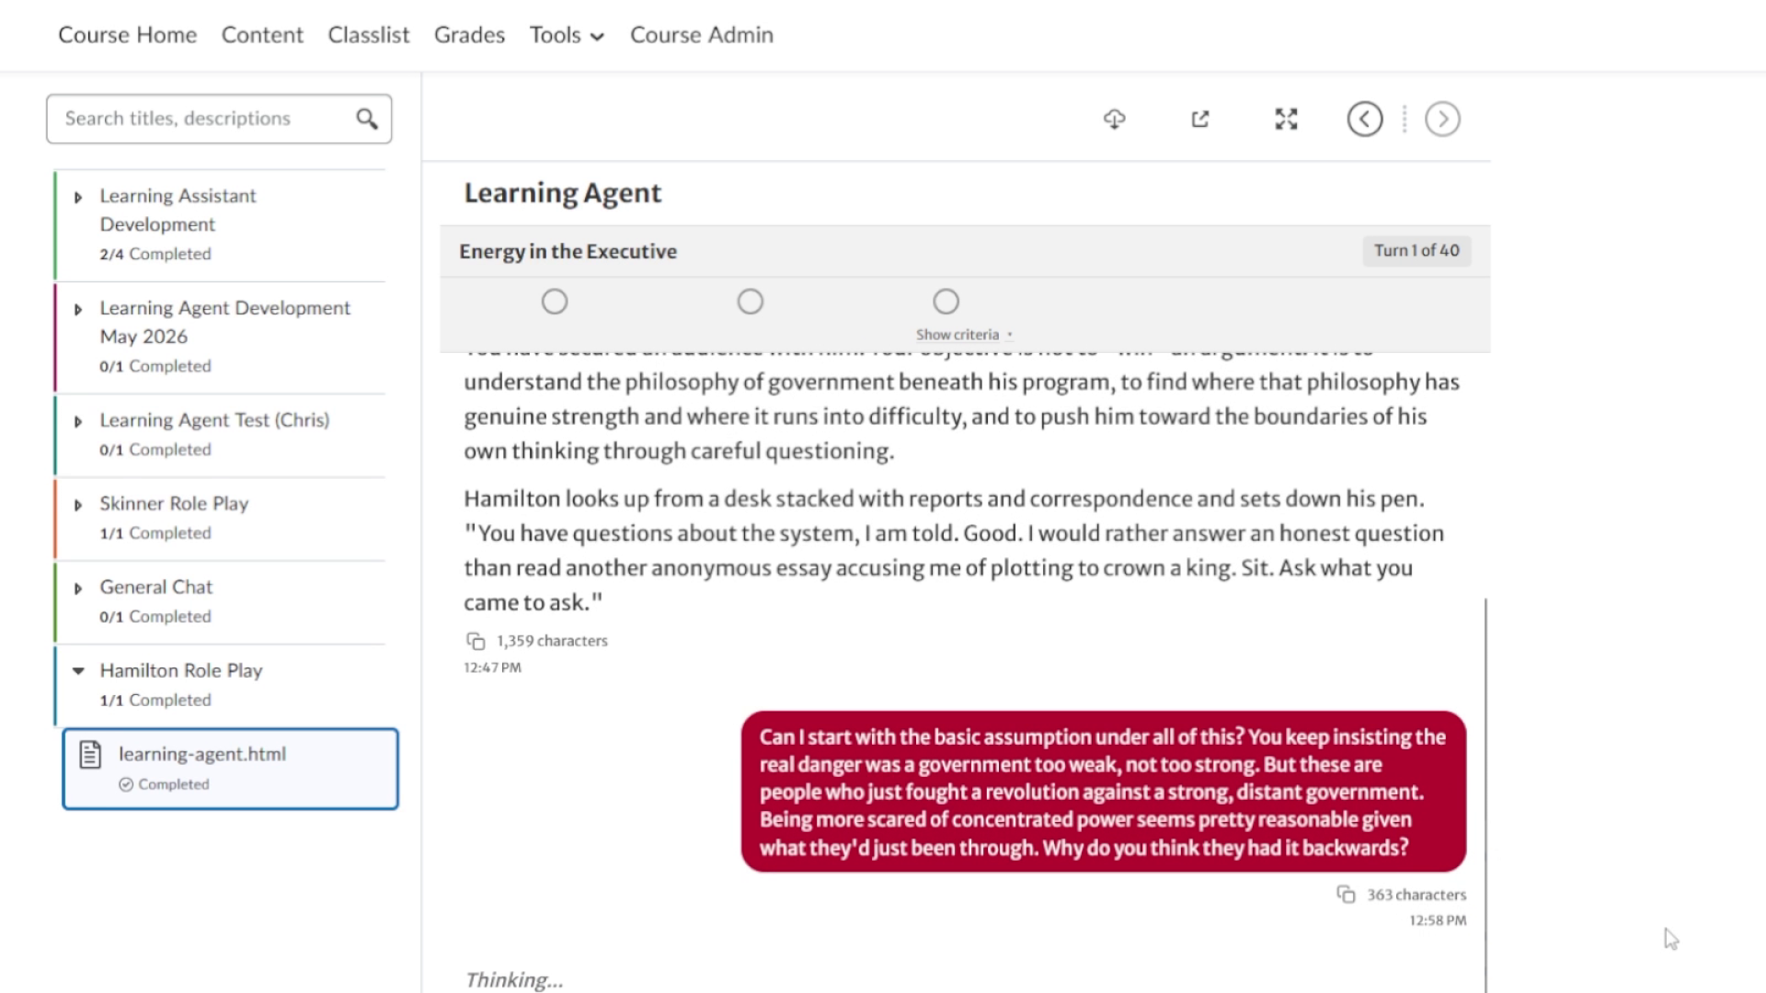
Send roleplay response 1
03 / 02:12
CLICK
Action
Paste the learner response, then click "Send."
Accompanying narration
"Prewritten responses are used to move the demonstration toward mastery without waiting for live typing."
Frame captured immediately before or after the click.

Slide 7
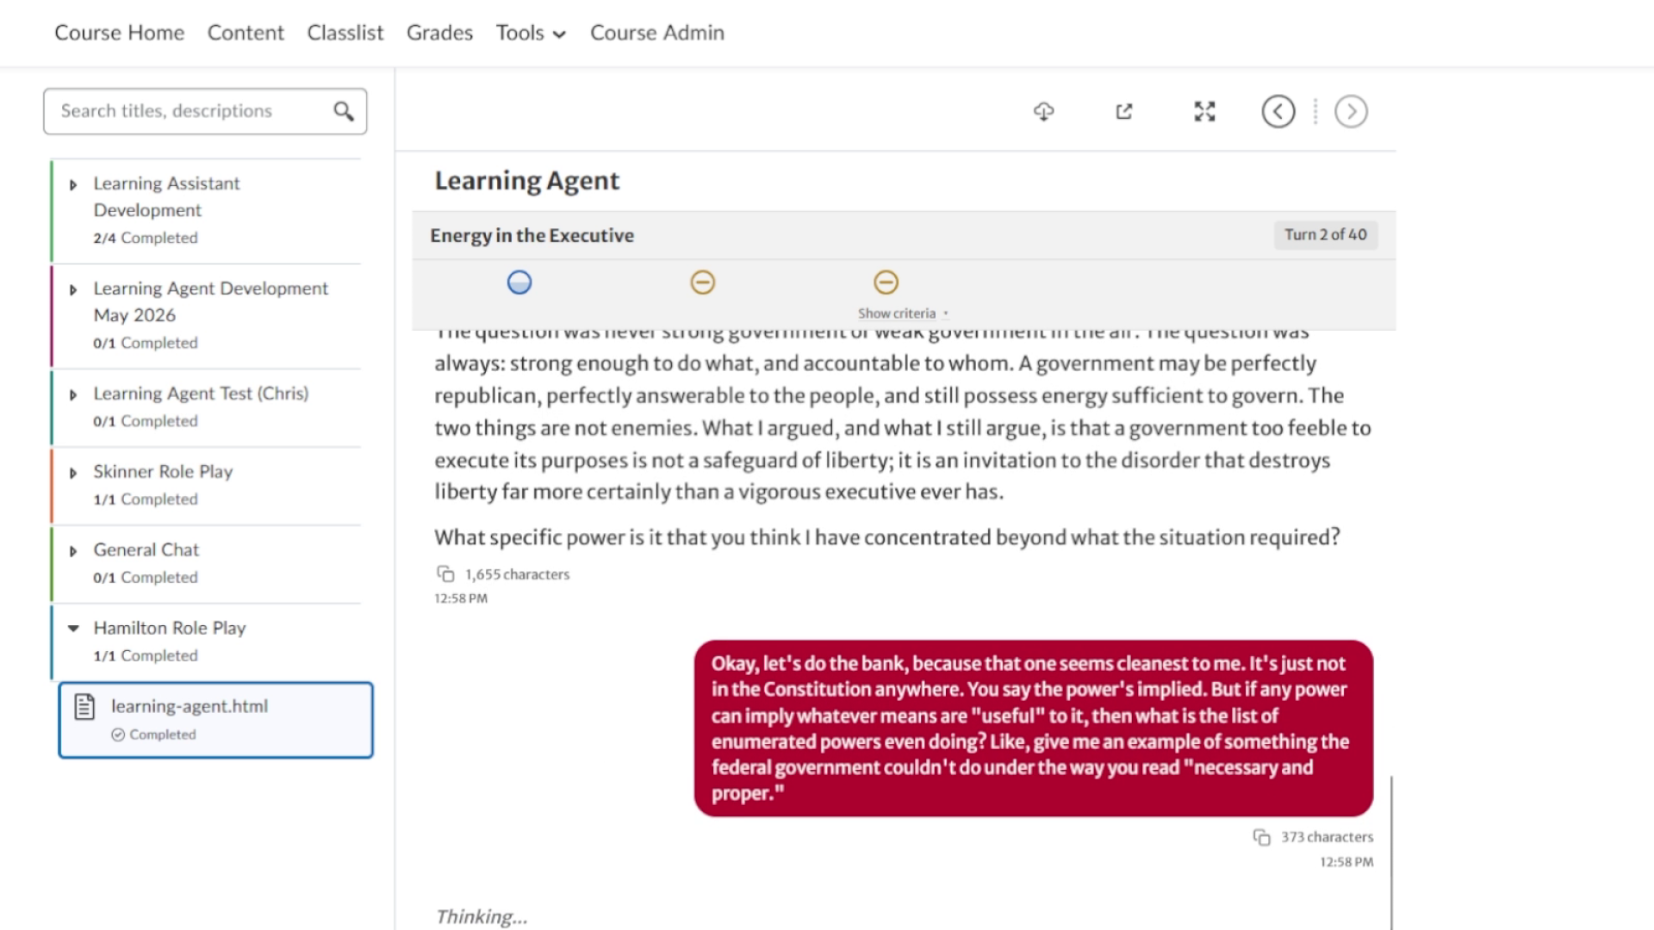
Send roleplay response 2
04 / 02:38
CLICK
Action
Paste the second learner response and click "Send."
Accompanying narration
"After the first exchange, one outcome shows partial progress. Each additional message triggers multiple cooperating AI agents."
Frame captured immediately before or after the click.

Slide 8
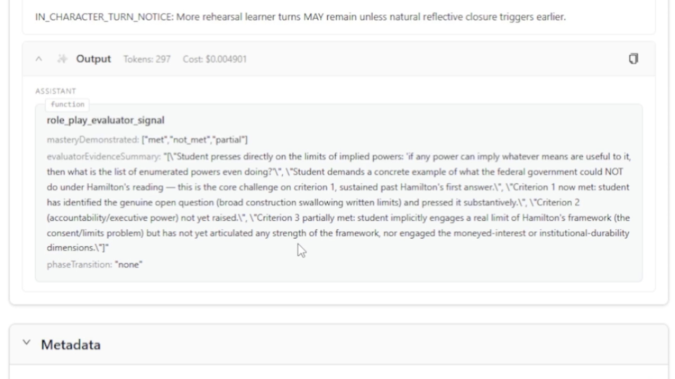
Inspect the evaluator-agent assessment
05 / 04:20
VIEW
Action
Switch to the Gateway log to inspect an evaluator assessment.
Accompanying narration
"The evaluator marks outcomes as met, not met, or partial and records the evidence used for each judgment."
Included to preserve the complete demo flow.

Slide 9
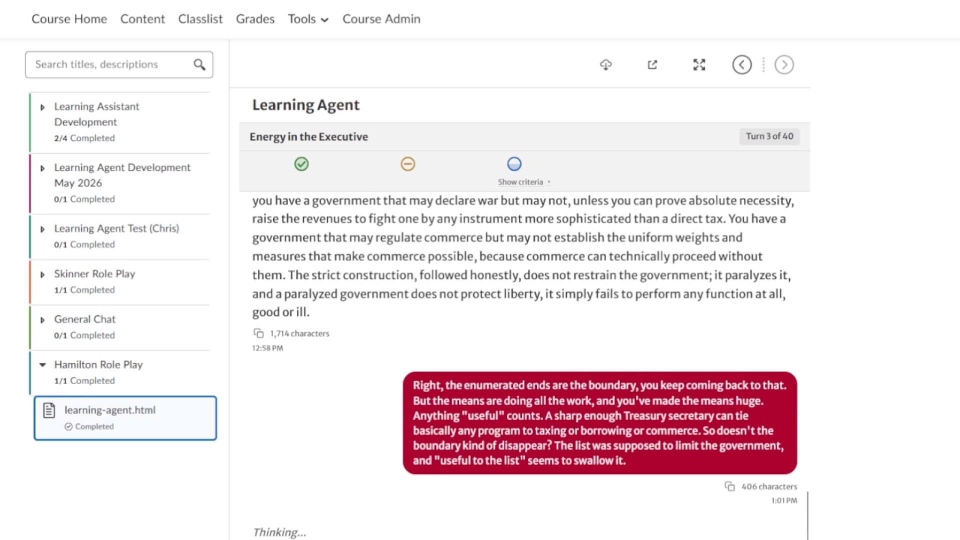
Send roleplay response 3
06 / 05:32
CLICK
Action
Paste the next learner response and click "Send."
Accompanying narration
"The conversation resumes after the architecture explanation, continuing to press Hamilton's position against the learning outcomes."
Frame captured immediately before or after the click.

Slide 10
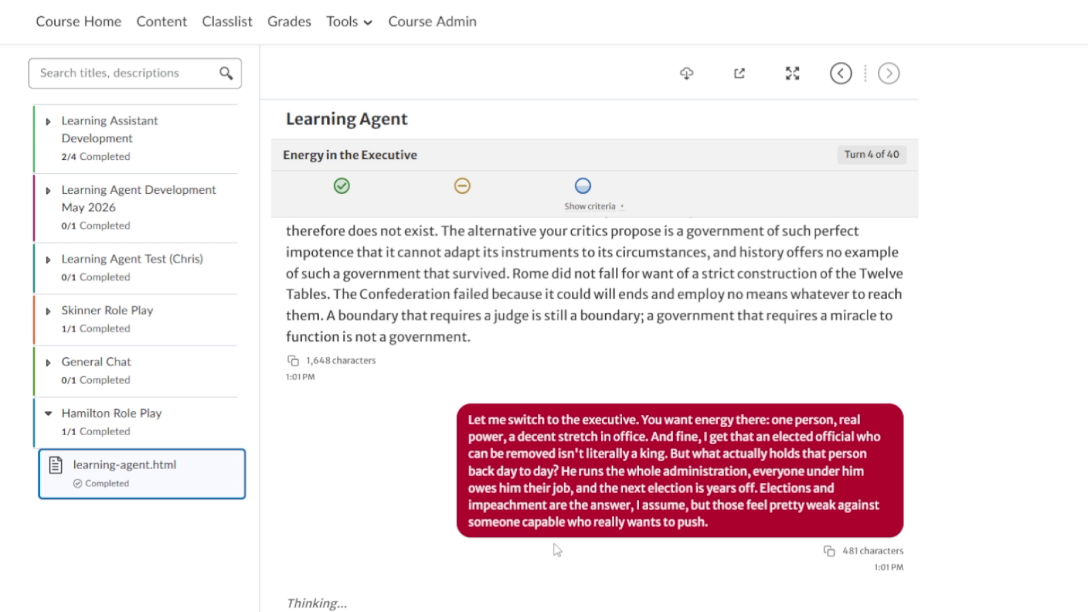
Send roleplay response 4
07 / 05:43
CLICK
Action
Paste the fourth roleplay response and click "Send."
Accompanying narration
"The Hamilton character is designed to speak authentically while the evaluator quietly tracks progress in the background."
Frame captured immediately before or after the click.

Slide 11
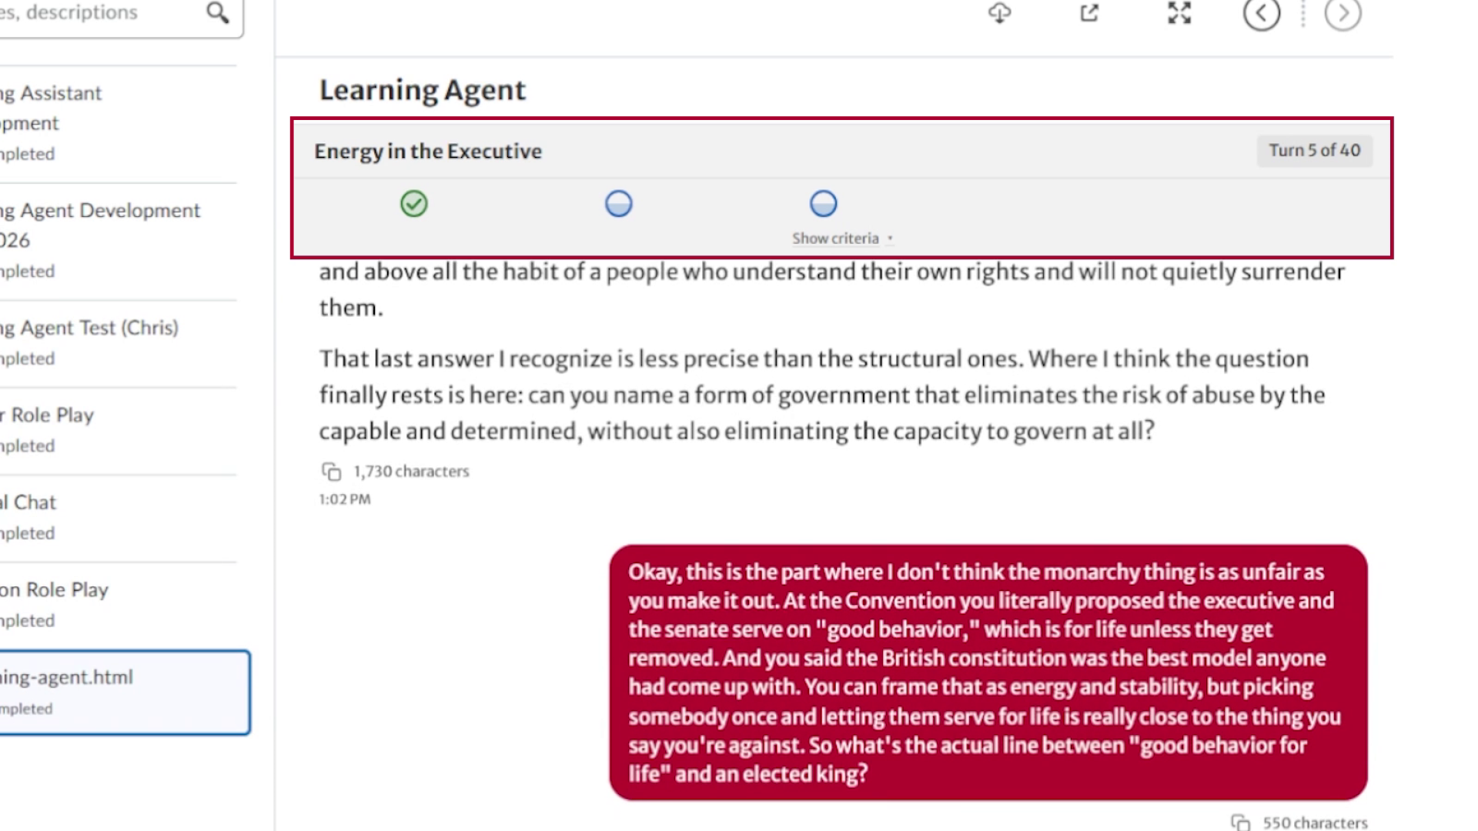
Send roleplay response 5
08 / 06:24
CLICK
Action
Paste the final roleplay response and click "Send."
Accompanying narration
"At this point one outcome is met and the remaining two are partially met; the final exchange completes the criteria."
Frame captured immediately before or after the click.

Slide 12
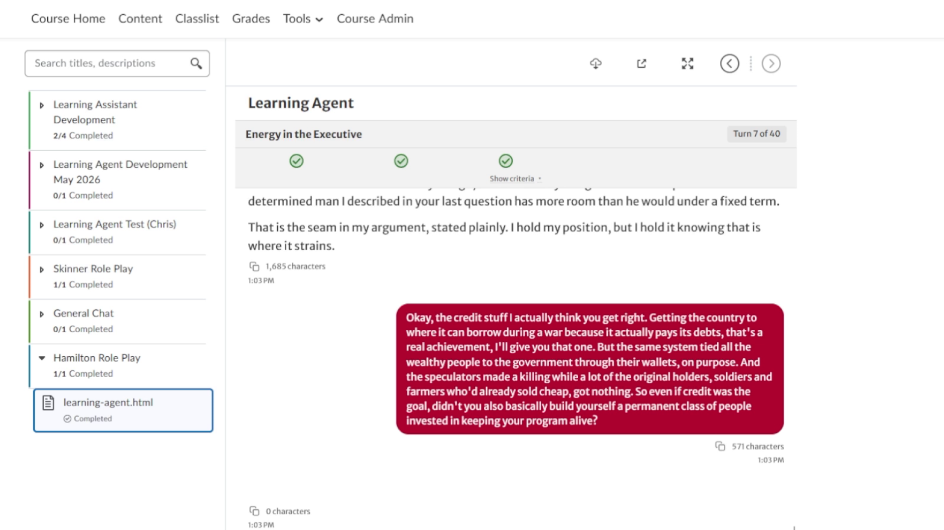
Roleplay transitions to reflection
09 / 07:00
AUTO
Action
Automatic transition after all three criteria are met.
Accompanying narration
"Hamilton gives a final message, then the learner is moved into a structured reflection workflow with a different agent."
Included to preserve the complete demo flow.

Slide 13
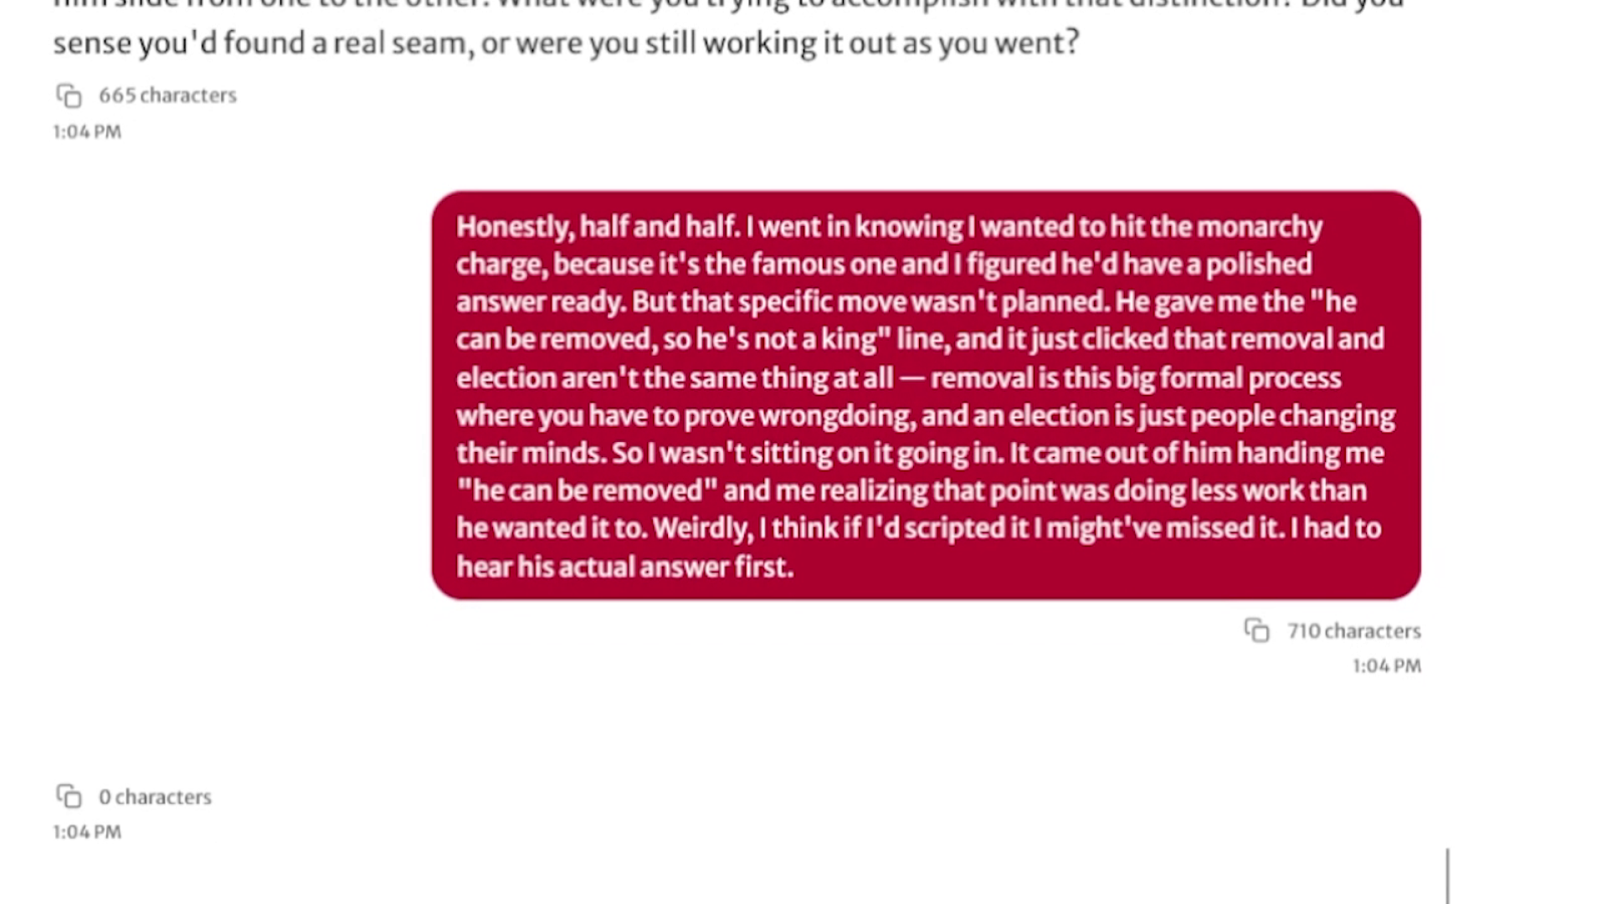
Send reflection response 1
10 / 07:32
CLICK
Action
Paste the first reflection response and click "Send."
Accompanying narration
"The facilitator pulls details from the roleplay and asks the learner to examine what worked and what they might do differently."
Frame captured immediately before or after the click.

Slide 14
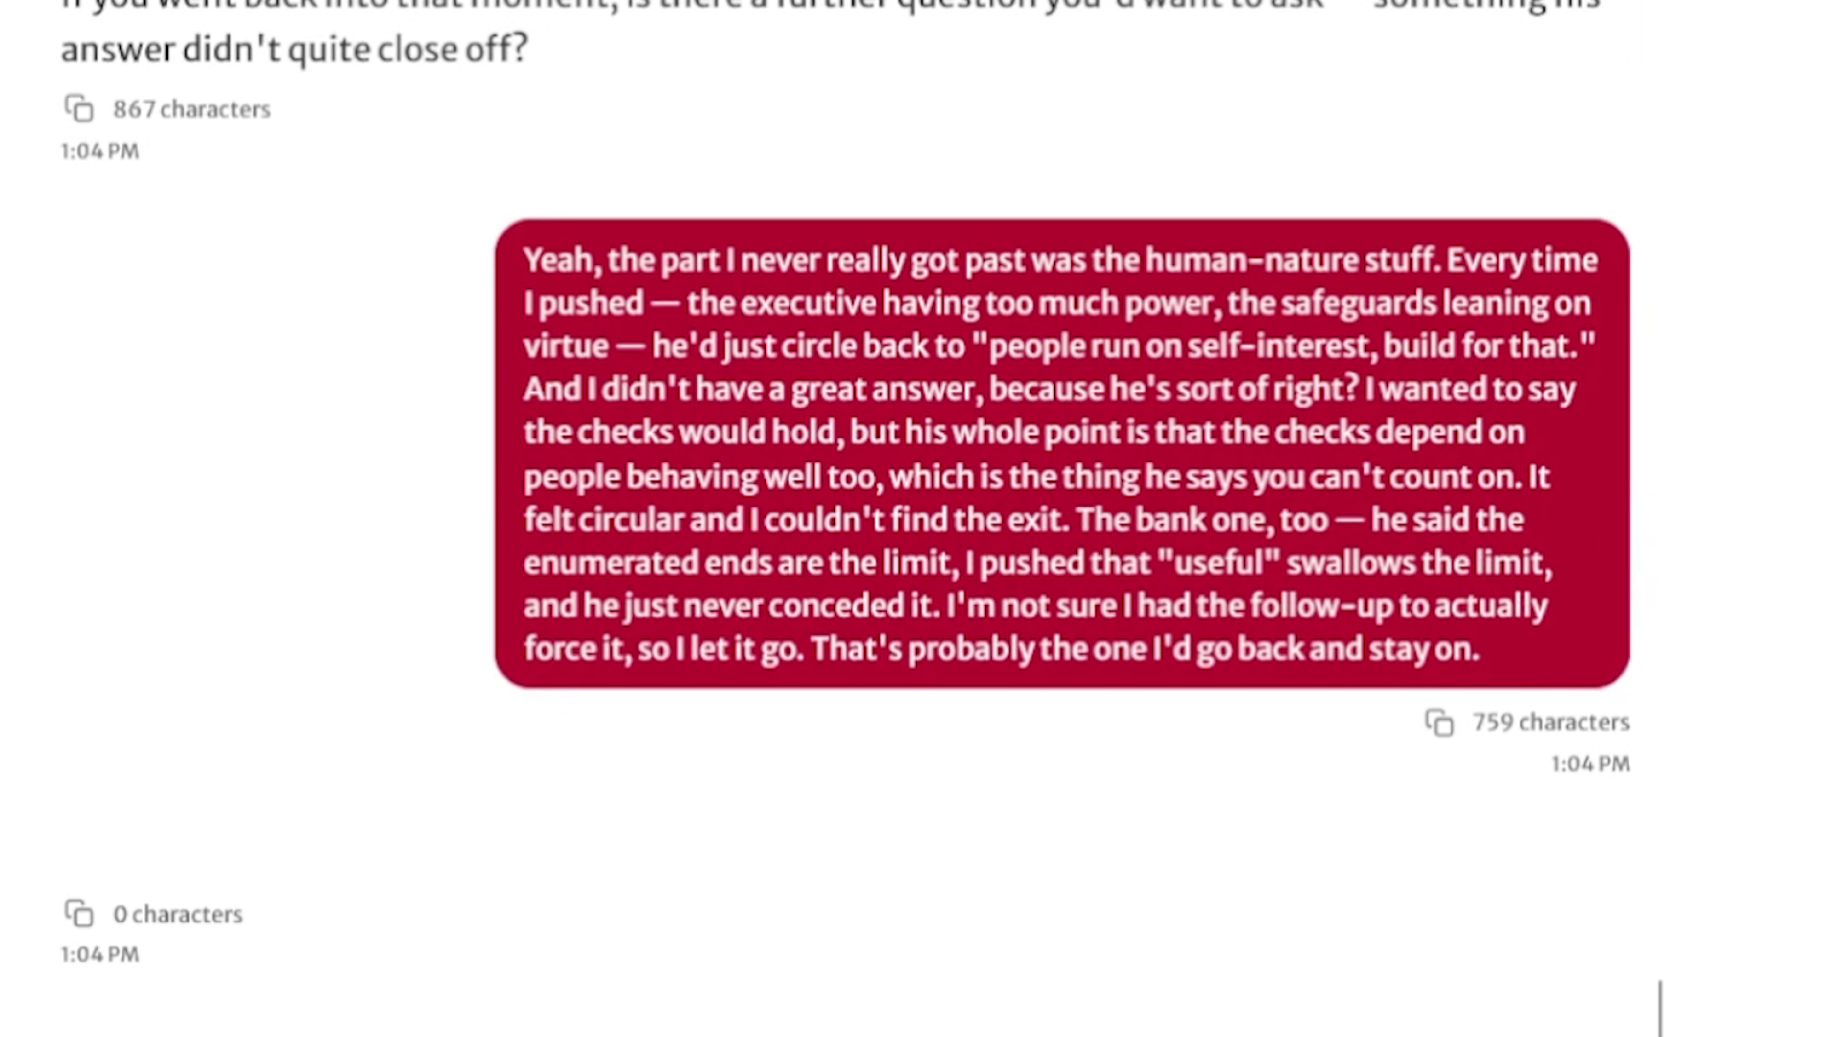
Send reflection response 2
11 / 07:45
CLICK
Action
Paste the second reflection response and click "Send."
Accompanying narration
"The reflection agent probes the learner's choices and compares their reasoning with the preceding exchange."
Frame captured immediately before or after the click.

Slide 15
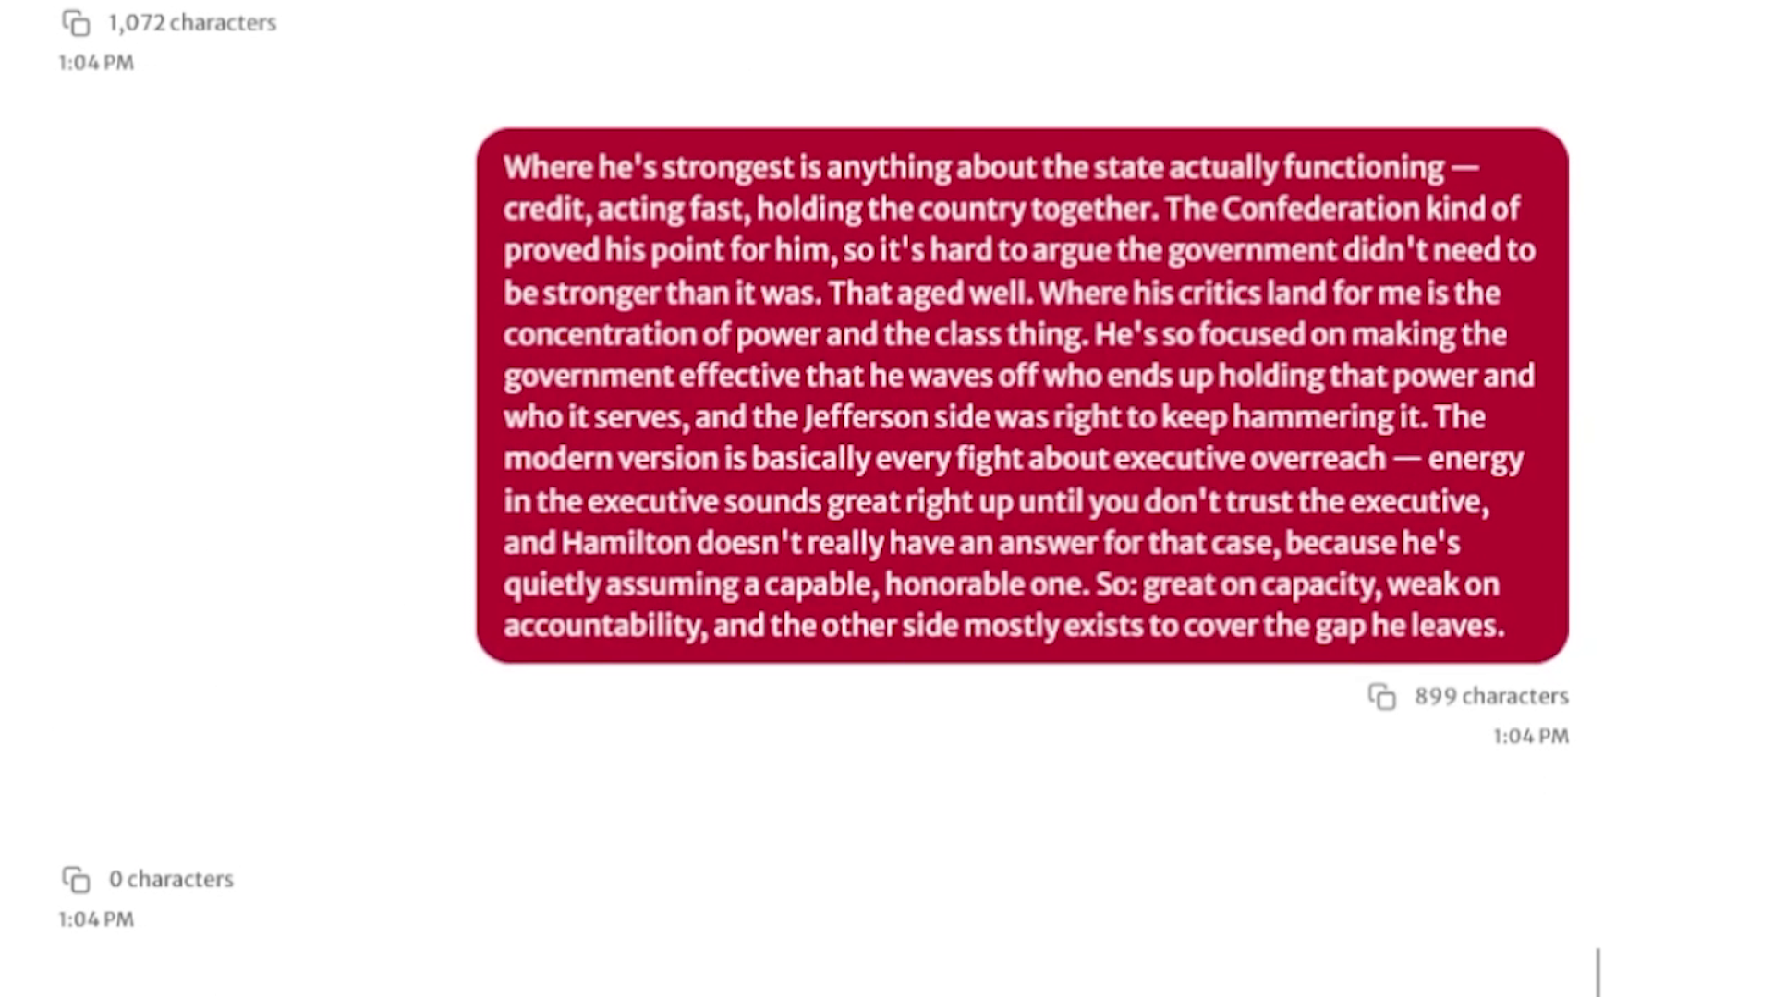
Send reflection response 3
12 / 07:55
CLICK
Action
Paste the third reflection response and click "Send."
Accompanying narration
"The learner identifies strengths, limits, and the conditions under which the argument would hold."
Frame captured immediately before or after the click.

Slide 16
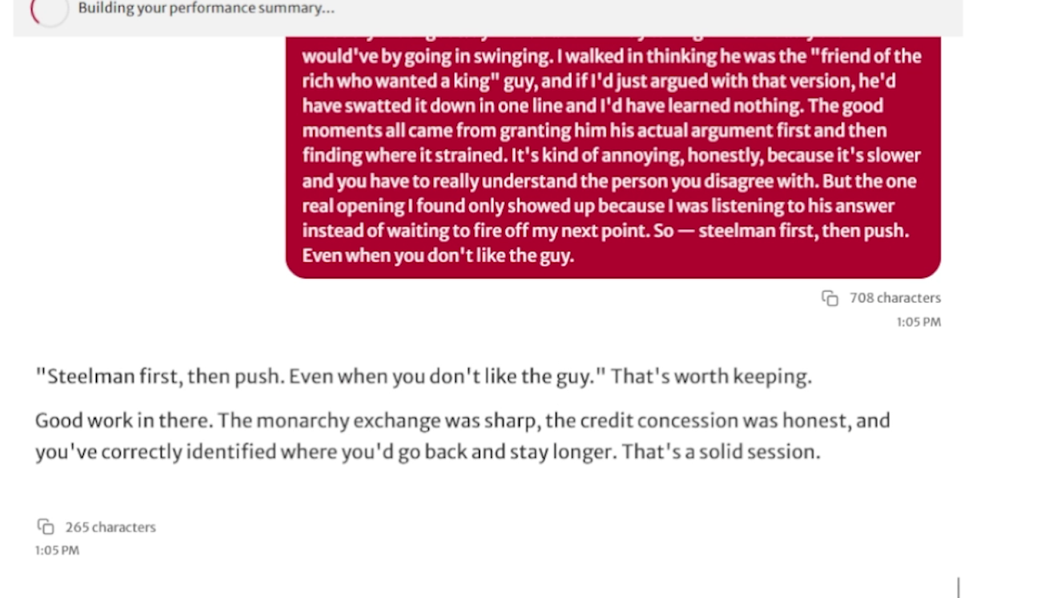
Send reflection response 4
13 / 07:59
CLICK
Action
Paste the final reflection response and click "Send."
Accompanying narration
"The final question asks for the learner's takeaway and closes the structured reflection phase."
Frame captured immediately before or after the click.

Slide 17

Summary agent starts
14 / 08:12
AUTO
Action
Automatic transition after reflection is complete.
Accompanying narration
"A fourth agent builds the activity summary and prepares a Dropbox submission."
Included to preserve the complete demo flow.

Slide 18
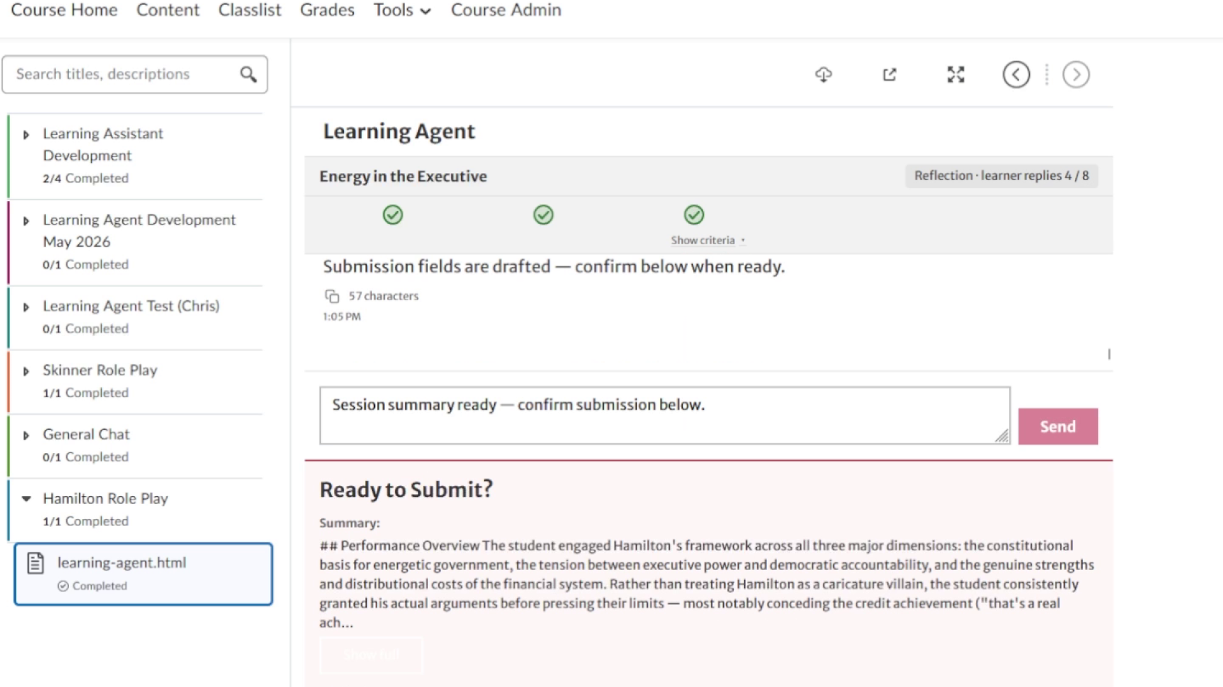
Review the generated submission preview
15 / 08:38
REVIEW
Action
Review the generated performance overview and evidence highlights.
Accompanying narration
"The submission includes learning-outcome status, evaluator evidence, reflection content, and a full conversation transcript."
Included to preserve the complete demo flow.

Slide 19
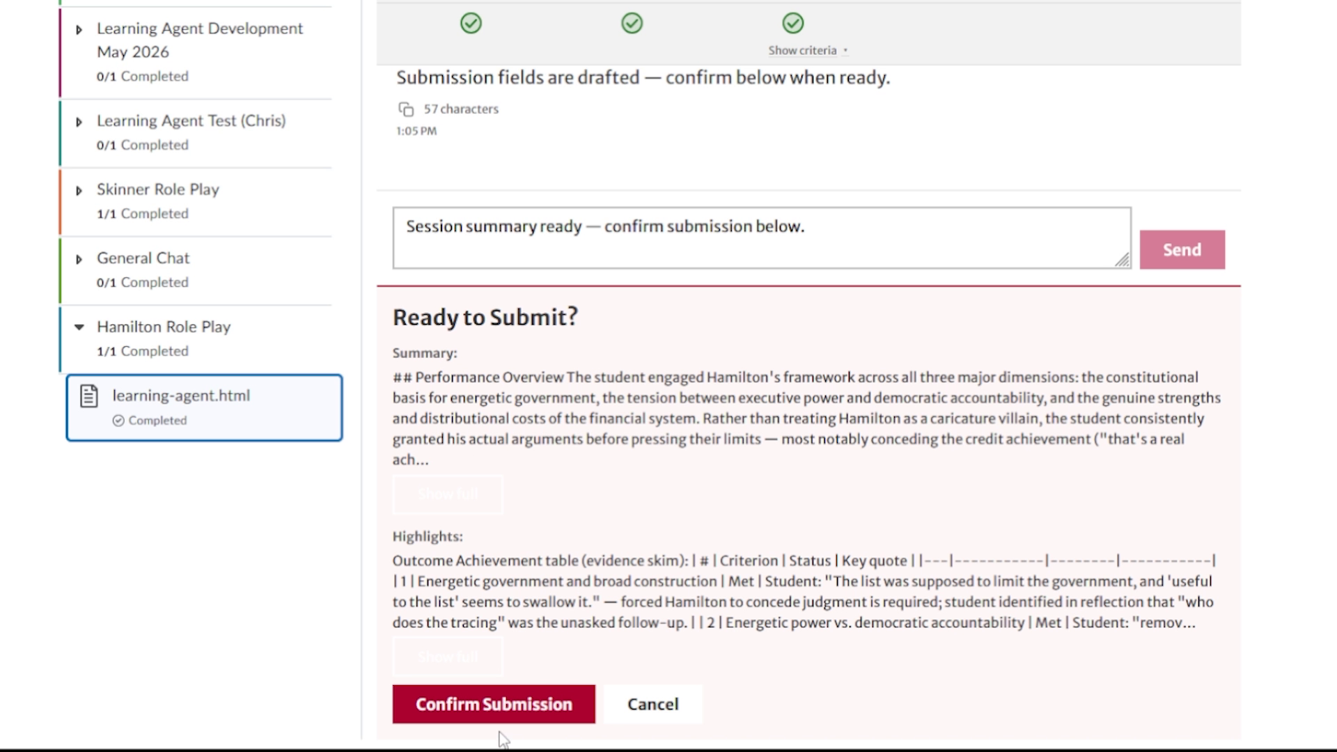
Confirm the Dropbox submission
16 / 08:44
CLICK
Action
Click "Confirm Submission."
Accompanying narration
"The summary is complete and the learner confirms creation of the assignment Dropbox submission."
Frame captured immediately before or after the click.

Slide 20
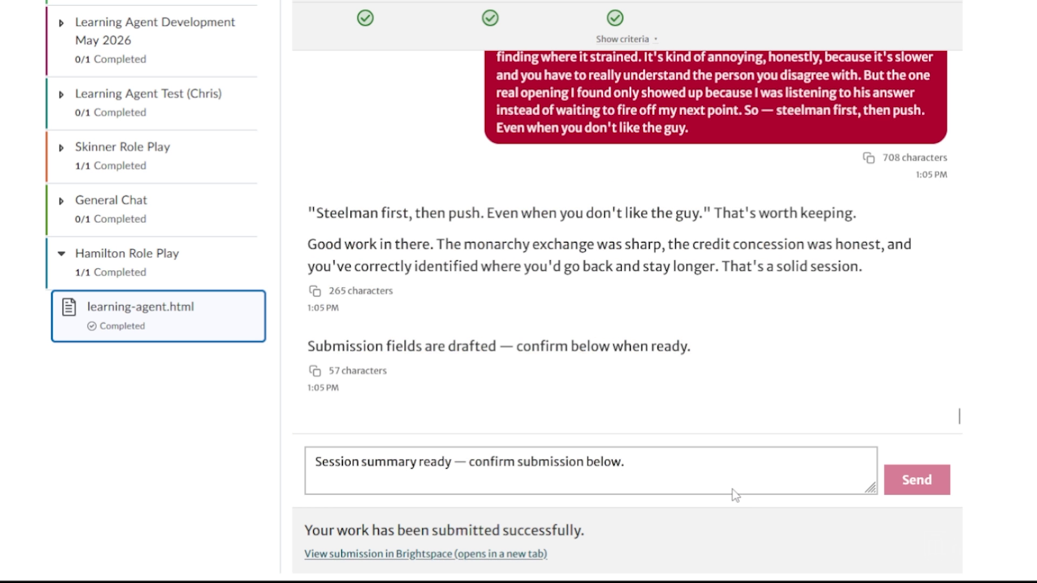
Submission created successfully
17 / 08:46
RESULT
Action
The learner receives an in-app success confirmation.
Accompanying narration
"The completed roleplay package is now available to the instructor like a normal assignment submission."
Included to preserve the complete demo flow.

Slide 21
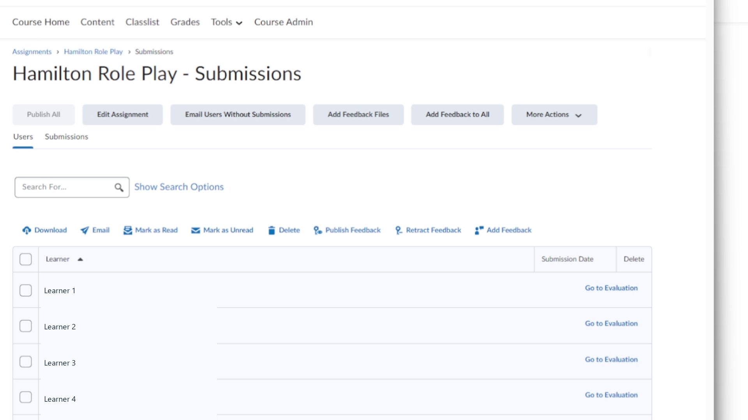
Open the instructor submissions list
18 / 08:53
VIEW
Action
Switch to the instructor view for the Hamilton Role Play assignment.
Accompanying narration
"The instructor can open the assignment submissions area and locate the learner's generated submission."
Included to preserve the complete demo flow.

Slide 22
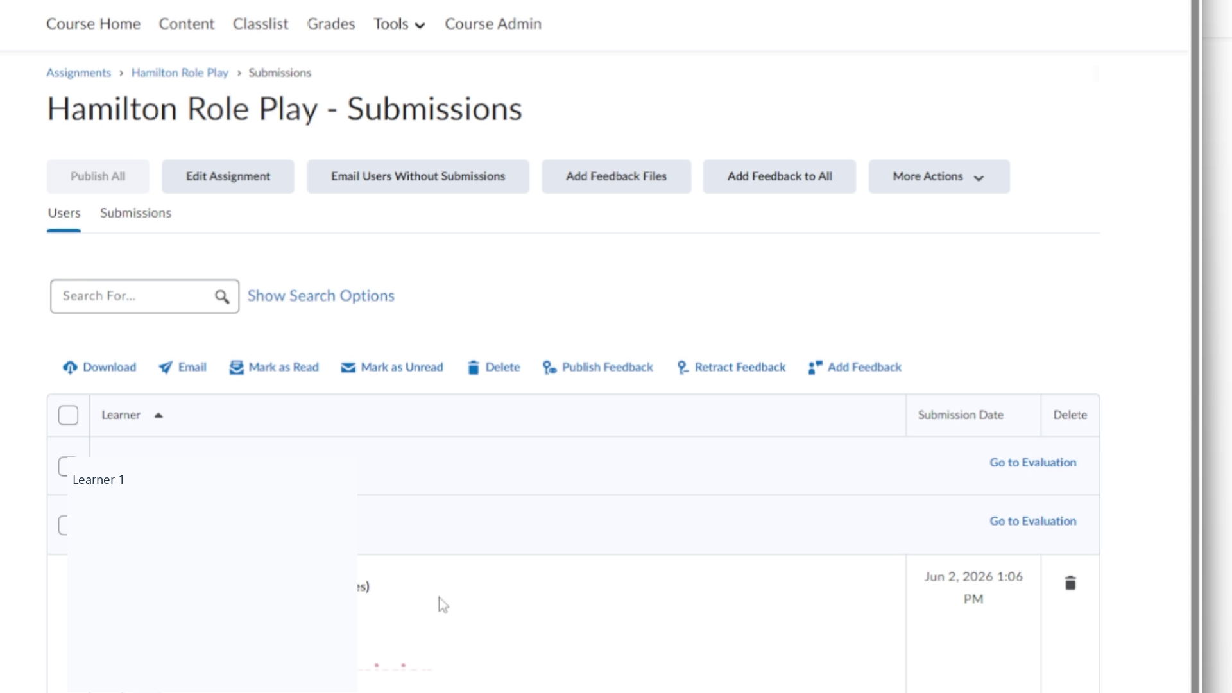
Expand the learner submission
19 / 08:58
CLICK
Action
Click the "Castle, James" learner row to expose its submitted file.
Accompanying narration
"The learner row expands to show the generated submission file and submission timestamp."
Frame captured immediately before or after the click.

Slide 23
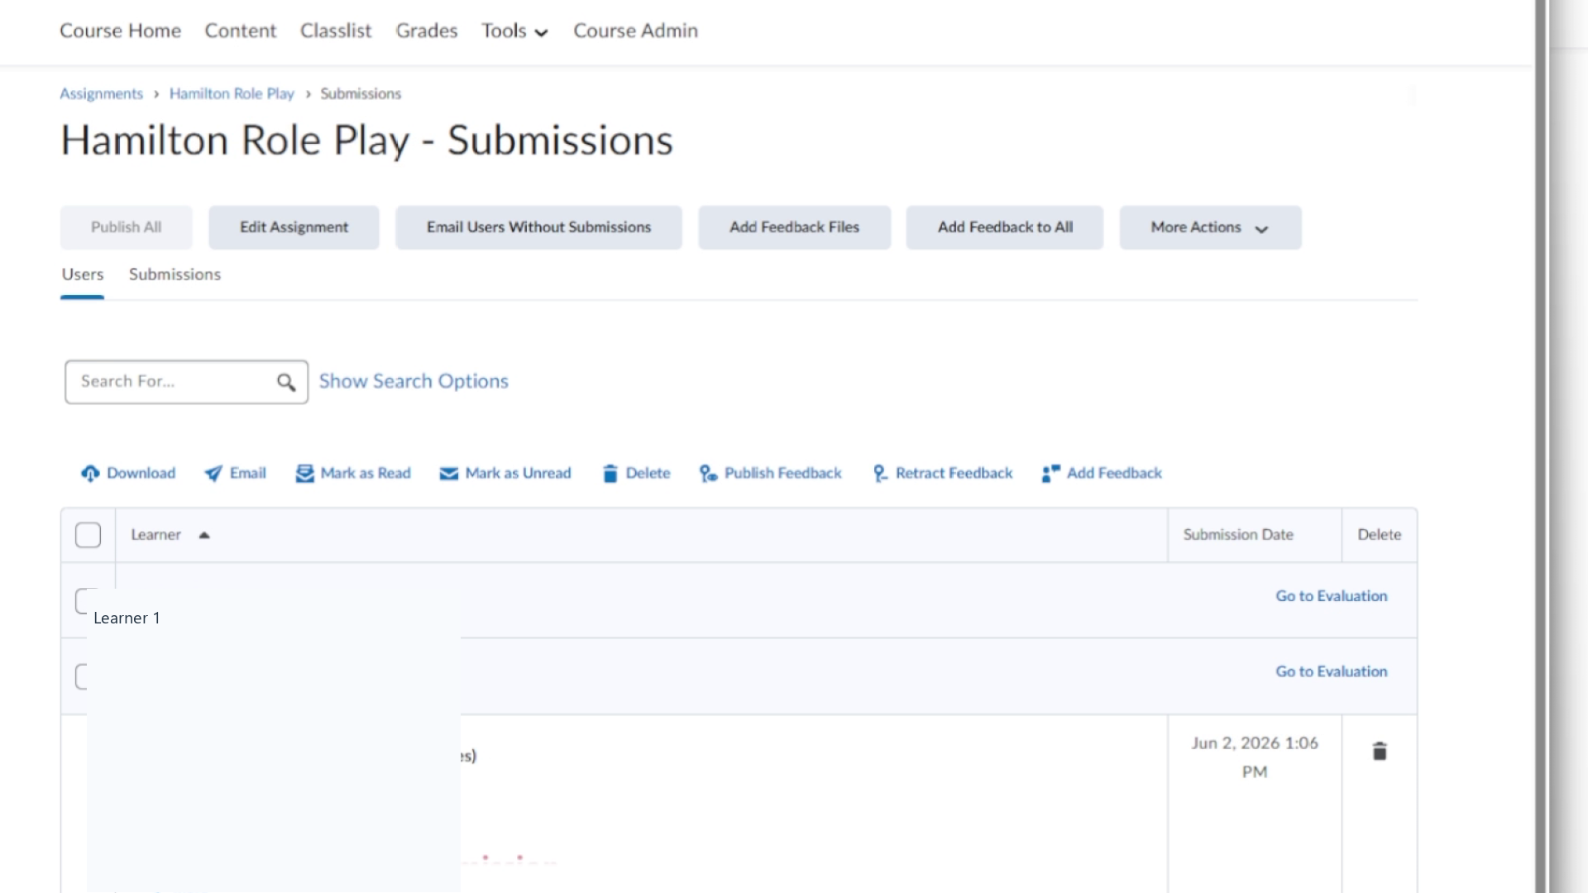
Open the generated submission
20 / 09:02
CLICK
Action
Click the submitted file, "submission-info.txt."
Accompanying narration
"The generated content opens in the standard assignment evaluation experience."
Frame captured immediately before or after the click.

Slide 24
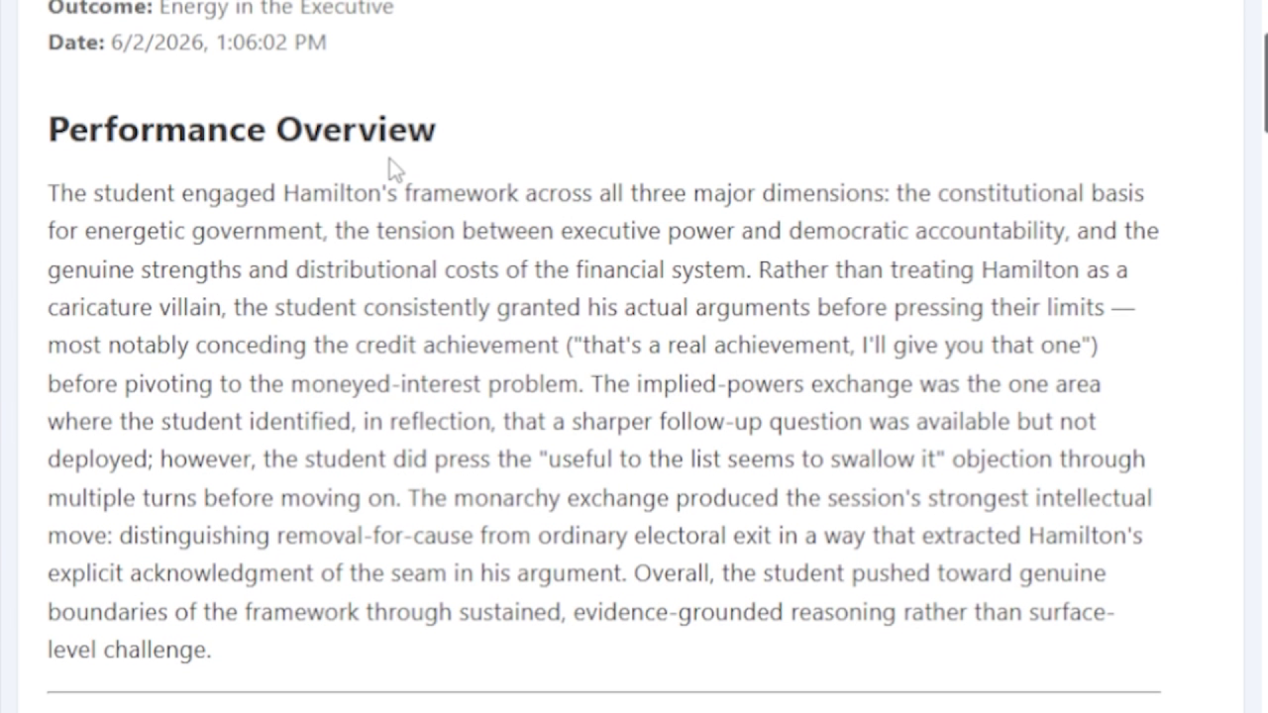
Instructor view: performance overview
21 / 09:15
REVIEW
Action
Review the high-level assessment of the learner's performance.
Accompanying narration
"The overview summarizes how the learner engaged Hamilton's framework across the major dimensions of the exercise."
Included to preserve the complete demo flow.

Slide 25
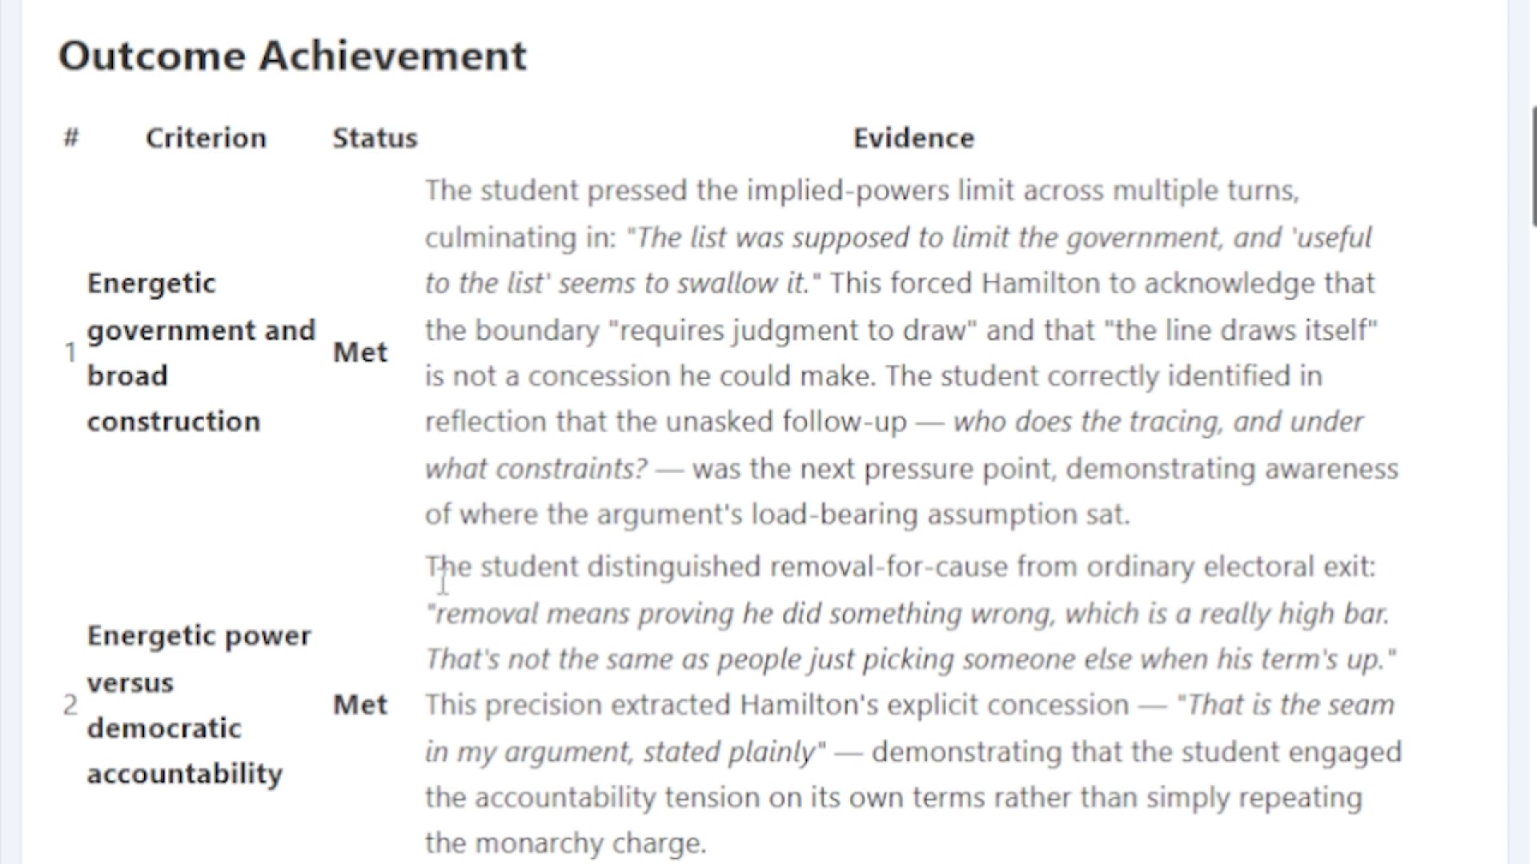
Instructor view: outcome achievement
22 / 09:25
REVIEW
Action
Review each criterion, its status, and the supporting evidence.
Accompanying narration
"The table shows the agent's status assessment and the evidence used to reach that assessment."
Included to preserve the complete demo flow.

Slide 26
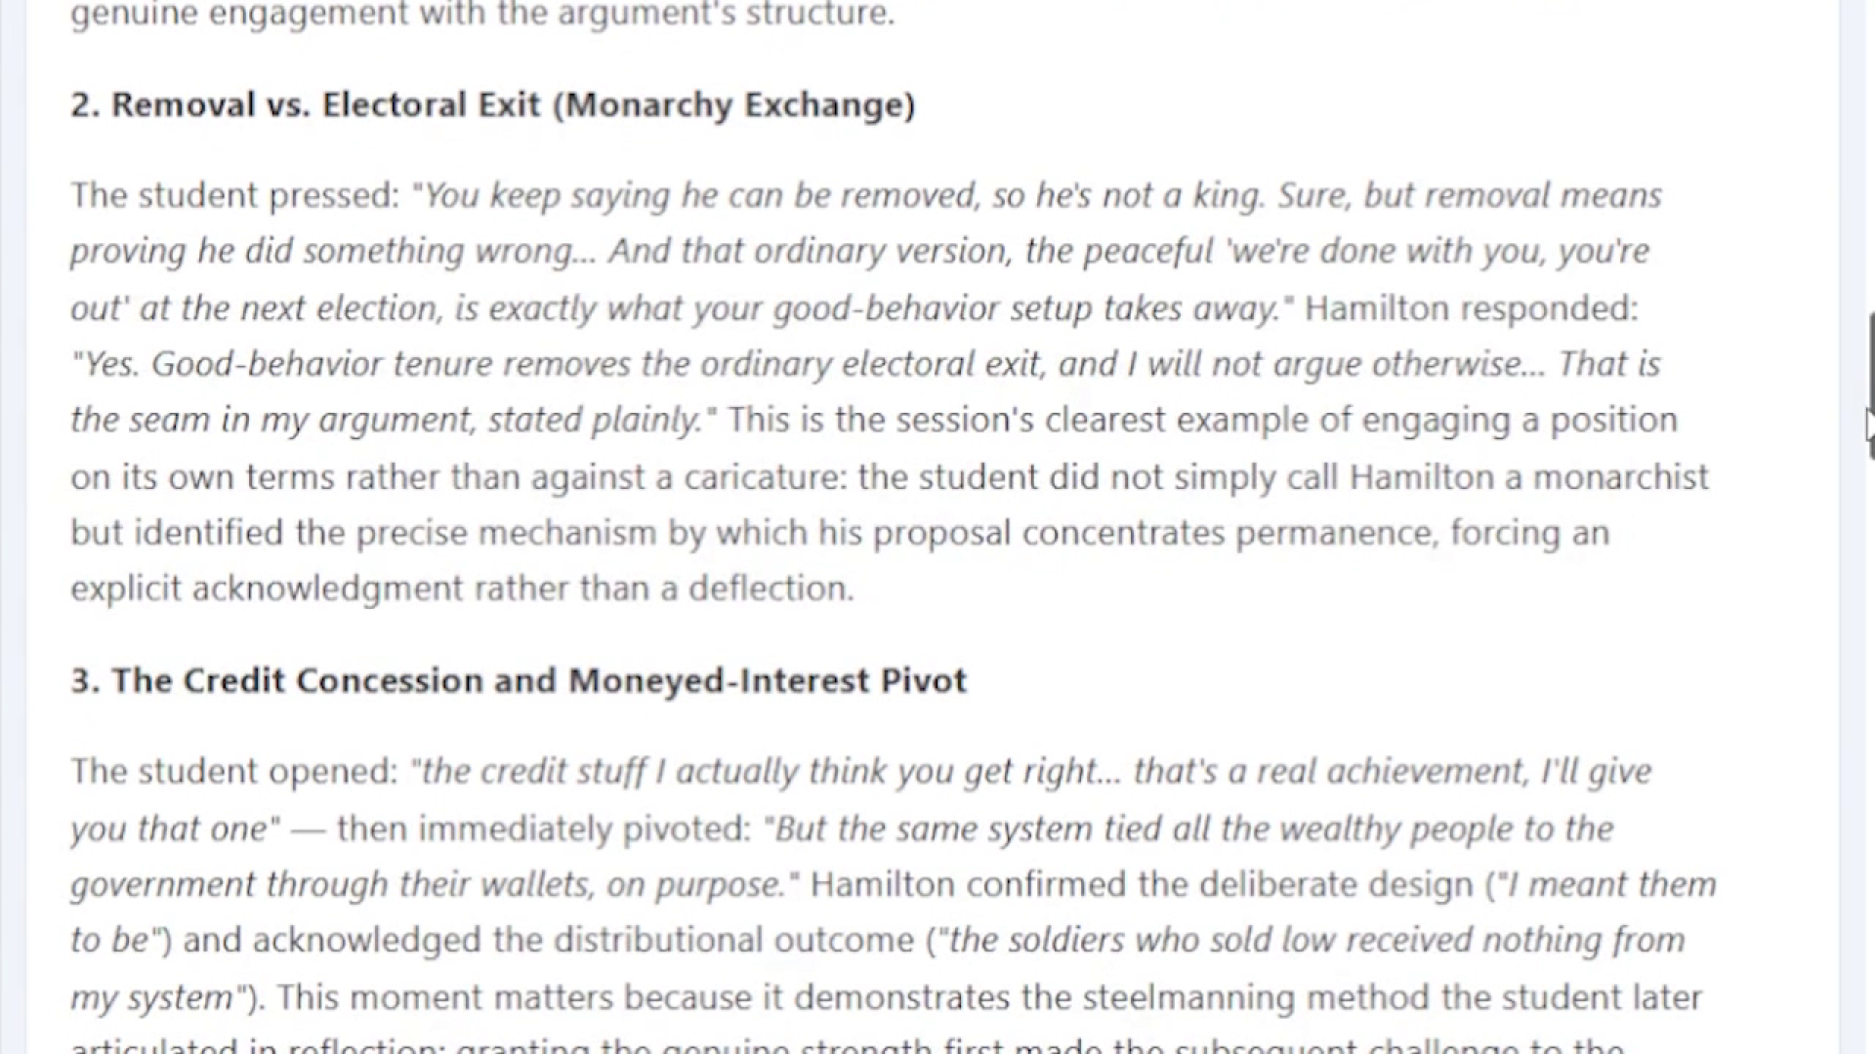
Instructor view: key moments
23 / 09:35
REVIEW
Action
Review key moments from the learner's conversation.
Accompanying narration
"The report identifies important exchanges that demonstrate the learner's reasoning and progress."
Included to preserve the complete demo flow.

Slide 27
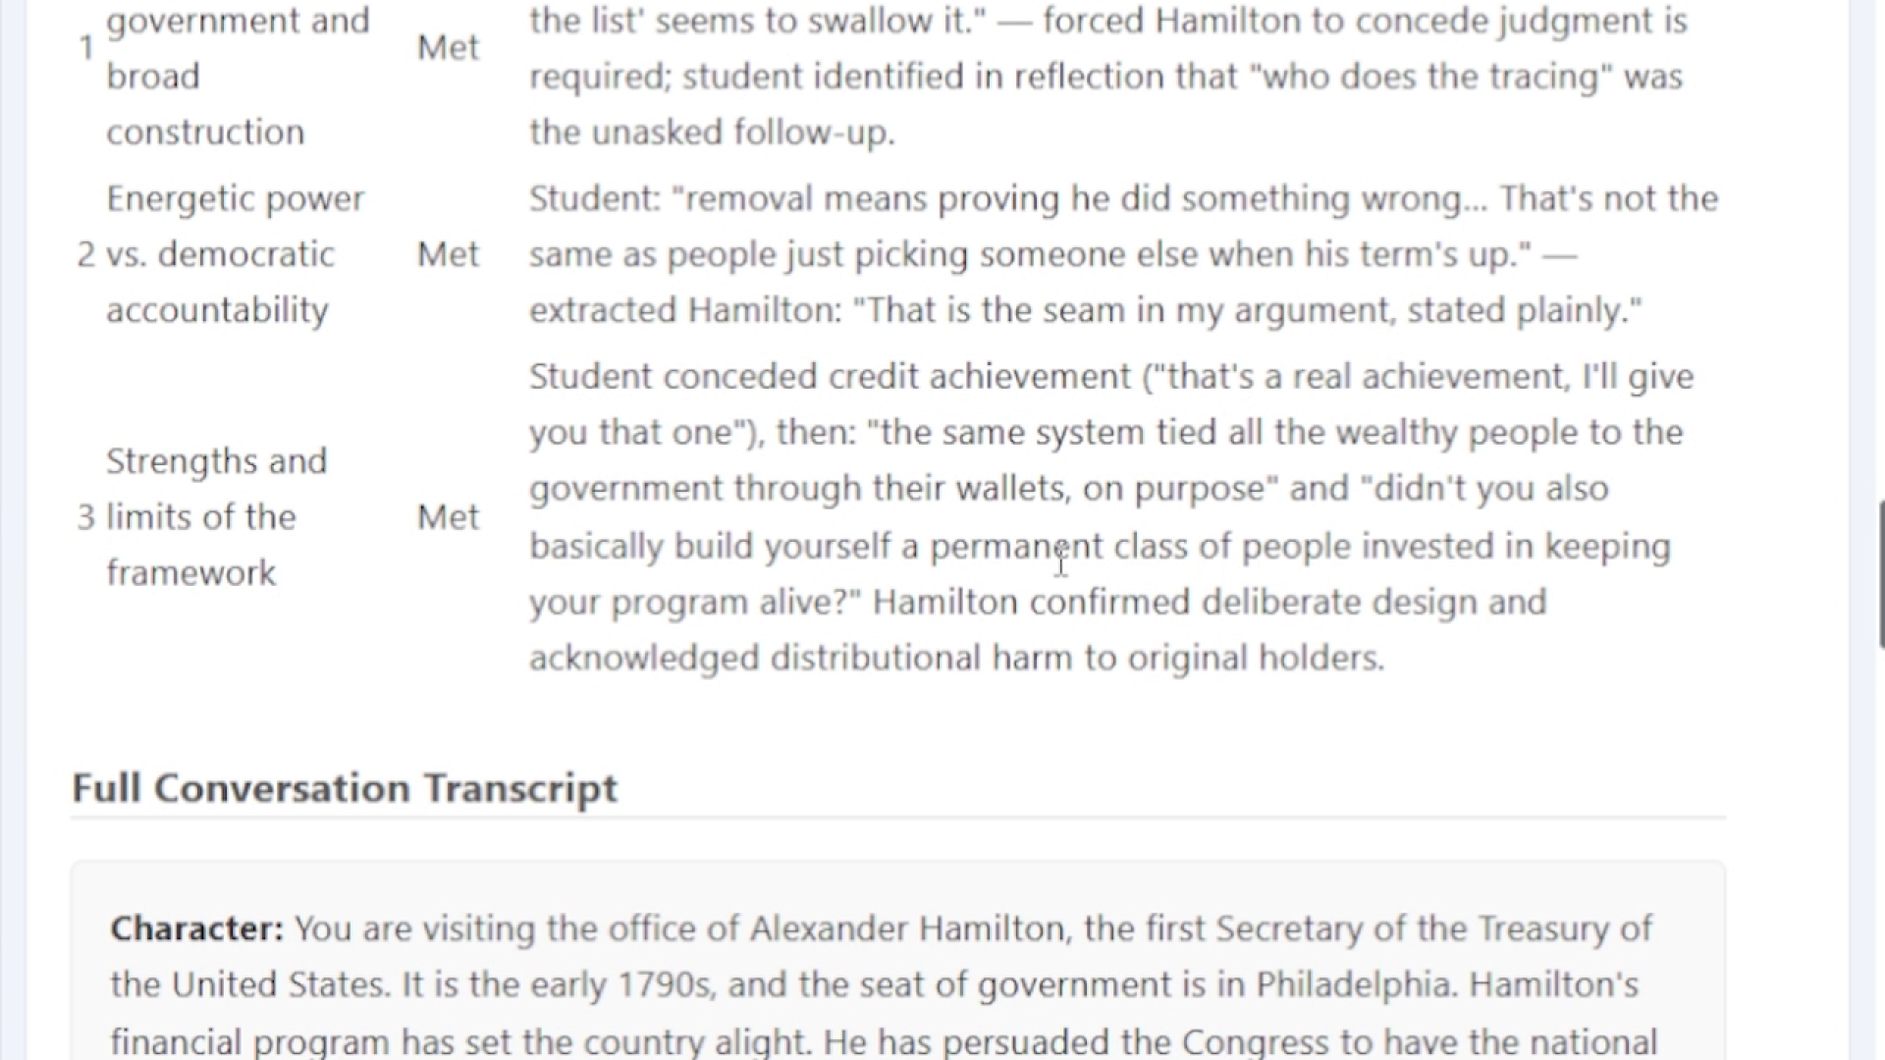
Instructor view: reflection summary
24 / 09:45
REVIEW
Action
Review the reflection summary and outcome achievements.
Accompanying narration
"The report connects the learner's reflection to the outcome evidence gathered during the roleplay."
Included to preserve the complete demo flow.

Slide 28
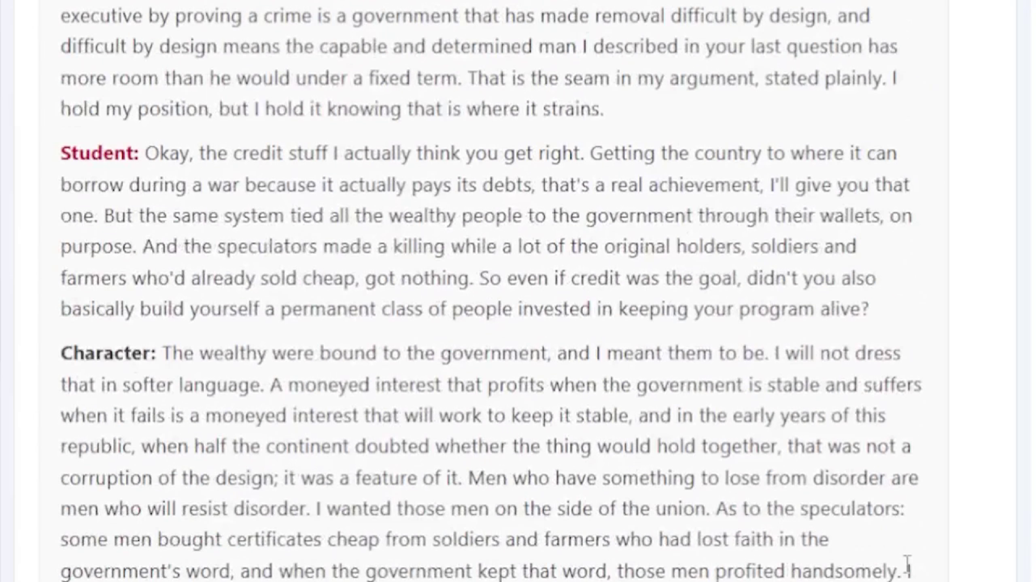
Instructor view: full transcript
25 / 09:55
REVIEW
Action
Review the complete character and reflection-agent transcript.
Accompanying narration
"The final section preserves the full conversation with both the Hamilton character and the reflection facilitator."
Included to preserve the complete demo flow.

