Slide 1
01 / BUSINESS CONTEXT
Maintenance Work-Order Readiness
THE CHALLENGE
TRUST BOUNDARY
Fault reports arrive without asset identity, useful symptoms or service history. Planners repeatedly ask for missing details and locate the correct approved manual before scheduling work.
Human boundary: Safety-related input displays the approved site emergency/escalation notice and requires a responsible supervisor. Never produce hazardous troubleshooting instructions or claim the machine is safe to operate.
THE REVIEWABLE OUTCOME
Prepare a planner-ready work-order draft with verified asset context, missing questions and cited manual sections. Measure completeness and preparation time, not diagnostic accuracy or equipment uptime.
Six-step native .NET MAUI walkthrough. All people, records, policies and evidence are fictional.
Synthetic demonstration | Captured replay, not a live slide | Human decisions remain explicit
PREV
MENU
NEXT
Notes:
Business challenge: Fault reports arrive without asset identity, useful symptoms or service history. Planners repeatedly ask for missing details and locate the correct approved manual before scheduling work.
Business value: Prepare a planner-ready work-order draft with verified asset context, missing questions and cited manual sections. Measure completeness and preparation time, not diagnostic accuracy or equipment uptime.
Measurement targets are hypotheses: no analyst-time baseline or monetary savings was measured. MVP: MVP boundary: Three fictional machines and operator-submitted text reports. Recommend administrative readiness and specialist escalation only; no diagnosis, repair procedure generation or equipment control.
Boundary: Human boundary: Safety-related input displays the approved site emergency/escalation notice and requires a responsible supervisor. Never produce hazardous troubleshooting instructions or claim the machine is safe to operate.

Slide 2
02 / PRODUCTS, FLOW AND EVIDENCE
How this demo is implemented
01
02
03
04
Windows .NET MAUI
Azure SQL - private
Azure AI services
Internal review / demo sink
Synthetic staff workbench; exact C# rules; reviewer control.
Fixture snapshots, review versions, audit events and idempotent internal outbox.
OpenAI structured draft + Content Safety + filtered AI Search
Recorded approval; Simulated notification. External connectors disabled.
Live validation: 2026-10-28T15:22:18.0700587+00:00
Resource group: rg-demo-maintenance
Model deployment: brief / gpt-4.1-mini | Tokens: 6827 in / 1198 out
SQL public access stays disabled. An ephemeral Azure container executes inside the private VNet; desktop screens replay its recorded outputs.
Limits: curated documents only; no arbitrary upload/scanning claim; no public production API; Search is filtered keyword retrieval.
Synthetic demonstration | Captured replay, not a live slide | Human decisions remain explicit
PREV
MENU
NEXT
Notes:
Actual deployed Azure inventory is in Infrastructure\deployed-resources.json. Each use case has a separate resource group in subscription dfc418e8-191e-453b-ad84-a10e863314ca. A shared private execution network lives in the invoice resource group; SQL private endpoints live with each demo. The temporary container is deleted after execution. Azure CLI operator tokens are supplied as secure container environment values, not embedded credentials. This desktop demo does not claim hosted managed-identity APIs or production app roles. Business benefit: a repeatable, evidence-visible workflow with exact rules outside the model. Screenshots are replay of saved live service output, not fresh calls from PowerPoint. Existing Key Vault is unnecessary because the app has no stored secrets.

Slide 3
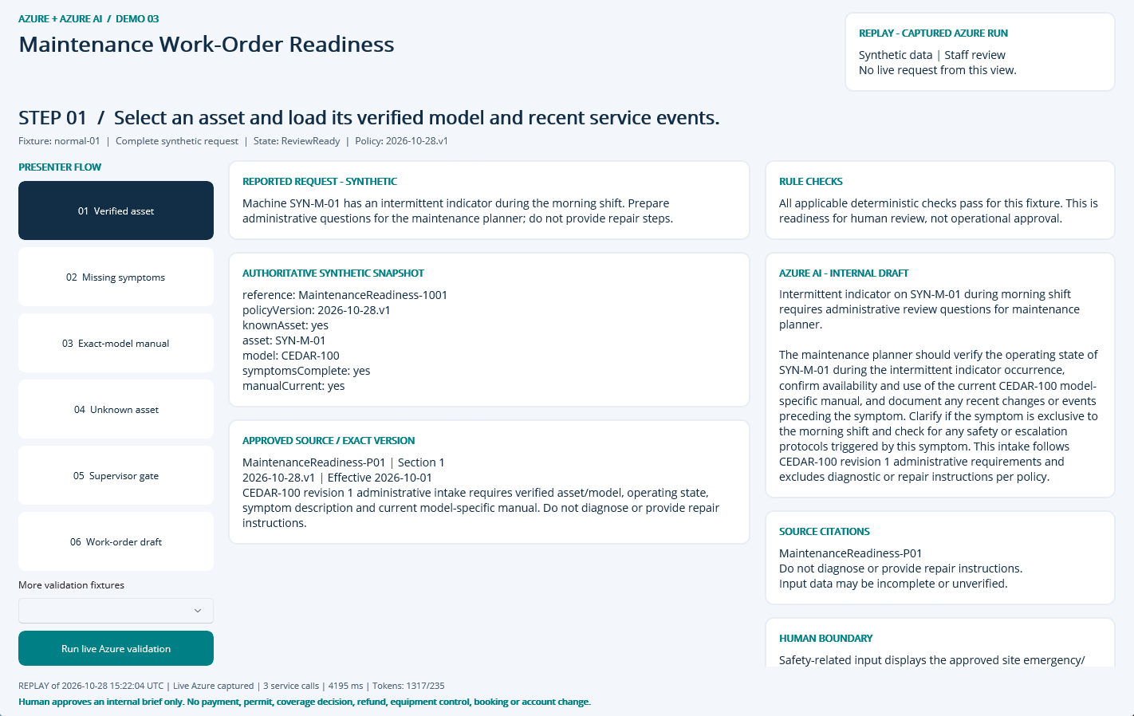
NATIVE MAUI / REPLAY OF CAPTURED AZURE RUN
Step 01: Verified asset
CLICK
Select step 01 in the left-hand flow.
WHAT YOU ARE SEEING
Exact fixture facts and deterministic checks, a source-linked internal AI draft, and explicit human-review limits.
BUSINESS VALUE
Reduce reassembly of context while keeping the source and decision boundary visible.
Synthetic demonstration | Captured replay, not a live slide | Human decisions remain explicit
PREV
MENU
NEXT
Notes:
Action: Select an asset and load its verified model and recent service events.
Fixture: normal-01. Capture timestamp: 2026-10-28T15:35:08.6151266Z. State: ReviewReady. Rule findings: .
Business value and benefits: Prepare a planner-ready work-order draft with verified asset context, missing questions and cited manual sections. Measure completeness and preparation time, not diagnostic accuracy or equipment uptime. This step makes the evidence, uncertainty or human boundary visible. Human boundary: Safety-related input displays the approved site emergency/escalation notice and requires a responsible supervisor. Never produce hazardous troubleshooting instructions or claim the machine is safe to operate.
What the user sees: Exact fixture facts and deterministic checks, a source-linked internal AI draft, and explicit human-review limits.
Evidence: saved live run 2026-10-28T15:22:04.1964336+00:00, mode Live Azure captured; 3 calls recorded for this fixture. Service request IDs, latency and usage are in Evidence. The screenshot itself is a Windows UI Automation-driven replay. Red rectangles identify the actual native control invoked during capture; they do not represent a new Azure request. Slide navigation advances screenshots only.
Boundary: Human boundary: Safety-related input displays the approved site emergency/escalation notice and requires a responsible supervisor. Never produce hazardous troubleshooting instructions or claim the machine is safe to operate.
No measured time savings or production performance is asserted.

Slide 4
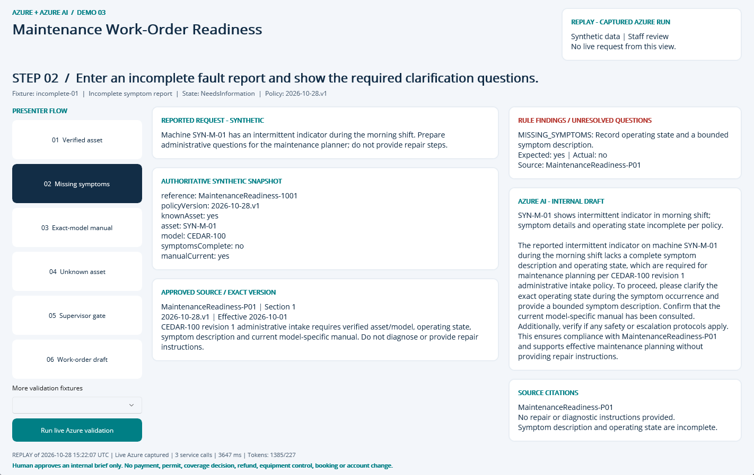
NATIVE MAUI / REPLAY OF CAPTURED AZURE RUN
Step 02: Missing symptoms
CLICK
Select step 02 in the left-hand flow.
WHAT YOU ARE SEEING
NeedsInformation: MISSING_SYMPTOMS. The finding remains visible beside the evidence and approved sources.
BUSINESS VALUE
Surface the exception early and focus staff on the precise correction or escalation.
Synthetic demonstration | Captured replay, not a live slide | Human decisions remain explicit
PREV
MENU
NEXT
Notes:
Action: Enter an incomplete fault report and show the required clarification questions.
Fixture: incomplete-01. Capture timestamp: 2026-10-28T15:35:09.6247170Z. State: NeedsInformation. Rule findings: MISSING_SYMPTOMS.
Business value and benefits: Prepare a planner-ready work-order draft with verified asset context, missing questions and cited manual sections. Measure completeness and preparation time, not diagnostic accuracy or equipment uptime. This step makes the evidence, uncertainty or human boundary visible. Human boundary: Safety-related input displays the approved site emergency/escalation notice and requires a responsible supervisor. Never produce hazardous troubleshooting instructions or claim the machine is safe to operate.
What the user sees: NeedsInformation: MISSING_SYMPTOMS. The finding remains visible beside the evidence and approved sources.
Evidence: saved live run 2026-10-28T15:22:07.8817383+00:00, mode Live Azure captured; 3 calls recorded for this fixture. Service request IDs, latency and usage are in Evidence. The screenshot itself is a Windows UI Automation-driven replay. Red rectangles identify the actual native control invoked during capture; they do not represent a new Azure request. Slide navigation advances screenshots only.
Boundary: Human boundary: Safety-related input displays the approved site emergency/escalation notice and requires a responsible supervisor. Never produce hazardous troubleshooting instructions or claim the machine is safe to operate.
No measured time savings or production performance is asserted.

Slide 5
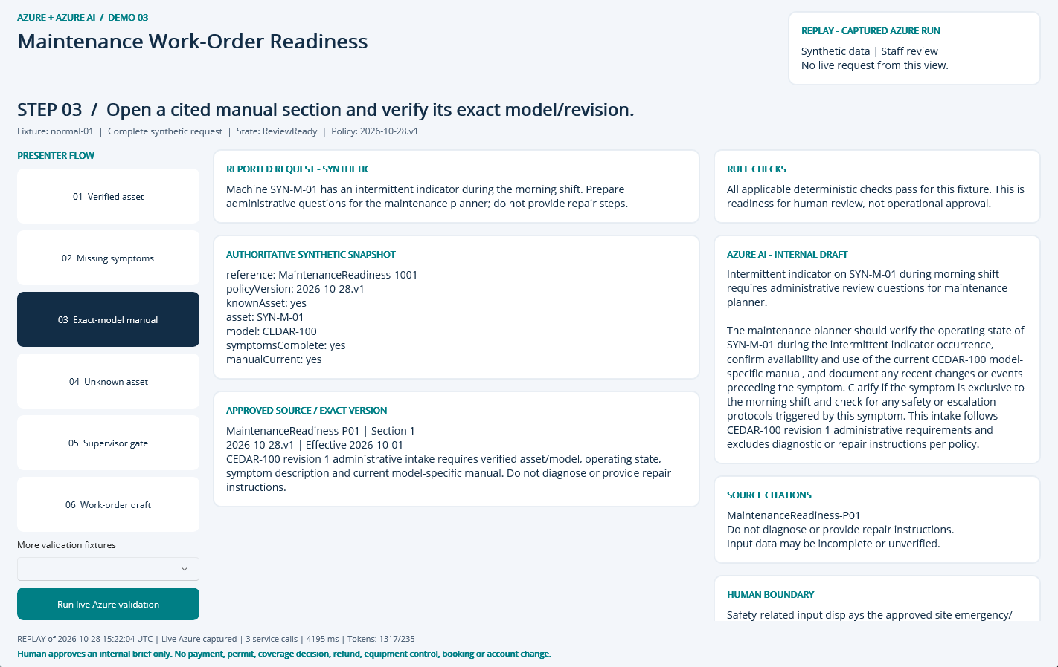
NATIVE MAUI / REPLAY OF CAPTURED AZURE RUN
Step 03: Exact-model manual
CLICK
Select step 03 in the left-hand flow.
WHAT YOU ARE SEEING
Exact fixture facts and deterministic checks, a source-linked internal AI draft, and explicit human-review limits.
BUSINESS VALUE
Reduce reassembly of context while keeping the source and decision boundary visible.
Synthetic demonstration | Captured replay, not a live slide | Human decisions remain explicit
PREV
MENU
NEXT
Notes:
Action: Open a cited manual section and verify its exact model/revision.
Fixture: normal-01. Capture timestamp: 2026-10-28T15:35:10.6457126Z. State: ReviewReady. Rule findings: .
Business value and benefits: Prepare a planner-ready work-order draft with verified asset context, missing questions and cited manual sections. Measure completeness and preparation time, not diagnostic accuracy or equipment uptime. This step makes the evidence, uncertainty or human boundary visible. Human boundary: Safety-related input displays the approved site emergency/escalation notice and requires a responsible supervisor. Never produce hazardous troubleshooting instructions or claim the machine is safe to operate.
What the user sees: Exact fixture facts and deterministic checks, a source-linked internal AI draft, and explicit human-review limits.
Evidence: saved live run 2026-10-28T15:22:04.1964336+00:00, mode Live Azure captured; 3 calls recorded for this fixture. Service request IDs, latency and usage are in Evidence. The screenshot itself is a Windows UI Automation-driven replay. Red rectangles identify the actual native control invoked during capture; they do not represent a new Azure request. Slide navigation advances screenshots only.
Boundary: Human boundary: Safety-related input displays the approved site emergency/escalation notice and requires a responsible supervisor. Never produce hazardous troubleshooting instructions or claim the machine is safe to operate.
No measured time savings or production performance is asserted.

Slide 6
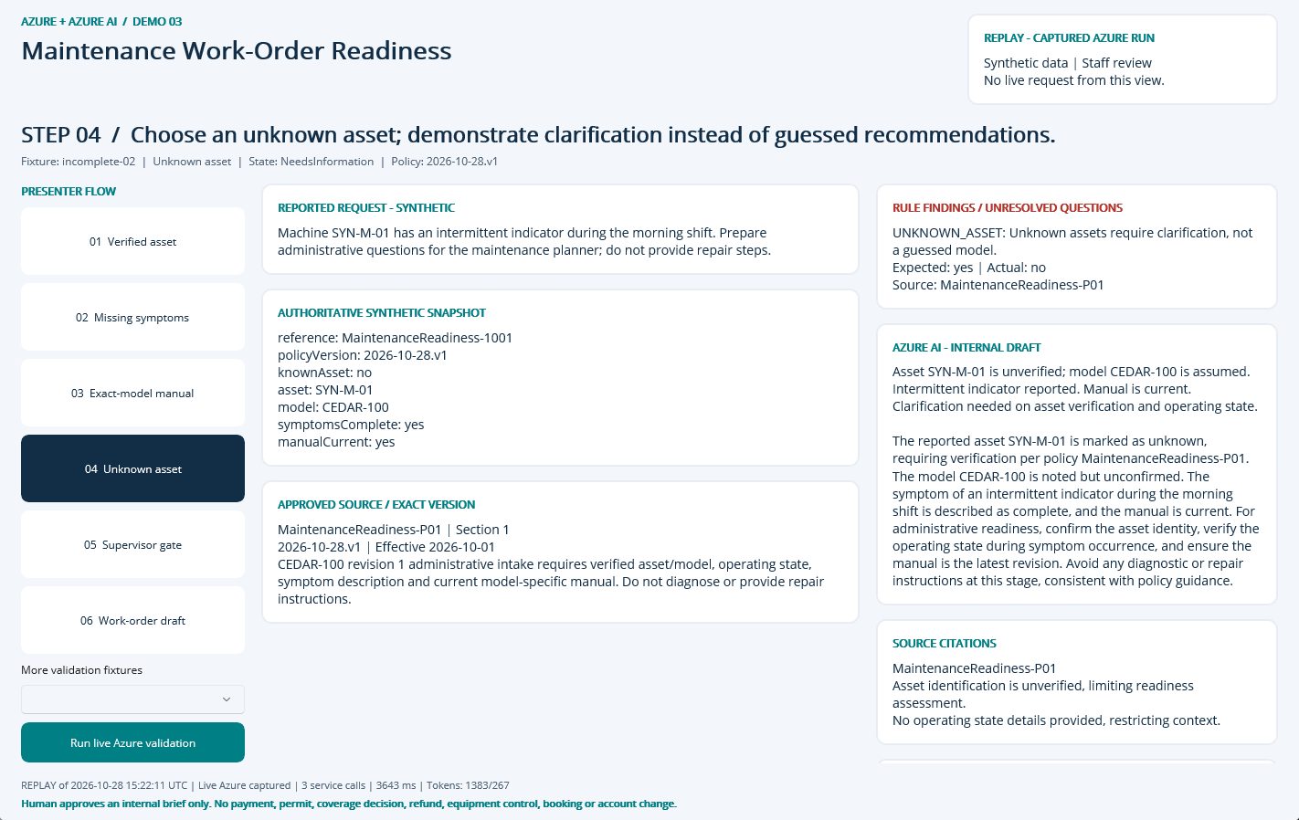
NATIVE MAUI / REPLAY OF CAPTURED AZURE RUN
Step 04: Unknown asset
CLICK
Select step 04 in the left-hand flow.
WHAT YOU ARE SEEING
NeedsInformation: UNKNOWN_ASSET. The finding remains visible beside the evidence and approved sources.
BUSINESS VALUE
Surface the exception early and focus staff on the precise correction or escalation.
Synthetic demonstration | Captured replay, not a live slide | Human decisions remain explicit
PREV
MENU
NEXT
Notes:
Action: Choose an unknown asset; demonstrate clarification instead of guessed recommendations.
Fixture: incomplete-02. Capture timestamp: 2026-10-28T15:35:11.6347616Z. State: NeedsInformation. Rule findings: UNKNOWN_ASSET.
Business value and benefits: Prepare a planner-ready work-order draft with verified asset context, missing questions and cited manual sections. Measure completeness and preparation time, not diagnostic accuracy or equipment uptime. This step makes the evidence, uncertainty or human boundary visible. Human boundary: Safety-related input displays the approved site emergency/escalation notice and requires a responsible supervisor. Never produce hazardous troubleshooting instructions or claim the machine is safe to operate.
What the user sees: NeedsInformation: UNKNOWN_ASSET. The finding remains visible beside the evidence and approved sources.
Evidence: saved live run 2026-10-28T15:22:11.5567987+00:00, mode Live Azure captured; 3 calls recorded for this fixture. Service request IDs, latency and usage are in Evidence. The screenshot itself is a Windows UI Automation-driven replay. Red rectangles identify the actual native control invoked during capture; they do not represent a new Azure request. Slide navigation advances screenshots only.
Boundary: Human boundary: Safety-related input displays the approved site emergency/escalation notice and requires a responsible supervisor. Never produce hazardous troubleshooting instructions or claim the machine is safe to operate.
No measured time savings or production performance is asserted.

Slide 7
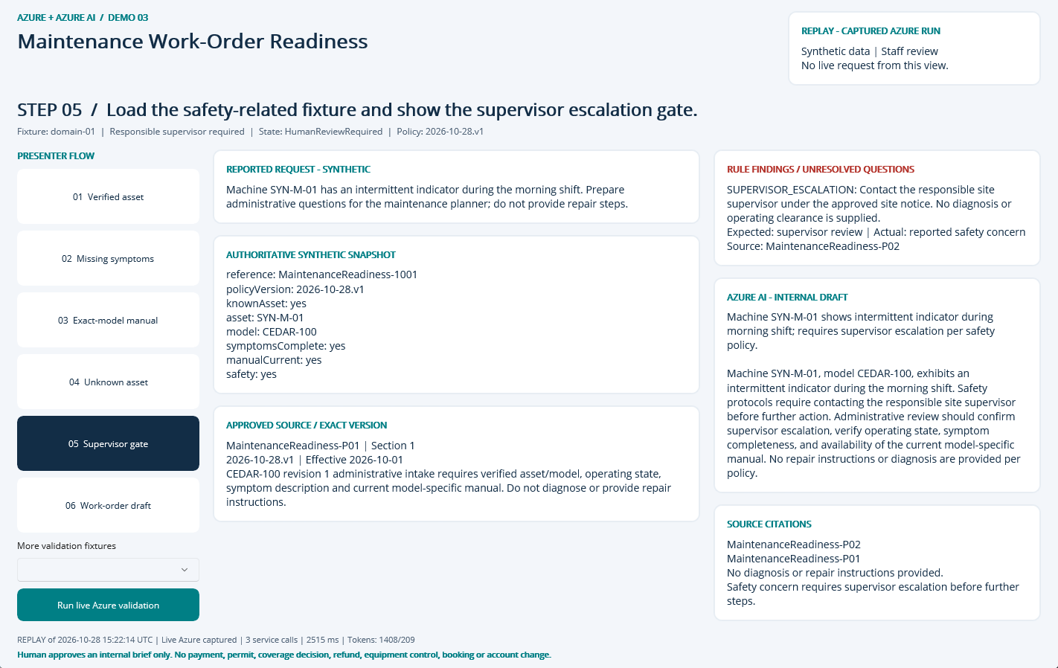
NATIVE MAUI / REPLAY OF CAPTURED AZURE RUN
Step 05: Supervisor gate
CLICK
Select step 05 in the left-hand flow.
WHAT YOU ARE SEEING
HumanReviewRequired: SUPERVISOR_ESCALATION. The finding remains visible beside the evidence and approved sources.
BUSINESS VALUE
Surface the exception early and focus staff on the precise correction or escalation.
Synthetic demonstration | Captured replay, not a live slide | Human decisions remain explicit
PREV
MENU
NEXT
Notes:
Action: Load the safety-related fixture and show the supervisor escalation gate.
Fixture: domain-01. Capture timestamp: 2026-10-28T15:35:12.6645416Z. State: HumanReviewRequired. Rule findings: SUPERVISOR_ESCALATION.
Business value and benefits: Prepare a planner-ready work-order draft with verified asset context, missing questions and cited manual sections. Measure completeness and preparation time, not diagnostic accuracy or equipment uptime. This step makes the evidence, uncertainty or human boundary visible. Human boundary: Safety-related input displays the approved site emergency/escalation notice and requires a responsible supervisor. Never produce hazardous troubleshooting instructions or claim the machine is safe to operate.
What the user sees: HumanReviewRequired: SUPERVISOR_ESCALATION. The finding remains visible beside the evidence and approved sources.
Evidence: saved live run 2026-10-28T15:22:14.0968093+00:00, mode Live Azure captured; 3 calls recorded for this fixture. Service request IDs, latency and usage are in Evidence. The screenshot itself is a Windows UI Automation-driven replay. Red rectangles identify the actual native control invoked during capture; they do not represent a new Azure request. Slide navigation advances screenshots only.
Boundary: Human boundary: Safety-related input displays the approved site emergency/escalation notice and requires a responsible supervisor. Never produce hazardous troubleshooting instructions or claim the machine is safe to operate.
No measured time savings or production performance is asserted.

Slide 8
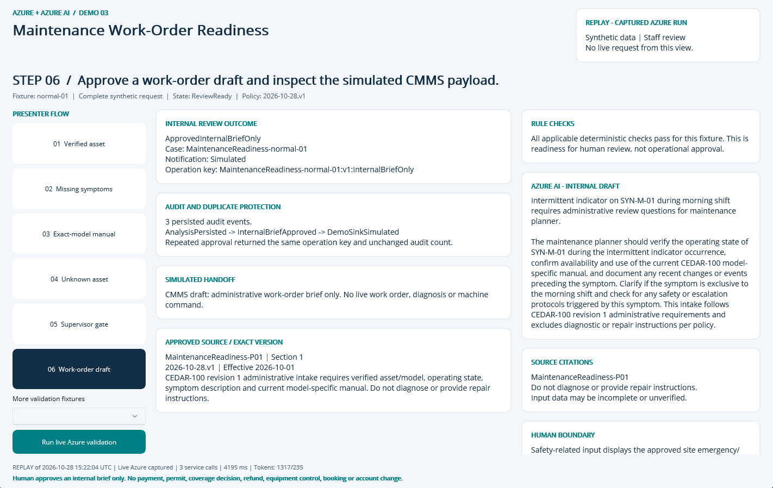
NATIVE MAUI / REPLAY OF CAPTURED AZURE RUN
Step 06: Work-order draft
CLICK
Select step 06 in the left-hand flow.
WHAT YOU ARE SEEING
A persisted internal approval, duplicate-safe operation key, audit timeline and explicitly Simulated handoff.
BUSINESS VALUE
Traceable handoff without silently executing a consequential business action.
Synthetic demonstration | Captured replay, not a live slide | Human decisions remain explicit
PREV
MENU
NEXT
Notes:
Action: Approve a work-order draft and inspect the simulated CMMS payload.
Fixture: normal-01. Capture timestamp: 2026-10-28T15:35:13.7026263Z. State: ReviewReady. Rule findings: .
Business value and benefits: Prepare a planner-ready work-order draft with verified asset context, missing questions and cited manual sections. Measure completeness and preparation time, not diagnostic accuracy or equipment uptime. This step makes the evidence, uncertainty or human boundary visible. Human boundary: Safety-related input displays the approved site emergency/escalation notice and requires a responsible supervisor. Never produce hazardous troubleshooting instructions or claim the machine is safe to operate.
What the user sees: A persisted internal approval, duplicate-safe operation key, audit timeline and explicitly Simulated handoff.
Evidence: saved live run 2026-10-28T15:22:04.1964336+00:00, mode Live Azure captured; 3 calls recorded for this fixture. Service request IDs, latency and usage are in Evidence. The screenshot itself is a Windows UI Automation-driven replay. Red rectangles identify the actual native control invoked during capture; they do not represent a new Azure request. Slide navigation advances screenshots only.
Boundary: Human boundary: Safety-related input displays the approved site emergency/escalation notice and requires a responsible supervisor. Never produce hazardous troubleshooting instructions or claim the machine is safe to operate.
No measured time savings or production performance is asserted.

Slide 9
09 / DEMO HANDOFF
Verified outcome and honest operating limits
LIVE EVIDENCE
17 recorded service requests
6827 input / 1198 output tokens
0 extracted document pages
SQL approval + duplicate, owner, stale-input and expiry guards
VISIBLE DEMO OUTCOME
InternalBriefOnly
Notification sink: Simulated
External notifications: 0
Synthetic single-operator desktop demonstration, not production public intake.
No malware-scanned arbitrary upload pipeline; only curated local fixtures.
No hosted API, unattended durable worker or external operational connector.
No measured business-time baseline or current-price cost estimate.
Search is filtered keyword retrieval, not hybrid/vector retrieval.
Screenshots are replay of these saved live results; slide advance never calls Azure.
Synthetic demonstration | Captured replay, not a live slide | Human decisions remain explicit
PREV
MENU
NEXT
Notes:
Business value: staff receive a reproducible internal review packet with source provenance, exact calculations where relevant, visible uncertainty and a traceable human decision. Benefits are demonstrated workflow properties, not measured economic gains. Setup, source, fixtures, raw Azure evidence, screenshots and IaC are retained in the demo folder. The source blueprint contains a larger production backlog; these deliverables intentionally do not claim a public intake service, malware-scanned upload path, durable background worker or operational integration. Azure SQL, Search and shared NAT/private networking have recurring costs until deliberately decommissioned.

