Slide 1
01 / BUSINESS CONTEXT
Building Permit Application Preflight
THE CHALLENGE
TRUST BOUNDARY
Permit staff receive incomplete forms and mismatched supporting documents. Applicants discover missing items late, while reviewers spend time chasing basic corrections instead of reviewing plans.
Human boundary: Do not infer code compliance, structural safety or legal entitlement. Conflicting/outdated guidance requires staff review. Map/GIS and payment gateways are out of MVP.
THE REVIEWABLE OUTCOME
Create a submission-readiness checklist with cited requirements and a correction-request draft. Track missing-item detection and staff preparation time, not permit approval rates.
Six-step native .NET MAUI walkthrough. All people, records, policies and evidence are fictional.
Synthetic demonstration | Captured replay, not a live slide | Human decisions remain explicit
PREV
MENU
NEXT
Notes:
Business challenge: Permit staff receive incomplete forms and mismatched supporting documents. Applicants discover missing items late, while reviewers spend time chasing basic corrections instead of reviewing plans.
Business value: Create a submission-readiness checklist with cited requirements and a correction-request draft. Track missing-item detection and staff preparation time, not permit approval rates.
Measurement targets are hypotheses: no analyst-time baseline or monetary savings was measured. MVP: MVP boundary: One fictional municipality and two residential permit types. Evaluate completeness only; no engineering review, fee collection, zoning ruling or permit issuance.
Boundary: Human boundary: Do not infer code compliance, structural safety or legal entitlement. Conflicting/outdated guidance requires staff review. Map/GIS and payment gateways are out of MVP.

Slide 2
02 / PRODUCTS, FLOW AND EVIDENCE
How this demo is implemented
01
02
03
04
Windows .NET MAUI
Azure SQL - private
Azure AI services
Internal review / demo sink
Synthetic staff workbench; exact C# rules; reviewer control.
Fixture snapshots, review versions, audit events and idempotent internal outbox.
OpenAI structured draft + Content Safety + filtered AI Search + Document Intelligence
Recorded approval; Simulated notification. External connectors disabled.
Live validation: 2026-10-28T15:28:47.0614811+00:00
Resource group: rg-demo-permit
Model deployment: brief / gpt-4.1-mini | Tokens: 6797 in / 921 out
SQL public access stays disabled. An ephemeral Azure container executes inside the private VNet; desktop screens replay its recorded outputs.
Limits: curated documents only; no arbitrary upload/scanning claim; no public production API; Search is filtered keyword retrieval.
Synthetic demonstration | Captured replay, not a live slide | Human decisions remain explicit
PREV
MENU
NEXT
Notes:
Actual deployed Azure inventory is in Infrastructure\deployed-resources.json. Each use case has a separate resource group in subscription dfc418e8-191e-453b-ad84-a10e863314ca. A shared private execution network lives in the invoice resource group; SQL private endpoints live with each demo. The temporary container is deleted after execution. Azure CLI operator tokens are supplied as secure container environment values, not embedded credentials. This desktop demo does not claim hosted managed-identity APIs or production app roles. Business benefit: a repeatable, evidence-visible workflow with exact rules outside the model. Screenshots are replay of saved live service output, not fresh calls from PowerPoint. Existing Key Vault is unnecessary because the app has no stored secrets.

Slide 3
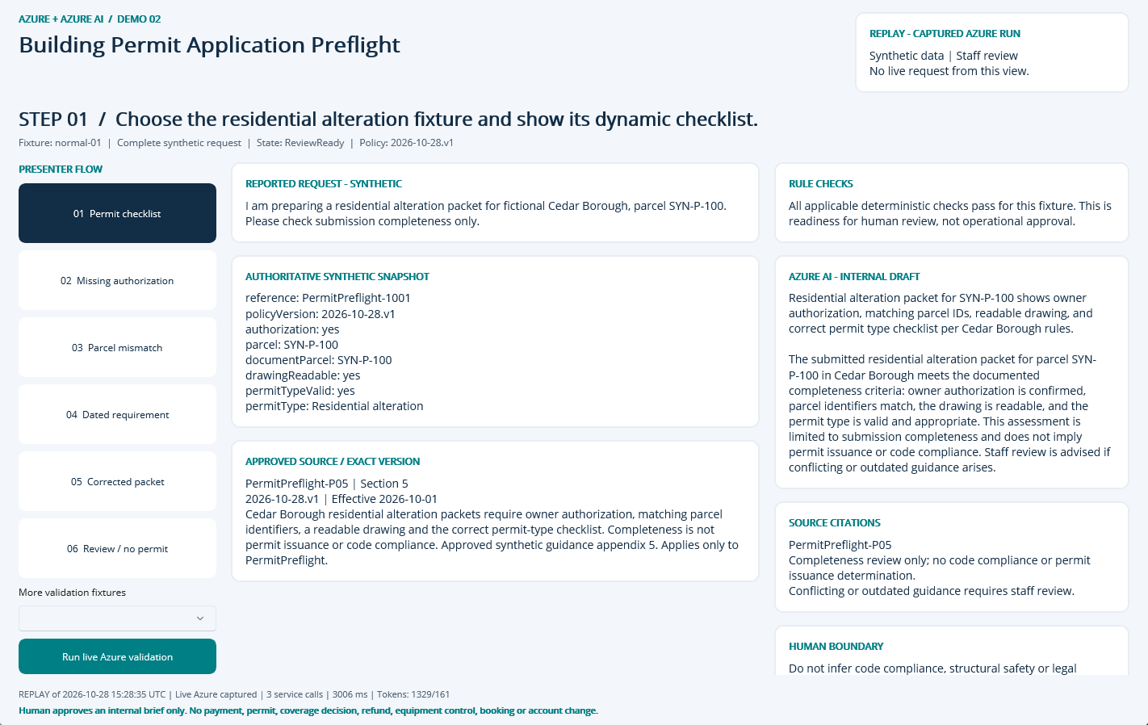
NATIVE MAUI / REPLAY OF CAPTURED AZURE RUN
Step 01: Permit checklist
CLICK
Select step 01 in the left-hand flow.
WHAT YOU ARE SEEING
Exact fixture facts and deterministic checks, a source-linked internal AI draft, and explicit human-review limits.
BUSINESS VALUE
Reduce reassembly of context while keeping the source and decision boundary visible.
Synthetic demonstration | Captured replay, not a live slide | Human decisions remain explicit
PREV
MENU
NEXT
Notes:
Action: Choose the residential alteration fixture and show its dynamic checklist.
Fixture: normal-01. Capture timestamp: 2026-10-28T15:34:57.7190196Z. State: ReviewReady. Rule findings: .
Business value and benefits: Create a submission-readiness checklist with cited requirements and a correction-request draft. Track missing-item detection and staff preparation time, not permit approval rates. This step makes the evidence, uncertainty or human boundary visible. Human boundary: Do not infer code compliance, structural safety or legal entitlement. Conflicting/outdated guidance requires staff review. Map/GIS and payment gateways are out of MVP.
What the user sees: Exact fixture facts and deterministic checks, a source-linked internal AI draft, and explicit human-review limits.
Evidence: saved live run 2026-10-28T15:28:35.9615486+00:00, mode Live Azure captured; 3 calls recorded for this fixture. Service request IDs, latency and usage are in Evidence. The screenshot itself is a Windows UI Automation-driven replay. Red rectangles identify the actual native control invoked during capture; they do not represent a new Azure request. Slide navigation advances screenshots only.
Boundary: Human boundary: Do not infer code compliance, structural safety or legal entitlement. Conflicting/outdated guidance requires staff review. Map/GIS and payment gateways are out of MVP.
No measured time savings or production performance is asserted.

Slide 4
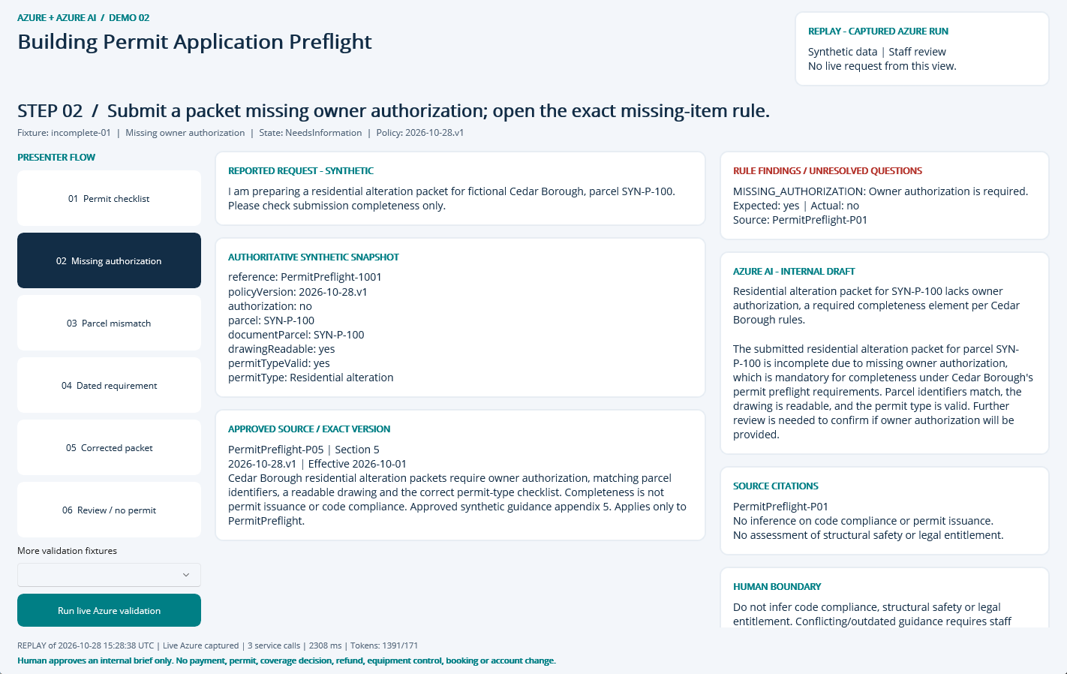
NATIVE MAUI / REPLAY OF CAPTURED AZURE RUN
Step 02: Missing authorization
CLICK
Select step 02 in the left-hand flow.
WHAT YOU ARE SEEING
NeedsInformation: MISSING_AUTHORIZATION. The finding remains visible beside the evidence and approved sources.
BUSINESS VALUE
Surface the exception early and focus staff on the precise correction or escalation.
Synthetic demonstration | Captured replay, not a live slide | Human decisions remain explicit
PREV
MENU
NEXT
Notes:
Action: Submit a packet missing owner authorization; open the exact missing-item rule.
Fixture: incomplete-01. Capture timestamp: 2026-10-28T15:34:58.7251801Z. State: NeedsInformation. Rule findings: MISSING_AUTHORIZATION.
Business value and benefits: Create a submission-readiness checklist with cited requirements and a correction-request draft. Track missing-item detection and staff preparation time, not permit approval rates. This step makes the evidence, uncertainty or human boundary visible. Human boundary: Do not infer code compliance, structural safety or legal entitlement. Conflicting/outdated guidance requires staff review. Map/GIS and payment gateways are out of MVP.
What the user sees: NeedsInformation: MISSING_AUTHORIZATION. The finding remains visible beside the evidence and approved sources.
Evidence: saved live run 2026-10-28T15:28:38.3037076+00:00, mode Live Azure captured; 3 calls recorded for this fixture. Service request IDs, latency and usage are in Evidence. The screenshot itself is a Windows UI Automation-driven replay. Red rectangles identify the actual native control invoked during capture; they do not represent a new Azure request. Slide navigation advances screenshots only.
Boundary: Human boundary: Do not infer code compliance, structural safety or legal entitlement. Conflicting/outdated guidance requires staff review. Map/GIS and payment gateways are out of MVP.
No measured time savings or production performance is asserted.

Slide 5
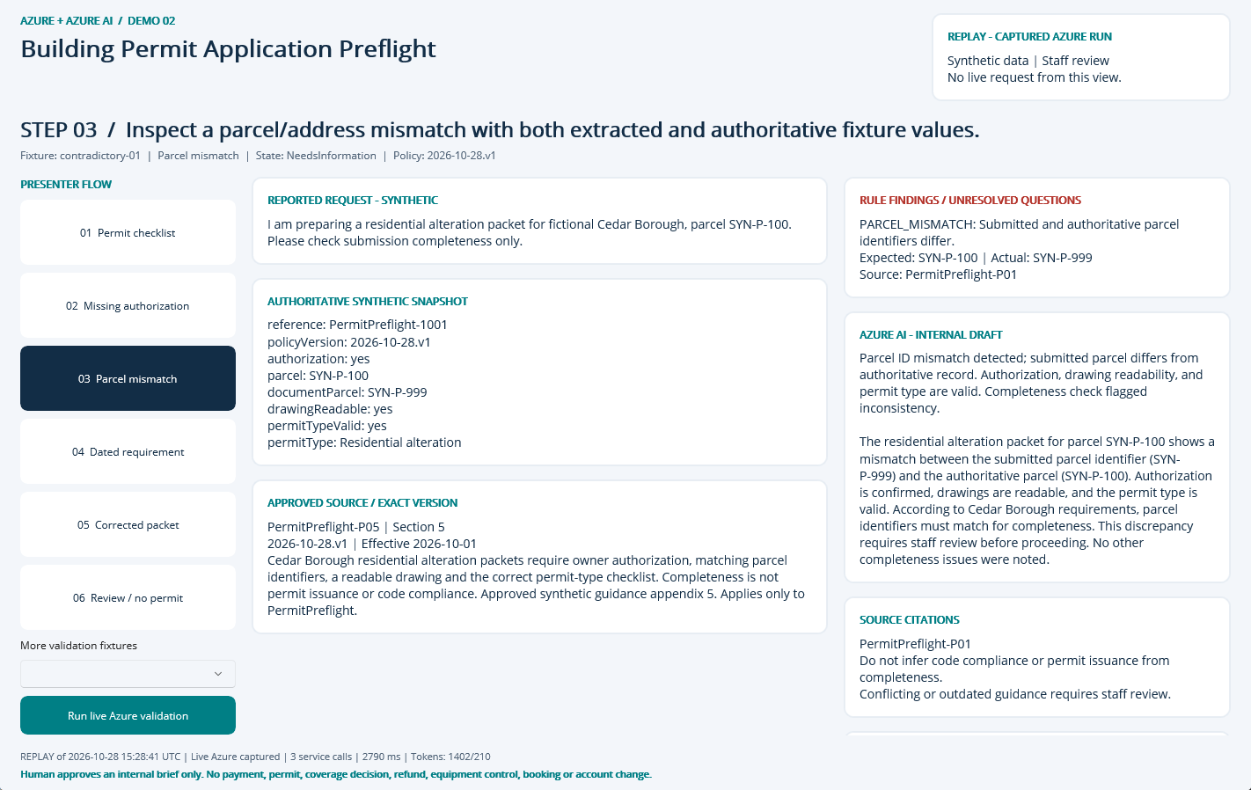
NATIVE MAUI / REPLAY OF CAPTURED AZURE RUN
Step 03: Parcel mismatch
CLICK
Select step 03 in the left-hand flow.
WHAT YOU ARE SEEING
NeedsInformation: PARCEL_MISMATCH. The finding remains visible beside the evidence and approved sources.
BUSINESS VALUE
Surface the exception early and focus staff on the precise correction or escalation.
Synthetic demonstration | Captured replay, not a live slide | Human decisions remain explicit
PREV
MENU
NEXT
Notes:
Action: Inspect a parcel/address mismatch with both extracted and authoritative fixture values.
Fixture: contradictory-01. Capture timestamp: 2026-10-28T15:34:59.7328768Z. State: NeedsInformation. Rule findings: PARCEL_MISMATCH.
Business value and benefits: Create a submission-readiness checklist with cited requirements and a correction-request draft. Track missing-item detection and staff preparation time, not permit approval rates. This step makes the evidence, uncertainty or human boundary visible. Human boundary: Do not infer code compliance, structural safety or legal entitlement. Conflicting/outdated guidance requires staff review. Map/GIS and payment gateways are out of MVP.
What the user sees: NeedsInformation: PARCEL_MISMATCH. The finding remains visible beside the evidence and approved sources.
Evidence: saved live run 2026-10-28T15:28:41.135355+00:00, mode Live Azure captured; 3 calls recorded for this fixture. Service request IDs, latency and usage are in Evidence. The screenshot itself is a Windows UI Automation-driven replay. Red rectangles identify the actual native control invoked during capture; they do not represent a new Azure request. Slide navigation advances screenshots only.
Boundary: Human boundary: Do not infer code compliance, structural safety or legal entitlement. Conflicting/outdated guidance requires staff review. Map/GIS and payment gateways are out of MVP.
No measured time savings or production performance is asserted.

Slide 6
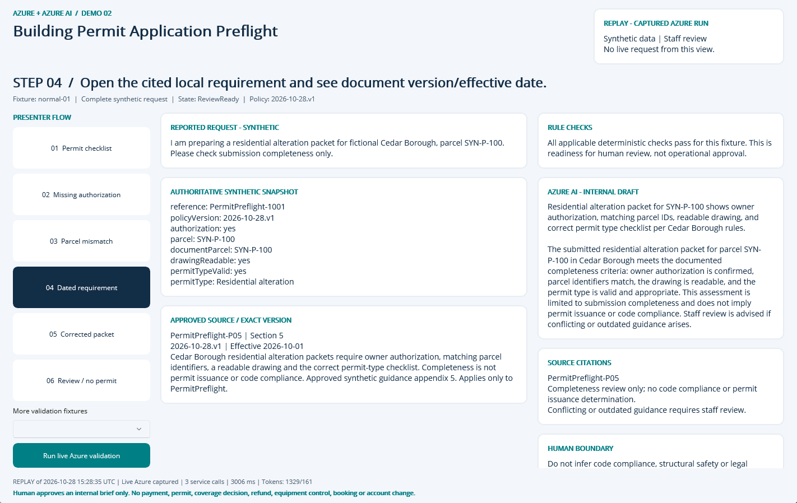
NATIVE MAUI / REPLAY OF CAPTURED AZURE RUN
Step 04: Dated requirement
CLICK
Select step 04 in the left-hand flow.
WHAT YOU ARE SEEING
Exact fixture facts and deterministic checks, a source-linked internal AI draft, and explicit human-review limits.
BUSINESS VALUE
Reduce reassembly of context while keeping the source and decision boundary visible.
Synthetic demonstration | Captured replay, not a live slide | Human decisions remain explicit
PREV
MENU
NEXT
Notes:
Action: Open the cited local requirement and see document version/effective date.
Fixture: normal-01. Capture timestamp: 2026-10-28T15:35:00.7642113Z. State: ReviewReady. Rule findings: .
Business value and benefits: Create a submission-readiness checklist with cited requirements and a correction-request draft. Track missing-item detection and staff preparation time, not permit approval rates. This step makes the evidence, uncertainty or human boundary visible. Human boundary: Do not infer code compliance, structural safety or legal entitlement. Conflicting/outdated guidance requires staff review. Map/GIS and payment gateways are out of MVP.
What the user sees: Exact fixture facts and deterministic checks, a source-linked internal AI draft, and explicit human-review limits.
Evidence: saved live run 2026-10-28T15:28:35.9615486+00:00, mode Live Azure captured; 3 calls recorded for this fixture. Service request IDs, latency and usage are in Evidence. The screenshot itself is a Windows UI Automation-driven replay. Red rectangles identify the actual native control invoked during capture; they do not represent a new Azure request. Slide navigation advances screenshots only.
Boundary: Human boundary: Do not infer code compliance, structural safety or legal entitlement. Conflicting/outdated guidance requires staff review. Map/GIS and payment gateways are out of MVP.
No measured time savings or production performance is asserted.

Slide 7
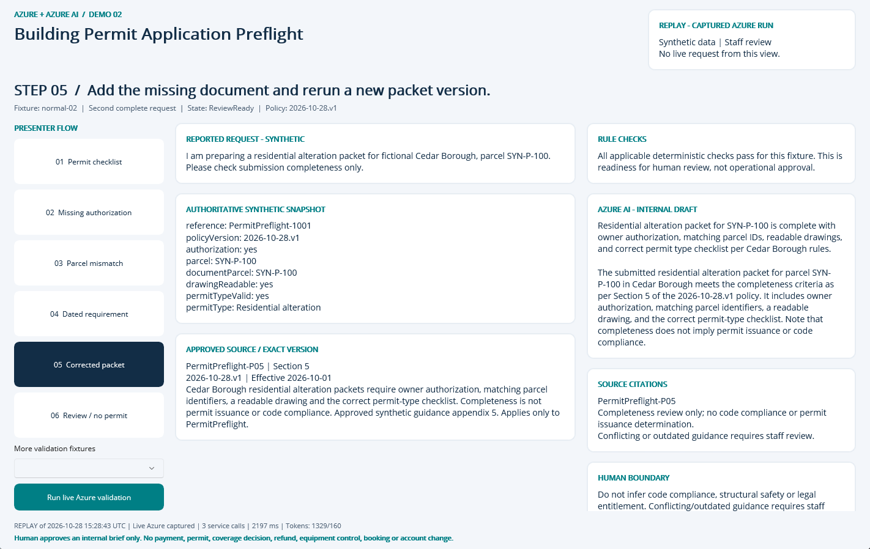
NATIVE MAUI / REPLAY OF CAPTURED AZURE RUN
Step 05: Corrected packet
CLICK
Select step 05 in the left-hand flow.
WHAT YOU ARE SEEING
Exact fixture facts and deterministic checks, a source-linked internal AI draft, and explicit human-review limits.
BUSINESS VALUE
Reduce reassembly of context while keeping the source and decision boundary visible.
Synthetic demonstration | Captured replay, not a live slide | Human decisions remain explicit
PREV
MENU
NEXT
Notes:
Action: Add the missing document and rerun a new packet version.
Fixture: normal-02. Capture timestamp: 2026-10-28T15:35:01.7493821Z. State: ReviewReady. Rule findings: .
Business value and benefits: Create a submission-readiness checklist with cited requirements and a correction-request draft. Track missing-item detection and staff preparation time, not permit approval rates. This step makes the evidence, uncertainty or human boundary visible. Human boundary: Do not infer code compliance, structural safety or legal entitlement. Conflicting/outdated guidance requires staff review. Map/GIS and payment gateways are out of MVP.
What the user sees: Exact fixture facts and deterministic checks, a source-linked internal AI draft, and explicit human-review limits.
Evidence: saved live run 2026-10-28T15:28:43.3538434+00:00, mode Live Azure captured; 3 calls recorded for this fixture. Service request IDs, latency and usage are in Evidence. The screenshot itself is a Windows UI Automation-driven replay. Red rectangles identify the actual native control invoked during capture; they do not represent a new Azure request. Slide navigation advances screenshots only.
Boundary: Human boundary: Do not infer code compliance, structural safety or legal entitlement. Conflicting/outdated guidance requires staff review. Map/GIS and payment gateways are out of MVP.
No measured time savings or production performance is asserted.

Slide 8
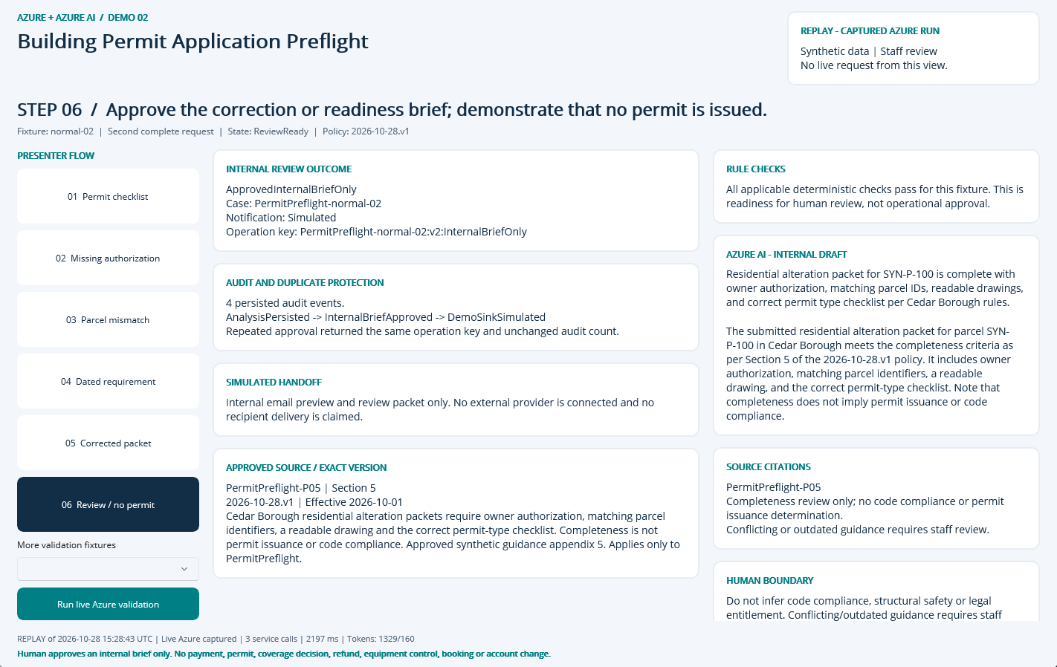
NATIVE MAUI / REPLAY OF CAPTURED AZURE RUN
Step 06: Review / no permit
CLICK
Select step 06 in the left-hand flow.
WHAT YOU ARE SEEING
A persisted internal approval, duplicate-safe operation key, audit timeline and explicitly Simulated handoff.
BUSINESS VALUE
Traceable handoff without silently executing a consequential business action.
Synthetic demonstration | Captured replay, not a live slide | Human decisions remain explicit
PREV
MENU
NEXT
Notes:
Action: Approve the correction or readiness brief; demonstrate that no permit is issued.
Fixture: normal-02. Capture timestamp: 2026-10-28T15:35:02.7485658Z. State: ReviewReady. Rule findings: .
Business value and benefits: Create a submission-readiness checklist with cited requirements and a correction-request draft. Track missing-item detection and staff preparation time, not permit approval rates. This step makes the evidence, uncertainty or human boundary visible. Human boundary: Do not infer code compliance, structural safety or legal entitlement. Conflicting/outdated guidance requires staff review. Map/GIS and payment gateways are out of MVP.
What the user sees: A persisted internal approval, duplicate-safe operation key, audit timeline and explicitly Simulated handoff.
Evidence: saved live run 2026-10-28T15:28:43.3538434+00:00, mode Live Azure captured; 3 calls recorded for this fixture. Service request IDs, latency and usage are in Evidence. The screenshot itself is a Windows UI Automation-driven replay. Red rectangles identify the actual native control invoked during capture; they do not represent a new Azure request. Slide navigation advances screenshots only.
Boundary: Human boundary: Do not infer code compliance, structural safety or legal entitlement. Conflicting/outdated guidance requires staff review. Map/GIS and payment gateways are out of MVP.
No measured time savings or production performance is asserted.

Slide 9
09 / DEMO HANDOFF
Verified outcome and honest operating limits
LIVE EVIDENCE
21 recorded service requests
6797 input / 921 output tokens
1 extracted document pages
SQL approval + duplicate, owner, stale-input and expiry guards
VISIBLE DEMO OUTCOME
InternalBriefOnly
Notification sink: Simulated
External notifications: 0
Synthetic single-operator desktop demonstration, not production public intake.
No malware-scanned arbitrary upload pipeline; only curated local fixtures.
No hosted API, unattended durable worker or external operational connector.
No measured business-time baseline or current-price cost estimate.
Search is filtered keyword retrieval, not hybrid/vector retrieval.
Screenshots are replay of these saved live results; slide advance never calls Azure.
Synthetic demonstration | Captured replay, not a live slide | Human decisions remain explicit
PREV
MENU
NEXT
Notes:
Business value: staff receive a reproducible internal review packet with source provenance, exact calculations where relevant, visible uncertainty and a traceable human decision. Benefits are demonstrated workflow properties, not measured economic gains. Setup, source, fixtures, raw Azure evidence, screenshots and IaC are retained in the demo folder. The source blueprint contains a larger production backlog; these deliverables intentionally do not claim a public intake service, malware-scanned upload path, durable background worker or operational integration. Azure SQL, Search and shared NAT/private networking have recurring costs until deliberately decommissioned.

